Slide 1
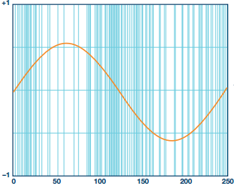
Single Bit Sigma-Delta Modulator
Output in Time Domain
Output (1 bits)
Input (multiple bits)
Time (clock cycles)

Slide 2
cpu_clk
pwm_clk
car_fcw
24xN_VOICES
valid
CPU/Synth CDC
Synth
Sampler
mod_fcw
RISC-V
Core
24
ready
. . .
5
pwm
mod_shift
Sigma-Delta DAC
note_en
14
Scaler
cpu_to_synth_cdc.v
synth.v
sample
(signed)
scaler.v
N_VOICES
MMIO
Regs
10
sampler.v
sample
(unsigned)
z1top.v

Slide 3
Modulator
NCO
mod_shift
car_fcw[0]
Carrier
NCO
5
24
mod_fcw
24
14
24
24
<<
14
mod_samp[0]
car_fcw_modulated[0]
. . .
. . .
x N_VOICES
14
Sample
mod_shift
car_fcw[N_VOICES-1]
mod_fcw
<<

Slide 4
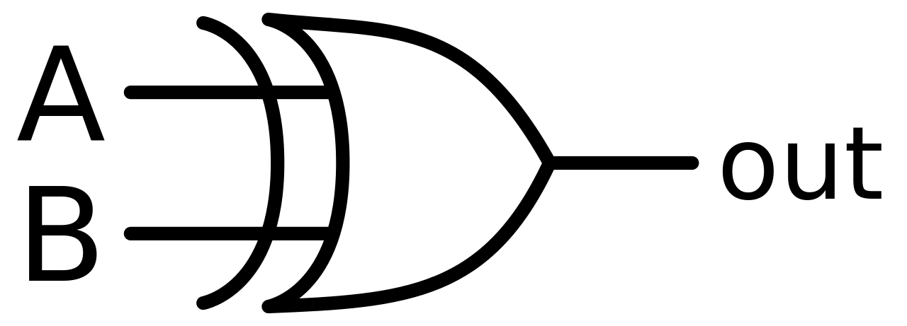
10
11
MSB
1
1
code[9:0]
pwm
MSB
1
11
clk, rst
sigma_delta_dac.v

Slide 5
cpu_clk
(50MHz)
synth_clk
(150MHz)
synchronizer
cpu_req
1
1
synchronizer
cpu_ack
1
4
2
…
en
…
N
3
MMIO Regs
(fcws, shift, note_en, etc)

