Slide 1
UBUNTU Operating System
Dinesh Kalia
CJ D’Alimonte
Alistair Scheuhammer
Ben Zhou

Slide 2
Overview
Introduction & History
Design & Architecture
Live Demonstration & Software Development Environment
Industrial Use
Advantages/Disadvantages
Future Innovations
Market Share

Slide 3

Introduction
Debian-based Linux Operating System
1st Release was Warty Warthog, 4.04, in 2004
Based on South African idea of universal bond of sharing among all humanity

Slide 4
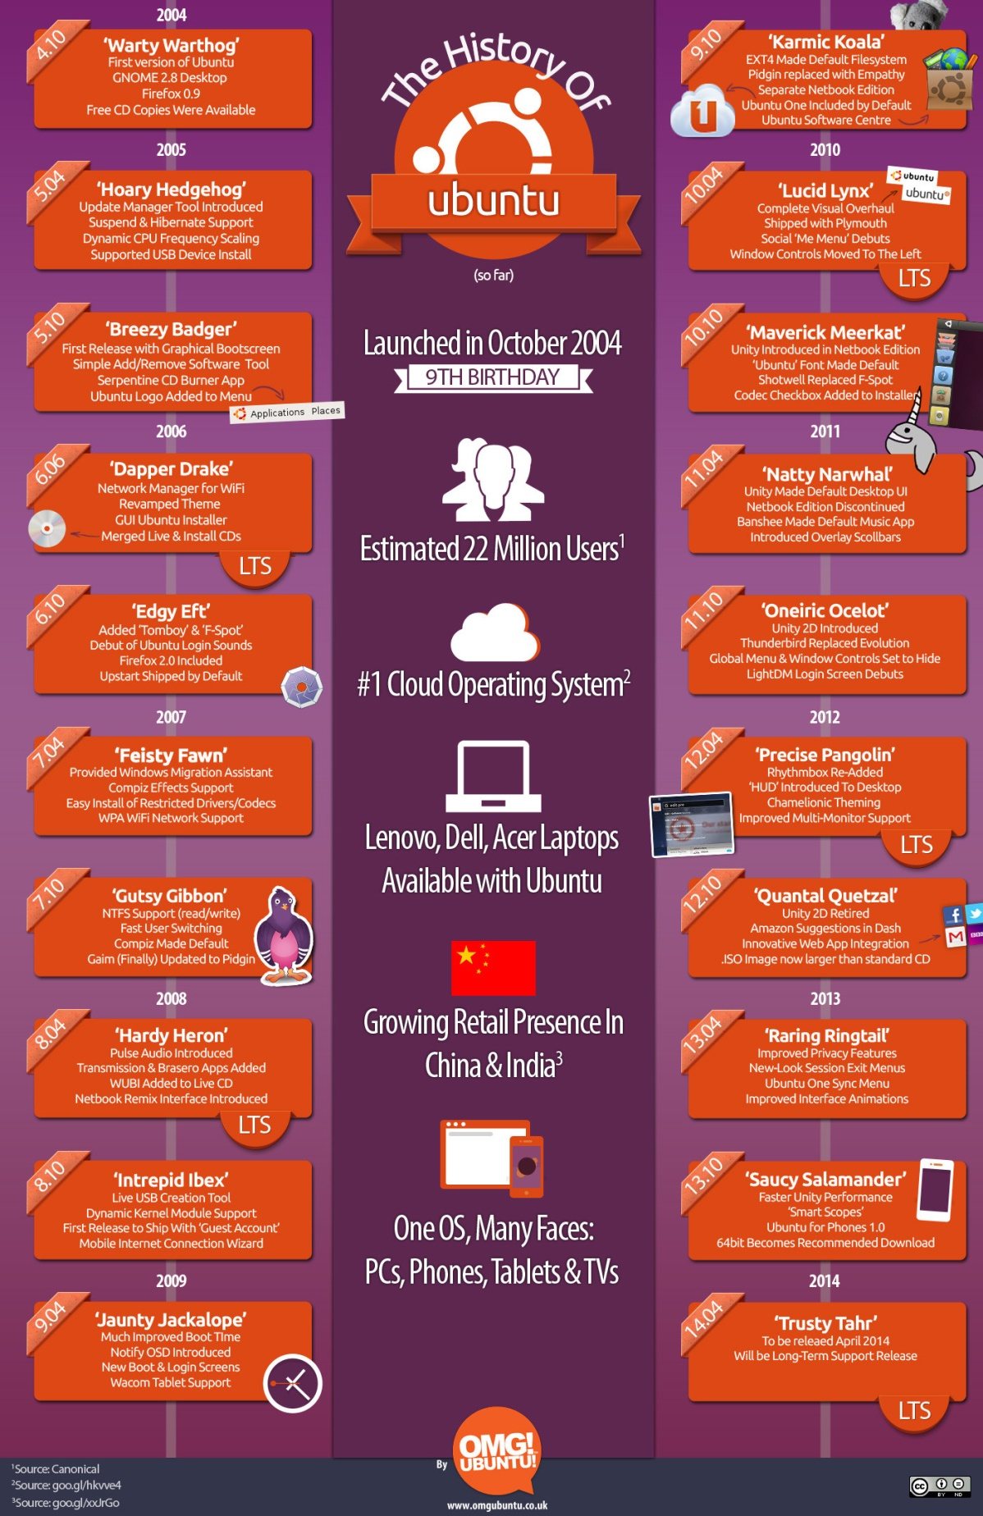
History

Slide 5
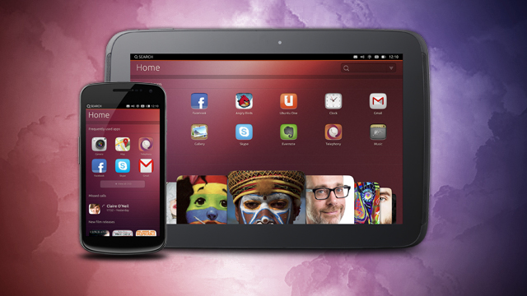
Ubuntu Variations
Ubuntu Touch
BQ Aquaris E4.5 Ubuntu Edition
Smartphones, tablets, desktops/laptops
Used in Vehicles and Drones
Tianhe-2 (Ubuntu Kylin)

Slide 6

Architecture
Ubuntu & Debian
Differences

Slide 7
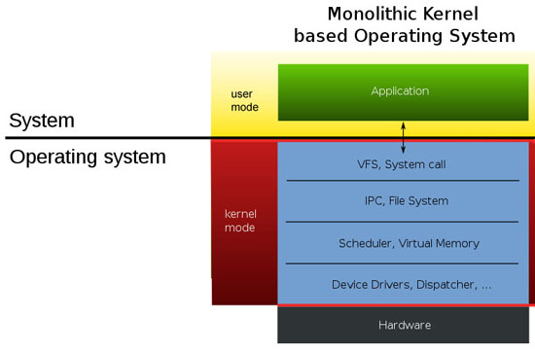
Monolithic Kernel

Slide 8
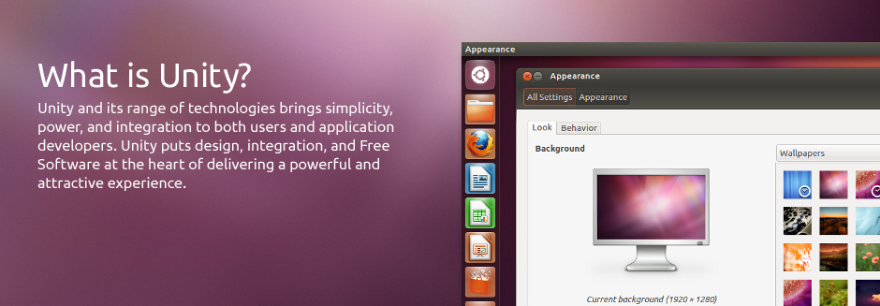
Unity
What is Unity?
Top Menu Bar
Launcher
Quicklist
Dash
HUD
Indicators

Slide 9
Installation
Hardware Requirements
700 MHz processor (about Intel Celeron or better)
512 MiB RAM (system memory)
5 GB of hard-drive space
VGA capable of 1024x768 screen resolution
Either a CD/DVD drive or a USB port for the installer media
Installing on Windows:
Obtain Installation LiveCD
Backup Windows & Disable Fast Startup
Change Boot Order
Insert LiveCD and Turn on the Machine

Slide 10
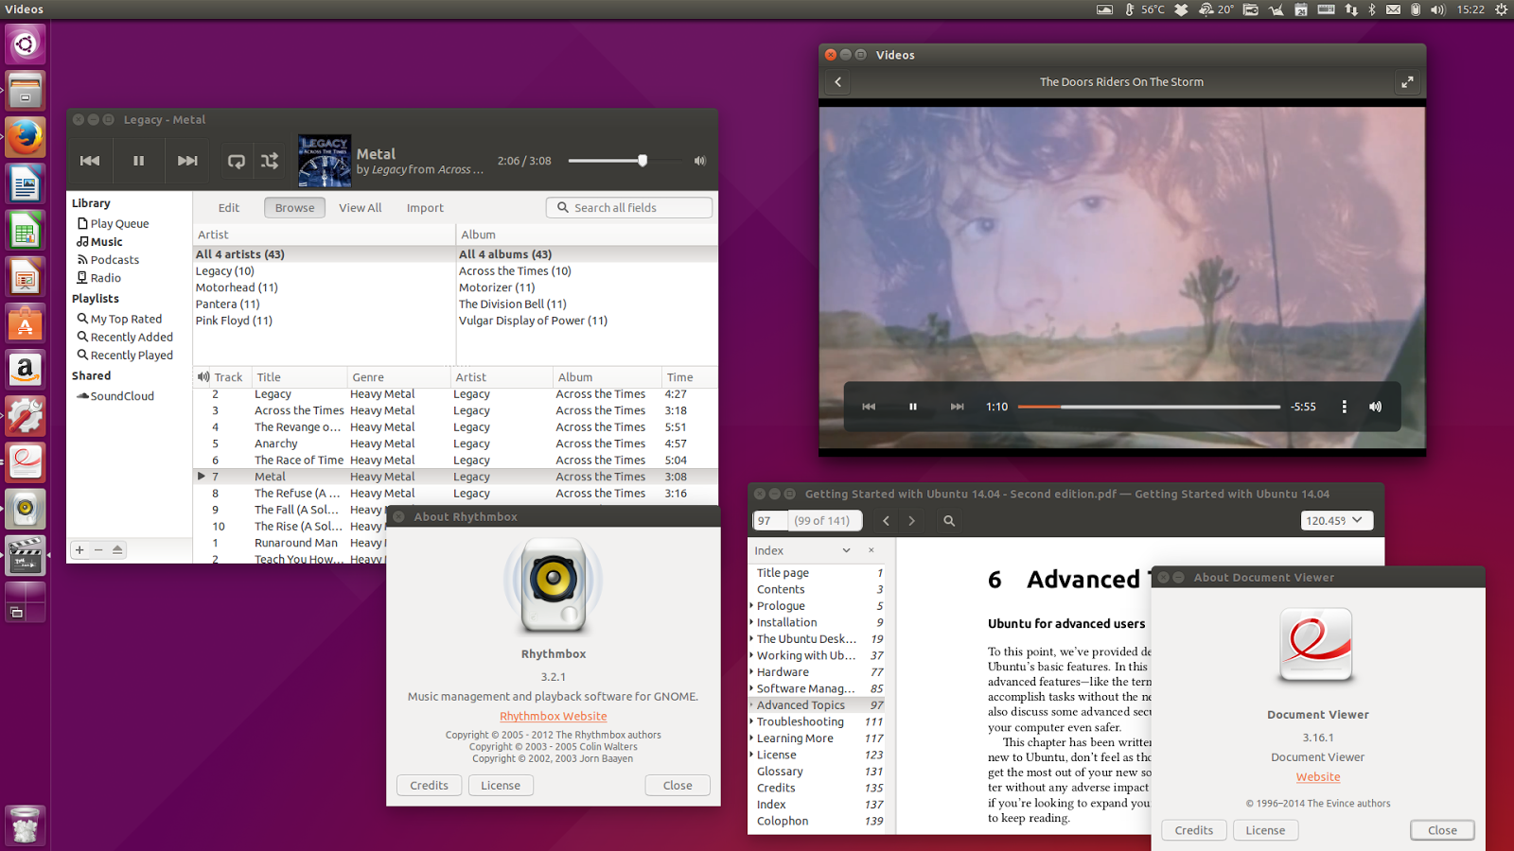
Current Version
Latest Version - 15.10 (Wily Werewolf)
Differences in Versions

Slide 11
LIVE DEMONSTRATION SOFTWARE DEVELOPMENT ENVIRONMENT

Slide 12
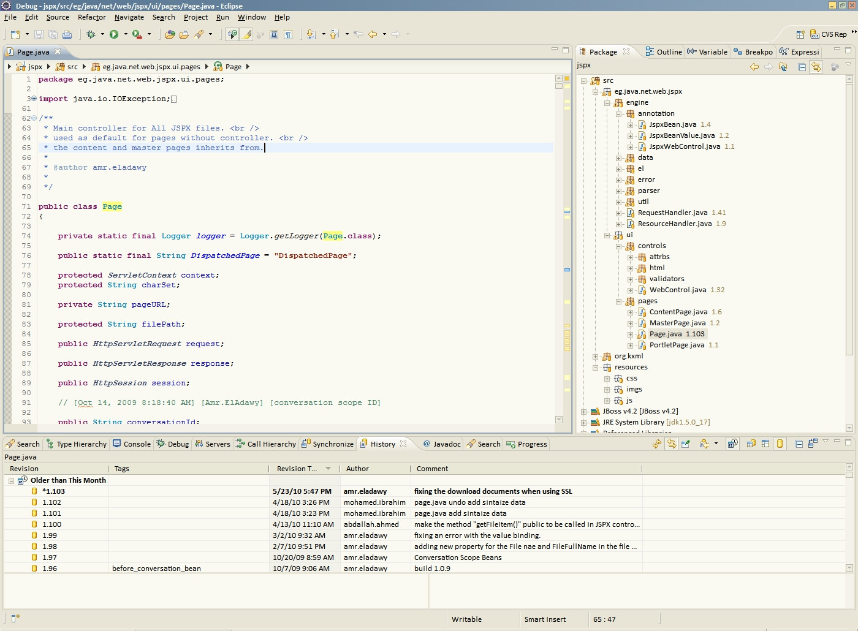

Slide 13
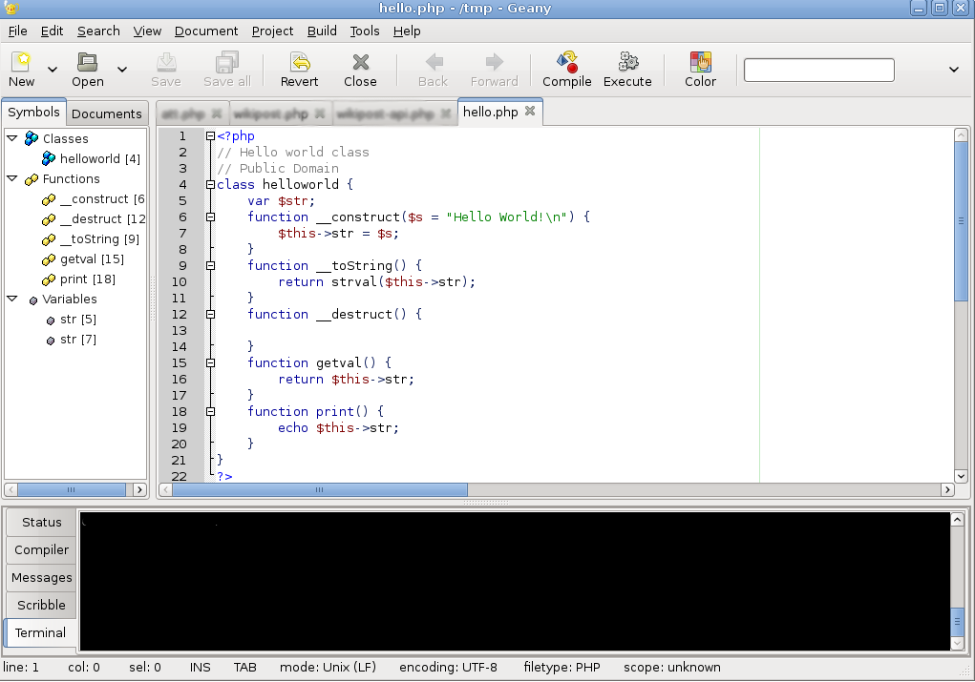

Slide 14
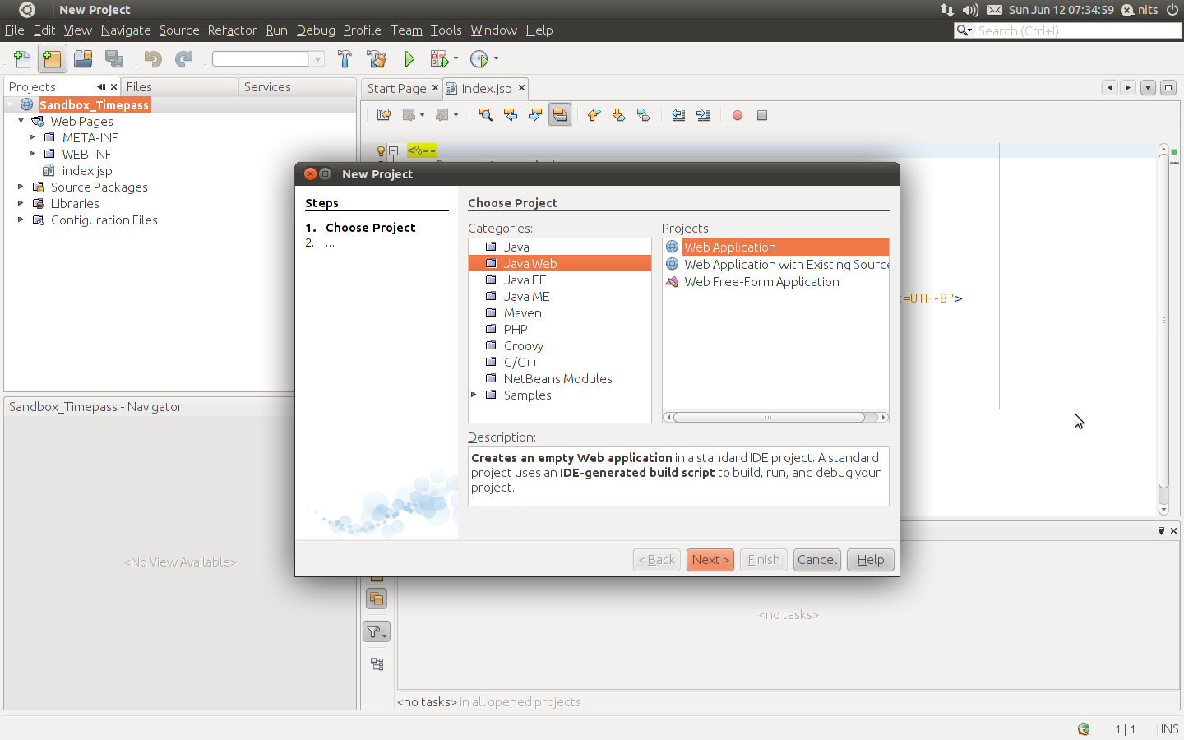

Slide 15
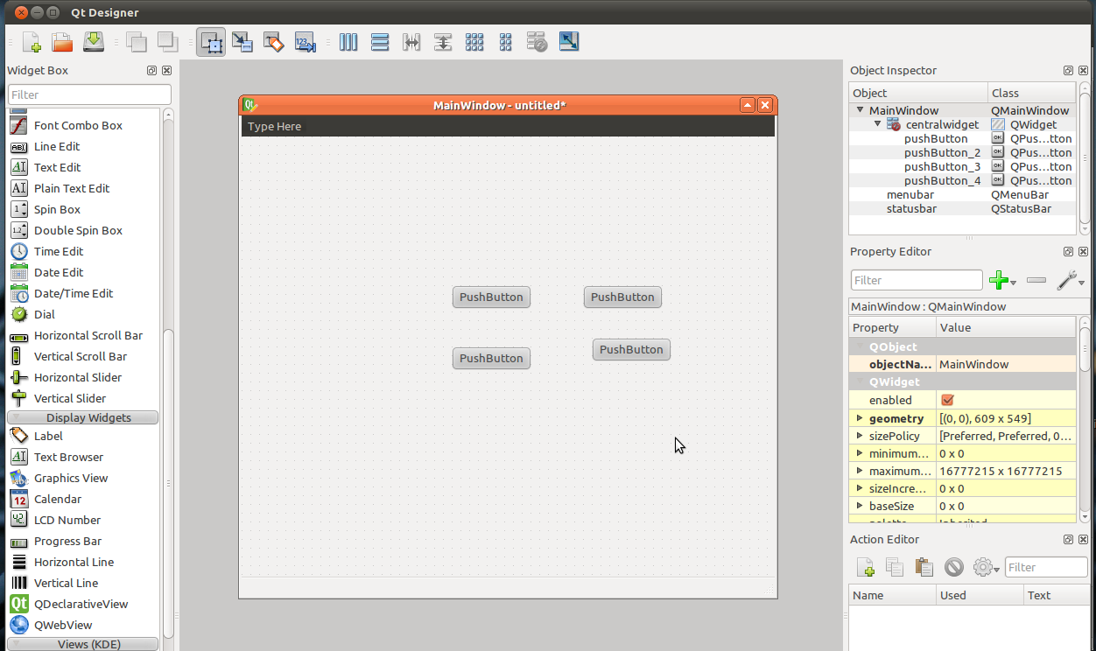

Slide 16
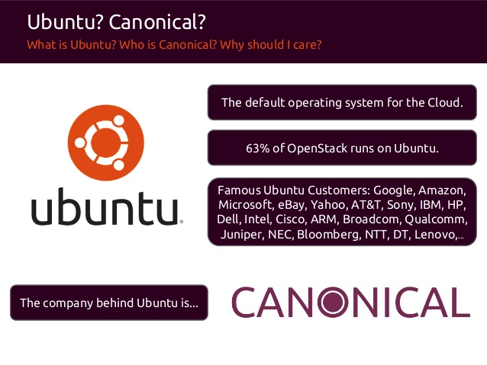
Industrial Use

Slide 17
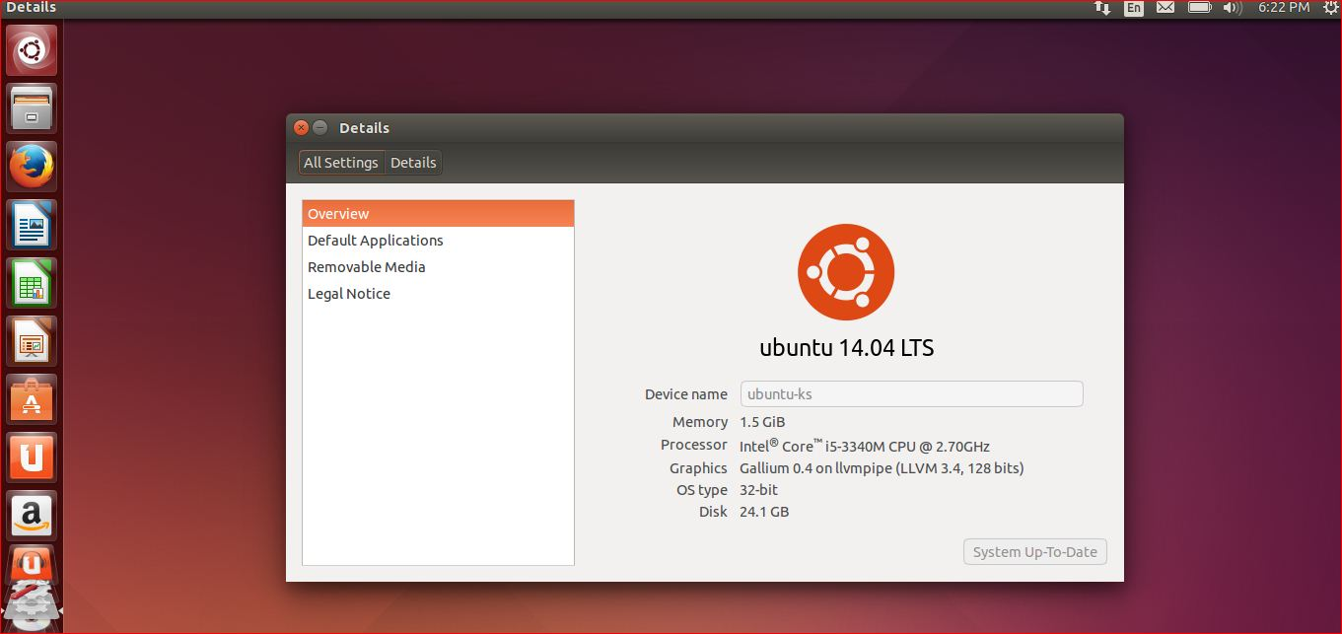
Advantages
Open Source
User-Friendly Layout
Compatibility
Multi Platform Advantage

Slide 18
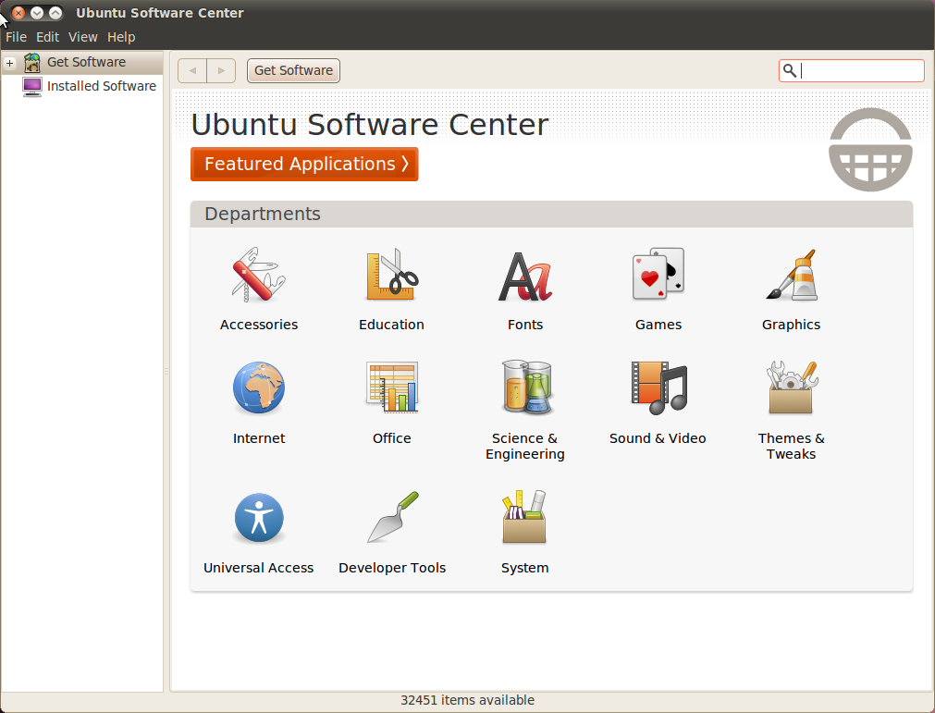
Disadvantages
Poor Gaming Abilities
Limited Default Packages
Minimal Support from Hardware Vendors

Slide 19

Future Innovations
Snappy
Digital Signature
AppArmor

Slide 20
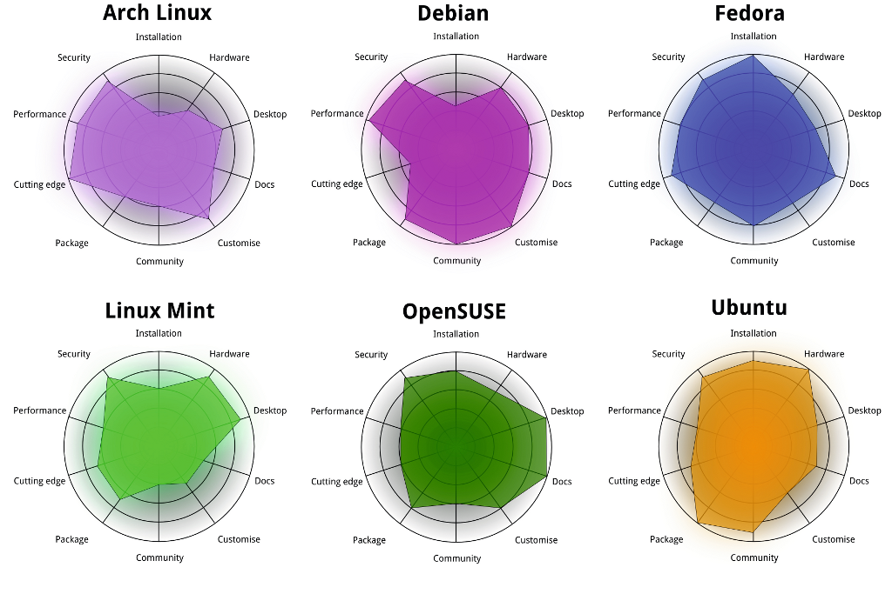

Slide 21
Canonical Ltd.
South African entrepreneur Mark Shuttleworth
Private company limited by shares
Created and Continues to Back Several Projects
Free/Open Source Software
Tools Designed to Improve Collaboration

Slide 22
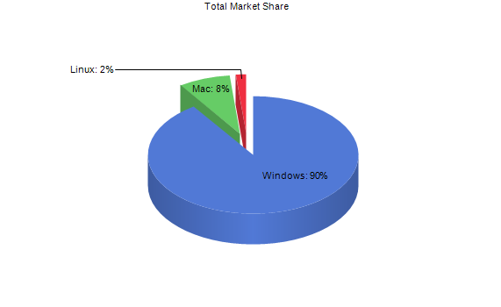
Desktop Operating System Market Share
Operating System | Total Market Share
Windows | 90.42%
Mac | 8.00%
Linux | 1.57%
FreeBSD | 0.00%
http://www.netmarketshare.com/ OCT 2015

Slide 23
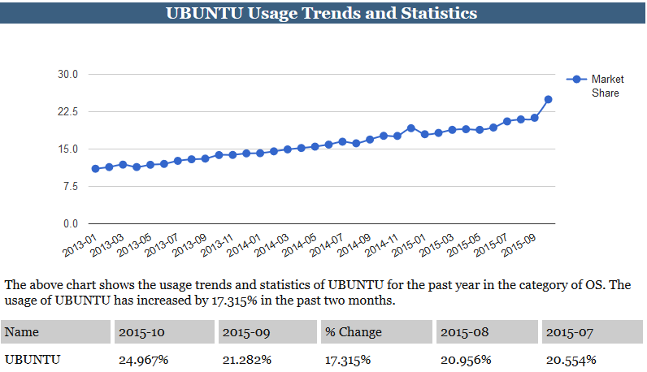
Usage Trends and Statistics
http://www.w3cook.com/os/ubuntu NOV 2015

Slide 24
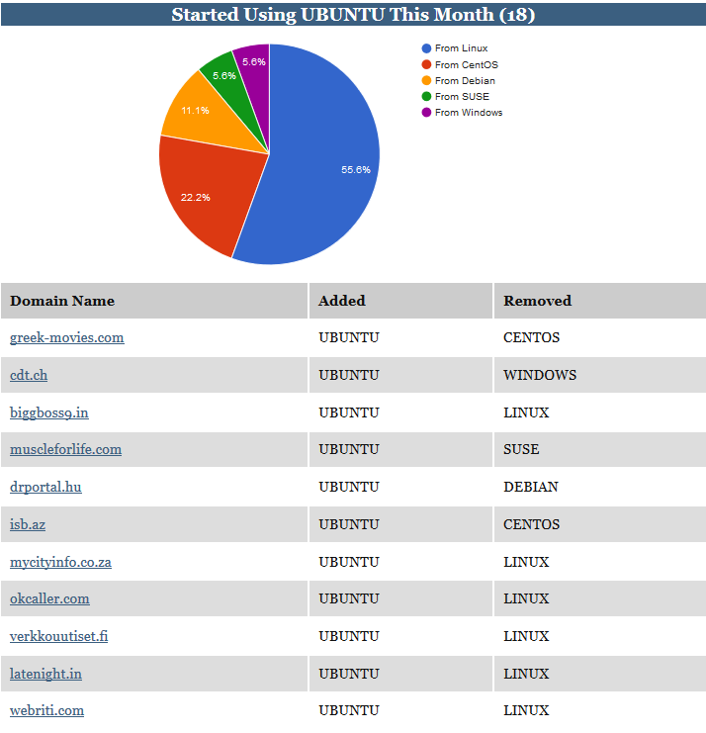
Began Use of Ubuntu
http://www.w3cook.com/os/ubuntu NOV 2015

Slide 25
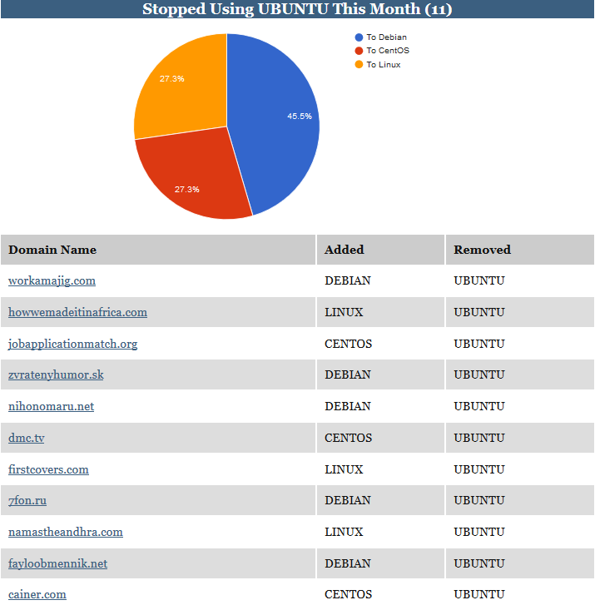
Terminated Use of Ubuntu
http://www.w3cook.com/os/ubuntu NOV 2015

Slide 26
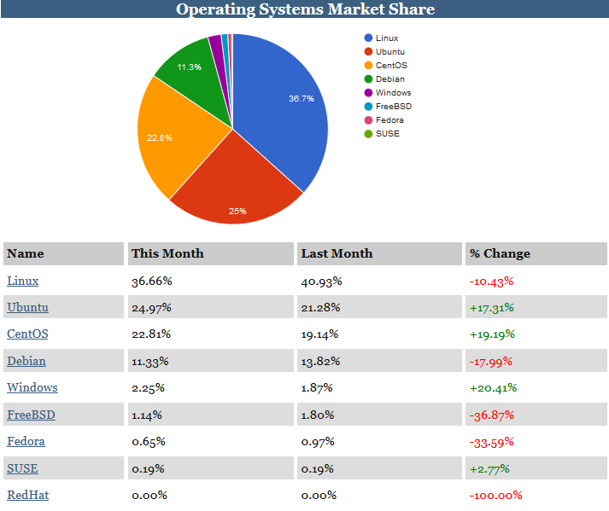
Operating Systems Market Share
http://www.w3cook.com/os/ubuntu NOV 2015

Slide 27
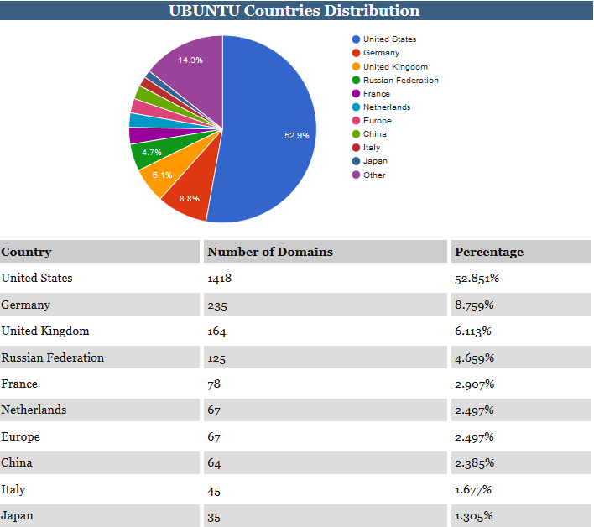
Distribution by Country
http://www.w3cook.com/os/ubuntu NOV 2015

Slide 28
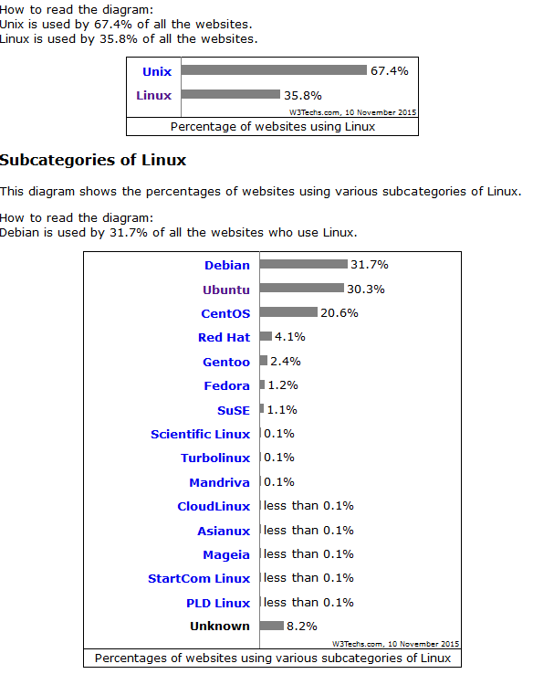
Usage Trends and Statistics
http://w3techs.com/technologies/
details/os-linux/all/all
NOV 2015

Slide 29
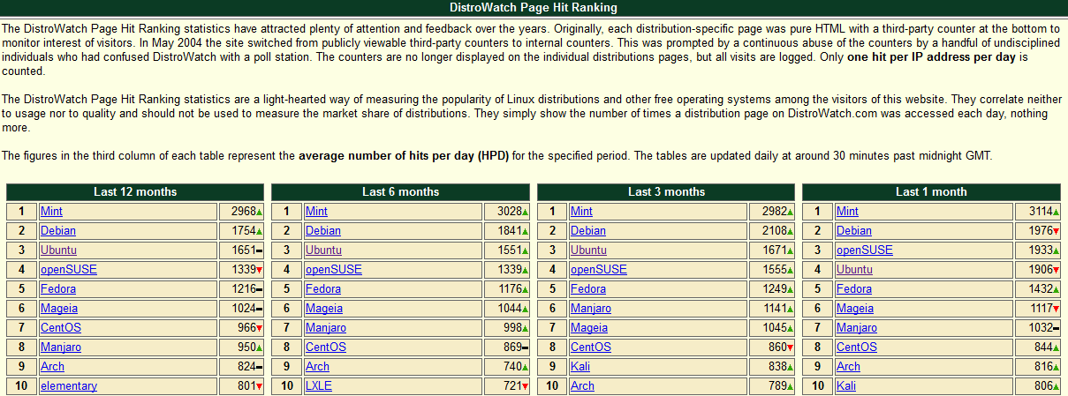
DistroWatch
http://distrowatch.com/dwres.php?resource=popularity/ NOV 2015

Slide 30

Questions

