Slide 1
Physical Layer Simulation of OFDM

Slide 2
Abstract
Orthogonal Frequency Division Multiplexing
4th Generation Wireless Communication like LTE, LTE-A, WiMAX
Multitone Modulation with higher data rate
Overcoming ISI and Multipath fading

Slide 3
OFDM
Advantage:
Robust to channel interference
Robust to ISI
Uses IFFT/FFT block
Disadvantage
Loss in efficiency due to guard interval
High PAPR

Slide 4
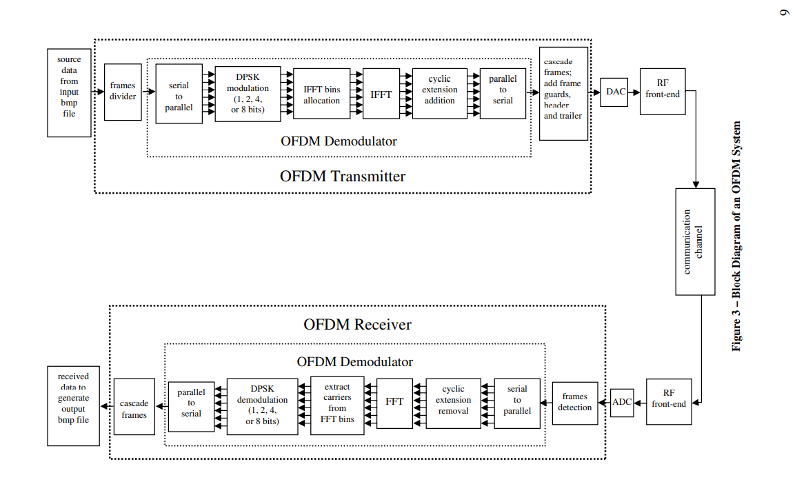
System Block Diagram

Slide 5

Transmission Channel
$w(t)$ = AWGN
$h(t)$= Channel Impulse Response
$s(t)=$Tranmitted Signal, $r(t)$ = Received Signal
$r\left(t\right)=s\left(t\right)⋆h\left(t\right)+w(t)$

Slide 6

Channel Estimation
$H\left(ω\right)=\frac{P\left(ω\right)}{X\left(ω\right)}$
$P=$Received Pilot value, X =Pilot value.
Channel estimation output, $Y\left(ω\right)=H^{−1}×R(ω)$, Here $R$ is the received signal.

Slide 7
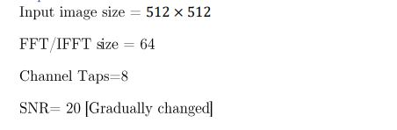
Project Parameters

Slide 8
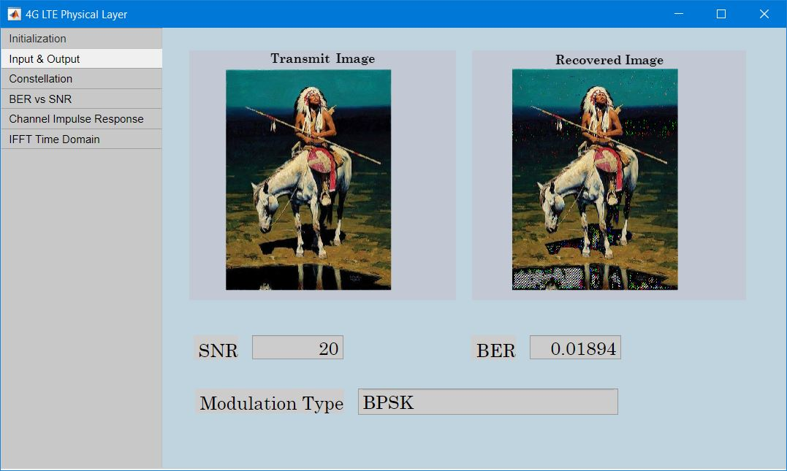
Output Demonstration

Slide 9
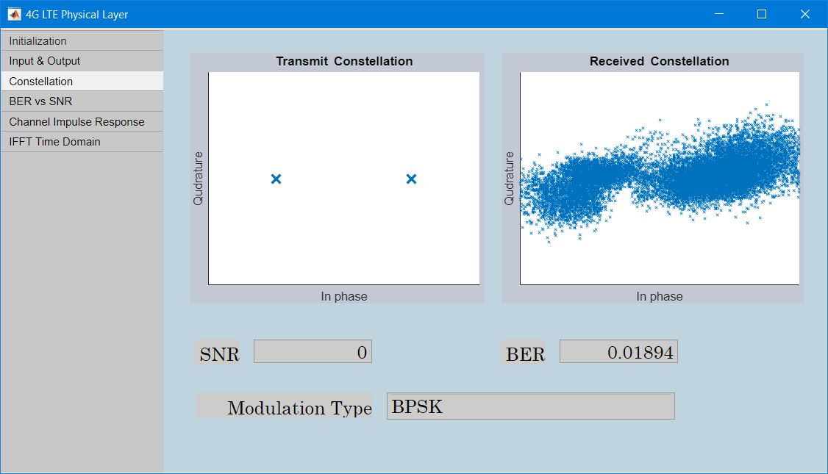
Output Demonstration

Slide 10
Output Demonstration

Slide 11
Output Demonstration

Slide 12
Thank You Everyone

