Slide 1
LAB01 Profiling and Performance Evaluation
Alberto Dequino – alberto.dequino@unibo.it
Francesco Conti, Alessio Burrello, Alberto Dequino

Slide 2
Class organization
VM startup and verification
LINPACK introduction and profiling tools
Hands-on: DGEMM
VALGRIND and KCACHEGRIND
Now…
Open your machine shared on virtuale.
All libraries and dependencies are already installed.

Slide 3
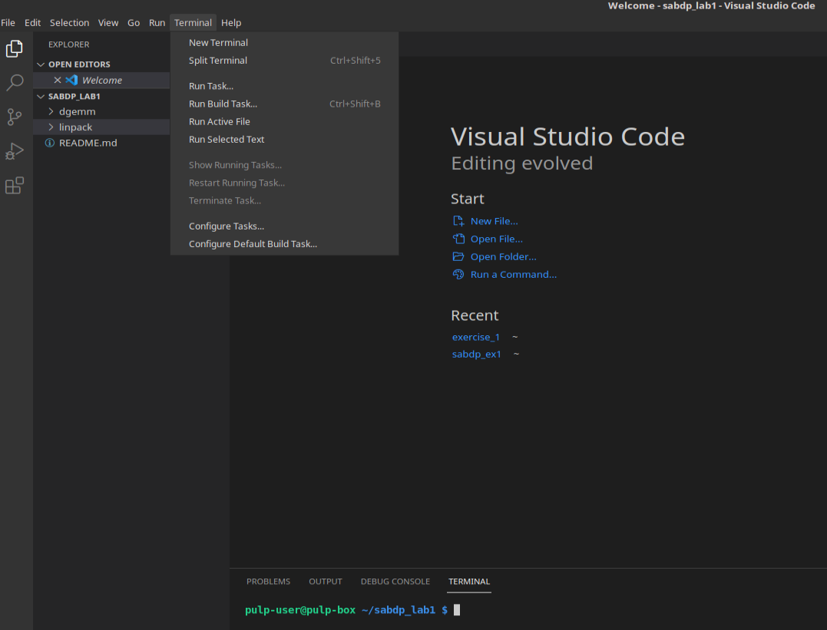
Getting Started: Environment Setup
Open a new terminal (CTRL + ALT + T)
Open a text editor (eg. Visual Studio Code)
Terminal → New Terminal
You can now work using the terminal
below the text editor.
$ cd sabdp_lab1/
$ code .

Slide 4

LINPACK Introduction
Benchmark measuring a computer’s floating point rate of execution
Solves a system of linear equations (Ax = b) using Gaussian Elimination and partial element pivoting
Developed to test supercomputers between the 70s and 80s
Uses BLAS (Basic Linear Algebra Subprograms) to execute vector and matrix operations

Slide 5
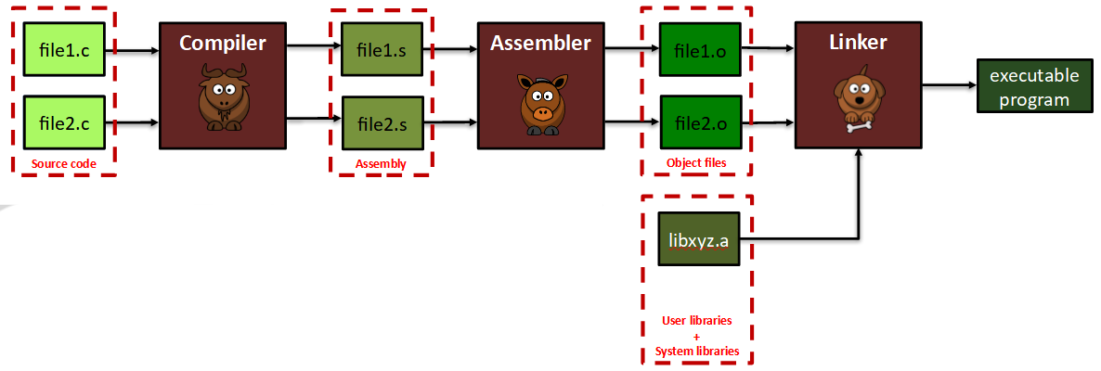
Compilation toolchain
A compilation toolchain includes several tools to achieve its final goal
The COMPILER translates high-level source code (e.g., C) to a lower-level representation (e.g., assembly)
The ASSEMBLER is program that translates assembly language to machine language
The LINKER combines multiple object files into a single executable
$ cd linpack/
$ gcc -Wall -pg -g -o linpack-pc linpack-pc.c -DDP -DROLL -lncurses
$ ./linpack-pc
LAB SABDP 21/22

Slide 6
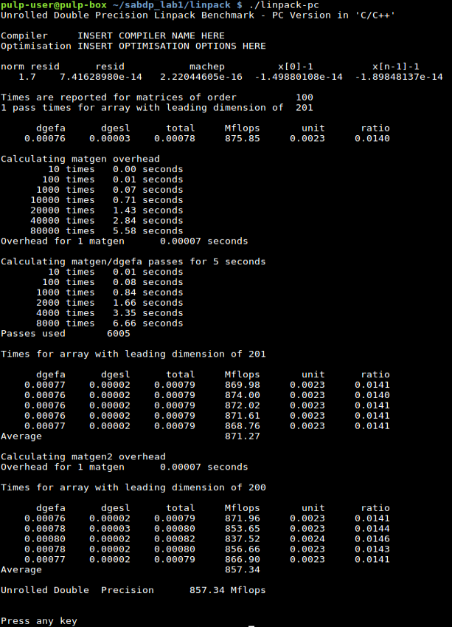
LINPACK Output
Computes a residual to verify results
LAB SABDP 21/22

Slide 7
LINPACK Output
Computes a residual to verify results
DGEFA: double-precision matrix factorization with gaussian elimination
LAB SABDP 21/22

Slide 8
LINPACK Output
Computes a residual to verify results
DGEFA: double-precision matrix factorization with gaussian elimination
DGESL: solves the system of linear equations represented in the form
A * X = B
Using the factors previously computed by DGEFA
LAB SABDP 21/22

Slide 9
LINPACK Output
Computes a residual to verify results
DGEFA: double-precision matrix factorization with gaussian elimination
DGESL: solves the system of linear equations represented in the form
A * X = B
Using the factors previously computed by DGEFA
Matrix generation overhead is calculated indipendently
LAB SABDP 21/22

Slide 10
Rolled / Unrolled
$ gcc -Wall -pg -g -o linpack-pc linpack-pc.c -DDP -DROLL -lncurses
Change this compiling flag for the UNROLLED implementation.
-DROLL
-DUNROLL
Why is the execution time different?
LAB SABDP 21/22

Slide 11
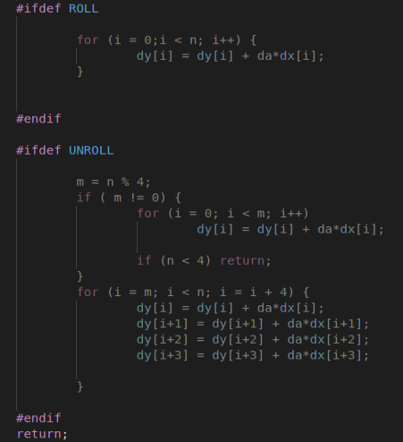
Rolled / Unrolled
Unrolling is a loop transformation technique.
Optimizes execution speed in exchange of binary size.
Advantages:
Branch penalty is minimized, fewer end-of-loop controls
If loops are independent, may allow parallelism
Disadvantages:
Increased code size
Less readable code
May not be compatible with inling
Increased register usage
LAB SABDP 21/22

Slide 12
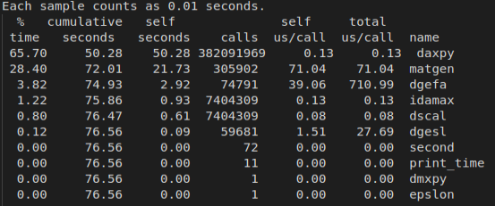
Gprof
$ gprof linpack-pc gmon.out > profile.txt
$ cat profile.txt
Gprof traces the call tree of the program, listing the percentage spent for each function, the total time, the number of calls and the average time spent for each call.
DAXPY: basic vector * scalar operation
IDAMAX: finds the index of the
maximum absolute value in a vector
LAB SABDP 21/22

Slide 13
DGEMM
Matrix – matrix operation:
D = alpha * op(A) * op(B) + beta * C
Where:
A, B and C are matrixes
Alpha and beta are scalar values
op(X) = X or X’
LAB SABDP 21/22

Slide 14
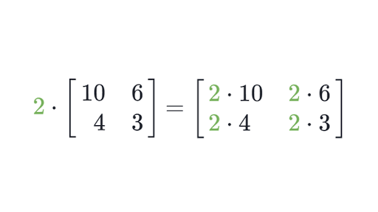
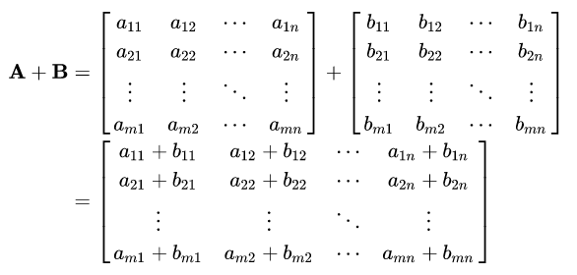
Scalar – Matrix Multiplication
Matrix – Matrix Addition
LAB SABDP 21/22

Slide 15
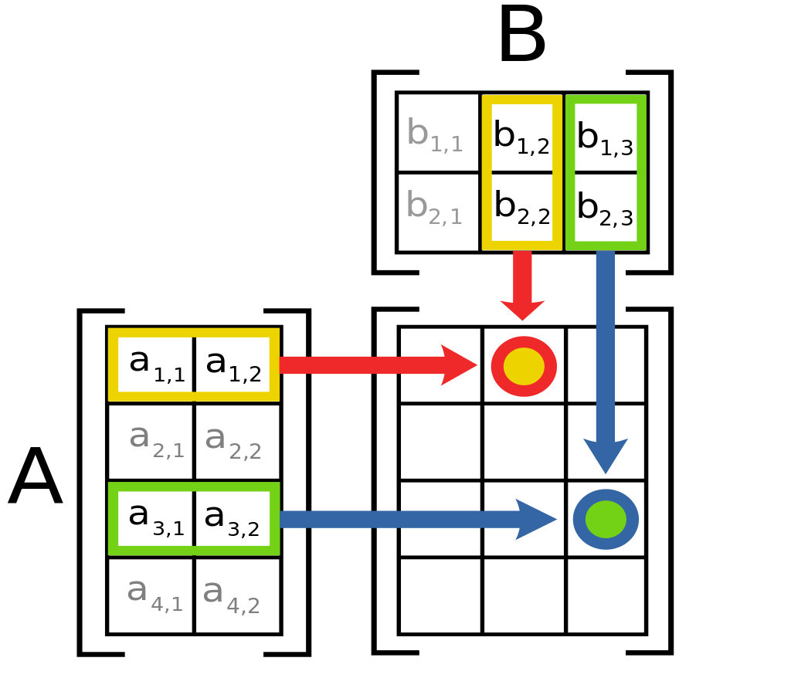
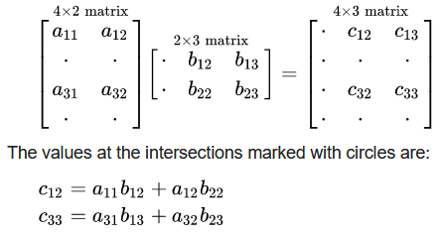
Matrix - Matrix multiplication
[M x N] * [N x P] = [M x P]
The second dimension of the first matrix must be the same as the first dimension of the second matrix
LAB SABDP 21/22

Slide 16
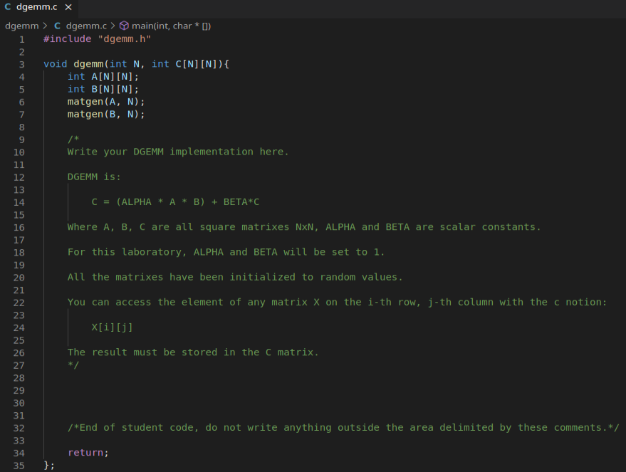
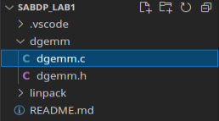
Hands – on: DGEMM
Write your own implementation of the DGEMM and evaluate its performance
Write your C implementation inside this block, you must not modify any other part of the code.
LAB SABDP 21/22

Slide 17
Compile and verify
$ cd dgemm/
$ gcc -Wall -pg -g -o dgemm dgemm.c
$ ./dgemm N
N is an integer value defining the dimension of the square matrixes.
Do not insert a value too big, since the VM memory is limited.
Possible outputs:
The implementation holds incorrect results, you need to fix them.
The implementation is correct, you can now evaluate with gprof and optimize it using techniques such as blocking and unrolling.
Implementation correct! Evaluate performance using a profiler.
You may have entered a N value too big (700 is a good value to evaluate your solution), or your implementation does an illegal memory access and must be fixed.
ERROR IN DGEMM, please correct your implementation
Segmentation fault (core dumped)
LAB SABDP 21/22

Slide 18




Evaluating performance
$ rm gmon.out profile.txt
$ ./dgemm 700
$ gprof dgemm gmon.out >profile.txt
$ cat profile.txt
Rolled implementation
Unrolled implementation
Block implementation
Block + Unroll implementation
LAB SABDP 21/22

Slide 19
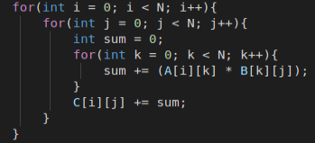
You have now 30 minutes to write down your own optimized DGEMM implementation.
LAB SABDP 21/22

Slide 20
In depth analysis: disassembly
$ gcc -S -o dgemm.s dgemm.c
An .s file is called the “assembly” file of the program. It is written in the Assembler language, which is specific to the machine architecture (in this case, is x86 assembly).
Assembler is an extremely low level language in which every instruction is executed in a sequential fashion. Loops, memory, stack and heap are also managed explicitly.
It is not easily interpretable by a human programmer, but understanding this form of code may reveal windows of optimization unspottable otherwise.
LAB SABDP 21/22

Slide 21
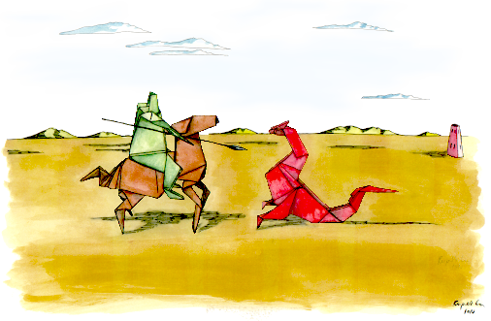
In depth analysis: VALGRIND & KCACHEGRIND
You may read Kcachegrind documentation at https://kcachegrind.github.io/html/Home.html.
Valgrind is a framework of powerful profiling tools such as memory checker, cache, branch predictor, heap profiler, thread error detector, call graph generator etc…
Part of the valgrind framework is Callgrind, which generates the call graph of the profiled program, and Kcachegrind which visualizes its output on a GUI.
$ rm -r callgrind.out.*
$ valgrind --tool=callgrind ./dgemm 700
$ kcachegrind
LAB SABDP 21/22

