Slide 1
Introduction
• SAWH = Solar-powered Atmospheric Water Harvester
• Extracts water from humidity using renewable energy
• Our website is the smart dashboard for monitoring & control

Slide 2
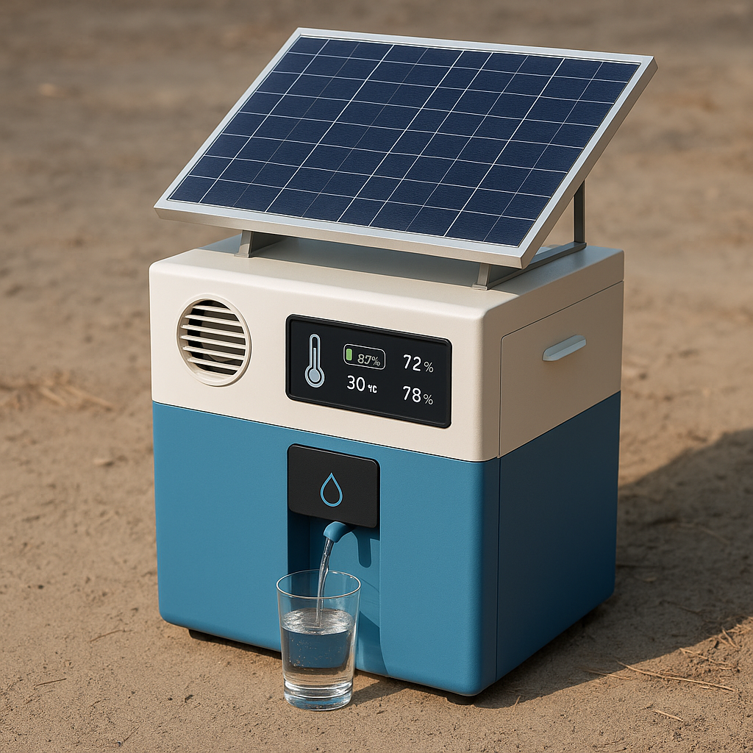

Slide 3
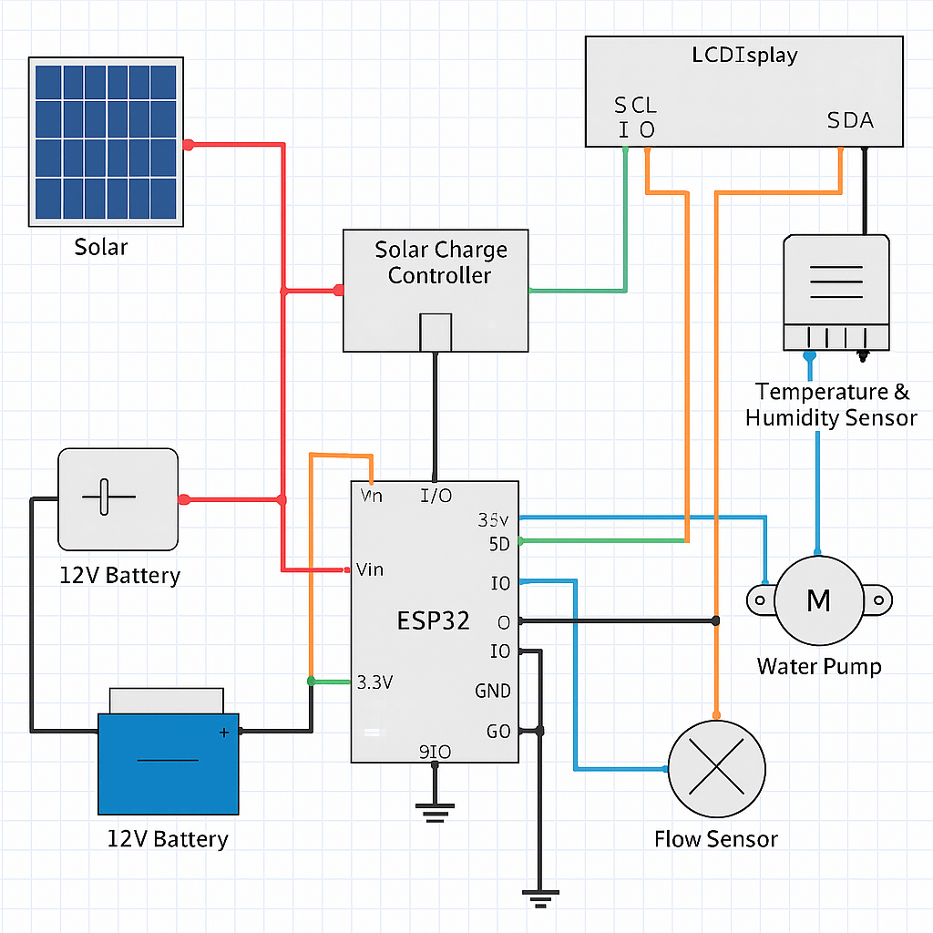

Slide 4
The Problem
• Rural areas lack reliable access to clean water
• Manual checking of devices is hard
• No visibility into daily performance

Slide 5
Our Solution
• SAWH device generates water using solar power
• Website shows real-time humidity, temp, and water data
• Remote control: Start, Stop, Reset
• Weather forecast & water chart included

Slide 6
AI Integration
• Predicts water yield based on weather
• Detects low performance or faults
• Suggests best installation areas

Slide 7
Why Common People Need This
• Easy access to daily water info
• No need to visit the device
• Helps with water planning
• Provides trust & transparency

Slide 8
Opportunities
1.Rural Water Access
• Provides drinking water in off-grid, drought- prone, or arid regions.
2. Disaster Relief
• Deployable in emergency zones (floods, earthquakes) where water is cut off.
3. Military and Remote Camps
• Useful for defense outposts or research stations without water infrastructure.
4.Smart Cities & IoT Integration
• Can be part of smart sustainable city projects with data monitoring.
5.Agricultural Applications
• Use harvested water for vertical farming or greenhouse irrigation.
6.CSR & ESG for Corporates
• Companies can sponsor deployments to meet environmental goals.
7.Export Potential
• Valuable for countries facing climate-induced water scarcity.
8.Educational Tool
• Demonstrates renewable energy and sustainability in schools and colleges.

Slide 9
Advantages
• Fully Renewable – Uses solar energy; no external power needed.
• Self-Sustaining – Can work autonomously with minimal maintenance.
• Zero Groundwater Depletion – Doesn’t tap aquifers or water bodies.
• Portable & Scalable – Easy to move and install in units.
• Eco-Friendly – No pollution or carbon emissions.
• Data Monitoring – Real-time stats help improve water efficiency.
Disadvantages
• Humidity Dependent – Less efficient in dry climates (<20% humidity).
• Initial Cost – Higher upfront cost compared to traditional methods.
• Limited Output – One unit produces only a few liters/day.
• Maintenance Required – Filters and solar panels need periodic cleaning.
• Weather Dependent – Low solar input affects production on cloudy days.

Slide 10
Conclusion
• Clean water + smart tech = SAWH Dashboard
• Solves real-world water problems
• Uses AI, solar power & web for better future
• Thank you!

Slide 11
Presented by:
Abhinav A.V
Abhijith A
Midhun Mohan
Visal V.S

