Slide 1
Balmorel Guidance presentation/changes from github Main/consistency checks
Jasper Geipel
AURES project

Slide 2
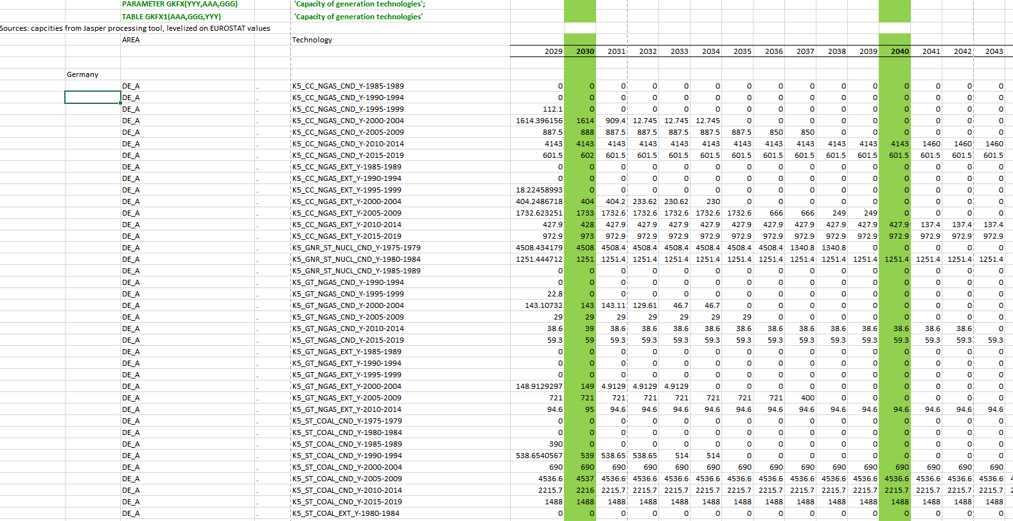
Changes on Balmorel_data_input (15)

Slide 3
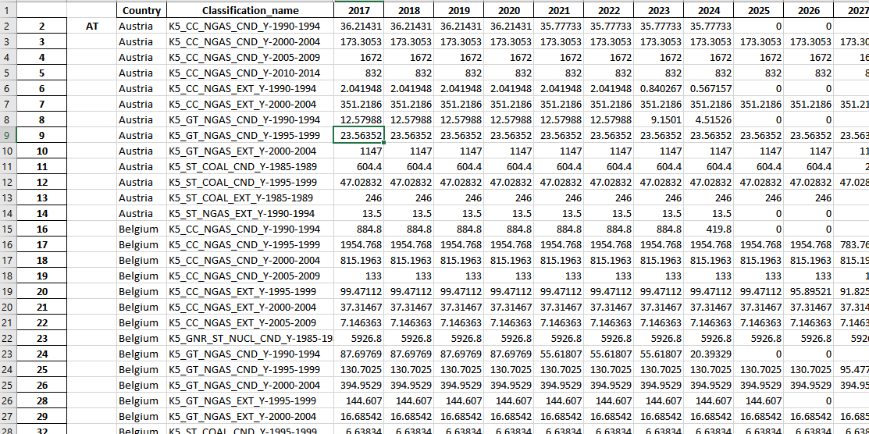
Changes on Balmorel_data_input (15)
Inclusion of conventional power data
Export capacity data as xlsx.
Change country into Balmorel Area : Austria → AT_A;etc

Slide 4
Changes on Balmorel_data_input (15)
USE Jasper processing tool to get conventional power plant data
Export capacity data as xlsx.
Change country into Balmorel Area : Austria → AT_A;etc

Slide 5
Changes on Balmorel_data_input (15)
USE Jasper processing tool to get conventional power plant data
“Export_conv_PP-Balmorel.xlsx”
Export capacity data as xlsx.
Change country into Balmorel Area : Austria → AT_A;etc
Use Formula in excel (Wenn
Copy into (15)

Slide 6
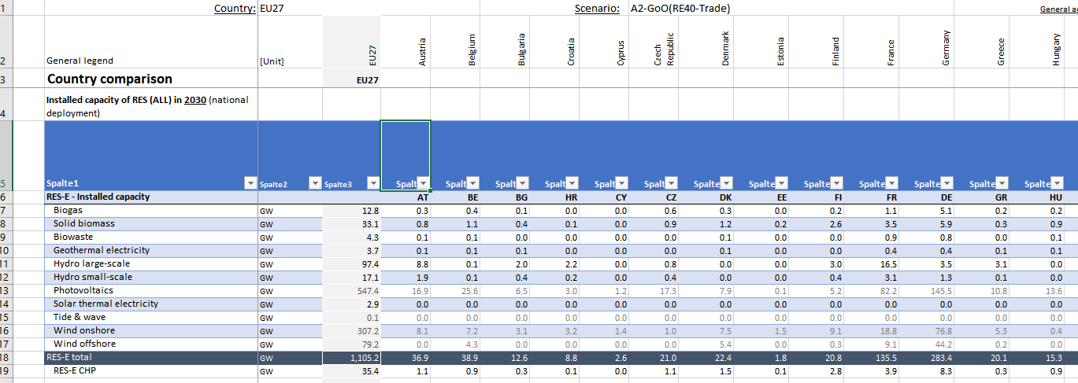
Changes on Balmorel_data_input (15)
Inclusion of RES-Power plants
Source here: “Balmorel_data_input_GX_scen.xlsx” → Gustav GX runs

Slide 7
Changes on Balmorel_data_input (15)
Inclusion of RES-Power plants
Source here: “Balmorel_data_input_GX_scen.xlsx” → Gustav GX runs
Trick: Use Power Pivot Addon
Calculate and add row “Centralised PV”
Add Balmorel Technology classifications “For example: K5_GNR_WT_WIND_ONSHORE_2030”
Add table data to Power Pivot model “Daten”→ “aus Tabelle”
“Start” → Im power query editor: erste Zeile als überschrift verwenden
“Transformieren” → Länderspalten “entpivotisieren”
Daten rauskopieren → nach Offshore filter
Bei Offshore: =Verknüpfen(“AT”, “.”, “Offshore”)
Copy RES capacities to Balmorel_data_input (15)

