Slide 1
Balmorel Guidance presentation/changes from github Main/consistency checks
Jasper Geipel
AURES project

Slide 2
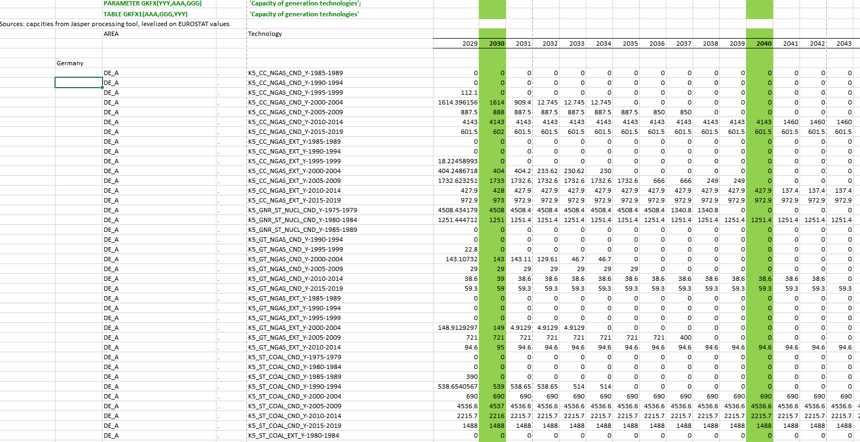
(15) Capacity of generation technologies ‘PARAMETER GKFX(YYY,AAA,GGG)

Slide 3
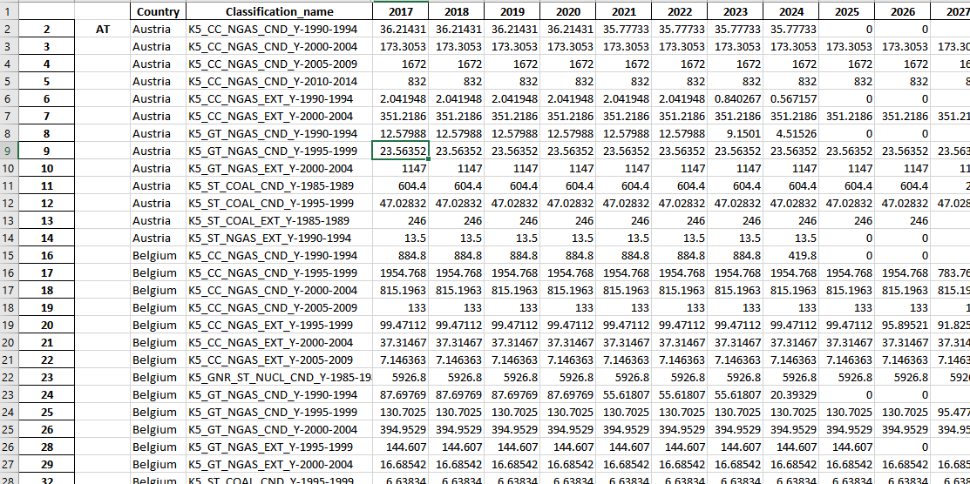
(15) Capacity of generation technologies
Inclusion of conventional power data

Slide 4
(15) Capacity of generation technologies
Inclusion of conventional power data
USE Jasper processing tool to get conventional power plant data
“Export_conv_PP-Balmorel.xlsx”
Export capacity data as xlsx.
Change country into Balmorel Area : Austria → AT_A;etc
Use Formula in excel (Wenn
Copy into (15)

Slide 5
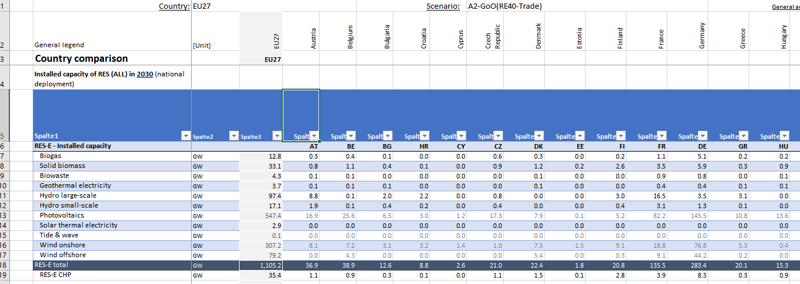
(15) Capacity of generation technologies
Inclusion of RES-Power plants data
Source here: “Balmorel_data_input_GX_scen.xlsx” → Gustav GX runs

Slide 6
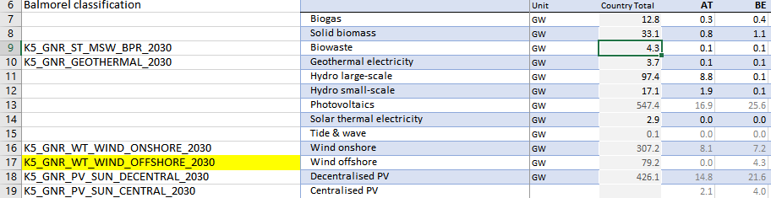
(15) Changes on Balmorel_data_input
Inclusion of RES-Power plants data
Source here: “Balmorel_data_input_GX_scen.xlsx” → Gustav GX runs
Trick: Use Power Pivot Addon
Calculate and add row “Centralised PV”
Add Balmorel Technology classifications “For example: K5_GNR_WT_WIND_ONSHORE_2030”

Slide 7
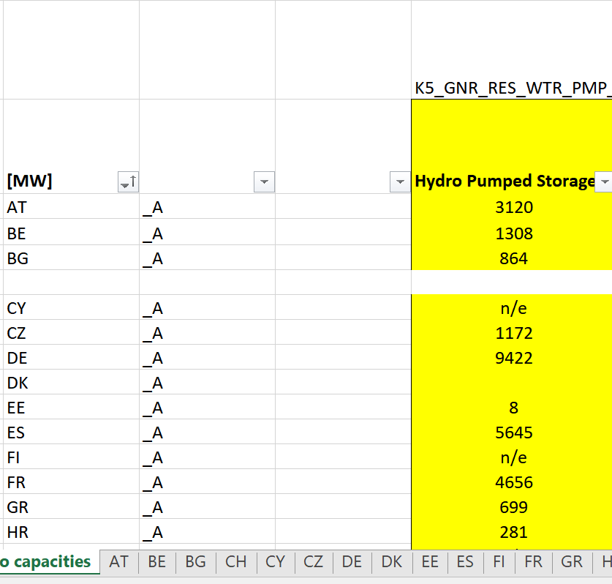
(15) Capacity of generation technologies
Inclusion of RES-Power plants data
Storage kommt von Hireps
C:\Users\geipel\Documents\GitHub
\EEG-policy modelling\EEG-Tools\AURES calcs

Slide 8
(15) Capacity of generation technologies
Inclusion of RES-Power plants data
Tide and Waveand Solarthermal currently not yet included in our Balmorel run
Hydro large scale and Hydro Small Scale has to be divided into
Run of River “K5_GNR_ROR_WTR_2030 „
Water No Pump “K5_GNR_RES_WTR_NOPMP_2030”
Full Load hours have to be adapted in (28)
Biomass is: “K5_GNR_ST_WOODCHIPS_EXT_2030”
Biowaste is : “K5_GNR_ST_MSW_BPR_2030”
Biogas is K5_GNR_ST_BIOGAS_EXT_2030

Slide 9
Municipal Waste
Gustavs Werte nur Biologischer Anteil
Eigentlich mehr
Ungefähr x2

Slide 10
(15) Changes on Balmorel_data_input
Inclusion of RES-Power plants data
Source here: “Balmorel_data_input_GX_scen.xlsx” → Gustav GX runs
Trick: Use Power Pivot Addon
Add table data to Power Pivot model “Daten”→ “aus Tabelle”
“Start” → Im power query editor: erste Zeile als überschrift verwenden
“Transformieren” → Länderspalten “entpivotisieren”
Daten rauskopieren → nach Offshore filter
Bei Offshore: =Verknüpfen(“AT”, “.”, “Offshore”)
Copy RES capacities to Balmorel_data_input (15)

Slide 11
(28) Full load hours
PARAMETER WTRRSFLH(AAA) 'Full load hours for hydro reservoir plants (hours)'
Based on Source: “Balmorel_data_input_GX_scen.xlsx” → Gustav GX runs
Check wether Gustav countries is equivalent to balmorel areas
Adaption of full load hour PARAMETER WTRRRFLH(AAA) 'Full load hours for hydro run-of-river plants (hours)‘
PARAMETER WNDFLH(AAA) 'Full load hours for wind power (hours)‘
PARAMETER SOLEFLH(AAA) 'Full load hours for solar power‘
PARAMETER SOLHFLH(AAA) 'Full load hours for solar heat (hours)‘
PARAMETER WAVEFLH(AAA) 'Full load hours for wave power (hours)'

Slide 12
=MTRANS('C:\Users\geipel\Documents\GitHub\EEG-policy modelling\EEG-Tools\AURES calcs\[ENTSOE_capacities_per_country.xlsx]Hydro capacities&FLH'!$F$6:$F$32)

