Slide 1
SEEG CASE Nifti-toolbox
from Today

Slide 2
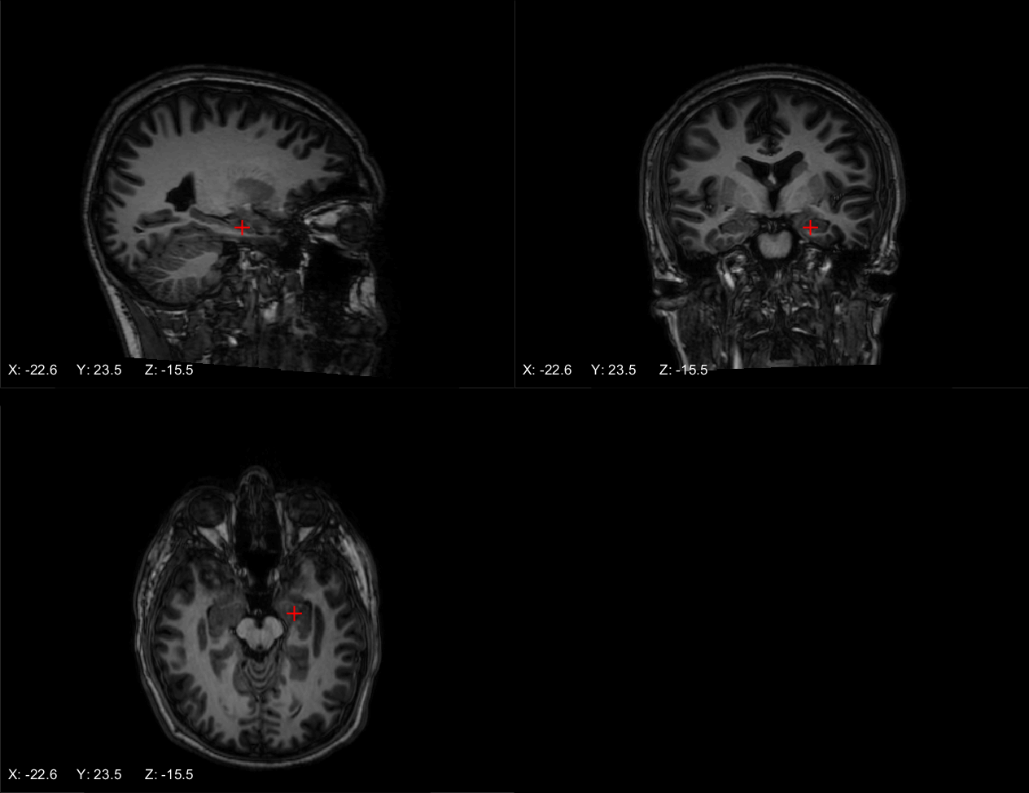
5 L hippo head - Ch 1

Slide 3
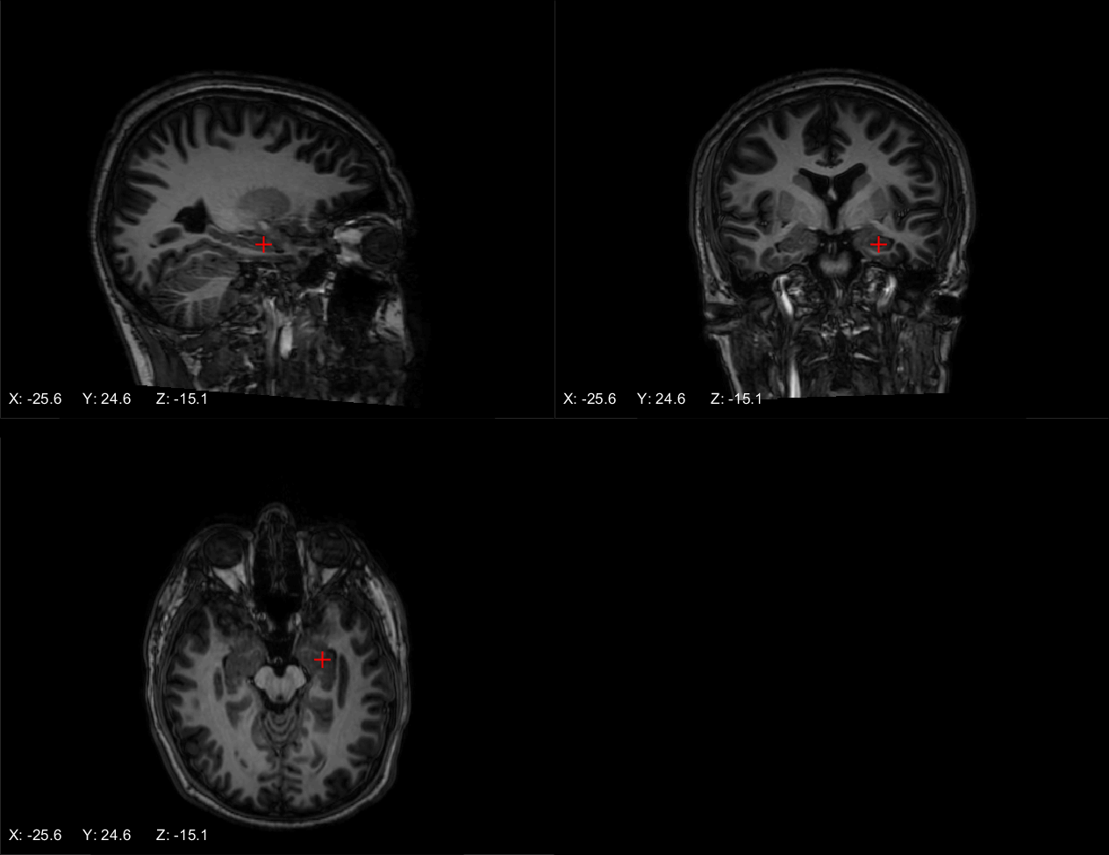
5 L hippo head - Ch 2

Slide 4
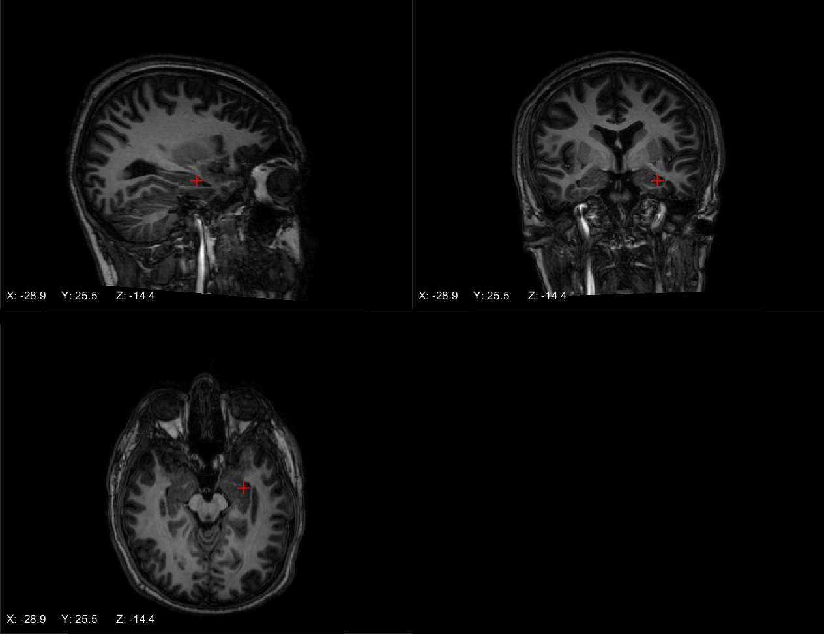
5 L hippo head - Ch 3

Slide 5

5 L hippo head - Ch 4

Slide 6
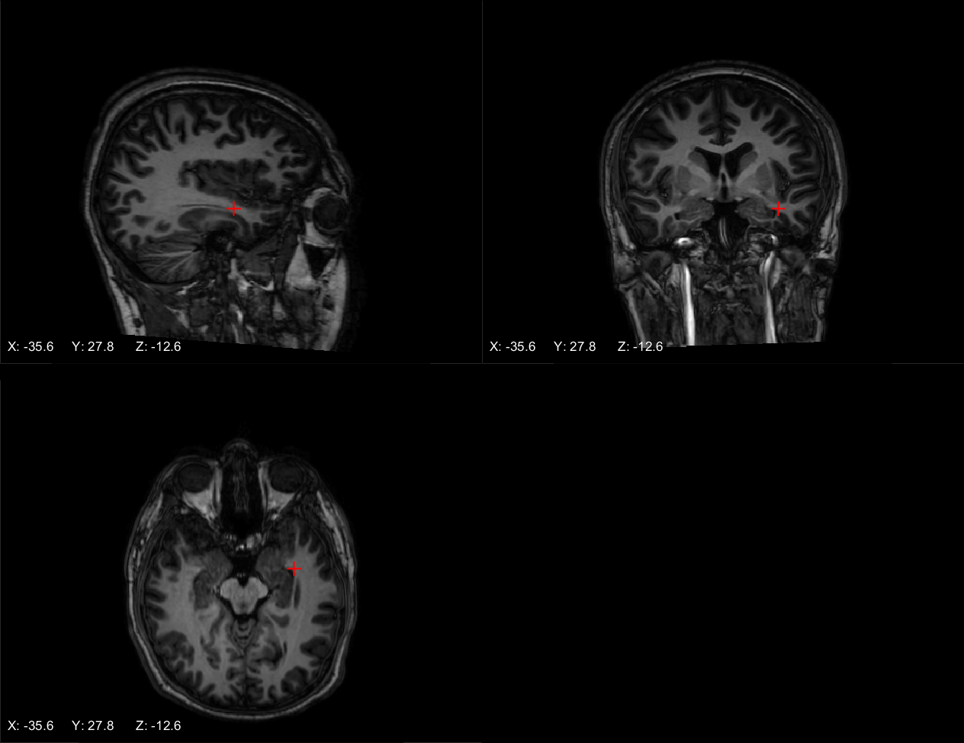
5 L hippo head - Ch 5

Slide 7
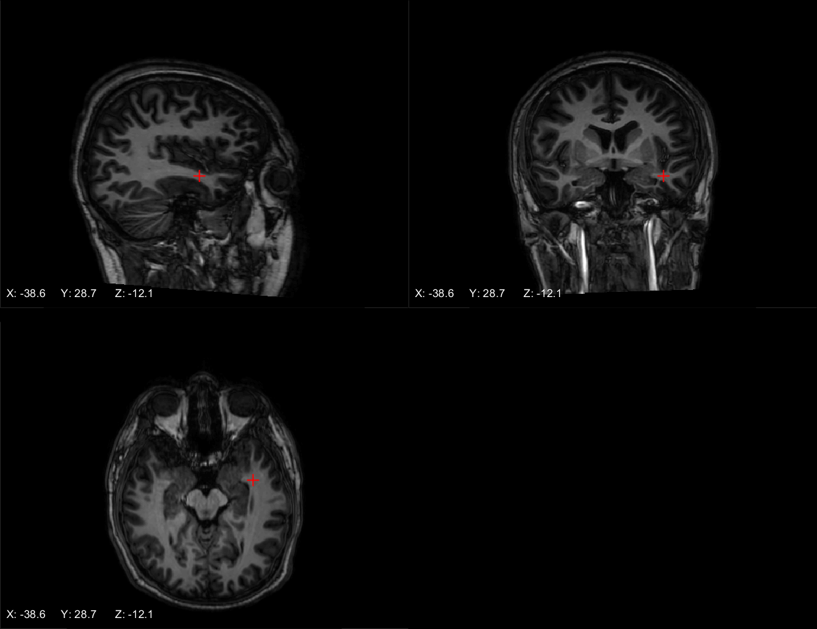
5 L hippo head - Ch 6

Slide 8
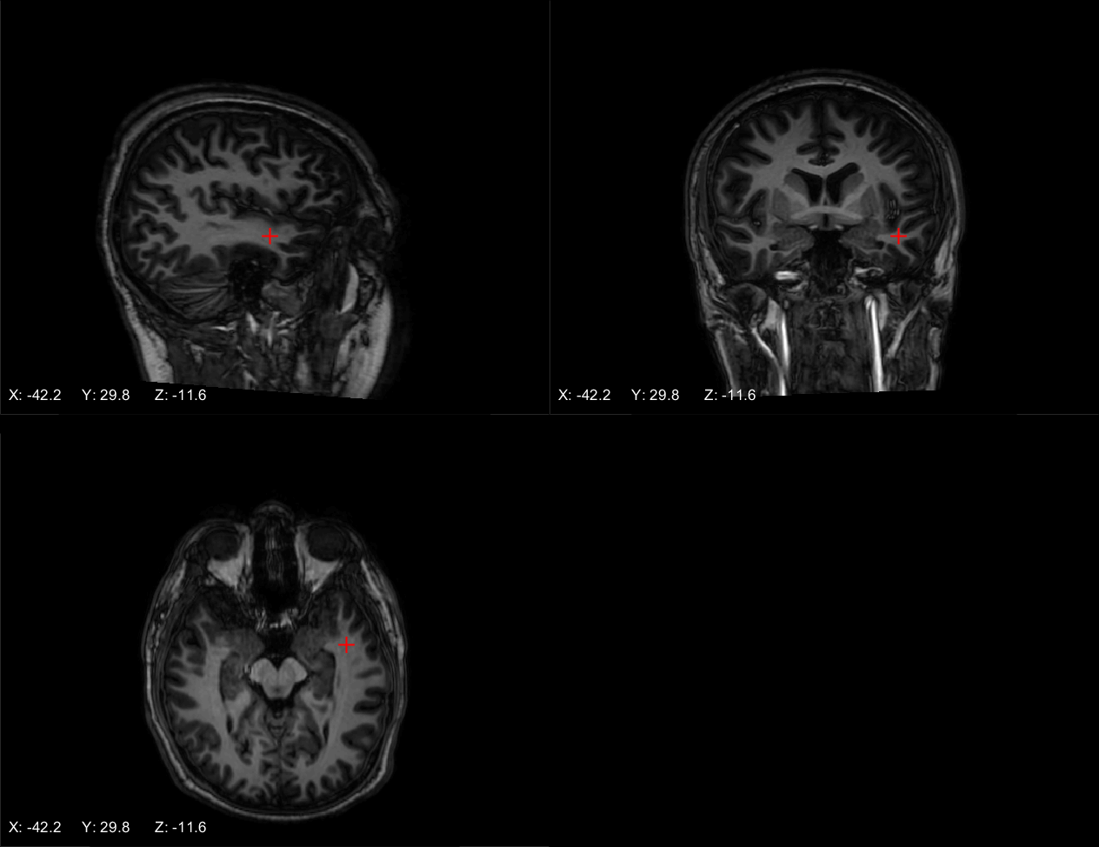
5 L hippo head - Ch 7

Slide 9
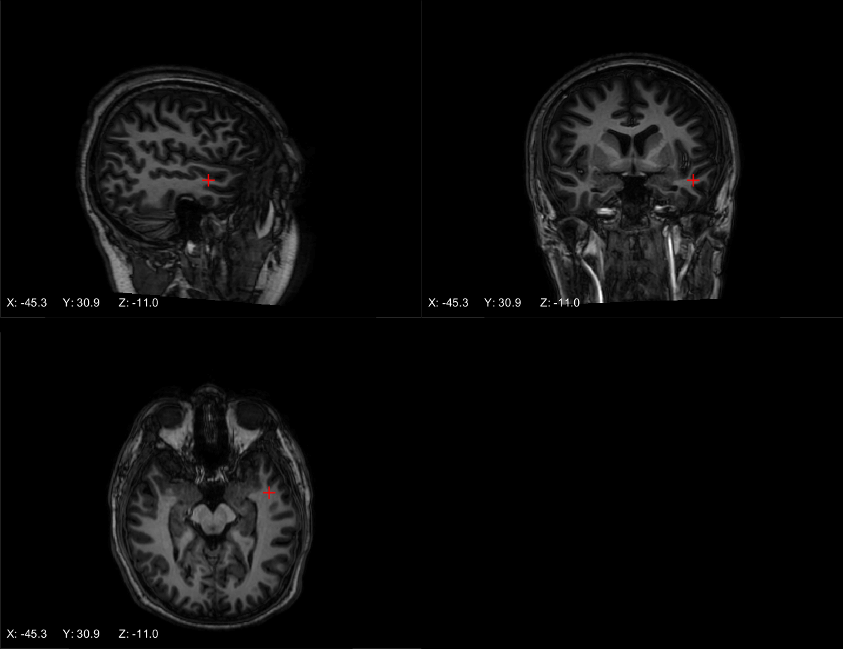
5 L hippo head - Ch 8

Slide 10
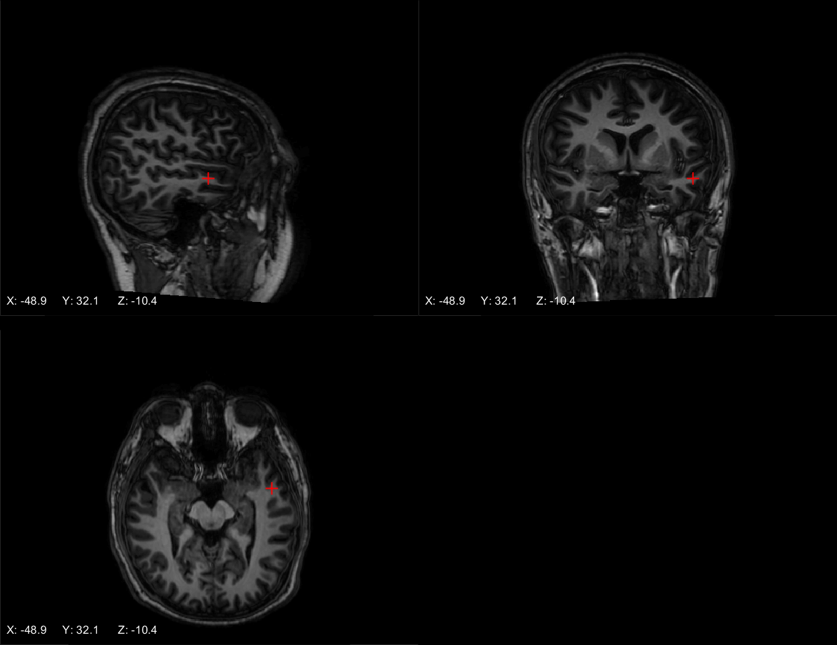
5 L hippo head - Ch 9

Slide 11
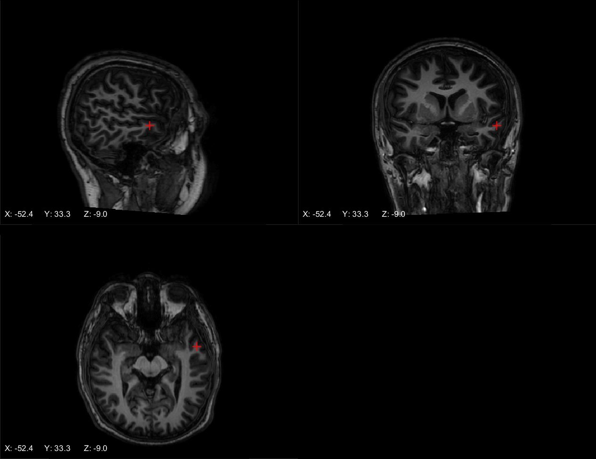
5 L hippo head - Ch 10

Slide 12
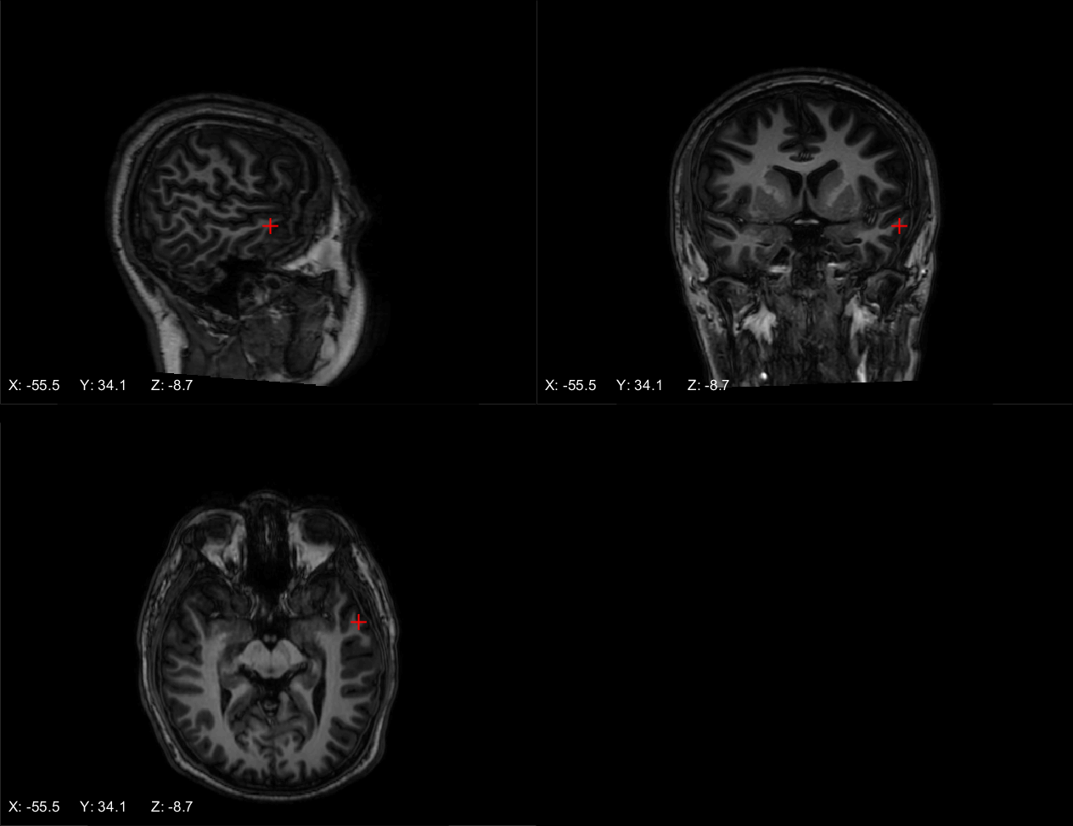
5 L hippo head - Ch 11

Slide 13

5 L hippo head - Ch 12

Slide 14
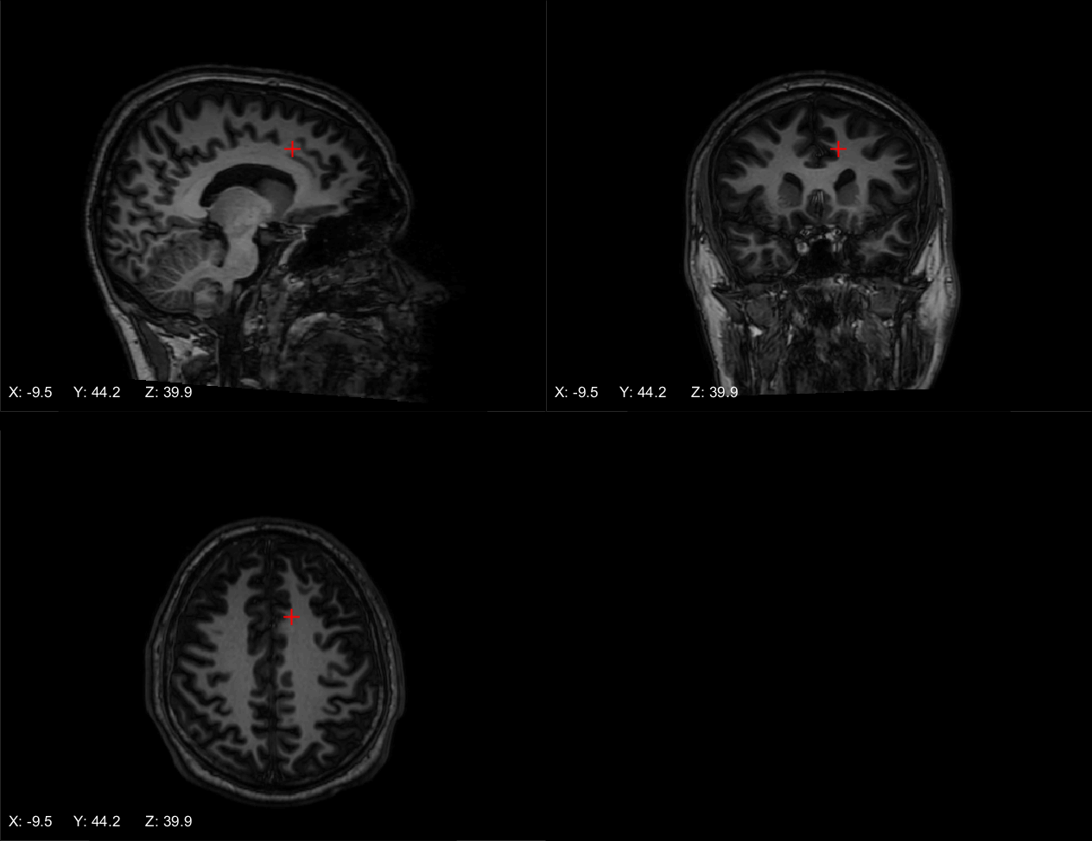
6 L premotor SMA - Ch 1

Slide 15
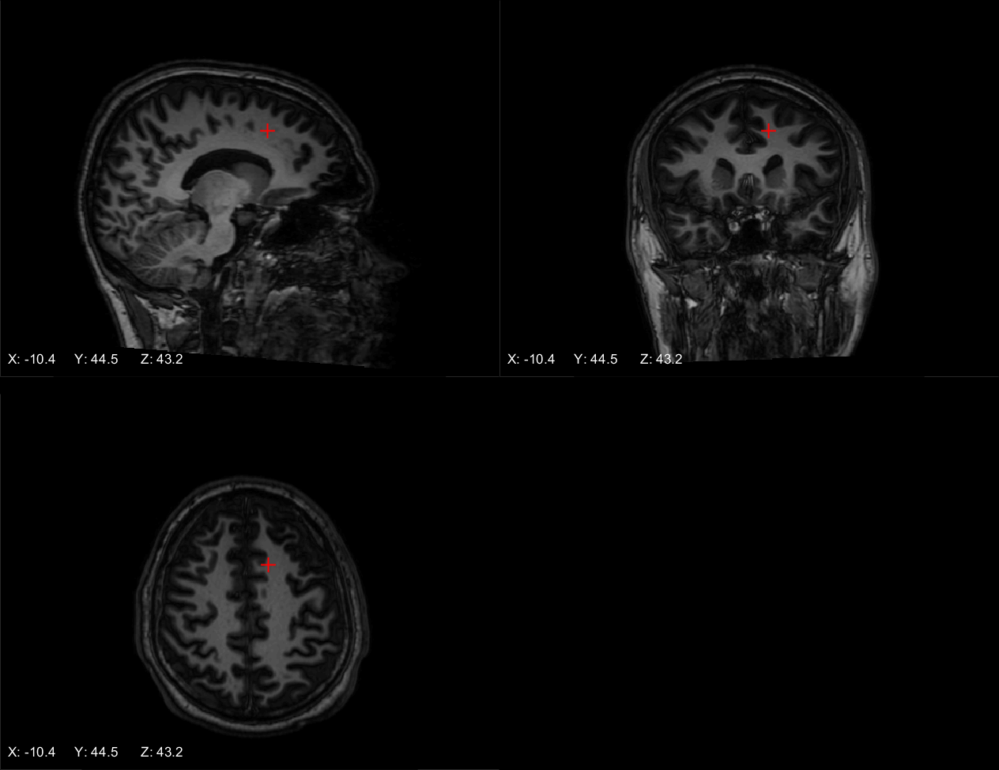
6 L premotor SMA - Ch 2

Slide 16
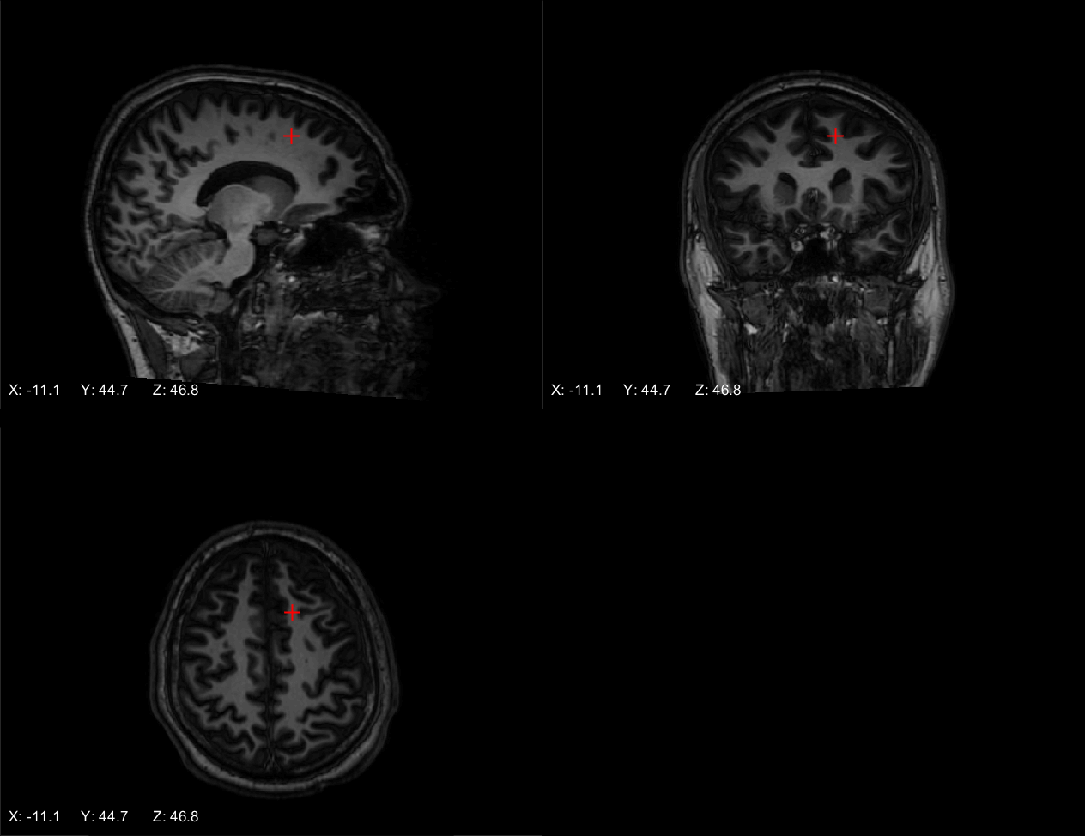
6 L premotor SMA - Ch 3

Slide 17
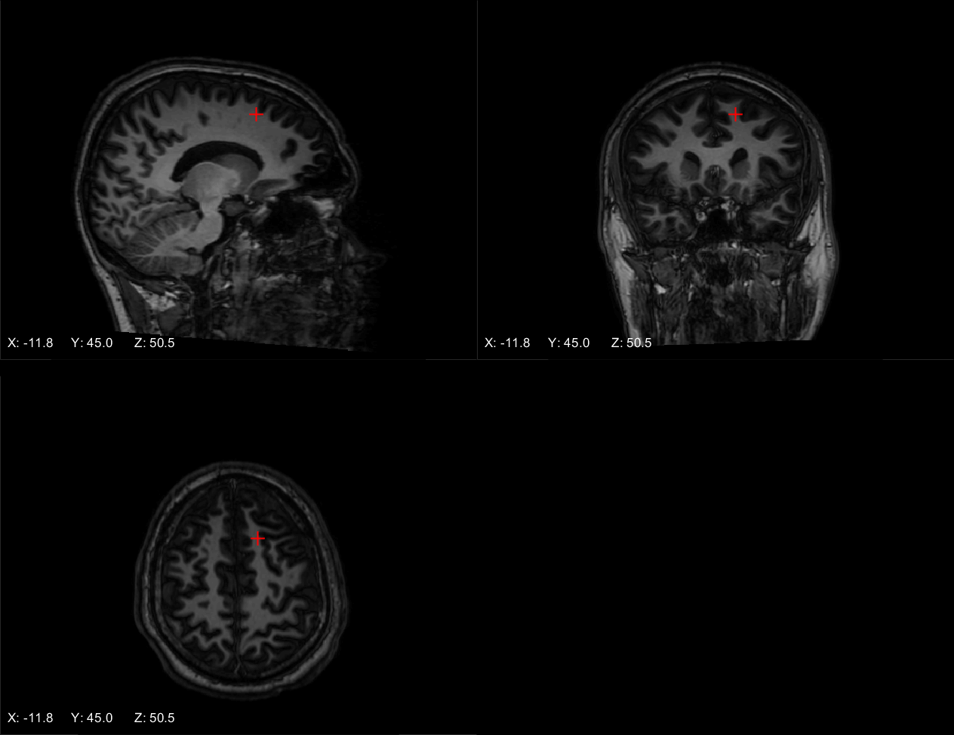
6 L premotor SMA - Ch 4

Slide 18
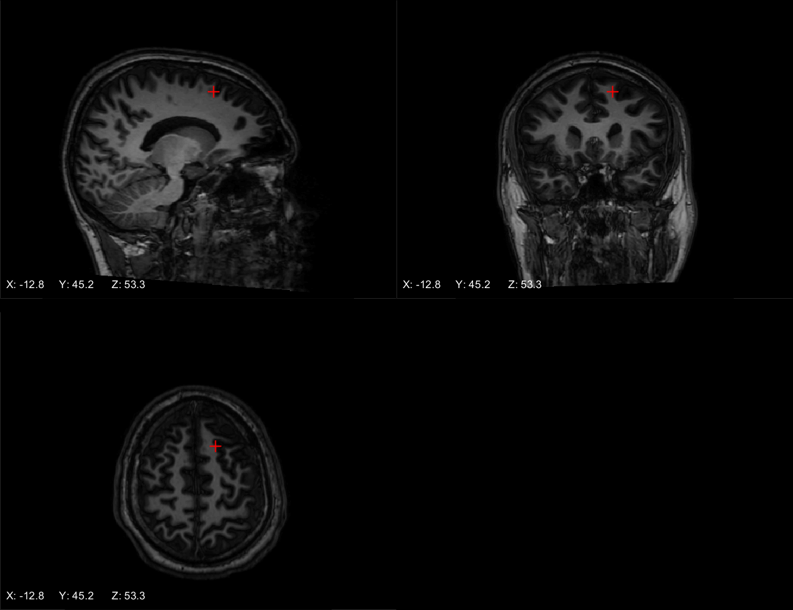
6 L premotor SMA - Ch 5

