Slide 1



1st Workshop on Extraction and Evaluation of Knowledge Entities from Scientific Documents (EEKE2020)
IEKM-MD: An Intelligent Platform for Information Extraction and
Knowledge Mining
in Multi-Domains
Author: Yu Li, Tao Yue and Wu Zhenxin
Reporter: Tao Yue
National Science Library, Chinese Academy of Sciences
University of Chinese Academy of Sciences
Notes:
Mister Chairman, Honorable guests, Ladies and gentlemen, good afternoon. I’m Tao Yue, from National Science Library, Chinese Academy of Sciences and also from University Chinese Academy of Sciences. It’s my honor to share our research IEKM-MD: An Intelligent Platform for Information Extraction and Knowledge Mining in Multi-Domains. Professor Yu Li and Wu Zhenxin came up with this great idea and we work together to build and improve the platform.

Slide 2
Outline
01 Introduction
02 Intelligent Platform
03 Evaluation and Display
04 Conclusion
Notes:
I’ll introduce our research from four parts.
Part one: Brief introduction. Part two: let’s talk about our platform. Part three: I will show the Evaluation and Display of our platform. Finally, let’s make a short conclusion and introduce further work.

Slide 3
1.1 Research Significance
Articles
Multiple Fields
Proceedings
Information extraction
+
knowledge mining
Meetings
Reports
Standards
Outline of field information
Fine-grained knowledge
Knowledge
Knowledge
Knowledge
Figure 1. Massive articles and fine-grained knowledge
Notes:
Ok, let’s go to the first part. With the progress of science, there are more and more fields and scientific articles. 按Information extraction and knowledge mining in specific field enable scholars to 按quickly grasp the overall outline of field information, and track the development of fine-grained knowledge. So, information extraction and knowledge mining has always been a concern.

Slide 4
1.2 Research Status – Supervised information extraction methods
Table 1. Information extraction methods
Information Extraction method | Advantage | Disadvantage
Rule-based | Reasoning ability | Portability
Statistics-based | Flexibility, robustness | Efficiency
Machine learning-based | 1. Deal with massive data 2. Strong portability | 3. Interpretability 2. Lack corpus
Supervised learning method
  Mature models: BiLSTM-CNN, CNN-BiLSTM-CRF, LM-LSTM-CRF
  Achieve best scores in information extraction tasks
Notes:
There are many kinds of information extraction methods, among them 按machine learning based method has become an excellent method due to its ability to deal with massive data and portability. Machine learning method has many mature 按supervised learning models to extract information, which have achieved best scores in many information extraction tasks.

Slide 5
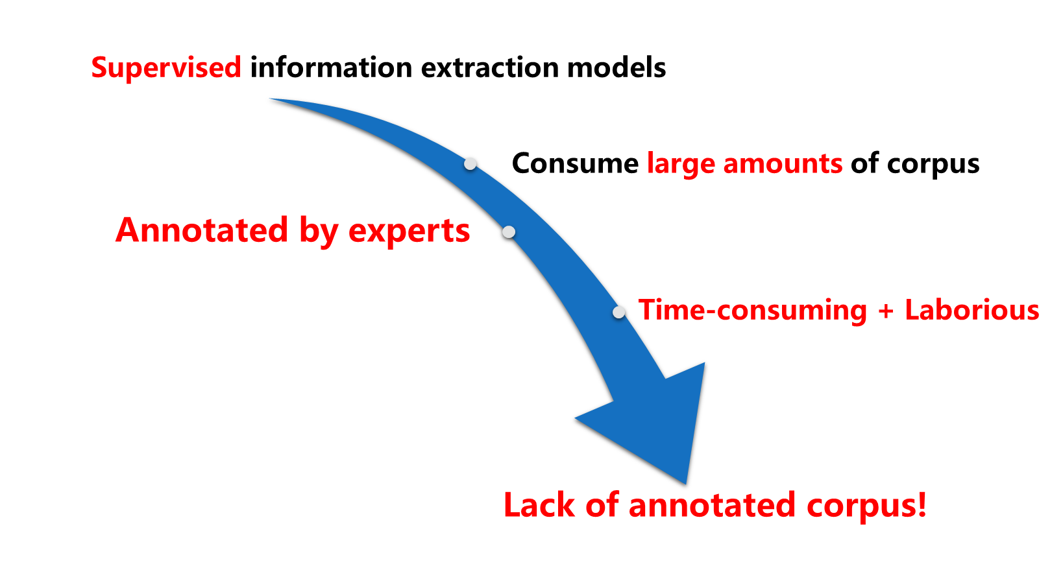

1.3 Problems – Lack of annotated corpus
Figure 2. Corpus annotated by experts
Notes:
Unfortunately, these supervised learning models consume large amounts of corpus in order to fully learn the characteristics. In most case, the annotated corpus in one specific field is annotated manually by several experts, which is time-consuming and laborious. So the biggest problem we faced is the lack of annotated corpus!

Slide 6
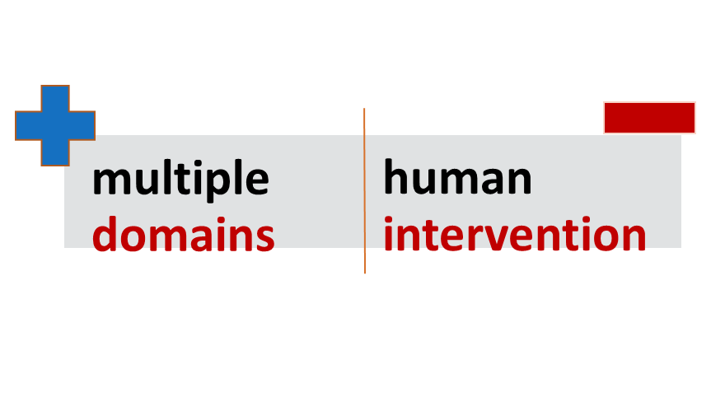
1.4 Aims & Highlights
Highlights
  1. Neural network + Active learning
  -> Application : Information extraction
  -> Solved problem : Corpus scarcity
  2. Improved translation model
  -> Application : Relation prediction
  -> Solved problem : Domain semantics
An intelligent platform
Method
Problem
Related/Unrelated
------------------------→
Method
Problem
Notes:
To solve the problem mentioned above. Our aim is to construct an intelligent platform for information extraction and knowledge mining, which can be used in multiple domains without much human intervention.
The first highlight is that, with the limited annotated corpus, an effective method combining neural network with active learning recognizes method entities and problem entities in multiple domains; The second highlight is the improved translation model. This model represents Domain semantics more accurately and can predict whether problem entities and method entities are related or not.

Slide 7
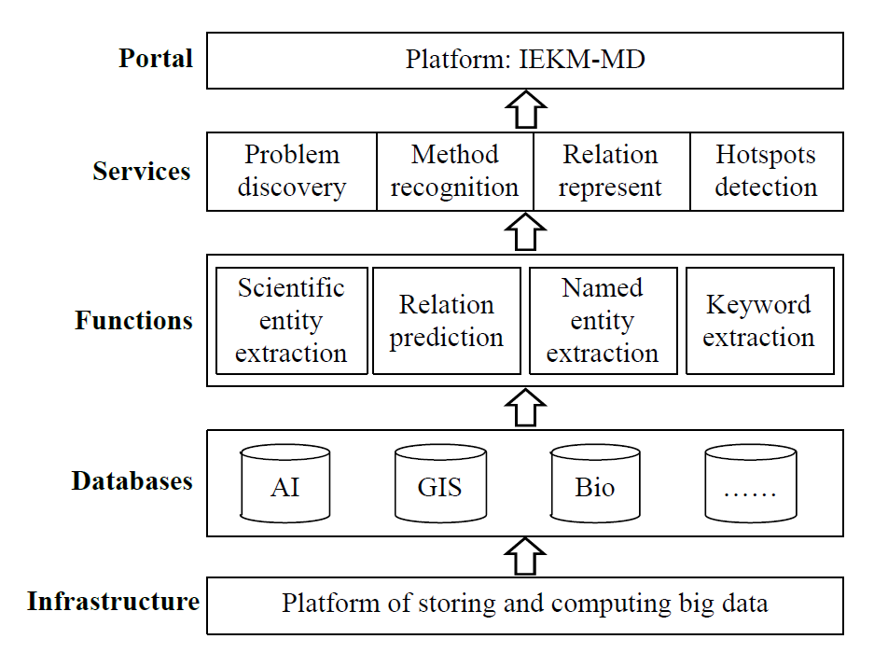
2 Technical Route
Discipline analysis/ Trend explosion/
New technology detection
spaCy.NER
RAKE
Multiple fields
Figure 3. Technical Route of IEKM-MD
Notes:
The Technical Route of our platform is shown in Figure 3. 按Our Infrastructure is the platform of storing and computing big data. 按Then massive articles from massive fields are contained in this platform. 按Four functions are realized. 按Finally, our platform provides a variety of services for researchers, including problem discovery, method recognition, relation representation and hot spot detection and so on.

Slide 8
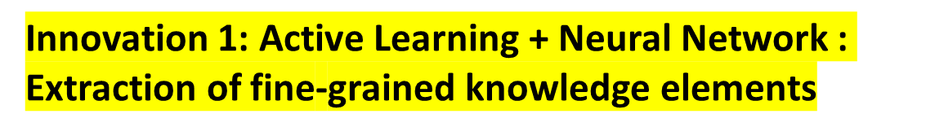
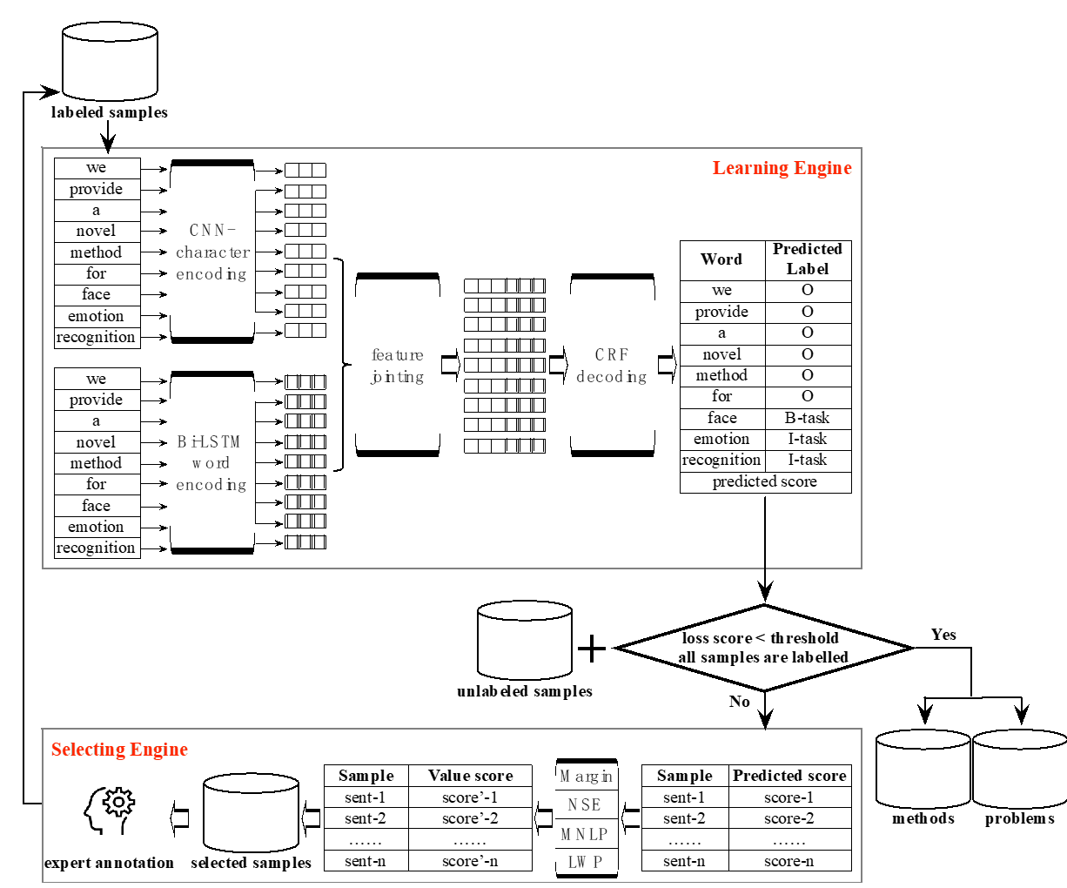
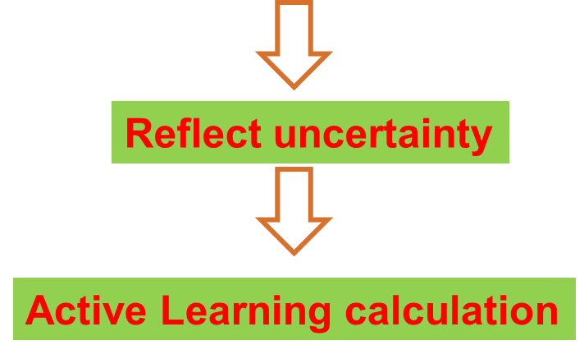
2.1 Scientific Entity Recognition
  Neural Network + Active Learning
Learning engine: CNN + BiLSTM + CRF
  Capture fine-grained characteristics
  CRF: optimal label and Viterbi score
Selecting engine: Margin+NSE+MNLP+LWP
  Compute value score of samples
  Pick top 10% most valuable samples
Cooperate
Figure 4. Information extraction model combining neural network with active learning
Notes:
Now let me introduce the first innovative technology: Scientific entity recognition.
The framework of the model is drawn in Figure 4. The framework contains two core components: 按Learning engine and 按selecting engine.
Here we chose CNN-BiLSTM-CRF as the learning engine which can capture fine-grained characteristics. The CRF layer will outputs the optimal label and Viterbi score of the sequence. Viterbi score can reflect the uncertainty of the current sequence which can be combined with the active learning calculation process.
In addition, we propose a hybrid approach for the selecting engine. We picked three kinds of active learning strategies and proposed a novel strategy to make up the selecting engine. Selecting engine will select the top 10% most valuable samples for annotation.
按Learning engine and selecting engine cooperate with each other to improve the extraction accuracy.

Slide 9
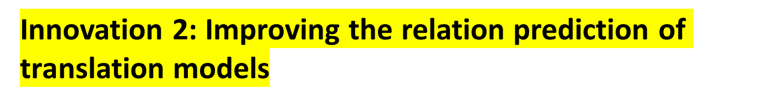
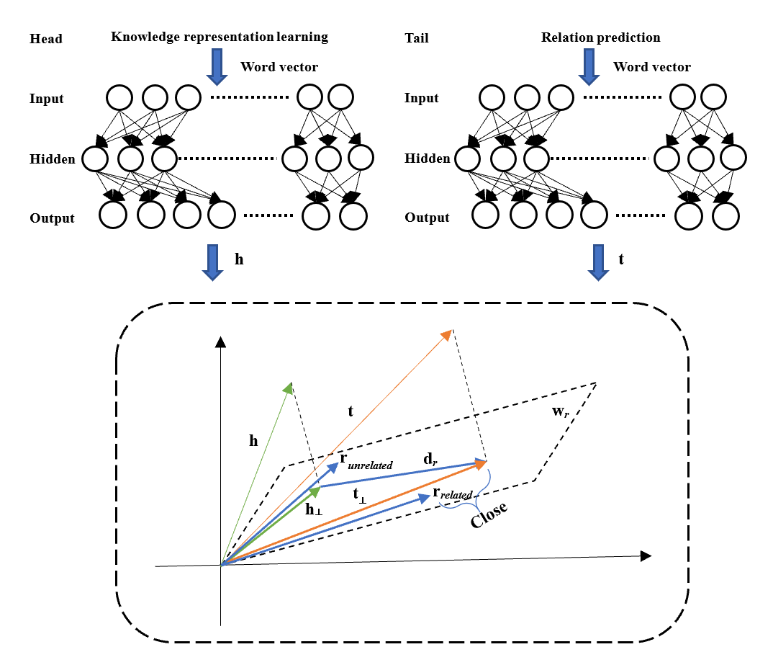

2.2 Relation Prediction
Improvements
  Initial embedding: word2vec
  Hidden layer: Nonlinear convolution transformation
  Balanced negative sample
  Score function: entity -> relation
Figure 5. Framework of improved TransH
Notes:
Another innovation is improving the relation prediction of translation models.
First We use the word2vec to generate the representation.
Second We add one layer of nonlinear convolution transformation respectively for the head entity and tail entity.
Third Considering that there are only two types of relationships, we construct the negative samples in a more balanced way.
Fourth We also change the score function, which aims to move the attention from entity to relation.

Slide 10
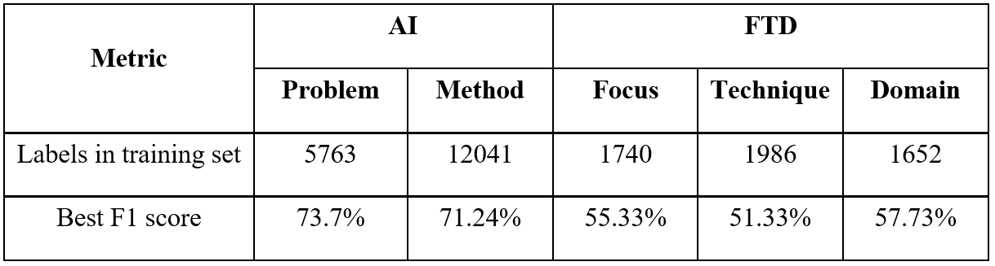
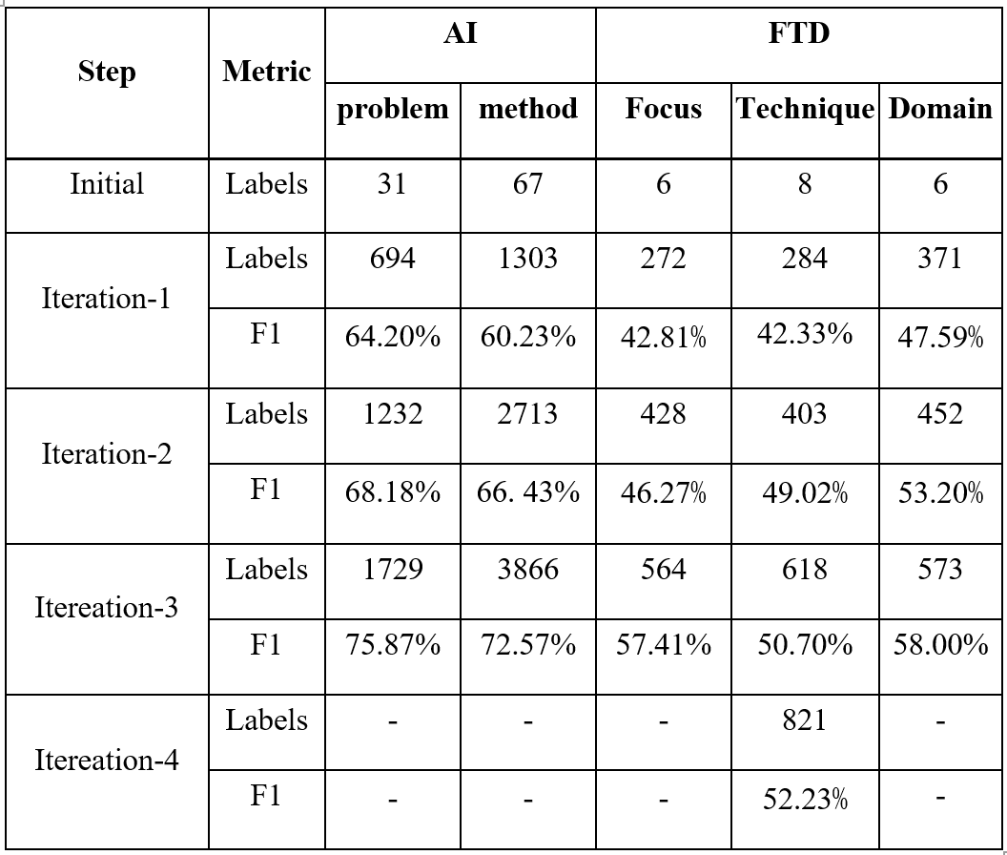
3. Experiment Results
3.1 Scientific Entity Recognition——Learning rate
Table 2: Best F1 trained by CNN-BiLSTM-CRF(CBC) model
Table 3: Learning effect of IEKM-MD in each iteration
IEKM-MD
  Only need 30%~40% annotated corpus
Notes:
We conducted experiments in our artificial intelligence corpus and Stanford FTD corpus respectively to test the learning rate of our platform.
The left table, shows the Best F1 of two datasets trained by CBC model, The right table records the Learning effect in each iteration. Only if the F1 score of IEKM-MD reaches the baseline, can the learning process be stopped. It can be seen from the figure that IEKM-MD only needs 30%-40% corpus to achieve the best performance.

Slide 11
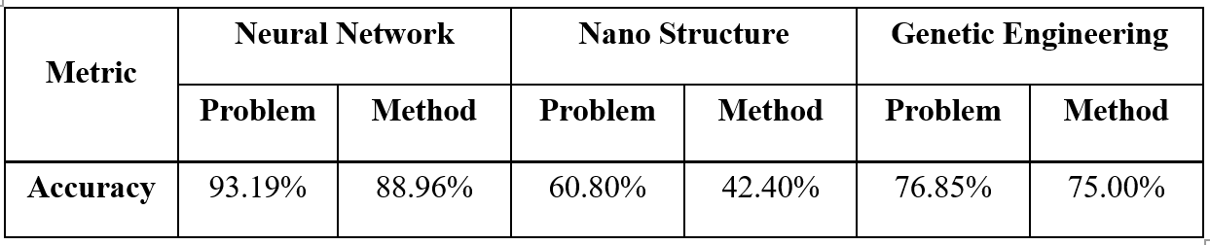
3.2 Scientific Entity Recognition——accuracy
Table 4. Multi-domain specific entity recognition results
NN and GE achieved good performance
Performed worst in Nano
  Various fields: biology, physics, chemistry, electronics, and metrology
  Lack professional knowledge to learn specific features
Notes:
Besides, We did experiments in three different domains to get the extraction accuracy. They are Neural network, nano structure and genetic engineering. Table 4 shows the results. Neural Network and Genetic Engineering all achieved good performance.
However, our platform performed worst in Nano. This may because that the articles of Nano include many complex and specialized terms in various fields. And we need to say, Our platform still lacks the professional knowledge to learn all the specific features.

Slide 12
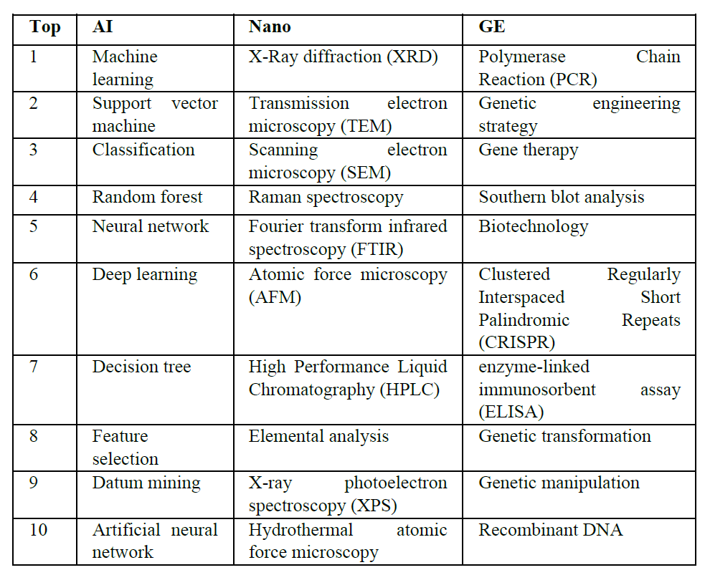
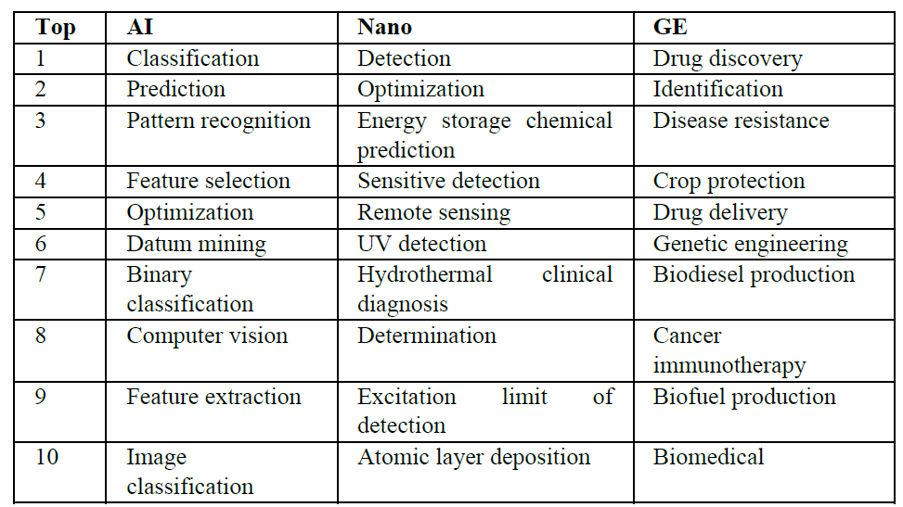
3.3 Scientific Entity Recognition——Top10 entities
Table 6. Multi-domain method recognition
Table 5. Multi-domain problem recognition
Notes:
The extracted top 10 problems of three fields are shown in the left table and the method is in the right. In general, our platform can identifies entities accurately in multiple domains.

Slide 13
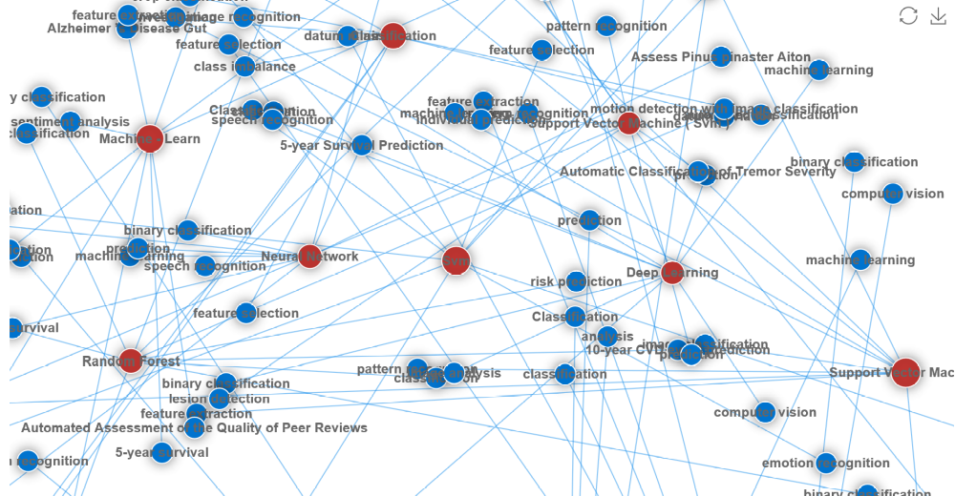
3.4 Method-Problem Network
Method-Problem network
  Red dots -> methods
  Blue dots -> problems
Figure 6. Problem-method relation network in AI
Notes:
By predicting the relations between problem and method, we can construct the method-problem networks for different domains. As shown in Figure 6, the methods and problems which were separated in the articles of AI are linked by relation prediction. The red dots refer to methods, and the blue dots refer to problems.

Slide 14
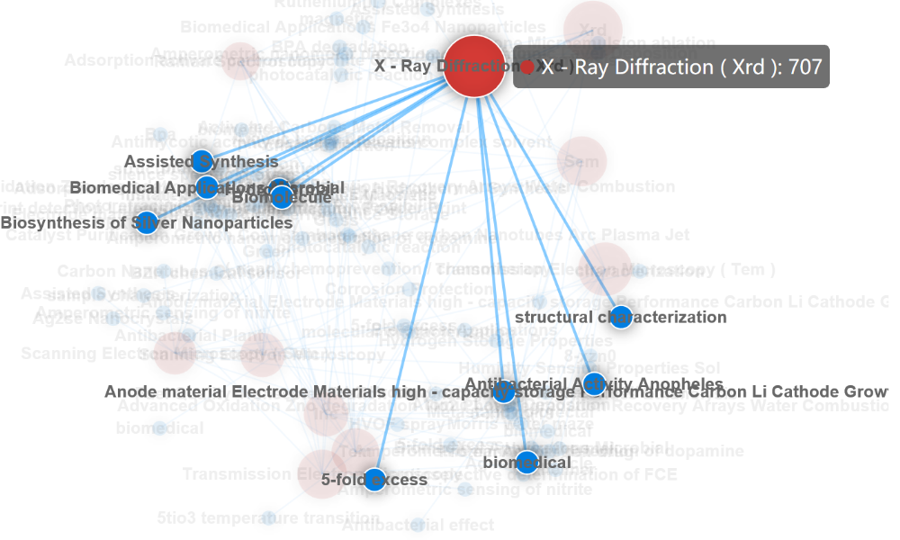
3.4 Method-Problem Network
X-Ray Diffraction (XRD) centered network
  Problems solved by XRD: Assisted Synthesis, Biomedical Application, Biosynthesis of Silver Nanoparticles
Figure 7. The problems solved by XRD method in Nano
Notes:
Specifically, we can get more details from the above-mentioned network.
By setting the method X-Ray Diffraction (XRD) as a center, Figure 7 reveals that what problems are solved by XRD.

Slide 15
4 Conclusion
4.1 Contribution
  A hybrid active learning strategy to solve the problem of annotated corpus scarcity which can reduce 60%~70% corpus.
Contribution 1
  An improved Translation embedding approach to optimize the performance of relation prediction with 96% accuracy in AI.
Contribution 2
Notes:
In conclusion, This paper introduced an platform to extract information and mine knowledge from scientific articles in multiple domains. One contribution is providing A hybrid active learning strategy to solve the problem of annotated corpus scarcity which can reduce 60%~70% corpus. Another is designing An improved Translation embedding approach to optimize the performance of relation prediction with 96% accuracy in AI.

Slide 16
4.2 Limitation & Further work
Limitation 1: Lack domain knowledge to learn specific features
Combine domain knowledge with text features.
Limitation 2: Low F1 in information extraction
Build annotation guidelines and expand annotated corpus.
Limitation 3: Low accuracy in relation prediction
Reduce noise in corpus or use weak-supervised learning.
Notes:
There are still some limitations in our work.
First of all, Lacks domain knowledge to learn specific features. So we need to Combine domain knowledge with text features.
The other two limitations related to extraction and prediction results, urge us to build more standard corpus and try weak-supervised learning method.

Slide 17

1st Workshop on Extraction and Evaluation of Knowledge Entities from Scientific Documents (EEKE2020)
Thanks for your attention！
Reporter：Tao Yue
Email：taoyue@mail.las.ac.cn
National Science Library, Chinese Academy of Sciences
University of Chinese Academy of Sciences
Notes:
That’s all. Thank you for your attention! Any questions about our research.

