Slide 1

^{1st} EEKE Workshop Workshop on Extraction and Evaluation of Knowledge Entities from Scientific Documents
https://eeke2020.github.io/
August 1, 2020
Chengzhi Zhang, Philipp Mayr, Wei Lu, Yi Zhang
Virtual Event, co-located with JCDL 2020

Slide 2
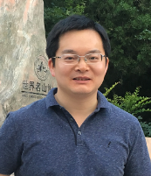

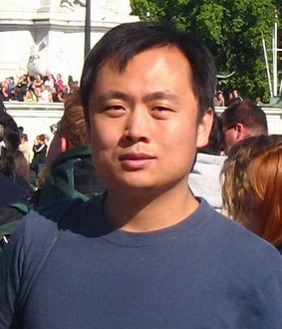

The EEKE Team
EEKE 2020
Chengzhi Zhang
Nanjing University of Science and Technology
Philipp Mayr
@philipp_mayr
GESIS - Leibniz-Institute for the Social Sciences department Knowledge Technologies for the Social Sciences
Wei Lu
Wuhan University
Yi Zhang @YiZhang0520
University of Technology Sydney (UTS)
… to our authors, programme committee and participants…thank you!

Slide 3
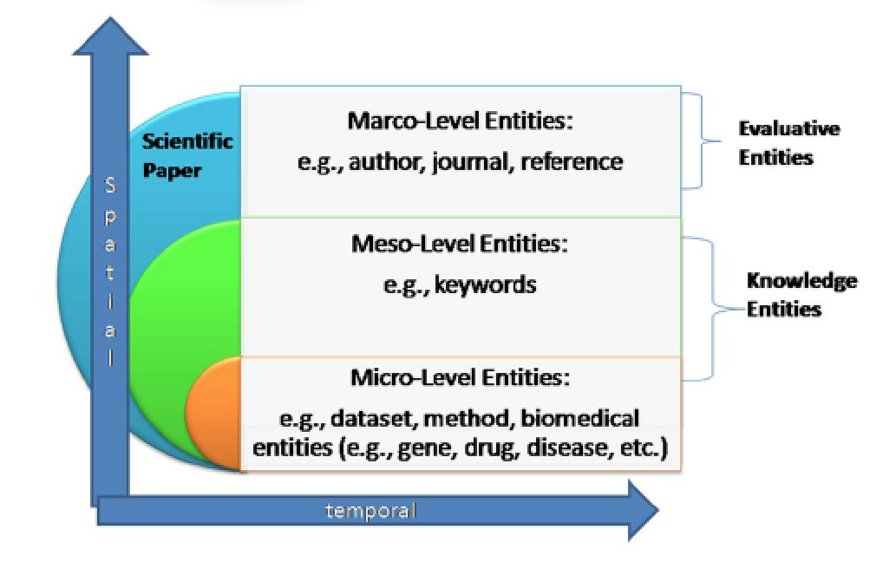
Goal
EEKE 2020
Knowledge entity： knowledge mentioned/used/cited by authors, such as algorithms, models, theories, datasets and software, which reflect the various resources proposed/used by the authors in solving problems.
(Ying Ding, etc. Entitymetrics: Measuring the Impact of Entities. PLoS ONE, 2013）

Slide 4
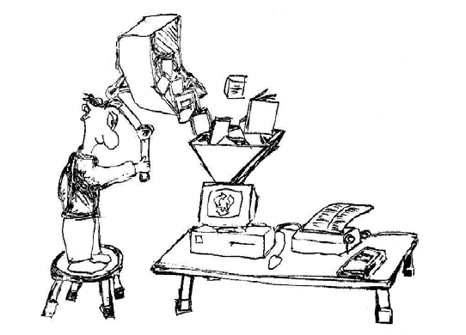
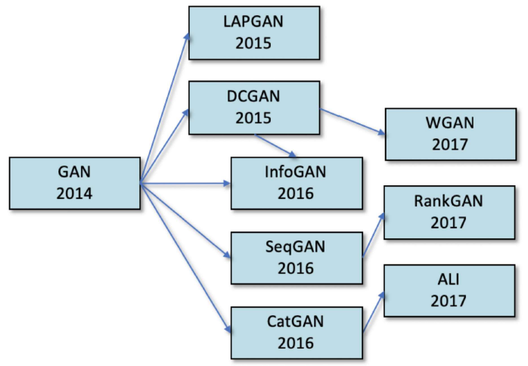
Goal
EEKE 2020
Knowledge entity： knowledge mentioned/used/cited by authors, such as algorithms, models, theories, datasets and software, which reflect the various resources proposed/used by the authors in solving problems.
Extracting knowledge entities from scientific documents in an accurate and comprehensive way becomes a significant topic. It is also a key issue in the filed of digital library.
(Zha et.al. Mining Algorithm Roadmap in Scientific Publications. KDD2019)

Slide 5
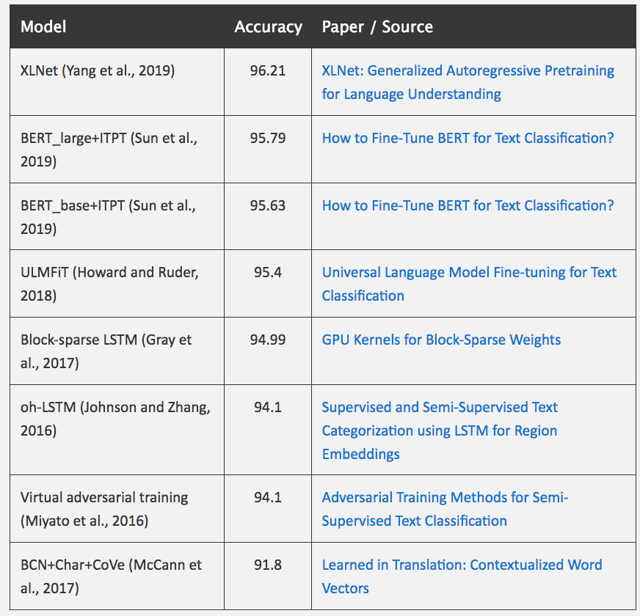
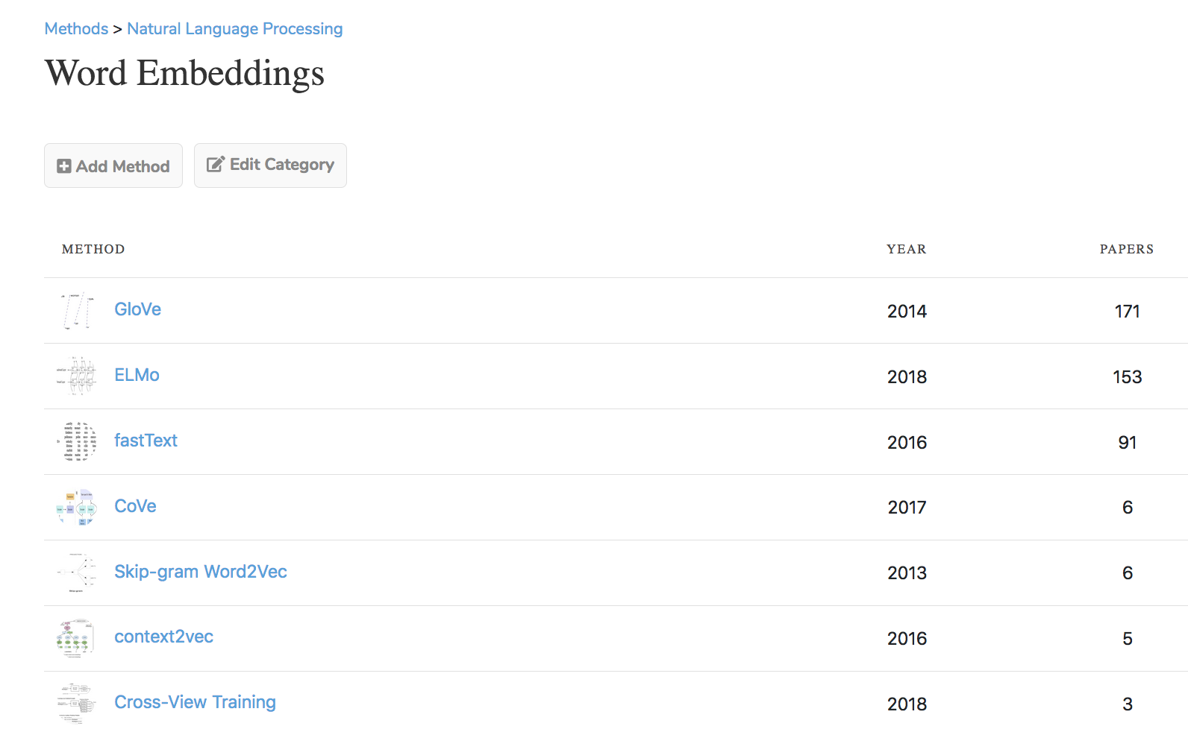
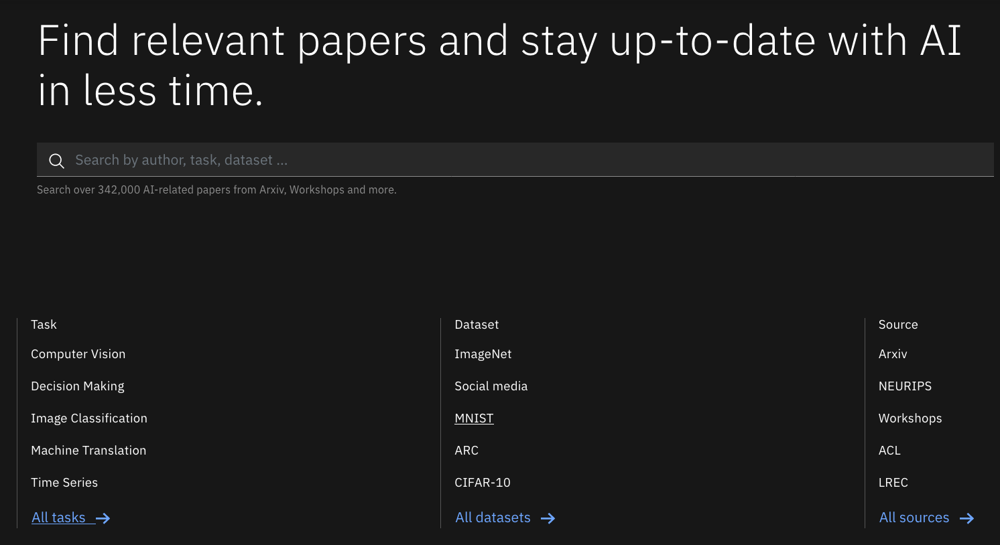
Goal
EEKE 2020
Knowledge entity： knowledge mentioned/used/cited by authors, such as algorithms, models, theories, datasets and software, which reflect the various resources proposed/used by the authors in solving problems.
Extracting knowledge entities from scientific documents in an accurate and comprehensive way becomes a significant topic. It is also a key issue in the filed of digital library.
EEKE workshop aims to extract knowledge entities from scientific documents, and explore the features of entities to conduct practical applications.
NLPprogress https://nlpprogress.com/english/sentiment_analysis.html
Paperswithcode https://www.paperswithcode.com/methods/category/word-embeddings
IBM science summarizer https://dimsum.eu-gb.containers.appdomain.cloud/

Slide 6
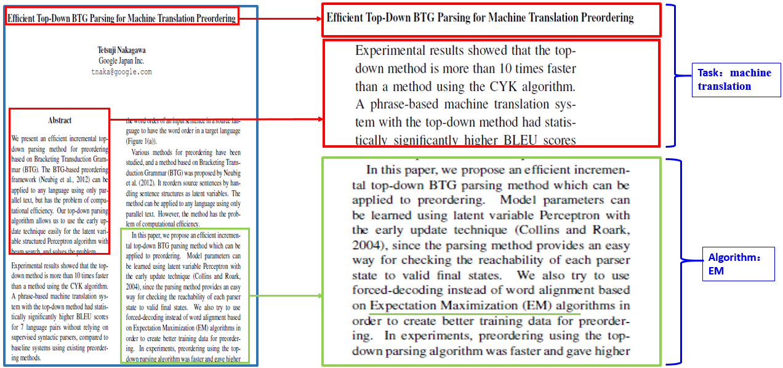
Topics
EEKE 2020
Extraction of Knowledge Entities (KEs)
Task and methodology
Model and algorithmize entity
Dataset and evaluation metrics
Software and tool
KEs Relation
Others
Evaluation and Applications of KEs
Construction of a knowledge entity graph and roadmap
Knowledge entity summarization
Modeling function of knowledge entity citation
Bibliometrics of knowledge entity
Other Application of KEs extraction
(Wang & Zhang, Using Full-text of Research Articles to Analyze Academic Impact of Algorithms. iConference2018)
(Zha et.al. Mining Algorithm Roadmap in Scientific Publications. KDD2019)

Slide 7
Agenda: Part 1
EEKE 2020
All times are Beijing Time
13:10-13:30 | Connection setup: we will provide details
13:30-13:40 | Introduction | Co-Chairs of EEKE2020
13:40-14:20 | Keynote 1: Entitymetrics 2.0: Measuring the Impact of Entities and Relations Extracted from Scientific Documents | Min Song |  | Chair: Chengzhi Zhang
14:20-15:00 | Session 1: Knowledge Entity Extraction and Application |  |  | Chair: Shuo Xu
14:20-14:40 | NLPContributions: An Annotation Scheme for Machine Reading of Scholarly Contributions in Natural Language Processing Literature | Jennifer D'Souza and Sören Auer
14:40-15:00 | Intelligent Bibliometrics for Discovering the Associations between Genes and Diseases: Methodology and Case study | Mengjia Wu and Yi Zhang
15:00-15:30 | Coffee break

Slide 8
Agenda: Part 2
EEKE 2020
All times are Beijing Time
15:30-16:35 | Session 2: Entity Extraction from Scientific Documents |  | Chair: Yingyi Zhang
15:30-15:50 | Automatic Keyphrase Extraction from Scientific Chinese Medical Abstracts Based on Character-Level Sequence Labeling | Liangping Ding, Zhixiong Zhang, Huan Liu, Jie Li and Gaihong Yu
15:50-16:05 | Investigating interdisciplinary knowledge flow through citances | Jin Mao, Shiyun Wang and Xianli Shang
16:05-16:20 | IEKM-MD: An Intelligent Platform for Information Extraction and Knowledge Mining in Multi-Domains | Yu Li, Tao Yue (Speaker) and Wu Zhenxin
16:20-16:35 | What is Special about Patent Information Extraction? | Liang Chen, Shuo Xu, Weijiao Shang, Zheng Wang, Chao Wei and Haiyun Xu

Slide 9
Agenda: Part 3
EEKE 2020
All times are Beijing Time
16:35-17:00 | Sesson 3: Interactive demos |  |  |  | Chair: Chong Chen
16:35-17:00 | Design and Implementation of an Academic Search System Based on a General Query Language and Automatic Question Answering | Zi Xiong, Yue Qi, Wei Lu and Qikai Cheng
17:00-17:30 | Coffee break
17:30-18:10 | Keynote 2: Building Scholarly Knowledge Bases with Crowdsourcing and Text Mining | Markus Stocker |  | Chair: Philipp Mayr
18:10-18:55 | Session 4: Entity Relation Extraction and Application |  |  | Chair: Yi Zhang
18:10-18:25 | A Novel Approach for Patent Similarity Measurement Based on Sequence Alignment | Xin An, Jinghong Li, Shuo Xu, Liang Chen and Sainan Pi
18:25-18:40 | Exploring the Relation between Biomedical Entities and Government Funding | Fang Tan, Siting Yang, Xiaoyan Wu and Jian Xu
18:40-18:55 | Document Clustering and Labeling for Research Trend Extraction and Evolution Mapping | Sahand Vahidnia, Alireza Abbasi and Hussein A. Abbass

Slide 10
Agenda: Part 4
EEKE 2020
All times are Beijing Time
18:55-19:50 | Session 5: Poster/ Greeting Notes of EEKE2020 |  | Chair: Jin Mao
18:55-19:05 | Long-tail dataset entity recognition based on Data Augmentation | Qikai Liu, Pengcheng Li, Wei Lu and Qikai Cheng
19:05-19:15 | Assessing Impact of Method Entities in a Special Task | Xiaole Li, Yuzhuo Wang
19:15-19:25 | Study on the Difference between Summary Peer Reviews and Abstracts of Scientific Papers | Chong Chen, Jingying Zhang, Xiaoyu Chu and Jinglin Zheng
19:25-19:35 | A Unsupervised Method for Terminology Extraction from Scientific Text | Wei Shao and Hua Bolin
19:35-19:50 | Greeting Notes of EEKE2020 | Co-Chairs of EEKE2020 (Chengzhi Zhang, Philipp Mayr, Wei Lu, Yi Zhang)
19:50 | End of workshop

Slide 11

Keynote 1
EEKE 2020
Min Song
KEYNOTE
Entitymetrics 2.0: Measuring the Impact of Entities and Relations Extracted from Scientific Documents

Slide 12

Keynote 2
EEKE 2020
Markus Stocker
KEYNOTE
Building Scholarly Knowledge Bases with Crowdsourcing and Text Mining
Notes:
Markus Stocker is Head of the Knowledge Infrastructures research group at the TIB Leibniz Information Centre for Science and Technology (Germany) and co-lead of the Open Research Knowledge Graph project.
He holds a PhD in Environmental Informatics from the University of Eastern Finland; a MSc in Environmental Science from the University of Eastern Finland; and a Diploma (MSc) in Informatics from the University of Zurich, Switzerland.
Research interests lie at the intersection between research infrastructures and research communities, and how such knowledge infrastructures acquire, maintain, and share scholarly knowledge about human and natural worlds.

Slide 13
Proceedings
EEKE proceedings to be published with CEUR-WS http://ceur-ws.org/ we need 4 things!
Camera-ready paper till August 15
+ Author agreement (signed by corresponding author) -> send via email to philipp.mayr@gesis.org
http://ceur-ws.org/ceur-author-agreement-ccby-ntp.pdf?ver=2020-03-02 if no copyrighted third party material
http://ceur-ws.org/ceur-author-agreement-ccby-tp.pdf?ver=2020-03-02 if copyrighted third party material
Submit PDF via Easychair -> update your submission
+ Send sources (tex->zip or MS word) of your paper via email to philipp.mayr@gesis.org

Slide 14
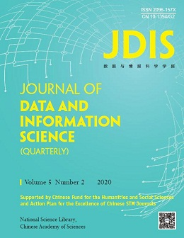
Next steps
Journal of Data and Information Science
Call for papers
Special Issue on “Extraction and Evaluation of Knowledge Entities from Scientific Documents”
Guest Editors：Chengzhi Zhang, Philipp Mayr, Wei Lu, Yi Zhang
Important dates
Paper submission: 31 October 2020
Review reports and invitation to submit revised paper: 30 November 2020
Revised paper submission: 15 January 2021
Expected publication: May 2021
Please submit your manuscript through https://mc03.manuscriptcentral.com/jdis
When submit, please put a note “EEKE2020” at the beginning of title.

Slide 15

Next steps
Data and Information Management
Call for papers
Special Issue on “Scientific Documents Mining and Applications”
Guest Editors：Chengzhi Zhang, Philipp Mayr, Wei Lu, Yi Zhang
Important dates
Paper submission: 31 October 2020
Review reports and invitation to submit revised paper: 30 November 2020
Revised paper submission: 15 January 2021
Expected publication: March, 2021
Please submit your manuscript via https://www.editorialmanager.com/dim/default.aspx
When submit, please put a note “EEKE2020” at the beginning of title.

Slide 16
Thank you!
Chengzhi Zhang, Philipp Mayr, Wei Lu, Yi Zhang
https://eeke2020.github.io/

