Slide 1
UTA EE LABS
LoRa Radio

Slide 2
PowerPoint and Code
Github.com/EELabMan
Go To Repositories and find LoRa-Radio
Click the green button to download the .zip file and extract it on your computer.

Slide 3
LoRa is very complex, we will not go over all there is to know about it. This is about just getting it to work!

Slide 4
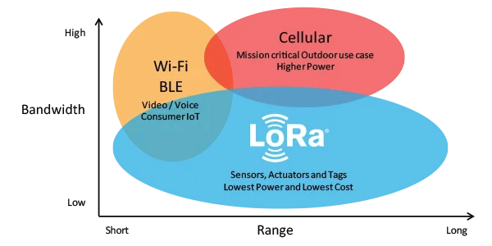
What is LoRa?
Long Range
In the United States, LoRa uses the 915 MHz frequency band, which is license-free and in the same band as GSM (3G). The US LoRaWAN frequency spectrum is made up of 64 uplink channels, 8 downlink channels, and is divided into sub-channels.

Slide 5
LoRaWAN Benefits
Ultra low power - LoRaWAN end devices are optimized to operate in low power mode and can last up to 10 years on a single coin cell battery.
Long range - LoRaWAN gateways can transmit and receive signals over a distance of over 10 kilometers in rural areas and up to 3 kilometers in dense urban areas.
Deep indoor penetration - LoRaWAN networks can provide deep indoor coverage, and easily cover multi floor buildings.
License free spectrum - You don’t have to pay expensive frequency spectrum license fees to deploy a LoRaWAN network.
Geolocation- A LoRaWAN network can determine the location of end devices using triangulation without the need for GPS. A LoRa end device can be located if at least three gateways pick up its signal.
High capacity - LoRaWAN Network Servers handle millions of messages from thousands of gateways.
End-to-end security- LoRaWAN ensures secure communication between the end device and the application server using AES-128 encryption.

Slide 6
LoRaWAN use cases
Vaccine cold chain monitoring - LoRaWAN sensors are used to ensure vaccines are kept at appropriate temperatures in transit.
Animal conservation - Tracking sensors manage endangered species such as Black Rhinos and Amur Leopards.
Dementia patients - Wristband sensors provide fall detection and medication tracking.
Smart farms- Real time insights into crop soil moisture and optimized irrigation schedule reduce water use up to 30%.
Water conservation- Identification and faster repair of leaks in a city’s water network.
Food safety- Temperature monitoring ensures food quality maintenance.
Smart waste bins - Waste bin level alerts sent to staff optimize the pickup schedule.
Smart bikes- Bike trackers track bikes in remote areas and dense buildings.
Airport tracking - GPS-free tracking monitors vehicles, personnel, and luggage.
Efficient workspaces - Room occupancy, temperature, energy usage and parking availability monitoring.
Cattle health - Sensors monitor cattle health, detect diseases and forecast calves delivery time.
LoRa in space - Satellites to provide LoRaWAN-based coverage worldwide.

Slide 7
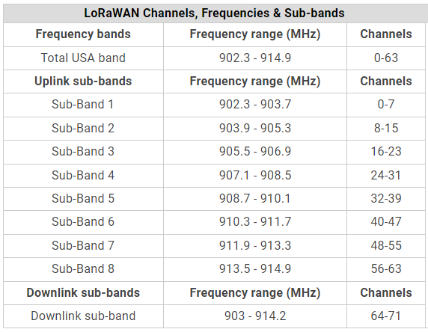
LoRa Frequencies and Bandwidth
Sensor to main controller
Main controller to sensors
200 KHz per channel with 125MHz bandwidth

Slide 8
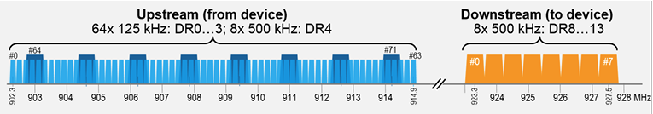
LoRa Frequencies and Bandwidth
LoRaWAN defines 64, 125 kHz wide uplink channels from 902.3 MHz to 914.9 MHz in steps of 200 kHz.
In addition, there are eight 500 kHz wide uplink channels with an interval of 1.6 MHz in the range 903 MHz to 914.9 MHz.
The eight downlink channels are 500 kHz wide and are in the range 923.3 MHz to 927.5 MHz

Slide 9
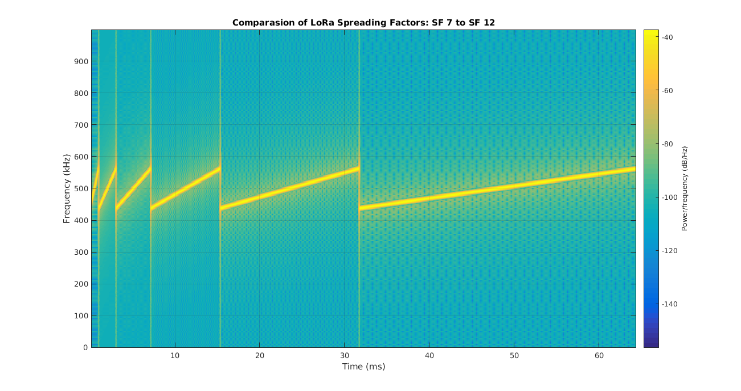
LoRa Spreading Factor
More Error
Less Error
Faster Data rate
Slower Data rate

Slide 10
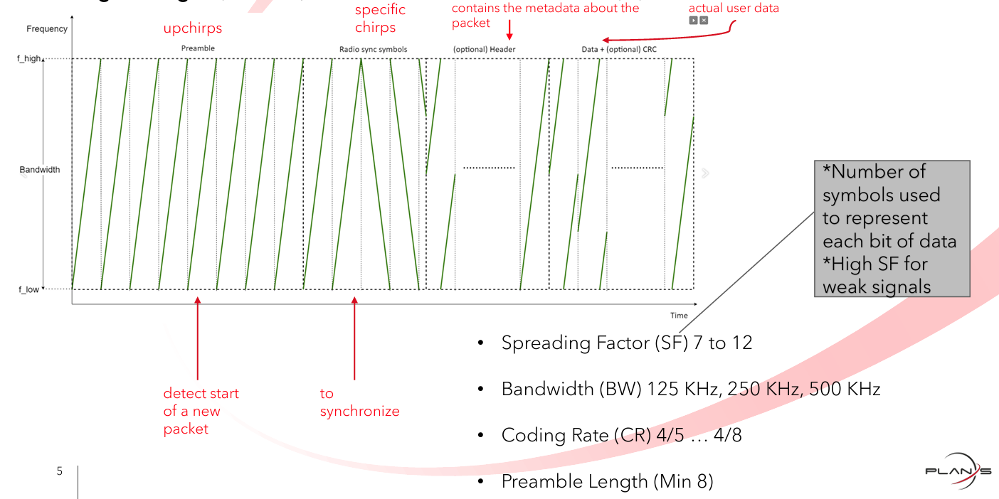
LoRa TX Frame

Slide 11
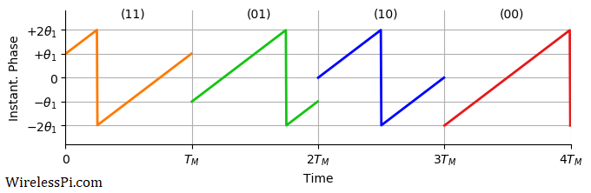
Phase Modulation
Simple Example of QPSK using a chirp signal.
LoRa work in a similar fashion, but more phase shifts for more bits per symbol.

Slide 12
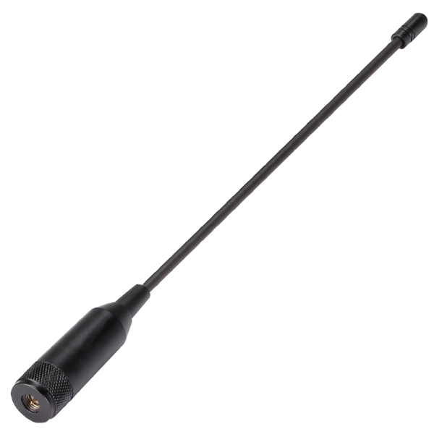
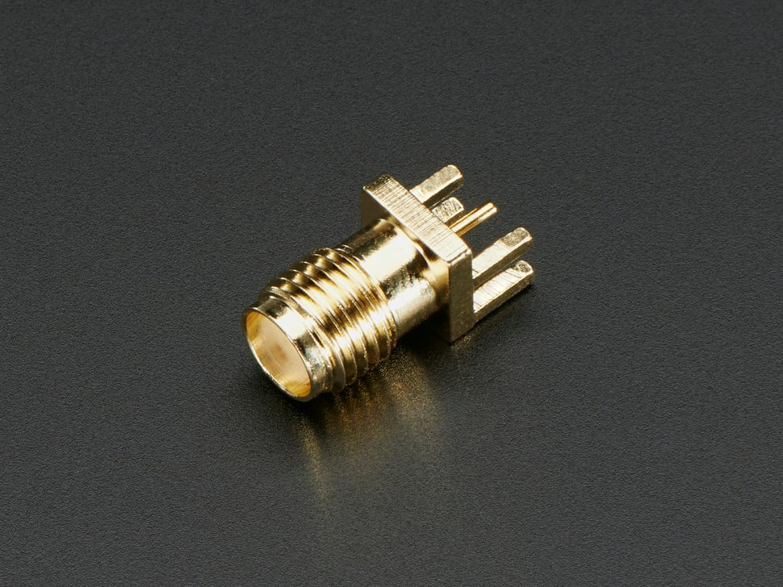
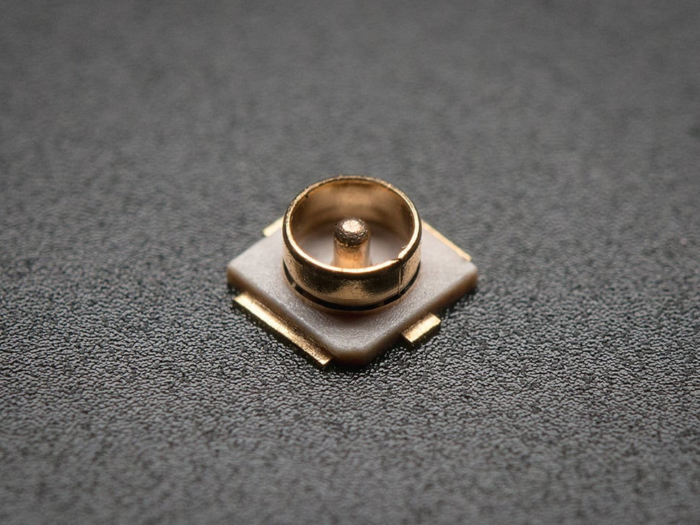
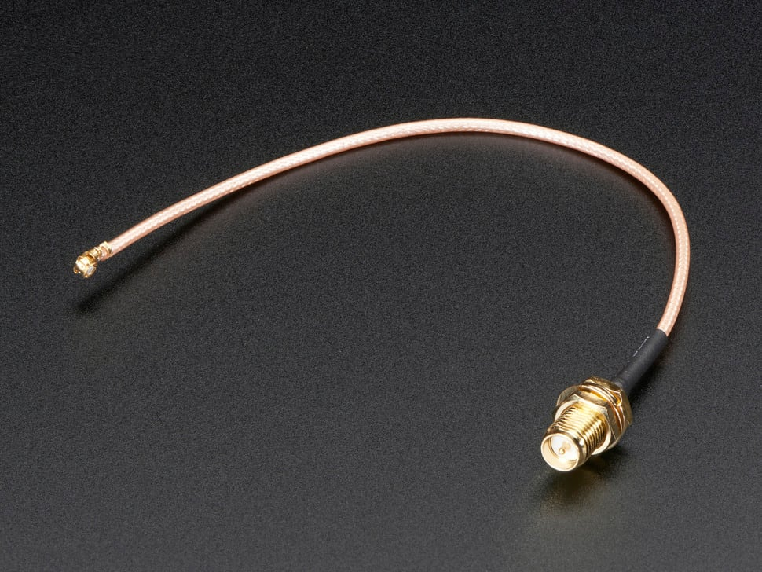
Lora Antenna options
SMA Edge Antenna Connector
uFL SMT Antenna Connector
The wire length for a 915 MHz LoRa antenna is 3 inches or 7.8 centimeters. The length of the wire depends on the frequency of the antenna. For example, the wire length for an 868 MHz antenna is 3.25 inches or 8.2 centimeters.

Slide 13
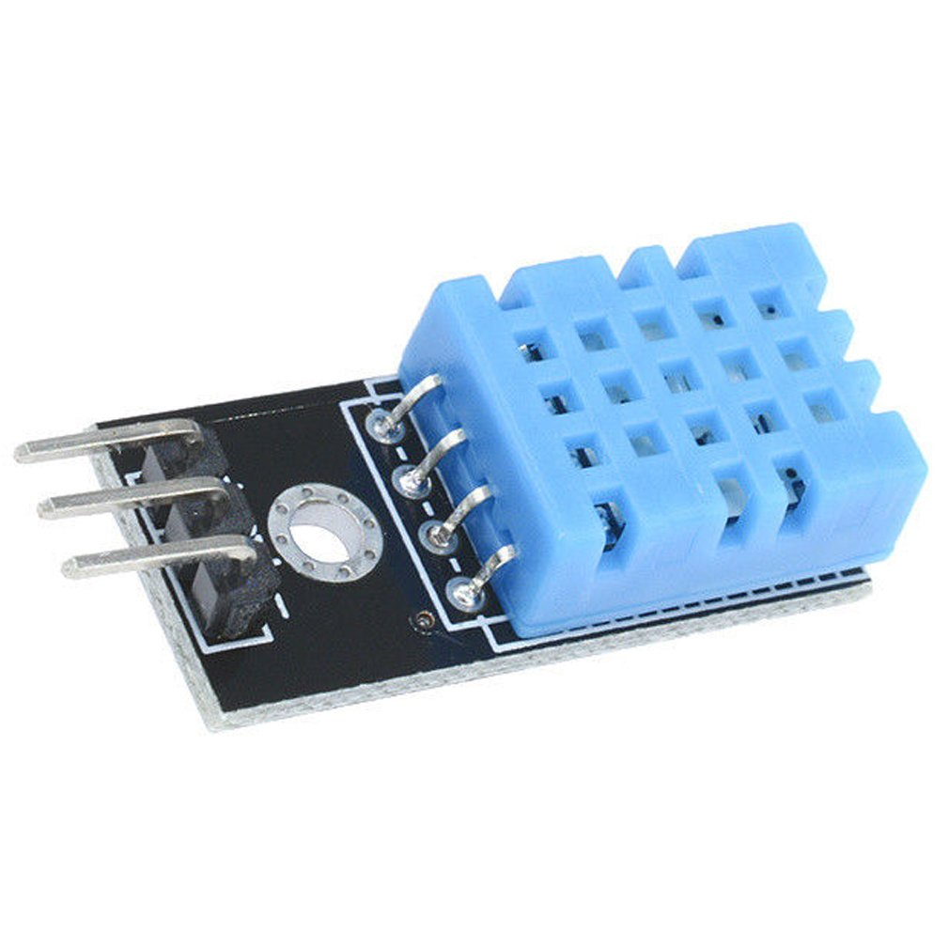
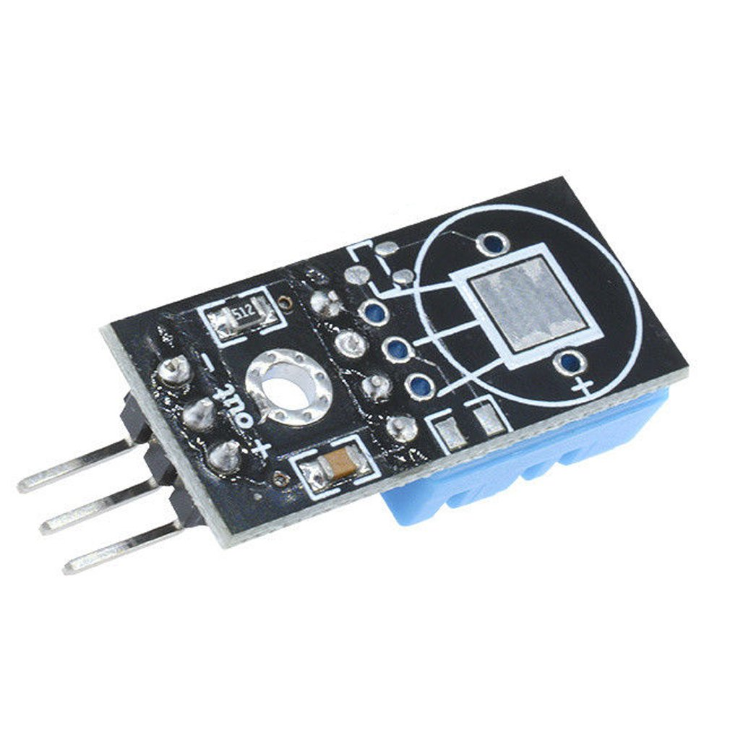
DHT-11
Specification:
Power supply voltage: 3.3~5.5V DC
Output: the single bus digital signal
Measuring range: 20-90%RH humidity, temperature 0~50°
The measurement accuracy of +-5%RH: humidity, temperature +-2 °
Resolution: 1%RH humidity, temperature 1 °
Exchangeability: fully interchangeable
Long term stability: <± 1%RH
Size: 28 * 12 * 7.2mm

Slide 14
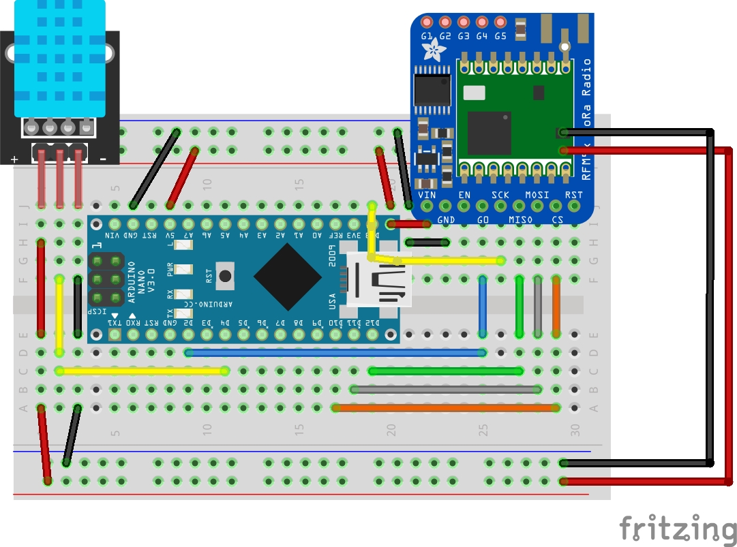
LoRa Transmitter
Transmitter:
Try to follow the wiring exactly!
Use Tweezers and keep the wires flat on the breadboard!
Under LoRa Radio

Slide 15
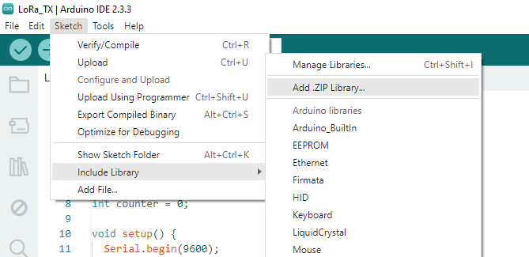
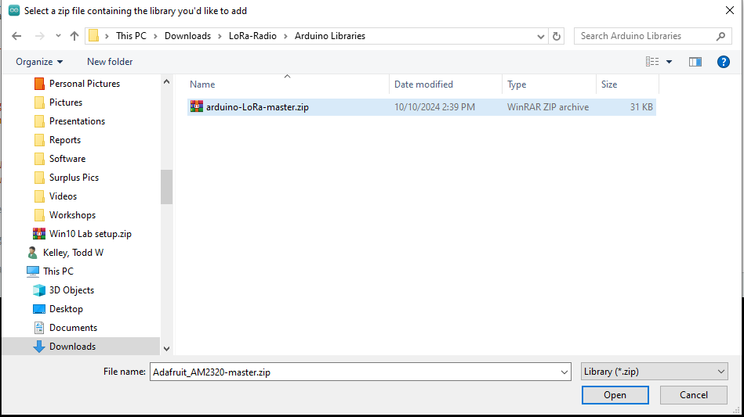
Arduino Library for LoRa
Once you get the Arduino nano to connect open LoRa_TX.ino
You will need to install a library that you downloaded and extracted from Github.
Select Sketch -> Include Library -> Add .ZIP Library.
Select Arduino-LoRa-master.ZIP

Slide 16
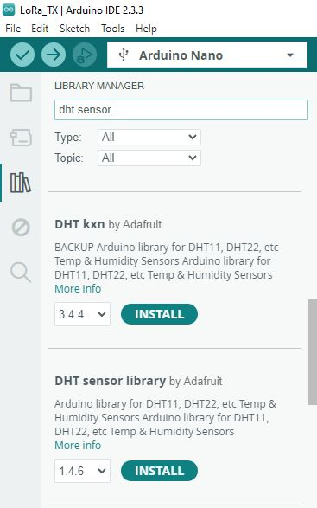
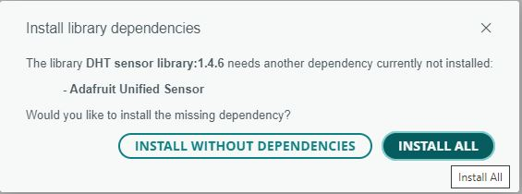
Arduino Library for DHT-11
You will need to install a library from the library manager called DHT Sensor.
Open the Library manager (1), then type dht sensor (2) scroll down to find DHT sensor library by Adafruit and click install.
Be sure to select INSTALL ALL. This will install libraries that make the DHT-11 sensor work properly.
1
2
3

Slide 17
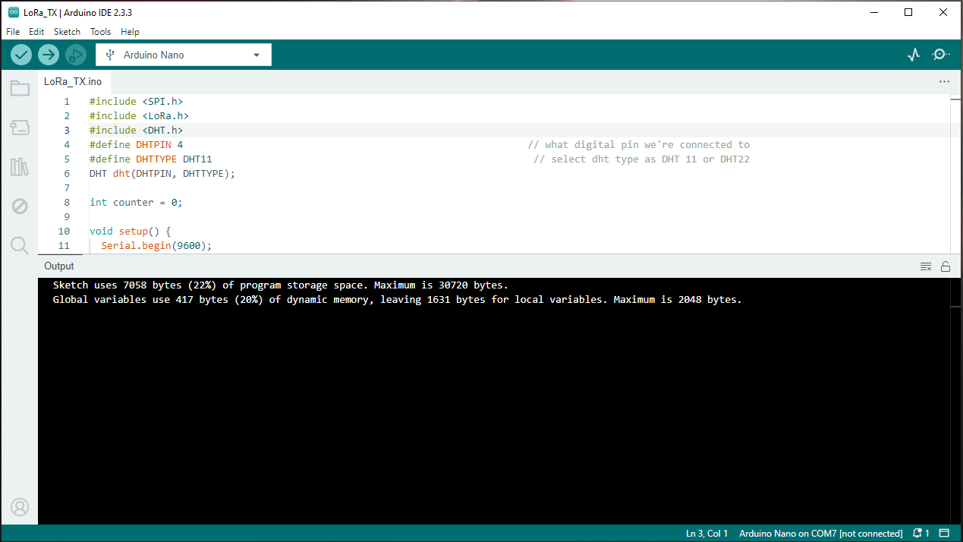
Open LoRa_TX.ino
Open the LoRa_TX.ino file from your extracted zip folder.
Click the check mark to compile and ensure the libraries are installed correctly.
Click the right arrow to upload the program to the Arduino Nano.
Open the serial monitor to ensure the DHT-11 and Lora radio modules are communicating with the Nano.
1
2

Slide 18
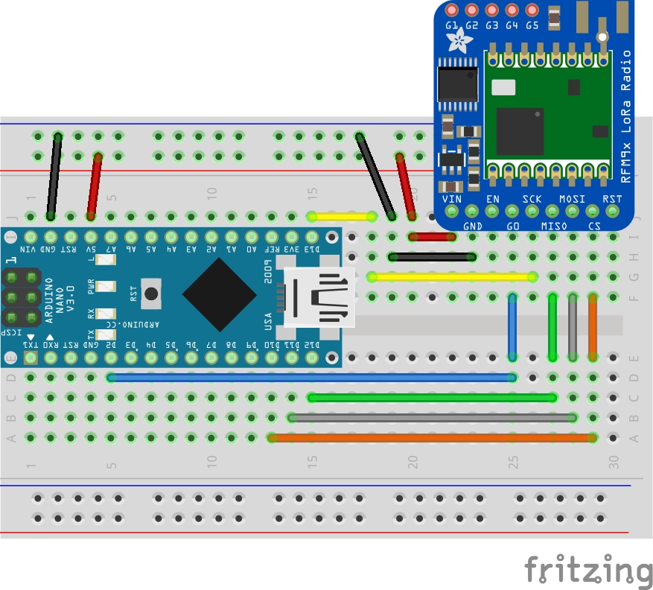
LoRa Receiver
Receiver:
Try to follow the wiring exactly!
Use Tweezers and keep the wires flat on the breadboard!

Slide 19
Open LoRa_RX.ino
Open LoRa_RX in the Arduino IDE
Make sure you select Arduino Nano
Be sure to check the correct com port
Open the serial monitor to check for errors and to receive data from your transmitter.

Slide 20
Open LoRa_RX.ino
Open LoRa_RX in the Arduino IDE and upload it to the Arduino nano.
Make sure you select Arduino Nano
Be sure to check the correct com port
Power on the Transmitter ( battery or lab computer )
Open the serial monitor on the Receiver.
Do you see the temp and humidity ?

Slide 21
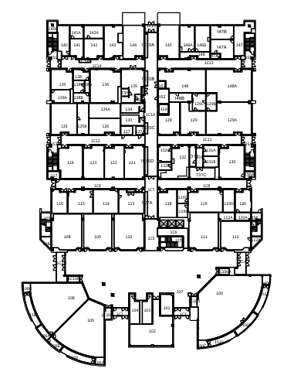
Long Range?
See how far you can take the transmitter before the receiver stops getting messages.

