Slide 1
NeoPixels
Dazzling addressable LED’s

Slide 2
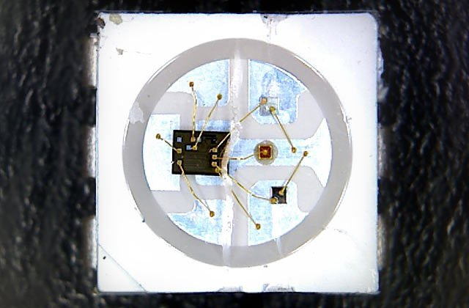
LED Drivers
WS2812, WS2811 and SK6812 LED/drivers
Notes:
Incorporating scads of LEDs into an electronic project used to be a hairy prospect, a veritable rat’s nest of wires and code. The arrival of dedicated LED driver chips brought welcome relief, offloading grunt work from the microcontroller and allowing one to focus on the application. Much simpler, but still not “Christmas light” simple. The WS2812 Integrated Light Source — or NeoPixel in Adafruit parlance — is the latest advance in the quest for a simple, scalable and affordable full-color LED. Red, green and blue LEDs are integrated alongside a driver chip into a tiny surface-mount package controlled through a single wire. They can be used individually, chained into longer strings or assembled into still more interesting form-factors.

Slide 3
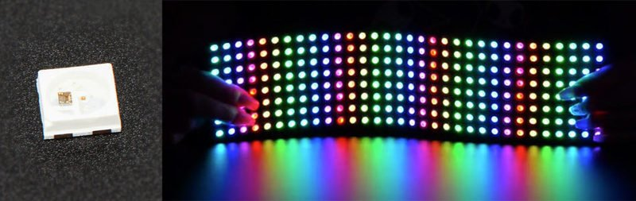
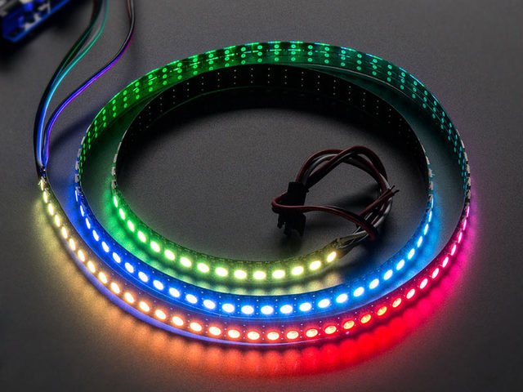
Form Factors
NeoPixel products are available in a zillion form factors…from individual tiny pixels to huge matrices…plus strips, rings and everything in-between. The same software drives all of them; they’re all “NeoPixels.”

Slide 4
Important Things to know
Not all addressable LEDs are NeoPixels.
“NeoPixel” is Adafruit’s brand for individually-addressable RGB color pixels and strips based on the WS2812, WS2811 and SK6812 LED/drivers, using a single-wire control protocol. Other LED products Adafruit carries — DotStars, WS2801 pixels, LPD8806 and “analog” strips — use different methodologies (and have their own tutorials).
NeoPixels require a microcontroller
NeoPixels aren’t the answer for every project.
The control signal has very strict timing requirements, and some development boards (such as Netduino or Raspberry Pi) can’t reliably achieve this in every situation.

Slide 5
Is there a limit to the number of NeoPixels in a chain?
There’s no inherent limit in the maximum length of a NeoPixel chain, but eventually you’ll encounter any of various practical limits:
RAM: NeoPixels require some RAM from the host microcontroller; more pixels = more RAM. It’s only a few bytes each, but as most microcontrollers are pretty resource-constrained, this becomes a very real consideration for large projects.
Power: each NeoPixel draws a little bit of current; more pixels = more power. Power supplies likewise have some upper limit.
Time: NeoPixels process data from the host microcontroller at a fixed data rate; more pixels = more time and lower animation frame rates.

Slide 6
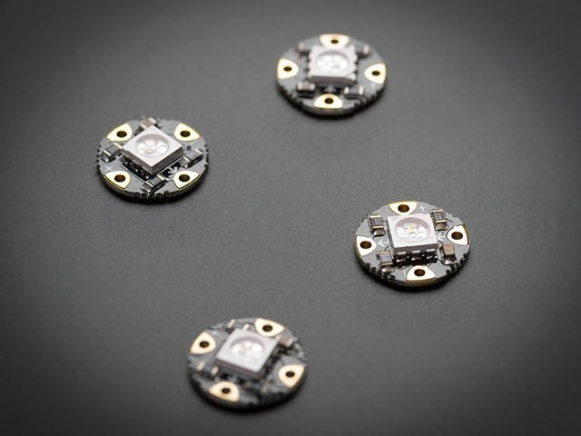
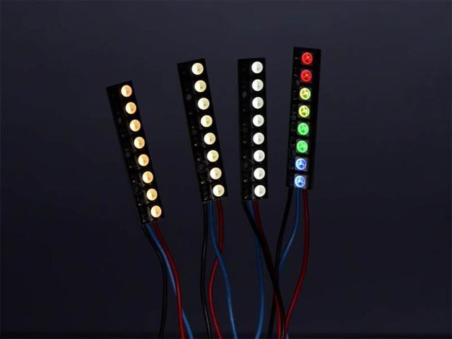
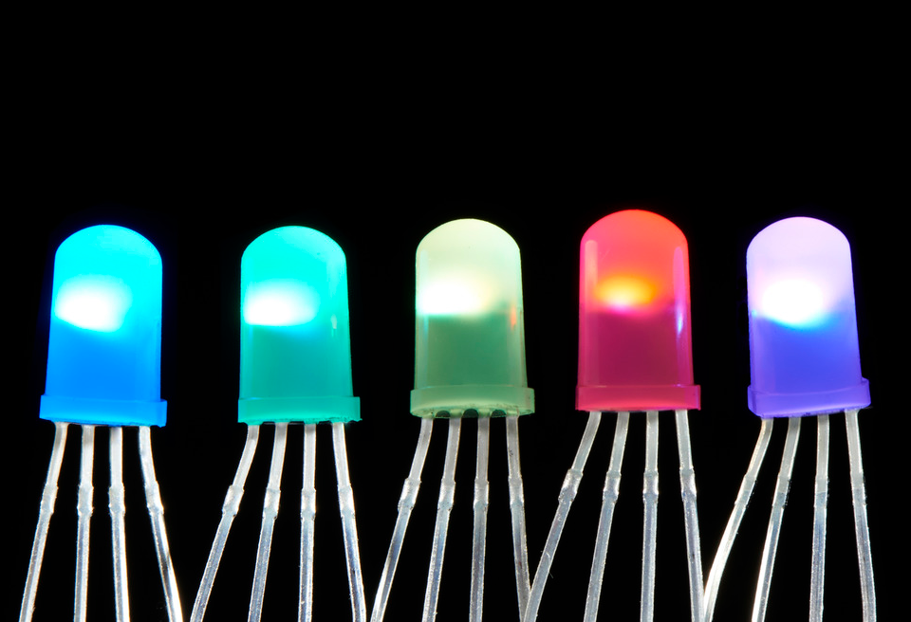
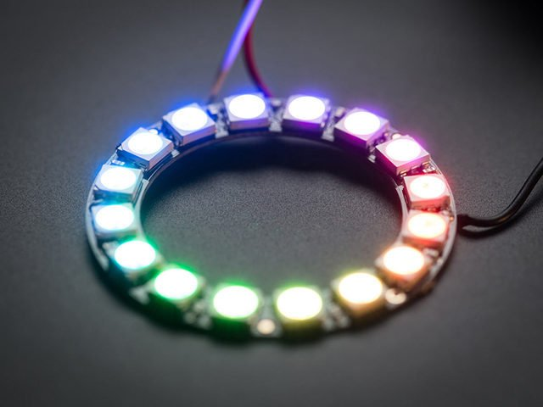
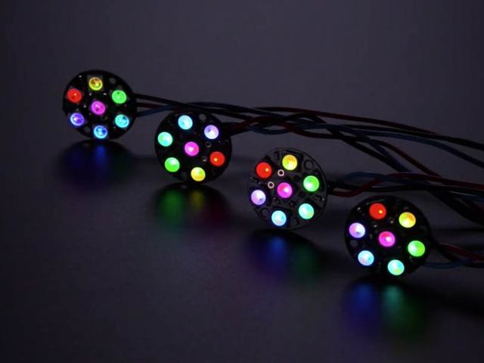
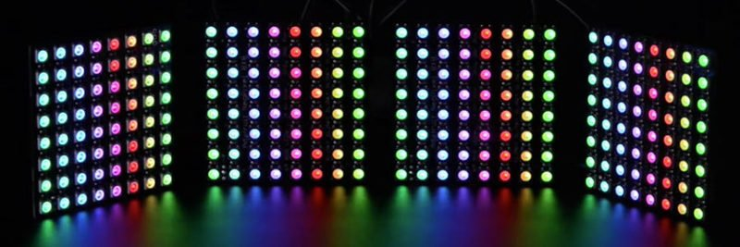
Form Factors
Strips and Strands
Rings
Matrices
Sticks / Jewels
SMD NeoPixels
Through Hole NeoPixels

Slide 7
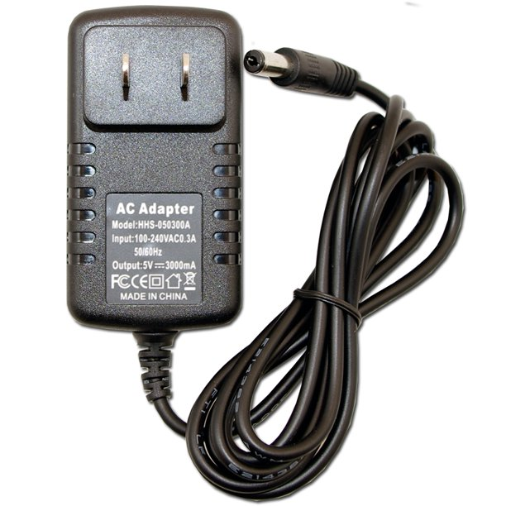
Power for NeoPixels
The Arduino can continuously supply only about 500 milliamps to the 5V pin.
Each NeoPixel can draw up to 60 milliamps at full brightness.
So Maximum is 8 Neopixels on an Arduino Uno
So yes, you can skip the separate DC supply and power directly off the Arduino as long as just a few pixels are used, more if the colors and overall brightness are low. When in doubt, give the pixels a separate power supply.

Slide 8
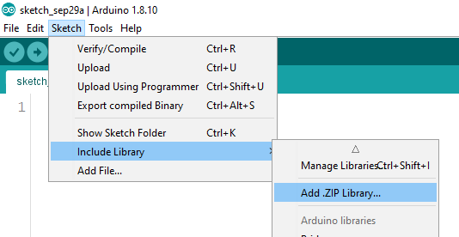
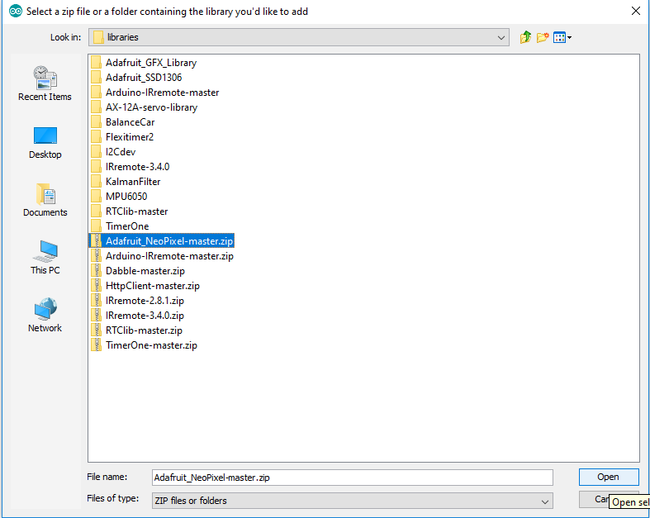
We need to add the Neopixel Library to the Arduino IDE
Download the Adafruit_NeoPixel-master.zip file from our GitHub Page and save it to the Documents\Arduino\libraries folder. Do not unzip the file.
Open the Arduino IDE and select Sketch -> Include Library -> Add .ZIP Library
Select the Adafruit_NeoPixel-master.zip and click Open.

Slide 9
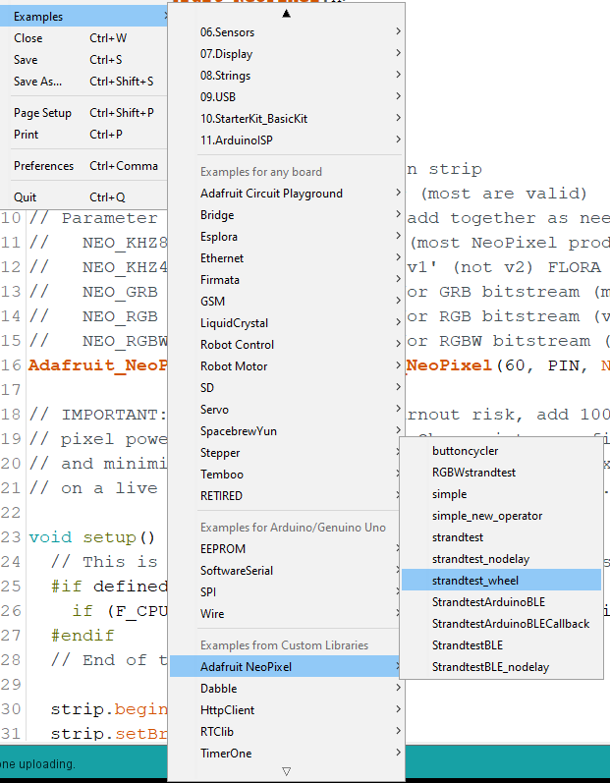
The Ring
We’ll start with getting the Ring lit up since it can be powered by the Arduino Uno.
Open File -> Examples -> Adafruit NeoPixel -> strandtest_wheel.
Upload the strandtest_wheel to the Uno.
Power off the Uno and use Alligator clips and M-M jumpers to connect the power to 5V, Ground to Ground and pin 6 to data input.
Should be 3 wires. Power, Ground and Signal input.
Power on and enjoy the show.

Slide 10
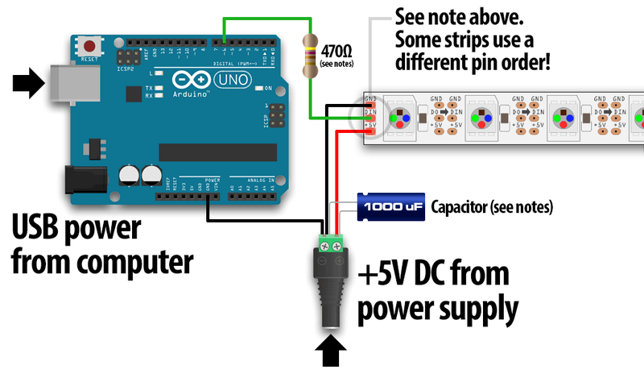
Connection to the NeoPixel Strip
When connecting NeoPixels to any LIVE power source or microcontroller, ALWAYS CONNECT GROUND (–) BEFORE ANYTHING ELSE. Conversely, disconnect ground last when separating.
When using a DC power supply, or an especially large battery, we recommend adding a large capacitor (100 to 1000 µF, 6.3V or higher) across the + and – terminals. This prevents the initial onrush of current from damaging the pixels. See the photo on the next page for an example.

Slide 11
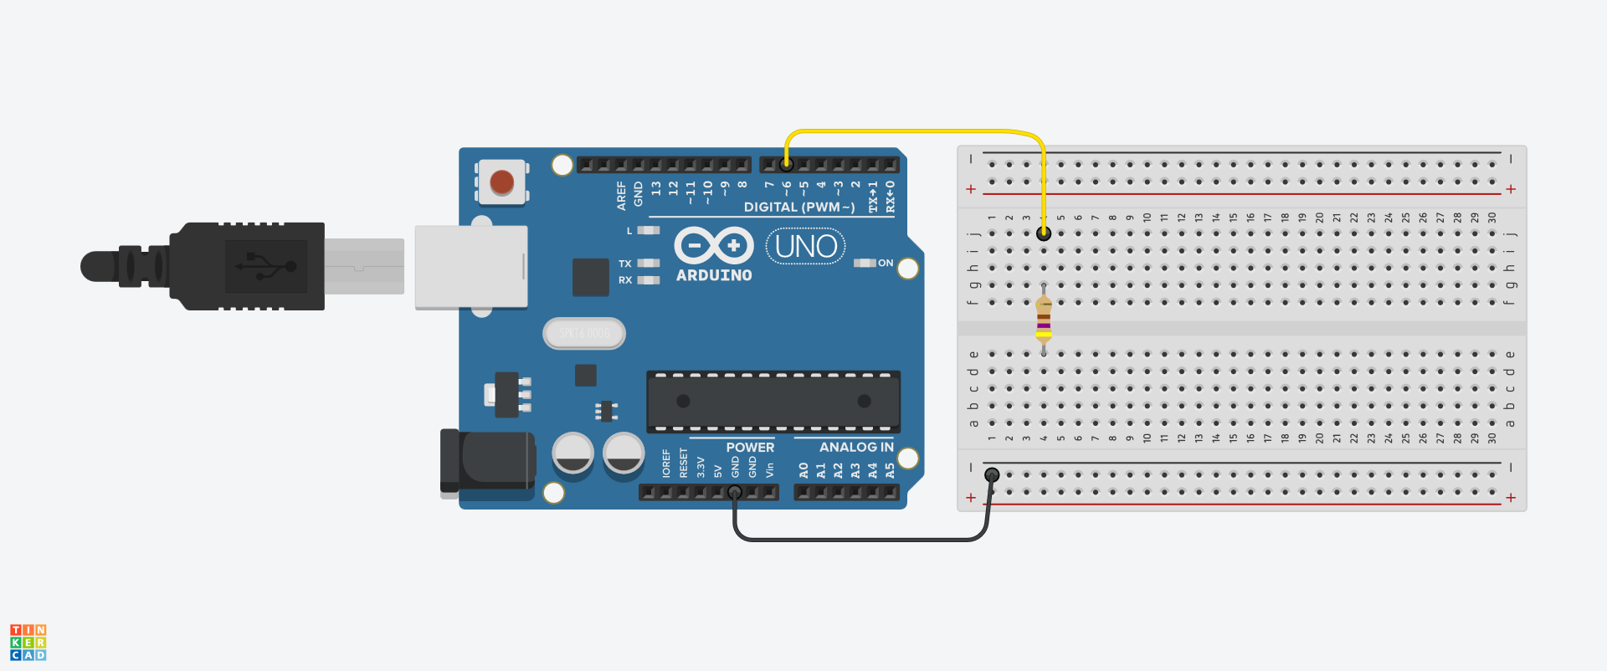



Let’s wire the 60 NeoPixel Strip
Use M-F
Use M-M
Tape the NeoPixel Strip to the front of the workbench

Slide 12
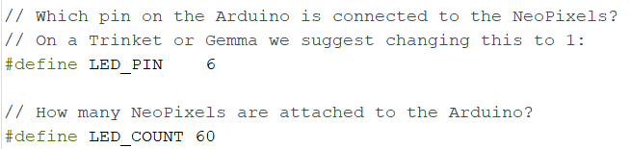
Configure and upload the strandtest
Open File -> Examples -> Adafruit NeoPixel -> strandtest
Ensure the LED_PIN is set to 6, or whatever pin you want .(should be a PWM pin)
The Strips we have , have 60 Neopixels in them. You can plug in one strip into another to
get 120, 180, 240, etc.
We have a 3 Amp power supply, so if each NeoPixel draws around 20-60 milli Amps, we can have up to 50- 150 in our strip. Up to 2 strips. If we don’t turn on all white.

Slide 13
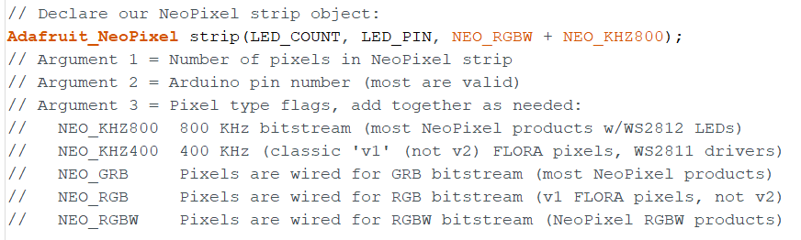
Configure and upload the strandtest
We have RGBW LED’s in our strip. So, ensure the NEO_RGBW + NEO_KHZ800 used as the third argument in our declaration of Adafruit_NeoPixel.
Other strips may be built differently, so check the data sheet.

Slide 14
Show time!
Upload the strandtest.ino to the Arduino Uno.
Plug in the Power and watch it glow.

Slide 15
How do we Control Individual Pixels?
Let’s load the simple.ino from the github page.
Download here.
Change the delay and color.

Slide 16
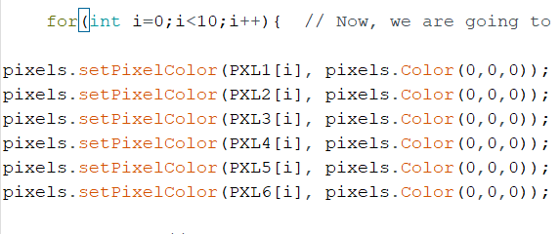
Download the Individual.ino from our GitHub Page
Download Here.
Change the for loop where it turns off the LEDS to the code below.

Slide 17
Download the Individual_test.ino from our GitHub Page
Download Here.
Upload to Uno
Challenge time:
Change the code to only light the 5th LED red.
Change the code to light the 5th LED to Blue and the 7th LED to red.
Change the code to light the 5th LED to Green and the 50th LED to white.
Team up and connect 2 strands together

Slide 18
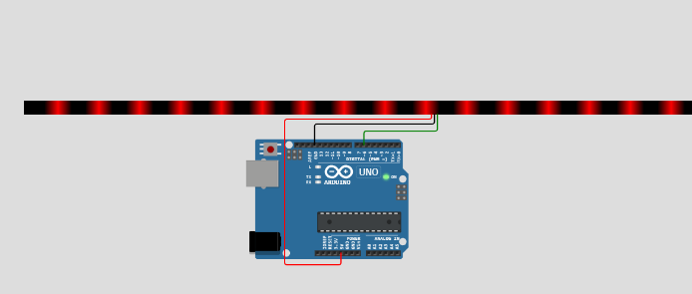
Perfect your code with a simulator
https://wokwi.com/arduino/libraries/Adafruit_NeoPixel/StrandTest

