Slide 1
NeoPixels
Dazzling addressable LED’s

Slide 2
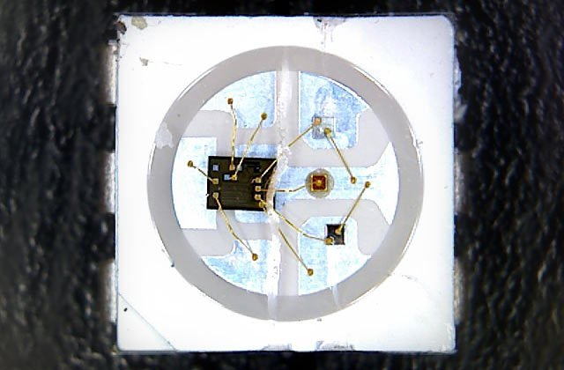
LED Drivers
WS2812, WS2811 and SK6812 LED/drivers
Notes:
Incorporating scads of LEDs into an electronic project used to be a hairy prospect, a veritable rat’s nest of wires and code. The arrival of dedicated LED driver chips brought welcome relief, offloading grunt work from the microcontroller and allowing one to focus on the application. Much simpler, but still not “Christmas light” simple. The WS2812 Integrated Light Source — or NeoPixel in Adafruit parlance — is the latest advance in the quest for a simple, scalable and affordable full-color LED. Red, green and blue LEDs are integrated alongside a driver chip into a tiny surface-mount package controlled through a single wire. They can be used individually, chained into longer strings or assembled into still more interesting form-factors.

Slide 3
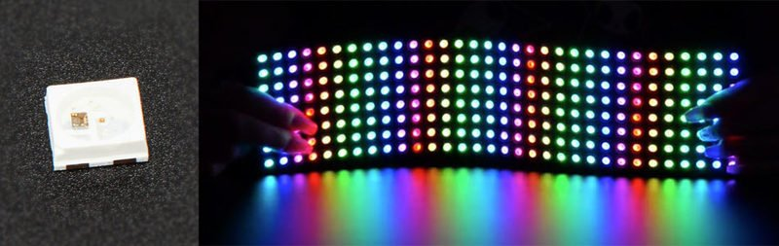
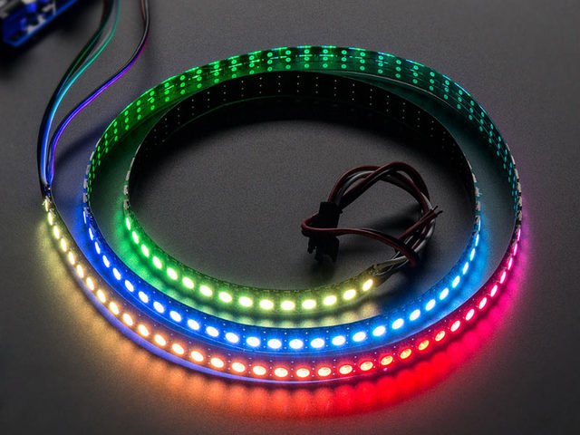
Form Factors
NeoPixel products are available in a zillion form factors…from individual tiny pixels to huge matrices…plus strips, rings and everything in-between. The same software drives all of them; they’re all “NeoPixels.”

Slide 4
Important Things to know
Not all addressable LEDs are NeoPixels.
“NeoPixel” is Adafruit’s brand for individually-addressable RGB color pixels and strips based on the WS2812, WS2811 and SK6812 LED/drivers, using a single-wire control protocol. Other LED products we carry — DotStars, WS2801 pixels, LPD8806 and “analog” strips — use different methodologies (and have their own tutorials).
NeoPixels require a microcontroller
NeoPixels aren’t the answer for every project.
The control signal has very strict timing requirements, and some development boards (such as Netduino or Raspberry Pi) can’t reliably achieve this in every situation.

Slide 5
Is there a limit to the number of NeoPixels in a chain?
There’s no inherent limit in the maximum length of a NeoPixel chain, but eventually you’ll encounter any of various practical limits:
RAM: NeoPixels require some RAM from the host microcontroller; more pixels = more RAM. It’s only a few bytes each, but as most microcontrollers are pretty resource-constrained, this becomes a very real consideration for large projects.
Power: each NeoPixel draws a little bit of current; more pixels = more power. Power supplies likewise have some upper limit.
Time: NeoPixels process data from the host microcontroller at a fixed data rate; more pixels = more time and lower animation frame rates.

Slide 6
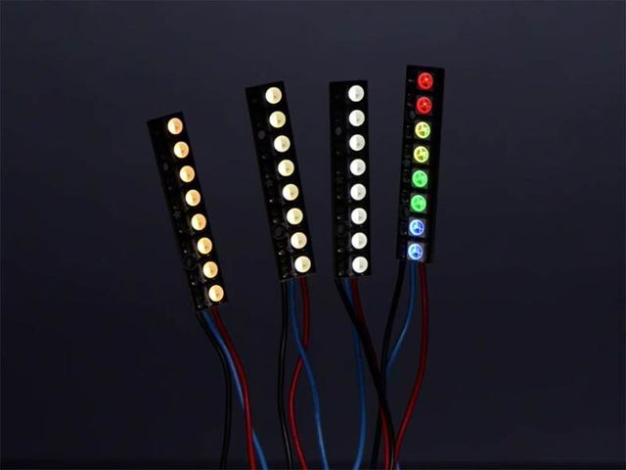
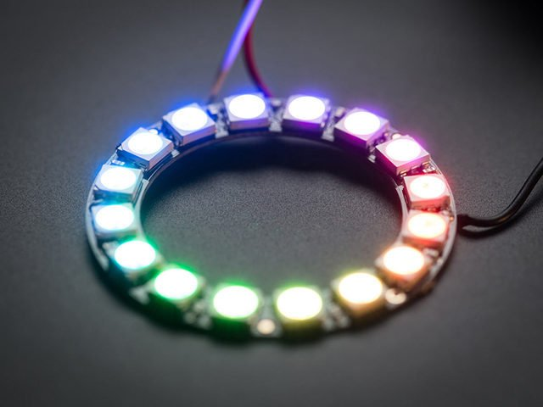
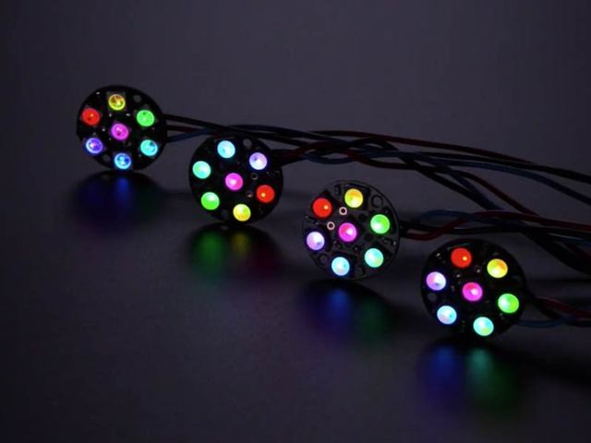
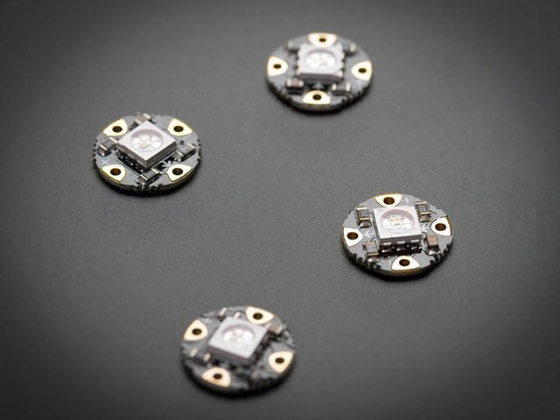
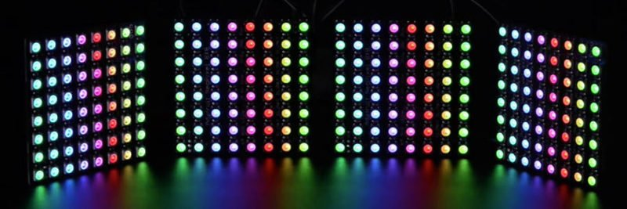
Form Factors
Strips and Strands
Rings
Matrices
Sticks / Jewels
Individual NeoPixels

Slide 7
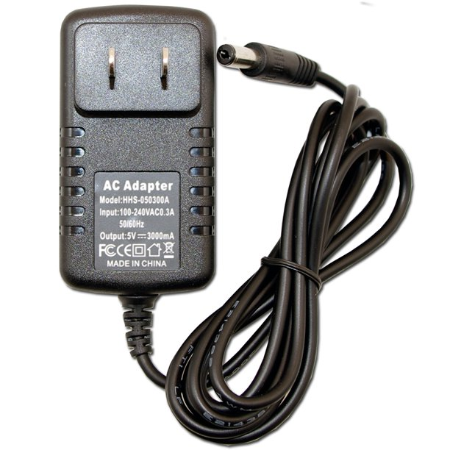
Power for NeoPixels
The Arduino can continuously supply only about 500 milliamps to the 5V pin.
Each NeoPixel can draw up to 60 milliamps at full brightness.
So Maximum is 8 Neopixels on an Arduino Uno
So yes, you can skip the separate DC supply and power directly off the Arduino as long as just a few pixels are used, more if the colors and overall brightness are low. When in doubt, give the pixels a separate power supply.

Slide 8
Best Practices
https://learn.adafruit.com/adafruit-neopixel-uberguide/best-practices

Slide 9
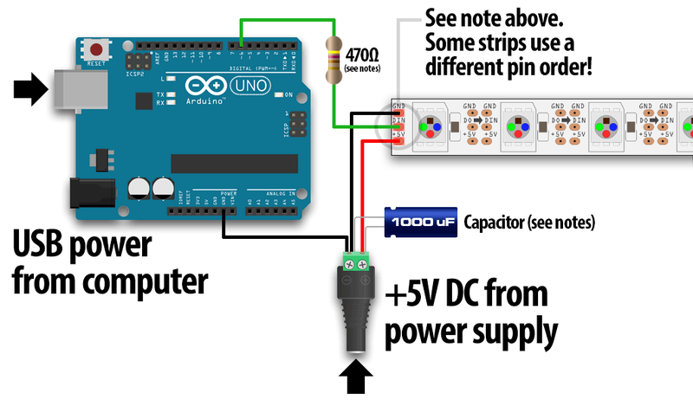
Let’s wire up a Neopixel
When connecting NeoPixels to any LIVE power source or microcontroller, ALWAYS CONNECT GROUND (–) BEFORE ANYTHING ELSE. Conversely, disconnect ground last when separating.
When using a DC power supply, or an especially large battery, we recommend adding a large capacitor (100 to 1000 µF, 6.3V or higher) across the + and – terminals. This prevents the initial onrush of current from damaging the pixels. See the photo on the next page for an example.

Slide 10
Perfect your code with a simulator
https://wokwi.com/arduino/libraries/Adafruit_NeoPixel/StrandTest

