Slide 1


Slide 2
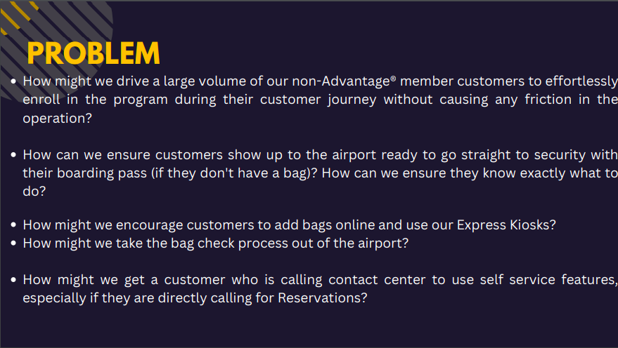

Slide 3


Slide 4


Slide 5
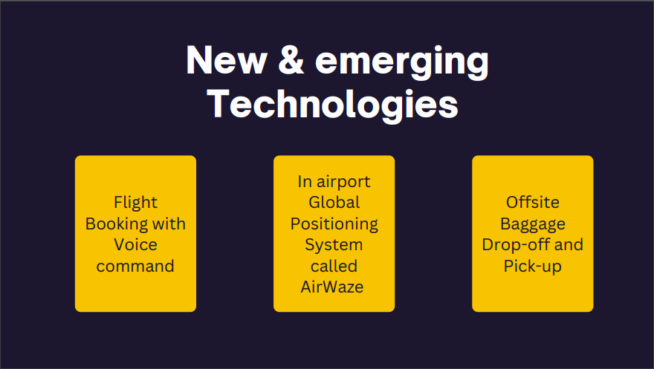

Slide 6
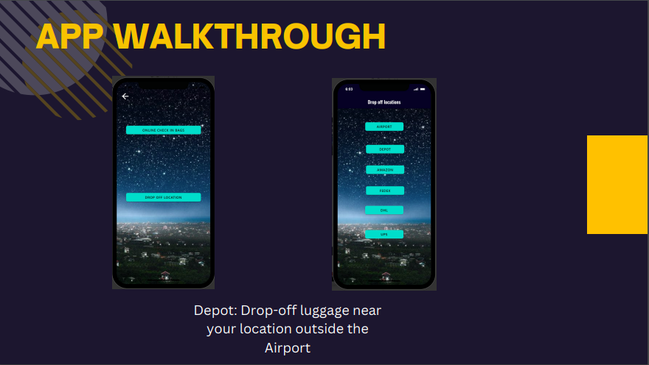

Slide 7

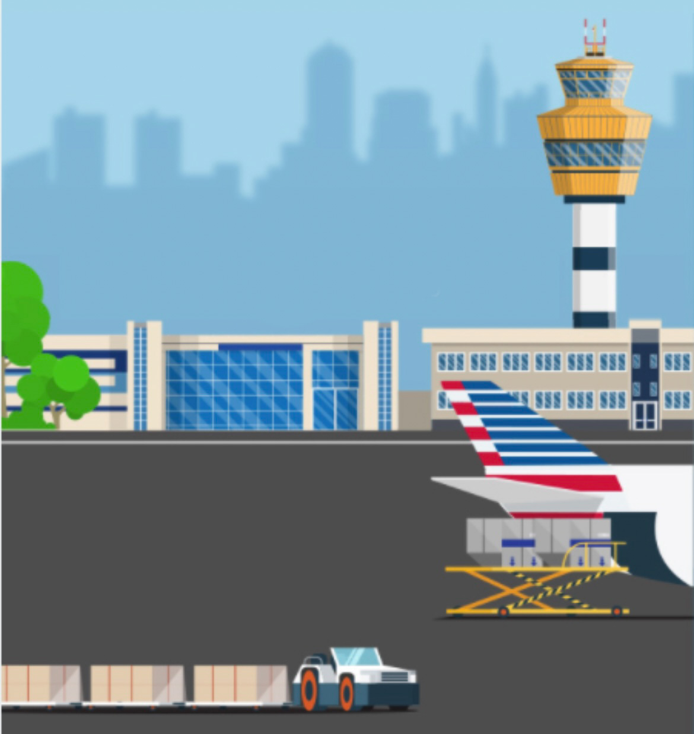



Customer
In transit
Affiliated Drop-off location
Airport
Offsite Baggage Drop-off to your nearest location

Slide 8
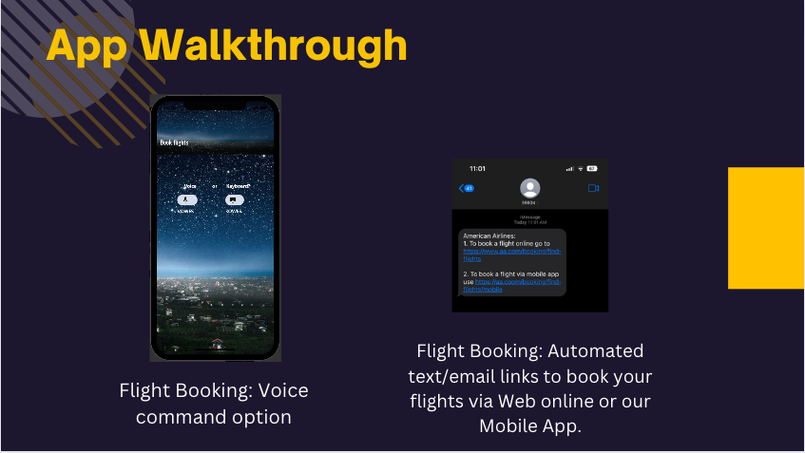

Slide 9
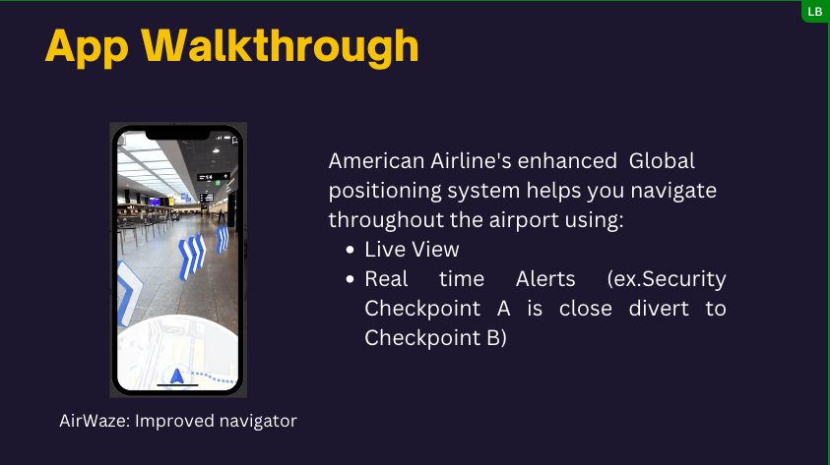

Slide 10


Slide 11


Slide 12


Slide 13


