Slide 1


AA FLIGHT BAG
BY
Southern University A & M College

Slide 2

TECH HUSTLERS
KUNAL JANJIRALA
SRAVANTHI PEDDI
SRI LAXMI MIRYALA
MURALI DEVI KATIKALA
SHARVANI DASARI
MENTOR : TASIA

Slide 3
PROBLEM STATEMENT
How might we take the bag check process outside of the airport?

Slide 4
How Do We move our Bags to the airport at affordable price?

Slide 5
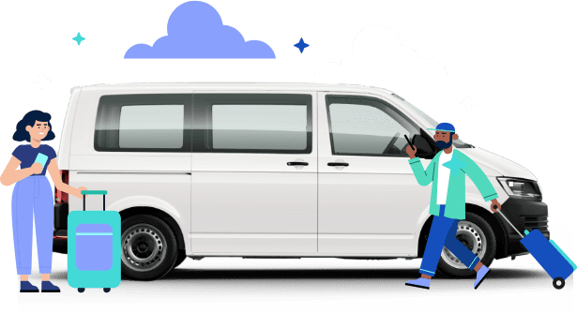
Cabify the bag:

Slide 6
Main Idea
Flight Booking
Bag Services
Flight Details
Reserve a pick-up time
Hand over the bag
Receive baggage status

Slide 7
Step-by-Step
Passenger books a flight and if they choose the flight bag services, they need to enter flight details.
Passenger receives the confirmation and then they should reserve a time slot for picking their bag.
Passenger will be notified regarding the airline employee arrival time and employee details.
Employee will weigh the bag , attaches a label on it and collects the bag from the passenger.

Slide 8
DESCRIPTION
When passenger books the flight they will find an option to choose “flight bag” services. If they choose it they need to enter the flight number , their baggage pick up location.
Based on availability passenger can reserve a time slot and then receives the confirmation.
After checking and weighing the bag at customer’s place, employee will attach a label on the bag(same as boarding pass number) and he picks up the bag.

