Slide 1
Micromorphology of Guadua foliage leaves
Elizabeth McMurchie
EEB590A Final Presentation

Slide 2
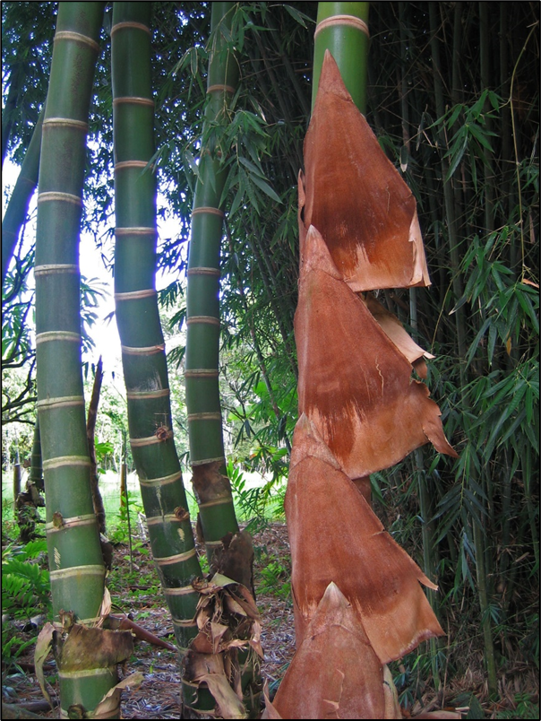
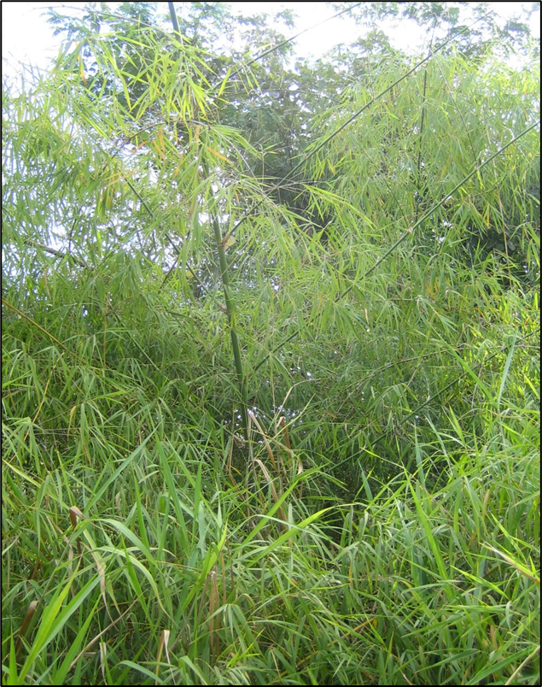
Introduction
Guadua: Neotropical genus of woody bamboos with 33 species
Genus ranges from central Mexico to southern Brazil
Unlike most bamboos, has species in diverse habitats including in forests/forest margins, along rivers, and in savannas
Also has a variety of habits: tall and erect, small and arching, or leaning and climbing on trees
We noticed that Guadua in different habitats and with different habits tended to have different macromorphology
It appeared that the micromorphology of foliage leaves also differed between species
G. angustifolia (forest)
G. paniculata (savanna)

Slide 3
Introduction
We asked whether there were differences in micromorphology based on:
Habitat (savanna/forest/river, especially savanna from other habitats) (Hypothesis: yes)
Habit (big erect/leaning and climbing/small arching, especially small arching from other habits) (Hypothesis: no)
Region (Mexico/Central America/Andes/Eastern South America) (Hypothesis: no)
Determining whether micromorphology differs based on these factors could indicate potential causes for these differences
We know that different species often differ in micromorphology
Is mircromorphology dependent on habitat?
Does habit (which also affects light exposure) affect micromorphology?
If there’s a regional pattern, could have taxonomic implications

Slide 4
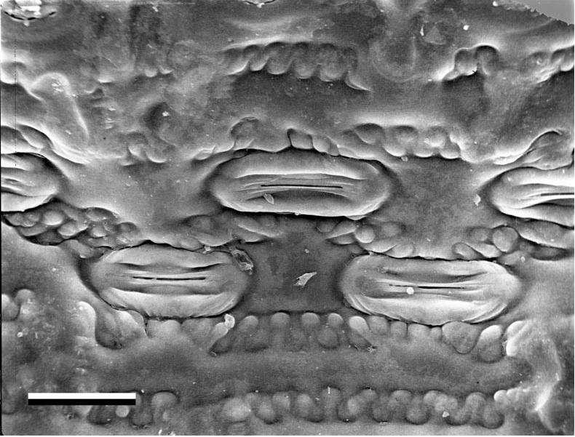
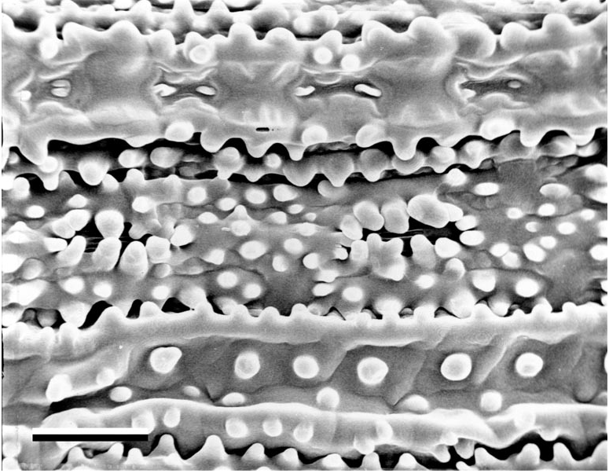
Methods
Used scanning electron microscope (SEM) images of both sides of Guadua foliage leaves
Created a binary dataset of presence/absence of 29 epidermal features of 83 Guadua leaf specimens
Including presence of papillae in different locations on each side of leaf, different silica body types, trichome types, stomatal complex shapes
Predictors included habit, habitat, and region
Hypothesized that micromorphological features would differ depending on habitat, but not by habit or region
G. chacoensis ad surface 940x
Images © L.G. Clark
G. paniculata ad surface 940x

Slide 5
Analysis
Looked at correlations between presence/absence of all different features
Ex. Presence of abaxial interstomatal papillae highly correlated with ridged-saddle-shaped silica bodies
Distance matrix obtained from binary dataset using simple matching coefficient
Why not Jaccard?
Because both presence and absence of features could potentially be important!
To visualize data, used Principal Coordinates Analysis (PCoA)
Also used a scree plot to examine principal coordinates to keep in PcoA

Slide 6
Analysis
Used a multivariate factorial analysis of variance (factorial MANOVA) for our data
Via permutation with randomized residuals
Considered: Habitat (savanna vs. forest and river), habit (small arching vs. big erect and climbing), and region (Mexico, Central America, Andes, and Eastern South America)
Due to small sample size, could not consider the interaction between these factors
model3.rrpp <- lm.rrpp(Y.dist.matrix ~ mydat3$Habit + mydat3$Habitat + mydat3$Region, print.progress = FALSE)
Equation: Y = β₀ + β₁Habitat + β₂Habit + β₃Region + ε
Each of 29 columns treated as separate “Y” but placed in a matrix, linear model run on each
Error distribution: binomial
Significance assessed using p-values (significant if p < 0.05)

Slide 7
Analysis
Model comparison
Used log likelihood to compare models
Model with the highest log likelihood best fits the data

Slide 8
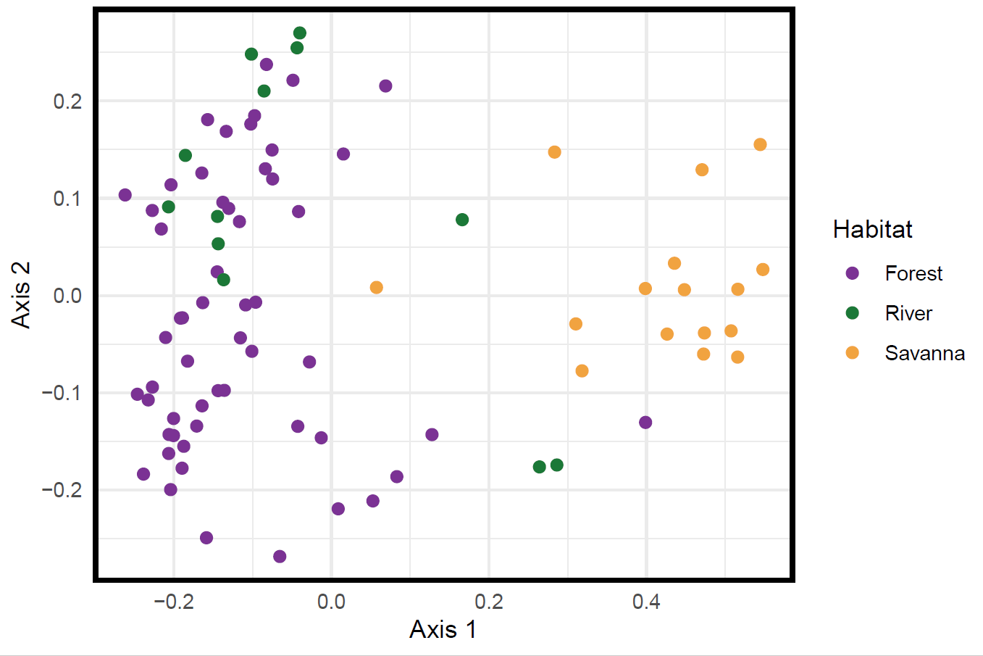
Results
PCoA colored by habitat:
Scree plot showed ca. 4 principal coordinates explain most variation

Slide 9
Results
Found that micromorphology differed significantly between:
Savanna and forest/river specimens (p = 0.001)
Small arching and big erect/climbing specimens (p = 0.001)
There were also significant differences in micromorphology based on region
(p = 0.003)
Could not determine which region differed significantly from others due to relatively small sample size
Model comparison: model considering habitat and habit only best fit the data (highest log likelihood)
Better to leave region out than include it

Slide 10
Discussion
We do see differences between micromorphology of foliage leaves based on habitat, habit, and region
But the differences in region aren’t quite as strong
Micromorphology of specimens in savanna differs from those in other habitats
Micromorphology of specimens with small arching habit differs from specimens with taller/climbing habits
However, there’s a lot of overlap between savanna habitat and small arching habit
May need to reconsider habit category
We need to observe more specimens to run post-hoc analyses comparing region and all three habits and habitats

