Slide 1
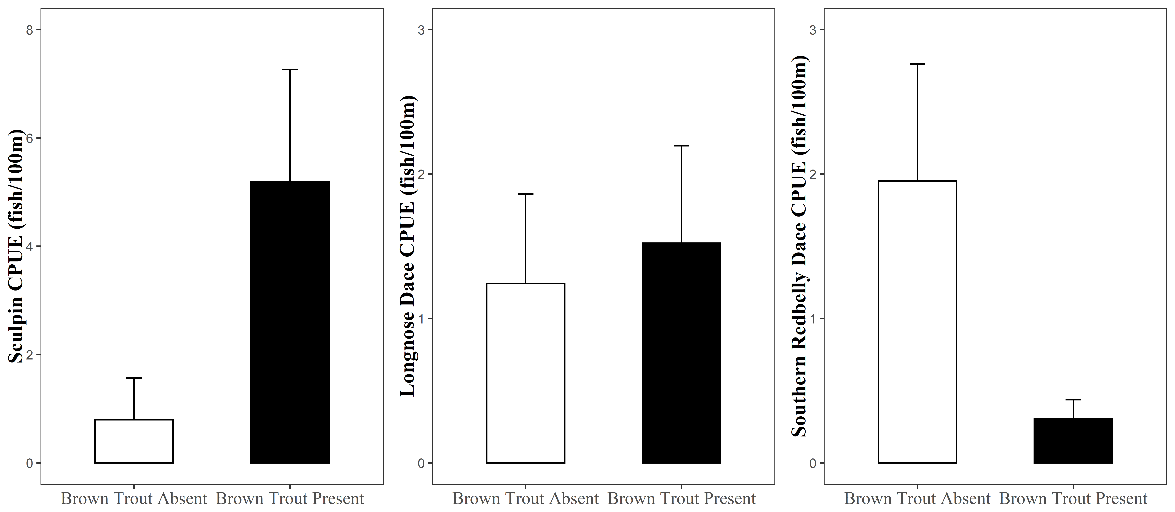
(a)
(b)
(c)
p < 0.01
p = 0.62
p = 0.01
(18)
(20)
(19)
(14)
(2)
(12)

