Slide 1
Food Consumption Trends in the United States: The Baseline for a Reimagined Localized Food System
Tiffanie F. Stone
EEB698 Final Presentation

Slide 2
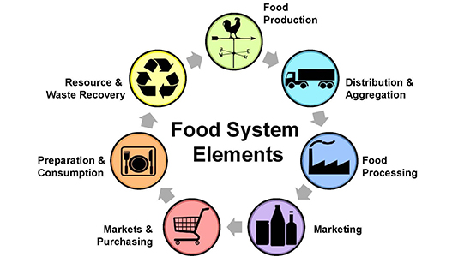
Introduction: Imagining a Localized Food Systems
Agricultural production alone makes up 19 -29% of anthropogenic greenhouse gas emissions (Vermeulen, Campbell, & Ingram, 2012)
Today: more than 50% of the global population live in urban areas
By 2050, urban populations are predicted to reach 70% (Kulak, Graves, & Chatterton, 2013)
Average grocery store items travel 1500 miles from farm to consumer (Knight & Riggs, 2010)
Understanding a city-scale food system
Source: texaslocalfood.org

Slide 3
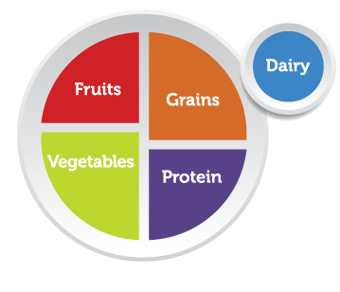
Introduction
Establish a baseline for food consumption patterns over time.
Used USDA National Food Consumption data
Mean and 95% confidence intervals
Nutrition inequity: Analyzing trends in low- and high-income populations
Mean and
Target key food groups in our model of this food system.

Slide 4
Methods
To run a Simulated vegetable consumption data using mean and 95% confidence intervals which were converted to standard deviations
How did you test your question? (focus just on the part you are analyzing for this class)
Be sure to clearly convey how you measured your response (what did you count/measure/observe?) and your predictors and covariates

Slide 5
Analysis (~3 slides)
What was your approach? What type of model did you fit?
Present the formula for your linear model (if relevant)
How did you assess significance/importance of predictors?

Slide 6
Results (1-2 slides)
What did you find? Show us the graph that best displays your results.

Slide 8
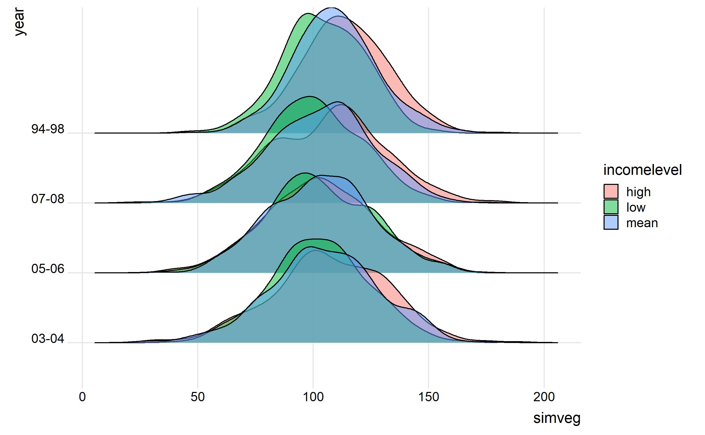
Simulated Vegetable Data

Slide 9
Discussion (1 slide)
What does this mean? Interpret your results in light of your original question/hypothesis

