Slide 1
Food Consumption Trends in the United States: The Baseline for a Reimagined Localized Food System
Tiffanie F. Stone
EEB698 Final Presentation

Slide 2
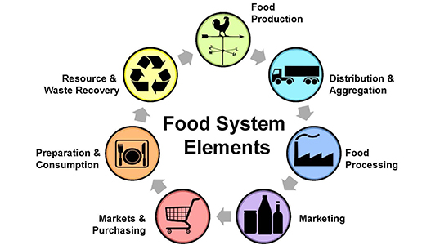
Introduction: Imagining a Localized Food Systems
Agricultural production alone makes up 19 -29% of anthropogenic greenhouse gas emissions (Vermeulen, Campbell, & Ingram, 2012)
Today: more than 50% of the global population live in urban areas
By 2050, urban populations are predicted to reach 70% (Kulak, Graves, & Chatterton, 2013)
Average grocery store items travel 1500 miles from farm to consumer (Knight & Riggs, 2010)
Understanding a city-scale food system
Source: texaslocalfood.org

Slide 3
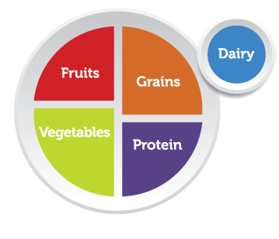
Introduction
Establish a baseline for food consumption patterns over time.
Used USDA National Food Consumption data
Mean and 95% confidence intervals
Nutrition inequity: Analyzing trends in low- and high-income populations
Mean and
Target key food groups in our model of this food system.

Slide 4
Methods: Part 1
Response: food category consumed (lbs) / year
Fruits
Vegetables
Meat
Dairy
Grain
Oil
Predictors: income level, year

Slide 5
Methods: Part 2
Simulated vegetable consumption data using mean and 95% confidence intervals which were converted to standard deviations
6000 total data points – similar to 5000 participants in the survey for vegetable consumption (lbs/year)
2000 per income level (low, average, high)
1500 per year (1994 – 1998, 2003 – 2004, 2005 – 2006, 2007 – 2008)
Response: vegetables consumed (lbs) / year
Predictors: income level, year

Slide 6
Simulated Vegetable Data Exploration
Compared three modeling approaches in data exploration:
Experimental Approach – removing non-significant interactions until remaining variables are significant
Fit-Full Model – no model selection – remove non-significant interactions
AIC/BIC – theoretical approach without p-values
Interactions between income level and year were not significant and were thus excluded from the final model selected

Slide 7
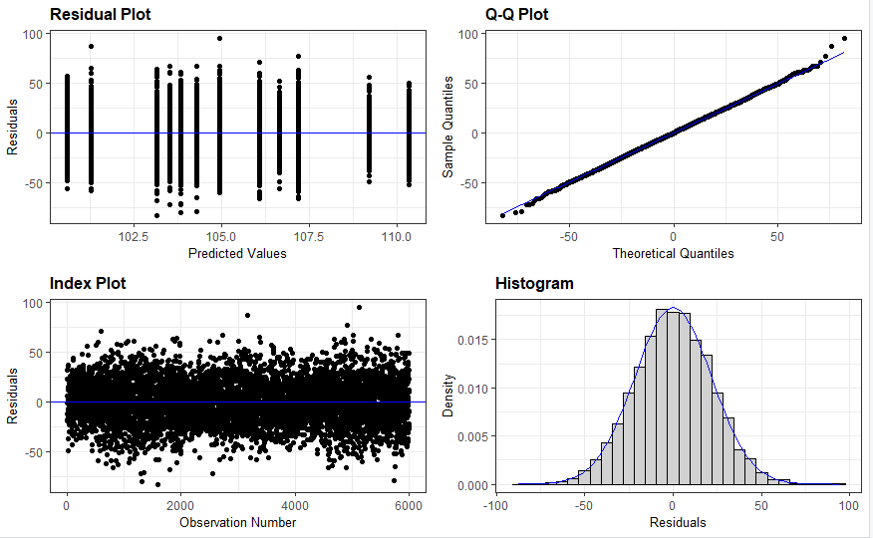
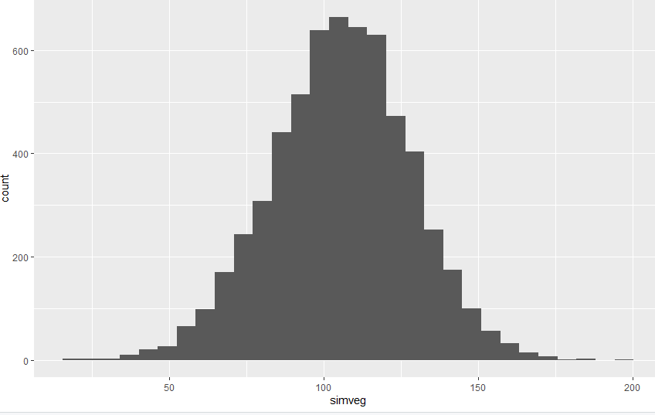
Simulated Vegetable Data Statistical Analysis
Assessed significance using p-values
Used lm (linear model) – response was normally distributed based on results from the resid_panel

Slide 8
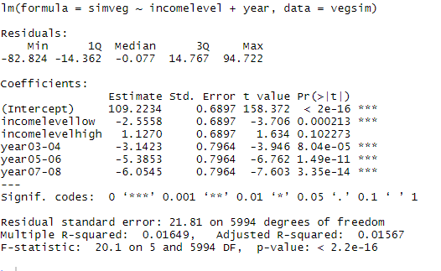
Simulated Vegetable Data Statistical Analysis
vegsimmod2a <- lm(simveg ~ incomelevel+year, data=vegsim)

Slide 9
Analysis (~3 slides)
What was your approach? What type of model did you fit?
Present the formula for your linear model (if relevant)
How did you assess significance/importance of predictors?

Slide 10
Results (1-2 slides)
What did you find? Show us the graph that best displays your results.

Slide 12
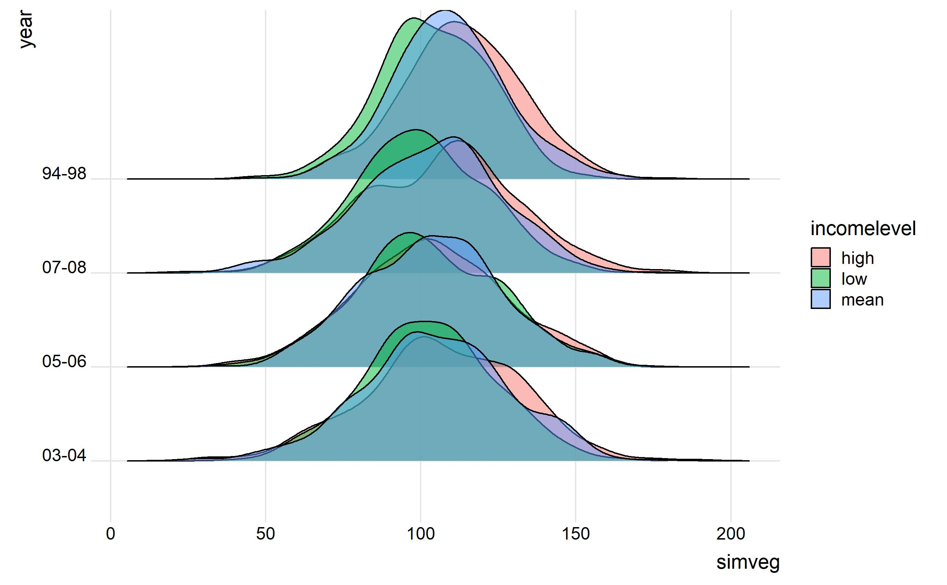
Simulated Vegetable Data

Slide 13
Discussion (1 slide)
What does this mean? Interpret your results in light of your original question/hypothesis

Slide 14
Sources
R Core Team (2013). R: A language and environment for statistical computing. R Foundation for Statistical Computing, Vienna, Austria. URL http://www.R-project.org/.
Wickham, Hadley. (2016) ggplot2: Elegant Graphics for Data Analysis. Springer-Verlag New York.
Wickham, Hadley (2017). tidyverse: Easily Install and Load the 'Tidyverse'. R package version 1.2.1. https://CRAN.R-project.org/package=tidyverse

