Slide 1

Closet App
Course: CS-3130
Team Members: Tom
Daniel
Eric
Shivam

Slide 2
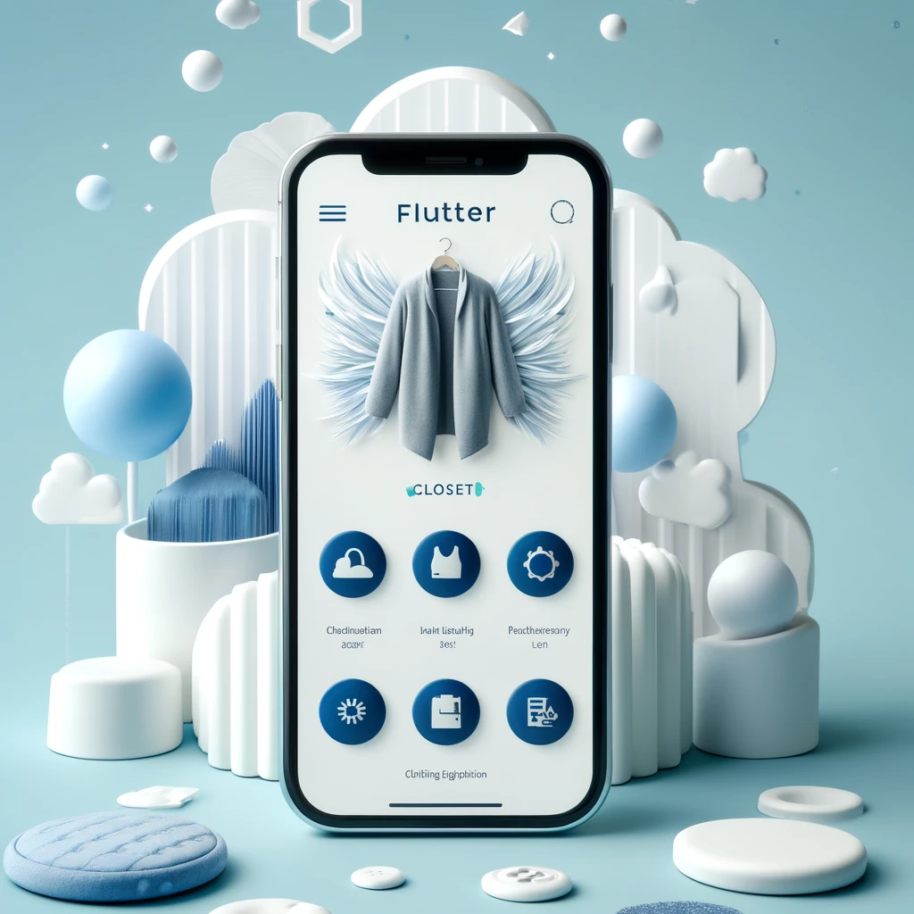
Introducing the Flutter Closet App
An innovative app designed to revolutionize your wardrobe management.
Capture and categorize your clothing digitally for easy access and outfit planning.
Mix and match to create the perfect look with our outfit assembly feature.
Understand and manage garment care with our unique laundry symbol recognition.
A fashion-forward application combining technology and style.

Slide 3
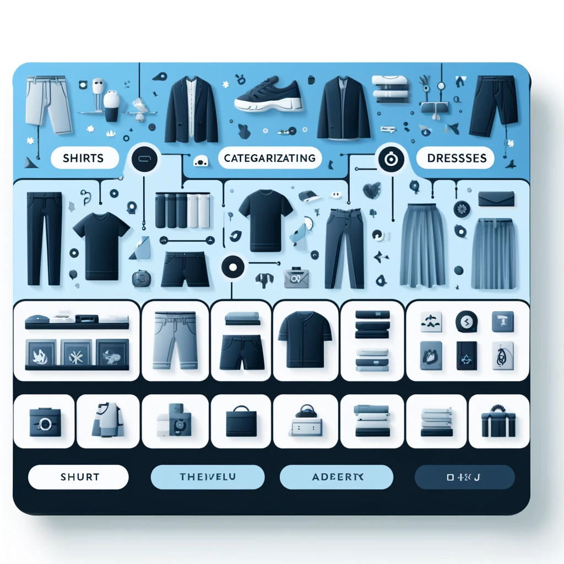
Organize Your Wardrobe Digitally
Simplify your wardrobe management with digital categorization.
Capture images of your clothes and categorize them by type: shirts, pants, dresses, accessories, etc.
Easy to navigate digital closet at your fingertips.
Enhance your wardrobe organization and make outfit selection a breeze.

Slide 4
Core features
Clothing Digitization
Capture your wardrobe: Simply use your phone's camera to snap pictures of your clothes and the app will categorize them for you.
Outfit Assembly
Style made easy: Mix and match pieces from your digital closet to create and save your favorite outfits for any occasion.
Laundry and Clothing Care
Care instructions decoded: Scan the tags on your clothes, and the app provides you with easy-to-follow washing and care instructions.
Social Interaction
Share your style: Post your outfits on the app’s community, get feedback, engage with fashion-forward users, and gather likes and comments.
Search and Purchase
Find and buy with a tap: See something you like? Use the app to search for items online and make purchases right from the comfort of your home.

Slide 5

Live app demo

Slide 6

This Photo by Unknown Author is licensed under CC BY-NC-ND

