Slide 1
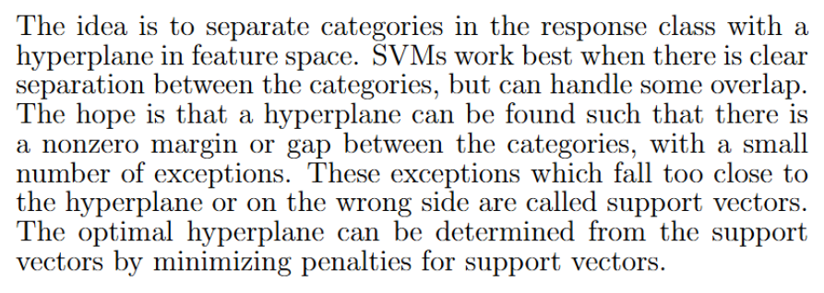
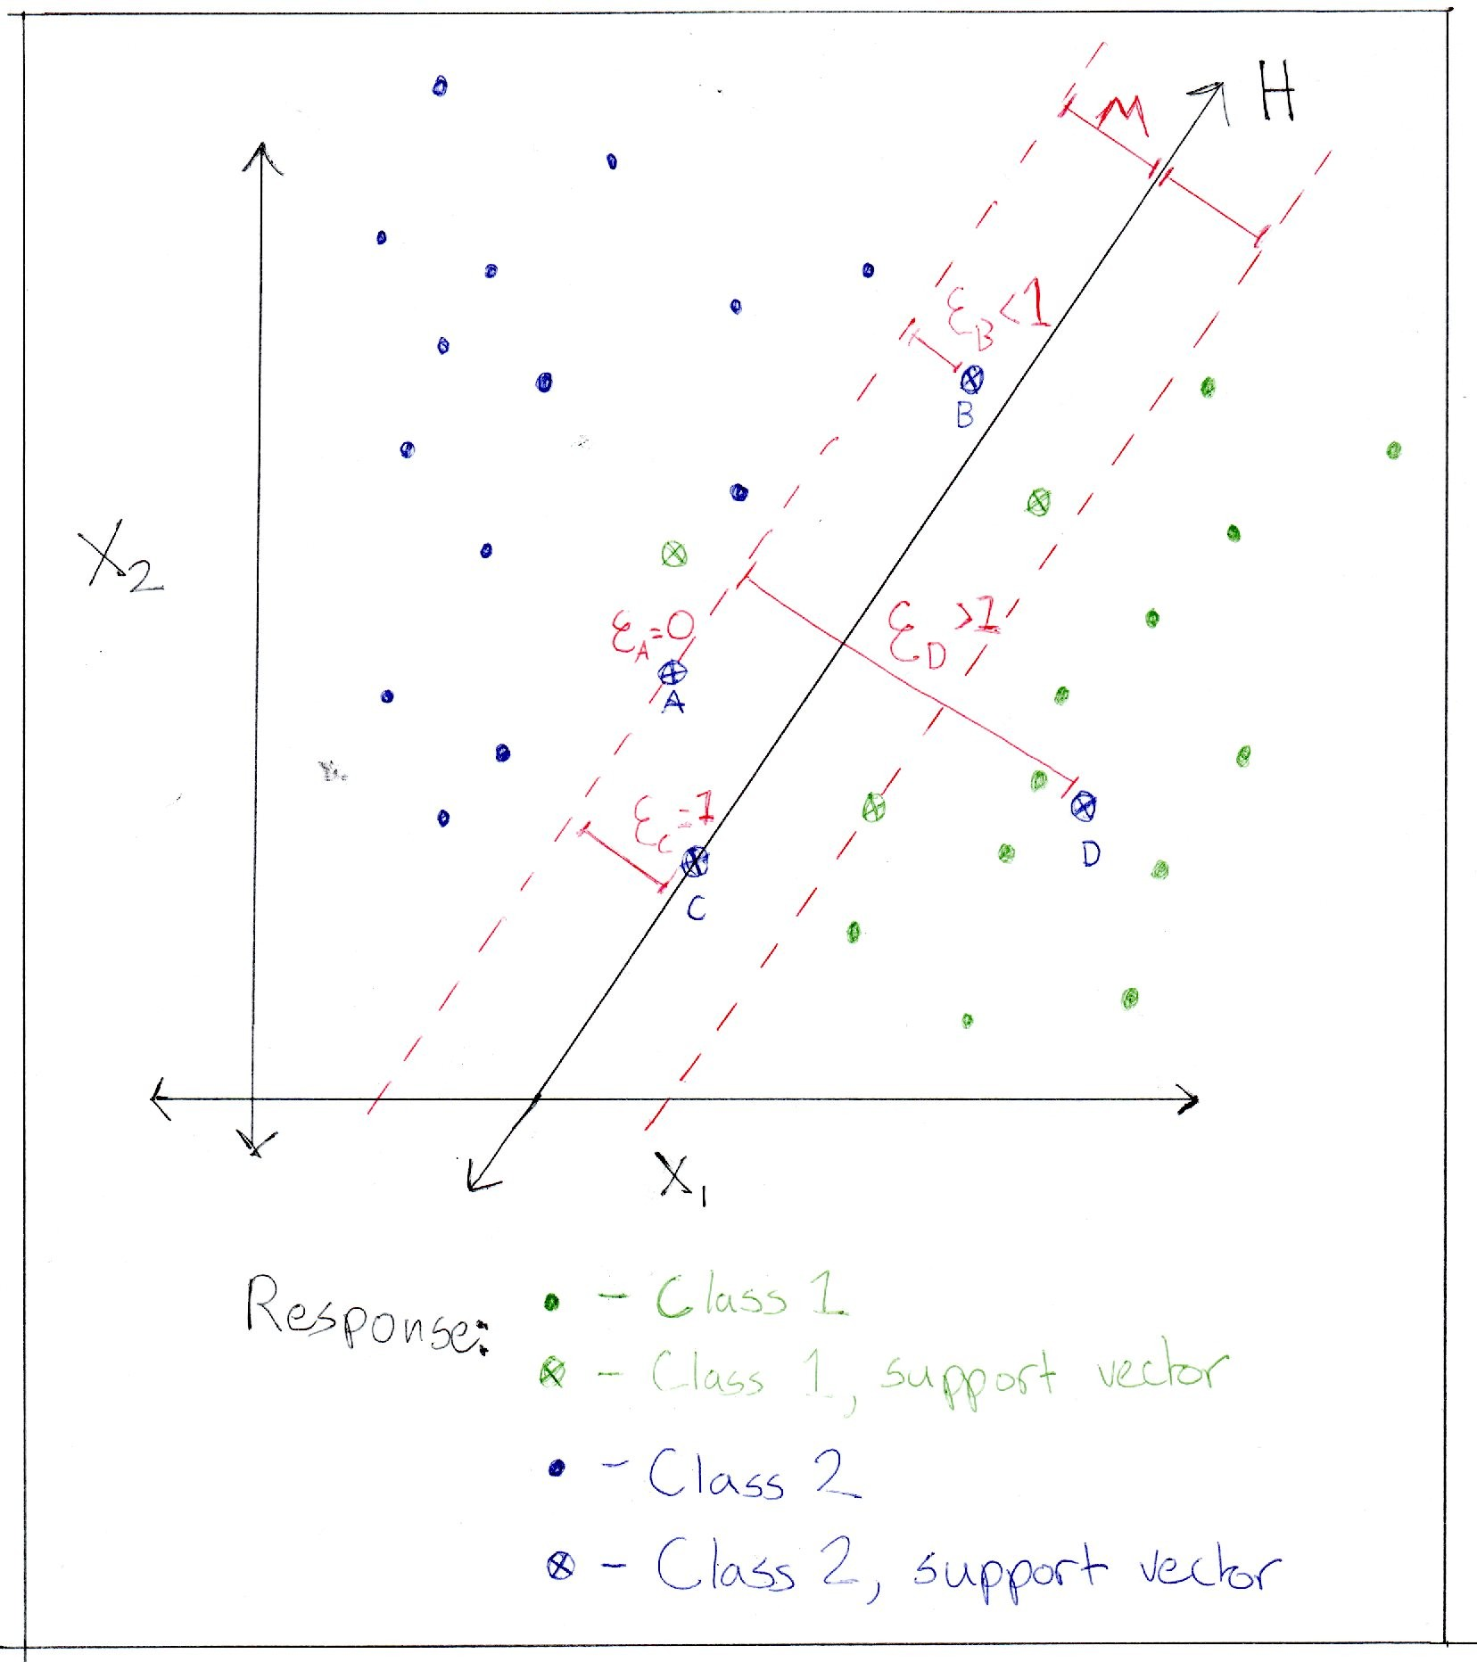
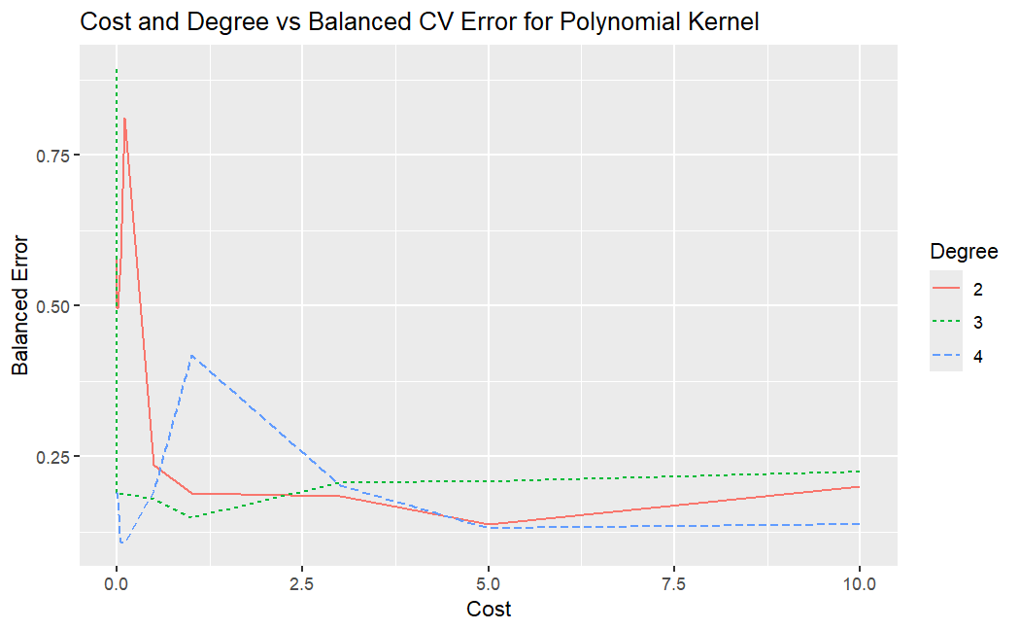
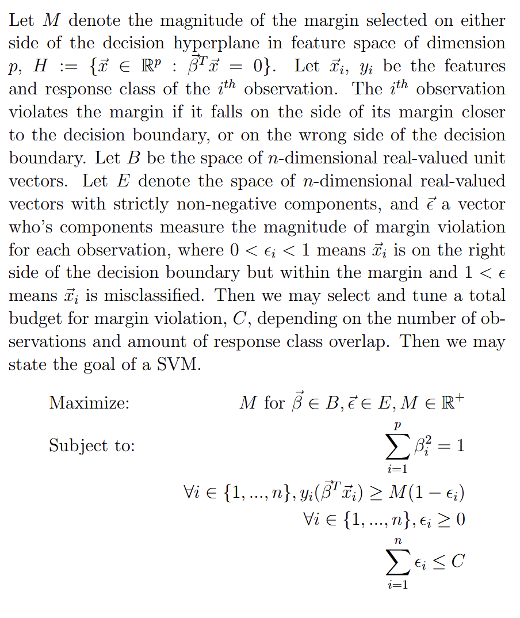
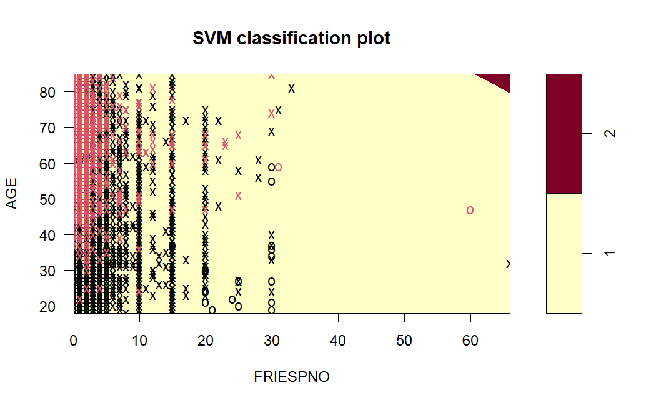
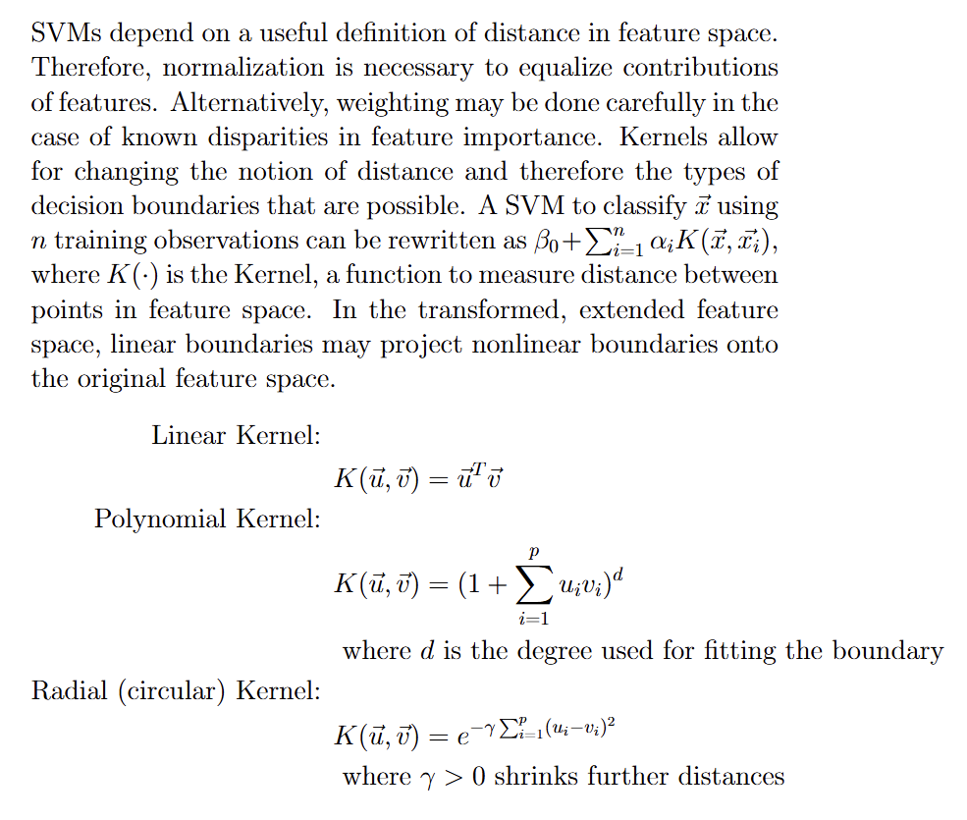
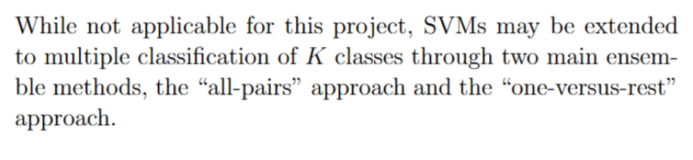
Introduction:
Accurately classifying diabetic status can mean the difference between receiving the correct targeted intervention or not. Since medical visits and tests can present a barrier, there is reason to seek other readily available information that can help categorize risk. The data in this study comes from the IPUMS Health Surveys National Health Interview Survey conducted in 2022 [1]. The original data set contained information from over 35,000 adults and children sampled from their households. The survey includes information about several health-related behaviors, past disease diagnosis status, and basic demographic information. The data used in this study was obtained through Dr. Mendible of Seattle University [2]. The central question explored is this: can age, BMI, weekly work hours, and consumption of things like alcohol, soda, and French fries be used to build a support vector machine to predict a past or present diabetes diagnosis?
Predicting Diabetes from IPUMS NHIS Data
with Support Vector Machines
Elling Payne, Seattle University, April 2025
Results:
Highlight: The best model by balanced CV Error used all six features, a cost of 0.05 (C = 20), and a polynomial kernel of degree d=4. However, recall was 0 for all trained models.
Tuning: Final Model Metrics:
Technical Background - Support Vector Machines:
kernel | CV Error | Training Error | Testing Error | Test Precision | Test Recall | Test F1-score
linear | 0.109961 | 0.109962 | 0.099507 | NA | 0 | 0
polynomial | 0.110207 | 0.109962 | 0.1 | 0 | 0 | 0
radial | 0.109961 | 0.109962 | 0.099507 | NA | 0 | 0
Discussion and Conclusions:
Initial exploration identified several features which stood out in terms of visible trends. The most obvious trend for all disease indicators in the dataset was age. This makes sense, as many of the diseases in the dataset, such as diabetes, cancer, and heart disease, can be the result of cumulative factors. Age also makes sense to include in a model because it is a datapoint that is often readily available and may have interactions with other risk factors. Calculated BMI was another basic health metric that appeared to have a relationship visually with diabetes. This makes sense given that diabetes is closely linked to metabolism, and severe diabetes often comes with difficulty in physical exertion. While higher BMI might not be the cause of diabetes, it may provide predictive power, especially in conjunction with other features. The last demographic variable used here was hours worked in the last week. Initially, it was considered that overwork might be associated with greater sickness, but the opposite was true. In hindsight, this is likely caused by the participant being too sick to work consistently. This variable may have less predictive power that is specific to diabetes than some of the others, given that any serious disease could be the cause of missing work or working less. However, if the feature can give extra confidence that someone has any disease, and other variables can narrow it down to diabetes, it might still be useful to include. The other three features included were all behavioral health metrics for substances that seem likely to be related to diabetes. Since diabetes is tied to metabolism, consumption of three things that can spike sugar intake seemed relevant. The boxplots also showed a weak but potentially real relationship between alcohol consumption, soda consumption, and French fry consumption. While the choice of features was not illogical, the performance obtained by the SVM models in this study are poor. While overall accuracy is high and the balanced error metric is low, precision and recall tell a different story. Recall is likely the most important of these metrics since a missed diagnosis is likely to result in the greatest harm, while a false positive may just result in additional screening. None of the models correctly identify any diabetic individuals. The model with the polynomial kernel makes the sole false positive prediction of the three. The problem is also apparent from the SVM classification plot above. To address this issue, the imbalance in the response class must be better addressed. More detailed, accurate, and consistent consumption information may also yield better results.
Methods:
Sample Subset: Male sample adults (10151 cleaned records)
Response: Has the participant ever been diagnosed with diabetes? (DIABETICEV)
1: No, 2: Yes (other values removed)
Features: (Codes not valid as numeric data removed)
Participant age in years (AGE)
Participant BMI calculated value (BMICALC)
Calculated yearly days of alcohol consumption last year (ALCDAYSYR)
Hours worked last week (HOURSWRK)
Number of sodas consumed over a time period (SODAPNO)
Number of fries consumed over a time period (FRIESPNO)
Model Types:
All six above features were used in the models. Models were tuned and compared using a linear, polynomial, and radial kernel.
Tuning and Training:
All numerical data was scaled by normalization for training. Inverse cost weighting was applied during tuning and training in an effort to address response class imbalance. Parameters were tuned using five-fold cross validation with a balanced classification error as the metric. The models with minimum balanced CV error for each kernel were selected. Balanced error is calculated as the equally-weighted mean of classification error for each class. Training was performed on a random training sample comprising 80% of the total sample subset.
Final Evaluation and Kernel Evaluation:
Tuned models were compared primarily using balanced error on the test set, precision, recall, and F1-score.
Note on Extrapolation:
Extrapolating from these results would require proper treatment and weighting of the sample as per IPUMS guidelines [1].
References:
[1] Lynn A. Blewett, Julia A. Rivera Drew, Miriam L. King, Kari C.W. Williams, Daniel Backman, Annie Chen, and Stephanie Richards. IPUMS Health Surveys: National Health Interview Survey, Version 7.4 [dataset]. Minneapolis, MN,: IPUMS, 2024, https://doi.org/10.18128/D070.V7.4. https://www.nhis.ipums.org
[2] Mendible, Ariana. (2025). 5322 [source code]. GitHub. https://github.com/mendible/5322
[3] R Core Team (2025). R: A language and Environment for Statistical Computing. R Foundation for Statistical Computing, Vienna, Austria. https://www.R-project.org
[4] Wickham H, Averick M, Bryan J, Chang W, McGowan LD, François R, Grolemund G, Hayes A, Henry L, Hester J, Kuhn M, Pedersen TL, Miller E, Bache SM, Müller K, Ooms J, Robinson D, Seidel DP, Spinu V, Takahashi K, Vaughan D, Wilke C, Woo K, Yutani H (2019). “Welcome to the tidyverse.” Journal of Open Source Software, 4(43), 1686. doi:10.21105/joss.01686. [5] Meyer D, Dimitriadou E, Hornik K, Weingessel A, Leisch F (2024). e1071: Misc Functions of the Department of Statistics, Probability Theory Group (Formerly: E1071), TU Wien. R package version 1.7-16, https://CRAN.R-project.org/package=e1071. [6] Lamport, Leslie (1986). LaTeX: A Document Preparation System. Addison-Wesley [7] Overleaf (2025). Overleaf, Online LaTeX Editor. https://www.overleaf.com [8] James, G. , Witten, D., Hastie, T., Tibshirani, R. (2023). An Introduction to Statistical Learning with Applications in R. Springer https://www.statlearning.com

