Slide 1
Predicting Substance Usage
Applying tree-based methods to youth data from the
National Survey on Drug Use and Health (NSDUH)
2023 [1]

Slide 2
Overview: Data
A little more than 10,000 records
Mostly categorical data with more or less meaningful codes [2]
Youth responses to NSDUH 2023, filtered [3]
Gives insight into social, demographic, and behavioral factors that may be related to drug use
As marijuana products are easily available and smokeless tobacco products make it easier in some ways for child usage to go undetected:
Can other data be used to identify youths who may be at higher risk to inform usage of limited outreach and health resources?

Slide 3
Trees
Regression
Classification
Split based on RSS (recursive binary splitting)
Predict based on mean
Early splits more important
Greedy approach can lead to high variance
Split based on node purity
Gini,
Entropy,
Deviance
Predict based on mode

Slide 4
Pruning
May decrease complexity and variance of the model since pruned trees are more likely to be similar.
Cost Complexity Pruning:
Too costly to check every subtree
Cost function penalizes depth
Create an index of penalties and find the best tree for each penalty, then choose the penalty based on CV error

Slide 5
Bagging
Reduces variance through resampling and averaging
No overfit on the number of trees but there are diminishing returns
Out-Of-Bag Error (OOB Error):
Like CV error, estimates the test error
Mean of errors for each tree on predicting the values not included in the bag
OOB metric depends on response type and context

Slide 6
Random Forest
Start with bagging but limit the features that a tree may use:
Decorrelation results in greater variance reduction
Cannot overfit the number of trees
Must tune Mtry, the number of features considered in a tree
Lower values will result in lower complexity and variance
Too low might miss important interactions
Tune based on OOB metric

Slide 7
Boosting for Tree Ensembles
Idea: learn slowly and carefully
Trees learn from previous trees incrementally by fitting residuals
Tuning:
Number of Trees (B): too many may overfit slowly
Learning rate (λ):
Weight contributions of trees to ensemble
Prevents large learning steps that may increase variance
Too small may result inefficient learning steps and more trees needed
Interaction Depth (D):
Limits the number of features and interactions allowed in a tree

Slide 8
Methods: Missing Data
Demographic Data:
Codes that did not represent legitimate question skips marked NA
Substance Use Data:
Histograms and Frequency Charts show little difference in cleaned data
After marking missing data, rows with missing data omitted
Notes:
While the data was largely cleaned by Professor Mendible, there was were still some missing data as well as some codes that were not very useful. Within the demographic data,
KS P-vals:

Slide 9
Methods: Data Transformations
Codes changed to zero to allow numeric or ordinal comparison
(except age of first use features):
91, 93, 991, 993,
5, 6
Skipped School → Binary
Current or upcoming grade → Categorical
Days of Marijuana Use → log(Days of use + 0.001)
ALCYDAYS → reduced levels to none, seldom, and often

Slide 10
Methods: Models
Problem 1:
Tree
Pruned Tree
Bagged Forest
Random Forest
Problem 2:
Tree
Pruned Tree
Random Forest
Problem 3:
Tree
Pruned Tree
Boosted Forest

Slide 11
Methods: Tuning
Random Forest Models:
Tuned on OOB error with randomForest::tuneRF
Start at the square root of the number of features and search nearby
Boosted Models:
Tuned features based on CV score, but also kept data for best parameters based on test score

Slide 12
Methods: Model Evaluation Details
Tuning was conducted using CV or OOB error on a training set
Comparison of tuned models based on validation set
MSE for comparison of regression models:
For transformed model, transformation was reversed on predictions so that training and validation error may be compared
Classification Models:
Accuracy fails to measure performance on imbalanced classes
F1 scores for each class and weighted mean F1 do better

Slide 13
Problem 1: Can NSDUH data predict whether a youth has ever used tobacco products?

Slide 14
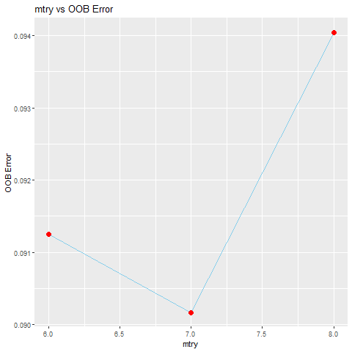
Results: Random Forest Tuning
Chosen Value: 7

Slide 15
Results: Metrics
Model | Test Error | Balanced f1 | NoTobacco f1 | YesTobacco f1
tree | 0.11194 | 0.264472 | 0.940239 | 0.117647
bagging | 0.109453 | 0.285314 | 0.941255 | 0.2
random_forest | 0.110075 | 0.265174 | 0.941294 | 0.119403

Slide 16
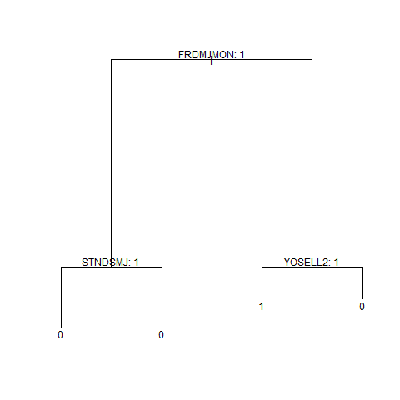
Results: Feature Importance
Bagging Variable Importance:
Feature | Gini Improvement
EDUSCHGRD2_T | 97.4475
NEWRACE2 | 67.59912
HEALTH2 | 60.9783
INCOME | 44.50357
FRDMJMON | 41.43099
YFLMJMO | 33.52151
YOSELL2 | 32.2252

Slide 17
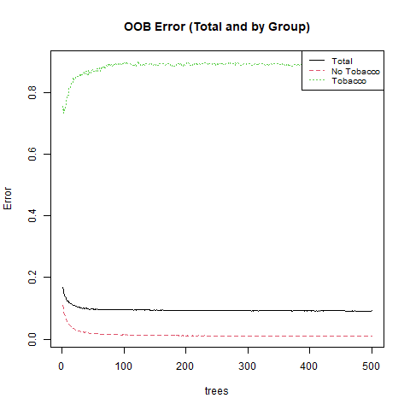
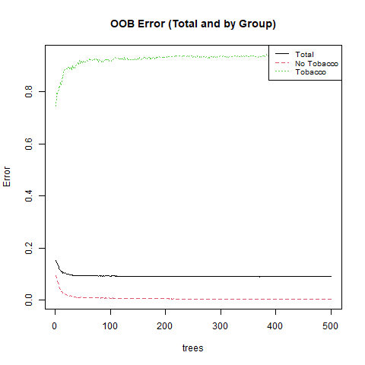
Error vs N-trees for bagging (left) and random forest (right)
Notes:
Error Rate Is very high for the tobacco users in both models. It is slightly better with smaller ensemble sizes but then overall error, and error for nonusers suffers. This may be worth the tradeoff if it is not just luck, given that it is likely more important to detect the smokers accurately.

Slide 18
Problem 2: Can NSDUH data predict whether a youth has had alcohol never, seldom, or more often over the past year?

Slide 19
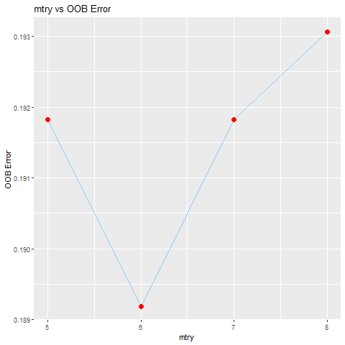
Results: Random Forest Tuning
Chosen Value: 6

Slide 20
Results: Metrics
Model | Test Error | Balanced F1 | Medium Use F1 | Low Use F1 | High Use F1
tree | 0.196517 | 0.099004 | 0 | 0.891034 | 0
pruned_tree | 0.196517 | 0.099004 | 0 | 0.891034 | 0
random_forest | 0.067786 | 0.137292 | 0.2 | 0.900494 | 0.135135

Slide 21
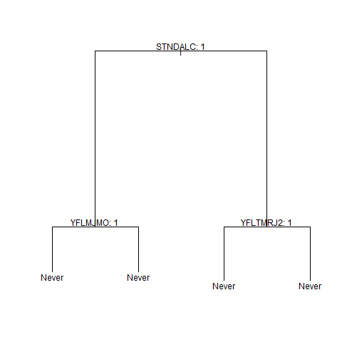
Results: Feature Importance
Feature | Moderate/Often | Never | Seldom | Gini Improvement
EDUSCHGRD2_T | 10.87651 | 9.612343 | 8.636564 | 147.9477
NEWRACE2 | 0.429546 | 8.30367 | 2.047458 | 88.82681
STNDALC | 24.5962 | 28.42077 | 14.85239 | 83.76328
HEALTH2 | 3.481492 | 2.04633 | -1.57251 | 73.74942
EDUSKPCOM_T | 1.178549 | 3.674957 | -1.35792 | 58.65024
INCOME | 3.447175 | 10.43357 | 2.645908 | 58.23583

Slide 22
Problem 3: Can NSDUH data predict the number of days a youth used marijuana in the past year?

Slide 23
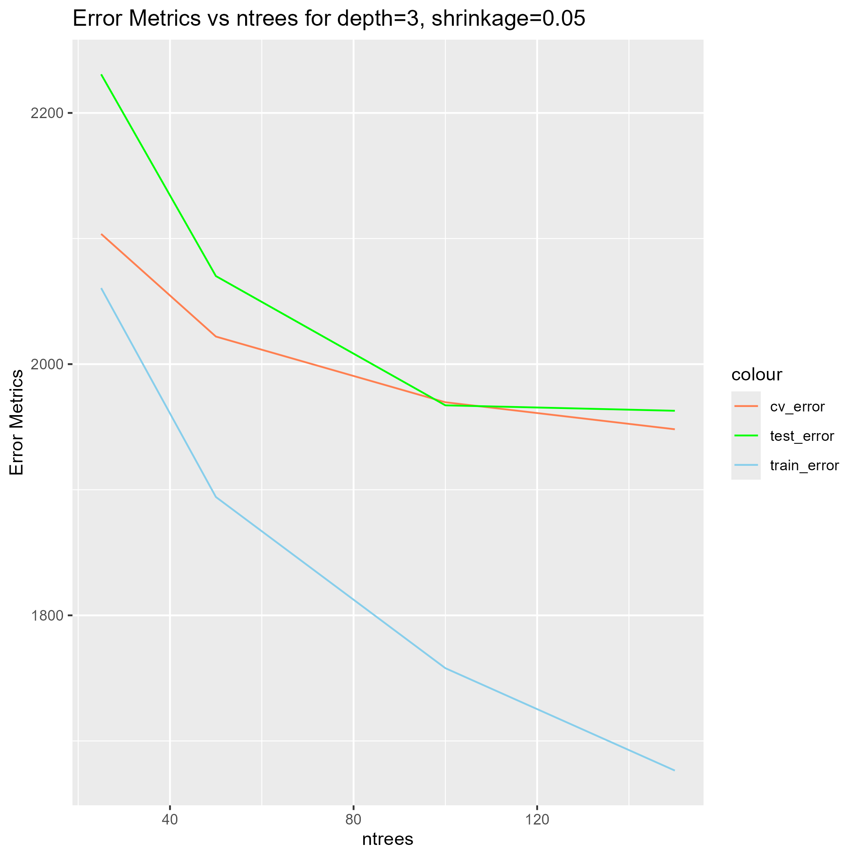
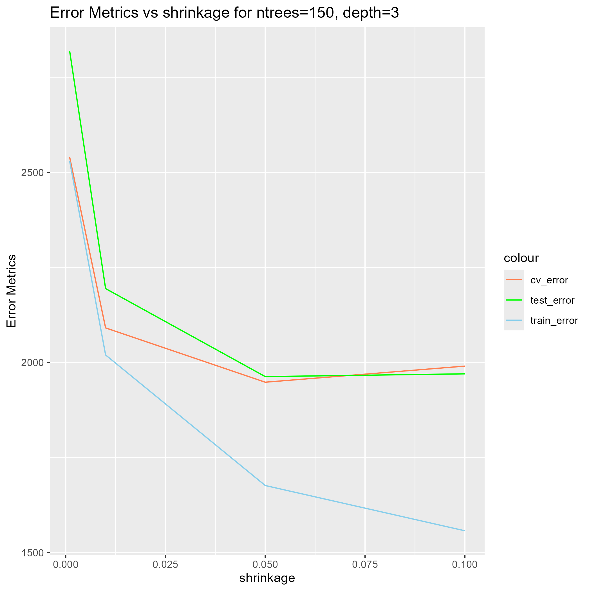
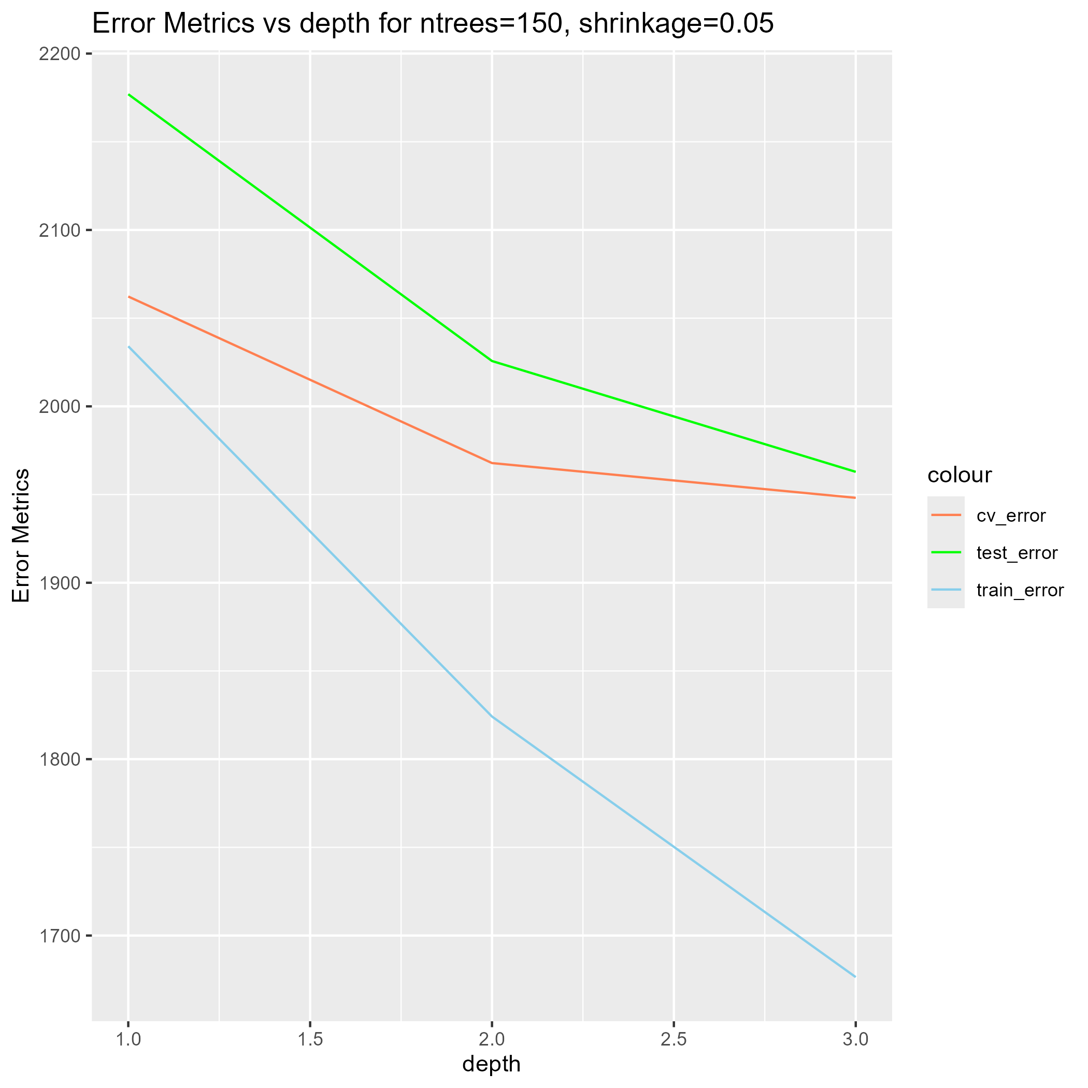
Results: Boosted Ensemble Tuning
Best Params based on Test MSE: (B, λ, D) = (150, 0.05, 3)

Slide 24
Results: Metrics
Model | Test MSE | Log Transformed Response?
tree | 2101.54 | FALSE
pruned_tree | 2132.539 | FALSE
tree | 2942.799 | TRUE
pruned_tree | 3232.882 | TRUE
boosting | 1976.785 | FALSE
boosting | 3199.137 | TRUE

Slide 25
Results: Feature Importance
Feature | Relative Influence
YOSELL2 | 15.18155
FRDMJMON | 13.81026
STNDSMJ | 8.434671
EDUSCHGRD2_T | 6.978973
PRMJMO | 6.18905
YFLMJMO | 6.172565
YOSTOLE2 | 5.441146

Slide 26
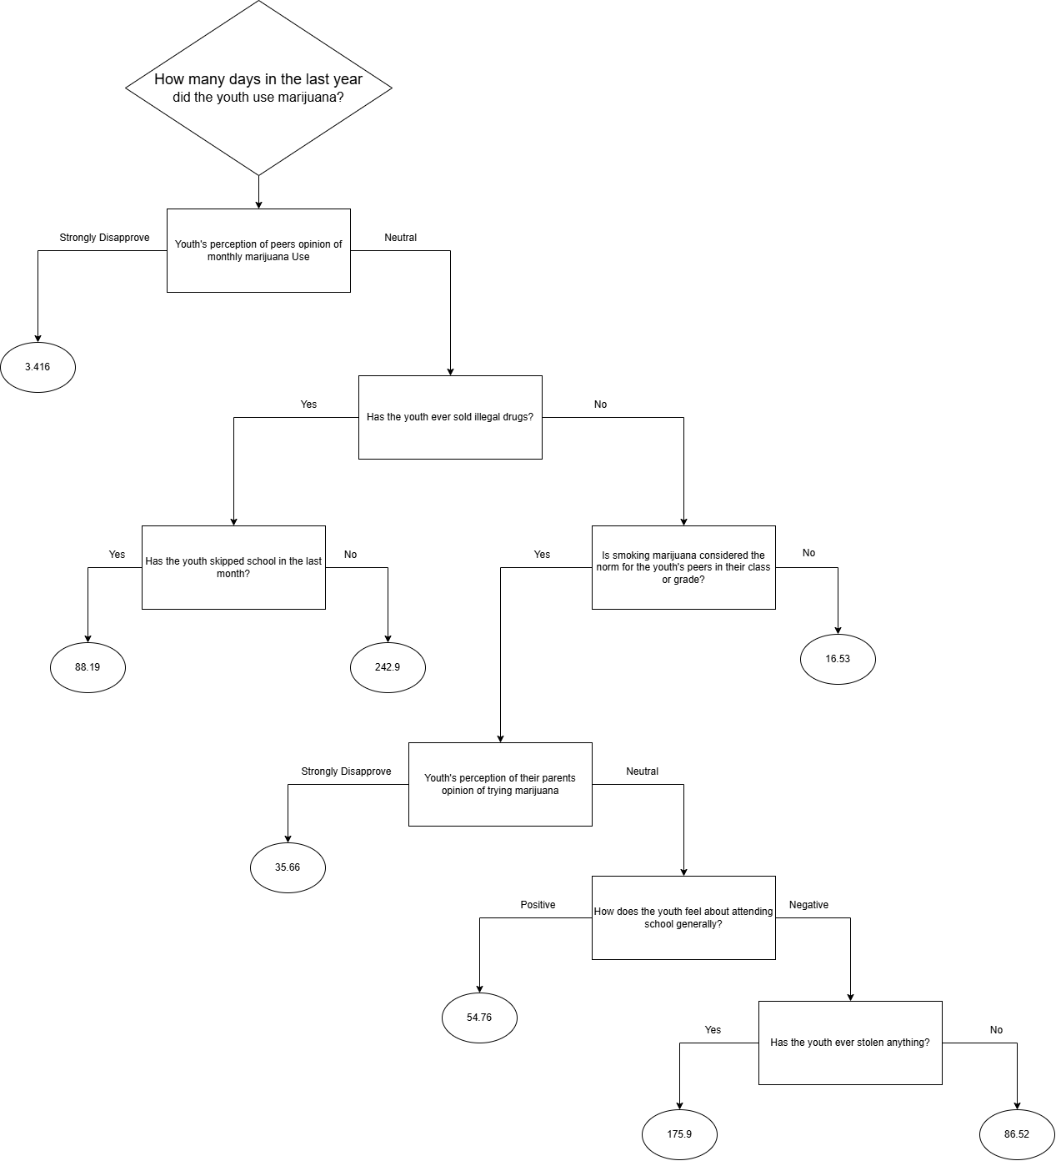
A youth:
=> Whose peers do no feel strongly about monthly marijuana use
=> Who has not sold drugs
=> Whose peers often use marijuana
=> Whose parents are not strongly against marijuana use
=> Who feels poorly about school
=> And who has stolen before
=> Predicted use is very high, 176/365
Notes:
Some Odd Things:
- A youth who has sold drugs is predicted to have higher usage if they did not skip school than if they did. This is likely a fluke, but a possible explanation could be that someone who both sells drugs and stays in school may have greater resources at home that help them both stay in school and afford more marijuana. This would require further exploration. It is also interesting in light of the fact that the later slit on the youth’s feelings about school suggests that negative feeling about school might generally be correlated with higher usage. Drug dealers may be outliers, with could be affecting the results.

Slide 27
Further Discussion: Choosing the Response
Predicting on the categorical versions depends on class imbalance
Can give a general idea of usage
May be more appropriate when classes result in more balance than the numeric version
Reducing number of classes may reduce class imbalance
Prediction on a numeric response depends in part on normality
Still can only predict a discrete set of values, unlike a linear model

Slide 28
Further Discussion: Variable Importance
Race as a predictor:
Important to models in part 1 and 2
Correlation is not causation
Use of race may lead to discrimination or bias feedback loop
Criminal history as a predictor:
Likely a causation link → may be useful
Could lead to a feedback loop

Slide 29
References
[1] Center for Behavioral Health Statistics and Quality. (2024). 2023 National Survey on Drug Use and Health (NSDUH), Substance Abuse and Mental Health Services Administration. Rockville, MD
[2] Center for Behavioral Health Statistics and Quality. (2024). 2023 National Survey on Drug Use and Health Public Use File Codebook, Substance Abuse and Mental Health Services Administration. Rockville, MD
[3] Mendible, Ariana. (2025). 5322 [source code]. GitHub. https://github.com/mendible/5322
[4] R Core Team (2025). R: A language and Environment for Statistical Computing. R Foundation for Statistical Computing, Vienna, Austria. https://www.R-project.org
[5] Wickham H, Averick M, Bryan J, Chang W, McGowan LD, François R, Grolemund G, Hayes A, Henry L, Hester J, Kuhn M, Pedersen TL, Miller E, Bache SM, Müller K, Ooms J, Robinson D, Seidel DP, Spinu V, Takahashi K, Vaughan D, Wilke C, Woo K, Yutani H (2019). “Welcome to the tidyverse.” Journal of Open Source Software, 4(43), 1686. doi:10.21105/joss.01686.

Slide 30
References
[6] Ripley, B.D. (2023). Tree: Classification and Regression Trees. R package version 1.0-43.
https://CRAN.R-project.org/package=tree
[7] Liaw A, Wiener M (2002). “Classification and Regression by randomForest.” R News, 2(3), 18-22.
https://CRAN.R-project.org/doc/Rnews/.
[8] Ridgeway, G., Greenwell, B., Boehmke, B., GBM Developers. (2024). gbm: Generalized Boosted Regression Models. R package version 2.2.2. https://CRAN.R-project.org/package=gbm
[9] James, G. , Witten, D., Hastie, T., Tibshirani, R. (2023). An Introduction to Statistical Learning with Applications in R. Springer https://www.statlearning.com

