Slide 1
Predicting Substance Usage
Studying youth data from the
National Survey on Drug Use and Health (NSDUH)
2023 [1]

Slide 2
Overview: Data
A little more than 10,000 records
Mostly categorical data with more or less meaningful codes [2]
Youth responses to NSDUH 2023, filtered [3]
Gives insight into social, demographic, and behavioral factors that may be related to drug use
As marijuana products are easily available and smokeless tobacco products make it easier in some ways for child usage to go undetected:
Can other data be used to identify youths who may be at higher risk to inform usage of limited outreach and health resources?

Slide 3
Overview: Methods
Simple trees for comparison and interpretability
Bagging improves the result by reducing variance (resampling)
Random Forest takes it one step further
Randomly limiting the features considered limits outsized effects during training
Penalizing complexity through number consider => more general
Boosted Tree Ensemble:
Also penalizes complexity through learning rate, interaction depth, and ensemble size
Adds idea that trees should focus on the relationships missed by previous trees, training on the residuals and weighting by contribution
Powerful, but prone to over-fitting in ensemble size
Tools: R [4], tidyverse [5], tree [6], randomForest [7], gbm [8]

Slide 4
Missing Data
Codes that did not represent legitimate question skips marked NA
Initial Chi-Squared and Kolmogorov-Smirnov tests suggest possible differences in IRALCFY, IRALCAGE, and ALCYDAYS after cleaning, but…
Histograms and Frequency Charts show little discernible difference
Kolmogorov-Smirnov can be unreliable for non-interval variables
Notes:
While the data was largely cleaned by Professor Mendible, there was were still some missing data as well as some codes that were not very useful. Within the demographic data,
KS P-vals:

Slide 5
Data Transformations
Substance use codes that mean zero use => zero
91, 93, 991, 993,
5, 6
Demographic codes that are not useful => NA
Treating days of school skipped and grade as categorical

Slide 6
Can NSDUH data predict whether a youth has ever used tobacco products?

Slide 7
Results
Tree:
Error Rate: 0.112
Pruned Tree assigned all to never-smoker status
Bagging:
Error Rate: 0.109
Slightly more nuance but error rate for smokers still high
Random Forest:
Error Rate: 0.11
M-features retained chosen as 7, but varies
Still fails to reliably identify smokers

Slide 8
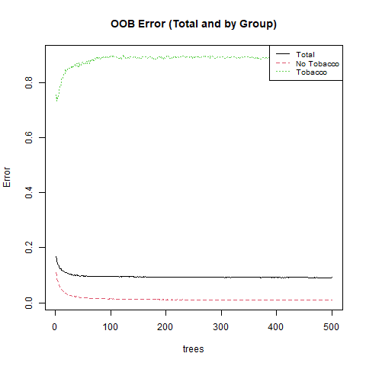
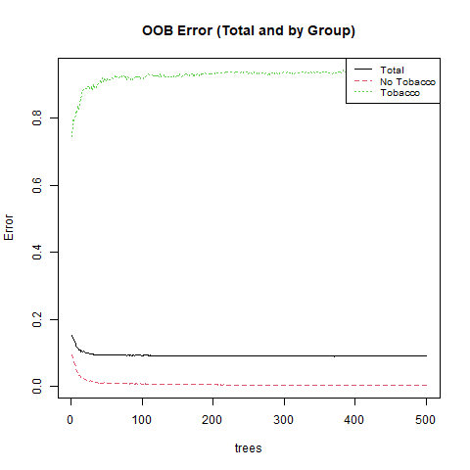
Error vs N-trees for bagging (left) and random forest (right)
Notes:
Error Rate Is very high for the tobacco users in both models. It is slightly better with smaller ensemble sizes but then overall error, and error for nonusers suffers. This may be worth the tradeoff if it is not just luck, given that it is likely more important to detect the smokers accurately.

Slide 9
Can NSDUH data predict whether a youth has had alcohol never, seldom, or more often over the past year?

Slide 10
Results
Tree:
Error Rate: 0.081
Both pruned and full tree assign all never-smoker status
Random Forest:
Error Rate: 0.068
M-features retained chosen as 6, but varies
Similarly, as ensemble size increases, smoker error gets close to 1
* Use of gbm in R not appropriate as no multinomial version exists

Slide 11
Can NSDUH data predict the number of days a youth used marijuana in the past year?

Slide 12
Model Results
Tree:
MSE: 2101.54
Much more interesting full and pruned decision tree
Boosted Tree Ensemble:
MSE: 1991.95, CV.Error: 1944.25, Train MSE: 1759.4
Chosen Parameters:
Ensemble Size: 100
Depth: 3
Shrinkage: 0.05

Slide 13
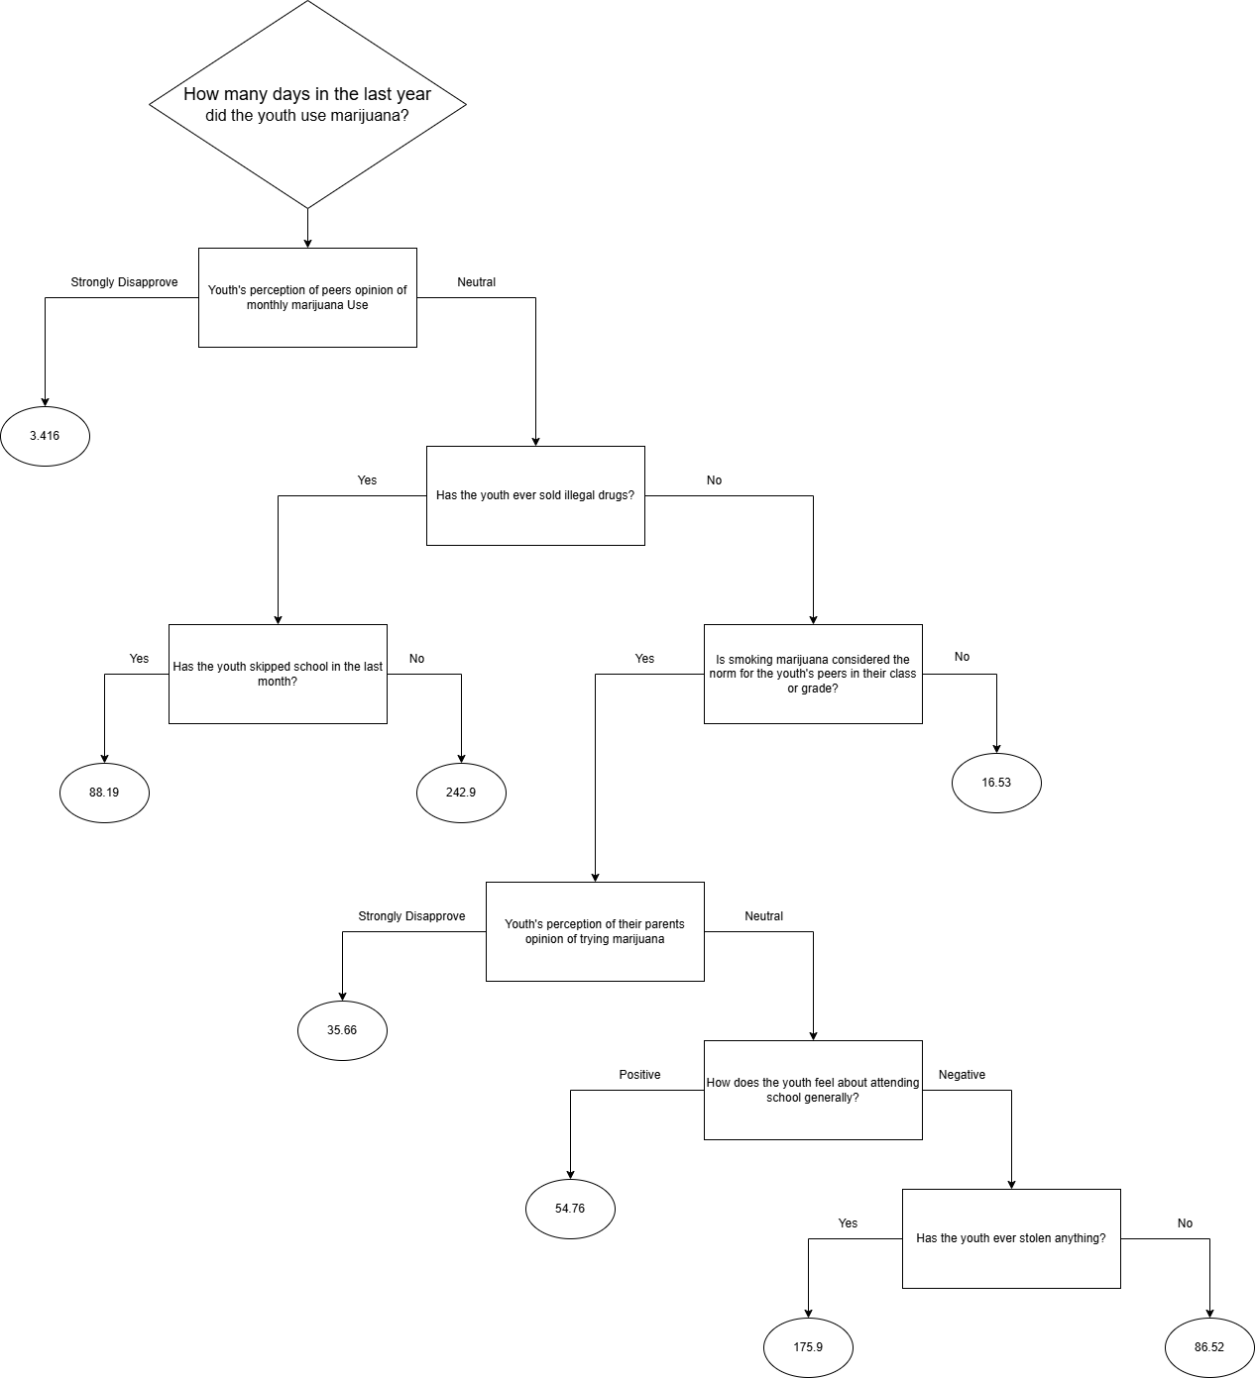
A youth:
=> Whose peers do no feel strongly about monthly marijuana use
=> Who has not sold drugs
=> Whose peers often use marijuana
=> Whose parents are not strongly against marijuana use
=> Who feels poorly about school
=> And who has stolen before
=> Predicted use is very high, 176/365
Notes:
Some Odd Things:
- A youth who has sold drugs is predicted to have higher usage if they did not skip school than if they did. This is likely a fluke, but a possible explanation could be that someone who both sells drugs and stays in school may have greater resources at home that help them both stay in school and afford more marijuana. This would require further exploration. It is also interesting in light of the fact that the later slit on the youth’s feelings about school suggests that negative feeling about school might generally be correlated with higher usage. Drug dealers may be outliers, with could be affecting the results.

Slide 14
What Features are Important?
With the exception of the boosting model in problem 3, a number of features maintain relative importance between the other models: grade, race, health level, income level, perception of peers and ones own opinion on marijuana, the sale of drugs, skipping school, poverty status, county population level, the ubiquity of marijuana use, history of theft, and census area population level
For the boosting model: Some of the same features were important, but in a different order.
History of selling drugs, opinion of peers, and ubiquity of use , most important

Slide 15
Conclusion
The models had some success, with ensemble methods obtaining fairly low test error each of the problems. However, the bagging and random forest methods tended to have very high error for users in problem one and seldom users in problem 2. To a degree, error was also high for the heavy users in problem 2. These are just the sort of youth we want to detect, limiting the usefulness of the models. Still some interesting factors were identified. Social pressures appear to have a major impact or relationship worth looking into. It’s also worth exploring difference in urban and rural areas, and in economic groups.

Slide 16
Limitations and Future Exploration
Models may benefit from over and undersampling skewed data
More data about the feelings of students towards various social issues might be interesting: perhaps data from social media could be used to gain further insights to tune the models
More rigorous testing is required to ensure proper treatment of missing data codes, since ALCYDAYS was used as a target

Slide 17
References
[1] Center for Behavioral Health Statistics and Quality. (2024). 2023 National Survey on Drug Use and Health (NSDUH), Substance Abuse and Mental Health Services Administration. Rockville, MD
[2] Center for Behavioral Health Statistics and Quality. (2024). 2023 National Survey on Drug Use and Health Public Use File Codebook, Substance Abuse and Mental Health Services Administration. Rockville, MD
[3] Mendible, Ariana. (2025). 5322 [source code]. GitHub. https://github.com/mendible/5322
[4] R Core Team (2025). R: A language and Environment for Statistical Computing. R Foundation for Statistical Computing, Vienna, Austria. https://www.R-project.org
[5] Wickham H, Averick M, Bryan J, Chang W, McGowan LD, François R, Grolemund G, Hayes A, Henry L, Hester J, Kuhn M, Pedersen TL, Miller E, Bache SM, Müller K, Ooms J, Robinson D, Seidel DP, Spinu V, Takahashi K, Vaughan D, Wilke C, Woo K, Yutani H (2019). “Welcome to the tidyverse.” Journal of Open Source Software, 4(43), 1686. doi:10.21105/joss.01686.

Slide 18
References
[6] Ripley, B.D. (2023). Tree: Classification and Regression Trees. R package version 1.0-43.
https://CRAN.R-project.org/package=tree
[7] Liaw A, Wiener M (2002). “Classification and Regression by randomForest.” R News, 2(3), 18-22.
https://CRAN.R-project.org/doc/Rnews/.
[8] Ridgeway, G., Greenwell, B., Boehmke, B., GBM Developers. (2024). gbm: Generalized Boosted Regression Models. R package version 2.2.2. https://CRAN.R-project.org/package=gbm

