Slide 1
Analyzing America’s War Zone
Anna Yanchenko, Lei Qian, Megan Robertson, and Reuben McCreanor
STA 644 Final Project

Slide 2

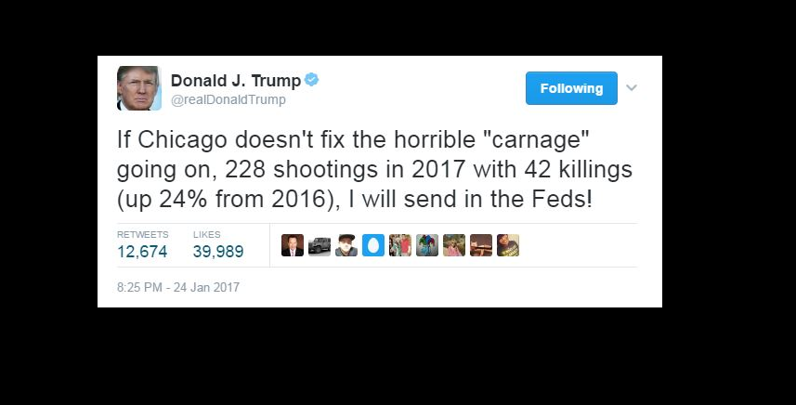
Is Chicago a War Zone?
4,367 shooting victims in 2016
735 homicides

Slide 3
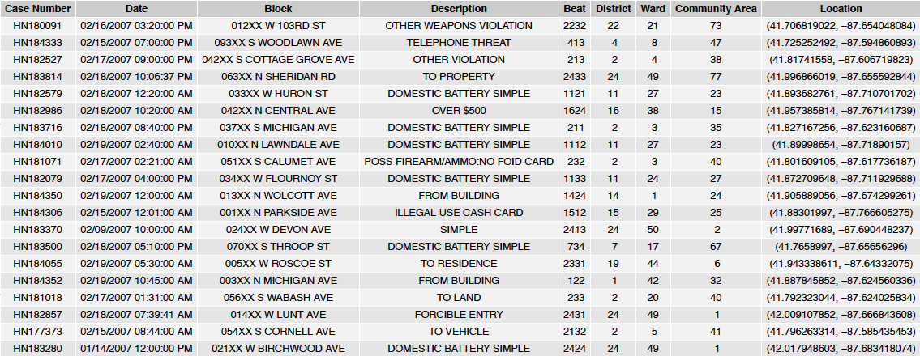
Data Sources

Slide 4
Images
Trump – https://tribwgntv.files.wordpress.com/2017/01/twwet.png
Chi-raq https://upload.wikimedia.org/wikipedia/en/thumb/e/e7/ChiRaqMoviePoster.png/220px-ChiRaqMoviePoster.png
Communities - https://upload.wikimedia.org/wikipedia/commons/thumb/2/24/Map_of_the_Community_Areas_and_%27Sides%27_of_the_City_of_Chicago.svg/350px-Map_of_the_Community_Areas_and_%27Sides%27_of_the_City_of_Chicago.svg.png

Slide 5
ARIMA Modeling
A time series analysis of crime data

Slide 6
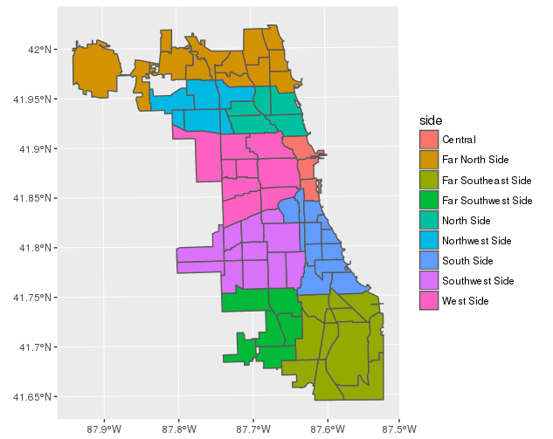
“Sides” of Chicago

Slide 7
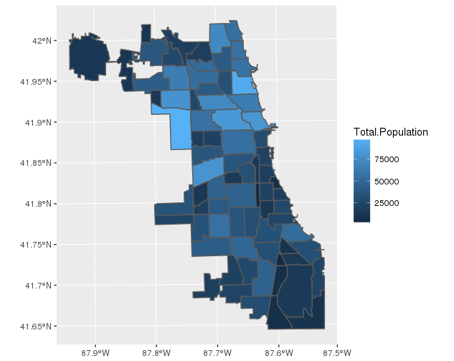
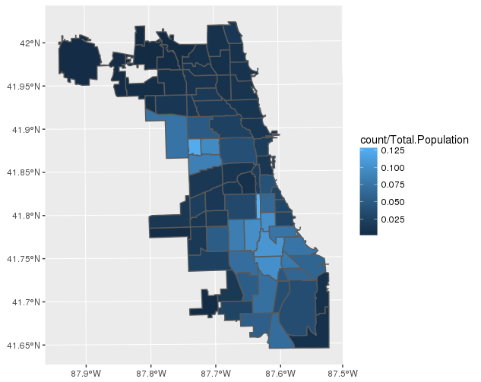
“Sides” of Chicago, cont.

Slide 8
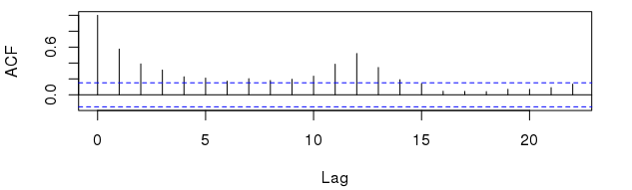
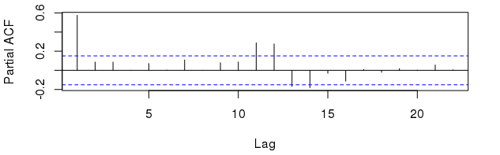
South Side

Slide 9
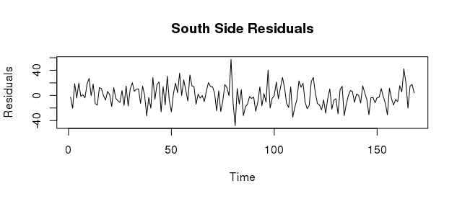
South Side – ARIMA(4,0,0)x(1,0,0)[12]

Slide 10
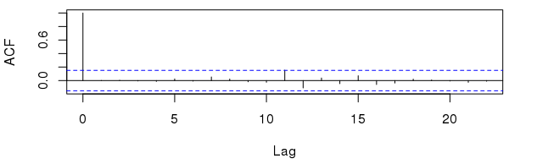
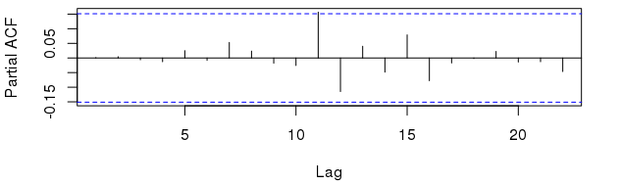
South Side - ARIMA(4,0,0)x(1,0,0)[12], cont.

Slide 11
Bayesian Regression Modeling
A spatial analysis of crime data

Slide 12
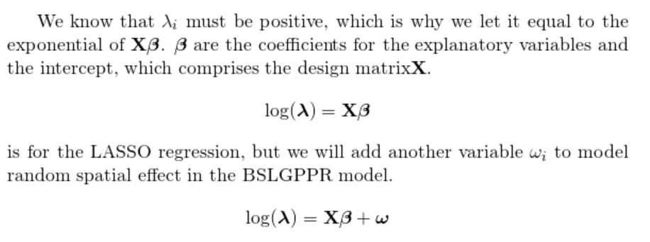
Poisson Likelihood Model

Slide 13
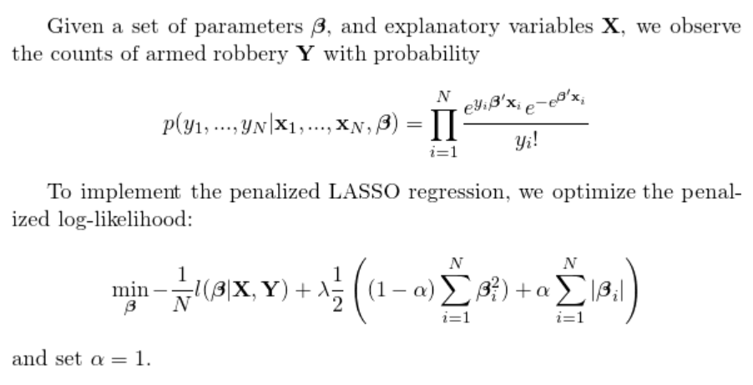
LASSO Regression Model

Slide 14
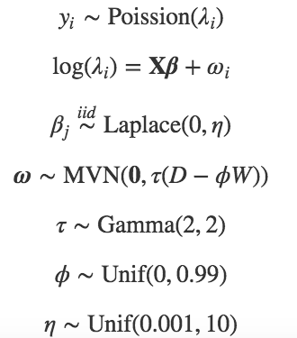
Penalized Spatial Regression Model

Slide 15
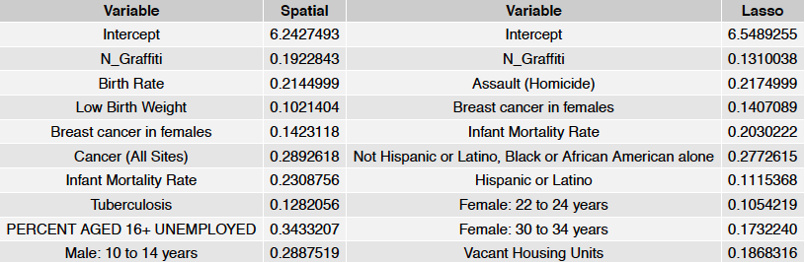
Results

Slide 16
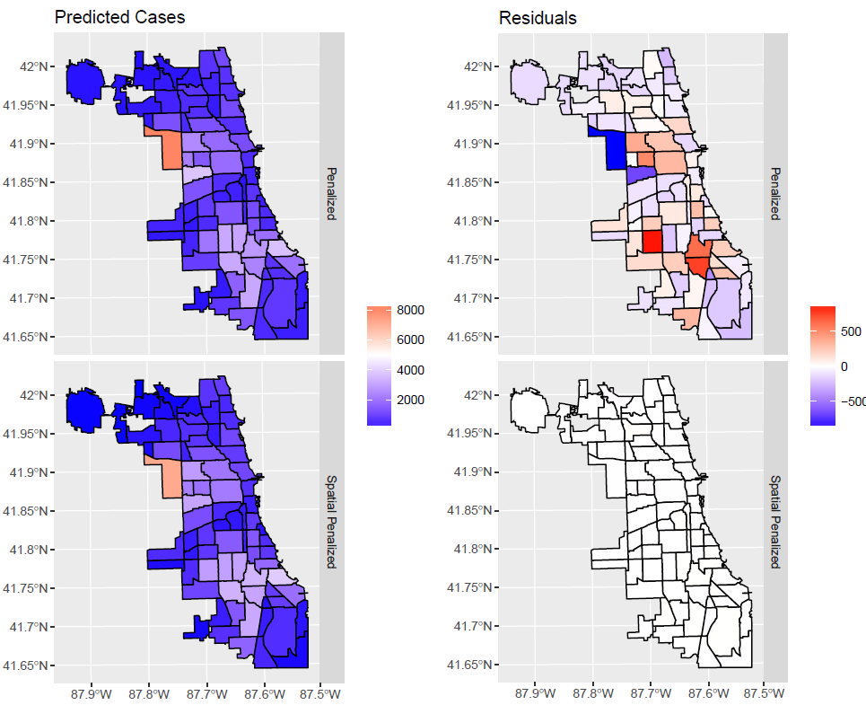
RMSE Values
Spatial | 3.65
LASSO | 252.43
Moran’s I
Spatial | 0.51

Slide 17
Conclusions
Temporal trends similar across city “sides”
Strong yearly and autoregressive trends

Slide 18
Next Steps
Trump – https://tribwgntv.files.wordpress.com/2017/01/twwet.png
Chi-raq https://upload.wikimedia.org/wikipedia/en/thumb/e/e7/ChiRaqMoviePoster.png/220px-ChiRaqMoviePoster.png
Communities - https://upload.wikimedia.org/wikipedia/commons/thumb/2/24/Map_of_the_Community_Areas_and_%27Sides%27_of_the_City_of_Chicago.svg/350px-Map_of_the_Community_Areas_and_%27Sides%27_of_the_City_of_Chicago.svg.png

