Slide 1
Analyzing America’s War Zone
Anna Yanchenko, Lei Qian, Megan Robertson, Reuben McCreanor
STA 644 Final Project

Slide 2

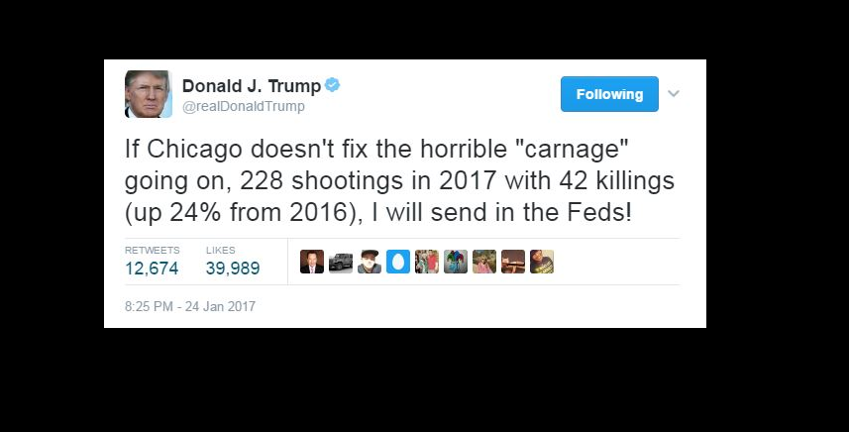
Is Chicago a war zone?
4,367 shooting victims in 2016
735 homicides

Slide 3
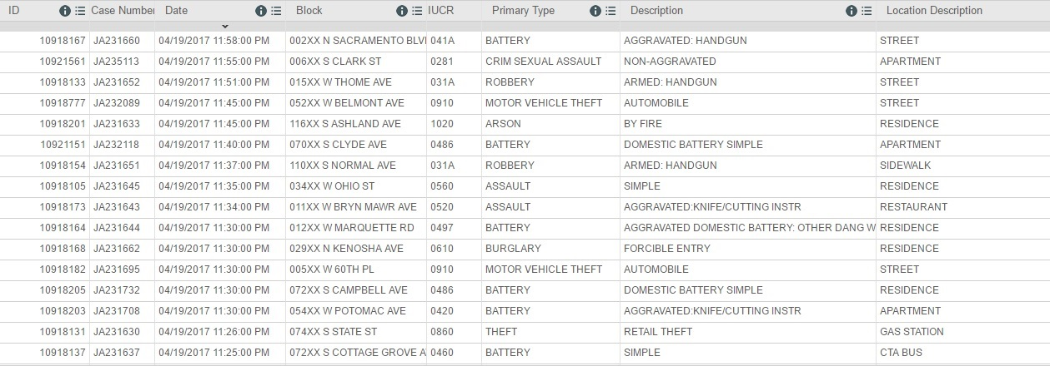
Data Sources

Slide 4
ARIMA Modeling

Slide 5
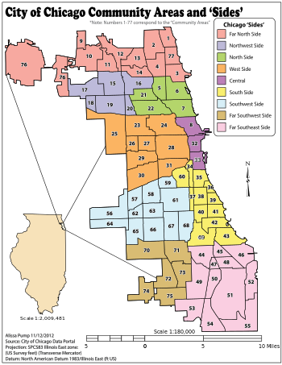

Slide 6
Images
Trump – https://tribwgntv.files.wordpress.com/2017/01/twwet.png
Chi-raq https://upload.wikimedia.org/wikipedia/en/thumb/e/e7/ChiRaqMoviePoster.png/220px-ChiRaqMoviePoster.png
Communities - https://upload.wikimedia.org/wikipedia/commons/thumb/2/24/Map_of_the_Community_Areas_and_%27Sides%27_of_the_City_of_Chicago.svg/350px-Map_of_the_Community_Areas_and_%27Sides%27_of_the_City_of_Chicago.svg.png

