Slide 1
Analyzing America’s War Zone
Anna Yanchenko, Lei Qian, Megan Robertson, and Reuben McCreanor
STA 644 Final Project

Slide 2

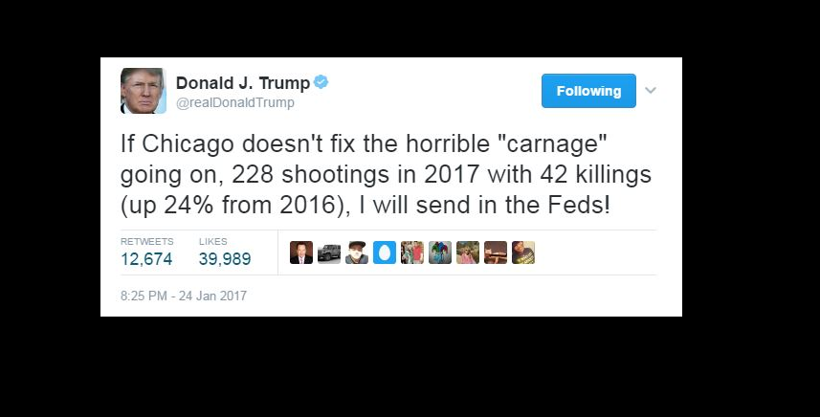
Is Chicago a War Zone?
4,367 shooting victims in 2016
735 homicides

Slide 3
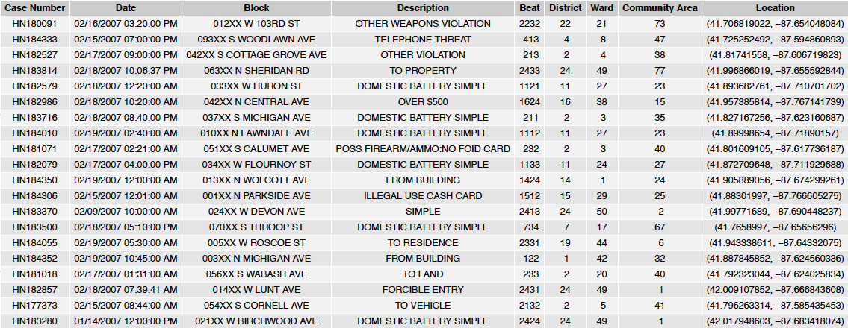
Data Sources

Slide 4
Data Sources
Affordable Rental Housing Developments
Census Data – Selected socioeconomic indicators
Average Electricity Usage per Square Foot
Average Gas Usage
Public Health Statistics
Vacant Properties
Graffiti Removal
2010 Census Data

Slide 5
ARIMA Modeling
A time series analysis of crime data

Slide 6
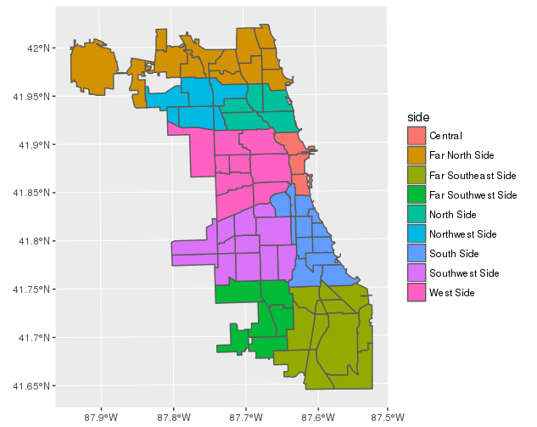
Sides of Chicago – Split by Area

Slide 7
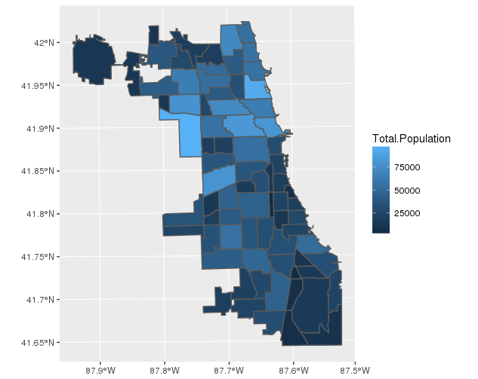
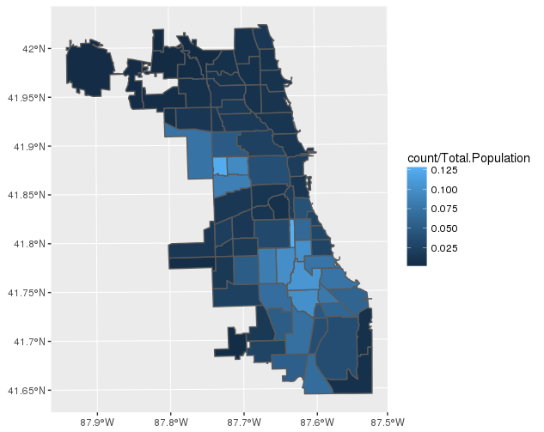
Armed Robberies by Area

Slide 8
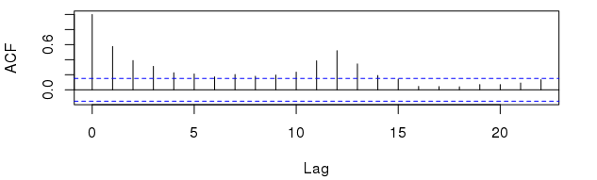
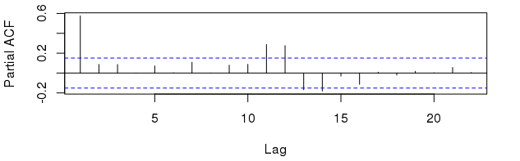
South Side

Slide 9
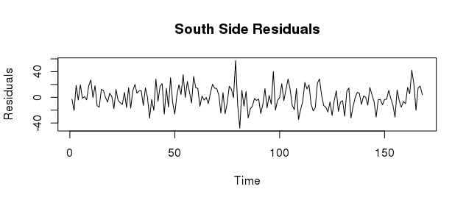
South Side – ARIMA(4,0,0)x(1,0,0)[12]

Slide 10
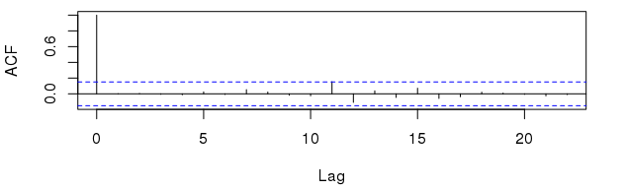
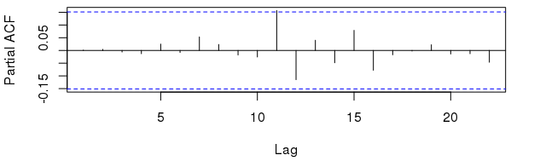
South Side - ARIMA(4,0,0)x(1,0,0)[12], cont.

Slide 11
Bayesian Regression Modeling
A spatial analysis of crime data

Slide 12
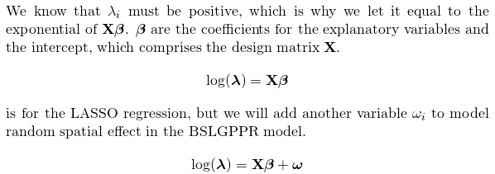
Poisson Likelihood Model

Slide 13
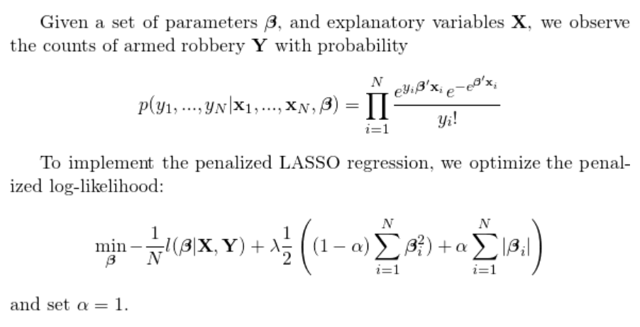
LASSO Regression Model

Slide 14
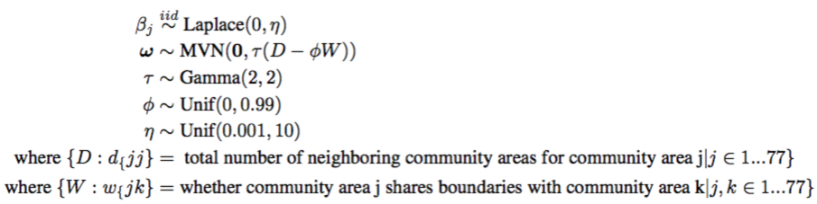
Penalized Spatial Regression Model

Slide 15
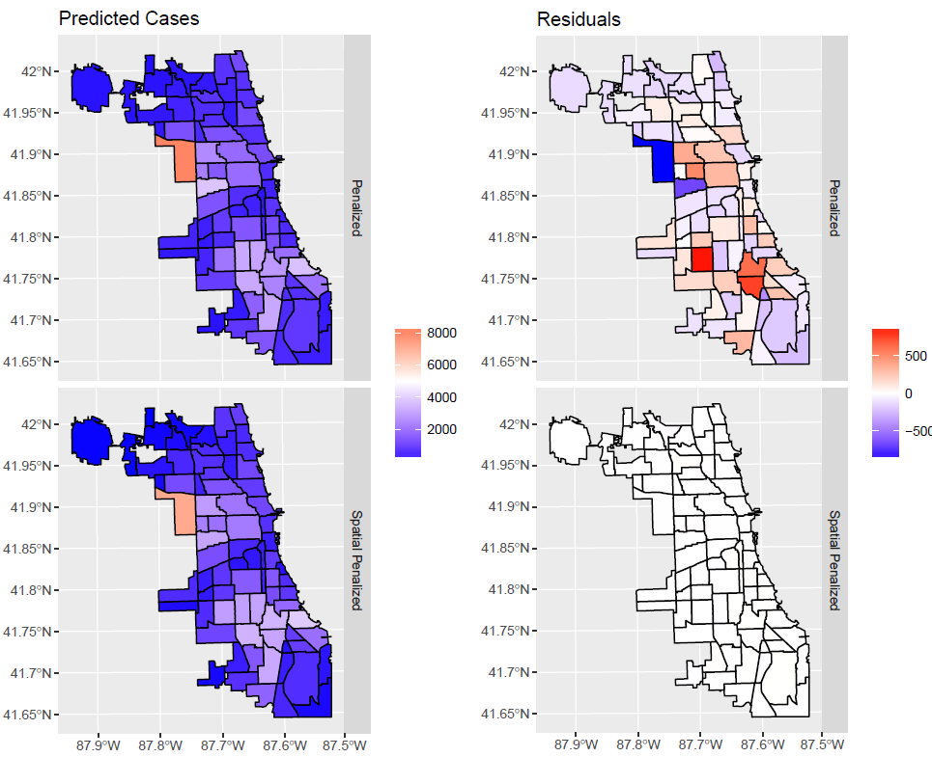
RMSE Values
Spatial | 3.65
LASSO | 252.43
Moran’s I
Spatial | 0.51

Slide 16
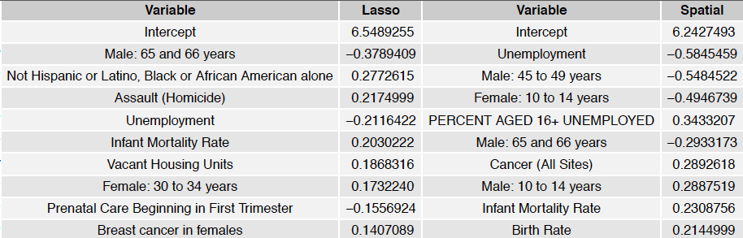
Results

Slide 17
References
City of Chicago, “Affordable Rental Housing Developments", City of Chicago Open Data Project https://data.cityofchicago.org/Community-Economic-Development/Affordable-Rental-Housing-Developments/s6ha-ppgi , May 2017.
City of Chicago, “Average Gas Usage per Square Foot by Community Area 2010”City of Chicago Open Data Project, https://data.cityofchicago.org/Service-Requests/311-Service-Requests-Graffiti-Removal/hec5-y4x5, May 2017.
City of Chicago, “Census Data - Selected socioeconomic indicators in Chicago, 2008 to 2012", City of Chicago Open Data Project, https://data.cityofchicago.org/Health-Human-Services/Census-Data-Selected-socioeconomic-indicators-in-C/kn9c-c2s2, May 2017.
CMAP Data Hub, “2010 Census Data Summarized to Chicago Community Area", Chicago Metropolitan Agency for Planning, https://datahub.cmap.illinois.gov/dataset/2010-census-data-summarized-to-chicago-community-areas/resource/b30b47bf-bb0d-46b6-853b-47270fb7f626?inner_span=True, May 2017.
Papachristos, Andrew V., ``48 Years of Crime in Chicago: An Analysis of of Serious Crime Trends from 1965-2013", http://isps.yale.edu/sites/default/files publication2013/12/48yearsofcrime_final_ispsworkingpaper023.pdf}, December 2013.
Pearson, Rick, ``Trump Again Assails Chicago gun violence in speech to Congress", Chicago Tribune, http://www.chicagotribune.com/news/local/politics/ct-donald-trump-congress-speech-chicago-met-20170228-story.html, March 2017.

