Slide 1
Analyzing America’s War Zone
Anna Yanchenko, Lei Qian, Megan Robertson, Reuben McCreanor
STA 642 Final Project

Slide 2
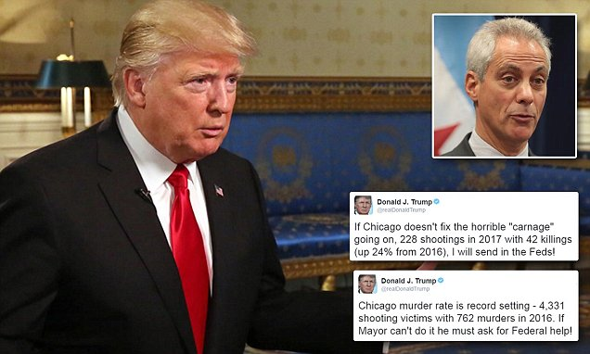
Is Chicago a war zone?

Slide 3
Title and Content Layout with Chart

Slide 4
Add a Slide Title - 1

