Slide 1
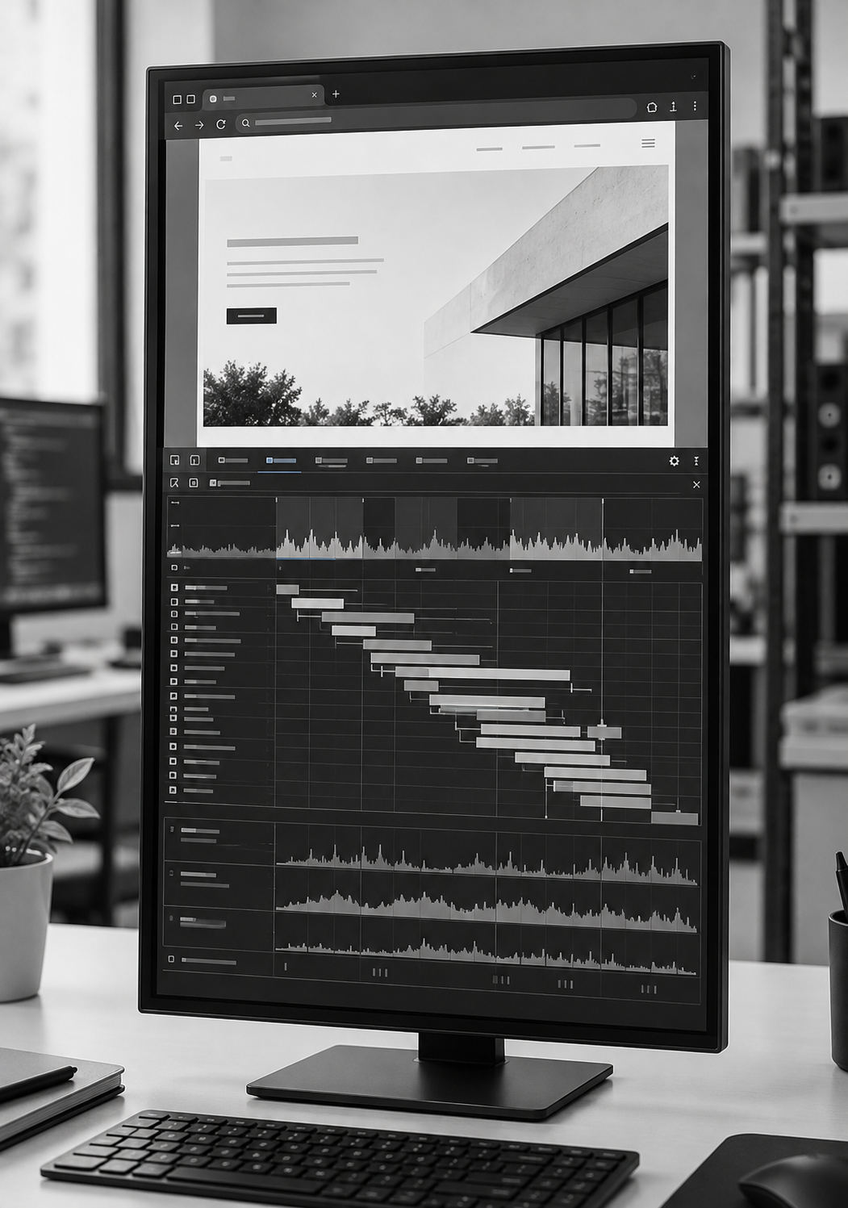
Research Proposal
November 2026
RELIABILITY OF
DELAYED WEBSITE OR
WEB APPLICATION
PERFORMANCE DIAGNOSIS
EEY6189
Research presentation
Literature review and
research proposal stage
Presented by
321424374
N. W. L. U. R. D. Nanayakkara
The Open University of Sri Lanka
Notes:
Delivery target: 15 seconds. Main talk total: 7 minutes. Allow approximately 5 minutes for panel questions within the 12-minute slot.
This research examines whether detailed profiling during a later browser visit can reliably explain an earlier slowdown. It is currently at the literature review and research proposal stage.
Source report: N. W. L. U. R. D. Nanayakkara, RELIABILITY OF DELAYED WEBSITE OR WEB APPLICATION PERFORMANCE DIAGNOSIS, final report, October 2026. Proposal-stage research.
Visual: Conceptual browser performance analysis on a desktop monitor. Illustrative only; not a study screenshot or measured result. Asset: browser-performance-monitor.png.

Slide 2
Introduction and background
Research Proposal Presentation
Repeated visits
Profilers revisit websites to establish baselines, detect changes and investigate slowdowns.
Condition | Original visit | Later visit
Login session | Expired session adds redirects | User is already authenticated
Image cache | Image requires a network request | Image is served from cache
Rendering | JavaScript delays image display | Main-thread activity has ended
A later profile may explain a different execution [1].
02
Notes:
Delivery target: 40 seconds. Main talk total: 7 minutes. Allow approximately 5 minutes for panel questions within the 12-minute slot.
Performance monitoring repeatedly visits the same website to learn its usual behavior and investigate changes. However, an expired login session may cause redirects on the first visit, while the user is authenticated on the next. An image may need a network request initially but later come from cache. JavaScript may delay the display of an image that has already loaded, then finish before profiling begins. These examples explain why another visit may offer different evidence. Repeated visits therefore motivate a reliability measure for diagnosis of the original episode.
Panel detail
Login and cache examples motivate the research. Authentication and cache manipulation are outside FP-0.1. The pilot uses controlled resource-loading and main-thread faults. Vesper discusses possible cross-load differences but observed no different functional state in its tested corpus.
Source report: N. W. L. U. R. D. Nanayakkara, RELIABILITY OF DELAYED WEBSITE OR WEB APPLICATION PERFORMANCE DIAGNOSIS, final report, October 2026. Proposal-stage research.
References
[1] R. Netravali, V. Nathan, J. Mickens and H. Balakrishnan, “Vesper: Measuring Time-to-Interactivity for Web Pages,” in Proc. NSDI, 2018, pp. 217–231. https://www.usenix.org/conference/nsdi18/presentation/netravali-vesper (Zotero HS3PKWFL).

Slide 3
Problem statement
Research Proposal Presentation
Research question
The original cause may disappear, persist or be replaced before detailed profiling begins.
RESEARCH QUESTION
How does detailed follow-up profiling compare with retained original-visit evidence in identifying an earlier regression’s cause, under matched resource limits and the same diagnosis deadline?
Application: performance monitoring and resource-use estimation with limited collection and storage budgets.
03
Notes:
Delivery target: 40 seconds. Main talk total: 7 minutes. Allow approximately 5 minutes for panel questions within the 12-minute slot.
The problem is a possible mismatch between the visit that experienced the slowdown and the visit used to explain it. The research question compares detailed follow-up profiling with evidence retained during the original visit, under matched resource limits and a common diagnosis deadline. The target is correct identification of the earlier cause. This can inform performance-monitoring and resource-use estimation projects that need to balance diagnostic accuracy and reliability against collection and storage cost. A later profile may remain useful when the original fault persists.
Source report: N. W. L. U. R. D. Nanayakkara, RELIABILITY OF DELAYED WEBSITE OR WEB APPLICATION PERFORMANCE DIAGNOSIS, final report, October 2026. Proposal-stage research.

Slide 4
Evidence and research gap
Research Proposal Presentation
Literature review
Source | Established finding | Boundary relevant to this study
Vesper [1] | Heavy discovery followed by lighter browser measurement | Cross-load differences are possible. Later diagnosis may still succeed.
WebREC [2] | Archived web executions support later analysis | Browser buffer feasibility and endpoint coverage require evaluation.
Hindsight [3] | Bounded event retention with later retrieval | Browser event coverage and collection cost remain unestablished.
web-vitals [4] | Original-visit attribution provides diagnostic clues | Attribution signals require independent fault verification.
Proposed gap: original-cause attribution across visits, compared under explicit budgets, deadlines and independent fault labels.
04
Notes:
Delivery target: 55 seconds. Main talk total: 7 minutes. Allow approximately 5 minutes for panel questions within the 12-minute slot.
The literature establishes several mechanisms that this research will use. Vesper applies heavy discovery before lighter browser measurement, and discusses differences between page loads. Its tested corpus did not show different functional state. WebREC preserves web executions for later analysis. Hindsight demonstrates bounded event retention in distributed systems. The web-vitals library also provides legitimate diagnostic information from the original visit. Together, these sources show that profiling and evidence retention are established. The proposed contribution is a controlled comparison of original-cause attribution across browser visits, with independent labels and explicit resource limits. Novelty remains provisional because an equivalent study may exist.
Panel detail
WebREC is cited as arXiv v4, not as an assertion that every publication edition is identical. Vesper’s historical interactivity metric is not modern Interaction to Next Paint. Hindsight does not prescribe the pilot buffer size.
Source report: N. W. L. U. R. D. Nanayakkara, RELIABILITY OF DELAYED WEBSITE OR WEB APPLICATION PERFORMANCE DIAGNOSIS, final report, October 2026. Proposal-stage research.
References
[1] R. Netravali, V. Nathan, J. Mickens and H. Balakrishnan, “Vesper: Measuring Time-to-Interactivity for Web Pages,” in Proc. NSDI, 2018, pp. 217–231. https://www.usenix.org/conference/nsdi18/presentation/netravali-vesper (Zotero HS3PKWFL).
[2] F. Hantke, P. Snyder, H. Haddadi and B. Stock, “Web Execution Bundles: Reproducible, Accurate, and Archivable Web Measurements,” arXiv:2501.15911v4, 2025. doi:10.48550/arXiv.2501.15911. https://arxiv.org/abs/2501.15911v4 (Zotero ZZSL9IPU).
[3] L. Zhang, Z. Xie, V. Anand, Y. Vigfusson and J. Mace, “The Benefit of Hindsight: Tracing Edge-Cases in Distributed Systems,” in Proc. NSDI, 2023, pp. 321–339. https://www.usenix.org/conference/nsdi23/presentation/zhang-lei (Zotero 3ED3FDXH).
[4] GoogleChrome/web-vitals contributors, “web-vitals library: usage and attribution build,” version 5.1.0. [Online]. https://github.com/GoogleChrome/web-vitals/blob/v5.1.0/README.md. Accessed in report: Oct. 31, 2026 (Zotero N33VTKAN).

Slide 5
Study objectives
Research Proposal Presentation
Research objectives
O1
Define a repeatable measurement and visit protocol
O2
Build a website-specific dataset with verified fault labels
O3
Implement and compare feasible profiling strategies
O4
Evaluate diagnostic effectiveness and total monitoring cost
O5
Identify the conditions where delayed diagnosis is reliable
HYPOTHESIS H₁
For intermittent faults, retained original evidence yields a higher rate of correct diagnoses than follow-up profiling, within the same budget and deadline.
05
Notes:
Delivery target: 35 seconds. Main talk total: 7 minutes. Allow approximately 5 minutes for panel questions within the 12-minute slot.
The five objectives move from measurement design to evidence about reliability. First, the protocol must define what each visit measures. Next, the dataset must include independently verified causes. The strategies can then be compared, including their failures and full monitoring costs. Finally, the analysis will identify the conditions in which delayed diagnosis remains reliable. The hypothesis is that retained original evidence improves correct attribution for intermittent faults. The null hypothesis is that it does not improve that proportion under the same conditions.
Source report: N. W. L. U. R. D. Nanayakkara, RELIABILITY OF DELAYED WEBSITE OR WEB APPLICATION PERFORMANCE DIAGNOSIS, final report, October 2026. Proposal-stage research.

Slide 6
Methodology aligned with O1 and O2
Research Proposal Presentation
Protocol and dataset
Primary symptom: Largest Contentful Paint (LCP)
Fixed browser build, recorded state and distinct original/follow-up IDs
Design element | Proposed feasibility pilot
Two fixtures | Image-led page and script-built content on owned localhost sites
Two fault classes | 500 ms response delay, or approximately 500 ms of main-thread work
Eight scenarios | Controls plus persistent, transient and replaced-cause faults
Independent labels | Evaluator-only activity checks, hidden from diagnosis rules
64 matched blocks / 320 comparison originals / 2 fixture templates
06
Notes:
Delivery target: 55 seconds. Main talk total: 7 minutes. Allow approximately 5 minutes for panel questions within the 12-minute slot.
Objectives one and two will use a controlled longitudinal experiment. Largest Contentful Paint will be the primary symptom. The Chromium build, browser conditions and visit boundaries will be fixed and recorded. Each original visit and follow-up will have a separate identity. Two owned localhost fixtures will support both fault classes: a delayed critical resource response, and main-thread work that delays paint. The scenarios will cover persistence, disappearance and replacement by the other cause, with stable and nuisance controls. Hidden evaluator checks will verify whether the fault actually executed. The proposed allocation gives 64 matched blocks and 320 comparison originals, but still only two fixture templates. The allocation will assess feasibility. It does not represent a population of websites.
Panel detail
Largest Contentful Paint, or LCP, is the primary pilot symptom. The image-led fixture and script-built fixture both support both faults. CPU rate 2 supplies the nuisance condition. There are 2 fixtures × 8 scenarios × 4 repetitions = 64 blocks, with 5 separate strategy executions per block. Eligibility requires independent execution and endpoint-applicability verification, not an alert or successful capture. All attempts and costs will be retained. Authentication, service workers, live sites and multiple browsers are excluded from FP-0.1.
Source report: N. W. L. U. R. D. Nanayakkara, RELIABILITY OF DELAYED WEBSITE OR WEB APPLICATION PERFORMANCE DIAGNOSIS, final report, October 2026. Proposal-stage research.

Slide 7
Methodology aligned with O3
Research Proposal Presentation
Profiling strategies
Arm | Evidence available | Role
A | Metrics plus supported original-visit attribution | Baseline
B | A plus one detailed follow-up after an alert | Delayed diagnosis
C | A plus a bounded record from the original visit | Retained evidence
D | A plus detailed capture on every fourth original | Periodic capture
E | A plus detailed capture on every original | Separate cost reference
Primary comparison: C versus B for intermittent faults
A–D share resource caps and a 90-second diagnosis deadline.
C retains up to 1,024 entries or 4 MiB, whichever limit is reached first.
07
Notes:
Delivery target: 50 seconds. Main talk total: 7 minutes. Allow approximately 5 minutes for panel questions within the 12-minute slot.
Objective three compares five evidence strategies. The baseline already includes supported original-visit attribution. Delayed profiling adds one detailed follow-up while retaining that baseline evidence. Strategy C adds a bounded record collected during the original visit, with diagnostic access released after the alert. Periodic capture is another practical alternative. Always-detailed capture has a separate allowance and provides a cost and coverage reference. The primary comparison is C against B for intermittent faults. A through D receive equal resource allowance vectors and the same 90-second deadline. All collection, export, waiting and failed attempts will be charged.
Panel detail
C contains supported Resource Timing, Long Animation Frame and Long Task entries, not a complete browser trace. Its limits are 1,024 entries or 4 MiB serialized data. D uses a randomized starting phase per fixture. E is not a fault oracle or guaranteed upper bound. Arm order is randomized within blocks and every arm receives a separate execution. A–D limits are 3 charged hours, 120 CPU-minutes and 2 GiB cumulative evidence each.
Source report: N. W. L. U. R. D. Nanayakkara, RELIABILITY OF DELAYED WEBSITE OR WEB APPLICATION PERFORMANCE DIAGNOSIS, final report, October 2026. Proposal-stage research.

Slide 8
Methodology aligned with O4 and O5
Research Proposal Presentation
Evaluation
DIAGNOSTIC RELIABILITY INDEX FOR STRATEGY s
Rₛ = cₛ / Nₛ
cₛ Correct original-cause diagnoses within budget and deadline
Nₛ All independently verified eligible original regression episodes
Missed alerts, failures, late diagnoses, abstentions and exhausted budgets stay in Nₛ.
O4 Report coverage, wrong attribution, delay and resource costs.
Calibrate instrumentation effects before comparison [6].
O5 Compare fault persistence and observed follow-up delay.
Preserve dependence between repeated observations [5].
08
Notes:
Delivery target: 60 seconds. Main talk total: 7 minutes. Allow approximately 5 minutes for panel questions within the 12-minute slot.
The diagnostic reliability index is the number of correct original-cause diagnoses delivered within budget and deadline, divided by all independently verified eligible original episodes. It is the attribution rate defined in the report. Missed alerts, failed captures, late answers, abstentions and exhausted policy allowances remain in the denominator. Unknown labels are recorded separately rather than treated as verified causes. The main contrast is C minus B on intermittent faults. Coverage and wrong attribution will accompany the index, and elapsed time, CPU time, memory and bytes will be reported separately. Reliability will be examined across persistence conditions and actual follow-up delay. Benchmarking literature motivates careful treatment of repeated observations, and measurement-effect literature motivates calibration. The pilot will report descriptive feasibility evidence. A main experiment requires a separate analysis and sample-size plan.
Panel detail
Rₛ on this slide is the same quantity as p-hatₛ in the report, not a new metric. The rate is undefined when Nₛ = 0. It is not a composite of cost, speed and accuracy. Matched assignment need not produce equal verified denominators. Unresolved-label sensitivity bounds will be shown. The pilot will not supply population confidence claims from two fixtures. Fault persistence is the primary condition. Follow-up launch targets are 1 or 15 seconds after the original observation window, and actual delay will be recorded.
Source report: N. W. L. U. R. D. Nanayakkara, RELIABILITY OF DELAYED WEBSITE OR WEB APPLICATION PERFORMANCE DIAGNOSIS, final report, October 2026. Proposal-stage research.
References
[5] T. Kalibera and R. Jones, “Rigorous benchmarking in reasonable time,” ACM SIGPLAN Notices, vol. 48, no. 11, pp. 63–74, 2013. doi:10.1145/2555670.2464160 (Zotero GJMALCNF).
[6] T. Mytkowicz, A. Diwan, M. Hauswirth and P. F. Sweeney, “Producing wrong data without doing anything obviously wrong!,” in Proc. ASPLOS XIV, 2009, pp. 265–276. doi:10.1145/1508244.1508275 (Zotero IWCIN2C5).

Slide 9
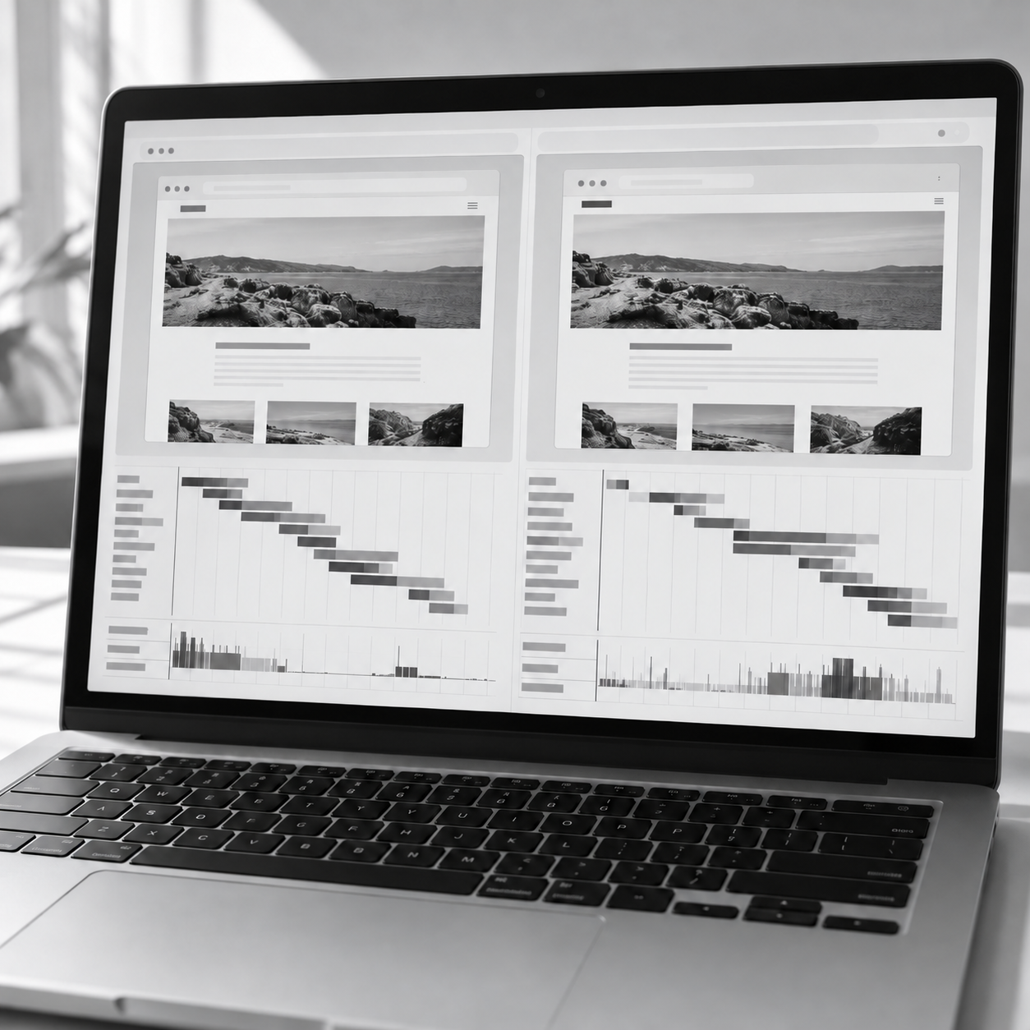
Significance and intended contributions
Research Proposal Presentation
Contributions
Evidence for choosing how much diagnostic information
to retain on each website visit
Reliability boundaries
Conditions where a later profile remains useful
or original evidence is needed.
Reproducible evaluation
A linked episode dataset, verified fault labels
and complete attempt records.
Profiler design guidance
Measured trade-offs between diagnostic
effectiveness and monitoring cost.
The contribution is a bounded empirical comparison. Novelty and any diagnostic advantage remain to be established.
09
Notes:
Delivery target: 35 seconds. Main talk total: 7 minutes. Allow approximately 5 minutes for panel questions within the 12-minute slot.
The intended value is evidence for profiler design decisions. The study should identify when a later profile remains informative and when retaining original evidence adds diagnostic value. It will also produce a reproducible episode dataset with verified fault labels, capture records and complete costs. These outputs can support performance-monitoring and resource-use estimation systems. The contribution is limited to the empirical comparison and the conditions tested. Evidence retention itself is established prior art, and neither novelty nor a diagnostic advantage has yet been demonstrated.
Source report: N. W. L. U. R. D. Nanayakkara, RELIABILITY OF DELAYED WEBSITE OR WEB APPLICATION PERFORMANCE DIAGNOSIS, final report, October 2026. Proposal-stage research.
Visual: Conceptual comparison of two recordings of the same website with different resource timing patterns. Illustrative only; not a study screenshot or measured result. Asset: saved-visit-comparison.png.

Slide 10

Conclusion and next stages
Research proposal
Conclusion
Reliable diagnosis must be evaluated
against the cause of the original episode.
Current stage: literature review
and research proposal
Next: implementation, verification and a feasibility pilot.
If feasible: a separate main protocol, experiment and analysis.
Discussion, limitations and future work follow the results.
Panel discussion
Questions and answers
No experiment has been conducted and no diagnostic advantage is claimed.
Notes:
Delivery target: 35 seconds. Main talk total: 7 minutes. Allow approximately 5 minutes for panel questions within the 12-minute slot.
The central question is whether evidence from a later visit can reliably identify the original cause of a slowdown at an acceptable monitoring cost. The planned comparison will test that question using verified faults, a shared deadline and complete outcome accounting. The current stage is the literature review and proposal. Implementation and verification come next, followed by the bounded feasibility pilot. Only then can a separate main experiment be specified and conducted. Discussion, limitations and future work will follow the observed results. Thank you. I welcome the panel’s questions.
Panel detail
The ten narrated slides have timing targets of 15, 40, 40, 55, 35, 55, 50, 60, 35 and 35 seconds, totaling 420 seconds. References and two technical backup slides follow.
Source report: N. W. L. U. R. D. Nanayakkara, RELIABILITY OF DELAYED WEBSITE OR WEB APPLICATION PERFORMANCE DIAGNOSIS, final report, October 2026. Proposal-stage research.
Visual: Conceptual workstation for browser performance monitoring and diagnosis. Illustrative only; not a study screenshot or measured result. Asset: profiling-workstation.png.

Slide 11
IEEE style / 1 of 2
Research Proposal Presentation
References
[1] R. Netravali, V. Nathan, J. Mickens and H. Balakrishnan, “Vesper: Measuring Time-to-Interactivity for Web Pages,” in Proc. NSDI, 2018, pp. 217–231.
usenix.org/conference/nsdi18/presentation/netravali-vesper
[2] F. Hantke, P. Snyder, H. Haddadi and B. Stock, “Web Execution Bundles: Reproducible, Accurate, and Archivable Web Measurements,” arXiv:2501.15911v4, 2025.
doi: 10.48550/arXiv.2501.15911
[3] L. Zhang, Z. Xie, V. Anand, Y. Vigfusson and J. Mace, “The Benefit of Hindsight: Tracing Edge-Cases in Distributed Systems,” in Proc. NSDI, 2023, pp. 321–339.
usenix.org/conference/nsdi23/presentation/zhang-lei
11
Notes:
Reference or Q&A slide. No planned narration during the seven-minute talk.
Bibliographic details correspond to the source editions cited in the final report.
Source report: N. W. L. U. R. D. Nanayakkara, RELIABILITY OF DELAYED WEBSITE OR WEB APPLICATION PERFORMANCE DIAGNOSIS, final report, October 2026. Proposal-stage research.
References
[1] R. Netravali, V. Nathan, J. Mickens and H. Balakrishnan, “Vesper: Measuring Time-to-Interactivity for Web Pages,” in Proc. NSDI, 2018, pp. 217–231. https://www.usenix.org/conference/nsdi18/presentation/netravali-vesper (Zotero HS3PKWFL).
[2] F. Hantke, P. Snyder, H. Haddadi and B. Stock, “Web Execution Bundles: Reproducible, Accurate, and Archivable Web Measurements,” arXiv:2501.15911v4, 2025. doi:10.48550/arXiv.2501.15911. https://arxiv.org/abs/2501.15911v4 (Zotero ZZSL9IPU).
[3] L. Zhang, Z. Xie, V. Anand, Y. Vigfusson and J. Mace, “The Benefit of Hindsight: Tracing Edge-Cases in Distributed Systems,” in Proc. NSDI, 2023, pp. 321–339. https://www.usenix.org/conference/nsdi23/presentation/zhang-lei (Zotero 3ED3FDXH).

Slide 12
IEEE style / 2 of 2
Research Proposal Presentation
References
[4] GoogleChrome/web-vitals contributors, “web-vitals library: usage and attribution build,” ver. 5.1.0. [Online]. Available: github.com/GoogleChrome/web-vitals/blob/v5.1.0/README.md. Accessed: Oct. 31, 2026.
[5] T. Kalibera and R. Jones, “Rigorous benchmarking in reasonable time,” ACM SIGPLAN Notices, vol. 48, no. 11, pp. 63–74, 2013.
doi: 10.1145/2555670.2464160
[6] T. Mytkowicz, A. Diwan, M. Hauswirth and P. F. Sweeney, “Producing wrong data without doing anything obviously wrong!,” in Proc. ASPLOS XIV, 2009, pp. 265–276. doi: 10.1145/1508244.1508275
12
Notes:
Reference or Q&A slide. No planned narration during the seven-minute talk.
The access date for the versioned documentation is retained from the final report. Benchmarking and measurement-effect papers motivate design safeguards, not browser-specific effect sizes.
Source report: N. W. L. U. R. D. Nanayakkara, RELIABILITY OF DELAYED WEBSITE OR WEB APPLICATION PERFORMANCE DIAGNOSIS, final report, October 2026. Proposal-stage research.
References
[4] GoogleChrome/web-vitals contributors, “web-vitals library: usage and attribution build,” version 5.1.0. [Online]. https://github.com/GoogleChrome/web-vitals/blob/v5.1.0/README.md. Accessed in report: Oct. 31, 2026 (Zotero N33VTKAN).
[5] T. Kalibera and R. Jones, “Rigorous benchmarking in reasonable time,” ACM SIGPLAN Notices, vol. 48, no. 11, pp. 63–74, 2013. doi:10.1145/2555670.2464160 (Zotero GJMALCNF).
[6] T. Mytkowicz, A. Diwan, M. Hauswirth and P. F. Sweeney, “Producing wrong data without doing anything obviously wrong!,” in Proc. ASPLOS XIV, 2009, pp. 265–276. doi:10.1145/1508244.1508275 (Zotero IWCIN2C5).

Slide 13
Q&A backup
Research Proposal Presentation
Feasibility pilot
Parameter | Proposed FP-0.1 allocation
Comparison | 2 fixtures × 8 scenarios × 4 repetitions × 5 arms = 320 originals
Per arm | 48 assigned fault opportunities, 8 stable and 8 nuisance controls
Follow-up | B: at most one per original. Launch targets: 1 or 15 seconds
Timing | 15-second observation. 30-second visit limit. 90-second diagnosis deadline
Campaign caps | 700 starts, 8 active hours, 7 calendar days or 8 GiB of artifacts
652 planned starts include preparation and follow-ups.
A 48-start reserve allows one repair cycle before comparison.
13
Notes:
Reference or Q&A slide. No planned narration during the seven-minute talk.
This slide supports panel questions about feasibility. Collection will stop at the first campaign cap. The 652 planned maximum consists of 12 warm-ups, 80 stable-history visits, 128 qualification visits, 48 perturbation calibration visits, 320 comparison originals and at most 64 follow-ups. The absolute cap of 700 includes a 48-start repair reserve. The pilot is not a powered efficacy experiment.
Panel detail
All numbers are proposed protocol choices. No comparison retries or visits until recurrence will be permitted. The 90-second deadline begins when the original 15-second observation window ends. Each fixture has 20 stable A visits for baseline training and 20 for validation. The alert rule and rule-based classifier will be locked before comparison. An incomplete campaign remains incomplete. A green progression decision permits preparation of a separate main-study protocol, not automatic main collection.
Source report: N. W. L. U. R. D. Nanayakkara, RELIABILITY OF DELAYED WEBSITE OR WEB APPLICATION PERFORMANCE DIAGNOSIS, final report, October 2026. Proposal-stage research.

Slide 14
Q&A backup
Research Proposal Presentation
Study safeguards
Ground truth
Hidden activity checks verify each original and follow-up separately.
Predictions are locked before labels are joined.
Fair comparison
B keeps all legitimate A evidence. E supplies a separately costed
reference and never provides fault labels.
Complete scoring
Capture failures and abstentions remain in verified denominators.
Unknown labels and unattempted cases are reported separately.
Study limits
Two fixtures cannot establish production prevalence or universal
accuracy. Main-study inference requires its own sample and analysis.
14
Notes:
Reference or Q&A slide. No planned narration during the seven-minute talk.
Use this slide for questions about causal verification, resource fairness and external validity. The evaluator uses separate access paths and independent activity checks. A rich trace is diagnostic evidence and is not itself ground truth. Assigned matching does not guarantee identical executions or equal verified denominators. Instrumentation may change the workload, so calibration against minimal observation will precede comparison.
Panel detail
If baseline A already distinguishes the selected causes, that result will be retained. If bounded record C cannot provide useful evidence, the protocol will be revised prospectively. C outperforming B is not a progression requirement. Browser-state contrasts require a separately specified extension.
Source report: N. W. L. U. R. D. Nanayakkara, RELIABILITY OF DELAYED WEBSITE OR WEB APPLICATION PERFORMANCE DIAGNOSIS, final report, October 2026. Proposal-stage research.

