Slide 1
2D Takeoff with Frontier VLMs
Can GPT-4.1 / Claude-Opus / Gemini-2.5 detect swing doors in floor plans?
CEE329 Final Project · Stanford · 2026
3 models · 2 prompts · 2 inference strategies · 10 floor plans · 261 GT bboxes
CEE329 Final Project · Door Takeoff MVP · 2026
1 / 20

Slide 2
Why door takeoff?
Counting doors is the first item on every architectural takeoff
• Manual takeoff today: estimator clicks every door on every sheet
• ~1–3 hours per floor plan, 10–50 plans per project
• Errors are expensive — under-count → change order, over-count → wasted bid
•
• Frontier VLMs can in principle do this in seconds.
• But CAN they? Recent vision-language models claim spatial grounding.
• We test three of the strongest on a controlled benchmark.
•
• Research question:
• How close are top VLMs to production-ready door takeoff,
• and what is the dominant failure mode if not yet?
Spec at a glance
• Task: detect swing-door arcs
• Output: pixel-space bboxes
• Metric: F1 @ IoU 0.5
• Stretch: multi-IoU + counting
•
• Models tested:
• claude-opus-4-8 (Anthropic)
• gpt-4.1 (OpenAI)
• gemini-2.5-pro (Google)
CEE329 Final Project · Door Takeoff MVP · 2026
2 / 20

Slide 3
Dataset & Ground Truth
10 floor plans · 261 hand-labelled swing arcs · VAL/TEST split
• Source: 4 architectural sets from real student housing project
• A2.x = floor plans (Ground / Floor 2-5)
• A7.1.1 = enlarged unit / signage plans
• Mixed scales: 608×1138 to 1728×4032 px
•
• Annotation: CVAT → VOC XML → CSV
• Convention: bbox tightly encloses ONLY the arc
• (not the straight door-leaf line)
• Mean h/w = 1.03 (consistently square)
•
• Splits:
• VAL = 6 images, 167 bboxes (prompt iteration)
• TEST = 4 images, 94 bboxes (held out)
Sheet | Folder | Image (px) | Doors | Door size
A2.1 | Ground | 688×1138 | 24 | 27×27
A2.1 | Floor 2 | 608×1138 | 32 | 25×26
A2.2 | Floor 3 | 754×1286 | 30 | 28×27
A2.3 | Floor 5 | 718×1288 | 30 | 30×27
A7.1.1 | Ground | 672×1304 | 23 | 45×45
A7.1.1 | Typical | 1728×4032 | 28 | 107×98
VAL split — note the 70× range in image-area
CEE329 Final Project · Door Takeoff MVP · 2026
3 / 20

Slide 4
Pipeline
PDF → PNG → VLM → JSON bboxes → IoU eval → multi-metric reanalysis
PDF
(set drawings)
PNG
(per sheet)
VLM call
3 models
JSON bboxes
(normalized)
Pixel bboxes
+ NMS (tile)
IoU eval
vs GT XML
Reanalysis
IoU + count + dist
• Per-image flow
• PDF rendered at 200 dpi → cached PNG
• PNG → base64 → multimodal request
• Response parsed into per-door bboxes
• Cache: hash(image) + model + prompt-ver
• Tile variant
• Image sliced 2×2 (or 2×6 for largest sheet)
• Each tile gets its own VLM call
• Tile-relative bboxes → full-image pixels
• Cross-tile NMS @ IoU 0.4
CEE329 Final Project · Door Takeoff MVP · 2026
4 / 20

Slide 5
What we tried
Three approaches, each strictly better than the previous
Approach | Models | Prompt | Inference | API calls | Best F1@0.5
A1: Baseline | 3 frontier | swing-v1 (L-shape) | Full image | 18 (VAL) | 0.000
A2: Refined | 3 frontier | swing-v2 (arc only) | Full image | 18 (VAL) | 0.023
A3: Tile | 3 frontier | swing-v2 (arc only) | 2×2 / 2×6 + NMS | 96 (VAL) | 0.077
• Each approach was motivated by a specific failure observed in the previous run:
• A1 → A2: Gemini returned `{"doors":[]}` 4/6 times; anthropic bboxes were too tall (h/w 1.4–1.9)
• A2 → A3: A2.x sheets still F1=0; hypothesis was "VLM resolution loss on small doors" → tile to preserve pixels
•
• Total work: 132 API calls (incl. tile retries), 36 viz PNGs, 21 metric CSVs, 4 src/ modules added.
CEE329 Final Project · Door Takeoff MVP · 2026
5 / 20

Slide 6
Approach 1 · Baseline (swing-v1)
Send the whole plan, ask for door-arc L-shape bboxes
• Prompt v1 (key excerpt):
• "bbox is normalized to [0,1] of THIS image,
• tightly enclosing the L-shape (door leaf + arc):"
•
• Output schema (per model):
• { "doors": [ {bbox: [x1,y1,x2,y2], confidence: 0..1} ] }
•
• Models (initial choice):
• anthropic = claude-opus-4-8
• openai = gpt-4.1
• gemini = gemini-3.1-pro-preview
VAL results (swing-v1, full image)
Model | F1@0.1 | F1@0.5 | Counting err
anthropic | 0.203 | 0.000 | 41 %
openai | 0.093 | 0.011 | 39 %
gemini | 0.020 | 0.000 | 84 %
All three F1 ≈ 0 at the standard IoU=0.5 threshold.
Gemini returned empty lists on 4 / 6 sheets.
Where do we go from here? → inspect outputs.
CEE329 Final Project · Door Takeoff MVP · 2026
6 / 20

Slide 7
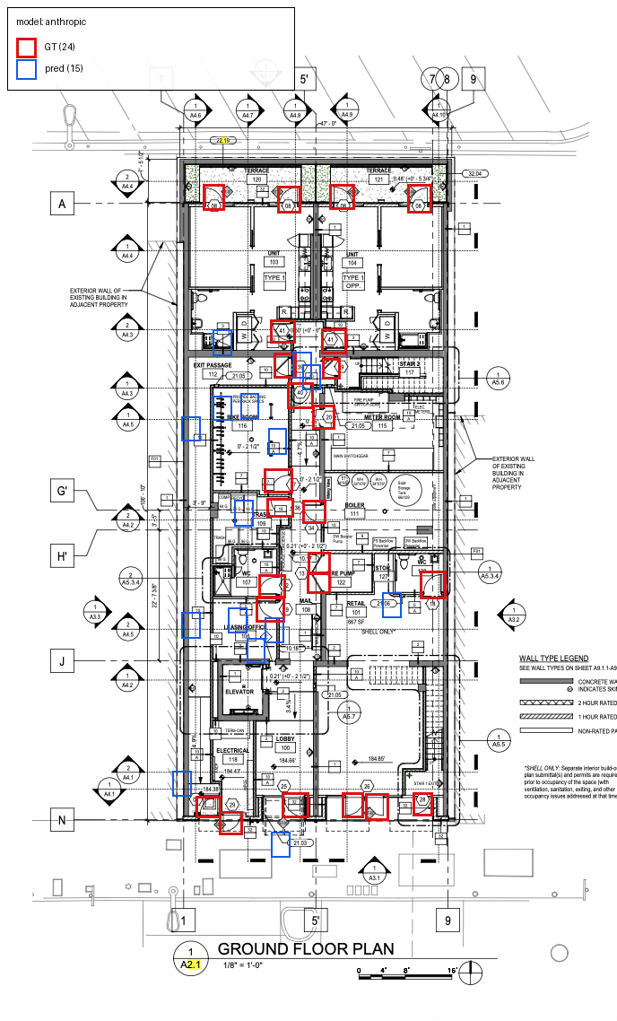
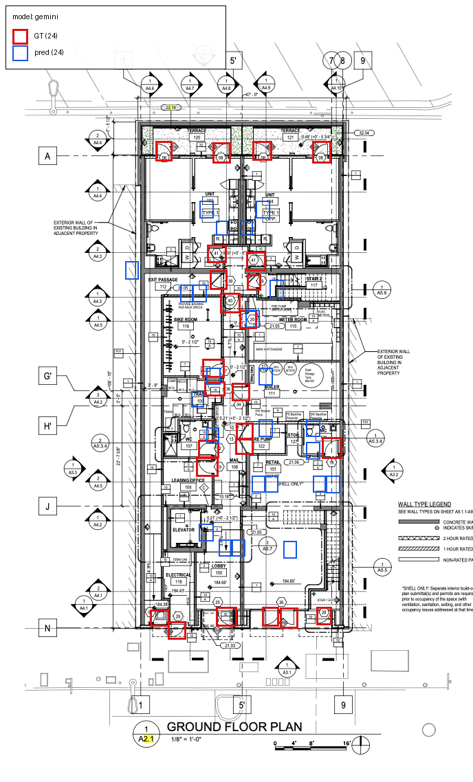
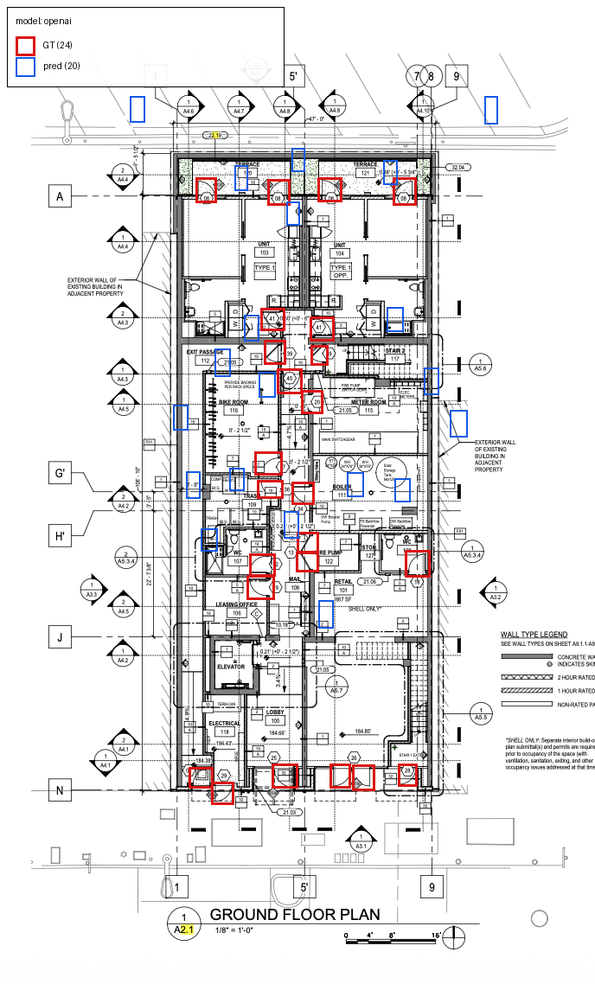
What the v1 outputs looked like
GT = red · model preds = blue
Anthropic — bboxes look about right shape, often misaligned
Gemini — many predictions outside the drawing extents
OpenAI — wider, shifted up-left of GT arcs
CEE329 Final Project · Door Takeoff MVP · 2026
7 / 20

Slide 8
Lessons from v1 — two distinct problems
Format chaos vs spatial chaos
Problem 1 — Gemini format chaos
Problem 2 — convention mismatch
• 4 of 6 sheets returned `{"doors": []}` (empty)
• 2 of 6 returned pixel coords (not normalized)
• Counting error = 84 % (predicted 28 vs 167 actual)
•
• Hypothesis: gemini-3.1-pro-preview is
• miscalibrated on dense bbox tasks.
• Model bboxes have aspect h/w ≈ 1.4–1.9
• GT bboxes have aspect h/w ≈ 1.0 (arc-only)
• Models include the straight door-leaf line
•
• Even when the model finds the right door,
• its bbox overlap with GT is < 0.5 IoU.
→ Two interventions for v2
• Swap gemini-3.1-pro-preview → gemini-2.5-pro (more mature checkpoint)
• Rewrite the bbox spec: "ONLY the quarter-circle arc · approximately square · ~one door-width"
• Bump cache namespace swing-v1 → swing-v2 so all 18 calls are fresh
CEE329 Final Project · Door Takeoff MVP · 2026
8 / 20

Slide 9
Approach 2 · Refined prompt (swing-v2)
Tighten the bbox spec, swap one model
Prompt diff
swing-v1 (before)
swing-v2 (after)
bbox is normalized to [0, 1] of THIS image, tightly enclosing the L-shape (door leaf + arc).
bbox encloses ONLY the quarter-circle arc — do NOT include the straight door-leaf line. Approximately SQUARE, ~one door-width on each side.
Model swap
• gemini-3.1-pro-preview → gemini-2.5-pro (production checkpoint, less format drift)
• anthropic & openai unchanged (claude-opus-4-8, gpt-4.1)
•
• Same cache namespace bump: swing-v2 → 18 new VAL API calls.
CEE329 Final Project · Door Takeoff MVP · 2026
9 / 20

Slide 10
Approach 2 · Results
Refined prompt + model swap → fixes gemini format, marginal IoU gain
VAL results · swing-v2 · full image
What changed vs v1
Model | F1@0.1 | F1@0.5 | Preds | Counting err | Dist F1
anthropic | 0.153 | 0.023 | 94 | 44 % | 0.32
openai | 0.088 | 0.006 | 153 | 14 % | 0.19
gemini | 0.155 | 0.000 | 169 | 8 % | 0.31
• Gemini counting: 84% → 8 % ✓
• → 2.5-pro emits clean normalized bboxes
•
• Anthropic F1@0.5: 0.000 → 0.023 ✓
• → arc-only spec is closer to GT convention
•
• OpenAI: ~unchanged
• → still wide & shifted bboxes
But: F1@0.5 still essentially zero. Why?
• Two metrics tell the diagnostic story:
• F1 @ IoU 0.1 stays in 0.09 – 0.16 range — predictions are spatially close but not pixel-precise
• Center-distance F1 reaches 0.32 — models DO find the right doors, they just can't draw a tight arc-only box
•
• Hypothesis: the limit is image resolution. At full-image, an arc occupies ~4% of width → too few pixels for tight bbox.
CEE329 Final Project · Door Takeoff MVP · 2026
10 / 20

Slide 11
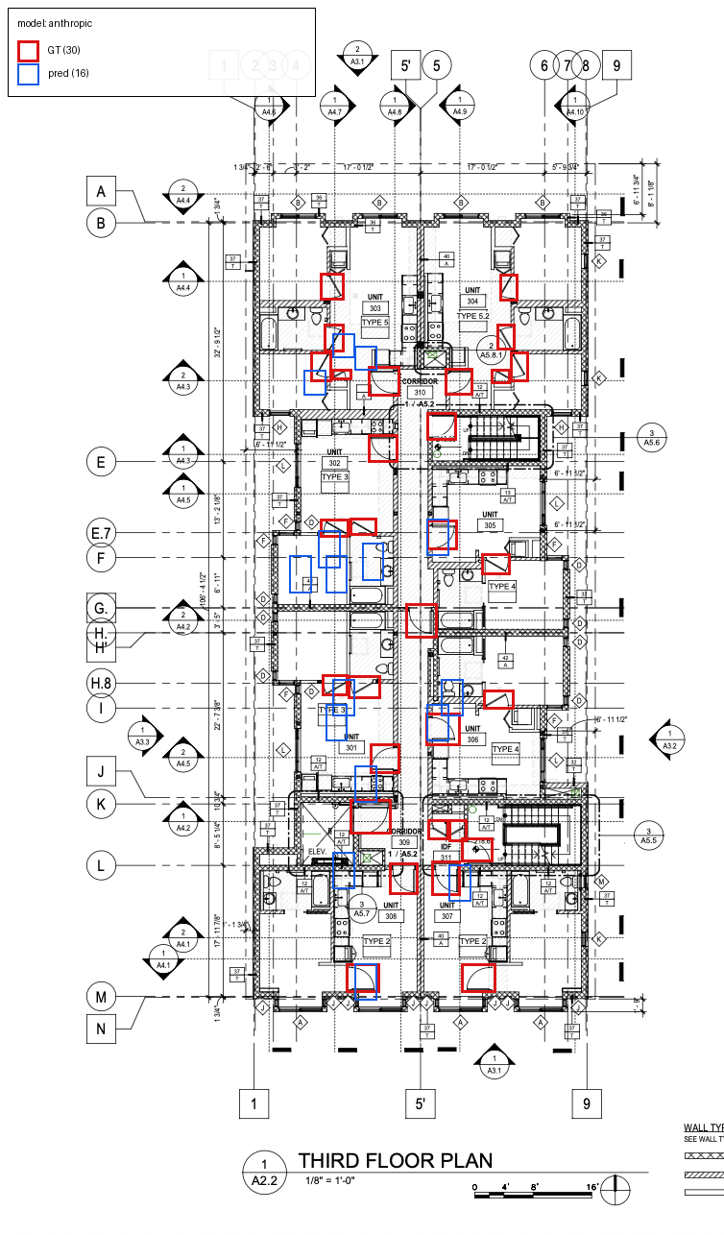
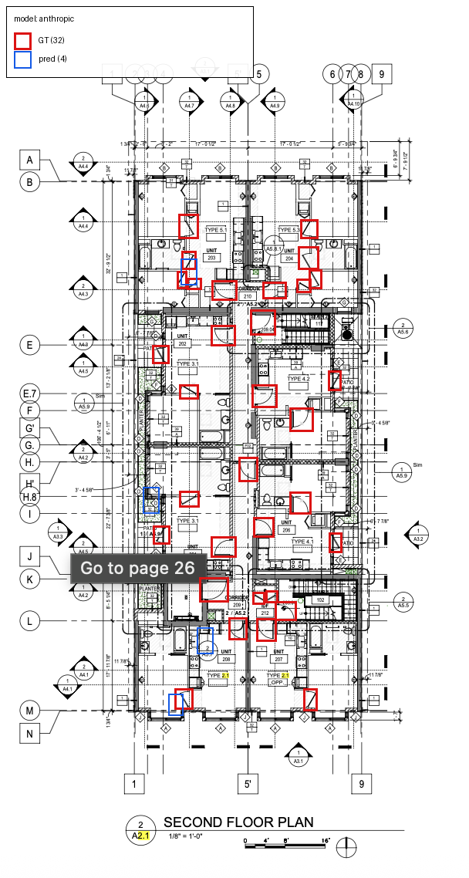
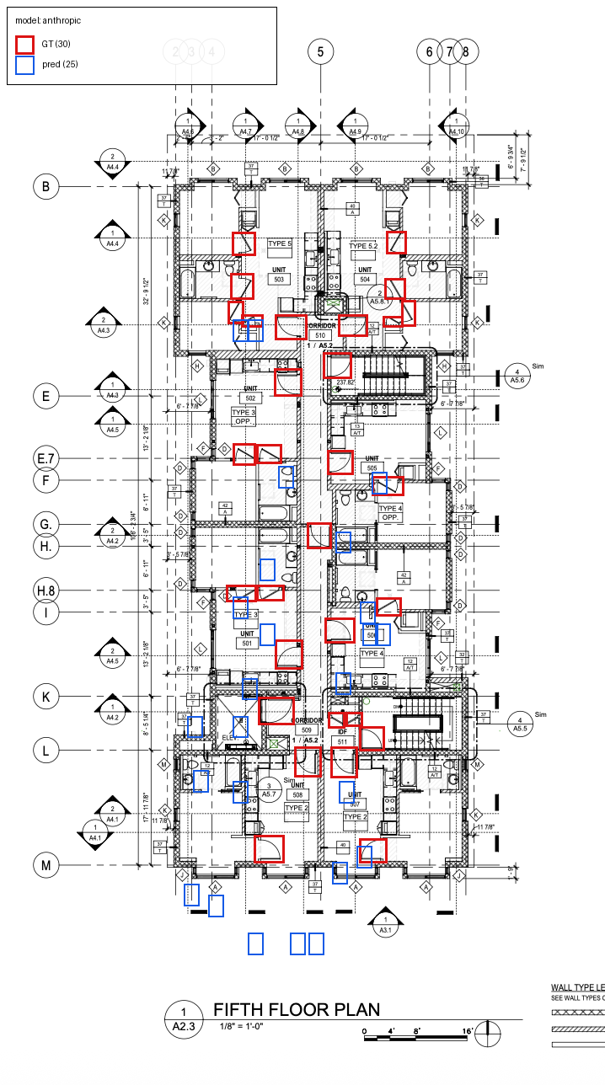
Diagnosis · GT vs model overlay
anthropic finds the doors but boxes the wrong sub-region
A2.2-1 / anthropic (full-image, swing-v2)
A2.1-2 / anthropic — blue often misses red by half-a-bbox
A2.3-1 / anthropic — same story
CEE329 Final Project · Door Takeoff MVP · 2026
11 / 20

Slide 12
Approach 3 · Tile-based grounding
Slice the plan, run the prompt per tile, NMS-merge
• Why tiling might help
• At full image, a 27-px door covers ~4 % of width
• At 2×2 tile, that same door is ~8 % of tile width
• Effective resolution roughly doubles
•
• Mechanics
• Target tile size = 700 px per side
• Overlap = 15 % (catches doors on tile edges)
• A2.x → 2×2 = 4 tiles · A7.1.1 Typical → 2×6 = 12 tiles
• 32 tiles per model · 3 models = 96 API calls / VAL run
•
• Post-processing
• Tile-relative normalized bbox → full-image pixel coords
• Cross-tile NMS @ IoU 0.4 (dedupes overlap-region doubles)
Tile grid (schematic)
4 tiles · 15 % overlap · NMS @ IoU 0.4
CEE329 Final Project · Door Takeoff MVP · 2026
12 / 20

Slide 13
Approach 3 · Tile results
anthropic +235 % at IoU 0.5 · others unchanged or worse
VAL · swing-v2 · 2×2/2×6 tile
Per-sheet F1@0.5 · anthropic
Model | F1@0.1 | F1@0.5 | Preds | Counting err | Dist F1
anthropic | 0.340 | 0.077 | 92 | 49 % | 0.42
openai | 0.085 | 0.000 | 161 | 13 % | 0.18
gemini | 0.160 | 0.005 | 196 | 17 % | 0.28
Sheet | Image px | Door px | F1@0.5
A2.1 | 688 × 1138 | 27 × 27 | 0.000
A2.2 | 754 × 1286 | 28 × 27 | 0.000
A2.3 | 718 × 1288 | 30 × 27 | 0.044
A7.1.1 G | 672 × 1304 | 45 × 45 | 0.048
A7.1.1 T | 1728 × 4032 | 107 × 98 | 0.271
Pattern
• Tiling helps only where doors are LARGE in absolute pixels.
• A2.x doors are 27 px — slicing the image doesn't make them bigger; convention mismatch dominates → F1 = 0
• A7.1.1 Typical doors are 107 px — full image was downsampling them past detection; tiling preserves them → F1 = 0.27
• anthropic specifically benefits because its v2 bboxes were already shape-correct, just placement-imprecise
CEE329 Final Project · Door Takeoff MVP · 2026
13 / 20

Slide 14
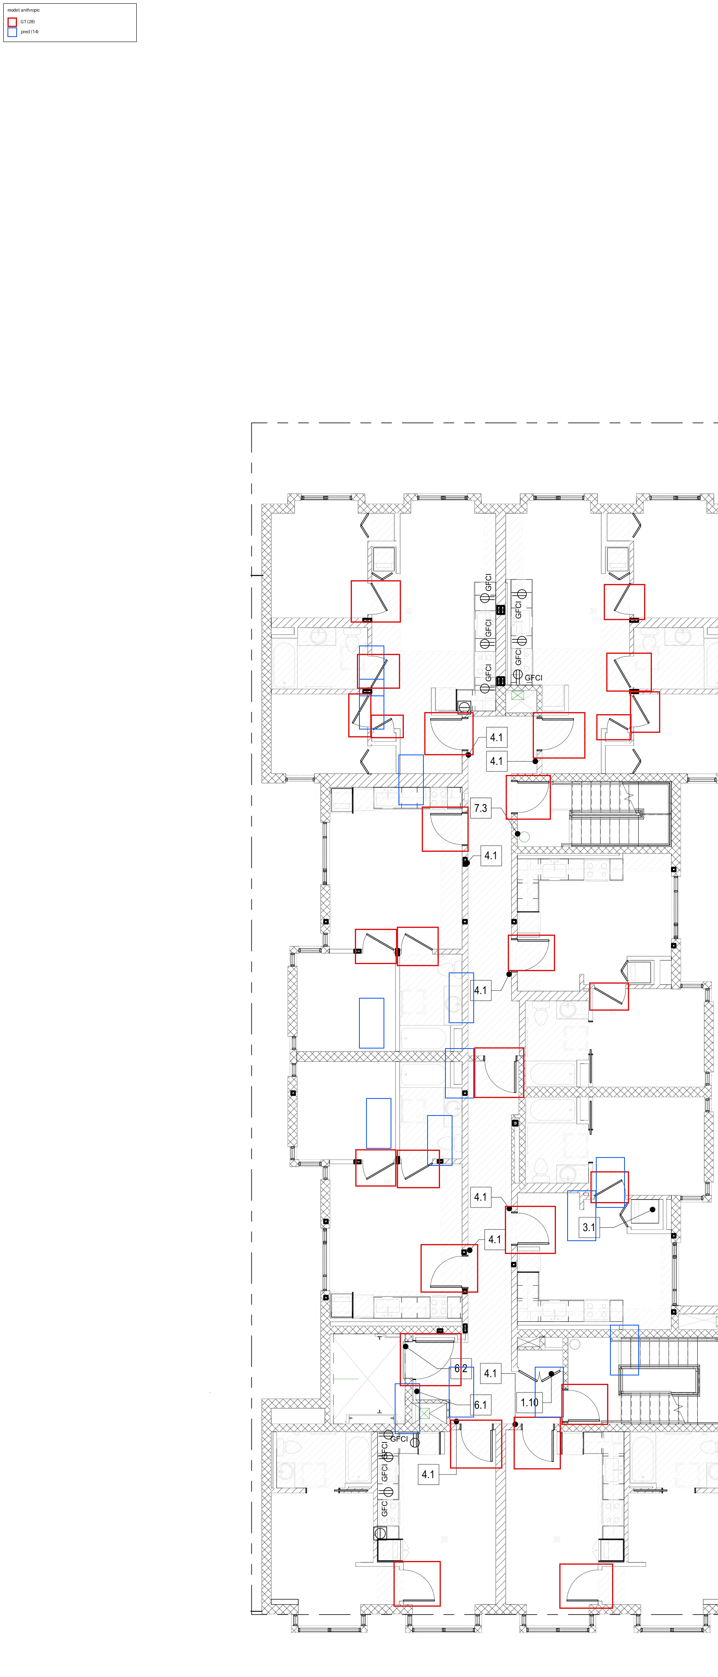
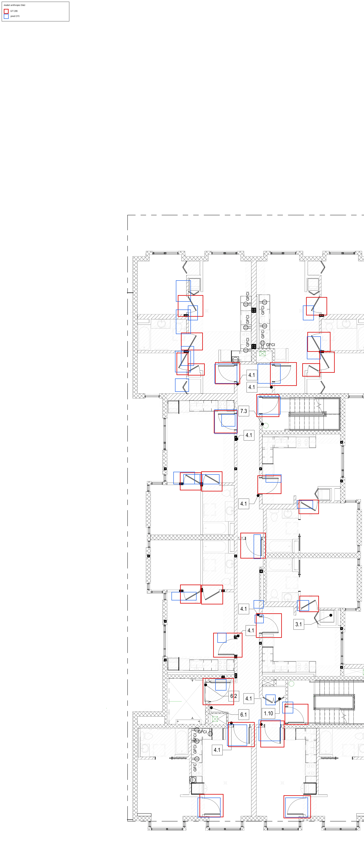
Best case: A7.1.1 Typical · anthropic
Full-image F1 = 0.000 → tile F1 = 0.271
Full-image (28 GT · 23 pred · TP = 0 · F1 = 0.000)
Tiled 2×6 (28 GT · 31 pred · TP = 8 · F1 = 0.271)
Same sheet, same model, same prompt — only the inference strategy changed.
CEE329 Final Project · Door Takeoff MVP · 2026
14 / 20

Slide 15
Multi-metric triangulation
IoU F1 is a single number; the failure mode is plural
• Why three metrics
• IoU @ multiple thresholds — shows the bbox-shape gap
• Counting — what contractors actually need
• Center-distance F1 — does the model point at the right door?
•
• All three implemented in src/swing_reanalyze.py
• Single CSV in → 3 metric CSVs out
• Works on full-image AND tile predictions
anthropic · IoU sweep (across split)
Config | F1@0.1 | F1@0.2 | F1@0.3 | F1@0.5
v1 full | 0.203 | 0.101 | 0.065 | 0.000
v2 full | 0.153 | 0.107 | 0.046 | 0.023
v2 tile | 0.340 | 0.247 | 0.193 | 0.077
Counting & distance (overall, swing-v2 full image)
Model | Count err | Dist P | Dist R | Dist F1
anthropic | 44 % | 0.45 | 0.25 | 0.32
gemini | 8 % | 0.31 | 0.31 | 0.31
openai | 14 % | 0.20 | 0.18 | 0.19
CEE329 Final Project · Door Takeoff MVP · 2026
15 / 20

Slide 16
Three failure modes, in order of impact
Diagnosed from per-sheet metrics + visual inspection of 36 PNGs
1. Convention mismatch
GT = arc only · Model = leaf + arc
Aspect ratio 1.0 vs 1.4–1.9
Caps F1 @ IoU 0.5 < 0.05
on all small-door sheets
2. Resolution loss
Full-image input is downsampled
Sub-30-px doors lose features
Tiling fixes this for the large
1728×4032 sheet (F1 0 → 0.27)
3. Gemini extent noise
~30 % of gemini preds land in
title block, north arrow, schedule
Inflates FP, depresses precision
Not present in v1's pixel mode
Gemini extent noise — preds in title block
Anthropic — close placement, wrong shape
OpenAI — wider, shifted up-left
CEE329 Final Project · Door Takeoff MVP · 2026
16 / 20

Slide 17
Recommendation
What to ship today, what to fix next
Best config of the four tested
claude-opus-4-8 + swing-v2 prompt + 700-px tiles + 15 % overlap + NMS @ IoU 0.4
Ship-today use cases
Do NOT ship
• Door counting
• Gemini-2.5-pro at full image: 8 % error
•
• "Where to click" UX overlay
• Anthropic+tile: P = 0.59 on found doors
•
• High-res enlarged-unit sheets
• Anthropic+tile F1 = 0.27 (production-ish quality)
• Pixel-precise takeoff for billing
• F1 @ IoU 0.5 = 0.077 across the split
•
• Small-door sheets without convention fix
• A2.x always F1 = 0 regardless of approach
•
• Unsupervised — needs human review
• Best counting model still off by ~14 doors / 167
CEE329 Final Project · Door Takeoff MVP · 2026
17 / 20

Slide 18
Limitations & Future Work
What this 1-week project couldn't address
Limitations of THIS evaluation
Concrete next experiments
• Small dataset (10 images, 261 bboxes)
• 95 % CI on recall is ±0.07
• Single annotator, no IRR
• Spot-checking suggests ~95 % GT recall on real doors
• Arc-only convention is one of several valid choices
• Models trained on COCO-style boxes don't share it
• Only 3 models, all closed-source
• Open VLMs (Qwen-VL, InternVL) not tested
• Dual-convention GT
• Re-annotate with arc-only AND leaf+arc; measure IoU under each
• Finer tile grid for small-door sheets
• 400-px tiles → 4×4 on A2.x; does IoU 0.5 recover?
• Bbox post-processing
• Shrink anthropic L-shape → square anchored at leaf endpoint
• Few-shot prompting
• Show 2-3 GT examples per call
CEE329 Final Project · Door Takeoff MVP · 2026
18 / 20

Slide 19
Thanks — questions?
All code, GT, predictions, viz, metrics in the repo
outputs/eval/phase4_findings.md — full writeup
CEE329 Final Project · Door Takeoff MVP · 2026
CEE329 Final Project · Door Takeoff MVP · 2026
20 / 20

