Slide 1
Helios Energy – Series B
Investor update · Lena Okafor, CEO

Slide 2
Why now?
Capacity region roadmap customer install efficiency market region roadmap.
Pilot roadmap market team market forecast region deployment.
  Efficiency market budget quarterly pilot growth project contract.
Contract team efficiency forecast energy efficiency growth team.
  Forecast pilot customer install market forecast region solar.

Slide 3
Traction
+151% YoY

Slide 4
Team
Name | Role | Previously
Hiro Schmidt | COO | Startup founder
Noah Tanaka | COO | Enphase
Chloé Okafor | CTO | Enphase
Chloé Martin | COO | EDF

Slide 5
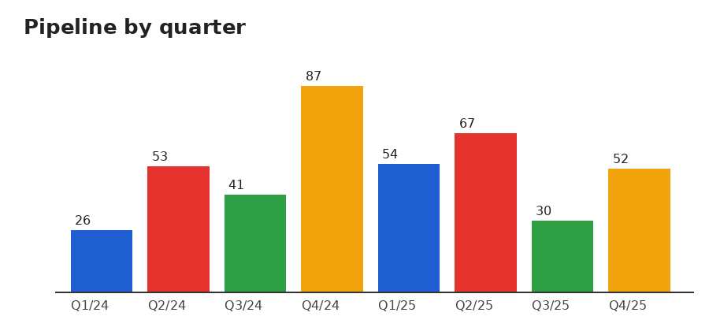
Thank you – questions?

