Slide 1
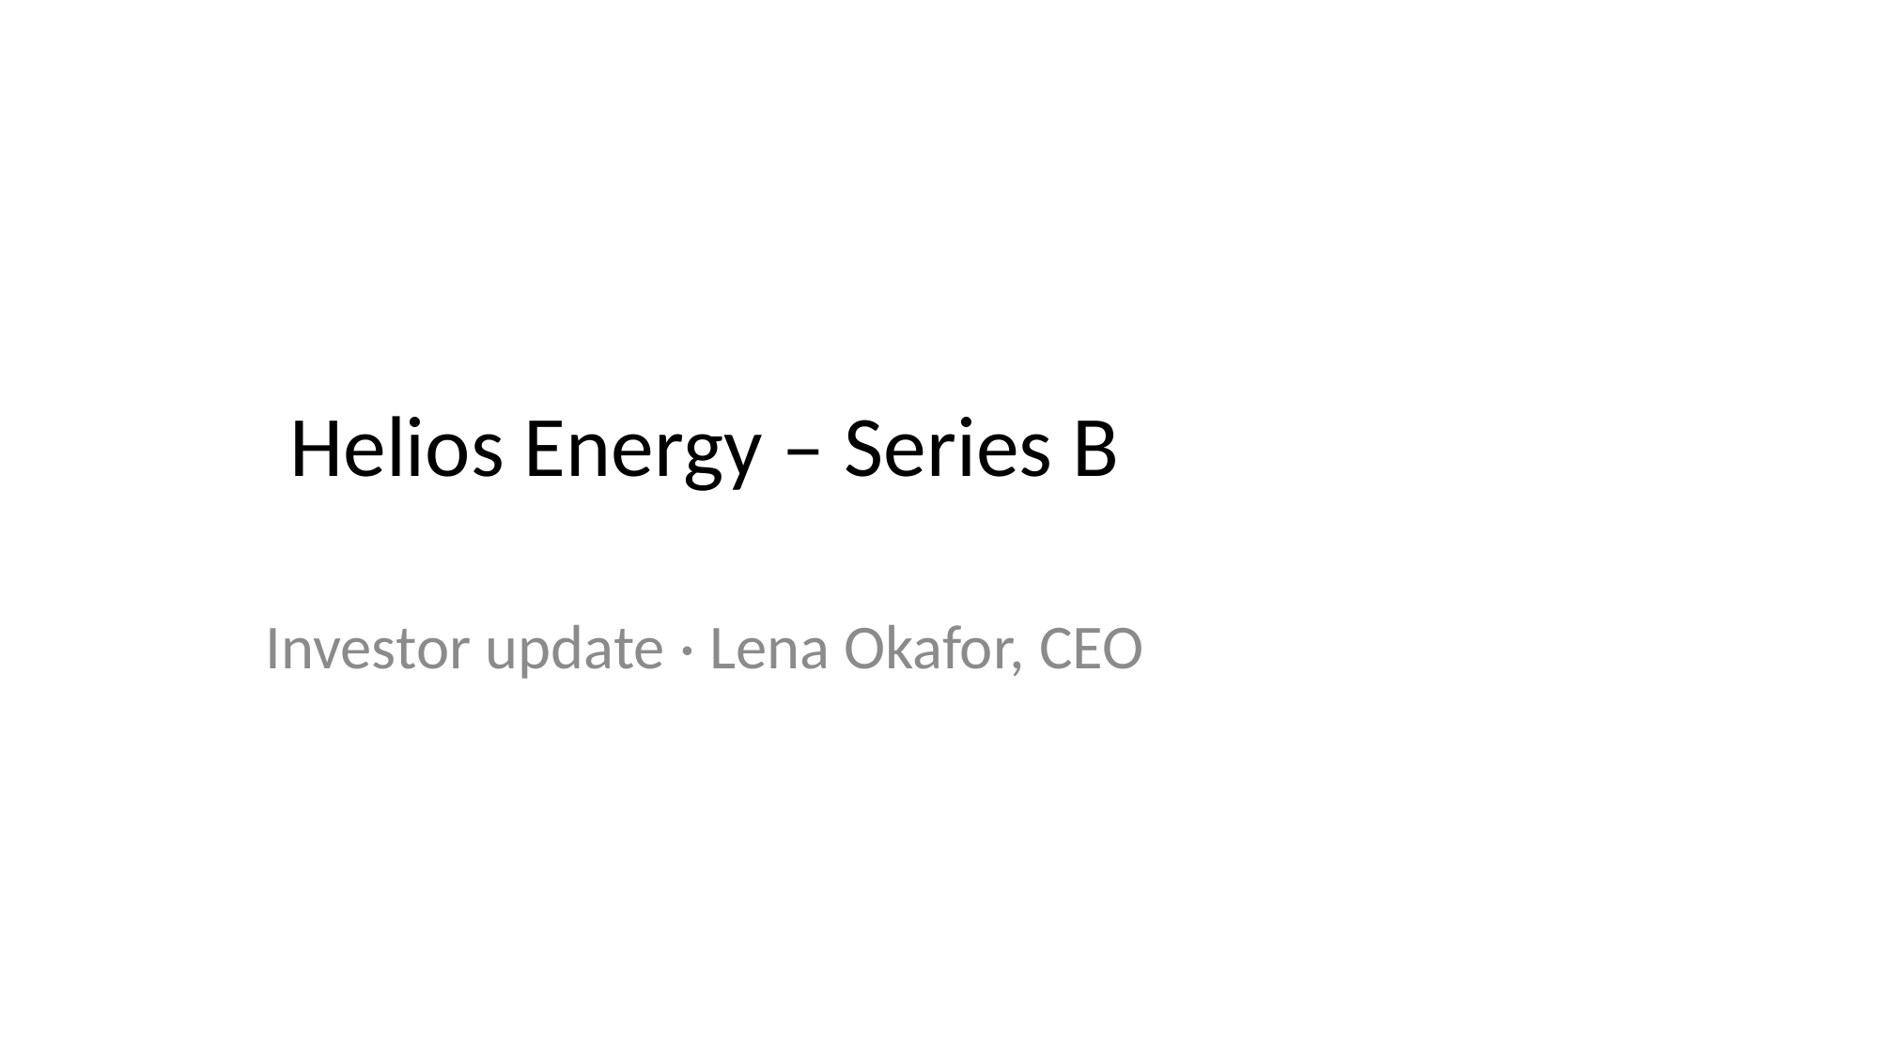
Notes:
Helios Energy – Series B
Investor update · Lena Okafor, CEO

Slide 2
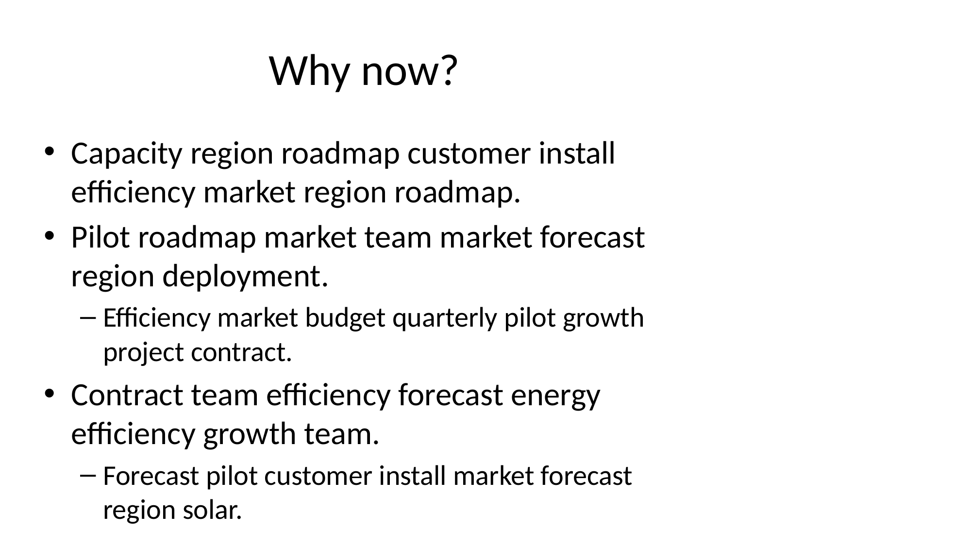
Notes:
Why now?
• Capacity region roadmap customer install
efficiency market region roadmap.
• Pilot roadmap market team market forecast
region deployment.
– Efficiency market budget quarterly pilot growth
project contract.
• Contract team efficiency forecast energy
efficiency growth team.
– Forecast pilot customer install market forecast
region solar.

Slide 3
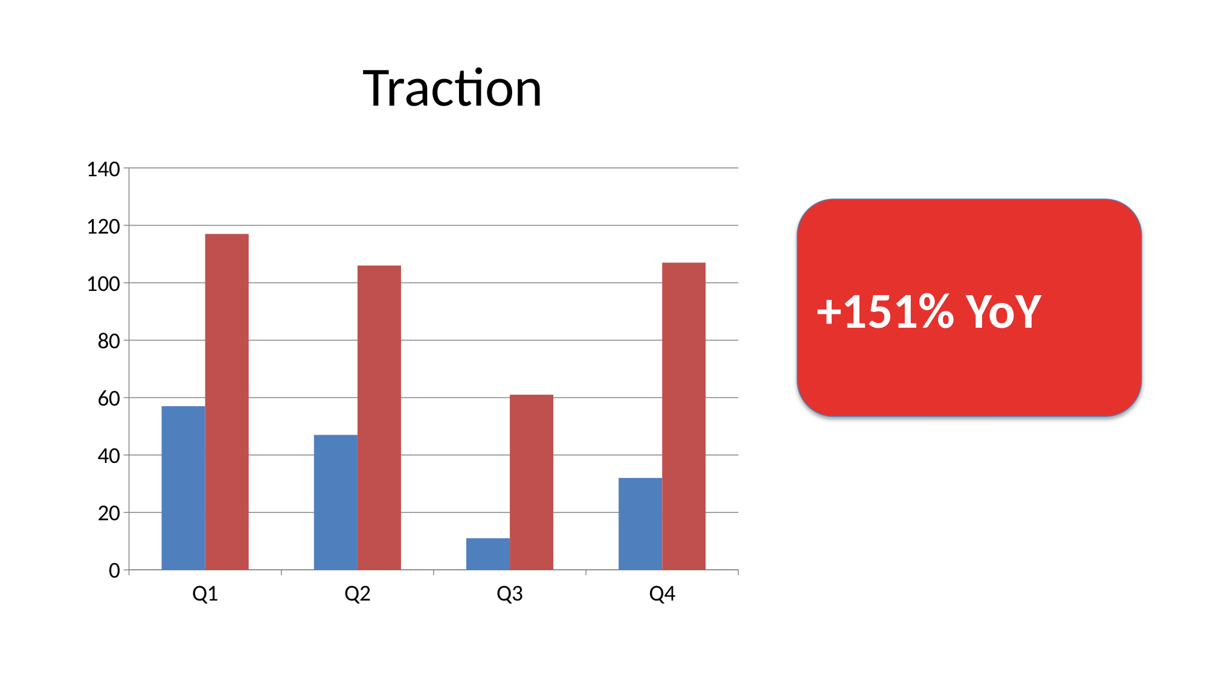
Notes:
Traction
Q1
Q2
Q3
Q4
0
20
40
60
80
100
120
140
+151% YoY

Slide 4
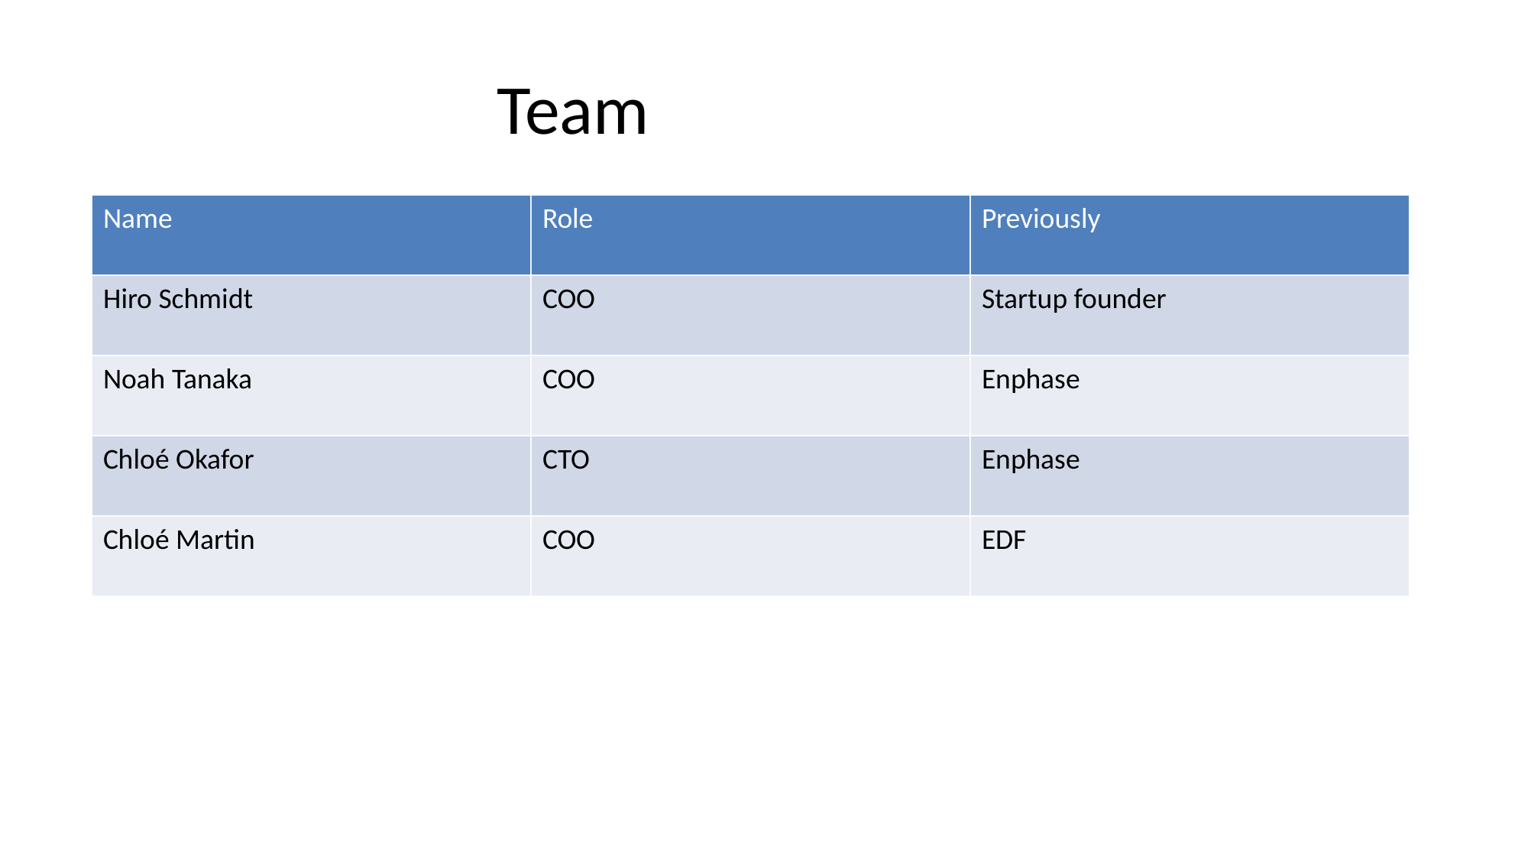
Notes:
Team
Name
Role
Previously
Hiro Schmidt
COO
Startup founder
Noah Tanaka
COO
Enphase
Chloé Okafor
CTO
Enphase
Chloé Martin
COO
EDF

Slide 5
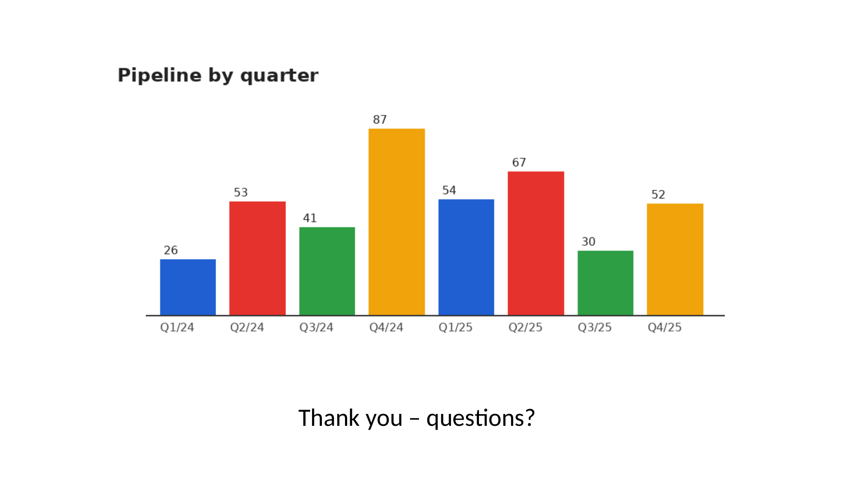
Notes:
Thank you – questions?

