Slide 1
Helios Energy – Series B
Investor update · Lena Okafor, CEO

Slide 2
Why now?
•
Capacity region roadmap customer install
efficiency market region roadmap.
•
Pilot roadmap market team market forecast
region deployment.
–
Efficiency market budget quarterly pilot growth
project contract.
•
Contract team efficiency forecast energy
efficiency growth team.
–
Forecast pilot customer install market forecast
region solar.

Slide 3

Traction
140
120
100
+151% YoY
80
60
40
20
0
Q1
Q2
Q3
Q4

Slide 4
Team
Name
Role
Previously
Hiro Schmidt
COO
Startup founder
Noah Tanaka
COO
Enphase
Chloé Okafor
CTO
Enphase
Chloé Martin
COO
EDF

Slide 5
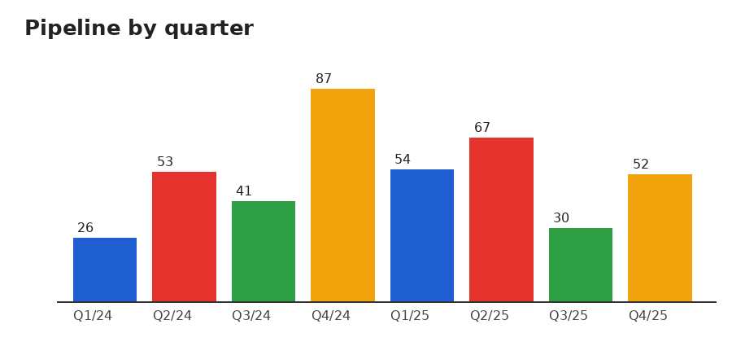
Thank you – questions?

