Slide 1



Data Science Career Accelerator
Employer Project - Bank of England
Team 9 - Quarterly Bytes: Jacques Wemegan Kareem El-Wakeel
Leslie Zi Pan
Maciej Wojtkowiak Muhammad Ali Ashraf-uz-zaman
Project Source Code Repository
https://github.com/EErlando/Quarterly-Bytes
03.07.2025 | Cambridge Institute Continued Education | Data Science with Machine Learning & AI Career Accelerator

Slide 2
Background & Business Context
03.07.2025 | Cambridge Institute Continued Education | Data Science with Machine Learning & AI Career Accelerator

Slide 3
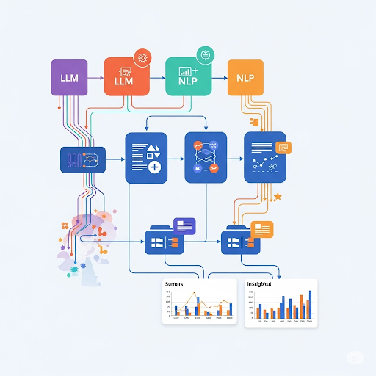
The Business Question
Can advanced NLP and Large Language Models (LLMs) enable the PRA team to more efficiently identify, assess, and monitor emerging risks and strategic shifts within regulated entities from earnings call data?
03.07.2025 | Cambridge Institute Continued Education | Data Science with Machine Learning & AI Career Accelerator

Slide 4
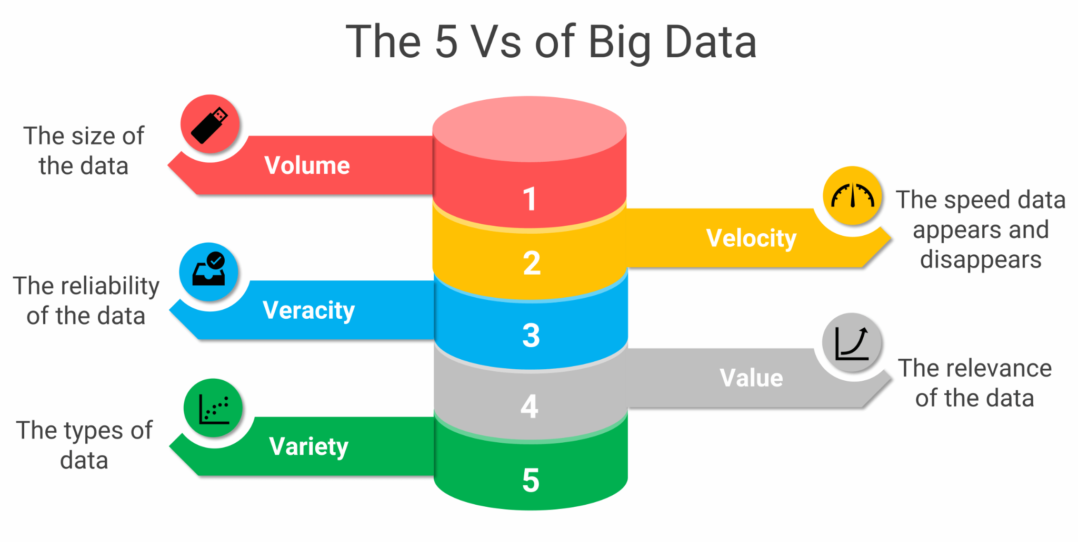
The Challenge
Information Overload
Unstructured Data Complexity
Identifying Nuance and Subtlety
Timeliness and Proactivity
Consistency
https://www.passionned.com/
03.07.2025 | Cambridge Institute Continued Education | Data Science with Machine Learning & AI Career Accelerator
Notes:
Information Overload: Regulated financial institutions release a vast volume of public disclosures, including earnings call transcripts. Manually reviewing every single transcript across numerous entities and over extended periods is incredibly time-consuming and resource-intensive.
Unstructured Data Complexity: Earnings call transcripts are unstructured text. Extracting specific, actionable insights from free-form discussions, especially identifying subtle cues, veiled warnings, or nuanced shifts in management tone, is a highly complex task that goes beyond simple keyword searches.
Identifying Nuance and Subtlety: Financial communication can be inherently complex, at times intentionally vague or strategic. Identifying "hidden risks," instances of managerial hedging, or discrepancies between management's answers and analyst's concerns requires deep contextual understanding and significant analytical effort.
Timeliness and Proactivity: To be effective, supervision needs to be proactive. Manually sifting through new transcripts to identify emerging risks quickly is a significant logistical hurdle.
Consistency: Ensuring a consistent level of scrutiny and analysis across all reviewed documents and by different analysts can be challenging without standardized, automated tools.

Slide 5
AI-Driven Approach
03.07.2025 | Cambridge Institute Continued Education | Data Science with Machine Learning & AI Career Accelerator

Slide 6
High Level Methodology
Traditional Data Science: For foundational analysis, structured insights, and trend identification (e.g., EDA, Topic Modeling)
Large Language Models (LLMs): Nuanced text understanding, generative capabilities, and complex information extraction.
Beyond the Scope: How can we leverage methodologies and theories beyond this scope to significantly enhance and expand this project for PRA (Prudential Regulation Authority) usage?
03.07.2025 | Cambridge Institute Continued Education | Data Science with Machine Learning & AI Career Accelerator

Slide 7
Data Sources
Comprehensive dataset of earnings calls from JP Morgan and Goldman Sachs over the last 3 years
Focus on the Q&A section and management discussions for in-depth analysis
03.07.2025 | Cambridge Institute Continued Education | Data Science with Machine Learning & AI Career Accelerator

Slide 8
Key Analytical Pillars
Enhanced Sentiment Analysis: Beyond the basic sentiment, identify the divergence between analyst and management.
Text Summarisation and Risk Profiling: Condensing information and identifying hidden risks.
Targeting Information Extraction: Pinpointing statements of concern for direct PRA action and questioning.
Topic Trend Analysis: Understanding the evolving discussion themes across time and by executive.
03.07.2025 | Cambridge Institute Continued Education | Data Science with Machine Learning & AI Career Accelerator

Slide 9
Project Development Process: Initial Exploration & Foundational Insights
03.07.2025 | Cambridge Institute Continued Education | Data Science with Machine Learning & AI Career Accelerator

Slide 10
EDA Objectives
In this EDA, we compare how Goldman Sachs and JP Morgan leadership teams communicate during earnings calls from 2022–2024. By segmenting transcripts by speaker role and session type (MD vs Q&A), we quantify who speaks most, track changes over time, analyze vocabulary and terminology, and measure how concise or detailed each speaker is. This lets us identify key communication patterns and differences in executive style across the two banks.
03.07.2025 | Cambridge Institute Continued Education | Data Science with Machine Learning & AI Career Accelerator

Slide 11
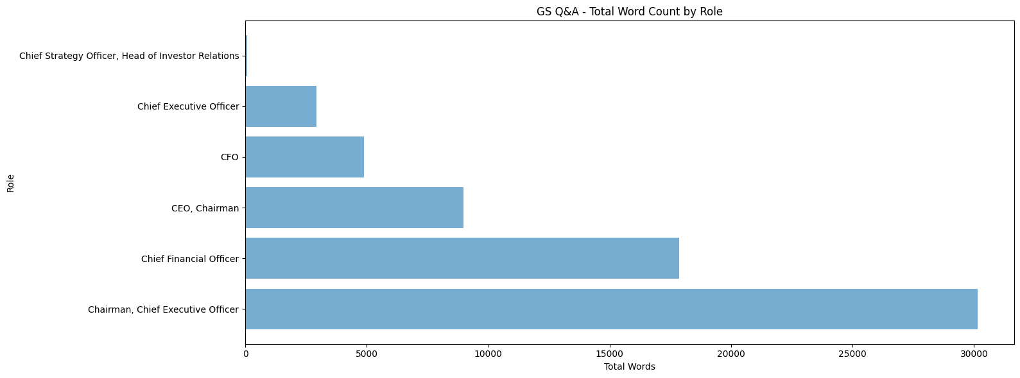
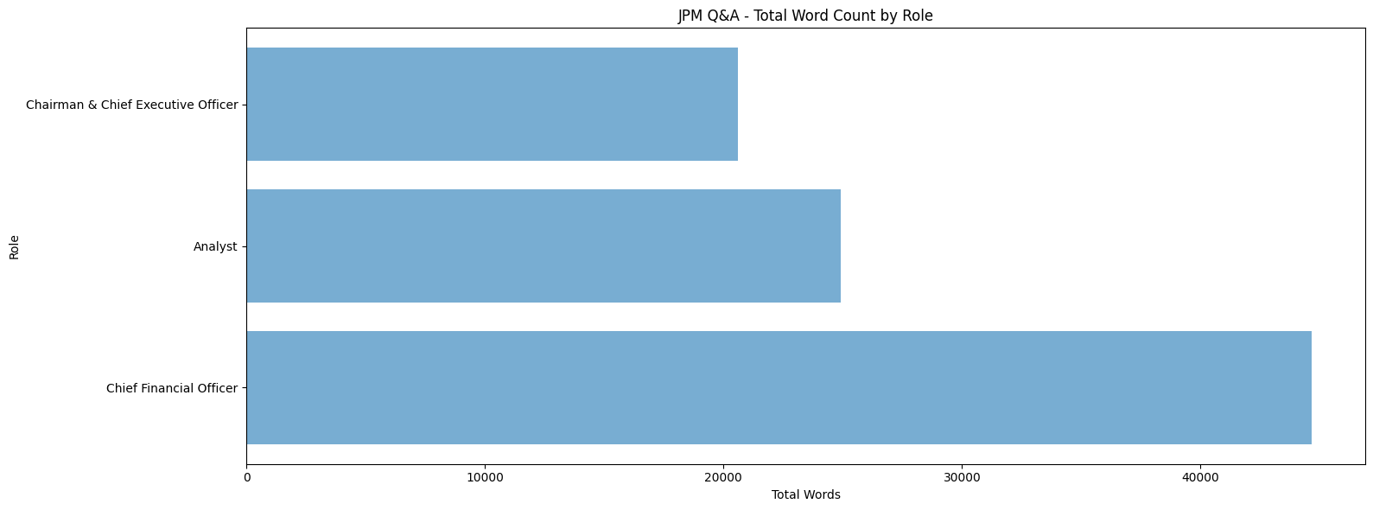
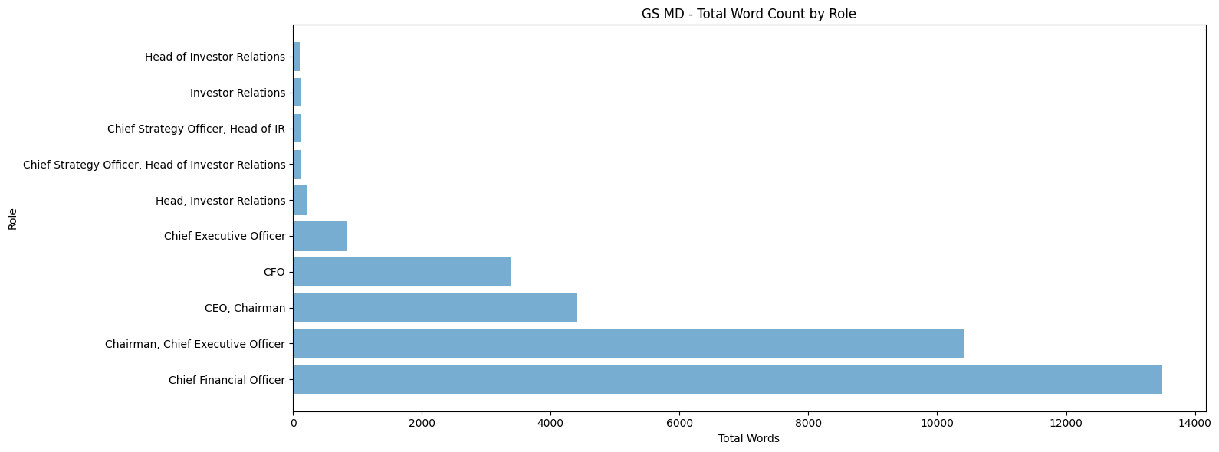
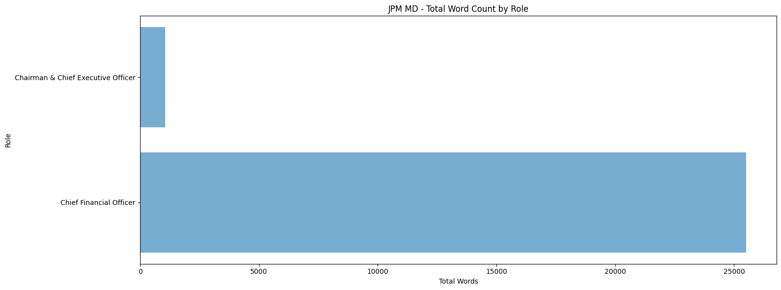
Word Count by Role & Over Time
Goldman Sachs
JP Morgan
Goldman Sachs:
JP Morgan:
The Chairman & CEO and CFO are the dominant speakers, especially in Q&A sessions.
CFO leads in total word count, with the Analyst and Chairman/CEO sharing the floor more evenly in Q&A.
Word count by quarter is steady, suggesting consistent meeting length and leadership engagement.
Some fluctuation in total word count and unique speakers by quarter, indicating shifts in participation or meeting format.
03.07.2025 | Cambridge Institute Continued Education | Data Science with Machine Learning & AI Career Accelerator

Slide 12
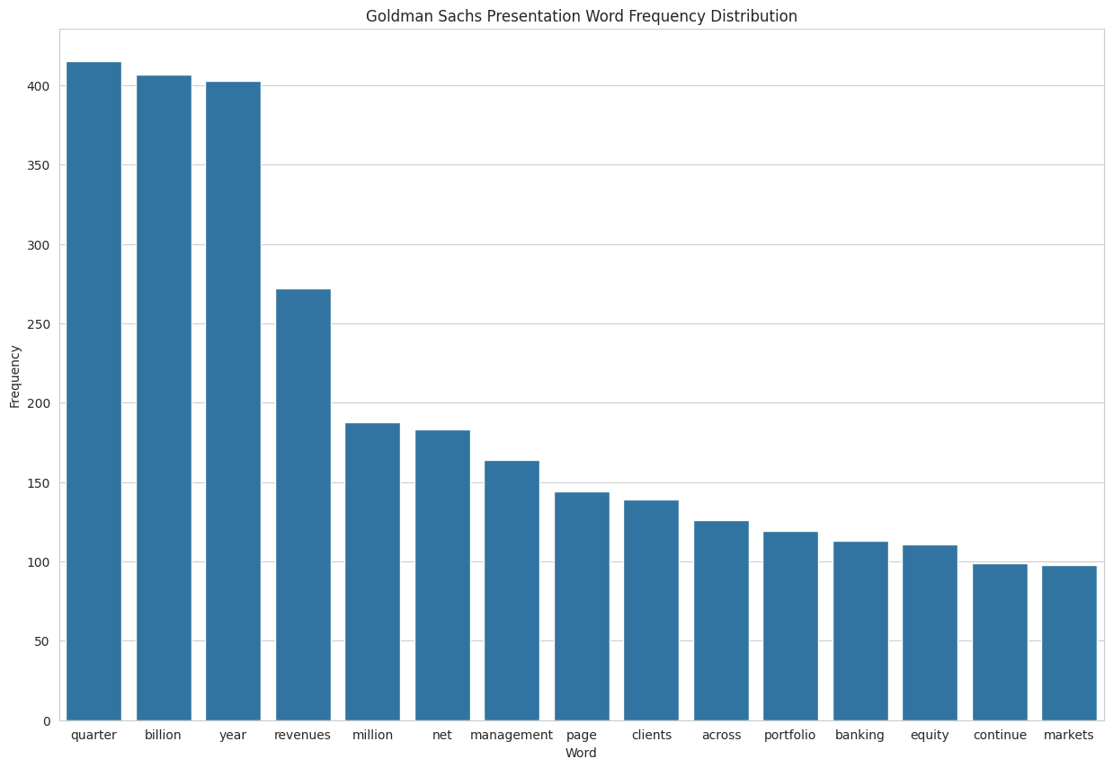
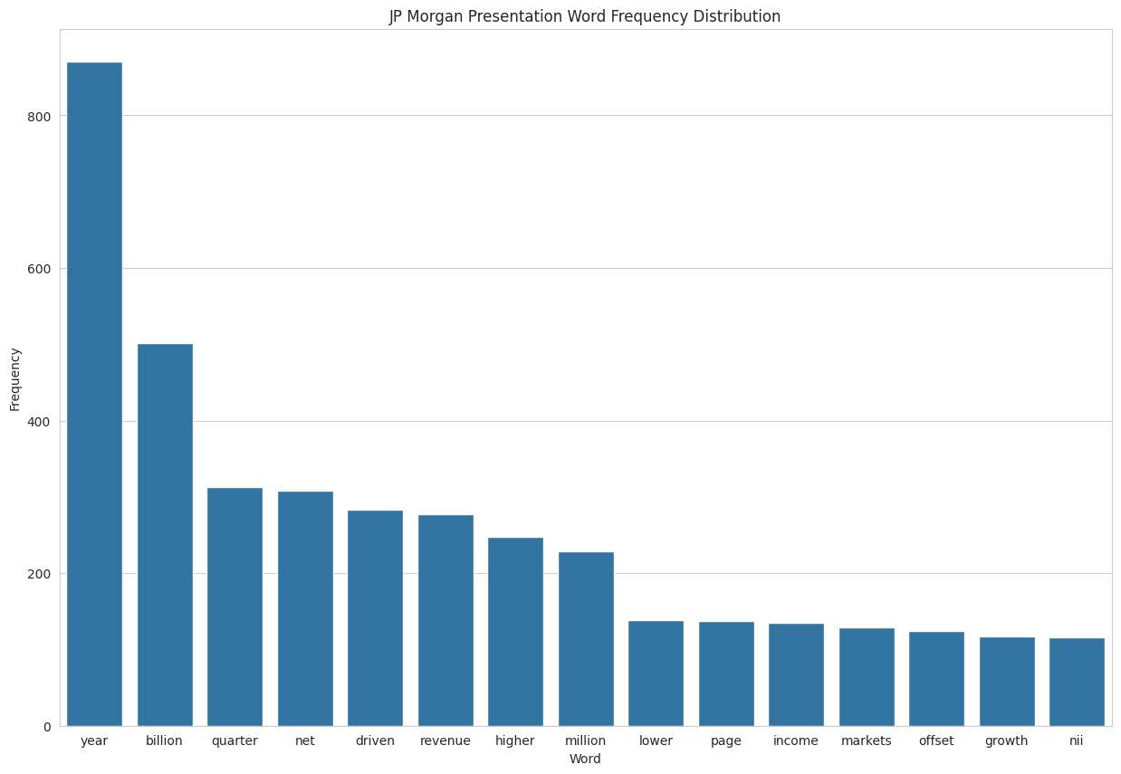
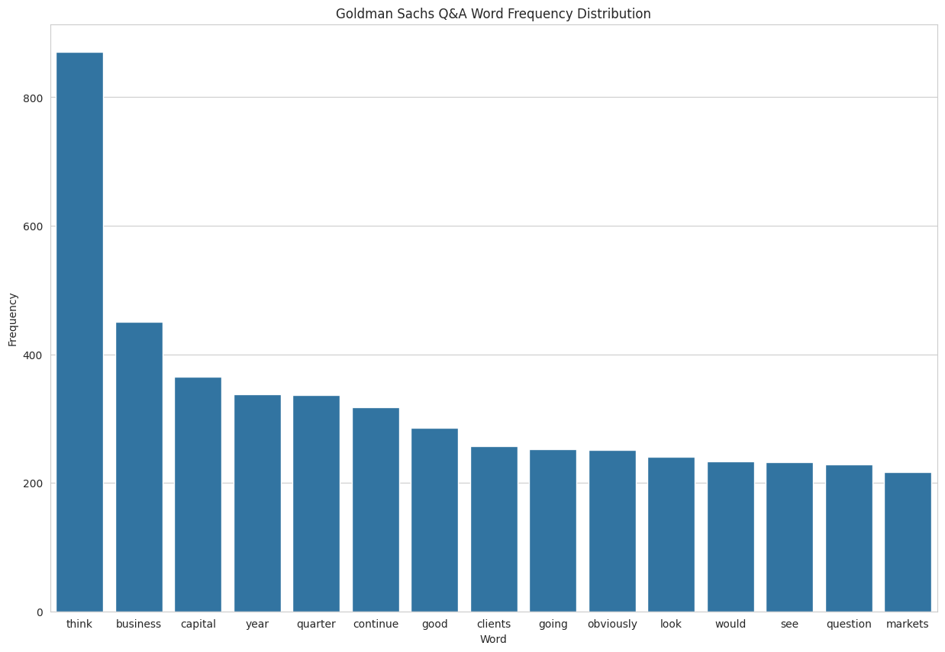
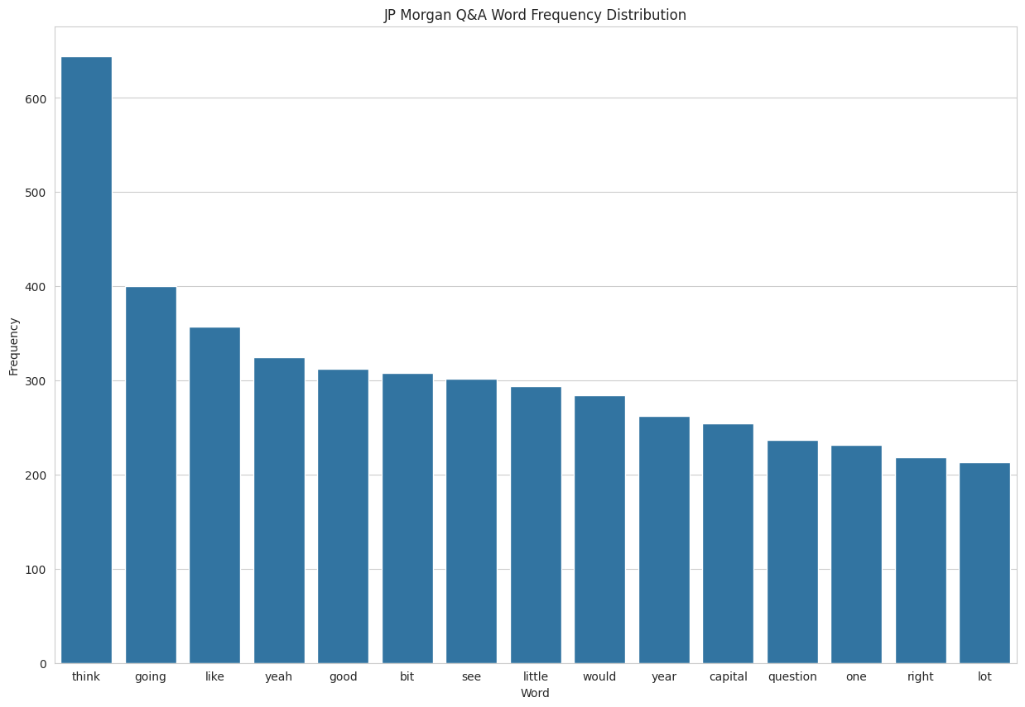
Top Words in Presentations vs Q&A
Goldman Sachs
JP Morgan
Presentation: Focus on “quarter,” “billion,” “revenues,” and “clients”—clear emphasis on financial performance and business growth.
Presentation: Top words are “year,” “billion,” “quarter,” and “net,” reflecting a strong financial reporting focus.
Q&A: Most common words include “think,” “business,” and “capital,” highlighting a more dynamic and interactive conversation.
Q&A: Words like “think,” “going,” “good,” and “capital” dominate, showing conversational and responsive dialogue with analysts.
03.07.2025 | Cambridge Institute Continued Education | Data Science with Machine Learning & AI Career Accelerator

Slide 13
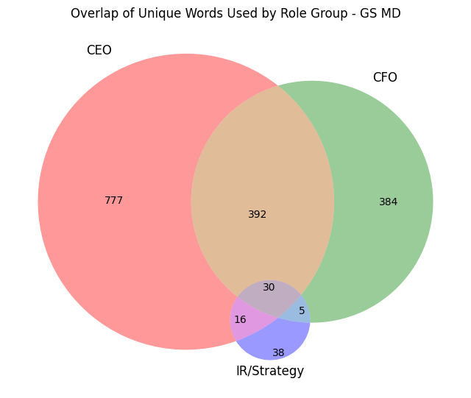
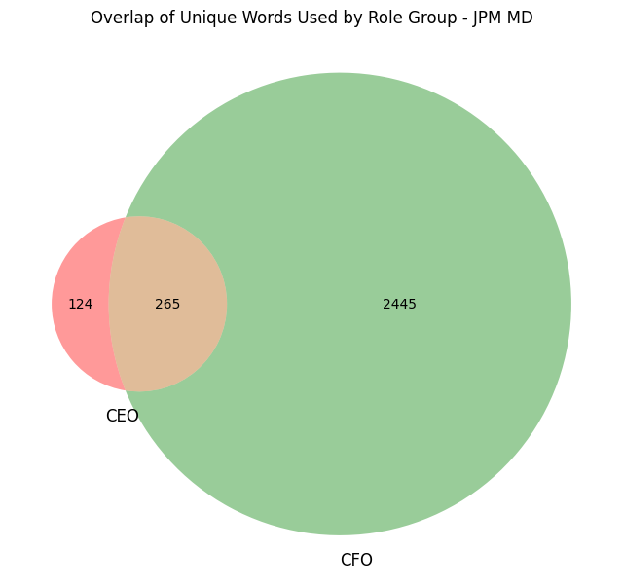
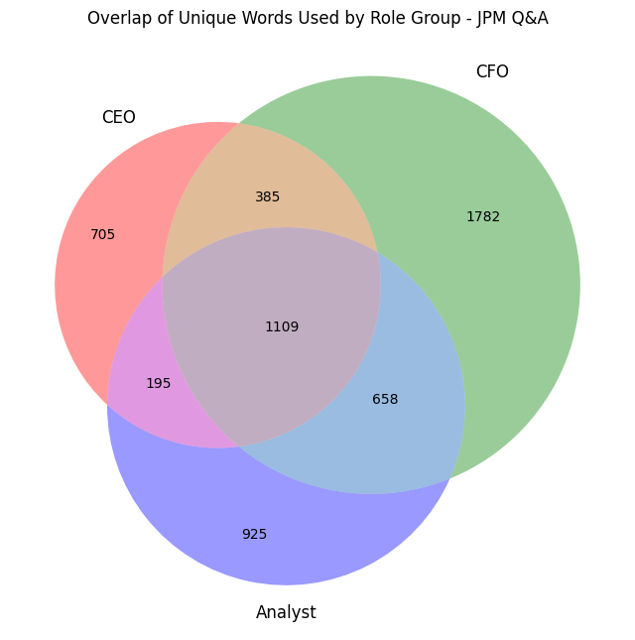
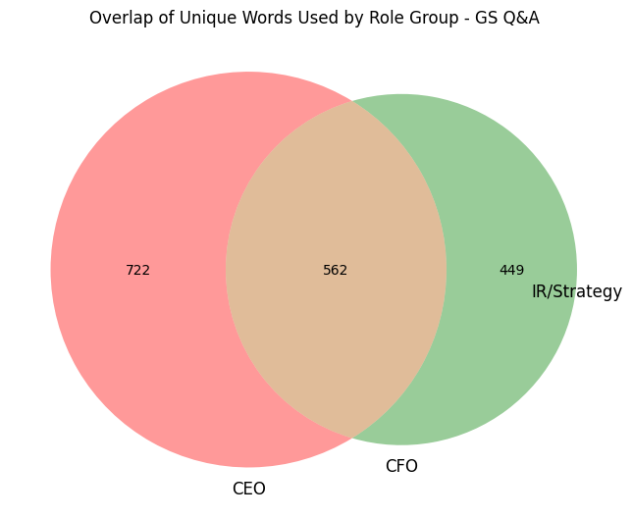
Role-Based Language & Overlap
Goldman Sachs
JP Morgan
Presentation: The CEO uses the most unique terms, with moderate overlap with CFO. IR/Strategy’s unique word count is minimal, reinforcing their targeted participation.
Presentation: The CFO dominates unique word usage, with only minimal overlap with CEO—showing the CFO’s central role in prepared management discussions.
Q&A: CEO and CFO roles share a significant portion of vocabulary, but each also uses a distinct set of words. IR/Strategy is the most specialized, with limited overlap—highlighting their distinct communication focus.
Q&A: Analyst, CFO, and CEO all share a large common vocabulary, but each group brings substantial unique language. Analysts especially contribute diverse terminology, reflecting varied questions.
03.07.2025 | Cambridge Institute Continued Education | Data Science with Machine Learning & AI Career Accelerator

Slide 14
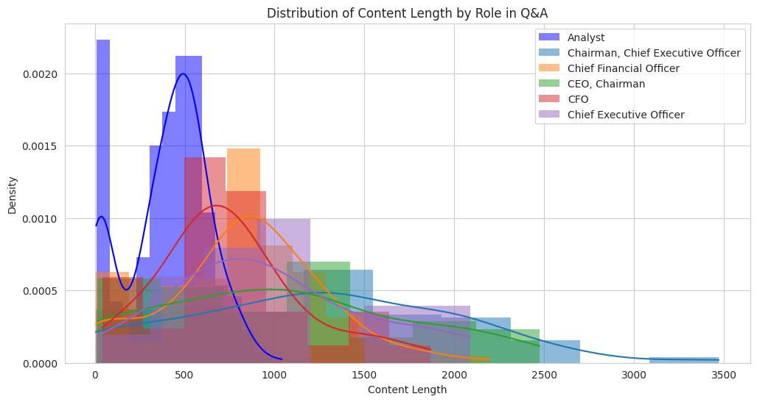
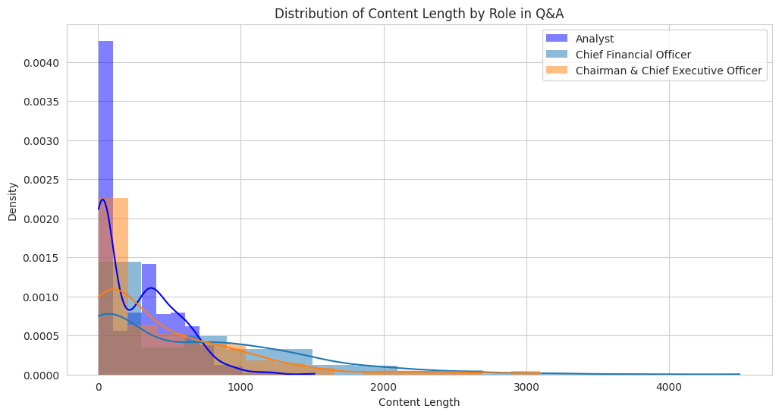
Content Length by Role
Goldman Sachs
JP Morgan
Goldman Sachs:
JP Morgan
Goldman Sachs analysts tend to ask longer, more detailed questions than those at JP Morgan, peaking around 500 characters on average.
A smaller peak at 50 characters still reflects some use of short or filler content, though it's less dominant than at JP Morgan.
This contributes to Goldman Sachs’ higher average analyst question length (407.21 vs. 273.18 characters).
The CEO at Goldman Sachs delivers consistently detailed responses, peaking around 1200 characters and extending up to 3500, surpassing both their own CFO and JPM’s CEO in length.
The CFO tends to be more concise, clustering around 800 characters with a sharper focus and shorter tail (ending near 2100 characters).
Overall, Goldman Sachs’ leadership shows a clear division of communicative roles, with the CEO offering in-depth strategic insights and the CFO delivering focused operational responses.
Analysts mostly ask very short questions, often consisting of greetings or acknowledgments, with a peak at 50 characters.
A smaller secondary peak near 500 characters points to some multi-part or more detailed questions.
The high volume of non-substantive content suggests preprocessing could help isolate meaningful analyst input.
The CFO tends to be concise but can deliver in-depth responses, with a long tail stretching to 4700 characters.
The CEO also provides concise answers but has a shorter response limit (up to 3100 characters), indicating a preference for strategic summaries over exhaustive detail.
These patterns imply distinct communication roles: analysts for brevity and social cues, CFOs for operational depth, and CEOs for strategic clarity.
03.07.2025 | Cambridge Institute Continued Education | Data Science with Machine Learning & AI Career Accelerator

Slide 15
Conclusion
In summary, this EDA confirms that simply analyzing raw text is insufficient. By segmenting data by speaker role and scrutinizing communication patterns like content length and specific vocabulary, we can extract far more meaningful and actionable intelligence from complex financial disclosures. These insights will directly inform the development of advanced NLP models and Large Language Models (LLMs) in the next phases of this project, enabling more precise information extraction, topic modeling, and sentiment analysis to further enhance the Bank of England's risk assessment capabilities.
03.07.2025 | Cambridge Institute Continued Education | Data Science with Machine Learning & AI Career Accelerator

Slide 16
Key Insight 1: Nuanced Sentiment – Divergence & Subtlety
03.07.2025 | Cambridge Institute Continued Education | Data Science with Machine Learning & AI Career Accelerator

Slide 17
Objectives
Examine overall tone of conversations during earning calls
Provides a structured view of diverging sentiment dynamics sessions and
Summarize all instances of sentiment divergence in earnings call Q&A between analysts and management
Provide explanations of the underlying mismatch in perspective.
Support PRA analysts by highlighting areas of potential concern or disconnect.
03.07.2025 | Cambridge Institute Continued Education | Data Science with Machine Learning & AI Career Accelerator

Slide 18
Methodology
Preprocessing
Traditional Sentiment Analysis
Q & A Pair Grouping
Phi-4 mini instruct
Outcome Reporting
03.07.2025 | Cambridge Institute Continued Education | Data Science with Machine Learning & AI Career Accelerator

Slide 19
LLM Driven Analysis
Regulatory Persona: LLM is framed as a financial assistant to a banking regulator (PRA), ensuring alignment with supervisory priorities.
Prompt Template: Structured Q&A prompts guide the model to explain sentiment differences and highlight potential risk areas in 1–2 sentences.
Targeted Extraction: A pipeline pairs analyst questions with management responses, flags sentiment divergence, and feeds high-signal cases into the model.
Focused Reasoning (Phi-4-mini): Phi-4-mini-instruct provides concise, financially grounded explanations that populate an enriched dataset and support PRA-facing reports.
03.07.2025 | Cambridge Institute Continued Education | Data Science with Machine Learning & AI Career Accelerator
Notes:
By "feeds high-signal cases into the model," I mean the pipeline selectively processes only Q&A pairs where a meaningful sentiment divergence exists

Slide 20
Sentiment Divergence Explained — An Example
Year: 2023, Quarter: 4
Analyst Question (Sentiment: Negative): Great. And on the flip side, in C&I;, you spoke about lower revolver utilization, more muted demand. What would it take for that to rebound? Do you think it accelerates from here if rates come down or is there room for this to slow even further if the capital markets open up even more ?
Management Answer (Sentiment: Neutral): Yeah. It's a good question. I mean, I think as you say, it's a little bit of a – I mean, I wouldn't necessarily say that, like, lack of debt market access in the last year, that was more of an earlier effect in terms of having that drive revolver utilization. I think the main driver there is just a little bit of residual anxiety in the C-suite, which increases as the companies get smaller in size. So, it's really going to be a function of how 2024 plays out. The softer the landing is, the more supported the utilization should be, I would think. If things turn out a little bit worse, I think management teams are going to be incrementally more cautious about CapEx and so on, and so you might see utilization even lower.
Explanation: The analyst expresses concern about lower revolver utilization and muted demand, suggesting a negative outlook, while management remains neutral, attributing the issue to residual anxiety and the uncertain economic outlook for 2024. The analyst's sentiment is driven by a fear of continued low demand and potential further decline, while management's sentiment is cautious, focusing on the impact of economic conditions on capital expenditure and utilization. Risk areas to focus on: Monitor the impact of economic conditions on capital expenditure and utilization, as well as the potential for further decline in demand and its effect on the company's financial health.
03.07.2025 | Cambridge Institute Continued Education | Data Science with Machine Learning & AI Career Accelerator

Slide 21
Impact on the PRA
Enhanced Supervisory Insight: Enables systematic, scalable detection of early risk signals by highlighting informational asymmetries, unacknowledged vulnerabilities, and instances where management downplays analyst concerns.
Regulatory Foresight & Thematic Reviews:Aggregates divergence patterns across firms and sectors to identify emerging systemic risks (e.g., credit tightening, market access stress), uncover themes for deeper review, and spotlight firms with persistent sentiment misalignment.
Behavioral & Governance Red Flags: Surfaces signs of overconfidence, lack of transparency, or cultural weaknesses in leadership. Supports governance evaluations, disclosure quality assessments, and early detection of risk management issues.

Slide 22
Potential Improvements
Enhance financial reasoning with domain-adaptive training by:
Integrating financial glossary via a RAG for enhanced language understanding
Add more sources of data ie. 10q/k reports, presentations, etc.
Test against real supervisory use cases — Human in the loop Refinement
Expand Explanation Quality with Chain-of-Thought Prompting

Slide 23
Key Insight 2: Proactive Risk Identification & Summarization
03.07.2025 | Cambridge Institute Continued Education | Data Science with Machine Learning & AI Career Accelerator

Slide 24
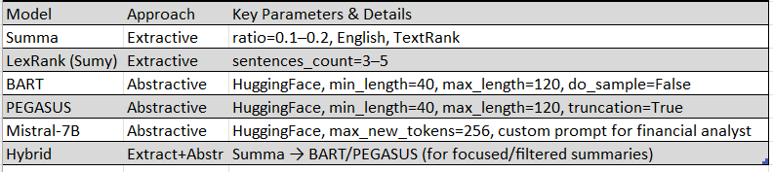
Methodology – LLM-Driven Risk Summarization Workflow
Transcript
Summarization Pipeline:
Extractive Models
Abstractive Models
Hybrid Approach
Risk Phrase Identification
Iterative Prompting & Validation:
03.07.2025 | Cambridge Institute Continued Education | Data Science with Machine Learning & AI Career Accelerator
Notes:
We benchmarked multiple extractive and abstractive models, including open-source LLMs, each tuned with explicit parameters for concise and risk-sensitive summaries. This ensures transparency and reproducibility for regulatory review or future audits

Slide 25
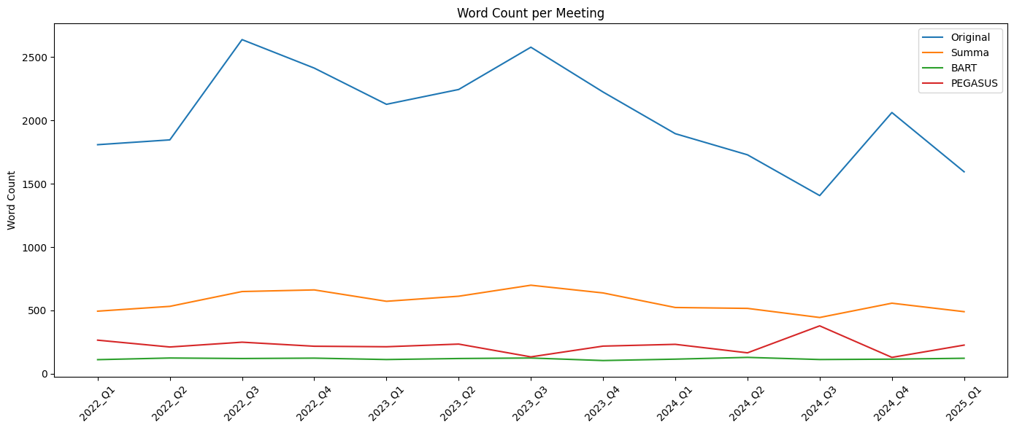
The LLM’s Role – Efficient Information Distillation
LLMs condense large, complex transcripts into concise, executive-ready summaries.
Both extractive (Summa) and abstractive (BART, PEGASUS) models tested for effectiveness.
Between 2022 Q1 and 2025 Q1, original transcripts consistently had the highest word counts, representing full meeting content. Among the summarization models shown—BART, PEGASUS, and T5—BART and PEGASUS produced the most compressed outputs. T5 offered summaries that were slightly longer, suggesting a trade-off between brevity and detail retention.
A potential risk is that overly compressed summaries—particularly from BART and PEGASUS—may omit nuanced discussions or critical context, which could impact decision-making accuracy in sensitive financial or strategic environments.
03.07.2025 | Cambridge Institute Continued Education | Data Science with Machine Learning & AI Career Accelerator
Notes:
LLMs reduce information overload and enable executives to focus on the big picture, without wading through pages of transcript
While we tested Mistral alongside BART and PEGASUS, its results aren’t included in this plot, since we did not have the human-written gold standards required for a fair quantitative evaluation.

Slide 26
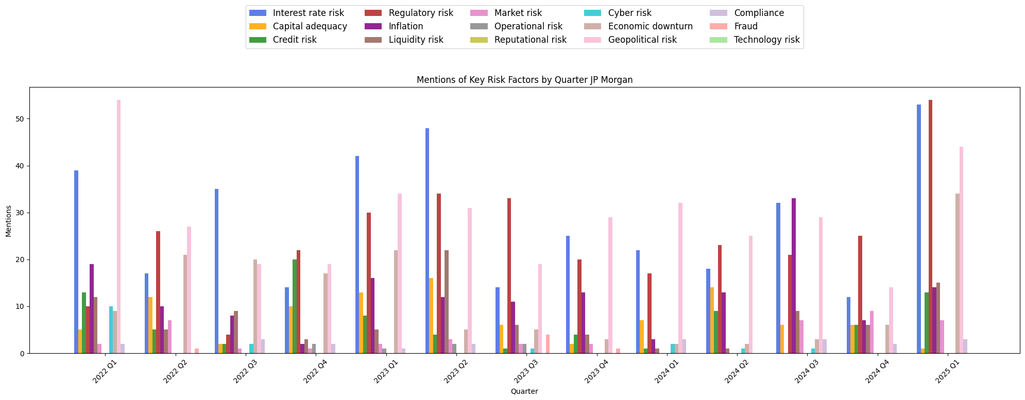
Hidden Risk Analysis – Surfacing Non-Obvious Risks
LLMs are prompted to highlight hedging and risk language: e.g., “may impact”, “volatility”, “uncertain”.
Automated extraction of risk/cautious phrases using regex and pattern matching from LLM output.
Mistral Risk Factors by Quarter Q&A
Reliance on LLMs for risk extraction introduces challenges: LLMs may miss implicit risks if phrasing is novel or ambiguous, may underreport rare but critical risk mentions, or may over-summarize, leading to omission of important details—making regular validation, precise tuning and human oversight essential.
03.07.2025 | Cambridge Institute Continued Education | Data Science with Machine Learning & AI Career Accelerator
Notes:
Our approach surfaces both explicit and subtle risks—even those buried in cautious or non-committal language that traditional models or manual review might overlook

Slide 27
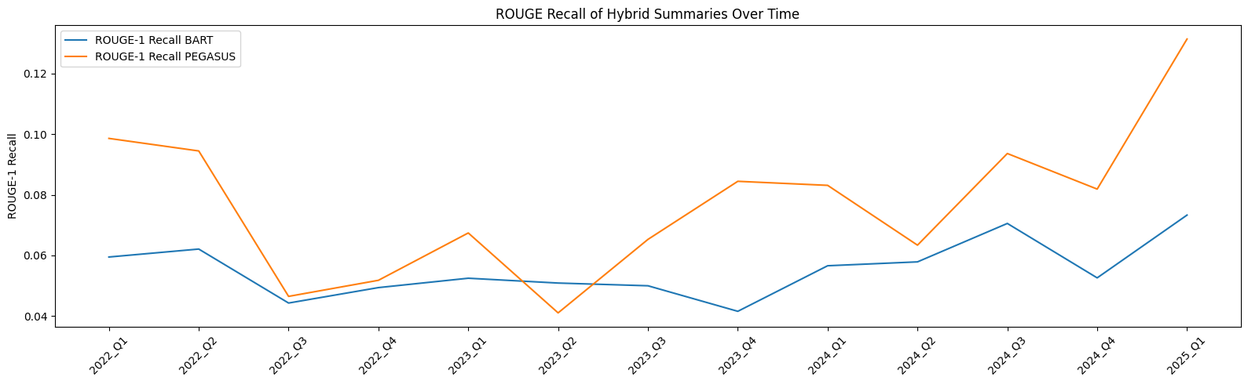
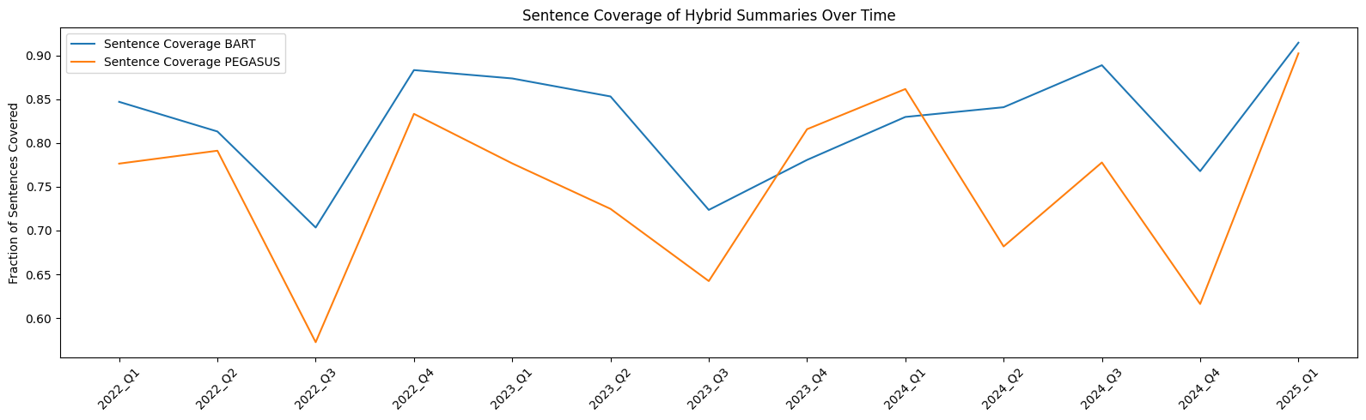
Model Comparison & Deployment Considerations
Benchmarked Models: BART and PEGASUS (abstractive LLMs) using ROUGE-1 recall and sentence coverage.
Evaluation Metrics: ROUGE-1 Recall, Sentence Coverage
RISK: both models can occasionally hallucinate or miss subtle but critical risk cues, so ongoing human validation and prompt refinement are necessary before deployment in sensitive, compliance-focused settings.”
Mistral was also evaluated as part of our experimentation pipeline. Its summaries were generally concise and relevant, particularly on financial topics. However, Mistral was not included in this formal ROUGE and coverage benchmark because human-generated ‘gold standard’ summaries were not available for these meetings, making direct quantitative comparison infeasible.
03.07.2025 | Cambridge Institute Continued Education | Data Science with Machine Learning & AI Career Accelerator
Notes:
“We directly compared BART and PEGASUS, two top LLM summarization models, using ROUGE-1 recall and sentence coverage as our evaluation metrics.”
“The ROUGE-1 recall plot shows PEGASUS typically achieves higher recall, capturing more of the main content, while BART’s performance is also robust across quarters.”
“Looking at sentence coverage, BART tends to include a broader range of discussion points from the original text, whereas PEGASUS is often more concise and focused.”
“There is a clear trade-off: PEGASUS excels at distilling the main message, but BART provides greater coverage for context-heavy material.”
“Importantly, both models can occasionally hallucinate or miss subtle but critical risk cues, so ongoing human validation and prompt refinement are necessary before deployment in sensitive, compliance-focused settings.”

Slide 28
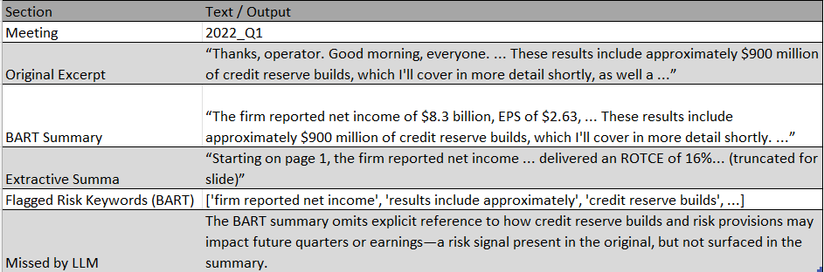
Limitations & Real-World Missed Risk Example
LLMs may hallucinate, over-summarize, or miss nuance—especially with risk disclosures.
Real Example (2022_Q1):
This real example shows BART summarized the numbers, but omitted nuance around credit reserve builds—a classic risk flag for analysts. Such omissions reinforce the need for human review in regulated or risk-sensitive workflows
03.07.2025 | Cambridge Institute Continued Education | Data Science with Machine Learning & AI Career Accelerator
Notes:
This real example shows BART summarized the numbers, but omitted nuance around credit reserve builds—a classic risk flag for analysts. Such omissions reinforce the need for human review in regulated or risk-sensitive workflows

Slide 29
Summary and Recommendations
Strengths:
PEGASUS: Achieves high ROUGE-1 recall and tightly captures main points and risk language
BART: Provides broader coverage and captures more context and nuance.
Mistral: Generates concise, relevant summaries and demonstrates strong performance on financial terminology and short-form text.
Limitations:
All models: Can hallucinate and may miss or misstate important quantitative values, especially in complex or data-rich discussions.
PEGASUS: Sometimes omits secondary details and tends to be too narrative.
BART: Sometimes produces longer summaries that include less relevant information, making it harder to pinpoint the key messages.
MITRAL: Sometimes fails to surface subtle risk cues compared to BART/PEGASUS, and its performance is more variable across quarters.
Recommendations:
Increase human validation
Create gold-standard benchmarks
Refine LLM prompts
Implement automated checks
03.07.2025 | Cambridge Institute Continued Education | Data Science with Machine Learning & AI Career Accelerator
Notes:
To further strengthen this workflow, we recommend regularly validating LLM summaries with human review, with particular attention to quantitative accuracy and the faithful representation of risk. Developing a set of gold-standard, human-written summaries will enable more robust evaluation and benchmarking of all models, including Mistral. As new language patterns and risks emerge, continuous prompt refinement and periodic retraining should be pursued. Finally, automated checks for missing key numbers or risk phrases can be implemented to improve quality control before summaries reach decision-makers.

Slide 30
Key Insight 3: Actionable Intelligence for Supervisory Teams
03.07.2025 | Cambridge Institute Continued Education | Data Science with Machine Learning & AI Career Accelerator

Slide 31
Key Objectives
Proactively identify potential concerns from earnings call transcripts.
Generate targeted, insightful follow-up questions for supervisory engagement.
Transcript
Phi-4
(Persona & Criteria)
Identify Concerns
Follow-up Questions
03.07.2025 | Cambridge Institute Continued Education | Data Science with Machine Learning & AI Career Accelerator

Slide 32
Our Phi-4 LLM-Driven Approach
PRA Analyst Personas: LLM guided by a defined persona and specific criteria for concerns.
Prompt Engineering & In-Context Learning: Meticulous prompt design, utilizing multi-shot examples for refined understanding.
Targeted Extraction: Pipeline systematically processes analyst questions to pinpoint relevant statements of concern.
Intelligent Question Generation: Based on identified concerns, phi-4 formulates relevant and probing follow-up questions.
03.07.2025 | Cambridge Institute Continued Education | Data Science with Machine Learning & AI Career Accelerator

Slide 33
Example Areas of Concern
Statement: "So we had worked all that out at Investor Day and talked about 12.5% to 13% target, which implies sort of a modest buffer to be used flexibly based on what we expected would be some increase in SCB. Obviously, the increase came in a bit higher than expected, so for now, we're really focused on 1Q 2023."
Area of Concern: Capital Adequacy & Solvency
Explanation: "The acknowledgment that the SCB increase was higher than expected and the focus on short-term targets (1Q 2023) without a clear long-term strategy for capital adequacy could be concerning. The PRA would be interested in the firm's plans to address the higher-than-expected SCB and ensure that capital levels remain robust in the face of regulatory changes."
03.07.2025 | Cambridge Institute Continued Education | Data Science with Machine Learning & AI Career Accelerator

Slide 34
Example Targeted Follow-up Questions
Based on the statement from Jeremy Barnum regarding the higher-than-expected SCB increase and short-term capital targets:
Focusing on detail/quantification: Can you provide a detailed plan on how the firm intends to adjust its capital targets to accommodate the higher-than-expected SCB increase?
Focusing on risk mitigation/controls: What measures are being taken to ensure that the firm's capital levels remain robust in the face of these regulatory changes?
Focusing on governance/future plans: How is the firm's governance structure ensuring that long-term capital adequacy is not compromised by focusing on short-term targets?
Focusing on contingency/broader impact: What are the potential risks to the firm's solvency if the capital targets are not adjusted in response to the higher SCB, and how does the firm plan to mitigate these risks?
03.07.2025 | Cambridge Institute Continued Education | Data Science with Machine Learning & AI Career Accelerator

Slide 35
Impact For The PRA Team
Efficiency: Automates initial screening of extensive textual data.
Enhanced Depth: Uncovers subtle and implicit risks often overlooked.
Proactive Engagement: Directly supports informed and targeted supervisory inquiries.
Foundational Framework: Provides an extensible method for ongoing risk monitoring.
03.07.2025 | Cambridge Institute Continued Education | Data Science with Machine Learning & AI Career Accelerator

Slide 36
Potential Improvements
Using an LLM Fine-tuned on Financial Text.
Incorporating a Glossary of Financial Terms with RAG.
Potentially also taking the Presentation itself as Additional Information.
03.07.2025 | Cambridge Institute Continued Education | Data Science with Machine Learning & AI Career Accelerator
Notes:
Using an LLM Fine-tuned on Financial Text:
Benefit: A model pre-trained or fine-tuned on a vast corpus of financial documents (earnings reports, analyst calls, regulatory filings, news) would inherently understand financial jargon, specific market dynamics, and common reporting practices far better than a general-purpose LLM like phi-4 out-of-the-box. This would lead to more precise identification of concerns and more contextually accurate follow-up questions.
Impact: Reduces hallucination, improves understanding of complex financial relationships, and better interprets subtle cues common in financial discourse.
Incorporating a Glossary of Financial Terms with RAG (Retrieval Augmented Generation):
Benefit: This is a very powerful addition. RAG would allow the LLM to access an external, authoritative knowledge base (your financial glossary) at inference time. If the LLM encounters a specific term or concept, it can retrieve its definition or related information from the glossary, ensuring factual accuracy and a deeper understanding of the context.
Impact: Ensures consistent interpretation of technical terms, prevents misunderstandings of niche financial concepts, and grounds the LLM's responses in verified information, which is critical for a regulatory body like the PRA. It helps overcome the "black box" nature of LLMs by providing transparent, retrievable context.
Potentially also taking the Presentation itself as Additional Information:
Benefit: Earnings call transcripts are often accompanied by a presentation slide deck. This slide deck contains key figures, charts, and often condensed summaries or forward-looking statements that are visually highlighted. Providing this to the LLM as additional context (e.g., as part of the prompt or via RAG if the content is extractable) could significantly enrich its understanding.
Impact: Helps the LLM connect spoken commentary with presented financial data, understand management's emphasis, and identify potential discrepancies or areas where the spoken word deviates from the presented visual. It provides a more holistic view of the communication.

Slide 37
Key Insight 4: Strategic Understanding through Topic Modelling
03.07.2025 | Cambridge Institute Continued Education | Data Science with Machine Learning & AI Career Accelerator

Slide 38
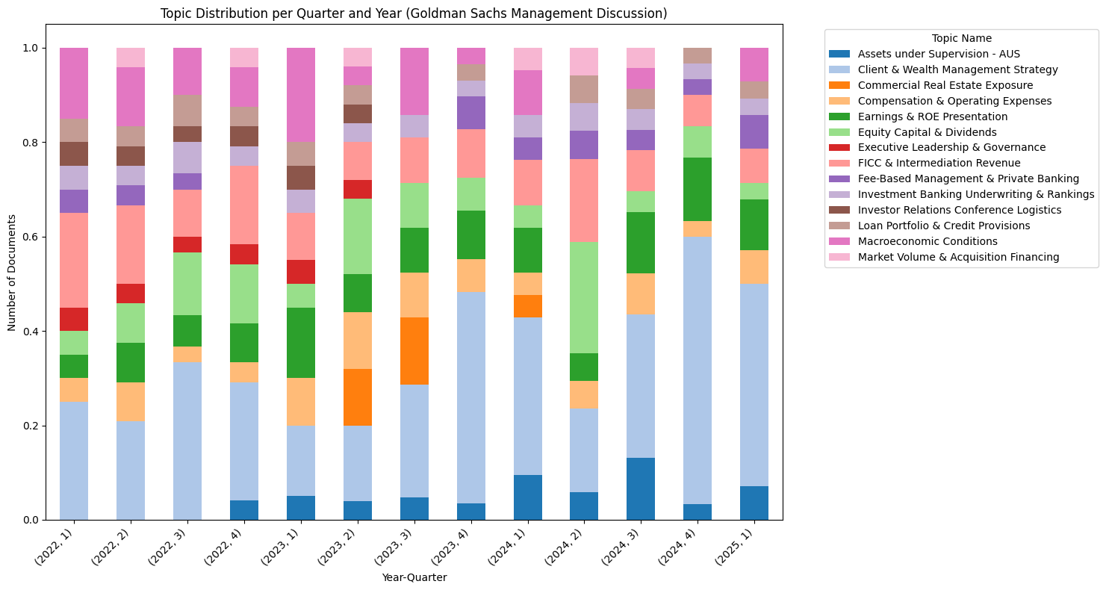
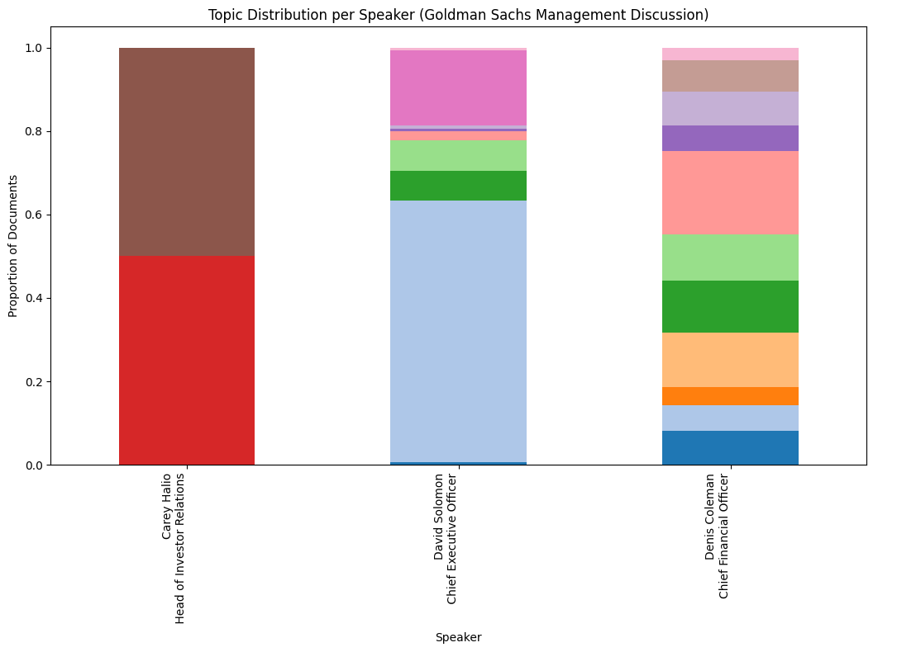
Increase mentions in client & wealth management strategy inline with AUS and fee-based management & private banking
Mentions of commercial real estate exposure in the year 2023 signifies de-risking strategies - droppin from $15 billion to $8.4 billion from q1 2023 to q1 2024
Mentions of Executive Leadership & Governance and Investor Relations Conference Logistics disappear from Q3 2023 onwards
Consistent mentions of FICC highlights its importance as a core revenue driver - although FICC can be volatile, Goldman Sachs has a strong and diverse FICC business
03.07.2025 | Cambridge Institute Continued Education | Data Science with Machine Learning & AI Career Accelerator

Slide 39
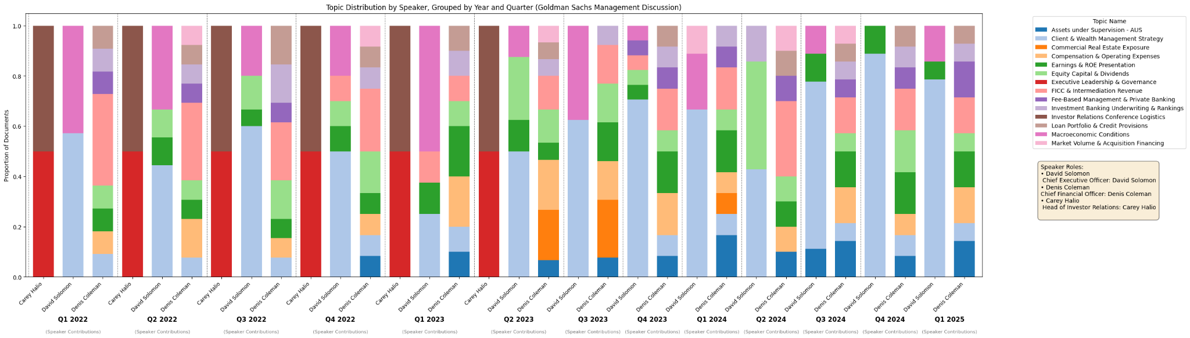
Structural changes in the company - Carey Halio promoted to Global Treasurer, replaced by Jehan Ilahi, in april 2024
Carey Halio's promotion to Global Treasurer signals Goldman Sachs' heightened strategic focus on financial resilience, disciplined capital management, and stable funding to support its pivot towards more recurring revenue streams.
03.07.2025 | Cambridge Institute Continued Education | Data Science with Machine Learning & AI Career Accelerator
Notes:
Building on our discussion of Goldman Sachs' strategic shifts, one significant internal move reinforces their commitment to stability: Carey Halio's promotion to Global Treasurer. This isn't just an executive reshuffle; it signals Goldman Sachs' heightened strategic focus on financial resilience, disciplined capital management, and ensuring stable funding. In a volatile market, putting a seasoned leader with a deep background in risk and balance sheet management into this critical role directly supports their overarching goal of pivoting towards more consistent, recurring revenue streams, especially within their Asset & Wealth Management and Platform Solutions businesses.

Slide 40
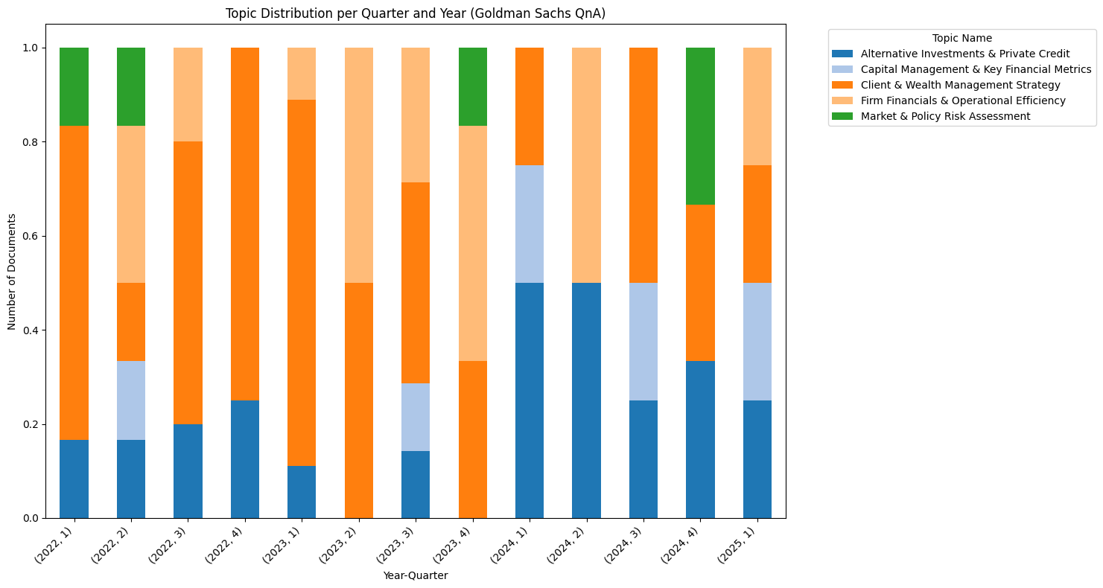
Mentions of alternative investments & private credit remain relatively low but saw a sharp spike in Q1 and Q2 2024
Increase in interest of Alternative Investments & Private Credit
Strategic clarity: consistent messaging on AWM growth
Market Momentum in private credit
03.07.2025 | Cambridge Institute Continued Education | Data Science with Machine Learning & AI Career Accelerator

Slide 41
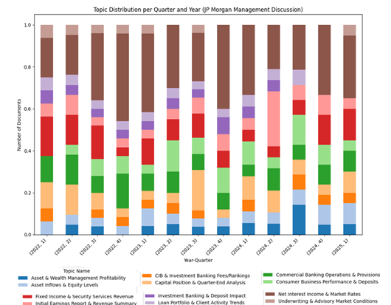
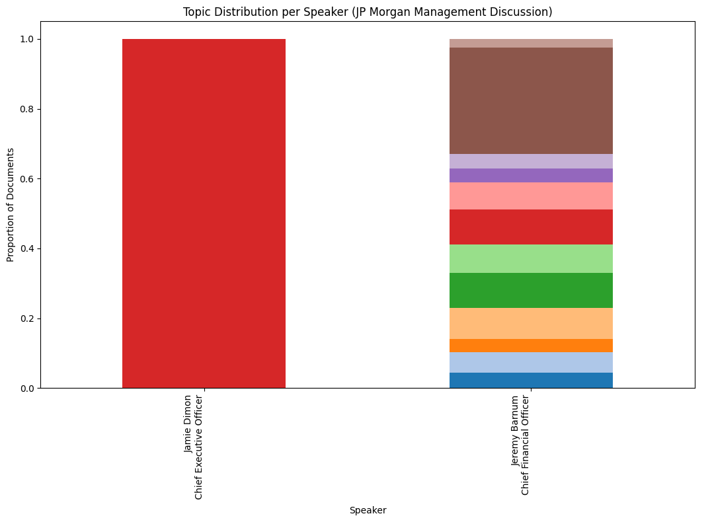
Topic discussions appear more consistent and structured over the last 3 years compared to Goldman Sachs
"NII & Market Rates" topic spikes primarily reflect periods of significant central bank interest rate changes (hikes in 2022-2023) and subsequent intense management discussion and re-forecasting around their impact on bank profitability and future rate expectations, particularly during year-end (Q4) and beginning-of-year (Q1) reporting cycles.
Mentions of topics “Investment Banking & Deposit Impact” and “Loan Portfolio & Client Activity Trends” appear to cease from Q3 and Q4 2024 respectively - No indication pertaining to external effects but likely management discussion restructuring.
03.07.2025 | Cambridge Institute Continued Education | Data Science with Machine Learning & AI Career Accelerator

Slide 42
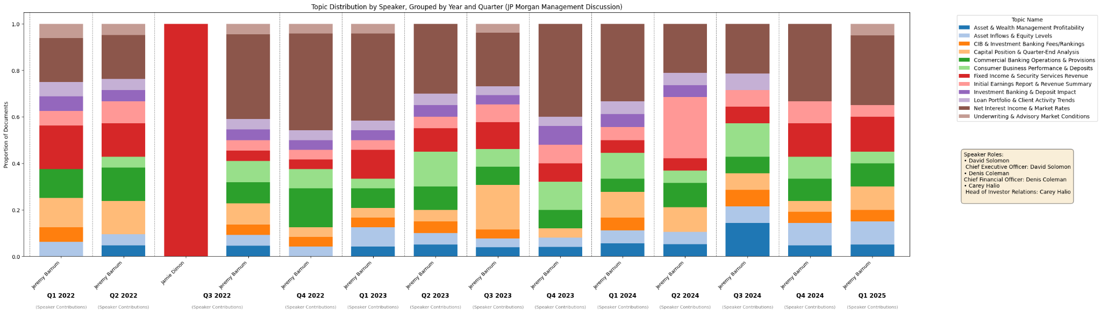
Speaker Roles:
Jamie Dimon: CEO
Jeremy Barnum: CFO
In CFO’s discussion he focuses heavily on Net Interest Income (NII) and market rates as NII is primary revenue source for the bank and Market rates determine interest income and expenses.
Jamie Dimon's prominent Q3 2022 remarks stemmed from a period of high macroeconomic uncertainty (e.g., "economic hurricane" warnings), where he provided crucial strategic guidance on capital and interest rate management, offering direct reassurance on the bank's resilience.
03.07.2025 | Cambridge Institute Continued Education | Data Science with Machine Learning & AI Career Accelerator

Slide 43
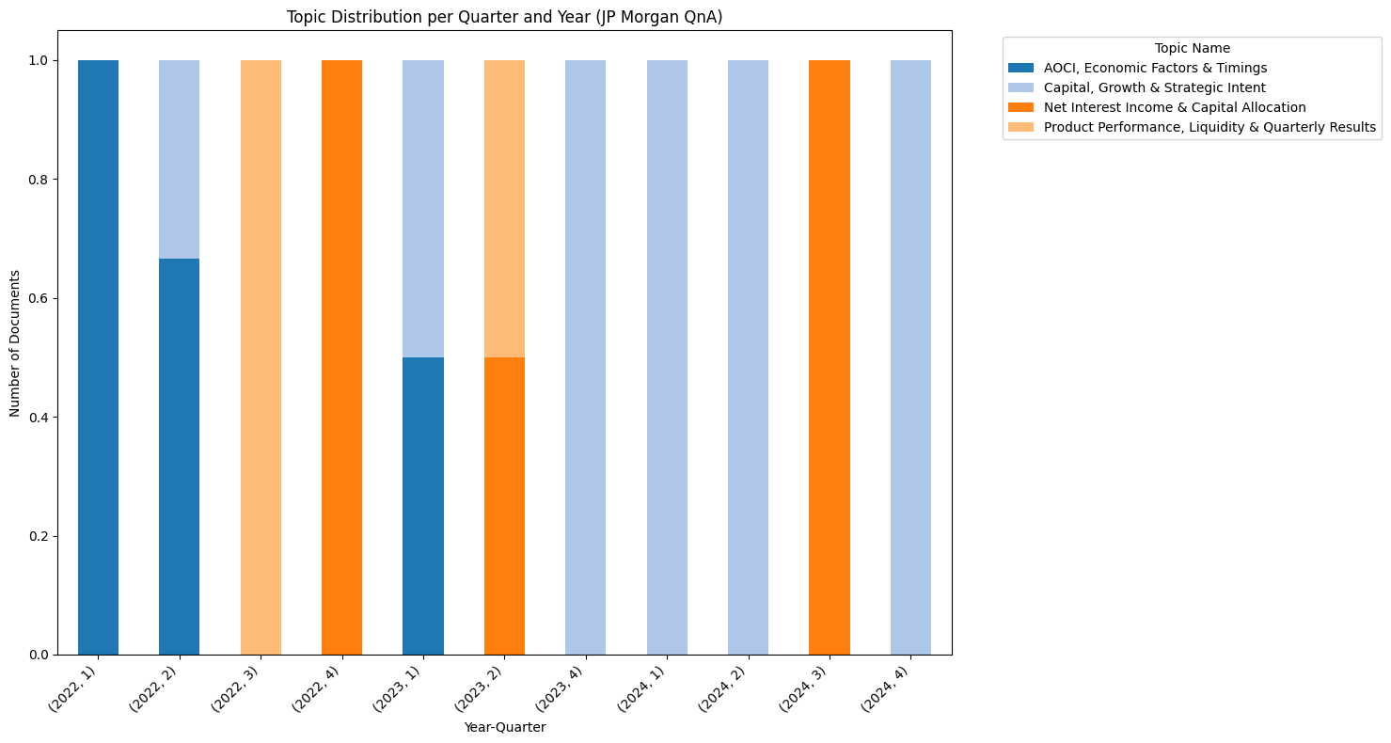
Early Focus (2022): Initial questions largely centered on macroeconomic factors, their timing, and balance sheet impacts like AOCI
Dominant Later Focus (2023-2024): The conversation quickly shifted and became consistently dominated by Net Interest Income (NII) & Capital Allocation and Capital, Growth & Strategic Intent.
Transient Concerns: Topics like Product Performance, Liquidity & Quarterly Results surfaced intensely but briefly
03.07.2025 | Cambridge Institute Continued Education | Data Science with Machine Learning & AI Career Accelerator
Notes:
In Q1 2022, JPMorgan flagged AOCI (Accumulated Other Comprehensive Income) as a key concern—primarily because sharp mark-to-market losses on its available-for-sale securities weighed heavily on its CET1 capital ratio, a critical regulatory cushion. Because of unrealized bond losses which eroded its CET1 ratio—a factor that influenced its flexibility on capital returns, regulatory compliance, and future growth strategy.
In Q2 2022, JPMorgan experienced high inflation, geopolitical uncertainty (esp. Russia‑Ukraine), and quantitative tightening as pressuring the macro outlook, slower loan growth & weaker investment-bank fees. As a direct result, JPMorgan paused its share buybacks to strengthen capital buffers in light of these headwinds which is reflected in the topic that took place of AOCI.
In Q2 2024, JPMorgan observe growth in revenue and profit and focus on the strategy to tackle geopolitical tensions, persistent inflation, and rising interest rates remain risks despite current strength
In Q3 2024, Incomes of JPMorgan beat expectations due to significant contribution from net interest income (NII), record investment banking fees and strong trading returns.
During Q4 2024, JPMorgan’s primary focus was on the growth in investment banking and trading, paired with strong profitability, strategic capital deployment, and cautious strategy on macroeconomic commentary.

Slide 44
Conclusion & Future Directions
03.07.2025 | Cambridge Institute Continued Education | Data Science with Machine Learning & AI Career Accelerator

Slide 45
Conclusions
Preliminary results demonstrate the potential of advanced NLP and LLMs to efficiently identify, assess, and monitor emerging risks and strategic shifts from earnings call data, directly addressing the business question
The six-week timeframe was restrictive, indicating that substantial further work is needed
More work is required to improve performance, refine capabilities, and prepare the system for production
03.07.2025 | Cambridge Institute Continued Education | Data Science with Machine Learning & AI Career Accelerator

Slide 46
Future Directions: Expand Data & Scope
Broader bank coverage
Extend time horizon
Additional public disclosures (Investor day presentations, 10-K, etc)
Extend out to different data types (numerical, image, video data)
03.07.2025 | Cambridge Institute Continued Education | Data Science with Machine Learning & AI Career Accelerator

Slide 47
Future Directions: Improve Model, Pipeline & Validation
Human in the loop (HITL)
LLM validation to improve
Continue fine-tuning existing models
Topic Modelling - Tag Models by risk level and forward feed these downstream for more comprehensive predictions
03.07.2025 | Cambridge Institute Continued Education | Data Science with Machine Learning & AI Career Accelerator

Slide 48
Future Directions: Bigger Picture
Add Interface / Output for predicted insights and alerts
Digital Twin and Business Operational Environment (BOE) system
03.07.2025 | Cambridge Institute Continued Education | Data Science with Machine Learning & AI Career Accelerator

Slide 49
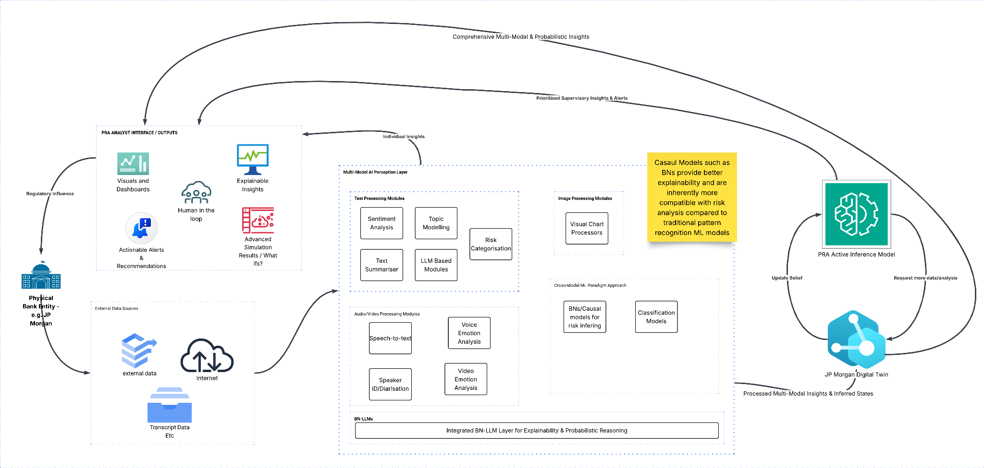
Digital Twin and Business Operational Environment (BOE) system likely Predictive analytics and risk management
03.07.2025 | Cambridge Institute Continued Education | Data Science with Machine Learning & AI Career Accelerator

Slide 50
Q&A
Thank you for listening. We welcome any questions
03.07.2025 | Cambridge Institute Continued Education | Data Science with Machine Learning & AI Career Accelerator

