Slide 1

Machine Translation Quality Estimation
in the Era of Large Language Models
Knowing when a translation can be trusted and when a human must step in.
Dr Tharindu Ranasinghe
School of Computing & Communications · Lancaster University
Promoting Machine Translation & GenAI Translation Literacy Professional Translation & Interpreting Labour Market

Slide 2

About me
Lecturer at Lancaster University
My research area can be broadly classified as NLP for Social Good.
One of the topics I am active engaged is machine translation quality estimation (QE)

Slide 3
The argument
Reliable translation depends not only on building better translation systems but on our ability to estimate quality and flag risk at the point of use, without a reference translation.
I
How MT evolved
II
Bigger ≠ better
III
Why errors remain
Rules → reasoning machines
The limits of scale
Fluency is not fidelity
IV
What QE is
V
How QE evolved
VI
The human role
Trust without a reference
Features → LLM judges
Oversight & literacy

Slide 4

I
PART I
How machine translation evolved
Seven decades from hand-written rules to reasoning machines.

Slide 5










THE BIG PICTURE
Four paradigm shifts in seventy years
1950s–80s
1990s–2010s
2014–16
2017
2020s
Rule-based
Statistical
Neural
Transformer
LLMs
Dictionaries
& grammar rules
Learning from
parallel corpora
End-to-end
sequence models
Self-attention,
then scale
Translation as
a side-effect
Each shift made translation more fluent and more autonomous.

Slide 6
PARADIGM 1 · 1950S–1980S
Rule-based MT: translating by dictionary and grammar
Hand-crafted bilingual dictionaries and linguistic rules, written by experts.
The Georgetown–IBM experiment (1954) translated 60+ Russian sentences and sparked decades of optimism.
Transparent and controllable you can see exactly why a rule fired.
But brittle: rules multiply, conflict, and never cover real language.
“If-then” linguistics
Every grammatical exception
requires another rule.
Strength interpretable
Weakness does not scale

Slide 7


PARADIGM 2 · 1990S–2010S
Statistical MT: learning translation from data
IBM alignment models, then phrase-based SMT (e.g. Moses) translation as probability.
Learns “which phrase usually maps to which” from millions of aligned sentence pairs.
Powered the first decade of Google Translate (launched 2006).
Scales to any language with a corpus but output is locally stitched and often disfluent.
Parallel corpora
Probability model
Most-probable translation

Slide 8

PARADIGM 3 · 2014–2016
Neural MT: one model, end to end
Encoder–decoder “sequence-to-sequence” networks (2014) read a whole sentence, then generate the translation.
Attention (2015) lets the decoder look back at the most relevant source words a leap in fluency.
Google’s GNMT (2016) narrowed the gap to human translation on high-resource pairs.
Fluency soared but so did confident, hard-to-spot errors.
Encoder
Decoder
attention
Source → vector → fluent target
Quality jumps; transparency drops.

Slide 9


PARADIGM 4 · 2017
“Attention is all you need”
Self-attention replaced recurrence. Models could now be trained in parallel and scaled almost without limit. This single architecture underpins everything that followed.
Self-attention
Parallelism
Scalability
Every word attends to every other — long-range context, captured directly.
No left-to-right bottleneck; train on far more data, far faster.
The same design works at 65M or 65B parameters — just add scale.
The hinge of the whole story: from here, “more data + more parameters” became the dominant strategy.

Slide 10

PARADIGM 5 · 2020S
The LLM era: translation as a side-effect of scale
General-purpose LLMs translate without being built for translation.
Multilingual by default strong zero-shot translation across hundreds of languages.
On high-resource pairs, output is often indistinguishable from human translation.
One model, many tasks: translate, summarise, post-edit, explain in a single prompt.
“Good enough”, fast
Fluency is now cheap and abundant.
So the hard question is no
longer “can it translate?”
— it is “can I trust this one?”

Slide 11


Slide 12
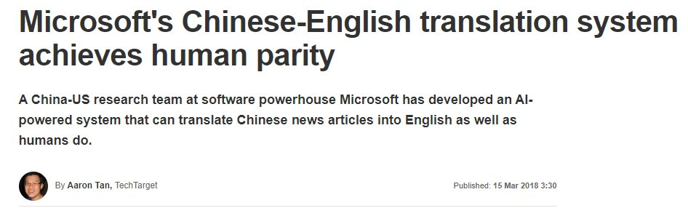
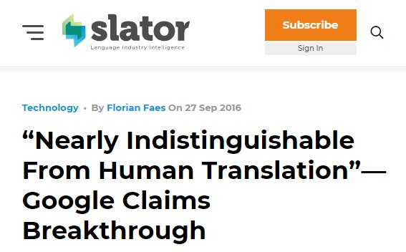

Slide 13
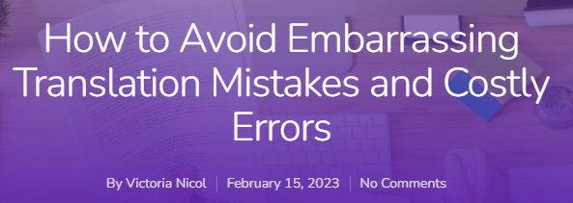
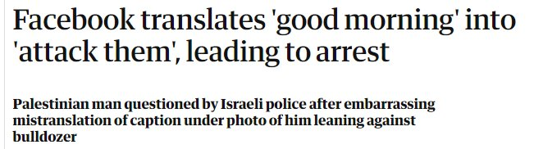
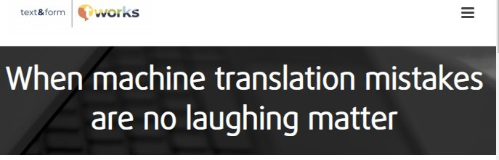
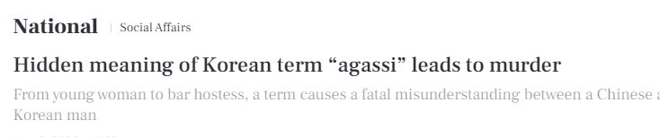
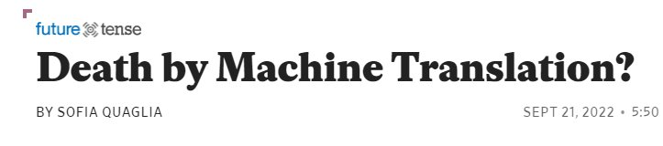

Slide 14

II
PART II
Bigger
but is it better?
A decade of explosive scaling, and what it did (and didn’t) fix.

Slide 15
THE SCALING CURVE
Parameters exploded — roughly 30,000× in seven years
~1.8T
540B
175B
1.5B
340M
65M
Transformer
BERT-large
GPT-2
GPT-3
PaLM
Frontier (MoE)
2017
2018
2019
2020
2022
2024+
Approximate parameter counts; the height axis is logarithmic (orders of magnitude). Frontier sizes are estimates.

Slide 16


THE UPSIDE
What scaling actually bought us
200+
0-shot
languages in a single model
translation, no training pair
Meta’s NLLB-200 put 200 languages — many low-resource — in one system.
LLMs translate pairs they were never explicitly trained on.
~Human
1 model
fluency on rich pairs
many tasks at once
On high-resource languages, raw output is often publication-smooth.
Translate, summarise, simplify and post-edit from a single prompt.

Slide 17

III
PART III
Yet the errors remain
Fluency is not the same as fidelity and scale does not erase risk.

Slide 18


THE CORE DANGER
Fluent does not mean faithful
Reads perfectly
May be wrong
Grammatical. Natural. Confident. Indistinguishable, on the surface, from a good human translation.
A mistranslated dose, a dropped negation, an invented clause wrapped in flawless prose.
This is exactly what makes modern MT useful and exactly what hides its mistakes.
The more fluent the output, the harder the error is to catch.

Slide 19





ANATOMY
The shapes MT errors take
Borrowing the Multidimensional Quality Metrics (MQM) lens, the failures cluster into recognisable types:
Mistranslation
Omission
Addition
The meaning is changed the most common and the most consequential.
Information present in the source silently disappears.
Content appears that was never in the source.
Terminology
Numbers & entities
Bias
Wrong domain term critical in legal, medical, technical text.
Dates, dosages, names and figures flipped or dropped.
Gender and other social biases reproduced or amplified.

Slide 20

THE WORST CASE
Hallucination: the confident, fluent fabrication
Output detached from the source plausible, fluent, and simply not what was said.
SOURCE
“The medication should not be taken with alcohol.”
FLUENT TRANSLATION (HALLUCINATED)
Why it is the hardest failure
“Take the medication together with a little alcohol.”
It reads perfectly nothing signals the error.
Most acute in low-resource pairs and out-of-domain input.
Grammatically perfect. Semantically inverted. Potentially dangerous.

Slide 21



WHERE IT MATTERS MOST
When a single error carries consequences
Legal
Medical
Government
A mistranslated clause shifts liability, voids a contract, or changes a verdict.
A flipped dosage or missed contraindication can directly harm a patient.
One wrong word in a statement can decide residency, rights, or a case.

Slide 22
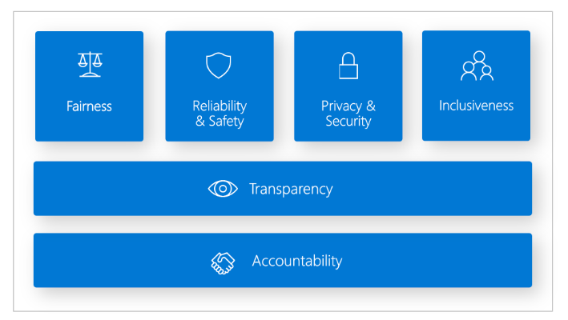

THE UNCOMFORTABLE TRUTH
Scaling makes errors rarer — not predictable
Bigger models lower the error rate. They do not tell you which sentence is the dangerous one.
The problem is not the error rate.
It is the uncertainty about where the errors are hiding and which ones matter.
Bigger and better is not always the answer.

Slide 23

IV
PART IV
Quality Estimation
A way to ask, right now and without a reference: can I trust this?

Slide 24

THE QUESTION THAT MATTERS
“Can I trust this translation?”
At the point of use.
Without a human reference.
Before the damage is done.

Slide 25


DEFINITION
Quality Estimation, defined
QE predicts the quality of a translation without access to a reference translation using only the source and the machine output.
Quality score
Source text
Risk flag
QE model
MT output
no reference required
Error spans
Run-time. At the point of use. On every new sentence.

Slide 26
A COMMON CONFUSION
Quality Estimation is not MT evaluation
MT Evaluation
Quality Estimation
NEEDS
a human reference translation
NEEDS
only the source + the MT output
COMPARES
MT output against a gold standard
JUDGES
this one translation, in isolation
USED
offline, on fixed test sets
USED
at run-time, on live content
ANSWERS
“How good is this system overall?”
ANSWERS
“Can I trust THIS translation, now?”

Slide 27
THE DEFINING DIFFERENCE
The reference is exactly what you don’t have when you need it
REFERENCE-BASED · research & benchmarking
Source
MT output
Human reference
Score
offline
REFERENCE-FREE (QE) · deployment & decision-making
Source
MT output
no reference
Score / flag
In real use a deadline, a patient, a court there is no gold translation to compare against. QE is built for precisely that moment.

Slide 28



HOW FINE-GRAINED?
QE at three levels of granularity
Word / span level
Which words are wrong? Highlight error spans.
Guides post-editing fix the flagged spans.
Sentence level
A single quality or risk score per segment.
Triage & routing send risky segments to a human.
Document level
Aggregate reliability across the whole text.
Decide whether the document needs human review at all.

Slide 29

V
PART V
How QE has evolved
From hand-crafted features to large language models as judges.

Slide 30
GENERATION 1 · 2009–2015
Feature engineering: QE by hand-crafted signals
Extract features: length ratios, language-model scores, word alignments then feed a regressor (often an SVM).
Tools: QuEst and QuEst++ defined the early pipeline.
The WMT Quality Estimation shared task begins in 2012 still the field’s benchmark today.
Strength: interpretable, lightweight.
Weakness: shallow, language-specific, and labour-intensive to design.
length ratio
LM score
Regressor
alignments
… dozens more
hand-built features → score

Slide 31

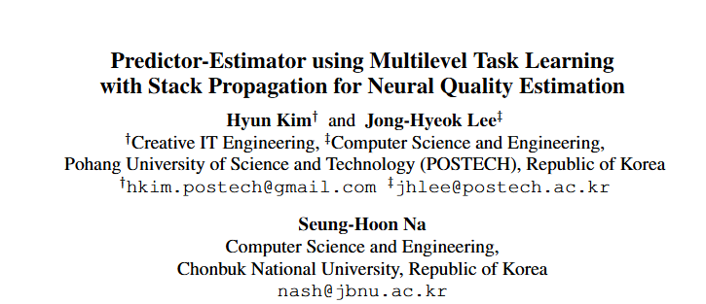
GENERATION 2 · 2017–2019
Neural QE: learn the representation, not the features
The predictor–estimator architecture (Kim et al.) and toolkits like deepQuest let the model learn quality signals directly from data.
RNN/LSTM encoders replace hand-crafted features.
Clear accuracy gains over feature-based QE.
But data-hungry and still trained one language pair at a time.
Representations,
not rules
The model discovers what “looks risky” — but needs labelled data for every language it must judge.

Slide 32

GENERATION 3 · 2020
TransQuest: cross-lingual transformers for QE
Built on multilingual transformers (XLM-R) so quality can be judged across many languages at once.
Two architectures
Cross-lingual transfer
Low-resource reach
MonoTransQuest (joint encoding) and SiameseTransQuest (paired encoders) for sentence-level QE.
Train on one pair, transfer to others — strong results even with little or no in-language data.
Brings usable QE to languages that never had enough labelled data of their own.
★ Open-source framework and a winning system at the WMT 2020 QE shared task — still a widely used QE baseline.

Slide 33

GENERATION 3+ · 2020–2022
Pretrained, learned metrics: COMET & CometKiwi
COMET (2020) trains a quality model on top of a pretrained multilingual encoder, learning directly from human judgments (Direct Assessment, MQM).
CometKiwi is the reference-free (QE) variant —a standard WMT baseline.
Human judgments
↓
learned QE model
Learns quality from people, not hand-built features.
One model serves many language pairs.
Outputs a single number accurate, but not yet explainable.
Quality, predicted from the source and translation alone calibrated against real annotators.

Slide 34

TOWARDS TRANSPARENCY · 2024
xCOMET: from a score to an explanation
xCOMET unifies a sentence-level quality score with fine-grained error-span detection and severity MQM-style. Not just “how good?” but “what is wrong, and how serious?”
TRANSLATION UNDER REVIEW
The contract is valid until March 2025 and may be renewed by either party.
Why it matters
Major — wrong date (mistranslation)
A score tells you to slow down. An error span tells you exactly where to look the difference between a warning and a guide.
Minor — terminology could be tighter
Quality score: 0.46 · flagged for review

Slide 35

GENERATION 4 · 2023–TODAY
LLMs as judges
Prompt an LLM to assess a translation with no reference GEMBA, GEMBA-MQM and AutoMQM use language-agnostic prompts to score quality and mark error spans.
Where the field is heading
WMT 2024 asked it directly: “Are LLMs closing the gap in QE?”
WMT 2025 unified the Metrics and QE tasks, and benchmarked 13 general-purpose LLMs as judges.
Focus is shifting to document- and context-level QE, not just single sentences.
The caveat
Powerful, but costly, opaque (black-box), and uneven for low-resource languages.

Slide 36
HONEST LIMITS
Where QE still falls short
Calibration
Low-resource gap
A score of 0.8 doesn’t mean the same thing across domains and language pairs.
The languages with least data carry the highest risk and the weakest QE.
Hallucination blind spots
Explainability & trust
The most dangerous errors remain the hardest to flag reliably.
A number with no reason behind it is hard for a professional to act on.

Slide 37

VI
PART VI
The human in the loop
QE does not replace the translator it repositions them.

Slide 38



THE LABOUR MARKET
QE empowers the professional as it does not replace them
MT / LLM
translates
QE flags
risk & errors
Human focuses
where it matters
Oversight
Risk management
Informed decisions
Review what QE marks as risky read with attention where it counts.
Route high-stakes content to human experts; let routine flow through.
Trust, post-edit, or reject backed by evidence, not gut feel.
As generative AI spreads, these judgement skills become more valuable not less.

Slide 39

WHAT MT & GENAI TRANSLATION LITERACY SHOULD MEAN
Know what these systems can and cannot do.
Remember that fluency is not reliability.
Use QE as an instrument.
Own the judgement that machines cannot.
The future of the profession is not translation without humans it is translation with better instruments, and humans who know how to read them.
Thank you. Dr Tharindu Ranasinghe · Lancaster University

