Slide 1
基于工程化链式Prompt的模型输出前后信息不对称问题

Slide 2
单功能场景下的Prompt作用的局限性
Prompt经常作用于单功能场景，但Prompt实现的单功能之间可以进行功能的结合和逻辑串接。
而基于单功能的Prompt通常提供的背景信息即context字段极其有限，无法与上步当中Prompt引导的模型输出形成信息的关联和一致性。
例如，在基于Llama、Stable Diffusion、Llava的自动化产品包装设计全流程中：需要先使用Llama进行目标产品包装设计进行构思，以生成可以被Stable Diffusion使用的图像Prompt，该Prompt以json形式进行输出表示，从而能够在接口中对Prompt具体内容进行提取；进而使用Stable Diffusion模型生成图片；最后使用Llava（Large Language and Vision Assistant）进行图片到文本的信息解读，以获得目标图片的画面元素描绘，并在用户对目标图片的发布流程中对目标图片的主题、画面大致描述、标签进行一键式生成填充，从而完成一套完整的基于设想目标的产品设计分析。
但是在LLava进行图像解读过程中，并未与前面LLama提供的信息（主题、Prompt）进行关联，而是只使用了模型本身的理解和知识存储对目标图片进行解读。与此同时，由于一张图片有着天生的多理解角度，所以这极易导致LLava对图像的解读分析与前过程中图像的具体主题（由Llama提供）产生差异，导致前后信息不对称问题。
即关键问题是模型之间理解和输出的一致性控制。这也是多模态中使用不同类型模型(text2text、img2text、text2img)组合来实现目标功能的关键问题。

Slide 3
Llava 图像解读助手Prompt-V1
As a skilled and professional art critic, your task is to appreciate and analyze the art of a given picture. I will provide a picture, and based on this picture, you will need to follow these steps in your thinking:
Extract the basic elements of the picture, observe their characteristics and think about what these elements represent.
Consider the style and color palette of the image and describe these elements in a creative and abstract way.
After completing your thought process, you will need to use creative and poetic language to summarize the picture in terms of the following three areas:
(a) cultural value, (b) artistic value, and (c) aesthetic perspective.
At last, you should output on the following json format:
{
"interpretation": "Cultural Value: [your cultural value summary], Artistic Value: [your artistic value summary], Aesthetic Perspective: [your aesthetic perspective summary]"
}
Please ensure that your response follows this format and is creative and in-depth in content, reflecting your professionalism as an art critic.

Slide 4
Llava 一键填充助手Prompt - V1
When you receive the image i give, analyze it by following these steps and structure your response in the specified format:
1. Title Creation: Craft a single phrase that captures the image's style and essence.
- Ask yourself: 'Which phrase summarizes the image's essence?'
2. Description: Briefly describe the image, focusing on important elements like characters and setting.
- Ask yourself: 'What key elements define this image?'
3. Tags: Identify single-word tags that reflect the image's key features or characteristics.
- Ask yourself: 'What tags best represent this image?'
Response Format: Structure your analysis in the following JSON format:
{
"topic": "[analysis of the picture's title]",
"description": "[description of the image]",
"tag": "["tag1", "tag2", "tag3", ...]"
}

Slide 5
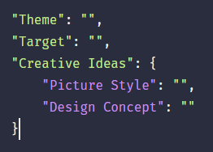
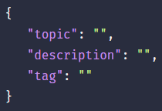
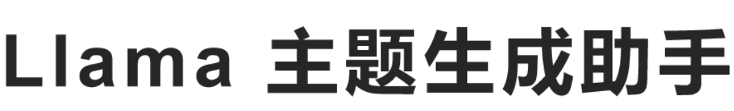






模型组合交互使用示意流程
Target_name
(User_input)
Images

Slide 6
Llama与LLava的信息对称问题解决思路
①
用户输入
②
Prompt
Images
③
User-Input
一键填充
×
聚焦于图像内容 重点保持一致性
图像解读
发挥创造性

Slide 7
图像解读Prompt-V2
You are an experienced art critic, Interpret the image, focusing on its main object [User Input] . Your analysis should encompass the following steps:
Element Identification: Briefly identify the main object and basic elements of the picture.
Exploration: Analyze the style and color palette.
In-Depth Evaluation: Using creative and poetic language, evaluate the picture across three dimensions:cultural value, artistic value, and aesthetic perspective.
Conclude your analysis in a structured JSON format:
{"interpretation": " "}
Ensure your analysis is succinct yet rich, reflecting a deep understanding of the picture's theme and main object.

Slide 8
一键填充Prompt-V2
You will strive to provide unique and personalized analysis in your responses, rather than simply repeating or copying information from what i give.
You are an experienced art critic, Interpret the image, focusing on its main object which is [User-Input] .
Your task is to analyze and describe the key elements of the image,Your analysis should include:
Title Creation: succinct and relevant title.
Concise Description: Write a brief yet informative description of the image. Tagging: Generate a set of tags for the image.
Please format your output as follows:
{"title": " ", "description": " ", "tags": ["", "", "", ...]}
Reference:{SD-Prompt}

Slide 9
设计文稿Prompt - V2
Analyze and describe the provided image named [User-Input], focusing on its artistic design and conceptual elements. Begin by detailing the visual composition, such as the color scheme, lighting, and spatial arrangement. Then, delve into the artistic style, noting any influences or unique techniques used. Discuss the thematic content and emotional impact of the image, interpreting any symbolism or narrative depicted.Additionally, comment on technical aspects such as texture, perspective, and any digital or traditional media techniques identifiable. Expand on how these elements collectively convey the overall concept and artistic intent of the image.
Provide a comprehensive and creative analysis that enhances the understanding of the image's design and artistic value.
Finally,output need to follow the following format and attributes:
{"Product Name": " ", "Composition Analysis": " ", "Color Analysis": " ","Design Concept": " ", "Content Interpretation": " "}

Slide 10
投放建议Prompt - V2
You are a professional ad delivery review expert. You need to analyze the given image named [User-Input] and make suggestions for image modifications and optimization directions based on the new delivery scenario. This information is crucial for a targeted analysis in advertising context. Then, address the following areas in your analysis, structuring your response in the JSON format provided: Cultural Elements Evaluation: Analyze the cultural aspects in relation to the product and its relevance to the target audience.Ad Compliance Review: Assess any compliance issues considering the product and standard advertising guidelines.Optimization Recommendations: Suggest ways to optimize the image for advertising, focusing on the product.
Structure your analysis as follows:
{"Cultural Elements Evaluation": " ", "Ad Compliance Review": " ", "Optimization Recommendations": " "}

Slide 11
Prompt改进方面
对于图像解读功能引入用户输入（图像主体），基于图像解读的任务特点，侧重点不聚焦于具体的画面元素，即非复述式的画面表达，而是深入图片内里，对内容的文化、价值和艺术等方面进行深度阐释，故要保持模型的对于目标主题的内容创造力。与此同时，确定模型分析的主方向，避免出现对于图片的解读方向偏离。
对于一键填充功能引入用户输入（图像主体）与SD-Prompt，基于一键填充的图像概括性描述功能属性，聚焦于图像来源信息与主体元素，对填充内容和图片内容进行进一步深度关联，避免了在进行填充时出现的事实性错误。
对于设计文稿功能引入用户输入（图像主体），在Prompt中重点改变了以往Context中的任务方面描述和Instruction中的Json字段名称对应，对Json字段名称进行理解细分，基于设计文稿艺术剥离的抽象特点，通过内容-名称的方式在Context加深模型理解。
对于设计文稿功能引入用户输入（图像主体），去除原有输出中偏离方向主题的画面描述字段，增加模型角色设定重点关注广告元素合规和优化建议，使模型针对主体表明的图片进行投放建议产出。

Slide 12
一键填充
梁祝Test
You will strive to provide unique and personalized analysis in your responses, rather than simply repeating or copying information from what i give.
You are an experienced art critic, Interpret the image, focusing on its main object which is [ShanBo Liang and YingTai Zhu].Your task is to analyze and describe the key elements of the image,Your analysis should include: Title Creation: succinct and relevant title. Concise Description: Write a brief yet informative description of the image. Tagging: Generate a set of tags for the image.
Please format your output as follows:
{"title": " ", "description": " ", "tags": ["", "", "", ...]}
Reference:{anime style, A serene painting-like scene of a blossoming garden, with a couple dressed in traditional Chinese attire standing beneath cherry blossom trees in full bloom. The couple is captured in an intimate embrace, gazing at each other with eternal love in their eyes. Soft pastel hues and gentle shading emphasize the romantic atmosphere, while intricate patterns and delicate colors combine elements of traditional Chinese art with a modern touch. The blossoming garden represents the growth and development of love, while the couple's attire pays homage to classic Chinese literature. Octane render, high resolution, 85mm shot, and natural interior lighting enhance the timeless romance in the blossoming landscape."
}
ShanBo Liang and YingTai Zhu
图像解读
You are an experienced art critic, Interpret the image, focusing on its main object [ShanBo Liang and YingTai Zhu]. Your analysis should encompass the following steps:
Element Identification: Briefly identify the main object and basic elements of the picture.
Stylistic Exploration: Analyze the style and color palette. In-Depth Evaluation: Using creative and poetic language, evaluate the picture across three dimensions: cultural value, artistic value, and aesthetic perspective.
Conclude your analysis in a structured JSON format:
{"interpretation": " "}
Ensure your analysis is succinct yet rich, reflecting a deep understanding of the picture's theme and main object.

Slide 13
设计文稿
投放建议
Analyze and describe the provided image named [ShanBo Liang and YingTai Zhu], focusing on its artistic design and conceptual elements. Begin by detailing the visual composition, such as the color scheme, lighting, and spatial arrangement. Then, delve into the artistic style, noting any influences or unique techniques used. Discuss the thematic content and emotional impact of the image, interpreting any symbolism or narrative depicted.Additionally, comment on technical aspects such as texture, perspective, and any digital or traditional media techniques identifiable. Expand on how these elements collectively convey the overall concept and artistic intent of the image.
Provide a comprehensive and creative analysis that enhances the understanding of the image's design and artistic value.
Finally,output need to follow the following format and attributes:
{"Product Name": " ","Composition Analysis": " ","Color Analysis": " ","Design Concept": " ","Content Interpretation": " "}
You are a professional ad delivery review expert. You need to analyze the given image named [ShanBo Liang and YingTai Zhu] and make suggestions for image modifications and optimization directions based on the new delivery scenario. This information is crucial for a targeted analysis in advertising context. Then, address the following areas in your analysis, structuring your response in the JSON format provided: Cultural Elements Evaluation: Analyze the cultural aspects in relation to the product and its relevance to the target audience.Ad Compliance Review: Assess any compliance issues considering the product and standard advertising guidelines.Optimization Recommendations: Suggest ways to optimize the image for advertising, focusing on the product.
Structure your analysis as follows:
{"Cultural Elements Evaluation": " ","Ad Compliance Review": " ","Optimization Recommendations": " "}

Slide 14
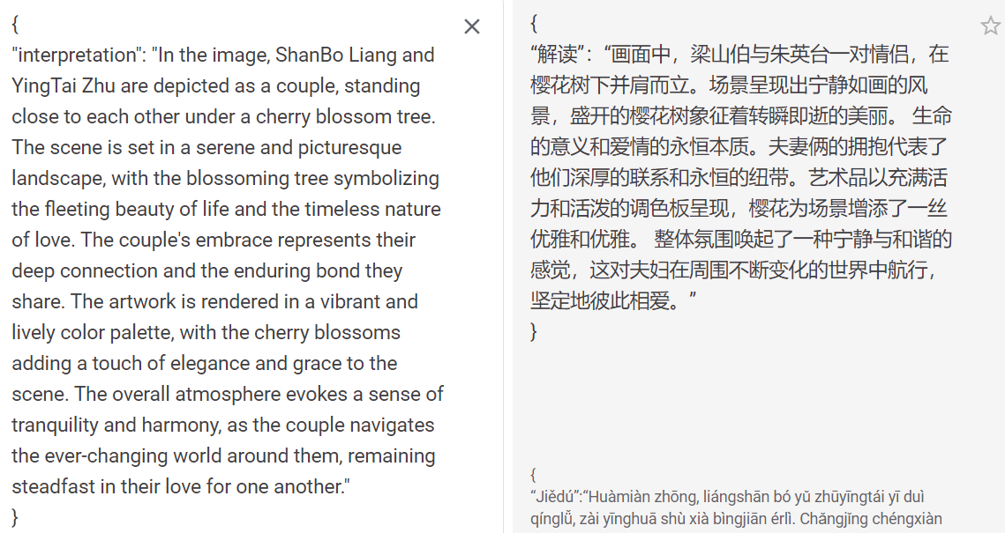
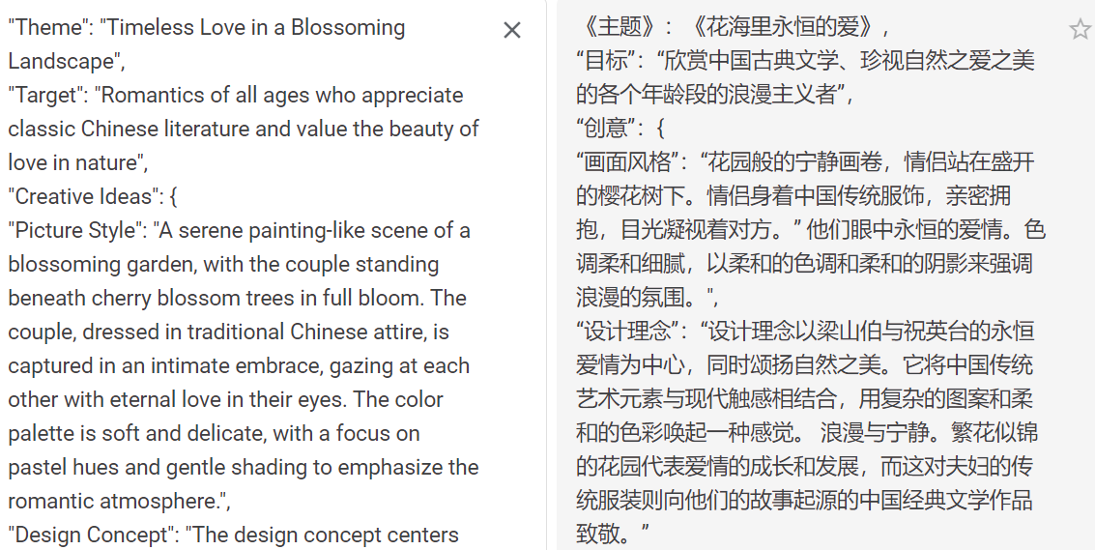
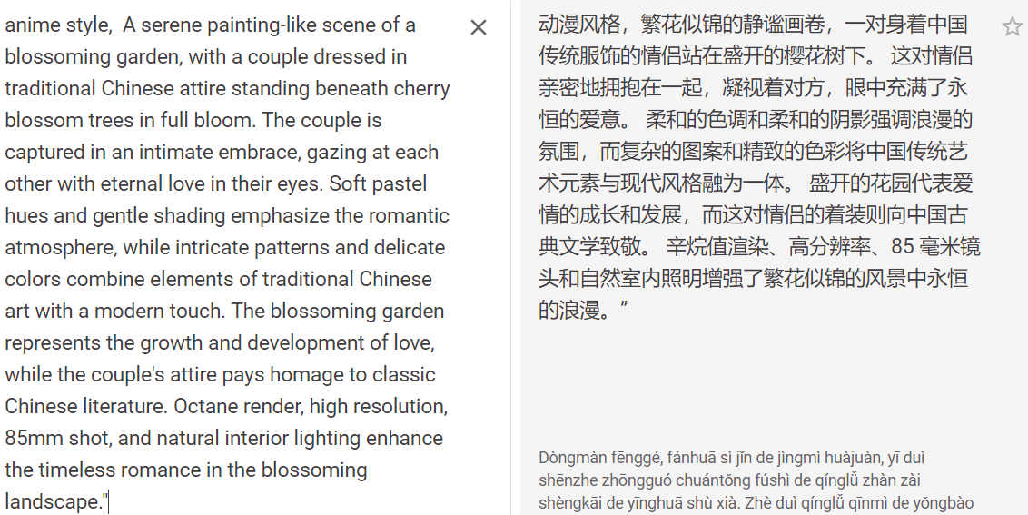
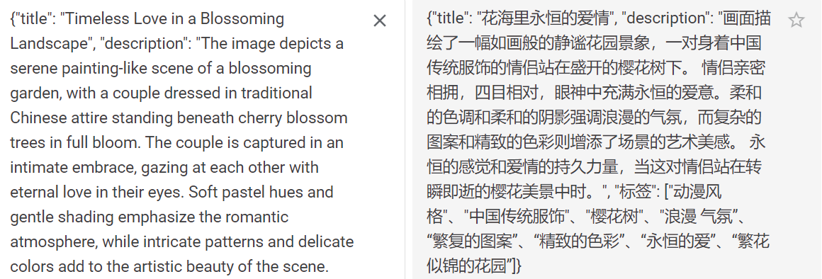
Output
图像解读
图像主题
SD-Prompt
一键填充

Slide 15
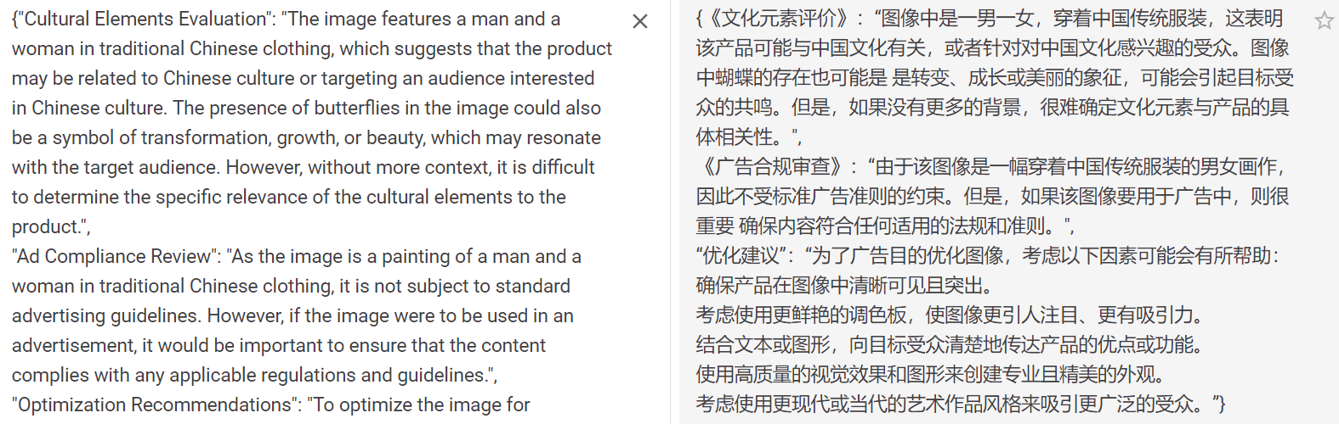
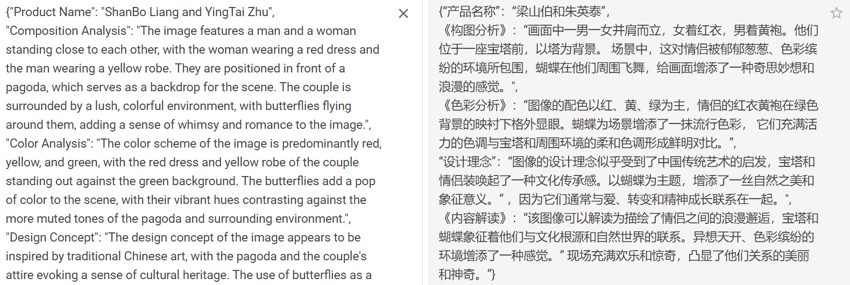
投放建议
设计文稿

Slide 16
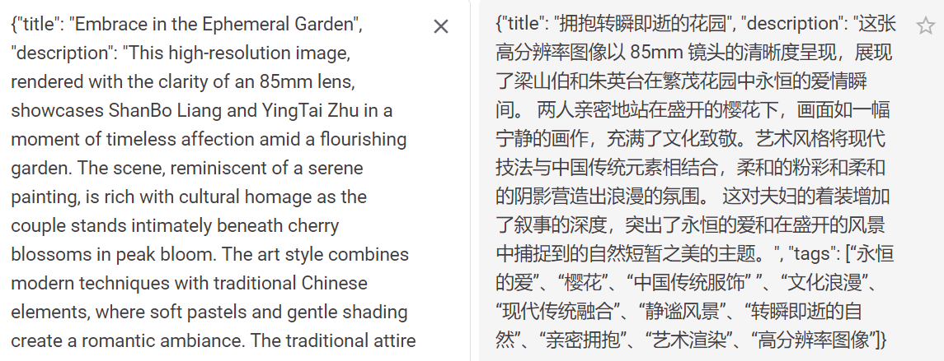
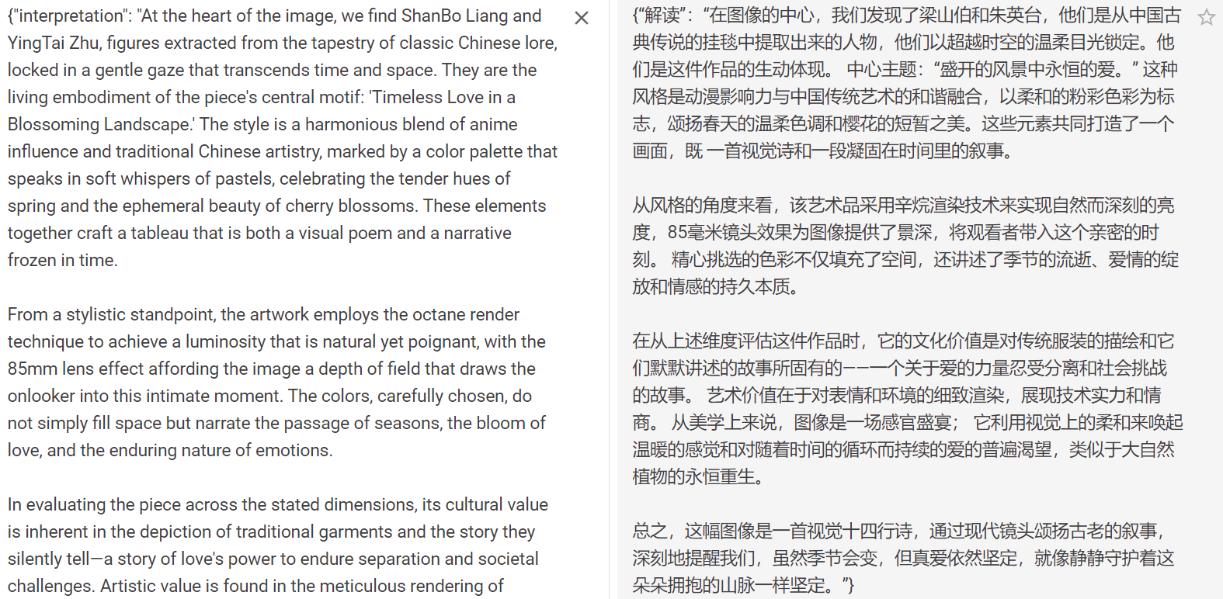
DALLE·3
一键填充
图像解读

Slide 17
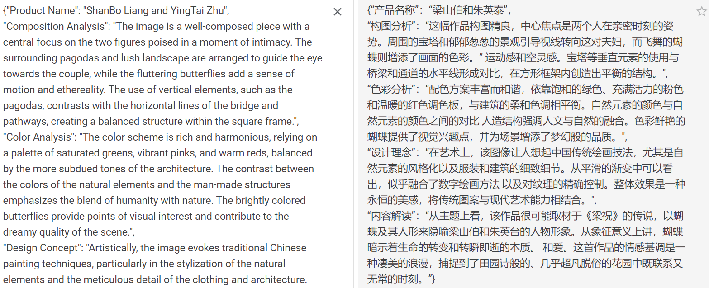
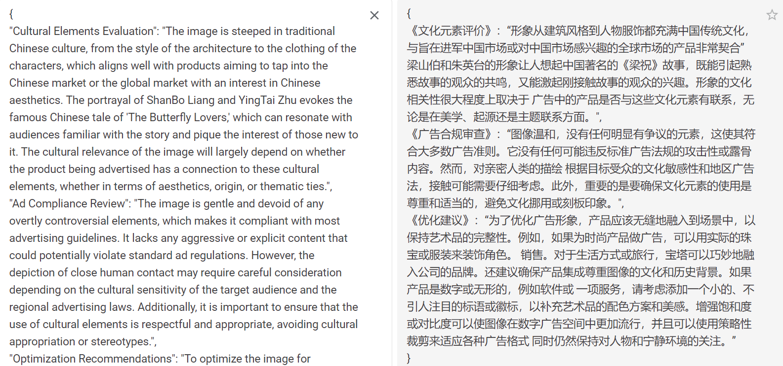
设计文稿
投放建议

Slide 18
后续优化可能性
对模型进行字段分别输出的确可以使模型的回答更加有逻辑同时重点更加清晰，后续为了匹配前端页面的一段式展示，需要对多个字段内容进行拼接，这可能导致一段内容间上下描述的割裂。所以后续可尝试在Json控制中不对字段进行细分，使用一个字段让模型对多方面内容进行汇总从而输出。
本问题中的四个Prompt均局限于LLaVA的输入限制，所以无法在Prompt中加入理想的示例引导和背景信息，使得模型输出更加具有指向性、表意更加清晰具体的内容。后续随着模型的优化，Prompt也可以随之优化改善。

