Slide 1
Port Security feature implementation on TRENDnet
徐科
2019-08

Slide 2
纲要
功能需求概述
端口安全特性原理简介
Port Security模块架构
HW实现
SW实现
实验测试与修正
遇到的问题和思考

Slide 3
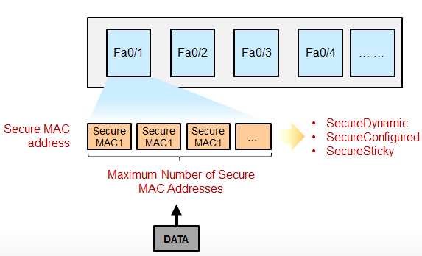
功能概述
主要的功能：
限制交换机每个端口下接入主机的数量（MAC地址数量）
限定交换机端口下所连接的主机（根据MAC地址）
当出现违规事件的时候能够检测到，并且进行相应的处理

Slide 4
原理简介
从基本原理上来讲：
通过MAC地址表维护端口上的以太网MAC
设定静态地址以允许某些MAC通过本端口
达到上限后，通过限制动态学习，阻止其它MAC通信
可根据对应模式，作出相应的事件处理机制

Slide 5
功能目的
使用端口安全模块可以防止未经允许的设备访问网络，增强网络安全性。此外，端口安全也可用于防止地址泛洪造成MAC地址表溢出
动态学习MAC地址
安全事件处理机制
设定空闲MAC的保持时间
设定系统最大MAC数

Slide 6
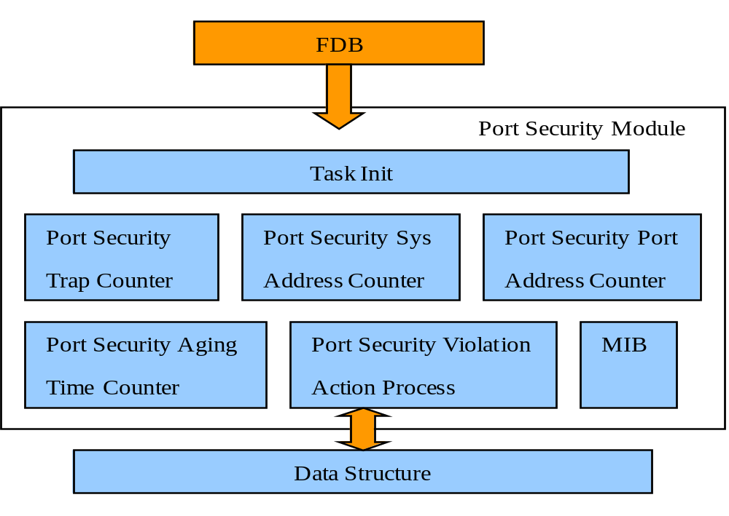
Port Security的架构

Slide 7
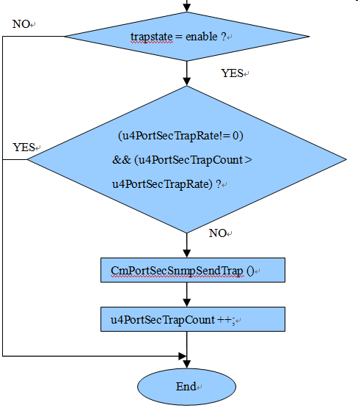
架构简介
*Task Init:
CmPortSecMain()
→CmPortSecTaskInit()
→CmPortSecEntryInit()
CmPortSecTmrInit()
*Port Security Trap Counter:
CmPortSecViolationActionProcess()
→CmPortSecTrapSend()
→CmPortSecSnmpSendTrap()
CmPortSecTrapTimerHandle()

Slide 8
架构简介
*Port Security Sys Address Counter:
u4PortSecSysAddrCount，i4SysLearntNum
*Port Security Port Address Counter:
CmPortSecLearnNumSet()，i4PortLearntNum
*Port Security Violation Action Process:
CmPortSecViolationActionProcess()
<Protect , restrict , shutdown>

Slide 9
Port Security的架构
*Port Security Aging Time Counter:
CmPortSecAgingTimerHandle()
u4PortSecRemainTime
u4AgingTime
Delete_on_Timeout
&& RemainTime!=0 ?
NO
YES
RemainTime - = Interval
NO
ReaminTime <=0 ?
YES
u1SAHit = CmPortSecSAHitGet()
(AgingType == absolute)
|| ((inactive)&&(u1SAHit==FALSE))
NO
YES
ReaminTime = AgingTime
AgingOutProcess()

Slide 10
HW实现
1、rtk_l2_limitLearningNum_set & rtk_l2_limitLearningAction_set
实现逻辑：
*Enable时，指定limiting learning number为MLA, action为 ACTION_DROP,
分别通过SDK API :
rtk_l2_limitLearningNum_set和rtk_l2_limitLearningAction_set进行设定
*Disable时，指定limiting learning number为-1，action不设，
同样通过API rtk_l2_limitLearningNum_set设定
*Enable设定之后flush FDB by per port

Slide 11
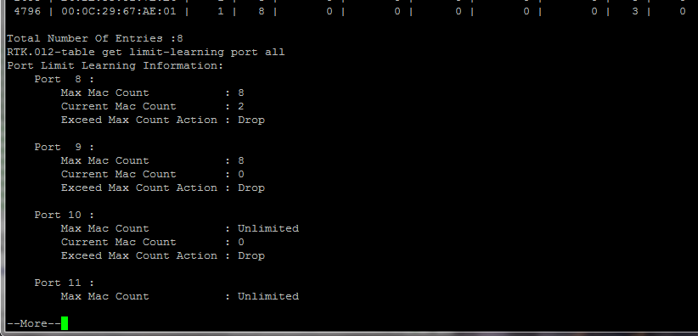
HW实现
具体实现的SDK命令：
指定MLA：mac_count
l2-table set limit-learning ( port | trunk )
( <MASK_LIST : port_trunk> | all ) <UINT : mac_count>
指定 action : drop
l2-table set limit-learning ( port | trunk )
( <MASK_LIST : port_trunk> | all )
action ( copy-to-cpu | drop | forward | trap-to-cpu )

Slide 12
HW实现
2、 rtk_l2_portNewMacOp_set
实现逻辑:
*Enable时，指定mode为NOT_LEARNING，action 为 ACTION_DROP
*Disable时，指定为HARDWARE_LEARNING，action为ACTION_FORWARD
以上参数均通过 rtk_l2_portNewMacOp_set 设定至 HW
具体SDK命令：
enable时设定为 not learn , disable 时设定行为为asic-learn 和 forward
l2-table set src-mac port (<PORT_LIST : port> | all )
lear-mode (asic-learn|software-learn|not-learn)
action (copy-to-cpu|drop|forward|trap-to-cpu)

Slide 13
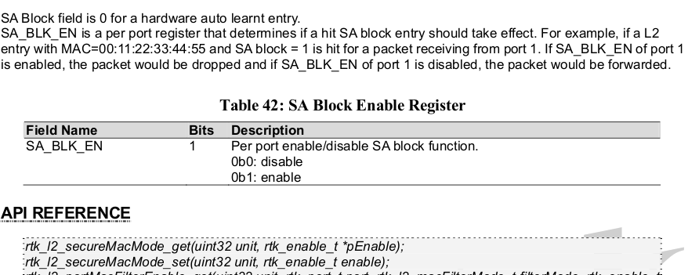
HW实现
3、添加函数 CmNPPortSecSAHitGetWithLock
*该函数用于在port securoty 模式下获取和更新mac是否允许删除的标志。
*通过调用CmPortSecSAHitGetWithLock（）函数获取u1SAHit标志。 (还要考虑 inactivity, absolute)
*remaining time需要reset为port aging time设置值。
*需要enable SA_Block

Slide 14
SW实现
具体由future下的cmportsec模块实现
1、cmportsec 模块内文件说明
1）inc/: cmportsecdb.h : 该模块mib的db文件的依赖头文件
cmportsecwr.h : mib中间层功能函数的声明
cmportseclw.h : mib下层功能函数的声明
cmportsecdfs.h : 模块相关的数据结构宏定义
cmportsecinc.h : Port Sec模块的依赖头文件
cmportsecvar.h : 定义被其他模块调用的相关宏、结构体、变量类型等
cmportsecproto.h : 声明用于OS、main system和本模块调用的函数和结构体
2) src/: cmportsecapi.c : 供其他模块调用的API函数
cmportsecmain.c : 控制本模块的startup/shutdown、相关变量和任务的初始化和
mib的注册
cmportsecwr.c : 定义mib的中间层功能函数
cmportseclw.c : 定义mib 的下层功能函数
cmportsecutil.c : 本模块的实用功能函数

Slide 15
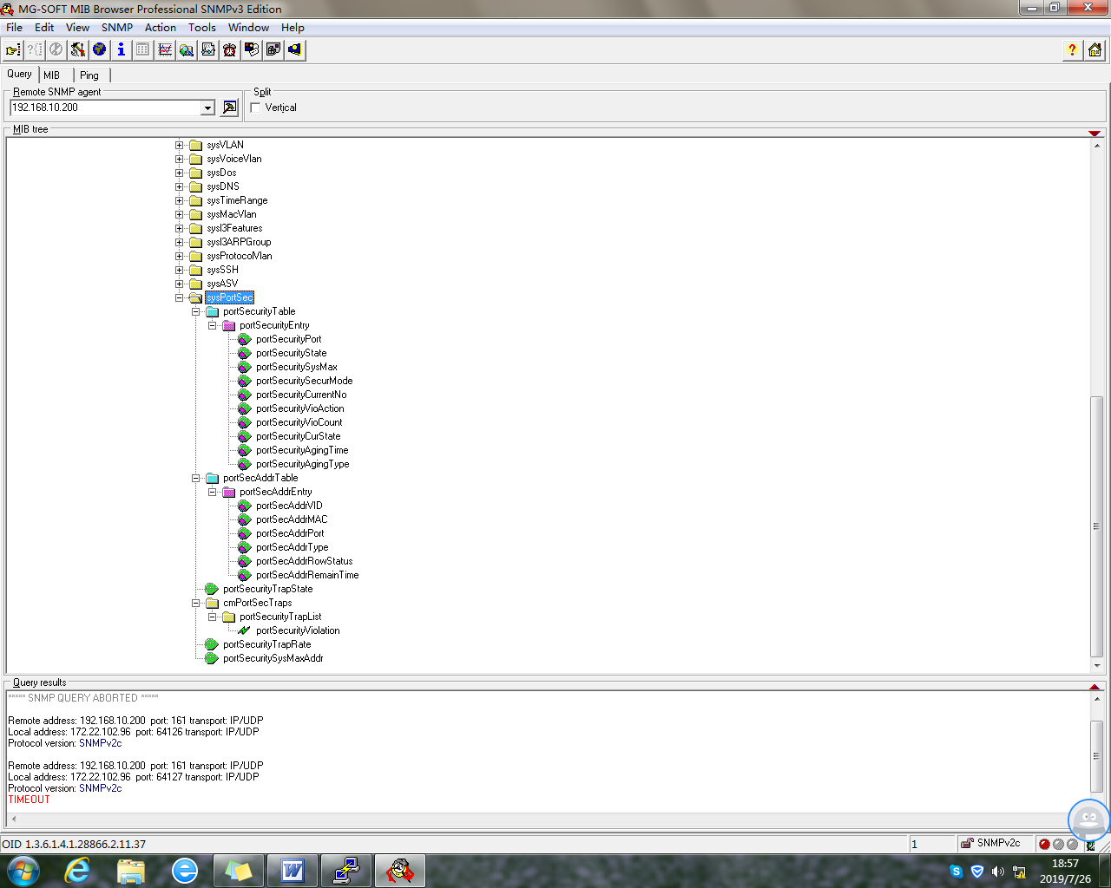
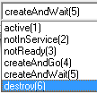
MIB设定
2、相关mib介绍

Slide 16
SW实现
3、源代码追踪
最终调用的NPAPI
cmPortSecState
cmPortSecMLA
cmPortSecLockAddrMode
CmNPPortSecSet
cmPortSecSysMaxAddr
CmNPNewMacDropSet
cmPortSecAgingTimerHandle
CmNPPortSecSAHitGet
cmPortSecViolationAction
cmPortSecAgingTime
cmPortSecAgingType
gPortSecEntry

Slide 17
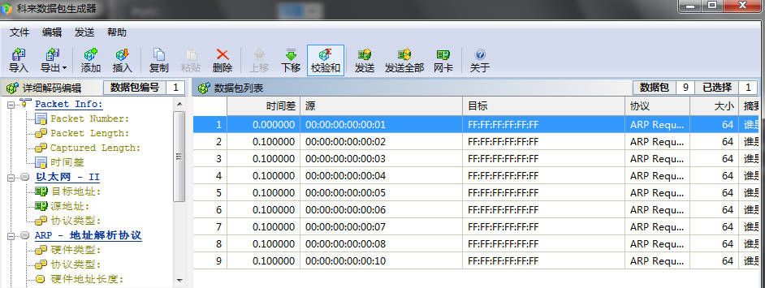
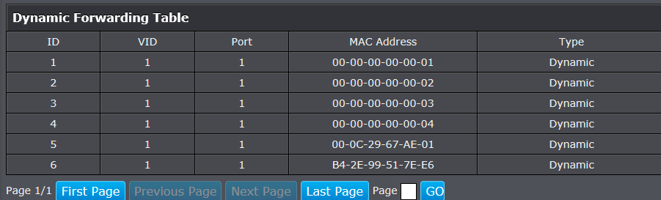
功能测试
采用PC直连switch的方式，设置max为6 ，发送9个不同MAC的单播包给交换机；
可以看到，虽然发送了9个包，但是Table中最多只接收6个地址；

Slide 18
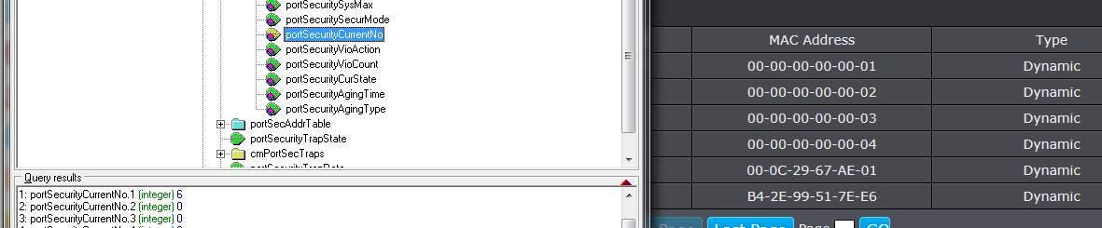
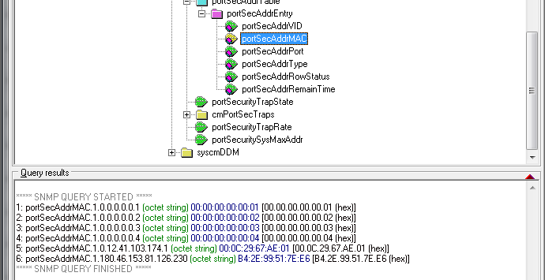
功能测试
mib上查看计数和地址表也只有6个MAC；

Slide 19
Port Security的Spec.
3.26.1 | Fundamental
3.26.1.1 | The port security can be set enablement and disablement per port. | M | FC
3.26.1.2 | Global System: The maximum quantity to limite all ports learnt entry is 6656 when it is "limit". The System Max Learning entry can be exceeded when it is not "limit". Per Port: The maximum quantity to limite the per port learnt entry is 64 when state is "enabled" Thse System Max Learning entry can be exceeded when state is "disabled" | M | FC
3.26.1.3 | When a port's state of port security is set from enablement to disablement, all mac address entries learnt on this port should be cleared no matter what its security mode is. | M | FC
3.26.1.4 | System MUST NOT allow to set max learnt entries to “0” to all ports when all their admin states of port security are set to enablement. | M | FC
3.26.1.5 | When a port's state of port security is set to enablement and security mode is placed to “Delete-on-Timeout”, all mac address entries learnt on this port should be cleared while aged by following the aging time set. | M | FC
3.26.1.6 | When a port's state of port security is set to enablement and security mode is placed to “Permanent ”, all mac address entries learnt on this port should be left until the switch reboots. | M | FC
3.26.1.7 | When a port’s security mode is placed to “Permanent”, the port’s manually added port security address entries are placed to "Permanent". When saving config, the "permanent" port security mac entries can not be stored after sytem reboot. | M | FC
3.26.1.8 | When a port's admin state of port security is set to enablement , the amount of learn mac address entry MUST NOT exceed the “max learning address” set. | M | FC
3.26.1.9 | When Port Security Violation Action is "Protect", Only invalid data frames are discarded(The source MAC of the data frame is not in the security address table item, and the security address has reached the maximum number) and others operating normally. | M | FC
3.26.1.10 | Port Security Aging Time range is 0~1440(min) | M | FC
3.26.1.11 | When Port Security Aging Type is "Absolute",All the secure addresses on this port age out exactly after the time (minutes) specified and are removed from the secure address list. | M | FC
3.26.1.12 | When port security mode changed from "Permanent" to "Delete-on-Timeout",all mac address entries learnt on this port could be cleared. | M | FC
3.26.1.13 | When port security mode changed from "Delete-on-Timeout" to "Permanent",all mac address entries learnt on this port could be cleared. | M | FC

Slide 20
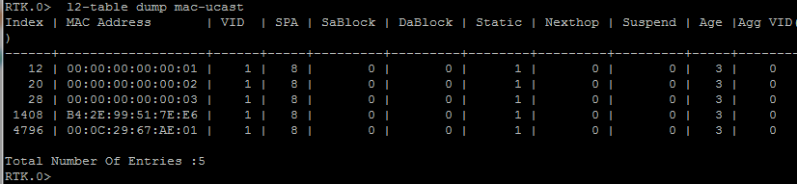
Bug修复
1. Bug:
*每当学到一个新的mac地址后，mib中的addrNum都加2，而不是1；
2. Bug:
*重新disable后，addrNum保留原计数，而不会清0；
3. Bug:
*当time out后清除已学到的mac时，web上可以看出完成了清除，而在mib上的计数器却只有部分减少；并且timeout后清除的mac，会被禁止再次学习到；而disable后被清除的mac可以正常再次被学到。

Slide 21
Bug修复
4. Bug:
*custom mib 编写正确情况下，出现oid mapping 错误,导致custom mib不能工作。
5. Bug:
*在使用SA_SECURE做标记后，enable Portsec 功能后对应的port链接会立即断开。

Slide 22
问题解答
1.问题：为何sysMaxAddr设值太小会出错。
2.问题：切换至“Delete-on-Reset”时mib索引报错。
3.问题：当某个 port 被 shutdown 后如何恢复？。
4.问题：cmPortSecViolationCount 在何时清0？
5.疑问：如何解决SW上的 Agingtime功能与HW 的MAC默认老化时间冲突？
6.为何添加customer mib后做oidmap时，不能將 .db文件名插入在列表中间？

Slide 23
Thank You

