Slide 1

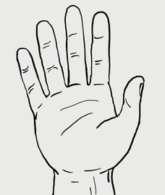
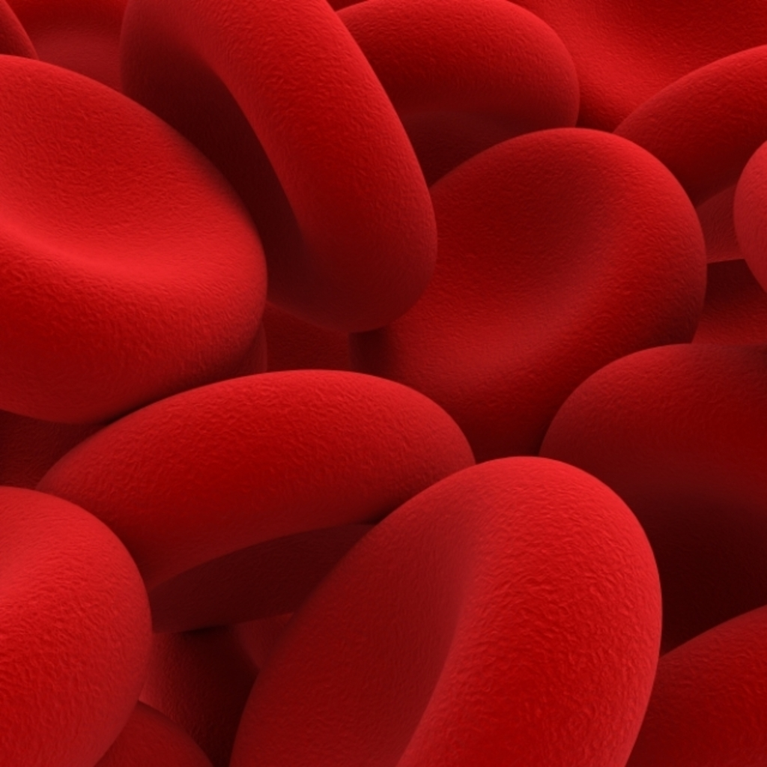

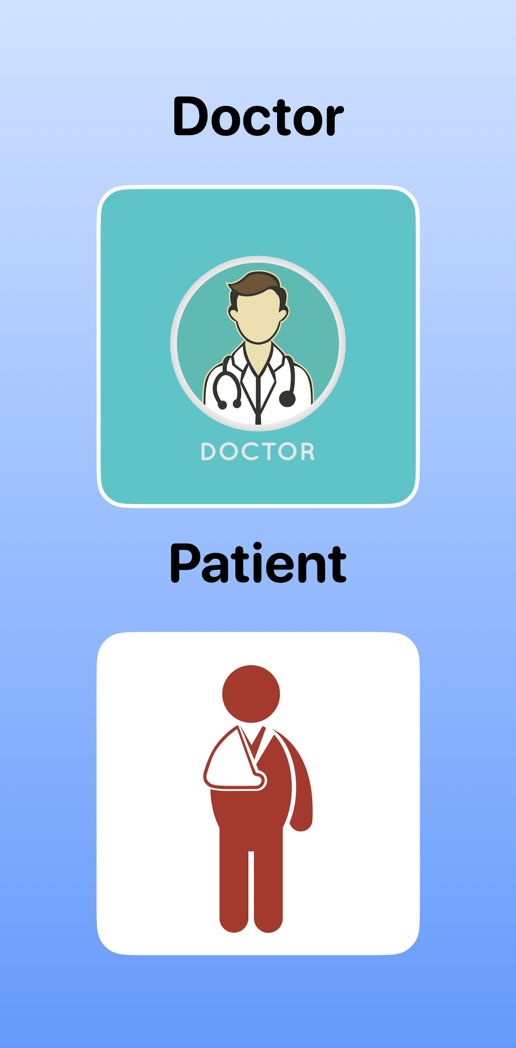
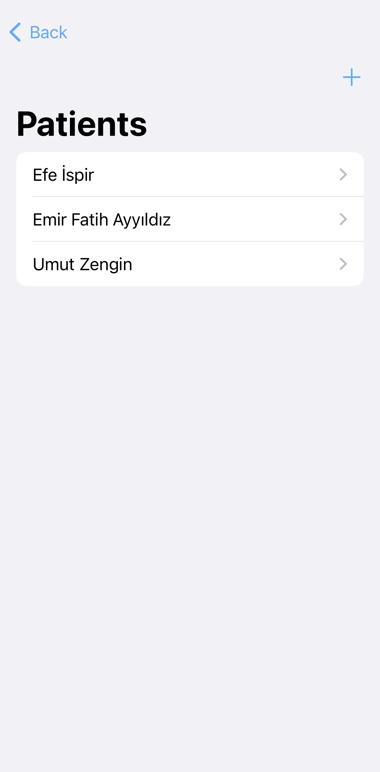
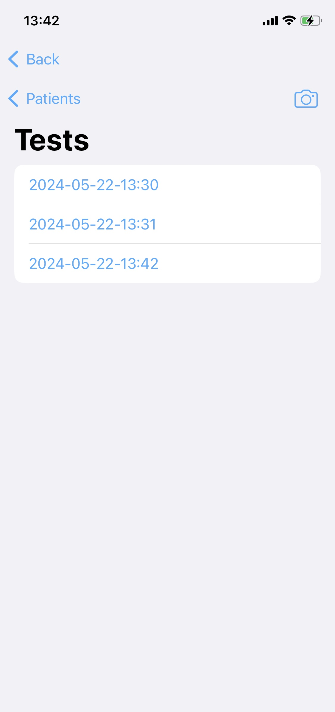
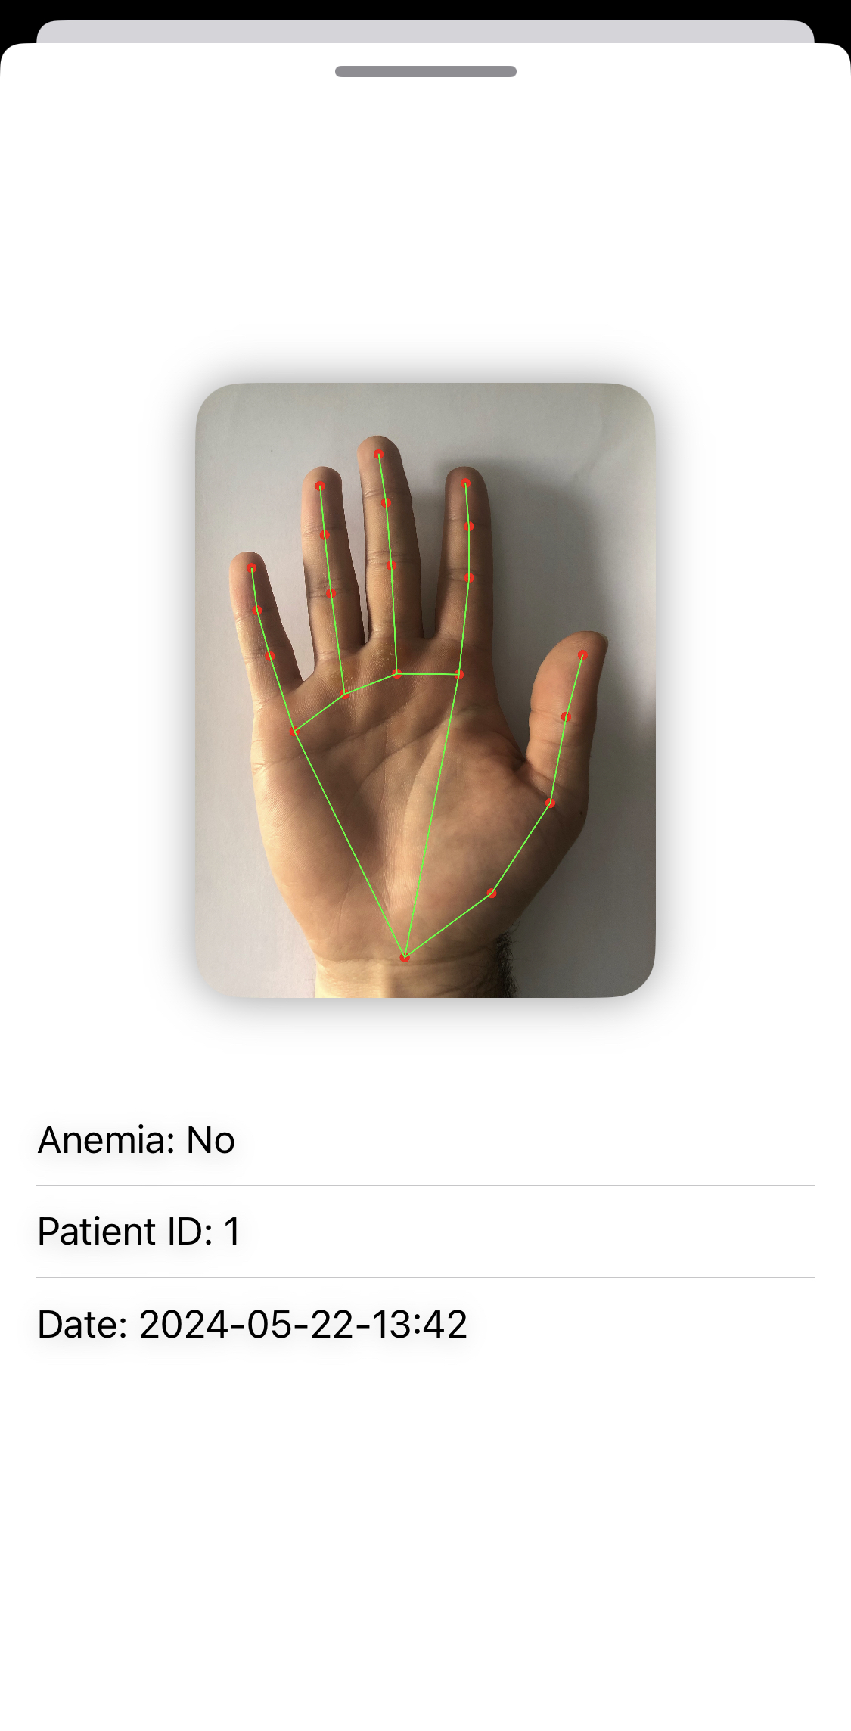

Team: Efe İspir, Umut Zengin, Emir Fatih Ayyıldız Advisor: Çiğdem Demir, Öznur Özkasap, Özlem Yalçın
COMP 491
SnapAnemia
Detect anemia from palm image
Easy to use environment for doctors to tracks their patients
SnapAnemia

