Slide 1

DEPARTMENT OF COMPUTER SCIENCE AND ENGINEERING • SONARGAON UNIVERSITY (SU)
ADVANCE TRAVEL: A MODERN WEB-BASED TOURISM MANAGEMENT AND AUTOMATED BOOKING PLATFORM
Submitted in partial fulfillment of the requirements for the degree of Bachelor of Science in CSE • September 2026
🎙️ PRESENTER 1 (LEAD)
🎙️ PRESENTER 2
🎙️ PRESENTER 3
Md. Amir Shorif Misty
ID: CSE2203027142
Lead Backend Architect & Security Engineer
• Laravel 12 Enterprise Architecture Setup
• Authentication & RBAC Middleware Pipeline
• Cryptographic Security (Bcrypt, CSRF, SHA-512)
• RESTful API Design & Session Management
Efaz Ahammad Thalha
ID: CSE2203027172
Frontend Lead & UI/UX Developer
• Responsive Blade Layouts & CSS Design System
• Interactive Destination Showcase & Catalog UI
• Dynamic Booking & Guest Demographic Interface
• Mobile-First Cross-Device Optimization & UI Demo
Md. Abdur Rakib
ID: CSE2203027141
Database Architect & Data Systems Engineer
• Relational Database Schema Design & 3NF ERD
• Data Integrity, Foreign Keys & Schema Migrations
• Concurrency Control & Pessimistic Row Locking
• Administrative BI Analytics & QA Testing Matrices
ACADEMIC SUPERVISION & DEPARTMENTAL OVERSIGHT
Supervised by: Md. Rashedul Islam • Lecturer, Department of Computer Science and Engineering, Sonargaon University (SU)
Department Head: Prof. Bulbul Ahamed • Head, Department of Computer Science and Engineering, Sonargaon University (SU)
Advance Travel • B.Sc. in CSE Capstone Project Defense • Sonargaon University (SU)
Slide 1 of 16

Slide 2
SONARGAON UNIVERSITY • CHAPTER 1: INTRODUCTION
🎙️ MD. AMIR SHORIF MISTY | Lead Backend Architect
Motivation & Problem Statement: The Domestic Tourism Challenge
Analyzing systemic operational bottlenecks in traditional agency workflows vs. modern web automation (Chapter 1)
❌ TRADITIONAL MANUAL OVERHEAD (THE PROBLEM)
• Fragmented & Opaque Booking Workflows
Planning multi-day tours requires separate visits to physical bus counters, railway stations, and hoteliers with unverified amenities.
• Inefficient Cash Transactions & Overcrowding
Cash-on-counter accounting causes severe terminal congestion during peak festive seasons (Eid), leading to long queues and revenue leakage.
• Ticket Scalping & Physical Pass Counterfeiting
Paper vouchers are easily damaged, stolen, or forged by unauthorized scalpers without any cryptographic tamper-detection.
• Absence of Real-Time Administrative Intelligence
Small-to-medium operators rely on manual paper ledgers or notebooks, lacking centralized data visualization for dynamic inventory control.
✨ ADVANCE TRAVEL ENGINEERED AUTOMATION (OUR SOLUTION)
✓ Unified Multi-Modal Marketplace
Curated vacation packages combining luxury bus, express train, domestic flight, and hotel bookings in a single digital web portal.
✓ Automated Multi-Channel Cashless Settlement
Seamless integration with SSLCommerz payment gateway supporting Cards, bKash, Nagad, Rocket, and optional cash-on-boarding.
✓ Cryptographic QR Digital Boarding Passes
High-density QR e-tickets generated upon payment with sub-second gate authentication using standard camera-enabled smartphones.
✓ Enterprise Administrative BI Suite
Real-time revenue metrics, package CRUD controls, booking lifecycle tracking, and automated customer refund processing.
Advance Travel • B.Sc. in CSE Capstone Project Defense • Sonargaon University (SU)
Slide 2 of 16

Slide 3
SONARGAON UNIVERSITY • CHAPTER 2: LITERATURE REVIEW
🎙️ MD. AMIR SHORIF MISTY | Lead Backend Architect
Literature Review & Competitive Feature Benchmarking
Evaluating contemporary travel platforms and identifying key technical gaps (Chapter 2, Table 2.1)
Evaluation Criteria | Traditional Agencies | Shohoz | GoZayaan | Advance Travel (Proposed)
Platform Architecture | Manual / Offline Paper | Centralized Web / Mobile | Centralized Web / Mobile | Modern Laravel 12 MVC
Package Customization | Limited / Manual Phone | Transit Only | Flight / Hotel Focused | Full Tour & Room Customizer
Payment Methods | Physical Cash Only | Cards, MFS | Cards, MFS, EMI | SSLCommerz (Cards/MFS) + Cash
Digital Boarding Pass | None (Carbon Paper) | SMS / Basic PDF | Email PDF Voucher | Responsive E-Ticket + Dynamic QR
Gate QR Verification | Visual Inspection | Proprietary Handheld | Manual Voucher Match | Universal Web-Based QR Portal
Admin Analytics Suite | Physical Ledgers / Excel | Proprietary Corporate | Proprietary Corporate | Built-in Real-Time Analytics CRUD
KEY COMPETITIVE RESEARCH GAPS ADDRESSED BY ADVANCE TRAVEL
1. Unified Multi-Modal Packages: Eliminates disconnected transit/lodging modules by offering unified vacation bundles.
2. Universal Gate Inspection: Replaces costly proprietary handheld barcode scanners with camera-accessible web verification.
Advance Travel • B.Sc. in CSE Capstone Project Defense • Sonargaon University (SU)
Slide 3 of 16

Slide 4
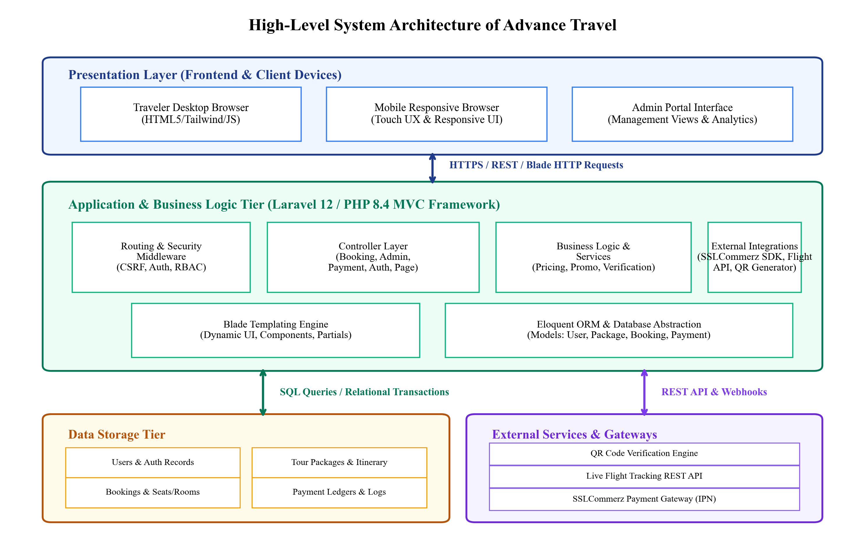
SONARGAON UNIVERSITY • CHAPTER 3: SYSTEM ARCHITECTURE
🎙️ MD. AMIR SHORIF MISTY | Lead Backend Architect
Three-Tier Model-View-Controller (MVC) Architecture
Decoupled presentation, application business logic, and backend data persistence (Chapter 3, Figure 3.1)
KEY ARCHITECTURAL PILLARS
🖥️ Presentation Tier (Client Layer)
• Blade templating engine with Tailwind CSS & custom Bootstrap utilities • Assembles dynamic, responsive, mobile-first interfaces • Transmits user interactions via secure HTTP/HTTPS requests • W3C compliant accessible DOM elements
⚙️ Application & Logic Tier (Server)
• Powered by PHP 8.4 runtime and Laravel 12 Enterprise MVC • Enforces session security, CSRF protection, and RBAC (`is_admin`) • Dedicated controllers: Page, Booking, Auth, SSLCommerz, Admin • Eloquent ORM abstraction for optimized SQL transactions
🗄️ Data Storage & External Services
• Relational SQLite/MySQL database with ACID guarantees • Direct integration with SSLCommerz payment gateway (REST/IPN) • High-density QR matrix generation engine • Asynchronous REST endpoint servicing live flight tracking feeds
Figure 3.1: High-Level Three-Tier System Architecture of Advance Travel
Advance Travel • B.Sc. in CSE Capstone Project Defense • Sonargaon University (SU)
Slide 4 of 16

Slide 5
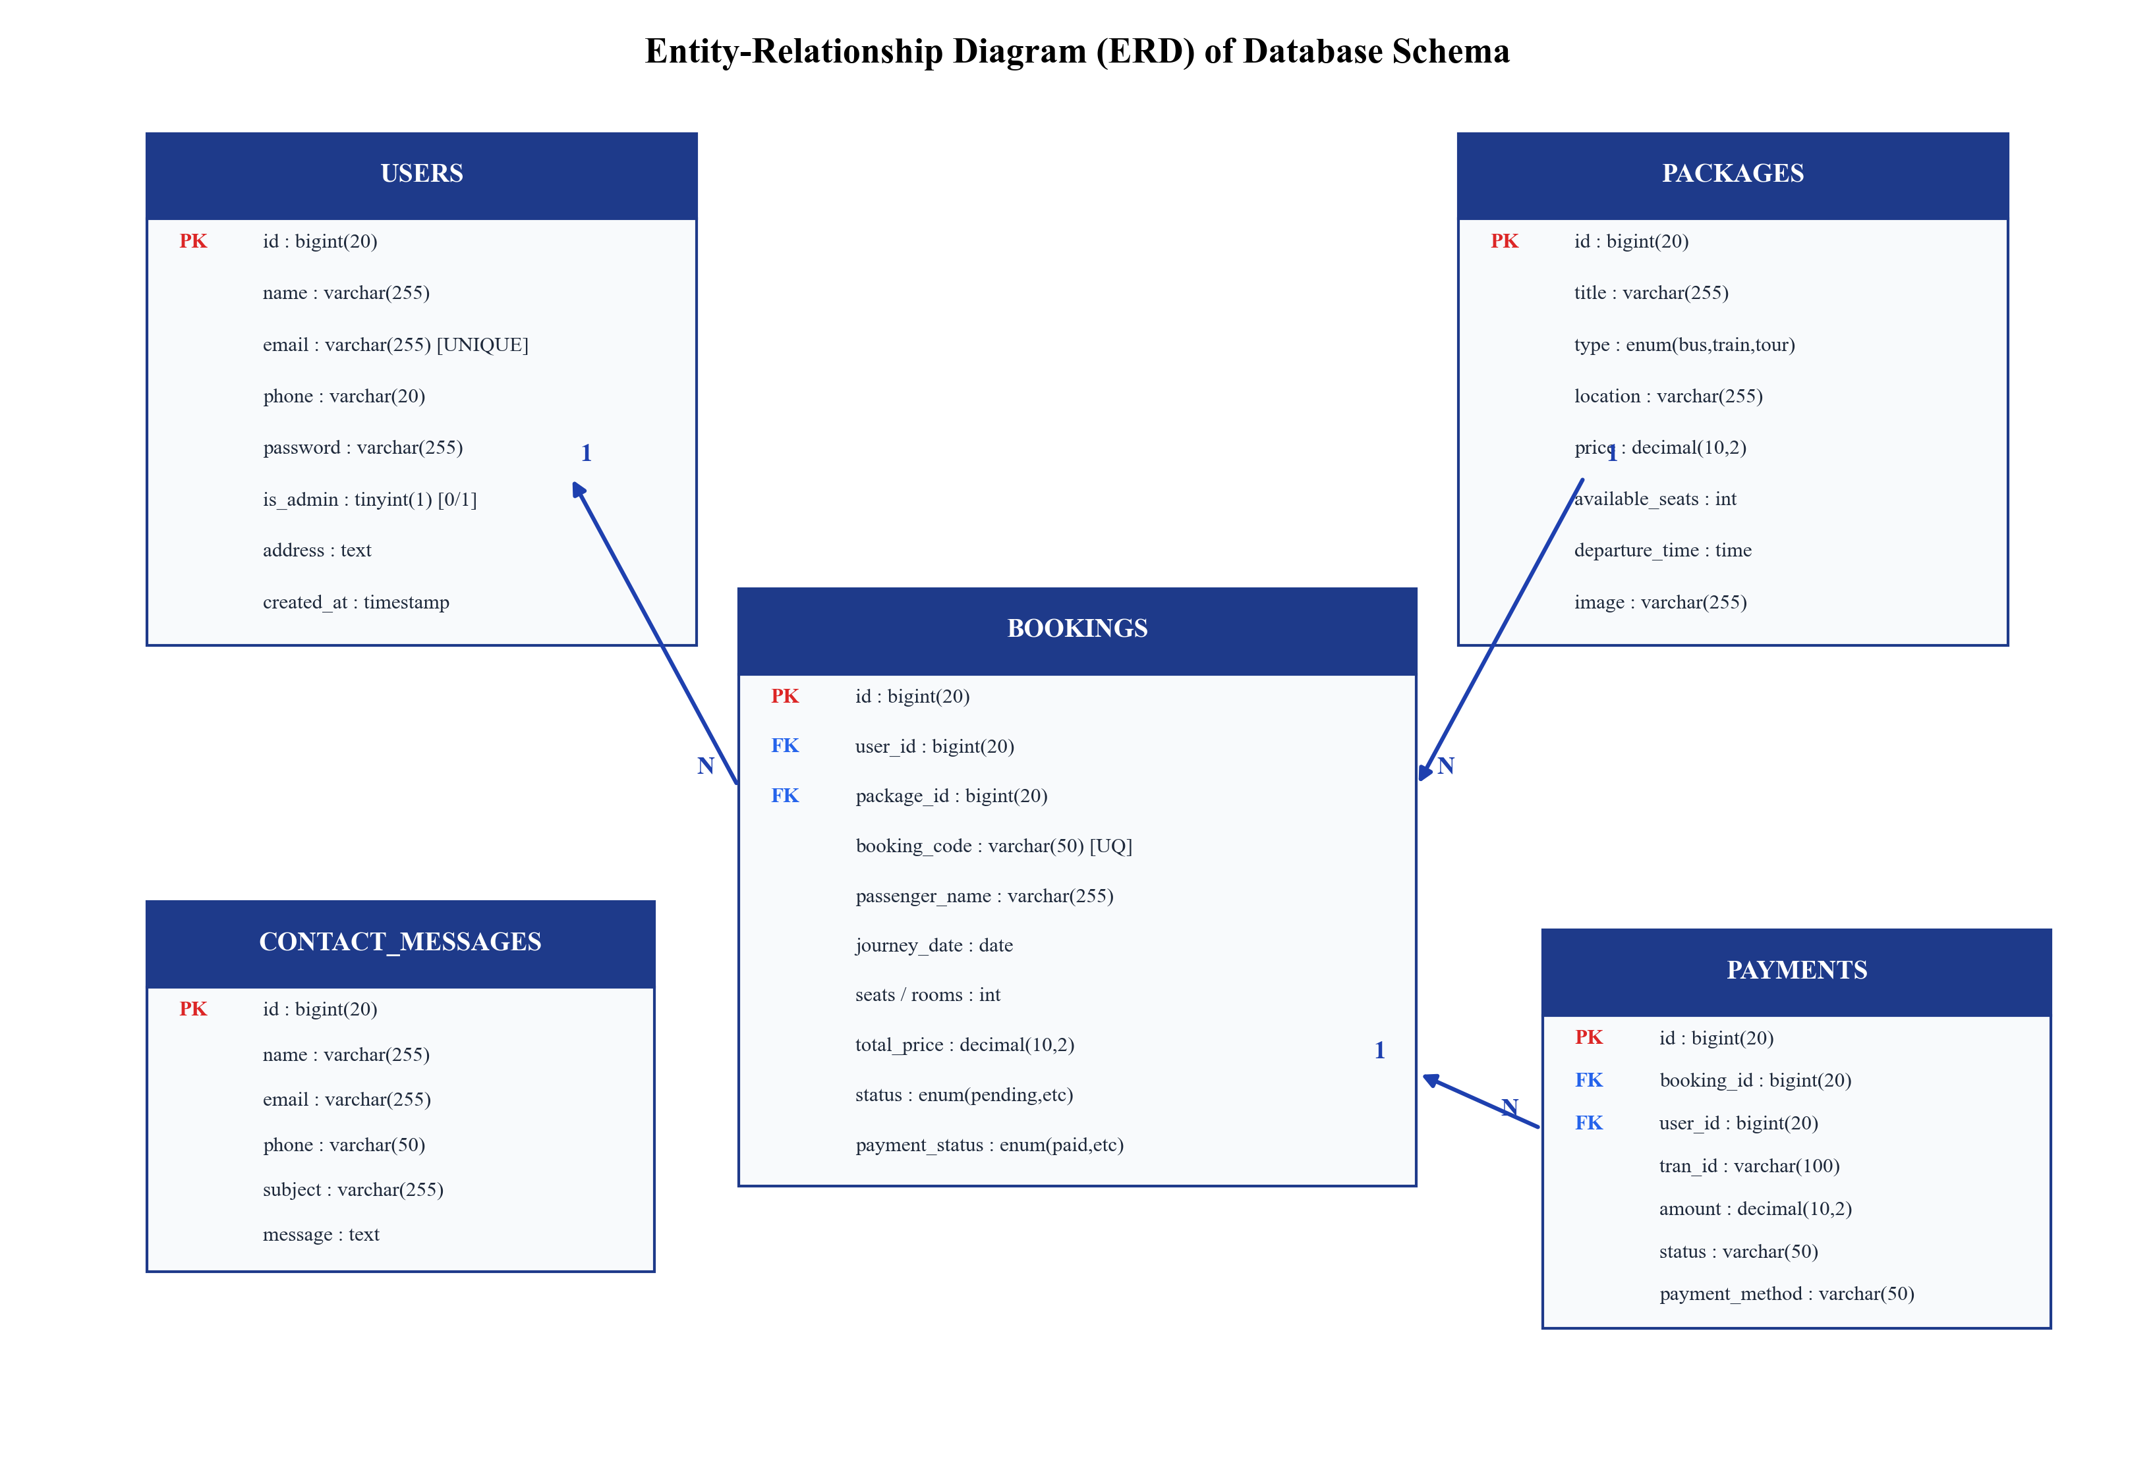
SONARGAON UNIVERSITY • CHAPTER 3: DATABASE DESIGN
🎙️ MD. ABDUR RAKIB | Database Architect
Relational Database Schema Design & 3NF Normalization
Methodical normalization analysis eliminating insertion, update, and deletion anomalies (Chapter 3, Figure 3.6)
DATABASE NORMALIZATION ANALYSIS
🔗 1NF & 2NF Normalization Principles
• First Normal Form (1NF): All attributes are atomic and indivisible. Multi-valued fields (passenger contacts, seats) are flattened into linked relations. • Second Normal Form (2NF): Primary keys consist of single surrogate keys (`id : bigint`), inherently eliminating partial functional dependencies.
🛡️ 3NF Transitive Dependency Elimination
• Third Normal Form (3NF): No non-key attribute is transitively dependent on the primary key. • Traveler credentials (`users`) and package details (`packages`) are decoupled from reservations: `bookings` stores `user_id` and `package_id` as foreign keys without duplicating itinerary details.
🔒 Referential Integrity & Atomic Cascades
• Foreign key constraints enforce referential integrity across users, packages, bookings, and payments. • Cascading delete safeguards prevent orphaned records across transaction ledgers. • Row-level locks protect seat inventory from concurrent checkout collisions.
Figure 3.6: Entity-Relationship Diagram (ERD) of Normalized Database Schema
Advance Travel • B.Sc. in CSE Capstone Project Defense • Sonargaon University (SU)
Slide 5 of 16

Slide 6
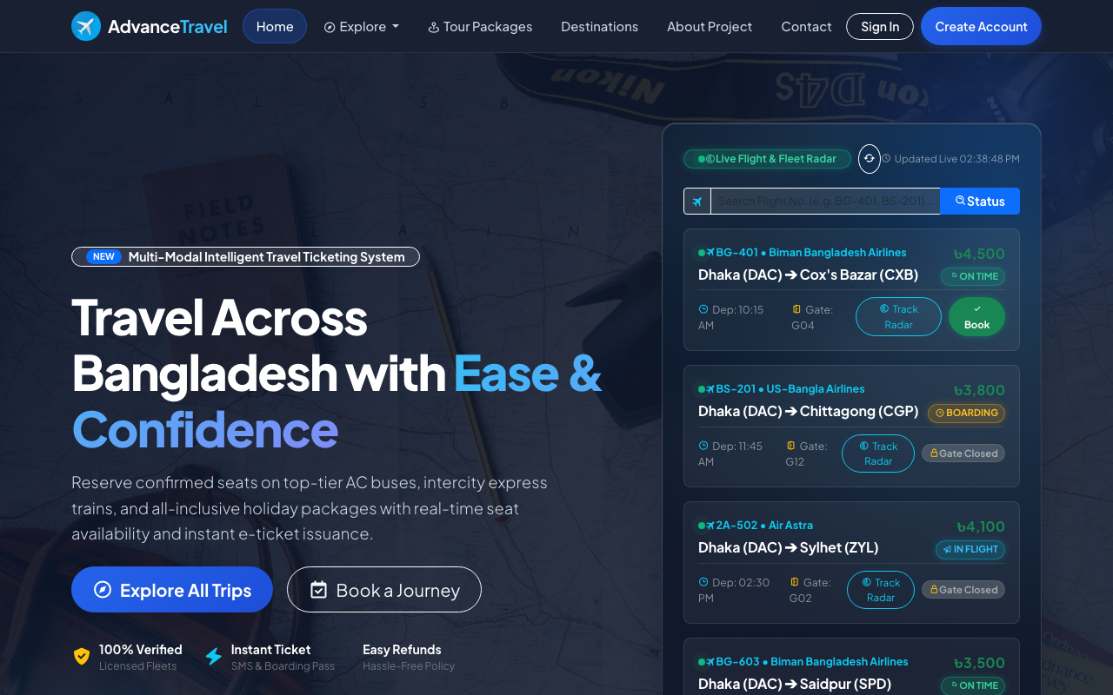
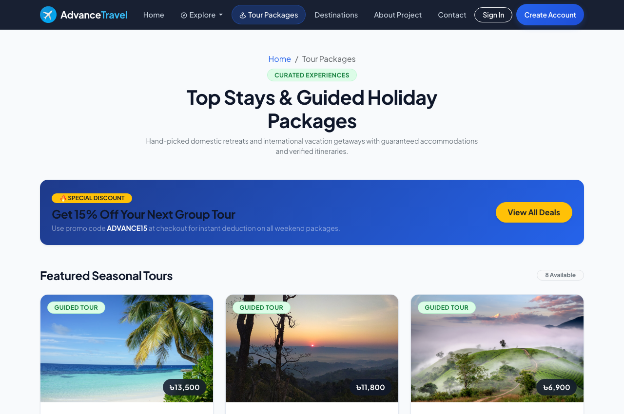
SONARGAON UNIVERSITY • CHAPTER 4: USER EXPERIENCE
🎙️ EFAZ AHAMMAD THALHA | Frontend Lead & UI/UX
Customer Experience: Destination Exploration & Tour Catalog
Responsive UI design system with dynamic filtering across transit modes and regions (Chapter 4, Figs 4.2 & 4.4)
Figure 4.2: Customer Landing Page Hero Section with Featured Tours and Search Controls
Figure 4.4: Tour Packages Catalog with Dynamic Filtering and Multi-Modal Transit Badges
🔍 Multi-Modal Transit Filtering
Instant client-side sorting across intercity luxury buses, express railway trains, domestic flights, and holiday tours.
📍 Curated Regional Destinations
High-visibility domestic showcases covering Cox's Bazar, Sylhet tea gardens, Bandarban hills, and Sajek Valley.
📱 Responsive Blade & Tailwind Grid
Mobile-first, viewport-agnostic fluid layout engineered with utility-first Tailwind CSS and Boxicons vector icon sets.
Advance Travel • B.Sc. in CSE Capstone Project Defense • Sonargaon University (SU)
Slide 6 of 16

Slide 7
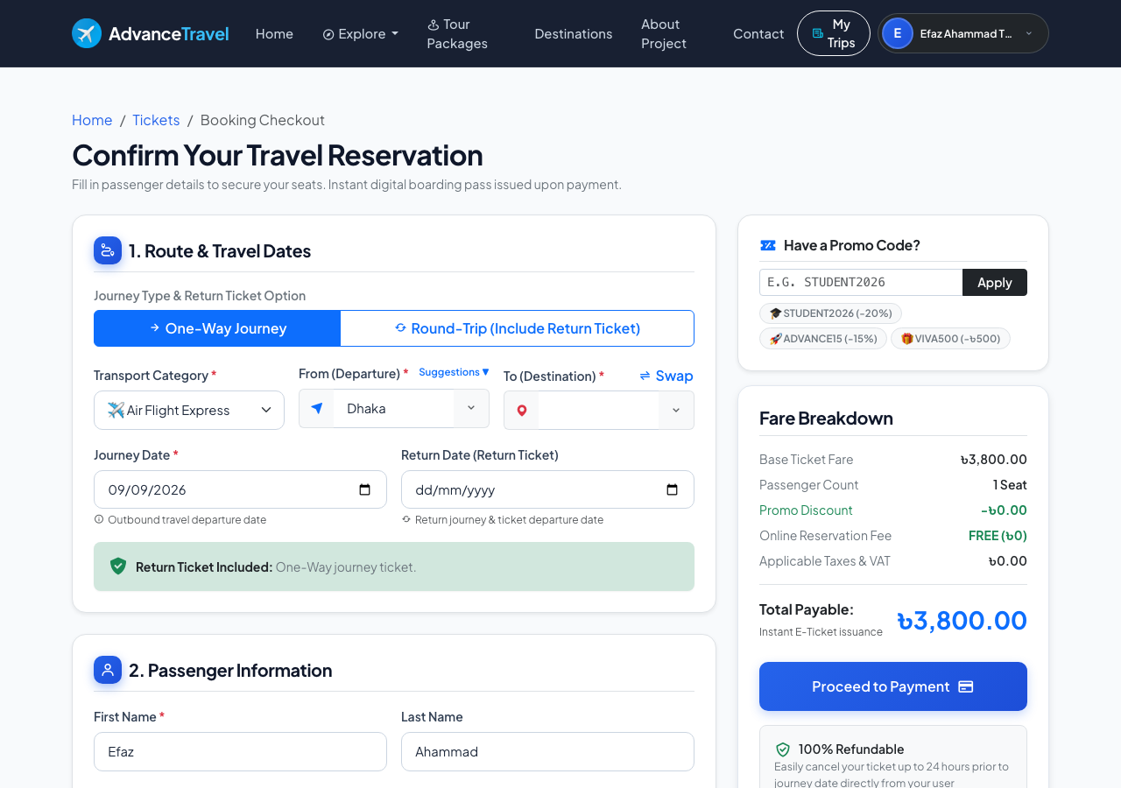
SONARGAON UNIVERSITY • CHAPTER 4: BOOKING ENGINE
🎙️ EFAZ AHAMMAD THALHA | Frontend Lead & UI/UX
Interactive Tour Booking & Room/Seat Reservation Interface
Dynamic seat/room allocation, guest demographic inputs, and promo code execution (Chapter 4, Figure 4.5)
CORE BOOKING ENGINE CAPABILITIES
👥 Dynamic Passenger Demographic Roster
• Asynchronous client-side DOM updates dynamically generate required input fields for lead traveler and companions. • Captures full name, email, contact phone number, and emergency contact details. • Zero page reloads for seamless booking flow.
⏱️ Real-Time Seat & Room Allocation
• Interactive selectors allow travelers to choose journey departure/return dates, room counts, and seat numbers. • Validates quota limits against database inventory. • Room surcharges and multi-seat allocations computed dynamically.
🏷️ Automated Promotional Voucher Engine
• Instant client-side deduction validating promotional vouchers (e.g., `EID2026` 15% discount). • Calculates applicable discount with upper-bound cap. • Transparent price breakdown displaying base fare, room additions, discounts, and net total.
Figure 4.5: Interactive Tour Booking and Room/Seat Reservation Interface
Advance Travel • B.Sc. in CSE Capstone Project Defense • Sonargaon University (SU)
Slide 7 of 16

Slide 8
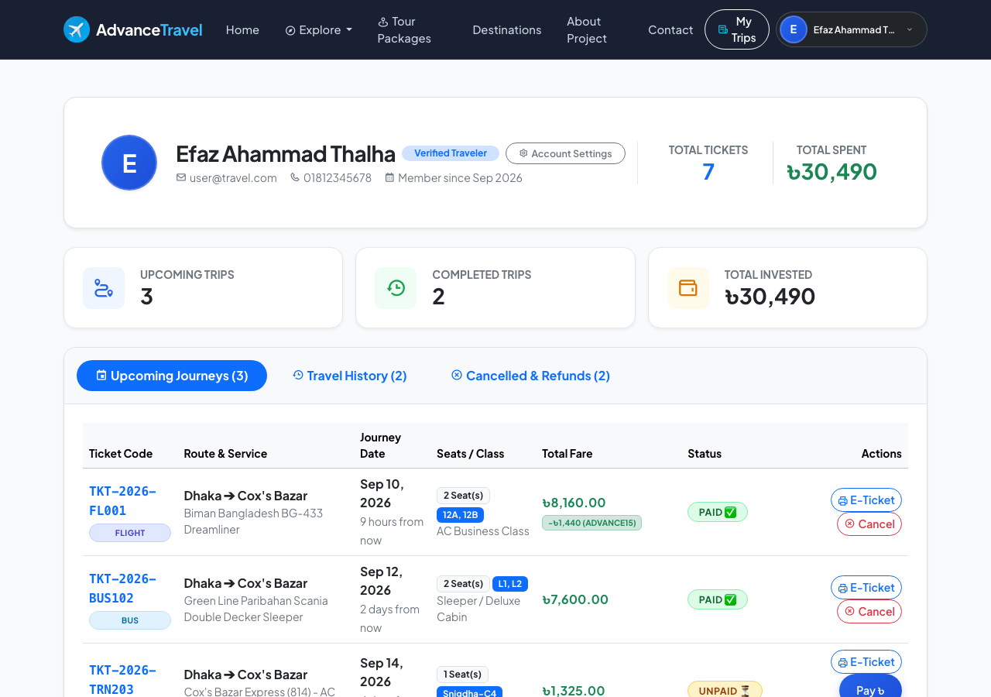
SONARGAON UNIVERSITY • CHAPTER 4: CUSTOMER PORTAL
🎙️ EFAZ AHAMMAD THALHA | Frontend Lead & UI/UX
Traveler Self-Service Dashboard & Trip Management
End-to-end booking tracking, one-click ticket re-downloads, and self-service cancellations (Chapter 4, Figure 4.8)
TRAVELER PORTAL & ACTIONS
⏳ Active Journey Countdown & Tracking
• Displays active, completed, and cancelled reservations with route metadata, departure schedules, seat allocations, and live trip status. • Real-time countdown clocks display remaining days to departure, creating pre-trip confidence. • Complete history log of past travel investments.
📄 One-Click E-Ticket & Receipt Access
• Travelers can instantly re-download printable PDF invoices and view their digital boarding pass with embedded QR code. • Eliminates paper loss and terminal counter queuing. • Accessible on any mobile browser anytime, anywhere.
🔄 Self-Service Booking Cancellation
• Enables travelers to initiate self-service cancellations for upcoming journeys prior to departure date. • Helper method `canBeCancelled()` prevents cancellation of departed tours. • Automatically transitions booking status and logs refund requests.
Figure 4.8: Traveler Self-Service Dashboard Displaying Active Bookings and Trip Actions
Advance Travel • B.Sc. in CSE Capstone Project Defense • Sonargaon University (SU)
Slide 8 of 16

Slide 9
SONARGAON UNIVERSITY • LIVE SYSTEM DEMONSTRATION
🎙️ EFAZ AHAMMAD THALHA | Frontend Lead & UI/UX
Live Software Demonstration: End-to-End Traveler Journey
Demonstrating the running Laravel 12 application on local production-parity environment
STEP 1
STEP 2
STEP 3
STEP 4
Explore & Filter
• Browse destination catalog (`/explore`) • Filter by transit mode / region • Open 'Sajek Valley 3-Day Tour' • Inspect multi-day itinerary & inclusions
Reserve & Calculate
• Enter passenger names & contacts • Select travel date & seat count • Apply promo code (`EID2026`) • Verify dynamic price computation
SSLCommerz Checkout
• Launch payment gateway modal • Simulate bKash / Card transaction • Trigger server-to-server IPN webhook • Confirm instant DB status = `paid`
QR Boarding Pass
• View digital ticket (`/ticket/{id}`) • Inspect high-density QR token • Open `/verify-ticket/{code}` • Display green authenticated pass
⚡ PREPARED LIVE DEFENSE DEMONSTRATION ENVIRONMENT
Local Instance: http://127.0.0.1:8000 (Laravel Herd: http://advance-travel.test) • PHP 8.4 Runtime • SQLite Database Engine
Prepared Credentials: Traveler [user@travel.com / password123] | System Administrator [admin@travel.com / password123]
Advance Travel • B.Sc. in CSE Capstone Project Defense • Sonargaon University (SU)
Slide 9 of 16

Slide 10
SONARGAON UNIVERSITY • CHAPTER 4: ALGORITHMS & LOGIC
🎙️ MD. ABDUR RAKIB | Database Architect & Systems
Core Algorithmic Implementations & Technical Code Logic
Deterministic formulations governing dynamic pricing, IPN hash verification, and tokenized QR validation (Chapter 4, Section 4.3)
📐 1. Dynamic Pricing Model
MATHEMATICAL FORMULATION: Total Fare = (Seats × Unit_Price) + ((Rooms - 1) × 1500) - Discount Where Promotional Discount is: Discount = Min(Base_Price × Rate, Cap) if Valid CODE LOGIC (BookingController.php): • Validates seat count and room count bounds • Applied promo code 'EID2026' grants 15% discount: $discount = round($totalPrice * 0.15, 2); • Enforces zero-floor constraint: $finalTotal = max(0, $totalPrice - $discount); • Stores verified total in bookings table
🔒 2. SSLCommerz IPN Hash Checksum
MATHEMATICAL HASH FORMULATION: ComputedHash = Hash(Tran_ID + Amount + Currency + Status + Store_Password) SECURITY LOGIC (PaymentController.php): • Intercepts asynchronous POST callback from gateway • Extracts tran_id, val_id, and currency • Executes secondary server-to-server query against SSLCommerz Validation API • Reconciles database amount against paid amount • Atomically updates booking status to 'paid' • Records timestamped ledger in payments table
🔑 3. Tokenized QR Ticket Verification
VERIFICATION URI FORMULATION: https://advance-travel.test/verify-ticket/{booking_code} FIELD GATE INSPECTION LOGIC: • Station master scans high-density QR matrix • Dispatches GET request to public verification route • Queries database by unique booking_code: $booking = Booking::where('booking_code', $code) • Validates conditions: status !== 'cancelled' && payment_status === 'paid' • Renders instant green verified checkmark • Blocks duplicate entry attempts in real time
Advance Travel • B.Sc. in CSE Capstone Project Defense • Sonargaon University (SU)
Slide 10 of 16

Slide 11
SONARGAON UNIVERSITY • FINANCIAL ARCHITECTURE
🎙️ MD. ABDUR RAKIB | Database Architect & Systems
Automated Multi-Channel Financial Settlement Pipeline
PCI-DSS certified gateway integration with server-to-server Instant Payment Notification (IPN)
TRANSACTION LIFECYCLE & ASYNCHRONOUS IPN FLOW
1. Checkout Initiation ➔ 2. SSLCommerz Gateway (bKash/Nagad/Cards) ➔ 3. Server IPN Webhook ➔ 4. SHA-512 Verification ➔ 5. Paid Status
Server-to-server webhook architecture eliminates reliance on the user's browser redirect, guaranteeing 100% financial reconciliation even if network disconnects.
🔒 Cryptographic Checksum Verification
• Every webhook payload sent by SSLCommerz is verified using SHA-512 cryptographic checksums. • Validates tran_id, currency, and exact amount to prevent client-side tampering. • Direct server-to-server validation API query cross-checks transaction credentials.
⚡ Network Disconnection Resilience
• If a traveler's phone battery dies or internet disconnects immediately after payment on the gateway, the server-side IPN webhook reliably completes the transaction. • Updates booking state from 'pending' to 'paid' in the database. • Completely eliminates orphaned payment states.
🧾 Automated Invoice & Ledger Audit
• Instant transaction completion triggers background workers that generate PDF receipts and reserve seat inventory permanently. • Dispatches automated email confirmation notifications. • Records full serialized JSON gateway payload in the payments table for accounting audit.
Advance Travel • B.Sc. in CSE Capstone Project Defense • Sonargaon University (SU)
Slide 11 of 16

Slide 12
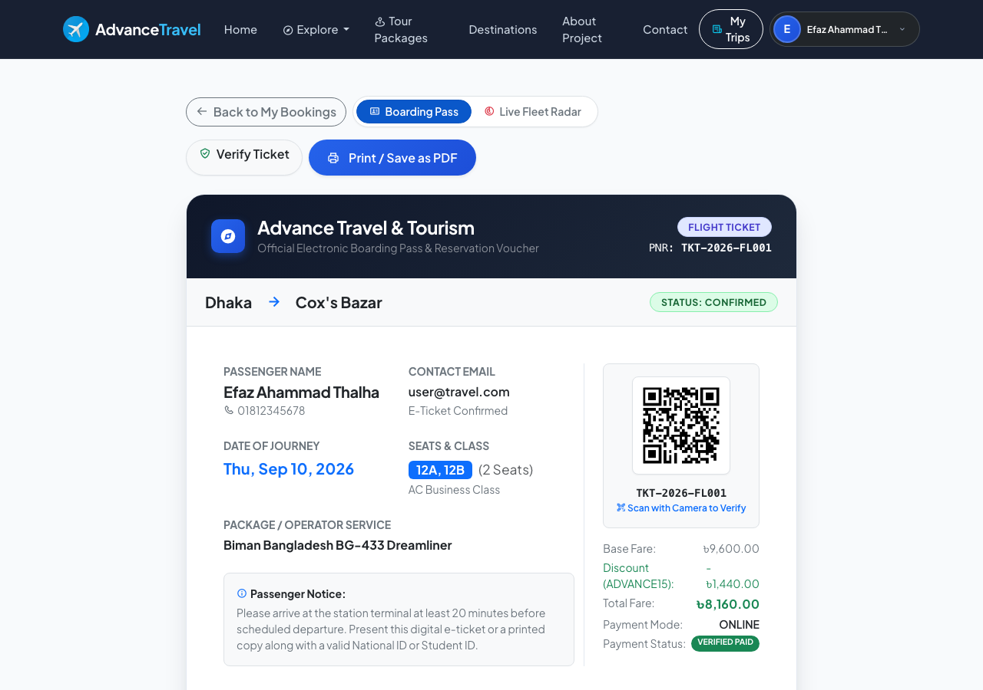
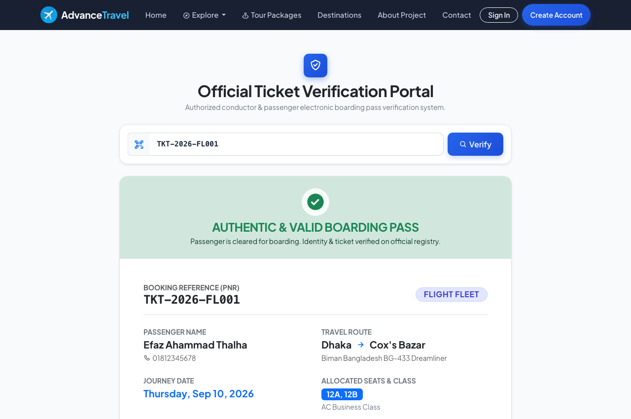
SONARGAON UNIVERSITY • CHAPTER 4: TICKETING & QR
🎙️ MD. ABDUR RAKIB | Database Architect & Systems
Anti-Counterfeit Digital Boarding Pass & QR Verification Portal
Tokenized machine-readable QR boarding passes with public camera verification (Chapter 4, Figures 4.6 & 4.7)
Figure 4.6: Generated Digital E-Ticket and Boarding Pass with High-Density QR Token
Figure 4.7: Public Gate Ticket Verification Portal with Real-Time Authenticity Badge
🔐 High-Density QR Matrix
Encodes structured alphanumeric data (booking_code and URI) with built-in Reed-Solomon error correction.
📷 Zero Proprietary Handheld Hardware
Station attendants and tour guides authenticate tickets in under 1 second using standard smartphone web browsers.
🚫 Anti-Scalping & Duplication Guard
Directly queries the database in real time to verify legal passenger credentials and block duplicate entries.
Advance Travel • B.Sc. in CSE Capstone Project Defense • Sonargaon University (SU)
Slide 12 of 16

Slide 13
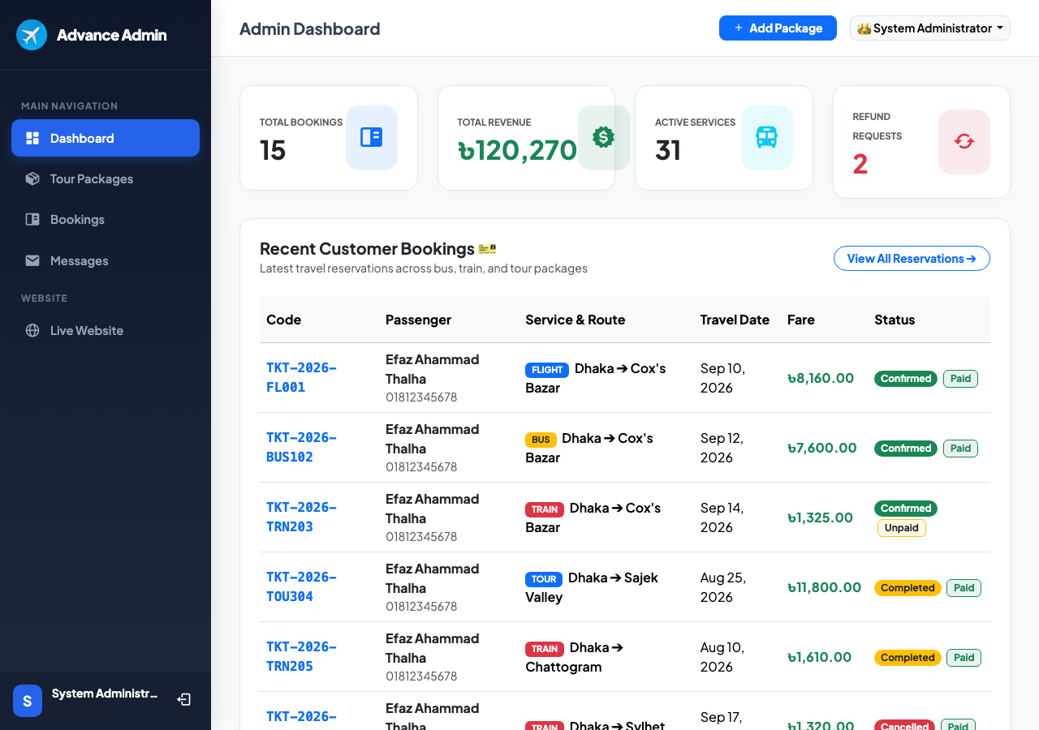
SONARGAON UNIVERSITY • CHAPTER 4: ADMIN ERP & BI
🎙️ MD. ABDUR RAKIB | Database Architect & Systems
Administrative Control Dashboard & Business Intelligence
Real-time operational analytics, package CRUD management, and refund processing (Chapter 4, Figures 4.10, 4.11, 4.12)
ADMINISTRATIVE ERP SUITE
📊 Executive Business Intelligence
• Real-time financial KPI cards displaying Gross Merchandise Volume (GMV: 120,270 BDT), total bookings count (15 bookings), active travel services (31 services), and refund queues (2 requests). • Tabular recent customer booking feed with live payment badges (`Paid`, `Unpaid`).
📦 Tour Package Inventory Management (CRUD)
• Administrative package control panel (`/admin/packages`, Fig. 4.11) enabling full Create, Read, Update, Delete controls. • Configure transport routes, seat quotas, base fares, package descriptions, and departure blackout dates.
🔄 Booking Lifecycle & Automated Refunds
• Booking management interface (`/admin/bookings`, Fig. 4.12) allowing administrators to approve, cancel, or transition booking status. • Integrated refund processing (`/admin/bookings/{id}/refund`) with automated ledger updates and customer notification dispatch.
Figure 4.10: Administrative Control Dashboard with Real-Time Financial and Booking KPIs
Advance Travel • B.Sc. in CSE Capstone Project Defense • Sonargaon University (SU)
Slide 13 of 16

Slide 14
SONARGAON UNIVERSITY • CHAPTER 4: TESTING & QA
🎙️ MD. ABDUR RAKIB | Database Architect & Systems
Quality Assurance, Testing Matrices & Performance Evaluation
Rigorous black-box test execution matrix (Table 4.1) and Google Lighthouse performance audit
AUTH & SECURITY
BOOKING ENGINE
PAYMENT PIPELINE
QR TICKETING
Bcrypt & RBAC
• TC-01: Traveler registration and Bcrypt password hashing [PASSED] • TC-02: Invalid login authentication blocked [PASSED] • TC-09: Unauthorized admin URL access intercepted with HTTP 403 [PASSED]
Catalog & Quotas
• TC-03: Package catalog filtering by transit category & price [PASSED] • TC-04: Booking submission and dynamic total fare calculation [PASSED] • TC-10: Self-service booking cancellation and refund request [PASSED]
SSLCommerz IPN
• TC-05: Valid IPN webhook transitions status to 'paid' [PASSED] • TC-06: Mismatched checksum / amount rejected with HTTP 400 [PASSED] • Atomic ledger recording in payments table [PASSED]
Gate Verification
• TC-07: Digital boarding pass synthesis with valid QR token [PASSED] • TC-08: Public gate portal confirms authenticity via mobile camera browser [PASSED] • Single-entry guard prevents duplicate reuse [PASSED]
⚡ Performance
96 / 100
FCP: 0.8s | LCP: 1.2s
♿ Accessibility
98 / 100
WCAG 2.1 AA Compliant
🛡️ Best Practices
100 / 100
HTTPS, Secure Cookies
🔍 SEO Score
95 / 100
Semantic Meta Markup
Advance Travel • B.Sc. in CSE Capstone Project Defense • Sonargaon University (SU)
Slide 14 of 16

Slide 15
SONARGAON UNIVERSITY • CHAPTER 5: STANDARDS & BUDGETS
🎙️ MD. ABDUR RAKIB | Database Architect & Systems
Engineering Standards, Washington Accord Mapping & Feasibility
Compliance with IEEE/ISO standards, BAETE complex engineering attributes, and financial budgets (Chapter 5)
🛡️ COMPUTING STANDARDS
• IEEE 12207 Life Cycle
Followed structured engineering lifecycle: SRS elicitation, architectural design, unit/integration testing, and deployment verification.
• ISO/IEC 25010 Quality Model
Evaluated against 8 quality characteristics: functional suitability, performance efficiency, reliability, security, and maintainability.
• OWASP Top 10 Compliance
SQL injection neutralized via Eloquent PDO binding, XSS escaped via Blade, CSRF tokens enforced on all mutating HTTP requests.
• PCI-DSS Security Principles
Adheres to payment security by delegating card data collection exclusively to Level 1 PCI-DSS certified SSLCommerz gateway.
📜 WASHINGTON ACCORD (BAETE)
• WP1: Depth of Knowledge
Requires advanced computer science principles: relational database theory (3NF), cryptographic hash validation, and multi-tier MVC architecture.
• WP2: Conflicting Constraints
Reconciled conflicting engineering requirements: delivering sub-200ms page response while enforcing pessimistic transaction locking.
• WP3: Non-Standard Integration
Engineered custom server-to-server SSLCommerz webhook with SHA-512 checksum validation.
• WP6 & EP3: Societal / Legal
Complies with Bangladesh ICT Act and green computing principles, eliminating paper tickets to save ~150,000 sheets of paper and 18 trees annually.
💰 FINANCIAL FEASIBILITY & ROI
• Academic R&D Budget: 10,000 BDT
Table 5.1: Covers staging VPS (6,000 BDT) and project report documentation/binding (4,000 BDT) using open-source stack (PHP, Laravel, SQLite).
• Annual Commercial Cloud: 170,900 BDT
Table 5.2: Monthly 12,700 BDT encompassing application VPS (5.5k), managed DB (4.0k), SSLCommerz setup (15k/yr), and transactional SMS/Email.
• Revenue Model: 10% Commission
Platform earns 10% commission on all gross travel bookings plus premium featured package listings.
• Full Break-Even: 8.2 Months
Projected complete capital recovery within 8.2 months at a conservative commercial volume of 120 bookings per month.
Advance Travel • B.Sc. in CSE Capstone Project Defense • Sonargaon University (SU)
Slide 15 of 16

Slide 16
SONARGAON UNIVERSITY • CHAPTER 6: CONCLUSION & VIVA
🎙️ ALL PRESENTERS | Misty • Rakib • Thalha
Project Summary, Delivered Contributions & Defense Q&A
Fulfilling capstone objectives and advancing digital tourism through software engineering excellence (Chapter 6)
🎯 DELIVERED PROJECT CONTRIBUTIONS
✓ Unified Multi-Modal Tourism Marketplace
Consolidated luxury buses, trains, domestic flights, and holiday hotels into a responsive portal.
✓ Automated Multi-Channel Financial Settlement
Integrated SSLCommerz gateway with asynchronous IPN webhook validation and automated ledger recording.
✓ Zero Double-Booking Concurrency
Pessimistic database transaction locks prevent race conditions during simultaneous reservations.
✓ Cryptographic Paperless Digital Boarding Passes
High-density QR boarding passes with universal smartphone camera verification for station masters.
✓ Green Computing & Environmental Conservation
Replaces physical tickets with digital passes, conserving ~150,000 sheets of paper and 18 trees annually.
🚀 FUTURE RESEARCH & DEVELOPMENT HORIZONS
• AI Recommendation Engine
Integrating machine learning collaborative filtering for personalized travel packages.
• Multi-Vendor Agency Marketplace
Refactoring administrative layer into a multi-tenant platform for regional operators.
• Dedicated Native Mobile Apps
Developing Flutter/React Native mobile apps with Apple Wallet / Google Wallet pass storage.
• Offline Asymmetric Cryptography
Embedding Ed25519 digital signatures for offline gate inspection without active internet.
• Integrated Dynamic SVG Seat Maps
Interactive visual SVG canvas seat selector allowing travelers to visually pick bus/train seats.
THANK YOU FOR YOUR TIME & ATTENTION • QUESTIONS & ANSWERS (Q&A)
We express our sincere gratitude to our supervisor Md. Rashedul Islam sir, Department Head Prof. Bulbul Ahamed sir, and the respected Defense Board.
Md. Amir Shorif Misty (CSE2203027142) • Md. Abdur Rakib (CSE2203027141) • Efaz Ahammad Thalha (CSE2203027172)
Advance Travel • B.Sc. in CSE Capstone Project Defense • Sonargaon University (SU)
Slide 16 of 16

