Slide 1


Instructors Joy Lan · Somya Iqbal
Materials Adapted from materials developed by Chris Oldnall

Slide 2
Arrangements for
the COURSE

Slide 3
Time | Session 1 25th September (Fri) 10:00-12:00 | Session 2 2nd October (Fri) 10:00-12:00 | Session 3 9th October (Fri) 10:00-12:00
Topic A | Introduction to Noteable and Python | Functions | Collections
Topic B | Conditions and Logic |  | List Comprehensions

Slide 4
Sessions Throughout the course
Wrap-Up
(10 minutes)
Presentation of Topic A
(10-15 minutes)
Paired Programming
Practice B
(30-35 minutes)
Paired Programming
Practice A
(35-40 minutes)
2hr Sessions
Presentation of Topic B
(10-15 minutes)
Mini-Break
(10 minutes)

Slide 5
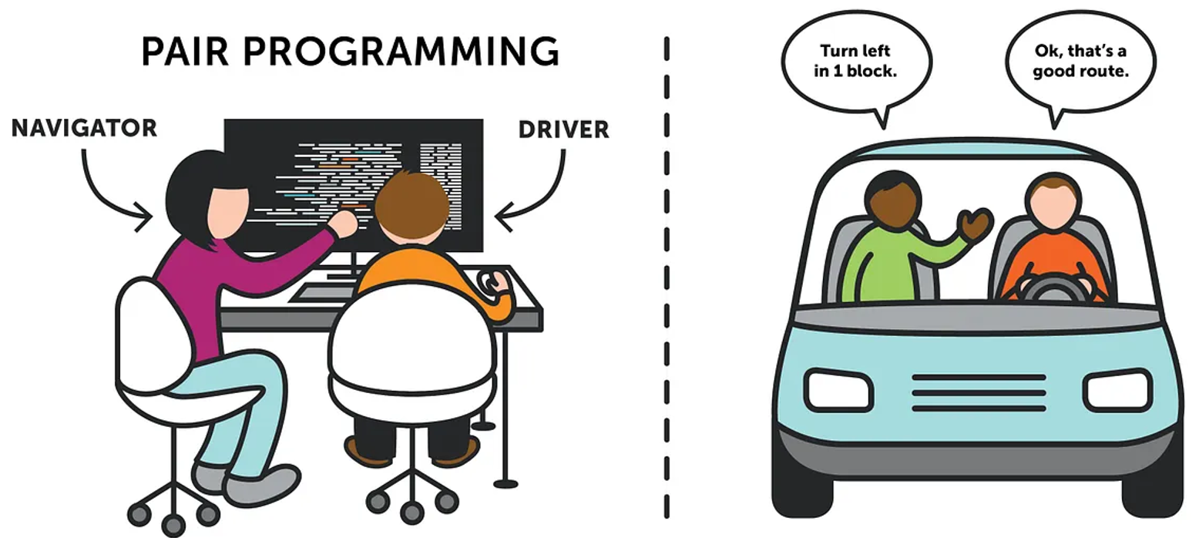
Paired Programming
Image from https://medium.com/@tomspencer_uk/pair-programming-and-problem-solving-4531ef3bf171

Slide 6
During demonstration
Feel free to ask any questions!
Code chunk Text
variable_name = sensible
print(variable_name)
“sensible”
In the slides we may see text which is ‘pink’ in colour and a different font. This is to indicate it is a chunk of text, written in Python. The colour/font don’t matter just noticing it is code is important!

Slide 7
Introduction to Noteable and Python

Slide 8
Programming = Telling the computer what to do
You need to speak a language the computer will understand,
e.g. Python

Slide 9
How do we ‘speak’ Python?
In order to ‘speak’ Python we will need two things…
1. The syntax (equivalent to the grammar of a language)
2. An interpreter (an interface to take in our Python syntax).

Slide 10
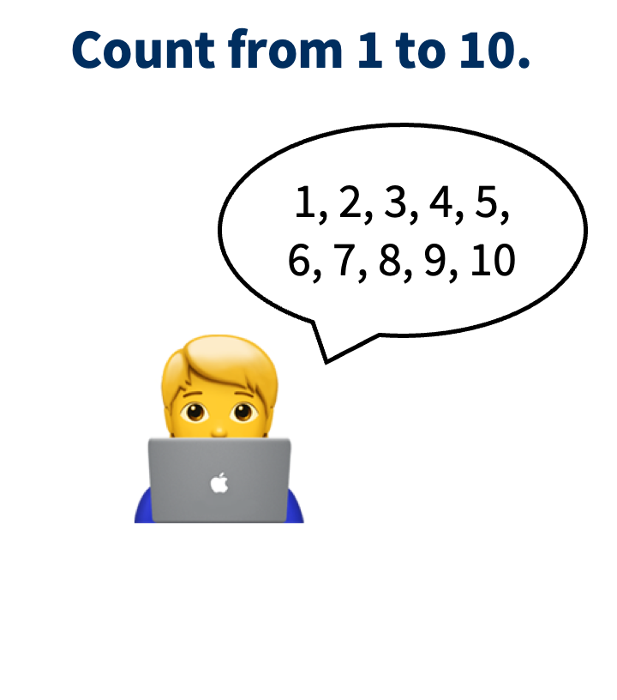
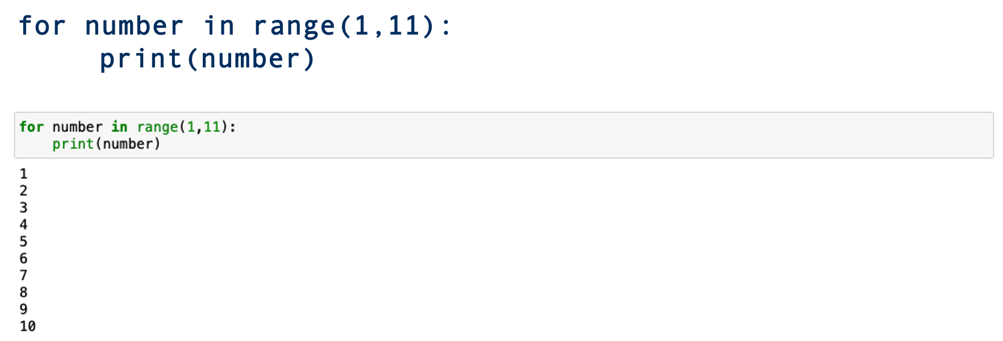
Syntax

Slide 11
The Interpreter

Slide 12
Jupyter Notebooks
Our choice of interpreter throughout the week will be Jupyter Notebooks. These have many benefits:
Easy to use and share with others,
can be run on the Noteable service,
very hard to break anything (properly).

Slide 13
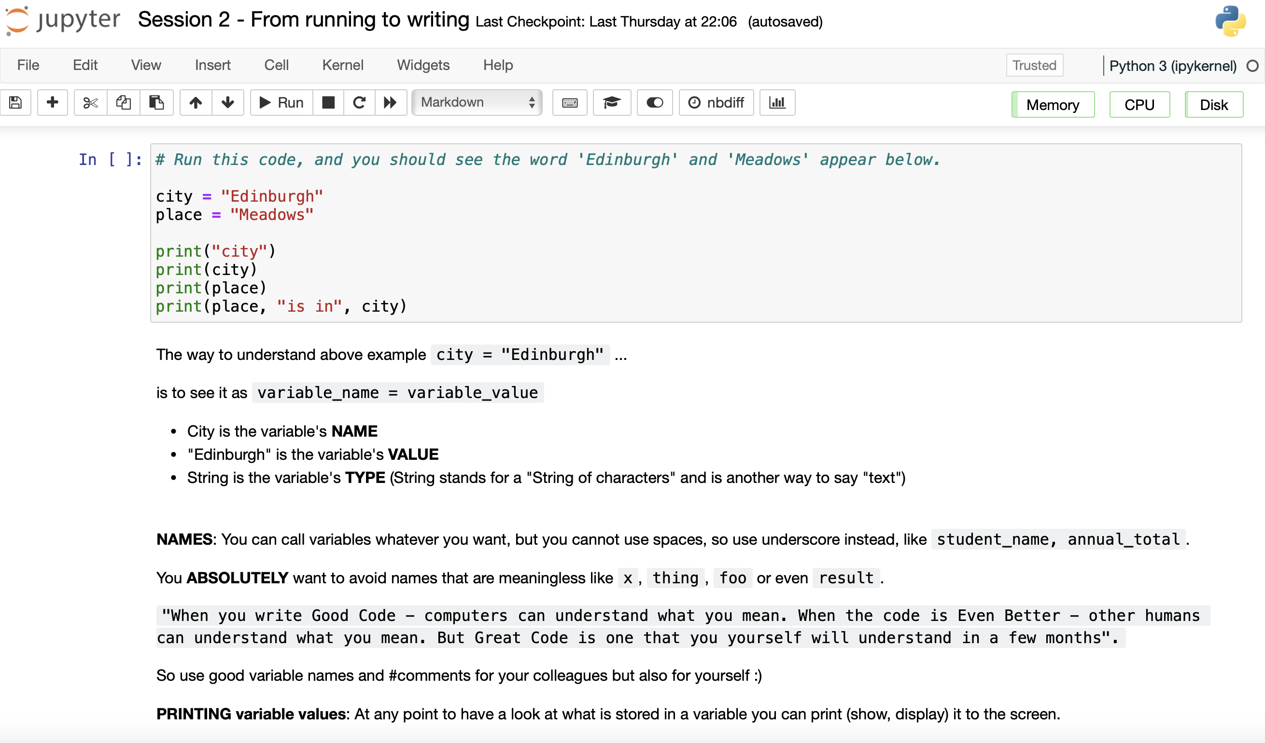
Jupyter Notebooks
}
Code (Python)
}
Text (Markdown)

Slide 14





How does Noteable come into this?
Noteable is a university of Edinburgh service which provides online web-based access to a Jupyter Notebook ‘server’. As it is not local this makes it great and easy for research and teaching!

Slide 15
Top to Bottom
Code is written in lines.
Each line does something, and they are executed from top to bottom.
count = 43
print(count)
______________
count = 44
print(count)
______________
count = 44
print(counter)
______________
count = 44
print(counter)
______________
count = count + 1
print(count)
______________

Slide 16
Top to Bottom
Code is written in lines.
Each line does something, and they are executed from top to bottom.
count = 43
print(count)
43
count = 44
print(count)
44
count = 44
print(counter)
ERROR
count = 44
print(count)
44
count = count + 1
print(count)
45

Slide 17
Variables
Variables are places to store values for later.
There are different types of variables:
string for text, e.g. “penguin” or “I like Python”
int (integer) for whole numbers, e.g. 1, 5, 2014
float for decimal numbers, e.g. 2.25, 6.1246, 16.2
bool (Boolean) for logic values: True, False
my_favourite_animal
“penguin”
my_favourite_animal = “penguin”

Slide 18
Lets get programming
Session 1a:
From Running to Writing

Slide 19
Conditions and Logic

Slide 20
Operators
Arithmetic operators
+ 2+1 =
- 2-1 =
* 2*1 =
/ 4/2 =
% 5%3 =
** 2**3 =
// 4//3 =

Slide 21
Operators
Arithmetic operators
+ 2+1 = 3
- 2-1 = 1
* 2*1 = 2
/ 4/2 = 2
% 5%3 = 2
** 2**3 = 8
// 4//3 = 1
Addition
Subtraction
Multiplication
Division
Modulus
Exponentiation
Floor division (to integer)

Slide 22
Operators
Assignment operators
+= x += 3 x = x + 3
-= x -= 3 x = x - 3
Assignment operators
+= x += 3 x = x + 3
-= x -= 3 x = x - 3

Slide 23
Comparing Variables
2 == 2
2 == 3
"penguin" == "penguin"
"penguin" == “whale"
"penguin" == "Penguin"
"2024" == 2024

Slide 24
Comparing Variables
2 == 2
2 == 3
"penguin" == "penguin"
"penguin" == “whale"
"penguin" == "Penguin"
"2024" == 2024
True
False
True
False
False
False

Slide 25
Comparing Variables
2 < 2
2 < 3
3 > 2
2 <= 2
3 != 2
3 != 3

Slide 26
Comparing Variables
2 < 2
2 < 3
3 > 2
2 <= 2
3 != 2
3 != 3
False
True
True
True
True
False

Slide 27
Comparing Variables
x = 5
print(x > 0 and x < 10)
x = 5
print(not(x > 3 and x < 10))
x = 5
print(x < 5 or x > 10)

Slide 28
Comparing Variables
x = 5
print(x > 0 and x < 10)
x = 5
print(not(x > 3 and x < 10))
True
False
x = 5
print(x < 5 or x > 10)
x = 5
x > 3 or x > 10
False
Notes:
https://www.w3schools.com/python/python_operators.asp

Slide 29
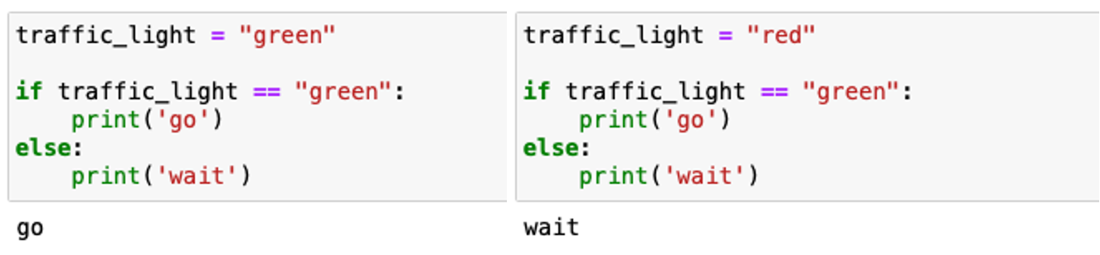
Conditionals
Controlling what part of your code gets executed based on some conditions can be very useful in capturing real life conditionals.
E.g. “If the traffic light is green, go, otherwise, wait.”

Slide 30
Lets get programming
Session 1b:
If (This AND That)

Slide 31
Functions
Part 1

Slide 32
Questions to ask…
1.What is a function?
2. Why do we use functions?
3. How do I make a function in Python?

Slide 33
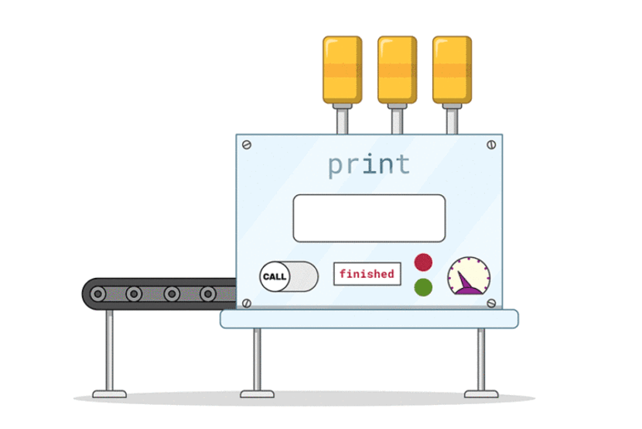
What is a Function?

Slide 34
What is a Function?
A way to generalise a process that will need to be done over and over again.

Slide 35
Why do we use functions?
Reduce lines of code,
Enhance computing performance,
Make life easier!

Slide 36
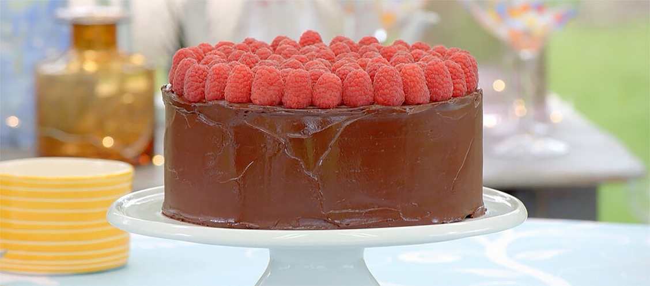
Why do we use functions?

Slide 37
What is the recipe For A function in Python?
'def'
Name
What goes into it (arguments)
What it does (the steps)
What it gives back (return value)

Slide 38
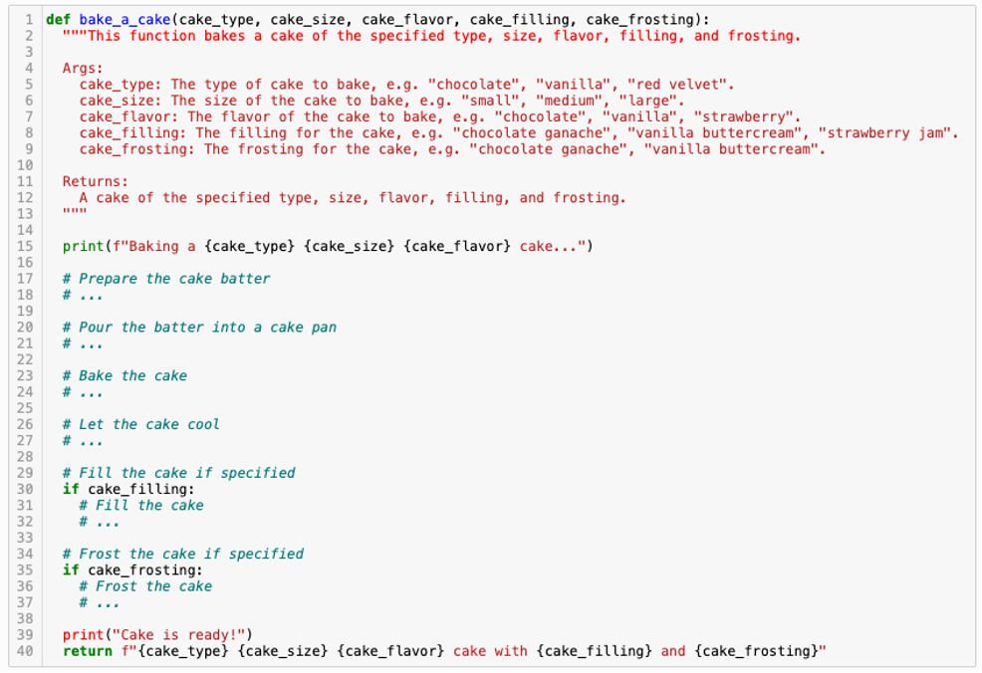

Slide 39
Lets get programming
Session 2a:
Write the Recipe

Slide 40
Functions
Part 2

Slide 41


Local and Global
Local:
Only those close to him (within the same function) who know about what he can do.
Global:
Can be accessed by anyone, anywhere – everyone knows what he can do!

Slide 42
The Scope Rules
Rule 1: Anything inside a function is mysterious to the outside...
You are not able to peek inside of a function elsewhere in code.
Only things returned will become available to the 'global' environment.
Rule 2: Functions can look outside, but shouldn't...
Things can get complicated when a function looks outside.
We tackle this by carefully specifying arguments with relevant names.

Slide 43
Lets get programming
Session 2b: SCOPE

Slide 44
Collections

Slide 45
Lists
planet0 = "Mercury"
planet1 = "Venus"
planet2 = "Earth"
planet3 = "Mars"
planet4 = "Jupyter"
planet5 = "Saturn"
planet6 = "Uranus”

Slide 46
Lists
planet0 = "Mercury"
planet1 = "Venus"
planet2 = "Earth"
planet3 = "Mars"
planet4 = "Jupyter"
planet5 = "Saturn"
planet6 = "Uranus”
planets = ["Mercury", "Venus", "Earth", "Mars", "Jupyter", "Saturn", "Uranus"]

Slide 47
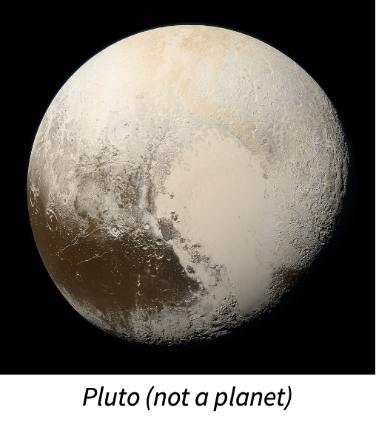
Why Use Lists?
planets = ["Mercury", "Venus", "Earth", "Mars", "Jupyter", "Saturn", "Uranus"]
✅ Count how many items are in the list
✅ Check if a specific item is in the list
✅ Find the location of a specific item
✅ Add and remove items
✅ Sort (alphabetically or otherwise)

Slide 48
Alternatives to Lists
Tuple
planets = ("Mercury", "Venus", "Earth", "Mars", "Jupyter", "Saturn", "Uranus”)
• Uses () instead of []
• Same as a list, except it cannot be changed after creating it

Slide 49
Alternatives to Lists
Set
planets = {"Mercury", "Venus", "Earth", "Mars", "Jupyter", "Saturn", "Uranus”}
• Uses {} instead of [] (list) or () (tuple)
Same as a list, except:
  Every item is unique (items cannot be listed twice)
  Order does not matter and will change (no indexing)

Slide 50
Alternatives to Lists
Dictionaries
Used to store multiple pieces of information about one thing
Uses key-value pairs: each piece of data (value) has a label (key)
mercury = {“name”: “Mercury”, “day_length”: 59, “hottest_temp”: 430}

Slide 51
Alternatives to Lists
Dictionaries and Lists Together
Combining lists and dictionaries is useful for real-world data: We often have multiple pieces of information about lots of different things and want to work with all of it at the same time!
planets = [
  {“name”: “Mercury”, “day_length”: 59, “hottest_temp”: 430},
  {“name”: “Venus”, “day_length”: 243.025, “hottest_temp”: 462},
  {“name”: “Earth”, “day_length”: 1, “hottest_temp”: 56.7},
  …
  ]

Slide 52
Lets get programming
Session 3a:
[({collections})]

Slide 53
List Comprehensions

Slide 54
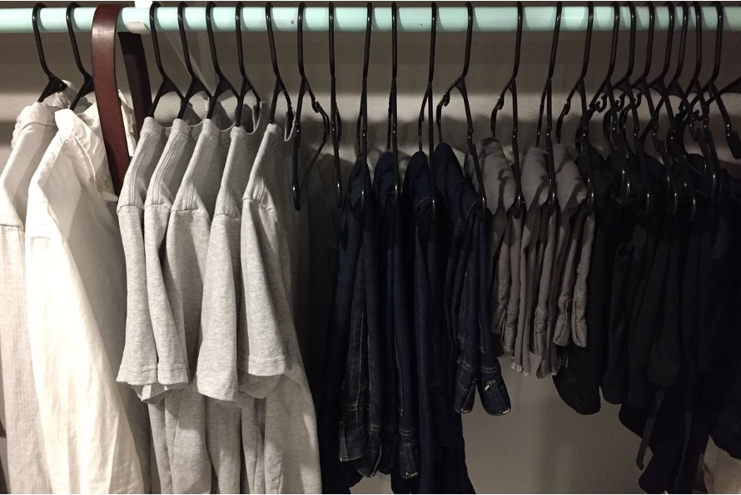
What Are List Comprehensions

Slide 55
How do I get someone to pick the shirts from the wardrobe?
Say that it is the shirts you want,
For each item of clothing, check if it is a shirt,
If it’s a shirt, then take it out the wardrobe.

Slide 56
shirts = [
item_of_clothing
for item in wardrobe
if item == shirt
                ]

Slide 57
initial_list = [thing1, thing2, …]
variable_name = [
<thing to get new list of>
for item in initial_list
if item ==/>/< <some condition>
              ]

Slide 58
Some math functions that may come in handy…

Slide 59
max( ) / min()
Get the largest/smallest element in a group. For letters it will mean 'highest/lowest in the alphabet'.
len( )
Size of the collection, can be used on lists, dicts, but also on strings.
sum( )
Combine all elements. Just used for numbers.

Slide 60
Lets get programming
Session 3b:
Lists of Lists

Slide 61
Finishing Up

Slide 62
How to import data
To import data there is a range of methods, the easiest is using the package 'pandas'
Eg.
import pandas as pd
data_frame = pd.read_csv("<Your File Pathway>")

Slide 63
Additional Resources
This course used (slightly modified) notebooks from Code Storytelling (http://www.codestorytelling.com).
We covered badges 1,2,4,5,7, and 8. Consider working through some more of the notebooks and watching some of the videos.
Think Python is an introductory Python book with many exercises, free to read online: https://greenteapress.com/wp/think-python-2e/

Slide 64
Feedback for us
Feedback for us...
We hope you've enjoyed the course as much as we did.
It is really useful for us to hear your feedback
https://edin.ac/45BpZFm
Should be really quick and only take 5 mins (maximum!)

