Slide 1
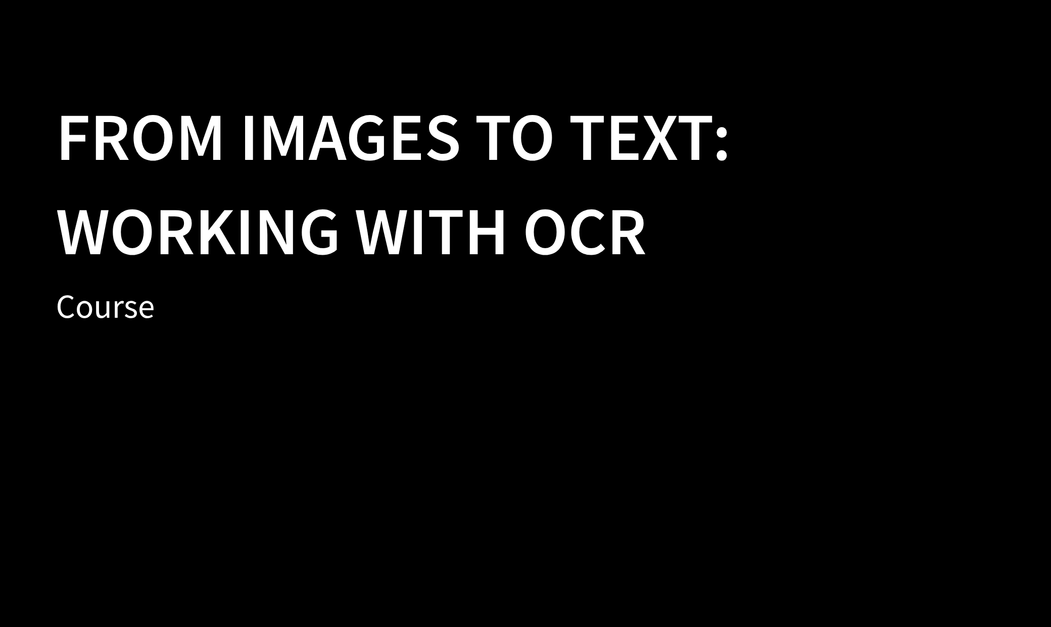

Instructors Joy Lan PhD Candidate Moray House

Slide 2
Arrangements for
the COURSE

Slide 3
Time | Session 1 28th October (Wed) 10:00-12:00 | Session 2 4th November (Wed) 10:00-12:00
Topic | Introduction to OCR Activity: OCR tools – Immarkus Challenges of OCR in practice | Review of programming basics Introduction to OCR packages Working with OCR in Python & R

Slide 4
Introduction to OCR

Slide 5
Optical Character Recognition
OCR is the technique to process images of text, such as written or printed documents, and produce machine-readable documents.

Slide 6
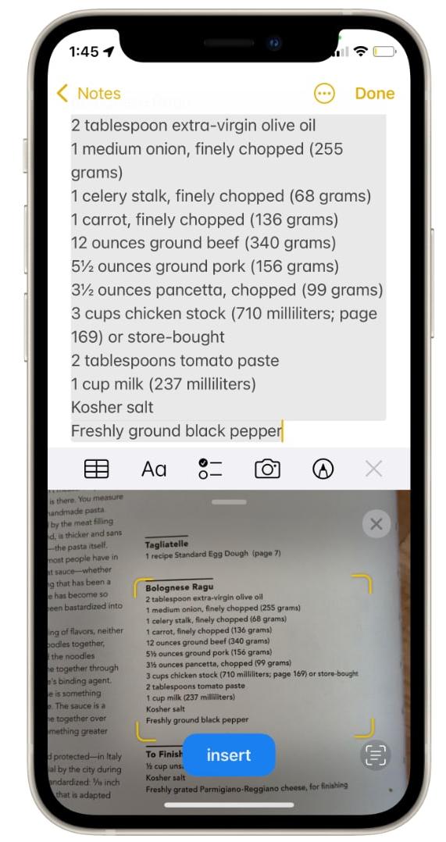

Examples
Scanning your passport at the airport.
Generate machine-readable text for text-to-speech technology.
Making physical archives searchable.
Creating a dataset of for text mining or text analysis.

Slide 7
OCR Workflow
Before OCR: inspect the image and preprocessing
          Inspect the data, and identify different source of error
          Preprocess the data to get better results
B. Applying OCR: choose the right methods
language packages
Fonts, text orientation and layout, stains, contrast, etc.
C. After OCR: clean up the text
Patching: Clean up the missing data and error using Regex (optional)

Slide 8
Activity: Ready made OCR tool

Slide 9
Try ready-made OCR tools
Choose a pdf containing images of text and use some these web-based tools to extract text:
(it can be either your own or from the course github repo)
https://tools.pdf24.org/en/ocr-pdf
https://www.onlineocr.net/
https://www.sodapdf.com/ocr-pdf/
https://www.sejda.com/ocr-pdf
https://ocr.space/
https://avepdf.com/pdf-ocr

Slide 10
Challenges of OCR
Accuracy depends on dataset quality. Some common sources of error include:
Age and damage (stained or blurry)
Mixed text and images, or multiple languages
Handwriting
Human errors and typos

Slide 11
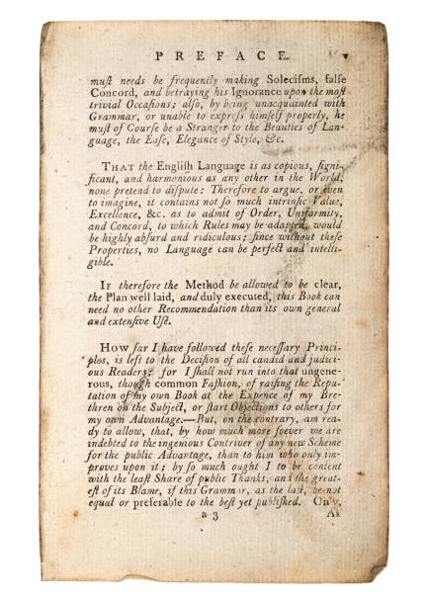
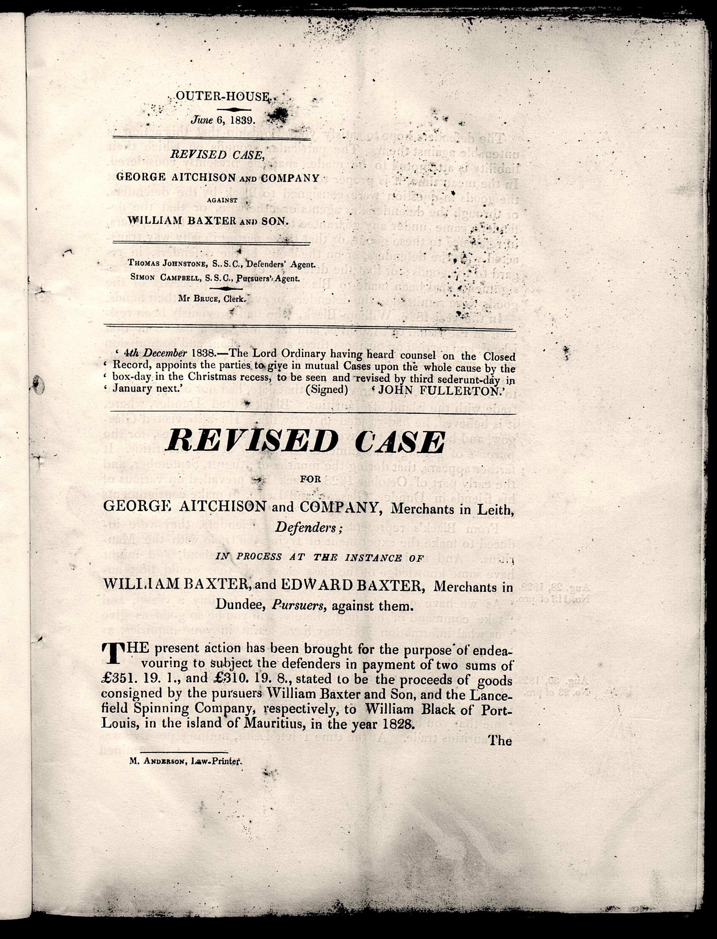
Stained archive

Slide 12
Challenges of OCR
Accuracy depends on dataset quality. Some common sources of error include:
Age and damage (stained or blurry)
Mixed text and images, or multiple languages
Cursive fonts, handwriting
Human errors and typos

Slide 13
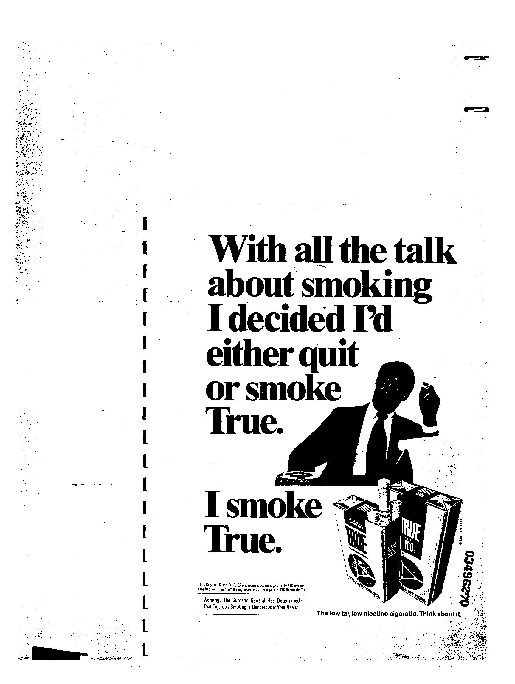
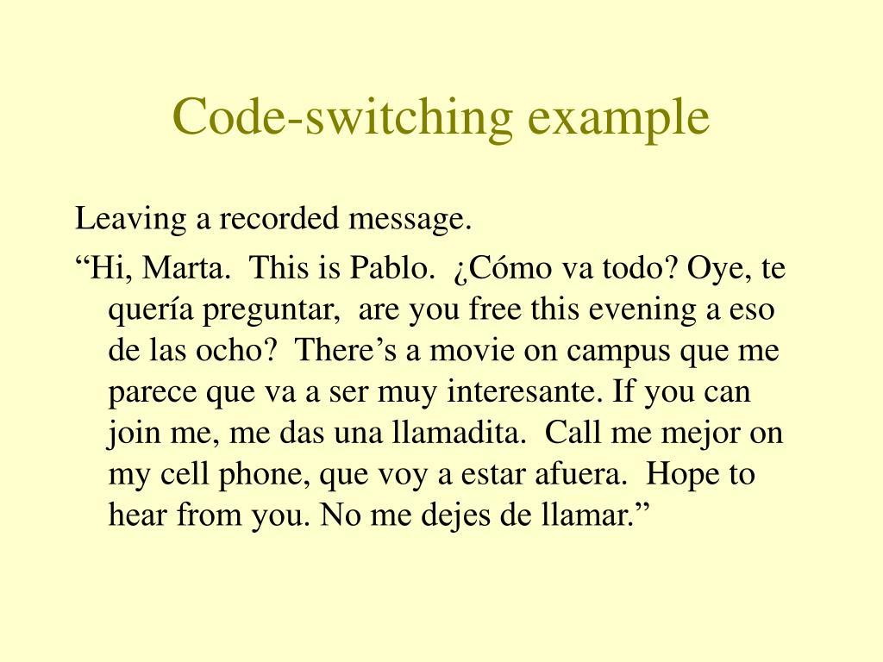
Pictures and multi-languages

Slide 14
Challenges of OCR
Accuracy depends on dataset quality. Some common sources of error include:
Age and damage (stained or blurry)
Mixed text and images, or multiple languages
Cursive fonts, handwriting
Human errors and typos

Slide 15
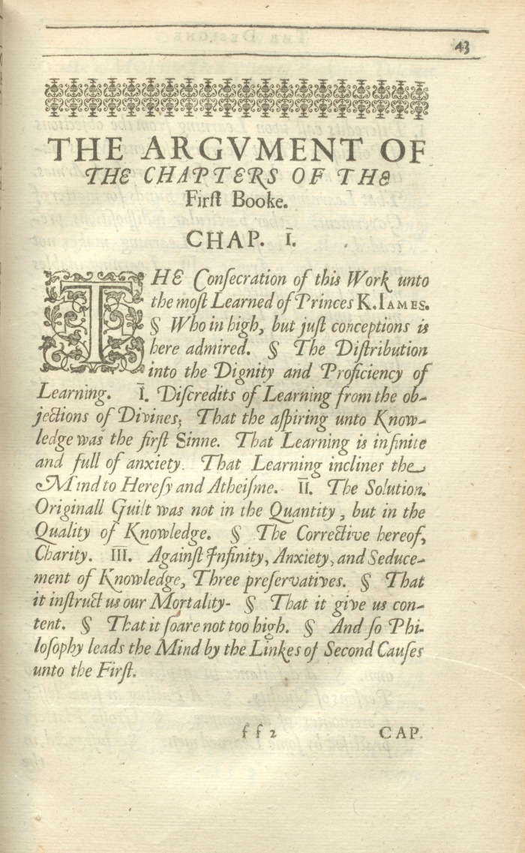
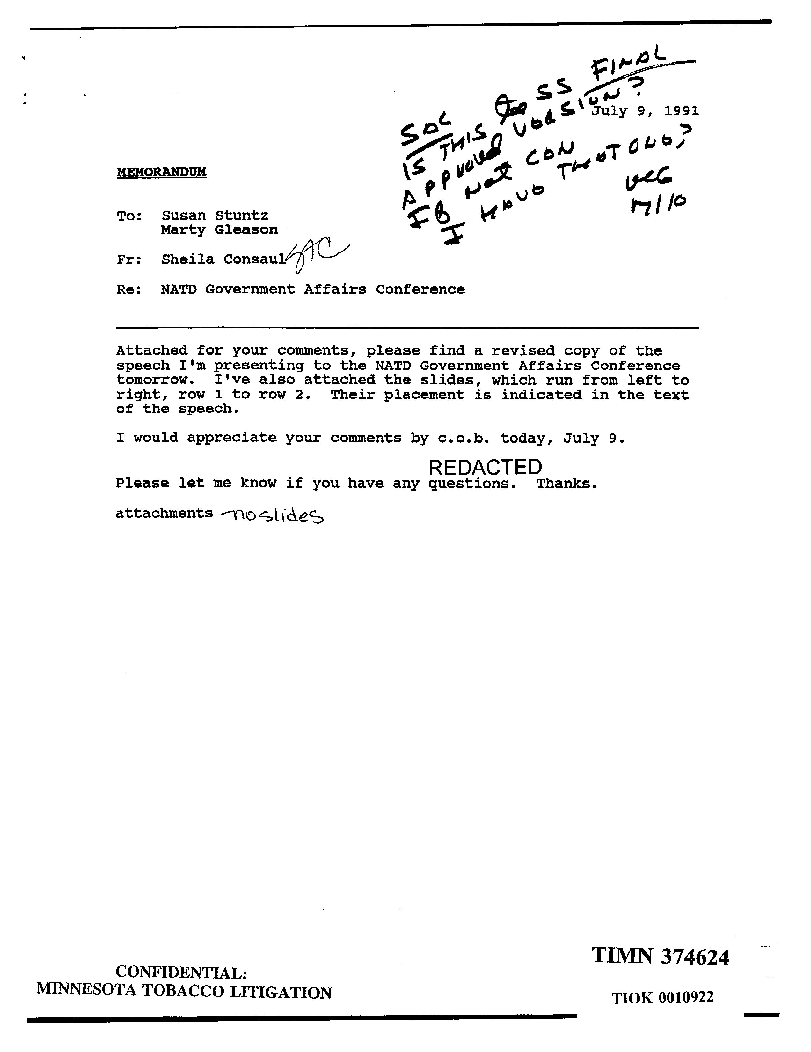
Cursive fonts, Handwritings

Slide 16
Challenges of OCR
Accuracy depends on dataset quality. Some common sources of error include:
Age and damage (stained or blurry)
Mixed text and images, or multiple languages
Handwriting
Human errors and typos

Slide 17
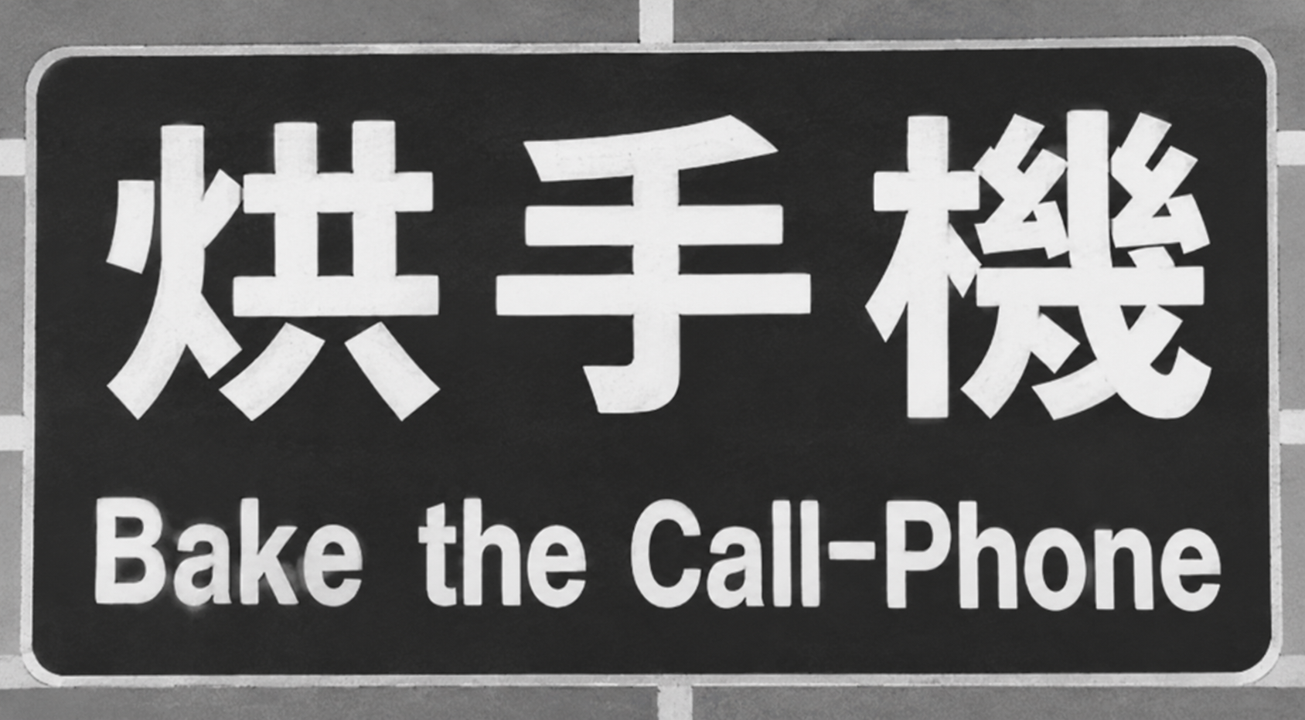
Human Errors - example

Slide 18
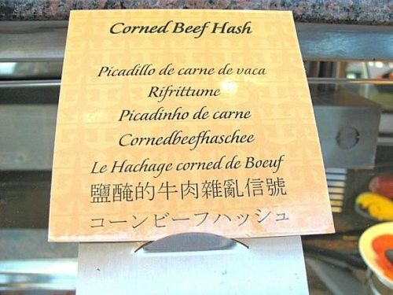
Human Errors - example

Slide 19
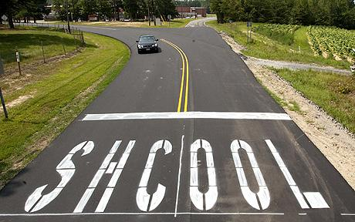
Human Errors - example

Slide 20
There is no best solution or software to perform OCR, but there are a few ways to improve OCR results.

Slide 21
Ways to improve OCR results
Select good quality dataset to begin with​
Improve OCR tool capability​
Pre-process your dataset to improve its quality​
Correct errors in OCR-produced files

Slide 22
Ways to improve OCR results
Select good quality dataset to begin with​
Improve OCR tool capability​(AI-powered)
Pre-process your dataset to improve its quality​
Correct errors in OCR-produced files

Slide 23
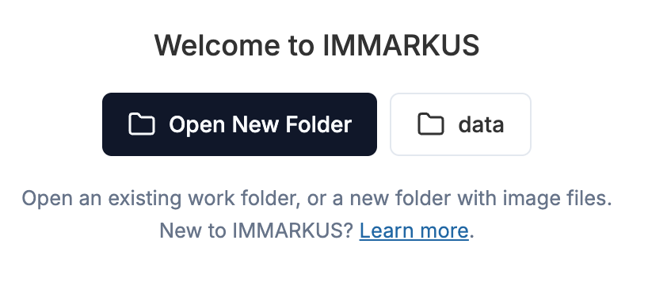
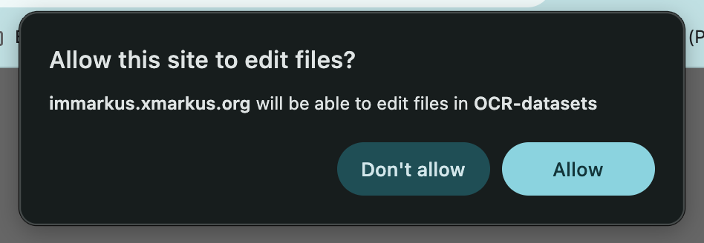
Activity – Out of the box tools
Download the dataset from github repo
Go to https://immarkus.xmarkus.org/
Click on Open New Folder, select the folder ”OCR dataset”
Click “allow”

Slide 24
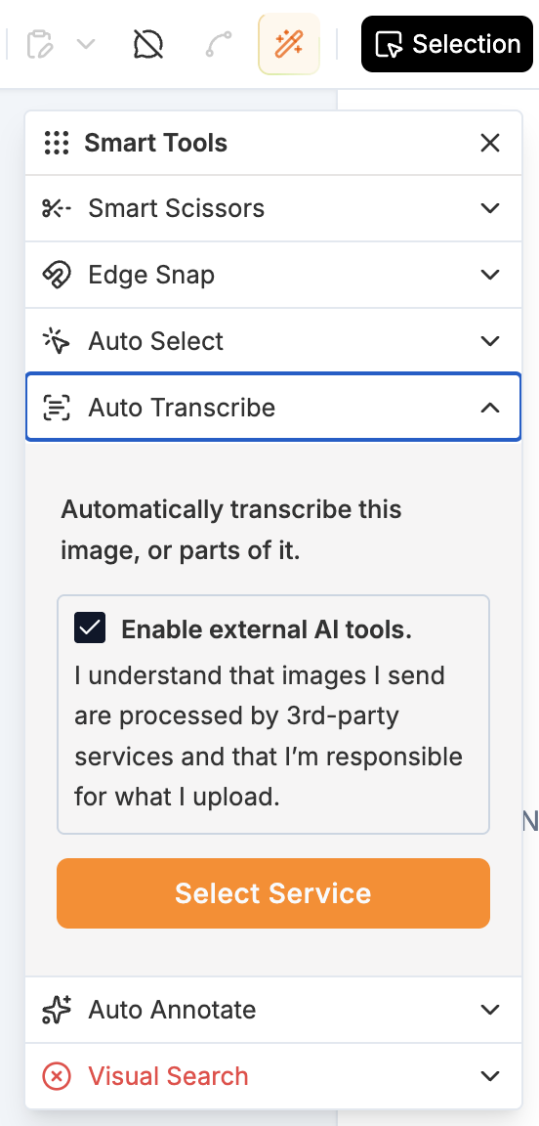
Activity – Out of the box tools
Click on the magic wand icon
Auto Transcribe
Check enable external AI tools
Select Service

Slide 25
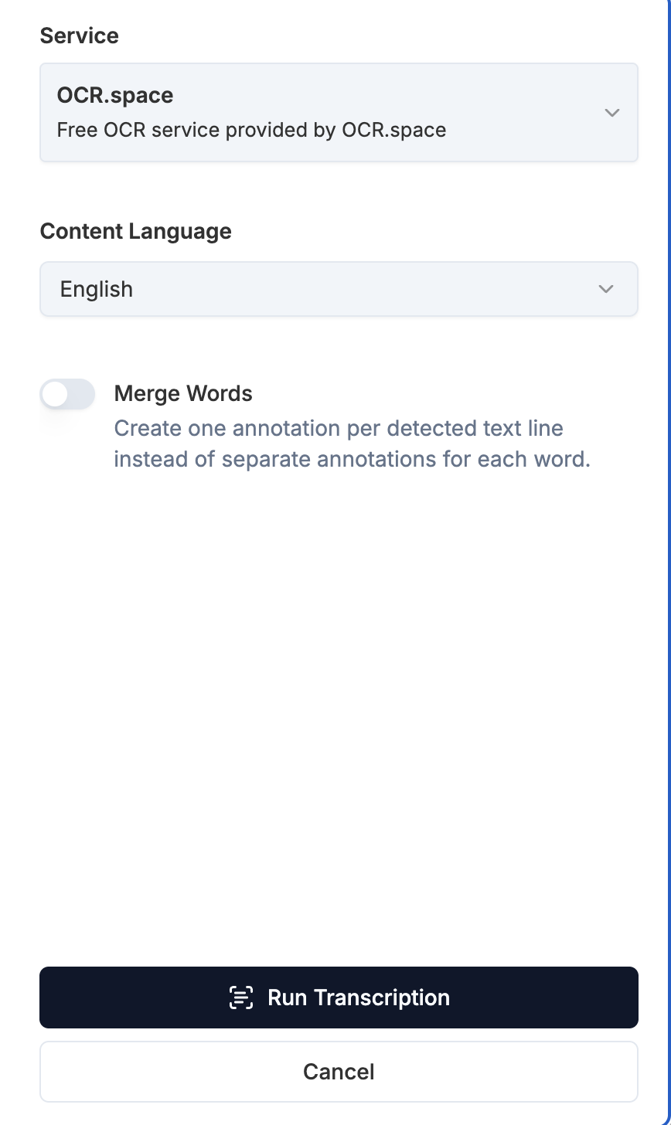
Activity – Out of the box tools
Select OCR.space (free)
Choose content language
Run Transcription
Import to Immarkus

Slide 26
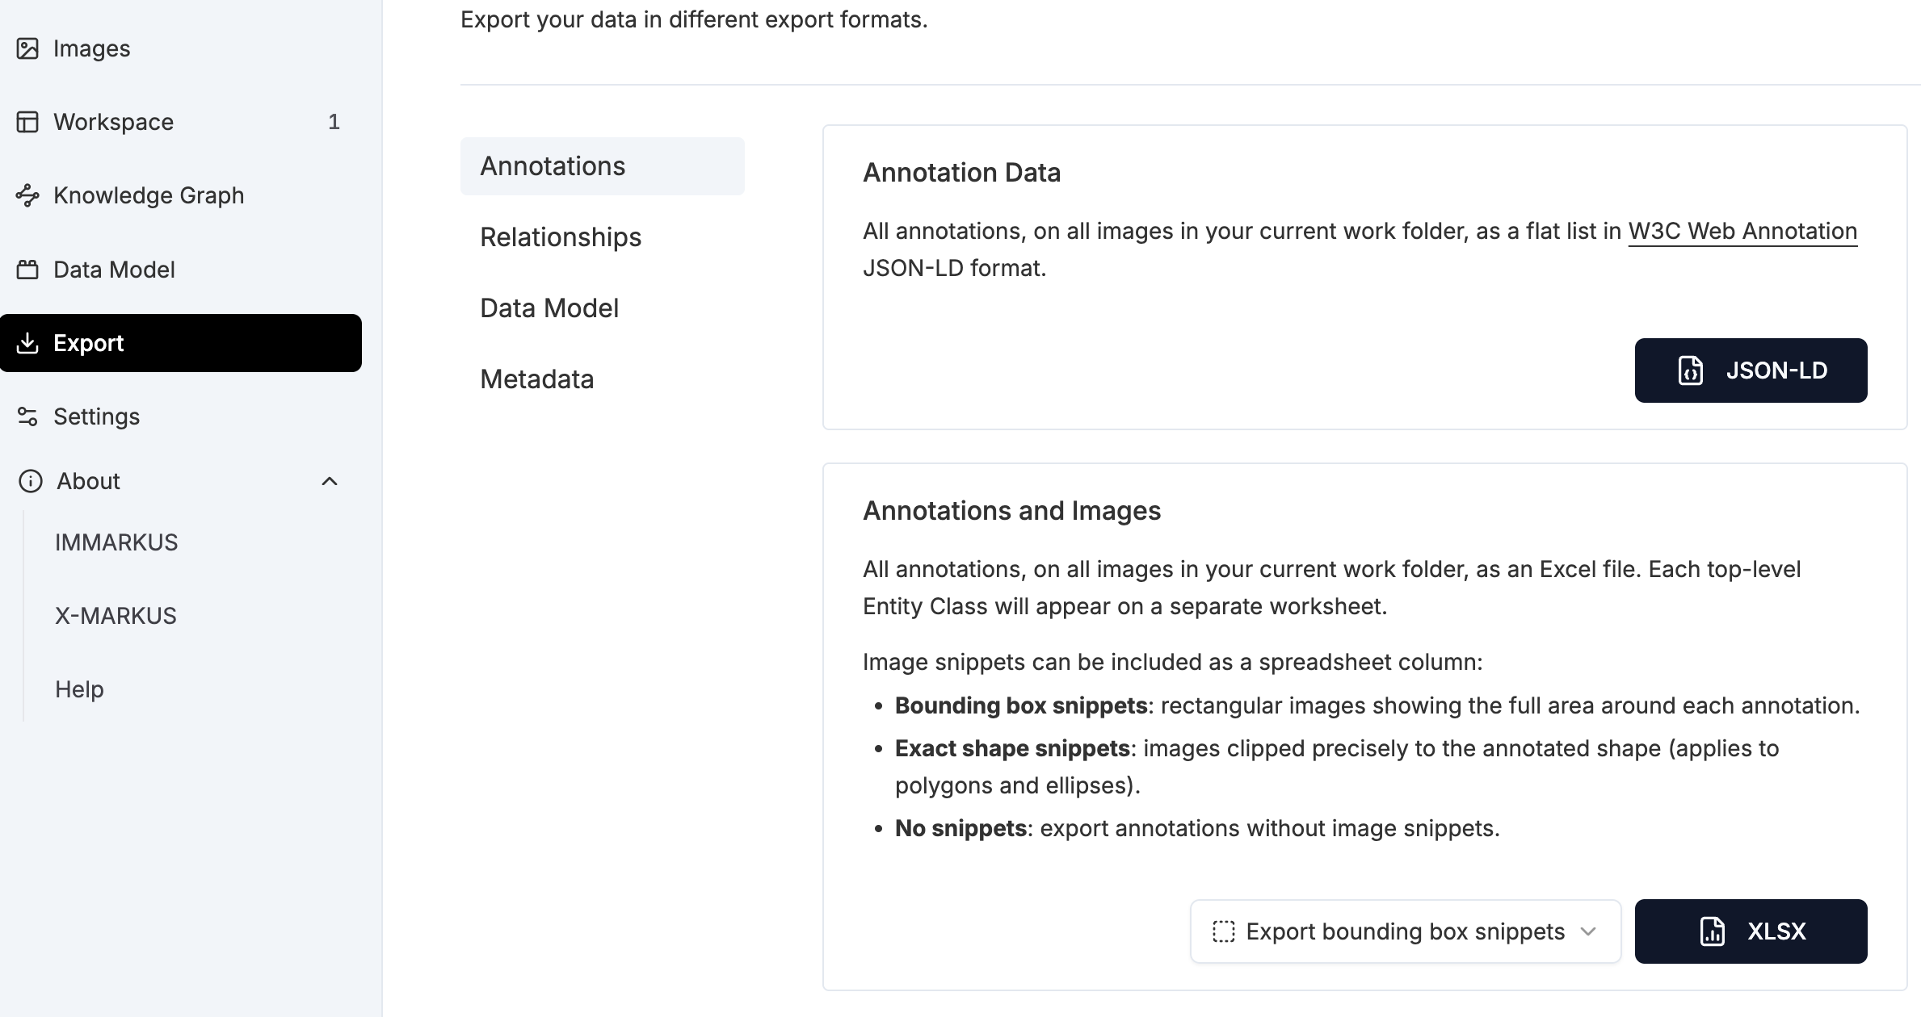
Activity – Out of the box tools
Export
Select XLSX

Slide 27
Clean up the dataset before OCR
avoid rubbish in, rubbish out

Slide 28
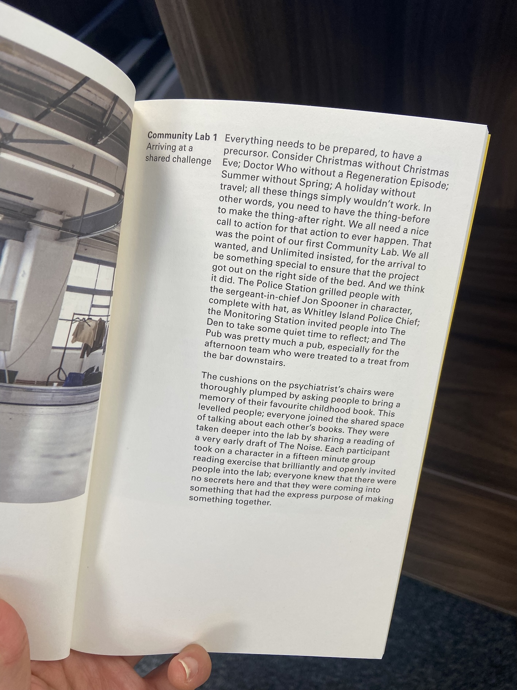
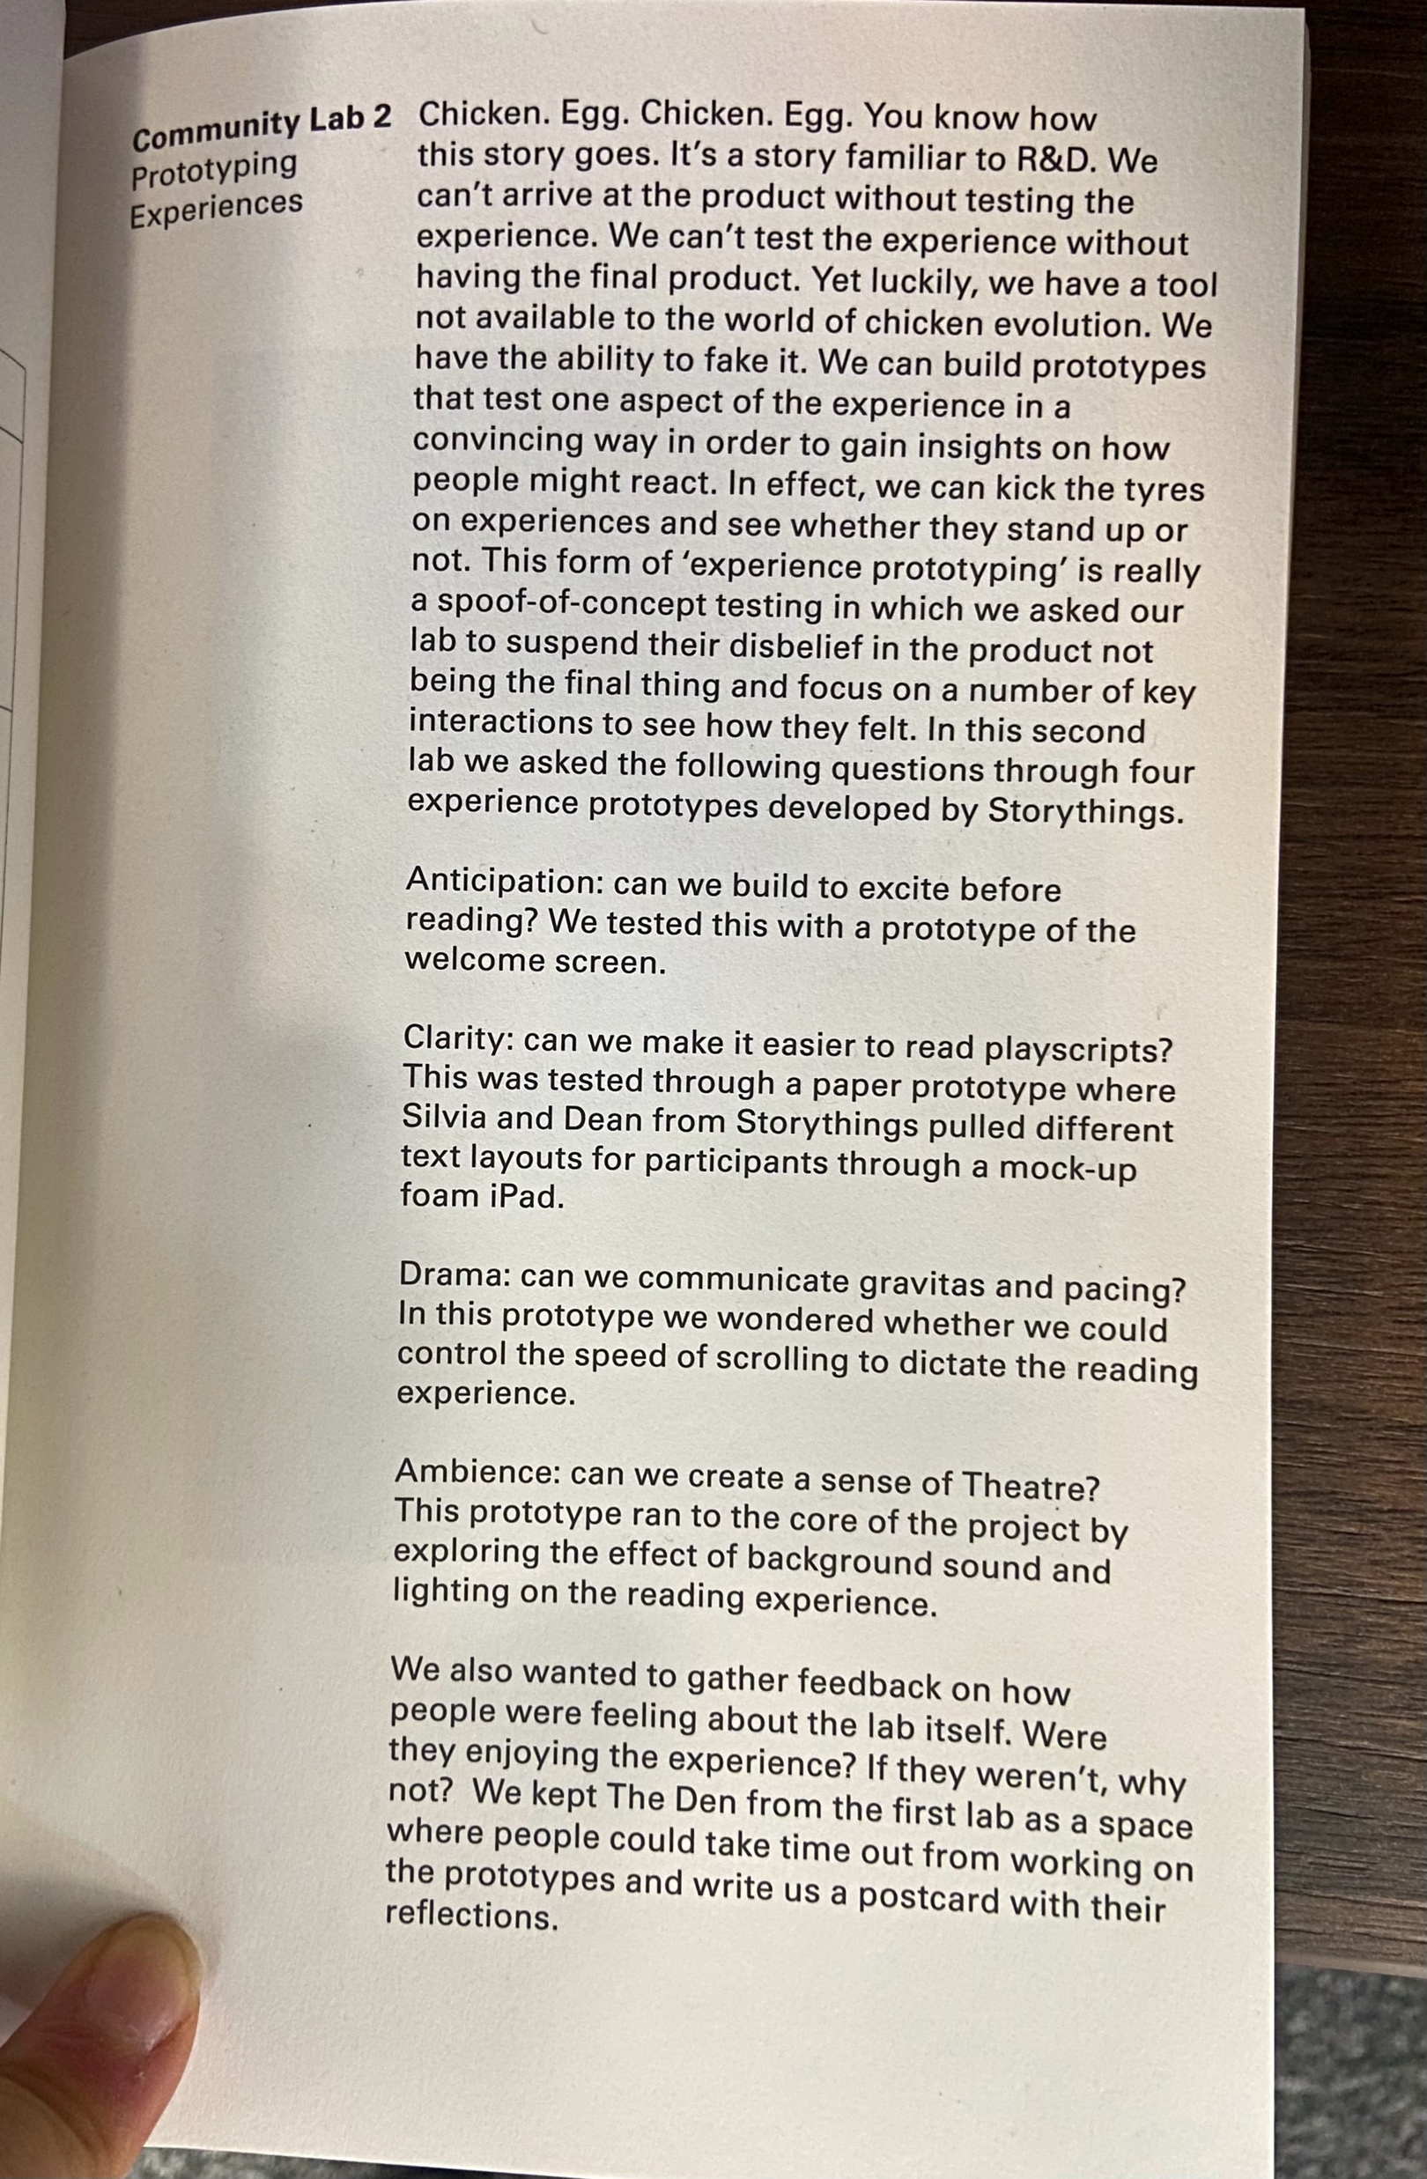
Inspect the data– scanning quality

Slide 29
Inspect the data– scanning quality
Image resolution
300 DPI is often used as a benchmark for good quality
printing reproducibility for photographs, but this may vary
Ex. National archive

Slide 30
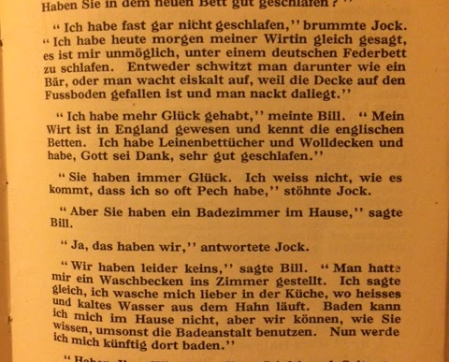
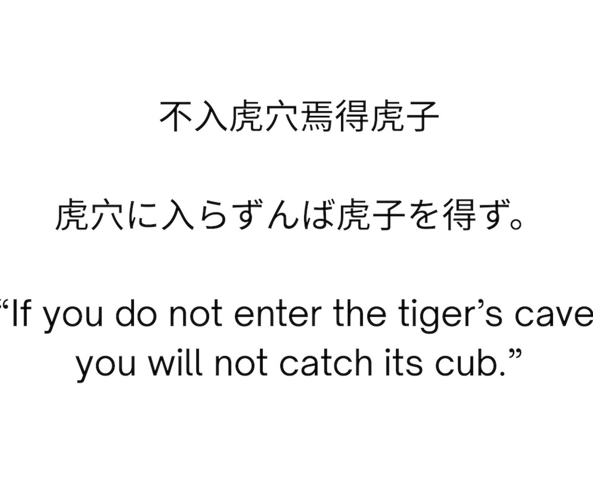
Inspect the image - language

Slide 31
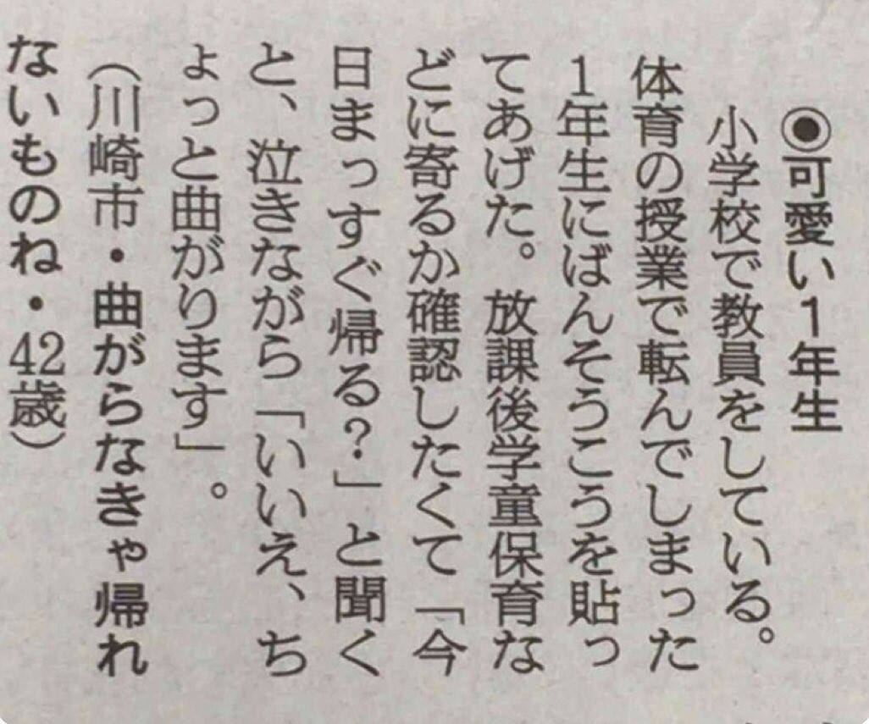
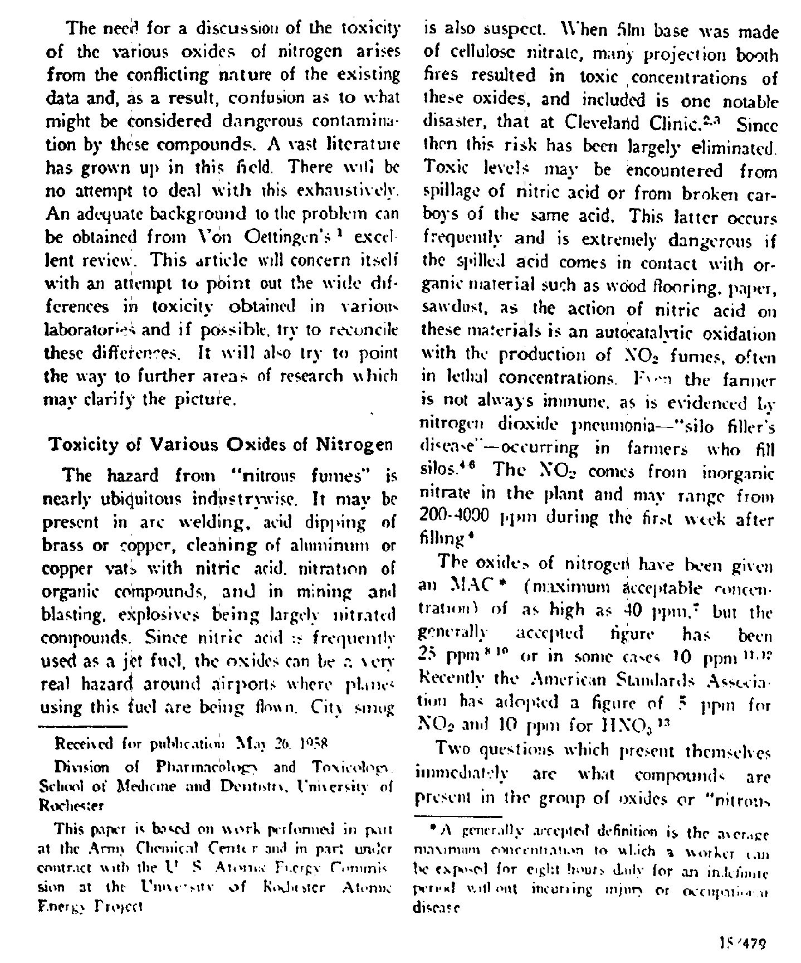
Inspect the image - typesetting
vertical
Multiple columns/ blocks

Slide 32
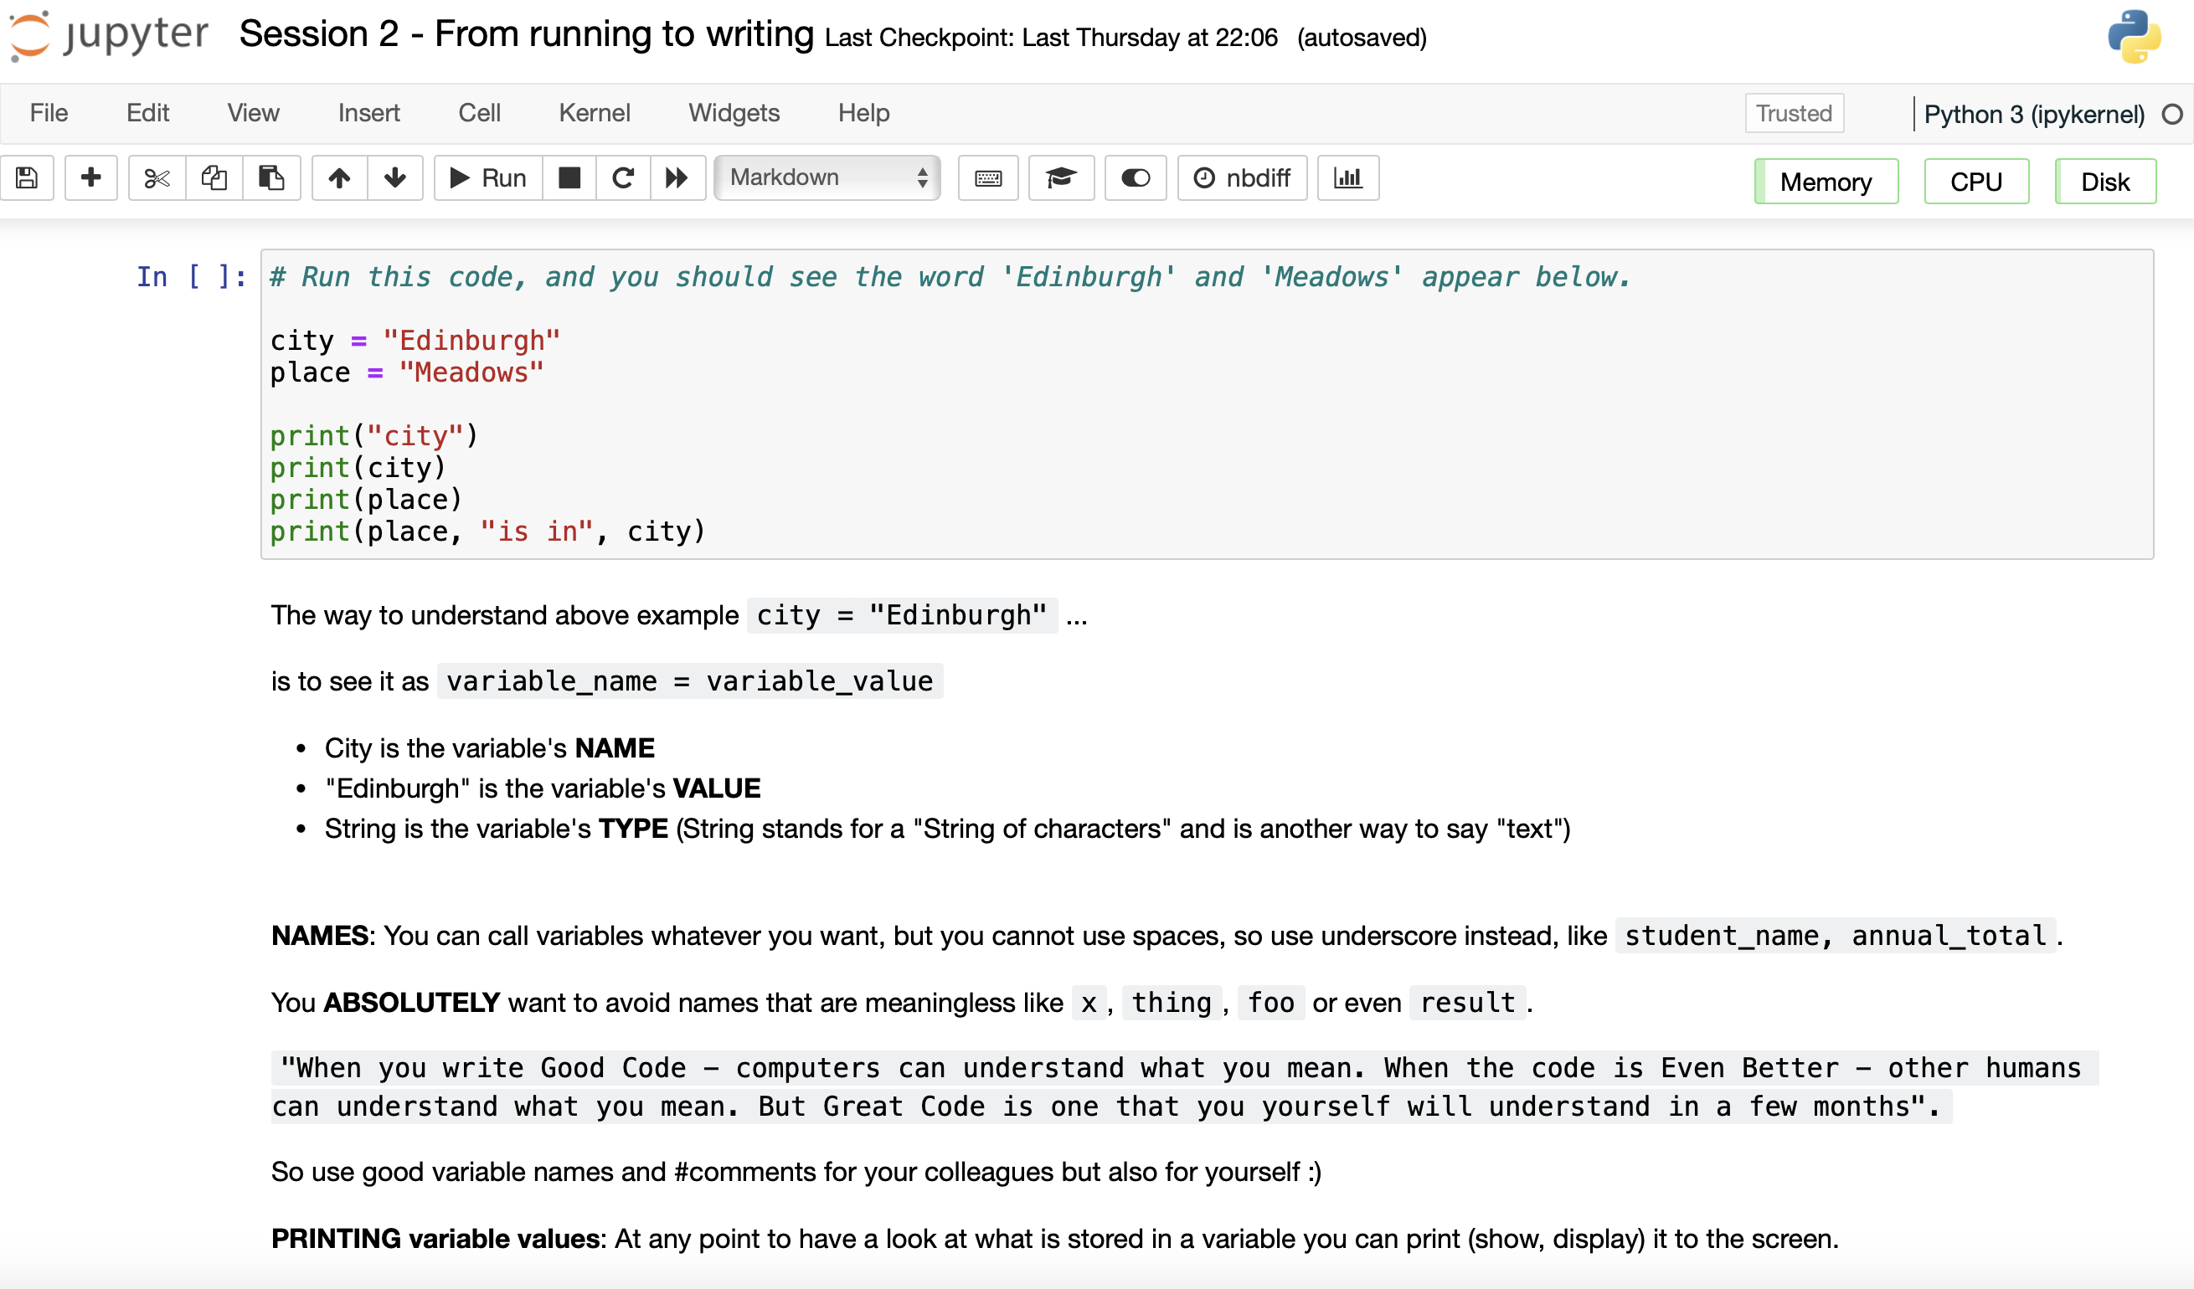
Jupyter Notebooks
}
Code (Python)
}
Text (Markdown)

Slide 33
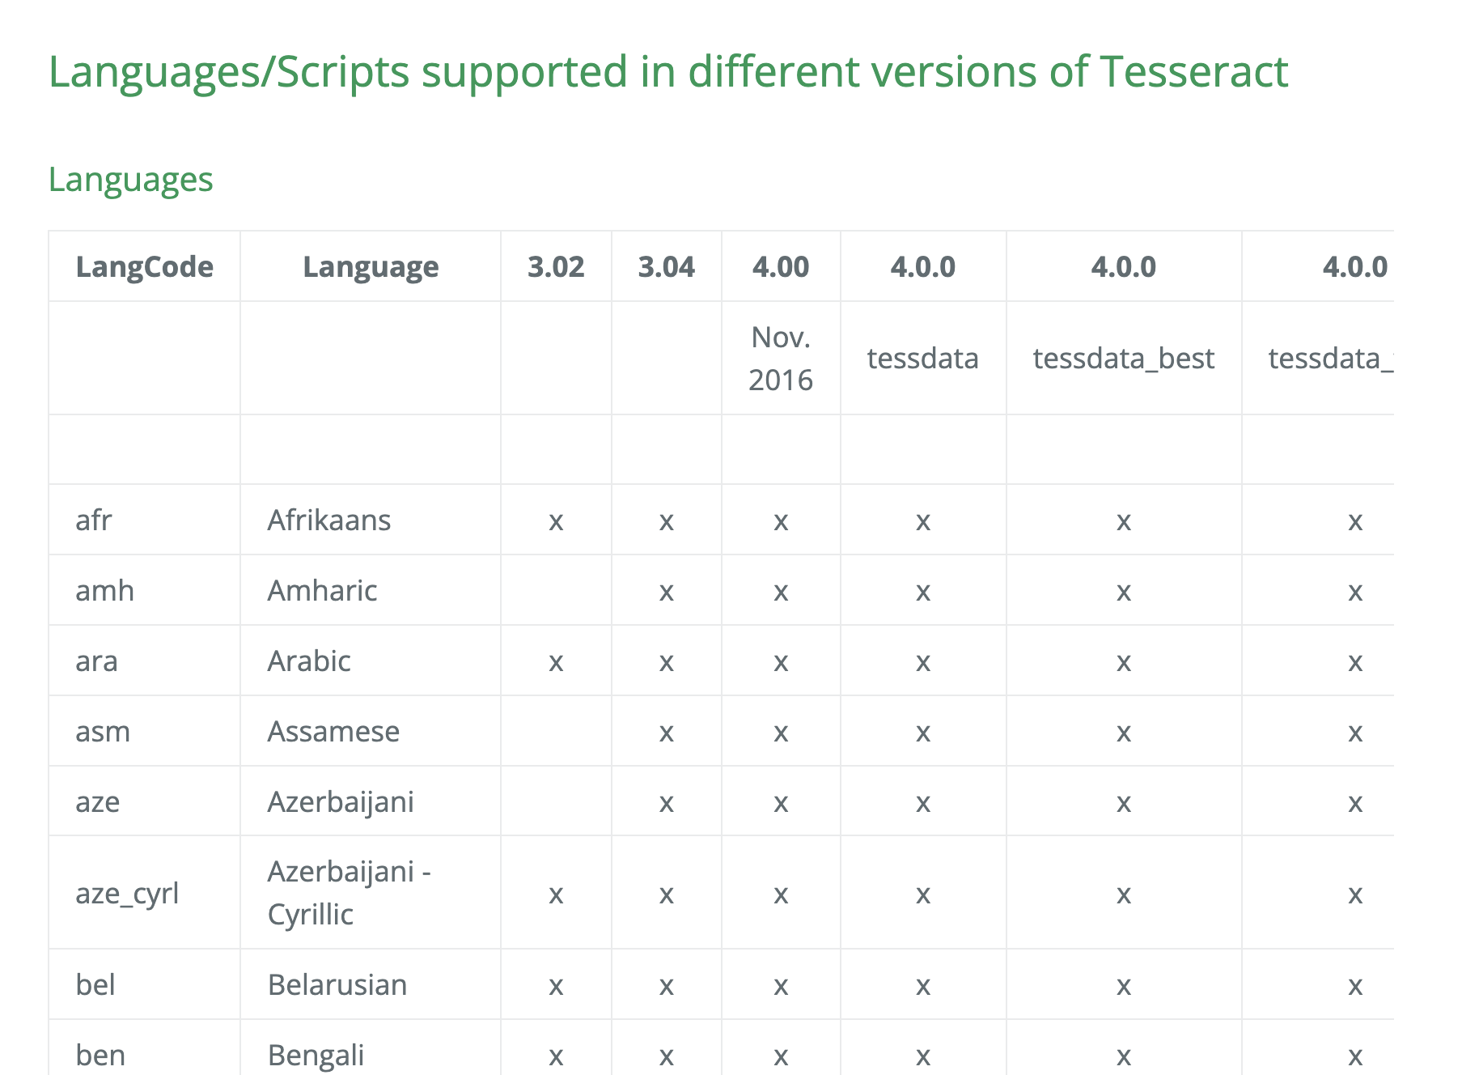
https://tesseract-ocr.github.io/tessdoc/Data-Files-in-different-versions.html

Slide 34
Finishing Up Session 1

Slide 35
Handwriting OCR

Slide 36
Machine learning basics
How OCR models are “trained”
1. Collect training data: Collect images of handwriting, and label each writing with the correct text for each image.
2 Make a prediction: The model processes an image and predicts what the text says.
3 Calculate the error: Compare the predicted text with the correct text. The difference is used to measure how well the model performed.
4 Adjust the model: An optimisation algorithm updates the model's parameters to reduce the error.
5 Repeat and evaluate: Repeat across many examples, then test the model on data it has not seen during training.

Slide 37
Handwriting OCR with TrOCR
We will use Microsoft's TrOCR handwriting model to recognize handwritten lines.
The model run the pretrained weights.

Slide 38
Clean up the dataset after OCR

Slide 39
Regex
Regex used in many different programming environments for pattern matching.
Use a sequence of characters to define a search to match strings
Match on types of characters and patterns to remove, or replace them

Slide 40
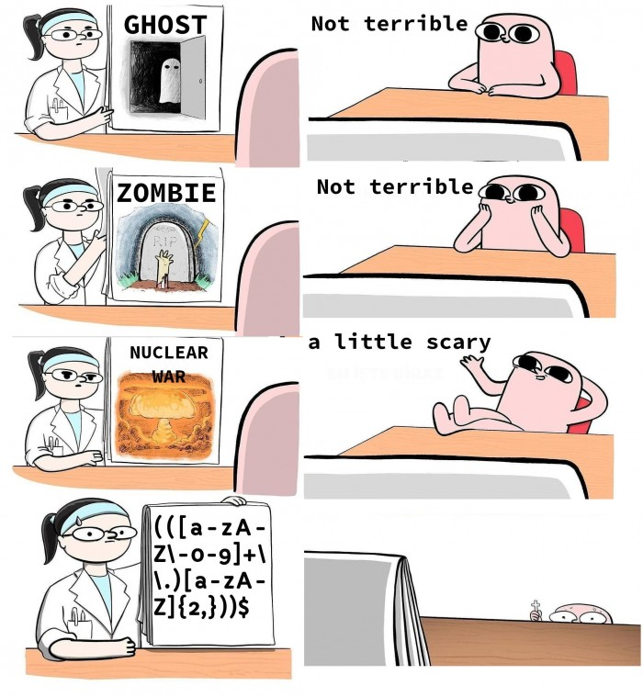
Regex

Slide 41
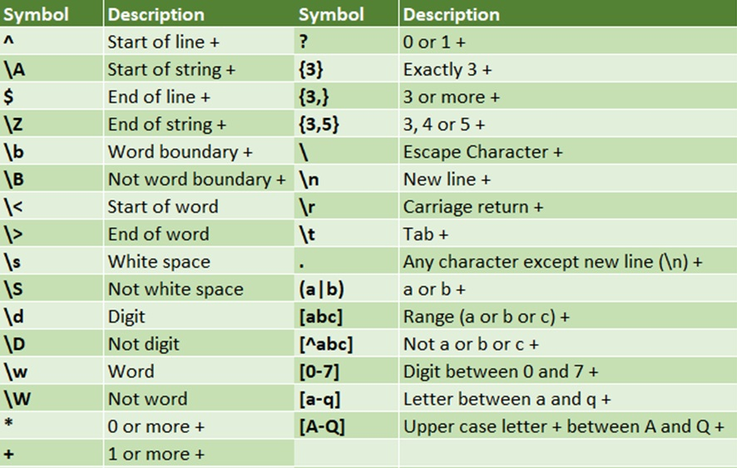
Regex
Useful sites for regex
https://programminghistorian.org/en/lessons/cleaning-ocrd-text-with-regular-expressions
https://programminghistorian.org/en/lessons/understanding-regular-expressions
https://librarycarpentry.org/lc-data-intro/01-regular-expressions/

Slide 42
Finishing Up

Slide 43
Additional Resources
This course used (slightly modified) notebooks from Code Storytelling (http://www.codestorytelling.com).
We covered badges 1,2,4,5,7, and 8. Consider working through some more of the notebooks and watching some of the videos.
Think Python is an introductory Python book with many exercises, free to read online: https://greenteapress.com/wp/think-python-2e/

Slide 44
Feedback for us
Feedback for us...
We hope you've enjoyed the course as much as we did.
It is really useful for us to hear your feedback
https://edin.ac/45BpZFm
Should be really quick and only take 5 mins (maximum!)

