Slide 1
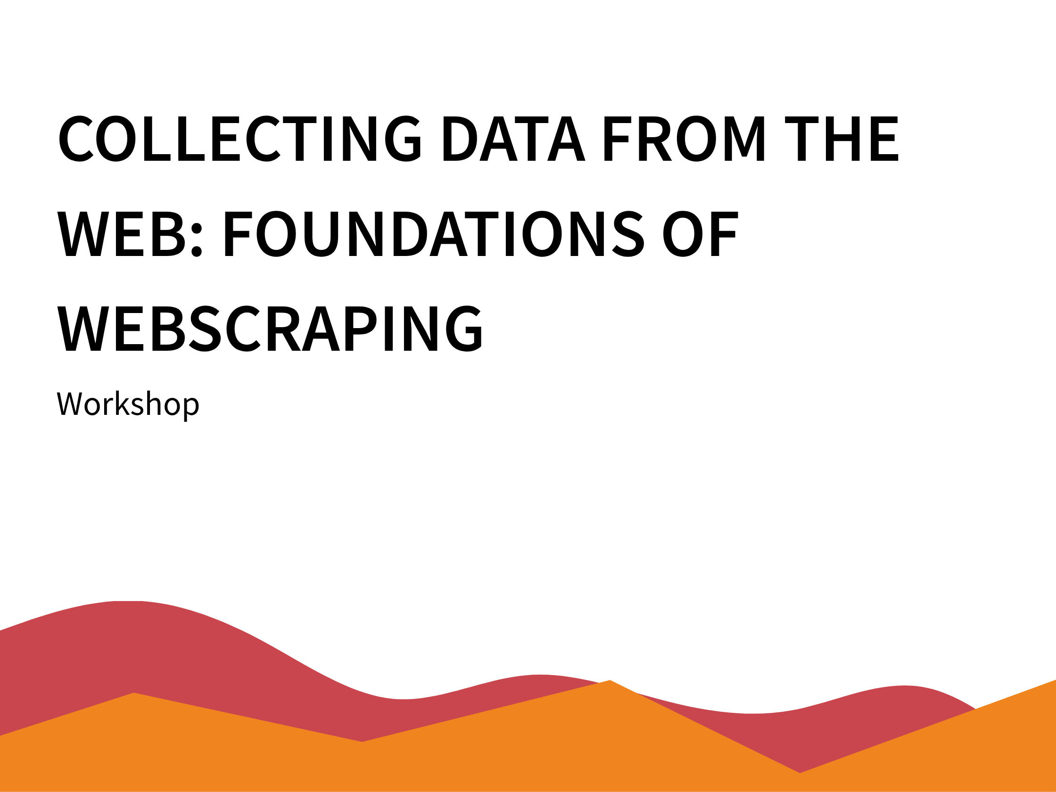

Understanding the Web delivered by Joy Lan

Slide 2
Understanding the Web

Slide 3


What is HTTP?
Understanding the Web
→
http request
←
http response
your browser
(client)
cloud/web server
(website)

Slide 4
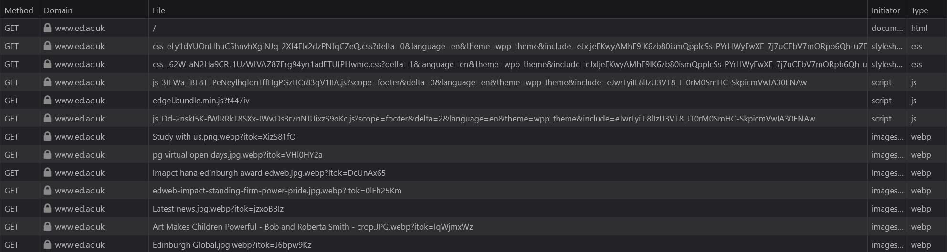
Understanding the Web
When you open a website in your browser, you are making HTTP(S) requests.
Opening a single website triggers a lot of requests.
If you hit F12 in your browser and go to the Network tab, you can see them.

Slide 5
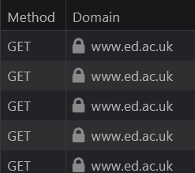
Understanding the Web
Different types of http(s) requests
Request | Examples
GET | Open a website, read the content
POST | Submit a form, log into your account
PUT | Update data/record
DELETE | Delete data record
Web-scraping is mostly done using GET requests

Slide 6
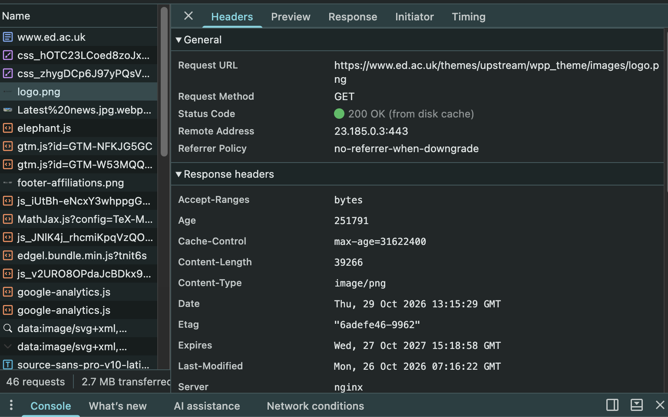
Understanding the Web
After receiving a request, server sends back a response.
Headers
Provides information of the requested data
These includes the type, size, address etc.
Status code
Tells you the status of the response. (if the request was successful or not)

Slide 7
Understanding the Web
Let’s have a look at the status codes.
1xx informational response – the request was received, continuing process
2xx successful - the request was successfully received, understood, and accepted
3xx redirection – further action needs to be taken in order to complete the request
4xx client error – the request contains bad syntax or cannot be fulfilled
5xx server error – the server failed to fulfil an apparently valid request
https://en.wikipedia.org/wiki/List_of_HTTP_status_codes
If the status code is 200 OK, you’re good.
If it’s 4xx or 5xx, it’s bad. (404 Not Found is a classic one).
That’s all we really need to know for now!

Slide 8
Sending Request
Web browsers send HTTP requests to web servers to retrieve webpage content.
Requests made by computer programmes
Web scraping involves sending requests to websites using computer programmes written in languages such as Python or R. These programmes can automate the process of retrieving and collecting data from websites.
Example using Python
import requests
url = "https://example.com"
response = requests.get(url)

Slide 9
HTML Basics

Slide 10
HTML Basics
HTML — The structure of a webpage
It determines what content a webpage contains, such as headings, paragraphs, images and links.
CSS — The appearance of a webpage
Controls colours, fonts, sizes, layouts and other visual elements.
JavaScript — The interactive and dynamic features of a webpage
Enables features such as button clicks, live searches and retrieving new data from a server.

Slide 11

HTML Basics
If you go to your favourite website and hit Ctrl + U, you’ll see its HTML.
<p>
  <strong>
    This is bold text.
    <font color=“red”>
    I’m red and bold! </font>
  </strong>
  <font color=“blue”>
    I’m not bold and blue.
  </font>
</p>
(You can try this out. If you open Notepad or TextEdit
and type these and save it as “test.html”. You can open it with your browser.)

Slide 12
HTML Basics
HTML stands for HyperText Markup Language. They look like this:
Html tags are interpreted by the browser and render into corresponding visual elements.
For example, <strong> … </strong> means “bold text”.
On the website we’ll see some text, instead of <strong>some text</strong>
  <strong>some text</strong>

Slide 13
HTML Basics
Most tags will come in pairs (<start tag> … </end tag>)
Some only have a start tag such as <img>
  <p>
  <strong>
  This is bold text.
  <font color=“red”> I’m red and bold! </font>
  </strong>
  <font color=“blue”>
  I’m not bold and blue
  </font>
  <img src=“dog.jpg”>
  </p>

Slide 14

HTML Basics
Attributes and values can be added to a tag, for example:
src is an attribute of the <img> that specifies the image location, ”dog.jpg” is the value of src
class is an attribute of the <div> that read the css script called test
the disabled attribute, which disables a button, does not need a value.
  <p>
  <img src=“dog.jpg”>
  <div class=“test”>ABCDEFG</div>
  <button disabled>Don’t click me</button>
  </p>

Slide 15
Finding data in HTML
You can scrap by identifying which tag(s) contains the information we want, then get the content inside (or get the value of an attribute), without knowing how to write HTML.

Slide 16
Finding data in HTML
Contents or data can be extrated using a combination of tag name, attribute and value.
  <p>
    <strong>
      This is bold text.
      <font color=“red”>
      I’m red and bold! </font>
    </strong>
    <font color=“blue”>
      I’m not bold and blue.
    </font>
  </p>
For example, if identify the <font> tag with a color attribute set to blue, it will extract
Text “_______”.

Slide 17
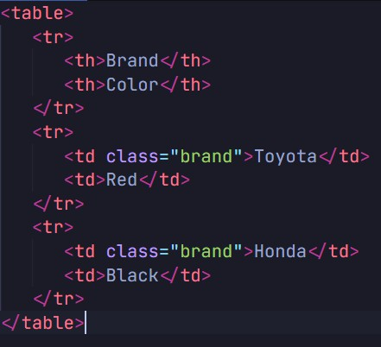
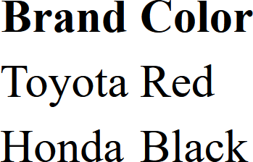
Exercise
The HTML produces the table on the right. Describe the combination of tag name, attribute and value (Do you need all three?) that will allow you to extract only the brands of the cars.

Slide 18

Exercise
“Any <td> tag that has the attribute class with the value brand”

Slide 19
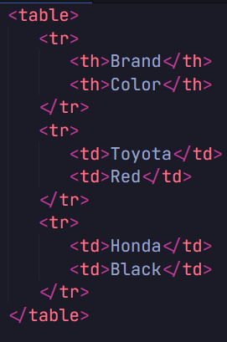
Exercise
Can you describe the combination of tag name, attribute and value that would get us the brands of the cars? Why (not?)

Slide 20
Exercise
Can you describe the combination of tag name, attribute and value that would get us the brands of the cars? Why (not?)
We need extra information (e.g., about where the tag is).
It is still possible to scrape using CSS selectors

Slide 21
CSS selectors
<h1 class="intro” href= “myweb.com”>My Website</h1>
<p >Hello World</p>
<p class="intro”>Welcome!</p>
<p id="special">Important text</p>
Selector | Symbol | Example | Action | Extracted contents
Tag | Tag name | p | Selects all <p> elements on the webpage | Hello World Welcome! Important text
Class | . | .intro | Selects elements with the class attribute class="intro" | My Website Welcome!
ID | # | #special | Selects elements with the id attribute id=”special" | Important text
Attribute | [ ] | [href] | Select element with href attribute | My Website

Slide 22
CSS and CSS selectors
 |  | Example | Action | Extracted contents
Nested Element | : | td:first-child | Select all <td> tag that are the first child node of its parent | Toyota Honda
Direct Child | > | table > tr | Select tag <tr> that is the direct child of <table> | BrandColor ToyotaRed HondaBlack

Slide 23
CSS and CSS selectors
Note that an ID is unique to a single HTML node/tag in a document (so most of the time you won’t need the tag name at all.)
A class can be applied across elements, and a single tag can have multiple classes
<a class=“link link-main”>link</a>
has two classes, link and link-main).

Slide 24
We can also specify where the tag is relative to another tag by adding the tag it is nested within.
Css selector strong a will select elements in
tag <a> </a>nested within <strong></strong>
It returns:
here
there
<strong><a>here</a></strong>
<strong><font color=“red”><a>there</a></font></strong>

Slide 25
CSS Selector Basics
We can repeat this process…
div strong.test a
selects any <a> that is inside <strong> with the class=“test" inside <div>
<div><strong class = “test”><a>
This is the text
</a></strong></div>

Slide 26
<table id="price">
<tr>
<td>1</td>
<td> <a class=“title”> Website: <a/></td>
<td>
<a class=”title” href="https://google.com">Google</a>
</td>
</tr>
</table>
Exercise
How can we extract “Google”?

Slide 27
<table id="price">
<tr>
<td>1</td>
<td> <a class=“title”> Website: <a/></td>
<td>
<a class=”title” href="https://google.com">Google</a>
</td>
</tr>
</table>
Exercise
How can we extract “Google”?
Ans: a.title[href] , #price a.title[href], a[href="https://google.com"]

Slide 28
Selector Gadget
You can get away with knowing how to write all CSS selectors because there are tools that can help you!
Selector Gadget is a browser extension that allow you to click on the elements that you want on a page, and it will create a CSS selector for you, and highlight all elements (tags) selected by the selector.

Slide 29
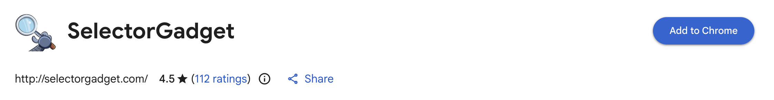
Activity
Uses Chrome, Edge, or any other Chromium-based browser
Download and install Selector Gadget from the Chrome store.
Play with it on https://www.connosr.com/. Try to figure out
selectors for various pieces of information.
E.g. What selector would you get all and only the names of Japanese distilleries?

