Slide 1
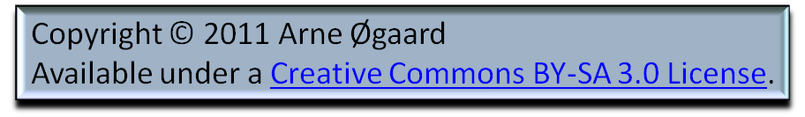

Our freedom is not threatened by dictators or foreign powers but by a chaotic economy.
1

Slide 2
Dream 1: A lot of money makes you free.
Dream 2: Freedom is the ability to live without money.

Slide 3
3
In the cultural life
money makes you egocentric.

Slide 4
4
Freedom means surmounting
the egocentric power of money.

Slide 5
5
The lack of work is not the issue at stake it is the lack of income

Slide 6
6
An profitless economy
does not provide investment.

Slide 7
7
You can lend money you first intend to use in a while, but you should be aware what this money is doing.

Slide 8
8
In the game of investors
the strongest always win.
Tobin tax can redress some of
the imbalance

Slide 9
9
A free cultural life/arena encourages donations. State donations provide predictability, private donations provide variety and development.

Slide 10
10
A rich cultural life can free us from the egocentric power of money.

