Slide 1
Outils et Méthodes du Développeur
OMB-102
Sammy Dieleman
OMB@amstram.be
Développeur d’interfaces WEB – X75
Développeur d’applications mobiles – X76

Slide 2
OMB-102
- 0 -
Précédemment dans OMB

Slide 3
OMB-102 | OMB-101
0. Tour de table
1. Méthode : les diagrammes
1.1 Le monde connu
1.2 Internet
1.3 Le nouveau monde
2. Les professions du web
3. WebDev
4. Les langages

Slide 4
OMB-102
0. Résumé cours précédent
1. Les lois du dev
1.1. Murphy, Occam, Pareto
1.2. Conception
1.3. Quality
1.4. Execution
1.5. Maintenance

Slide 5
OMB-102
2. Les principes du design
2.1. Universal Principles
2.2. Gestalt Principles
2.3. Exercices
3. Web Forensics
  3.1 Théorie
  3.2 Exercices

Slide 6
OMB-102
- 1 -
Les lois du dev

Slide 7
OMB-102
- 1.1 -
Murphy, Occam, Pareto

Slide 8
OMB-102 | Les lois du dev
« If there is any way to do it wrong, someone will »
Murphy’s Law, Air Force Captain, Edward A. Murphy, 1949

Slide 9
OMB-102 | Les lois du dev
« Entities should not be multiplied without necessity »
Analyze each element and remove as many as possible, without compromising the overall function
Less code = Less bugs
Occam’s Razor, William of Ockham, Theologian, 1287–1347

Slide 10
OMB-102 | Les lois du dev
« Roughly 80% of the effects come from 20% of the causes »
Vilfredo Pareto, Economist, 1896

Slide 11
OMB-102 | Les lois du dev
Pareto Principle
80% of work productivity comes from 20% of the time you put in
80% of errors are caused by 20% of code
80% of revenue comes from 20% of customers
80% of sales come from 20% of sales staff
80% of attention is spent on 20% of the web page
Focus the majority of effort on the areas
that will bring the largest benefits to the most users.

Slide 12
OMB-102 | Les lois du dev
- 1.2 -
Conception

Slide 13
OMB-102 | Les lois du dev | Conception
« Inside every large problem
is a small problem struggling to get out »
Hoare's Law of Large Problems, Oxford professor C.A.R. Hoare, 1984

Slide 14
OMB-102 | Les lois du dev | Conception
« Build a program that even a fool can use,
and only a fool will want to use it »

Slide 15
OMB-102 | Les lois du dev | Conception
« Users truly don't know what they want
in a program until they use it »

Slide 16
OMB-102 | Les lois du dev
- 1.3 -
Quality

Slide 17
OMB-102 | Les lois du dev | Quality
« A carelessly planned project takes
three times longer to complete than expected.
A carefully planned project takes only twice as long »

Slide 18
OMB-102 | Les lois du dev | Quality
« Adding programmers to a late project makes it later »
Frederick P. Brooks Jr., in his 1975 book The Mythical Man-Month

Slide 19
OMB-102 | Les lois du dev | Quality
« Any system that relies on computer reliability is unreliable.
Any system that relies on human reliability is unreliable »

Slide 20
OMB-102 | Les lois du dev | Quality
« The value of a program is inversely proportional
to the weight of its output »

Slide 21
OMB-102 | Les lois du dev | Quality
« Program complexity grows until it exceeds
the capabilities of the programmer
who must maintain it »

Slide 22
OMB-102 | Les lois du dev | Quality
« Software bugs are impossible to detect
by anybody except the end user »

Slide 23
OMB-102 | Les lois du dev | Quality
« The probability of a flawless demo is
inversely proportional to the number of people watching,
raised to the power of the amount of money involved »

Slide 24
OMB-102 | Les lois du dev
- 1.4 -
Execution

Slide 25
OMB-102 | Les lois du dev | Execution
« Any given program, once deployed, is already obsolete »

Slide 26
OMB-102 | Les lois du dev | Execution
« Any given program costs more and
takes longer each time it is run »

Slide 27
OMB-102 | Les lois du dev | Execution
« Software expands to consume all available resources »

Slide 28
OMB-102 | Les lois du dev | Execution
« Not until a program has been in production
for at least six months
will its most harmful error be discovered »

Slide 29
OMB-102 | Les lois du dev
- 1.5 -
Maintenance

Slide 30
OMB-102 | Les lois du dev | Maintenance
« Any non-trivial program contains at least one bug »
Corollary 1 : A sufficient condition for program triviality is that it has no bugs
Corollary 2 : At least one bug will be observed after the author leaves the organization.

Slide 31
OMB-102 | Les lois du dev | Maintenance
« There's always one more bug »
Lubarsky's Law of Cybernetic Entomology

Slide 32
OMB-102 | Les lois du dev | Maintenance
« Any code of your own
that you haven't looked at in months
might as well have been written by someone else »
Corollary 1 : The effort required to correct an error increases with time

Slide 33
OMB-102 | Les lois du dev | Maintenance
« A hardware failure will cause system software to crash,
and the engineer will blame the programmer »
« A system software crash will cause hardware to act strangely
and the programmers will blame the engineer »

Slide 34
OMB-102
- 2 -
Les principes du design

Slide 35
OMB-102
- 2.1 -
Les lois générales

Slide 36
Serial Position Effect
« Users have a propensity to best remember
the first and last items in a series »
Placing the least important items in the middle of lists can be helpful because these items tend to be stored less frequently in long-term and working memory
Positioning key actions on the far left and right within elements such as navigation can increase memorization
1913, Herman Ebbinghaus, psychologist

Slide 37
Zeigarnik Effect
« People remember uncompleted or interrupted tasks
better than completed tasks »
Use progress bars for complex tasks to visually indicate when a task is incomplete, and thus increase the likelihood it will be completed
1920s, Bluma Wulfovna Zeigarnik, psychologist and psychiatristc

Slide 38
Hick’s Law
« The time it takes to make a decision increases
with the number and complexity of choices »
Simplify choices for the user by breaking down complex tasks into smaller steps.
Avoid overwhelming users by highlighting recommended options
Use progressive onboarding to minimize cognitive load for new users
1952, William Edmund Hick and Ray Hyman, psychologists

Slide 39
Fitt’s Law
« The time to acquire a target is a function of
the distance to and size of the target »
touch targets should be large enough, have ample spacing between each other and be placed in areas of an interface that allows them to be easily acquired : the distance between a user’s task/attention area and the task-related button should be kept as short as possible.
1954, Paul Fitts, psychologist

Slide 40
Miller’s Law
« The average person can only keep
7 (plus or minus 2) items in their working memory »
Chunking is an effective method of presenting groups of content in a manageable way. Organize content in groups of 5-9 items at a time
Menus, sidebar, word clouds, categories, filters,..
1956, George Miller, psychologist

Slide 41
Jakob’s Law
Users spend most of their time on other sites. This means that users prefer your site to work the same way as all the other sites they already know
  Users will transfer expectations they have built around one familiar product to another that appears similar
  By leveraging existing mental models, we can create superior user experiences in which the user can focus on their task rather than learning new models.
  Use progressive onboarding to minimize cognitive load for new users
1980s, Jakob Nielsen, a User Advocate and principal of the Nielsen Norman Group

Slide 42
Doherty treshold
Productivity soars when a computer and its users interact at a pace that ensures that neither has to wait
  Provide system feedback within 400ms in order to keep users’ attention and increase productivity
  Use perceived performance to increase response time and reduce the perception of waiting
a research paper that set the requirement for computer response time to be 400 milliseconds, not 2,000 (2 seconds) which had been the previous standard
1982, Walter J. Doherty and Ahrvind J. Thadani, in the IBM Systems Journal

Slide 43
Peak-End Rule
People judge an experience largely based on how they felt at its peak and at its end, rather than the total sum or average of every moment of the experience
  Pay close attention to the most intense points and the final moments (the “end”) of the user journey.
  Identify the moments when your product is most helpful, valuable, or entertaining and design to make those moments even better
  People recall negative experiences more vividly than positive ones
1993, “When More Pain Is Preferred to Less: Adding a Better End”

Slide 44
Aesthetic Usability Effect
Users often perceive aesthetically pleasing design as design that’s more usable
  make users more tolerant of minor usability issues
  creates a positive response and leads them to believe the design actually works better
  tested on 26 variations of an ATM UI, asking the 252 study participants to rate each design on ease of use, as well as aesthetic appeal
1995, Masaaki Kurosu and Kaori Kashimura from the Hitachi Design Center

Slide 45
OMB-102
- 2.2 -
La Gestalt

Slide 46
OMB-102 | Gestalt laws of grouping
« the whole is more than the sum of its parts »
the mind has an innate disposition to perceive patterns in the stimulus based on certain rules :
Grouping, Proximity, Similarity, Symmetry, Closure, Continuity, ..
Early 20th century, Austria & Germany

Slide 47
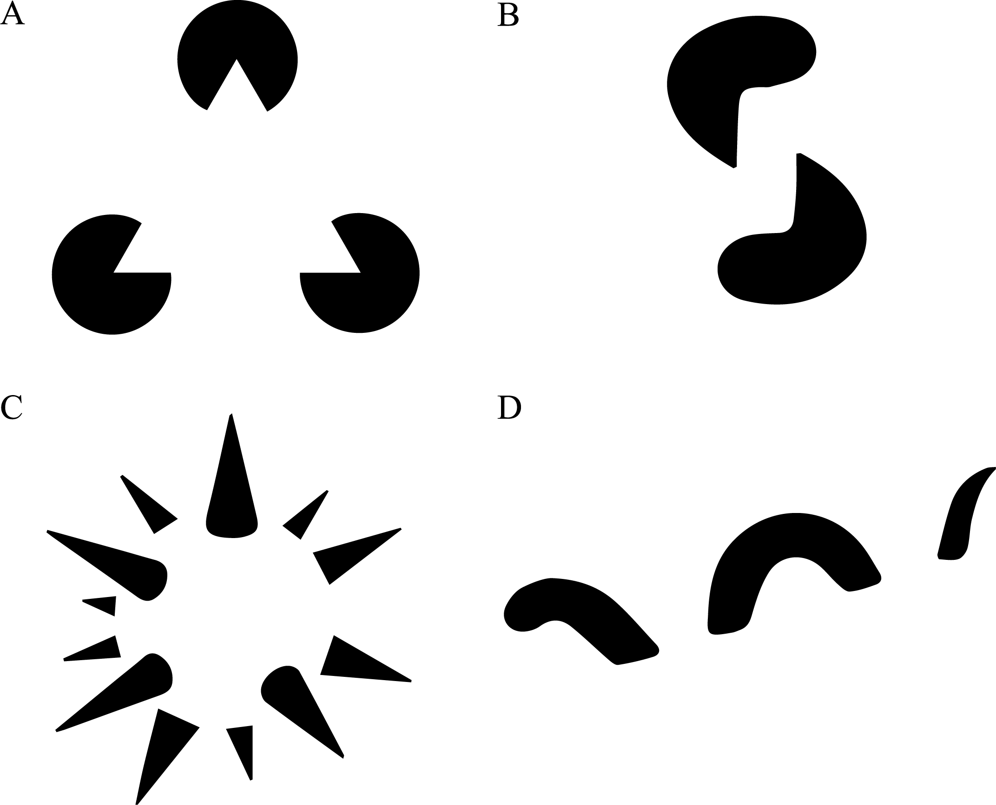
OMB-102 | Gestalt laws of grouping

Slide 48

OMB-102 | The figure-ground principle

Slide 49
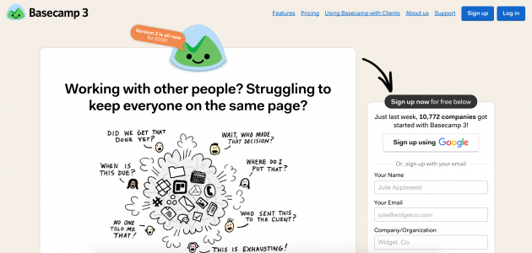
OMB-102 | The figure-ground principle
People instinctively perceive objects as either being in the foreground or the background

Slide 50

OMB-102 | The figure-ground principle
People instinctively perceive objects as either being in the foreground or the background

Slide 51

OMB-102 | The figure-ground principle
  ?

Slide 52
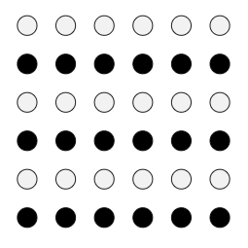
OMB-102 | Gestalt | Similarity

Slide 53
OMB-102 | Gestalt | Similarity
« The human eye tends to perceive similar elements in a design
as a complete picture, shape, or group,
even if those elements are separated »
Ensure that links and navigation systems are visually differentiated from normal text elements, and are consistently styled

Slide 54

OMB-102 | Gestalt | Similarity
3 sections + links

Slide 55
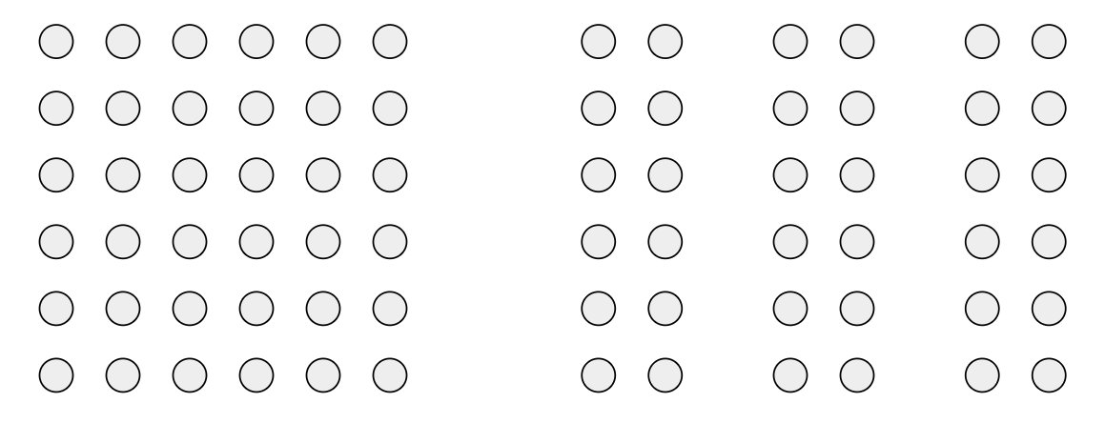
OMB-102 | Gestalt | Proximity

Slide 56
OMB-102 | Gestalt | Proximity
« Objects that are near, or proximate to each other,
tend to be grouped together »
Proximity helps to establish a relationship with nearby objects
Proximity helps users understand and organize information faster and more efficiently

Slide 57
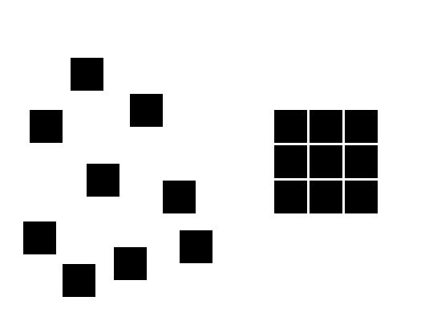
OMB-102 | Gestalt | Proximity
Proximity has tresholds

Slide 58

OMB-102 | Gestalt | Proximity
Proximity takes precedence on similarity

Slide 59
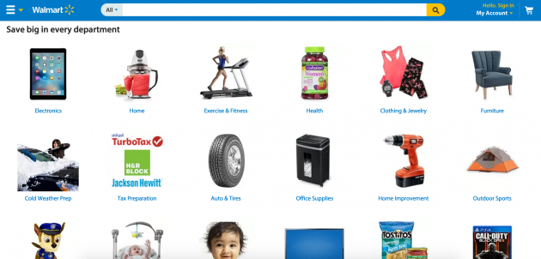
OMB-102 | Gestalt | Proximity
Text & images

Slide 60

OMB-102 | Gestalt | Proximity
Text & images

Slide 61
OMB-102 | Gestalt | Common region
« Elements tend to be perceived into groups
if they are sharing an area with a clearly defined boundary »
Adding a border around an element or group of elements is an easy way to create common region
Common region can be created by defining a background behind an element or group of elements

Slide 62

OMB-102 | Gestalt | Common region
Text & images

Slide 63

OMB-102 | Gestalt | Closure

Slide 64

OMB-102 | Gestalt | Closure
« The human eye tends to perceive similar elements in a design
as a complete picture, shape, or group,
even if those elements are separated »

Slide 65
OMB-102 | Gestalt | Symmetry
« The mind perceives objects as being symmetrical
and forming around a center point »
{ } [ ] { }

Slide 66

OMB-102 | Gestalt | Continuity

Slide 67

OMB-102 | Gestalt | Continuity
The eye is drawn along a path, line or curve,
preferring to see a single continuous figure than separate lines
4 lines or 2 ?

Slide 68
OMB-102
- 2.3 -
Exercices

Slide 69


Slide 70
OMB-102 | Gestalt | Maps
similarity allows the reader to selectively isolate cities, rivers, or state boundaries;
closure allows the dashed boundary lines to be perceived as continuous borders;
proximity makes the collection of river segments appear as a single watershed;
continuity helps the reader "see" whole states even when boundaries are obscured under rivers.

Slide 71
OMB-102 | Gestalt | Maps
Comparez ces paires de sites, quelles lois sont appliquées et pourquoi ?
      Amazon vs Wikipedia
      Google vs Yahoo

Slide 72
OMB-102
- 3 -
Web Forensics

Slide 73
OMB-102 | Web Forensics
UX evaluation is based on 3 key factors
  Loading
  Interactivity
  Stability

Slide 74
OMB-102 | Web Forensics
PageSpeed Insights
  Key factors
  Data, Opportunities, Diagnostics

Slide 75
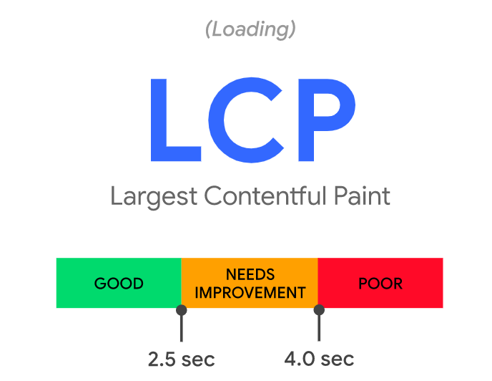
OMB-102 | Web Forensics
The Largest Contentful Paint (LCP) metric reports the render time of the largest image or text block visible within the viewport
Loading

Slide 76
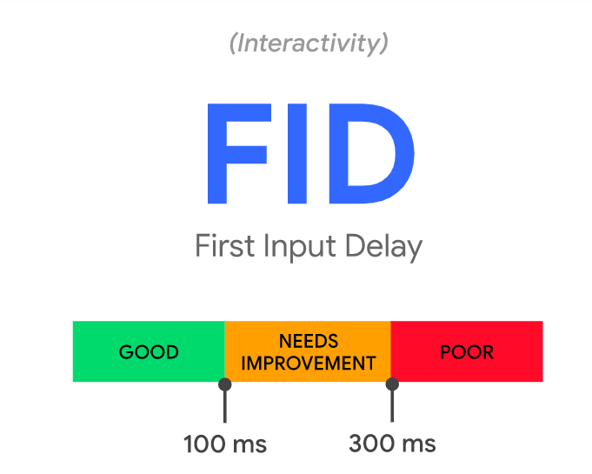
OMB-102 | Web Forensics
Interactivity
FID measures the time from when a user first interacts with a page (clicks a link, a button, or any controller) to the time when the browser is actually able to begin processing event handlers in response to that interaction

Slide 77
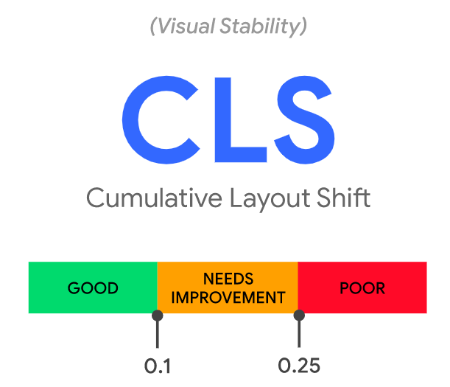
OMB-102 | Web Forensics
Stability
A layout shift occurs any time a visible element changes its position from one rendered frame to the next.
score = impact * distance
https://web.dev/cls/

Slide 78
OMB-102 | Web Forensics
Exercice : analyser ces sites, quelles sont les problème les plus courants ? Les solutions recommandées ?
https://www.spike.be/
https://bigsmile.be/
https://www.indnamur.be/
https://www.efp.be

Slide 79
OMB-102 | Web Forensics
Pour aller plus loin
  uitest.com

Slide 80
Des questions ?

