Slide 1
The Network Layer
Chapter 5

Slide 2
Congestion
The onset of congestion
When the number of packets sent into the network is well within its capacity, the number delivered is proportional to the number sent.
As the load approaches the capacity, bursts of traffic fill up the buffers inside router and some packets are lost. These lost packets consume some capacity, so the number of delivered packets falls below the ideal curve.
Congestion collapse: performance plummets as the load increases beyond the capacity.

Slide 3
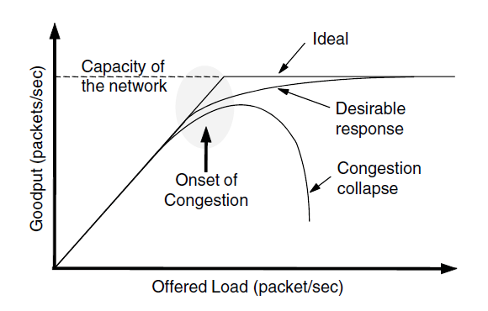
Congestion Control Algorithms
When too much traffic is offered, congestion sets in and performance degrades sharply.

Slide 4
Congestion Control vs Flow Control
Congestion Control: make sure the network is able to carry the offered traffic.
A global issue involving all hosts and routers.
Consider a network with 1Mbps lines and 1000 large computers, half are trying to send at 100kbps to the other half. No problem of fast senders overpowering slow receivers, but congestion in the network.
Flow control: make sure that a fast sender will not overwhelm a slow receiver.
Between a particular sender and a particular receiver
Consider a network made up of 100-Gbps fiber optic links. A supercomputing is forcing a large file to a PC that can handle only 1Gpbs. No congestion, but flow control is needed.

Slide 5
Congestion Control Algorithms
Approaches to congestion control
Traffic-aware routing
Admission control
Traffic throttling
Load shedding

Slide 6
Approaches to Congestion Control
The presence of congestion means that the load is greater than the resources can handle.
Solution 1: increase the resources
Solution 2: decrease the load
These solutions are applied on different time scales to either prevent congestion or react to it once it has occurred.

Slide 7
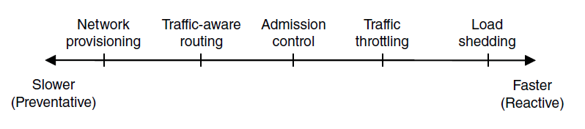
Approaches to Congestion Control
Timescales of approaches to congestion control

Slide 8
Approaches to Congestion Control
Network provisioning.
Build a network that is well matched to the traffic that it carries.
Turn on spare routers or enable lines that are normally used as backups.
Long-term, on a time scale of months.
Traffic-aware routing.
Tailor the routes to traffic patterns that change during the day as network users wake and sleep in different time zones. E.g., change the shortest path weights.
Split traffic across multiple paths.
Admission control.
Reject new VC connections if they would cause congestion.

Slide 9
Approaches to Congestion Control
Traffic throttling.
Deliver feedback to the sources whose traffic flows are responsible for congestion, telling them to slow down the traffic.
Two problems. 1) how to identify the onset of congestion. 2) how to inform the source to slow down.
Solution to 1): routers can monitor the average load, queueing delay, or packet loss. Rising numbers indicate growing congestion.
Solution to 2): routers must participate in a feedback loop with the sources. Delivering timely feed back is a nontrivial matter.
Load shedding: the network is forced to discard packets. Choose which packets to discard.

Slide 10
Traffic-Aware Routing
Take load into account when computing routes.
Shift traffic away from hotspots.
Set the link weight to be a function of the (fixed) link bandwidth and propagation delay plus the (variable) measured load or average queuing delay.
Least-weight path will favor paths that are more lightly loaded.
Traffic-aware routing may lead to oscillation problem.
Example. The following figure. Suppose that most traffic is using link CF, which is heavily loaded with long delays. Including load in the shortest path calculation will choose EI. But then, most traffic will go via EI and congest it, making CF more attractive.
The routing table oscillate wildly

Slide 11
Traffic-Aware Routing
If load (variable) is ignored and only bandwidth and propagation delay (both fixed) are considered, this problem does not occur.
Solution 1: multipath routing.
The traffic can be spread across multiple path from a source to a destination.
Solution 2: shift traffic across routes slowly enough that it is able to converge.

Slide 12
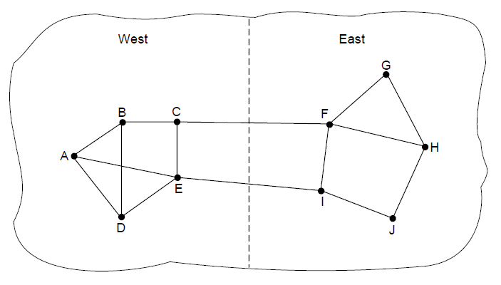
Traffic-Aware Routing
A network in which the East and West parts are connected by two links.

Slide 13
Admission Control
Admission control: do not set up a new virtual circuit (VC) if the network will become congested.
How to decide when a new VC will lead to congestion?
Difficult since VC in computer networks come in all shapes and sizes.
Traffic description.
Traffic is often described in terms of its rate and shape.
Traffic is typically bursty. Bursty traffic is more likely to congest routers.
A commonly used descriptor that captures this effect is the leaky bucket or token bucket. (introduced later.)

Slide 14
Admission Control
With traffic descriptions, the network can decide whether to admit the new VC.
The network reserves enough capacity. The traffic description is a service agreement that the network will guarantee its users. (quality of service, introduced later)
Estimate how many VCs will fit within the capacity? Suppose that VC may blast traffic at up to 10Mbps and the capacity of the physical link is 100Mbps. 10 circuits can be admitted without congestion, but this is wasteful in the normal case since it may rarely happen that all 10 are transmitting full blast simultaneously. Tradeoff better performance for acceptable risk.

Slide 15
Admission Control
Combine traffic-aware routing with admission control.
For example, in the following figure.
In (a), two routers are congested.
Router A wants to set up a connection to router B.
Normally, this connection will pass through one of the congested router.
In (b), we omit the congested routers and their lines
The dashed line shows a possible route for the VC that avoids the congested routers.

Slide 16
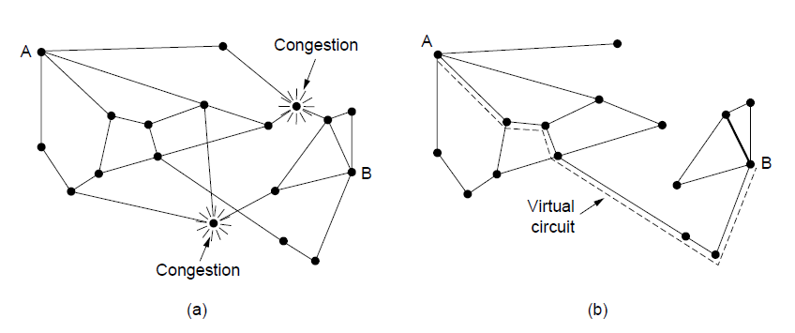
Admission Control
(a) A congested network. (b) The portion of the network that is not congested. A virtual circuit from A to B is also shown.

Slide 17
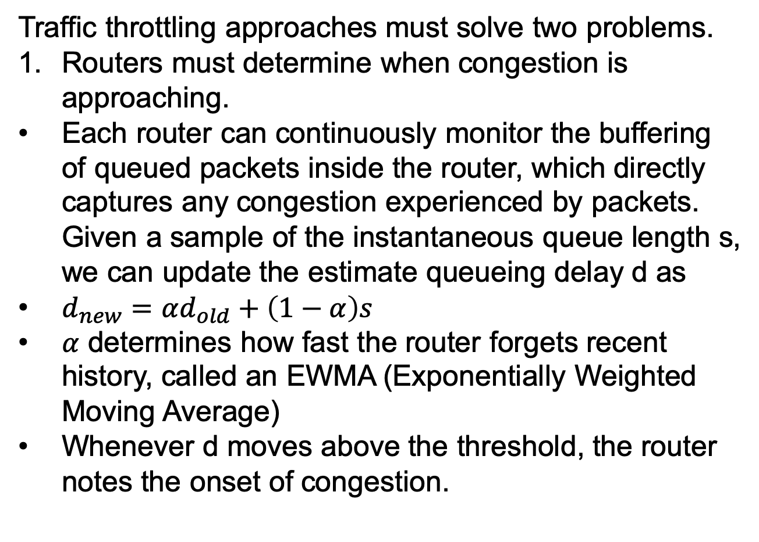
Traffic Throttling
Traffic throttling approaches must solve two problems.
Routers must determine when congestion is approaching.
Each router can continuously monitor the buffering of queued packets inside the router, which directly captures any congestion experienced by packets. Given a sample of the instantaneous queue length s, we can update the estimate queueing delay d as
$d_{new}=αd_{old}+\left(1−α\right)s$
$α$ determines how fast the router forgets recent history, called an EWMA (Exponentially Weighted Moving Average)
Whenever d moves above the threshold, the router notes the onset of congestion.

Slide 18
Traffic Throttling
Traffic throttling approaches must solve two problems.
2. routers must deliver timely feedback to the senders that are causing the congestion.
Scheme 1: choke packets
The router selects a congested packet and sends a choke packet back to the source host, giving it the destination found in the packet.
The original packet may be tagged (in the header) so that it will not generate any more choke packets along the path.
When the sender gets the choke packet, it reduces the traffic to the specified destination.
In a datagram network, simply picking packets at random is likely to find the fast sender.

Slide 19
Traffic Throttling
Traffic throttling approaches must solve two problems.
2. routers must deliver timely feedback to the senders that are causing the congestion.
Scheme 1: choke packets
Multiple choke packets may be sent to the same host and destination. The sender will ignore additional chokes for the fixed time interval. After that period, further choke packets indicate that the network is still congested.
Scheme 2: Explicit Congestion Notification (ECN).
Tag any packet it forwards to single that the packet is experiencing congestion.
When receiving the packet, the destination will inform the sender of the congestion when it sends a reply packet.

Slide 20
Traffic Throttling
Traffic throttling approaches must solve two problems.
2. routers must deliver timely feedback to the senders that are causing the congestion.
Scheme 2: Explicit Congestion Notification (ECN).
Tag any packet it forwards to single that the packet is experiencing congestion.
When receiving the packet, the destination will inform the sender of the congestion when it sends a reply packet.
Example. Packets are unmarked when they are sent. If the router along the way is congested, the packets will be marked. The destination will echo any marks back to the sender as an explicit congestion signal in its next reply packet.

Slide 21
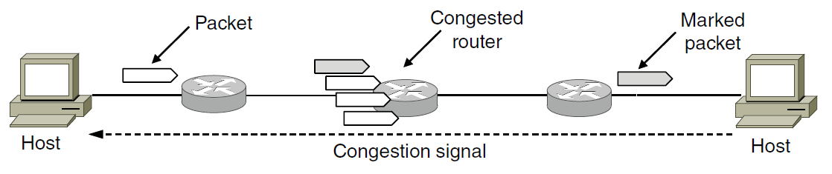
Traffic Throttling
Explicit congestion notification

Slide 22
Traffic Throttling
Traffic throttling approaches must solve two problems.
2. routers must deliver timely feedback to the senders that are causing the congestion.
Scheme 3: Hop-by-Hop backpressure.
At high speeds or over long distance, many new packets may be sent after congestion has been signals due to the delay before the signal takes effect.
Example, in (a), router A sends traffic to router D. Using ECN, only in the 7th diagram router D will be relieved from congestion.
An alternative is in (b), have the choke packet take effect at every hop it passes through. As the choke packet reaches F, F is required to reduce the flow to D by buffering the packets.
Provide quick relief at the price of more buffers.

Slide 23
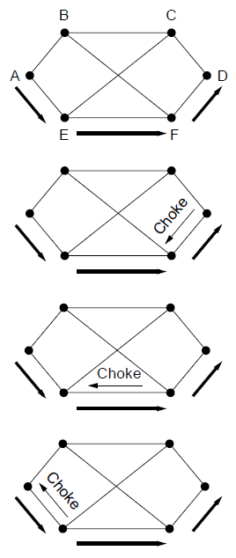
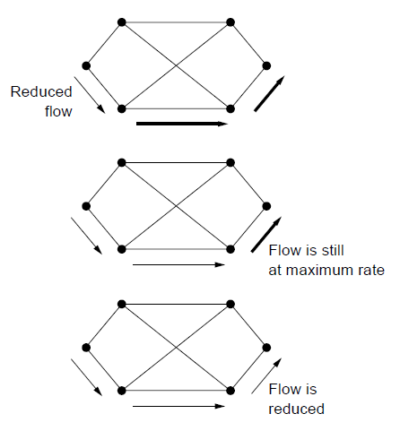
Traffic Throttling
A choke packet that affects only the source..

Slide 24
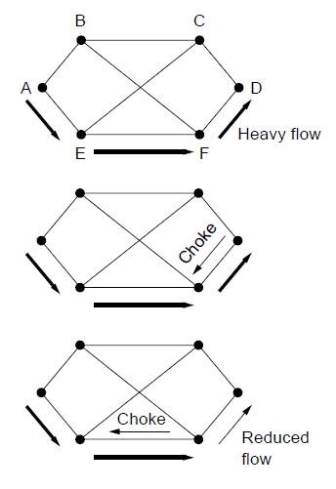
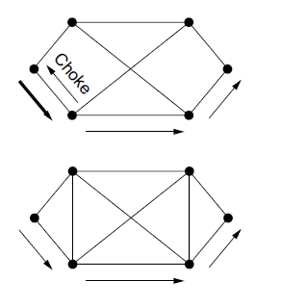
Load Shedding
A choke packet that affects each hop it passes through.

Slide 25
Load Shedding
Load shedding. When routers are congested, they just throw packets away.
Which packets to drop? Depending on the application.
For a file transfer, an old packet is worth more than a new one. This policy is called wine.
For a realtime media, a new packet is worth more than an old one. This policy is called milk.
Packets that carry routing information are more important than regular data packets because they establish routs and connectivity.
To implement an intelligent discard policy, application must mark their packets to indicate to the network how important they are. Router can first drop packets from the least important classes.

Slide 26
Load Shedding
Random early detection (RED). Discard packets before all the buffer space is really exhausted. Replace ECN when some Internet hosts do not get congestion signals from routers in the form of ECN.
Packet loss is the only reliable indication of congestion
RED have routers maintain a running average of their queue length. When the average queue length on some link exceeds a threshold, the link is said to be congested, and a small fraction of the packets are dropped at random.
The affected sender will notice the loss when there is no acknowledgement, and slow down.
The ideal number of packets to drop depends on how many senders need to be notified of congestion.

Slide 27
Quality of Service
Application requirements
Traffic shaping
Packet scheduling
Admission control
Integrated services
Differentiated services

Slide 28
Quality of Service
Quality of service mechanisms let a network with less capacity meet application requirements at a lower cost.
Four issues must be addressed to ensure quality of service:
What applications need from the network?
How to regulate the traffic that enters the network?
How to reserve resources at routers to guarantee performance?
Whether the network can safely accept more traffic?

Slide 29
Application Requirements
Flow: A stream of packets from a source to a destination.
In connection-oriented services, all packets of a connection.
In connection-less services, all packets from one source to one destination.
The needs of each flow can be characterized by four primary parameters that determine the flow’s required QoS (Quality of Service):
Bandwidth
Delay
Jitter
loss

Slide 30
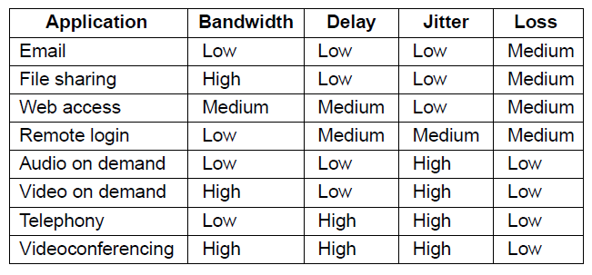
Application Requirements
How stringent the quality-of-service requirements are.

Slide 31
Application Requirements
Bandwidth
Remote login not needing much, but file sharing and video needing a great deal.
Delay
File transfer are not delay sensitive.
Interactive applications, such as Web surfing and remote login, are more sensitive.
Real-time applications have strict delay requirements.
Jitter: the variation in the delay or packet arrival time.
Video and especially audio are extremely sensitive to jitter. If all frames are delayed by 2 sec, no harm is done. But if the transmission time varies between 1~2 sec, the result will be terrible.

Slide 32
Application Requirements
Loss
The first four applications have more strict loss requirement since all bits must be delivered correctly. Achieved with retransmission.
Audio and video can tolerate some lost packets without retransmission.

Slide 33
Categories of QoS and Examples
Constant bit rate
Telephony
Real-time variable bit rate
Compressed videoconferencing
Non-real-time variable bit rate
Watching a movie on demand
Available bit rate
File transfer

Slide 34
Traffic Shaping
Traffic shaping: a technique for regulating the average rage and burstiness of a flow of data that enters the network.
The goal is to allow applications to transmit a wide variety of traffic including some bursts, yet have a simple and useful way to describe the possible traffic patterns to the network.
SLA (Service Level Agreement): the user and the network aggress on a certain traffic patter.
Traffic policing: monitoring a traffic flow so that the provider can tell if the customer is following the agreement.

Slide 35
Traffic Shaping Leaky and Token Buckets
Leaky and token buckets algorithms: limit the amount of data an application sends.
Leaky buckets
A bucket with a small hole in the bottom.
The outflow is at a constant rate R when there is any water in the bucket, and 0 when empty.
If the bucket is full to capacity B, additional water entering it spills over the sides and is lost.
Leaky bucket algorithm
Each host is connected to the network by an interface containing a leaky bucket.
If a packet arrives when the bucket is full, the packet must be either queued or discarded.

Slide 36
Traffic Shaping Leaky and Token Buckets
Token buckets
The tap is running at rate R and the bucket has a capacity of B.
To send a packet we must be able to take water, or tokens out of the bucket.
No more than a fixed number of tokens, B, can accumulate in the bucket.
If the bucket is empty, must wait until more tokens arrive before we can send another packet.

Slide 37
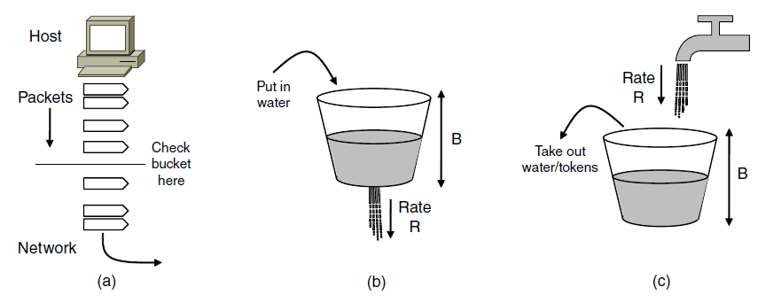
Traffic Shaping
(a) Shaping packets. (b) A leaky bucket. (c) A token bucket

Slide 38
Traffic Shaping Leaky and Token Buckets
Example.
The original traffic shape is in (a). The host produces data at up to 1000 Mbps (125 MB/s) for 125 msec, stops a little while, and then produces data at 25 MB/s for 250 msec. The average rate over one second is 200 Mbps.
The capacity of the network is 200 Mbps. And the buffer size at the router is B. B = 16000KB, 9600KB, 0 KB.
We shape the traffic with a toke bucket with rate R = 200 Mbps, and capacity B = 16000KB, 9600KB or 0KB. Initially, the bucket is full.

Slide 39
Traffic Shaping Leaky and Token Buckets
Initially, the rate at which the tokens are taken out of the bucket (1000Mbps) is greater than the rate at which the tokens are filled in the bucket (200Mbps). The number of tokens in the bucket decreases.
When the bucket size reaches 0, the data can only be sent at the rate at which the the tokens are filled in the bucket (200Mbps).
If the real data rate is smaller than 200Mbps (if B=16000, when the bucket size is 0, the real data rate becomes 0), the number of tokens increases.
Otherwise, (if B=9600, when the bucket size is 0, the real data rate is still 1000Mbps), the bucket size is remains 0.

Slide 40
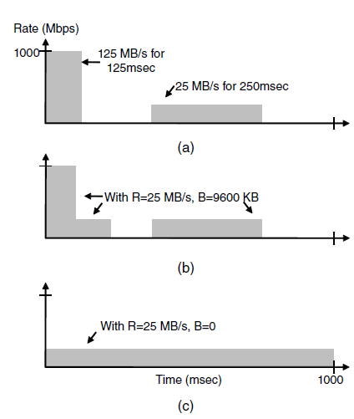
Traffic Shaping
(a) Traffic from a host. Output shaped by a token bucket of rate 200 Mbps and capacity (b) 9600 KB, (c) 0 KB.

Slide 41
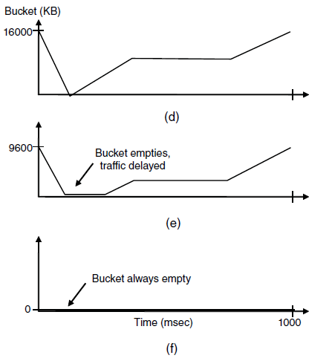
Traffic Shaping
Token bucket level for shaping with rate 200 Mbps and capacity (d) 16000 KB, (e) 9600 KB, and (f) 0KB..

Slide 42
Packet Scheduling
To provide a performance guarantee, we must reserve sufficient resources along the route. We assume that the packets of a flow follow the same route.
Three different resources can be reserved:
Bandwidth. If a flow requires 1Mbps and the outgoing line has a capacity of 2Mbps, we cannot direct 3 flows via that line.
Buffer space. A packet is buffered at the router until it can be transmitted. For good QoS, some buffers may be reserved for a specific flow.
CPU cycles. It takes routers CPU time to process a packet, so a router can process only a certain number of packets per second. Some packets may require greater CPU processing.

Slide 43
Packet Scheduling
Packet scheduling algorithm determines which of the buffered packets to send on the output line next.
Scheduling algorithm 1: FIFO (First-In First-Out) or FCFS (First-Come First-Serve)
Each router buffers packet in a queue, and they are sent in the same order that they arrived.
Drop newly arriving packets when the queue is full. Since the newly-arriving packets are put at the end of the queue, this is called tail drop.
Simple to implement, but is not suited when there are multiple flows. An aggressive first flow may starve all other later flows.

Slide 44
Packet Scheduling
Scheduling algorithm 2: fair queuing 1
Provide stronger isolation between flows.
Each router has separate queues, one for each flow for a given output line.
The router scans the queues round-robin.
With n hosts, each host gets to send one out of every n packets.
Disadvantage: gives more bandwidth to hosts that use large packets than to hosts that use small packets.

Slide 45
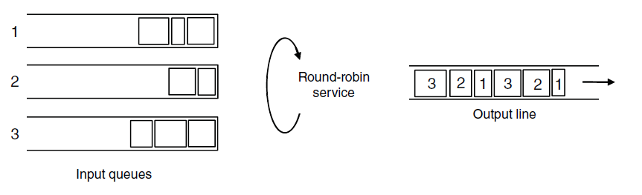
Packet Scheduling
Round-robin Fair Queuing

Slide 46
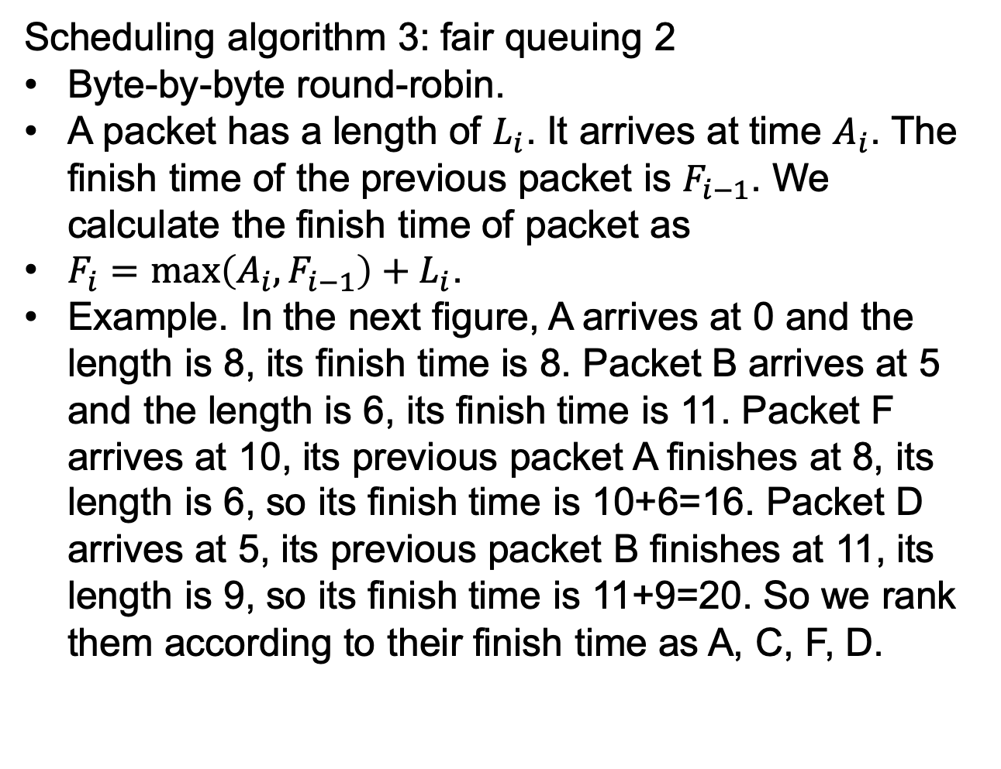
Packet Scheduling
Scheduling algorithm 3: fair queuing 2
Byte-by-byte round-robin.
A packet has a length of $L_{i}$. It arrives at time $A_{i}$. The finish time of the previous packet is $F_{i−1}$. We calculate the finish time of packet as
$F_{i}=\max\left(A_{i},F_{i−1}\right)+L_{i}$.
Example. In the next figure, A arrives at 0 and the length is 8, its finish time is 8. Packet B arrives at 5 and the length is 6, its finish time is 11. Packet F arrives at 10, its previous packet A finishes at 8, its length is 6, so its finish time is 10+6=16. Packet D arrives at 5, its previous packet B finishes at 11, its length is 9, so its finish time is 11+9=20. So we rank them according to their finish time as A, C, F, D.

Slide 47
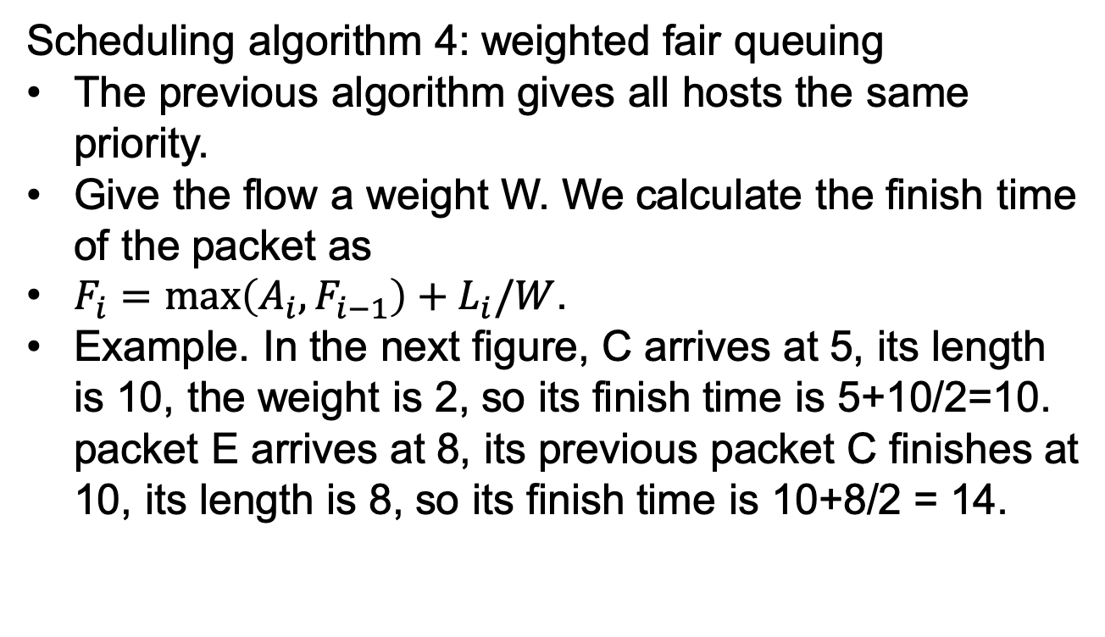
Packet Scheduling
Scheduling algorithm 4: weighted fair queuing
The previous algorithm gives all hosts the same priority.
Give the flow a weight W. We calculate the finish time of the packet as
$F_{i}=\max\left(A_{i},F_{i−1}\right)+L_{i}/W$.
Example. In the next figure, C arrives at 5, its length is 10, the weight is 2, so its finish time is 5+10/2=10. packet E arrives at 8, its previous packet C finishes at 10, its length is 8, so its finish time is 10+8/2 = 14.

Slide 48
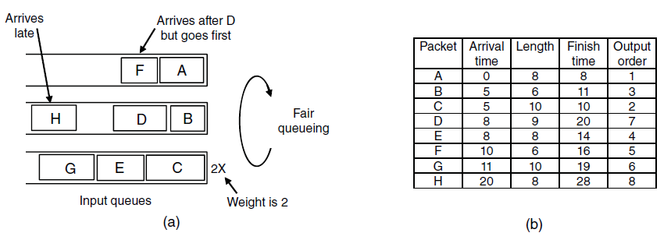
Packet Scheduling
Weighted Fair Queueing.
Finishing times for the packets.

Slide 49
Packet Scheduling
Scheduling algorithm 5: priority scheduling
Each packet is marked with priority.
High-priority packets are always sent before any low-priority packets that are buffered.
Within a priority, packets are sent in FIFO order.
Disadvantage: a burst of high-priority packets can starve low-priority packets.
It is better to use the weighted fair queuing with a larger weight to the high-priority packets.
Scheduling algorithm 6: timestamp based scheduling
Each packet carry a timestamp, which records how far the packet is behind or ahead of schedule.
Send the packet according to the timestamp.
Speed up slow packets and slow down fast packets.

Slide 50
Admission Control
QoS guarantees are established by application requirements, traffic shaping and packet scheduling.
The user generates a flow with an accompanying QoS requirement to the network. The network decides whether to accept or reject the flow based on its capacity and the commitments it has made to other flows.
It it accepts, the network reserves capacity at all routers along the route.
QoS routing. If there is not enough spare resource on the best path, find a different route that has excess capacity.
May split the flow over multiple paths to find excess capacity.

Slide 51
Admission Control
Many parties may be involved in the flow negotiation (the sender, the receiver, and all routers along the path), flows must be described in terms of specific parameters, called flow specification.
The sender produces a flow specification.
The specification propagation along the route, each router examines it and modifies the parameters as need be. The modification can only reduce the flow, not increase it, e.g., a lower data rate, not a higher one.
Example. A flow specification based on RFCs 2210 and 2211 for Integrated Service, a QoS design introduced later.

Slide 52
Admission Control
Token bucket rate and token bucket size
Use a token bucket algorithm to shape the traffic
Peak data rate
The maximum transmission rate tolerated, even after the traffic has been shaped by the token bucket algorithm
Maximum and minimum packet size.
The minimum packet size is useful since processing each packet takes some fixed time, no matter how short.
The maximum packet size is important due to internal network limitations.

Slide 53
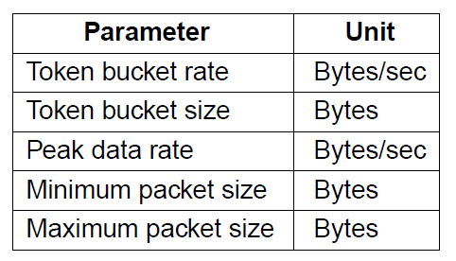
Admission Control
An example flow specification

Slide 54
Admission Control
How to turn a flow specification into a set of specific resource reservations?
One method is based on traffic sources shaped by (R, B) token buckets and WFQ at routers.
Each flow is given a WFQ weight W large enough to drain its token bucket rate R. This guarantees the flow a minimum bandwidth. If it cannot be given a large enough rate, the flow cannot be admitted.
The largest queueing delay of the flow is a function of the burst size of the token bucket. .
The token buckets bound the burstiness of the source, and fair queuing isolates the bandwidth to the flow. This means that the flow will meet its bandwidth and delay guarantees.

Slide 55
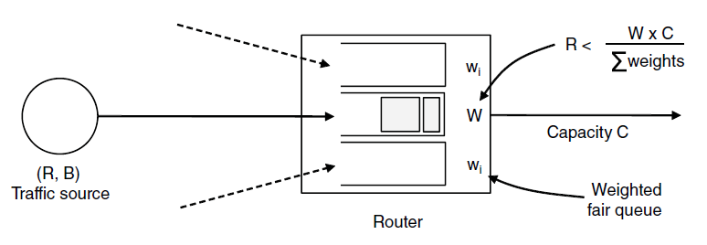
Admission Control
Bandwidth and delay guarantees with token buckets and WFQ.

Slide 56
Integrated Services
Integrated services: devised by IETF, an architecture for streaming multimedia, RFCs 2205-2212.
Aim at both unicast and multicast applications.
We focus on multicast applications.
RSVP – The Resource reSerVation Protocol
The main part of the integrated services architecture used for making the reservations.
Allow multiple senders to transmit to multiple group of receivers.
Use multicast routing using spanning trees.
Each group is assigned a group address.
To send to a group, the sender puts the group’s address in its packets.
The standard multicast routing algorithm then builds a spanning tree covering all group members.

Slide 57
Integrated Services
For example. Consider the network in the following figure.
Hosts 1 and 2 are multicast senders
Hosts 3, 4 and 5 are multicast receivers.
The multicast trees for hosts 1 and 2 are shown in (b) and (c)
Any receiver can send a reservation message up the tree to the sender using the reverse path forwarding algorithm.
At each hop, the router notes the reservation and reserves the necessary bandwidth via a weighted fair queueing scheduler.
If insufficient bandwidth is available, it reports back failure.

Slide 58
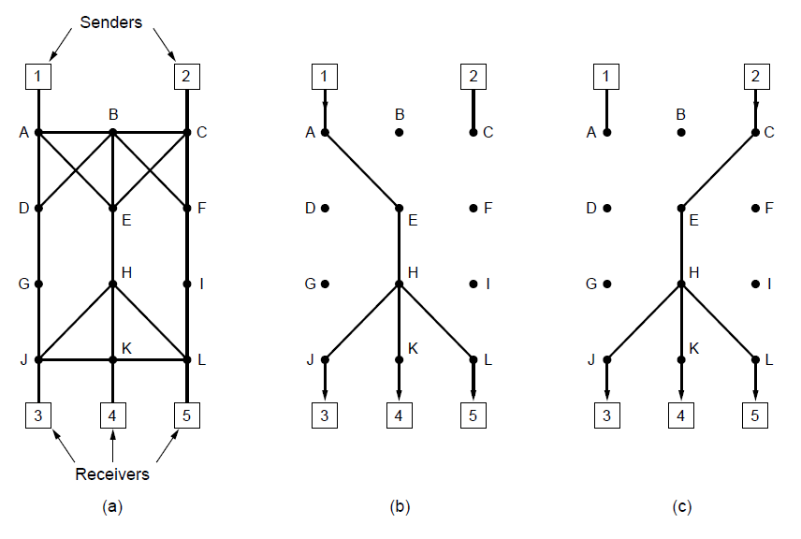
Integrated Services
(a) A network. (b) The multicast spanning tree for host 1. (c) The multicast spanning tree for host 2.

Slide 59
Integrated Services
Example of reservation.
Host 3 requests a channel to host 1 in (a). once it has been established, packets can flow from 1 to 3 without congestion.
Host 3 next reserves a channel to host 2. a second path is reserved in (b). Two separate channels are needed from host 3 to router E since two independent streams are being transmitted.
Host 5 reserves a channel to host 2 in (c). Dedicated bandwidth is reserved from host 5 to router H. H sees that it already has a feed from host 1.
If host 5 demands a lower or equal bandwidth as host 3, H does not have to reserve anymore.
If host 5 demands a higher bandwidth than host 3, H reserves the amount of bandwidth required by host 5.

Slide 60
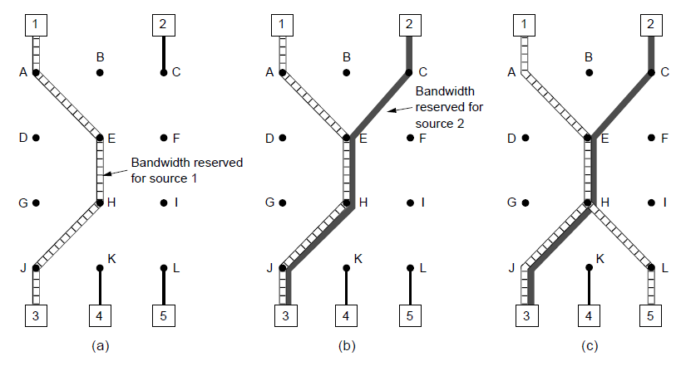
Integrated Services
(a) Host 3 requests a channel to host 1. (b) Host 3 then requests a second channel, to host 2. (c) Host 5 requests a channel to host 1.

Slide 61
Differentiated Services
Flow-based algorithm have a downside.
Require advance setup to establish each flow.
IETF also devised a simpler approach to QoS.
Class-based quality of service, called differentiate services.
Class-based QoS
A customer subscribes to differentiated services.
The customer packets are marked with the class to which they belong.
The class may differ in terms of delay, jitter and others.

Slide 62
Differentiated Services Expedited Forwarding
Two classes: regular and expediated.
Expediated packets get low loss, low delay and low jitter services, which is needed for VoIP.
For example, in the following figure. There is one physical line. The two logical pipes represent a way to reserve bandwidth for different classes of services.
Implementation method.
The packets are classified as expedited or regular at the sender or the ingress (first) router.
The ingress router may police the traffic to ensure that customers are not sending more expedited traffic than they have paid for.
Each router has two queues for each class of packets.
Using a priority scheduler.

Slide 63
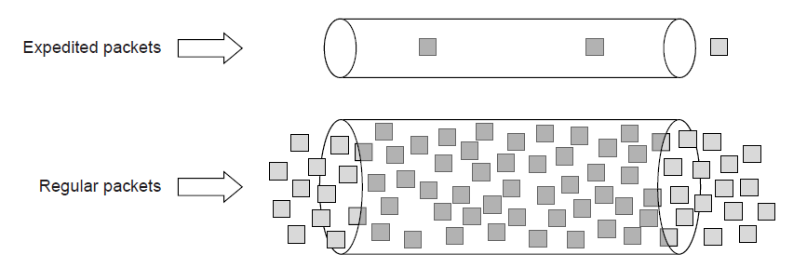
Differentiated Services Expediated Forwarding
Expedited packets experience a traffic-free network

Slide 64
Differentiated Services Assured Forwarding
4 priority classes: gold, silver, bronze and regular + 3 discard classes: low, medium and high.
Classify packets into one of the 4 priority classes at the sender or the ingress router.
A traffic policer determine the discard class for each packet.
Each router uses weighted fair queueing for the 4 priority classes, with higher classes given higher weights.
Within a priority class, packets with a higher discard class can be preferentially dropped by running an algorithm such as RED (Random Early Detection).

Slide 65
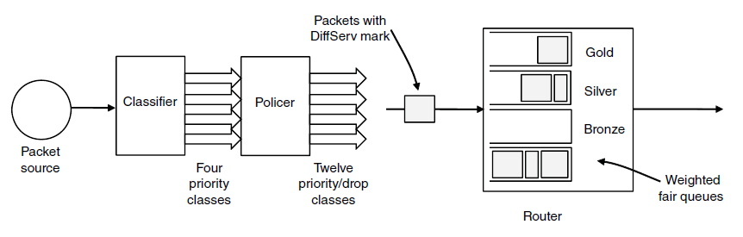
Differentiated Services
A possible implementation of assured forwarding

Slide 66
Internetworking
How networks differ
How networks can be connected
Tunneling
Internetwork routing
Packet fragmentation

Slide 67
Internetworking
We look at issues when two or more networks are connected for form an internetwork, or simply an internet.
The purpose of joining networks is to allow users on one network to communicate with users on other networks, or to exchange packets with users on other networks.

Slide 68
How Networks Differ
We list the differences that are exposed to the network layer.
Service offered.
Packets would cross from a connectionless network to a connection-oriented one. This may require a new connection to be set up on short notice, which injects a delay and overhead.
Addressing
How to specify a WiMAX destination from an Ethernet source?
Broadcasting.
How to multicast a packet on a network that does not support multicast?

Slide 69
How Networks Differ
Packet size.
How to pass an 8000-byte packet through a network whose maximum size is 1500 bytes.
Ordering
If packets on a connection-oriented network transit a connectionless network, they may arrive in a different order than they were sent.
Quality of service.
If one network has strong QoS and the other offers best effort service, it will be impossible to make bandwidth and delay guarantees for real-time traffic end to end.

Slide 70
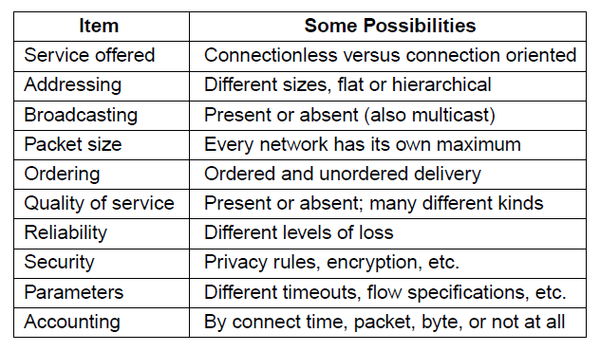
How Networks Differ
Some of the many ways networks can differ

Slide 71
How Networks Can Be Connected
Two basic choices for connecting different networks
Build devices that translate or convert packets from one network to another network.
Build a common network layer to hide the differences of existing networks.
Choice 1 has many problems.
Translate the packets can work only if the packet formats have the same information fields. E.g., 128-bit IPv6 will never fit in a 32-bit IPv4 address field.
Translating between connectionless and connection-oriented network protocols is hard.
Choice 2 features IP protocols, which provides a universal packet format that all routers recognize.

Slide 72
How Networks Can Be Connected
IP has extended its reach from computer networks to take over the telephone network. It also runs on sensor networks and other tiny devices.
We have introduced many devices that connect networks, including repeaters, hubs, switches, bridges, routers and gateways. In this section, we focus on routers, the network layer devices.
An example, in the following figure (a). An internet of 802.11, MPLS and Ethernet. The source machine on 802.11 wants to send a packet to the destination machine on Ethernet.

Slide 73
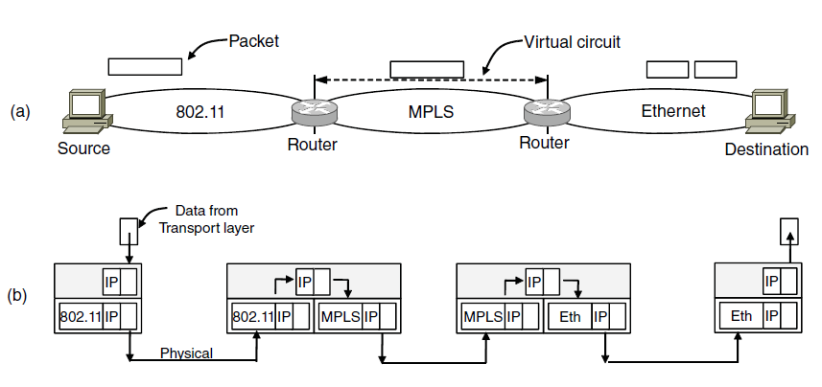
How Networks Can Be Connected
A packet crossing different networks.
Network and link layer protocol processing.

Slide 74
How Networks Can Be Connected
At the boundary between 802.11 and MPLS.
802.11 provides a connectionless service but MPLS provides ad connection-oriented service.
A VC must be set up to reach the Ethernet.
At the boundary between MPLS and Ethernet.
The 802.11 and MPLS supports larger frames than Ethernet.
Divide the packet into fragments which are sent separately. When the fragments reach the destination, they are reassembled.

Slide 75
How Networks Can Be Connected
Protocol processing shown in figure (b).
The source accepts data from the transport layer and generates a packet with the common network layer header, i.e., IP header. The packet is encapsulated in the 802.11 frame.
At the first router, the 802.11 frame header is removed. The IP address in the packet is examined to forward the packet. For this path, an MPLS VC is established and the packet is encapsulated with an MPLS header.
At the second router, the MPLS header is removed, IP address is used to decide the next hop. The packet is split into two portions, each forms an Ethernet frame.
At the destination, the Ethernet header is removed, and the contents are reassembled.

Slide 76
How Networks Can Be Connected
Difference between routers and switches:
Routers: network layer devices. Switches: data link layer devices.
Routers: extract packet from the frame and use the network address for deciding where to send it. Switches: use MAC address to transport frames; do not have to understand the network layer protocol.
Routers: usually used to connect different networks at the network layer using the common IP protocol. Switches: usually used to connect the same kind of network at the link layer (different LANs with the same technology).

Slide 77
Tunneling
A special case of internet: the source and destination hosts are on the same type of network, but there is a different network in between.
Solution: Tunneling.
Example. An international bank with an IPv6 network in Paris and London, and connectivity between the offices via the IPv4 Internet.
The host in Paris constructs the IPv6 packets in London, and sends it to the multiprotocol router that connects the Paris IPv6 network to the IPv4 Internet.
The router encapsulates the IPv6 packet inside an IPv4 packet, sends it to the multiprotocol router that connects the London IPv6 network.
The London router retrieves the original IPv6 packet and sends it onward to the London host.

Slide 78
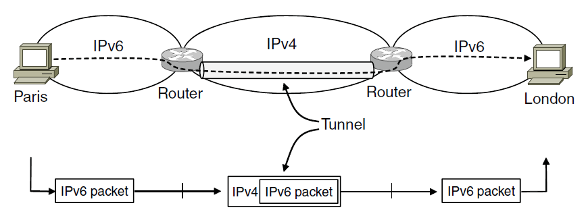
Tunneling
Tunneling a packet from Paris to London.

Slide 79
Tunneling
The path through the IPv4 Internet can be seen as a big tunnel extending from one multiprotocol router to the other. The IPv6 packet just travels from one end of the tunnel to the other, snug in its nice box.
An analogy: a person driving her car from Paris to London.
Within France, the car moves under its own power.
When it hits the English Channel, it is loaded onto a train and transported to England through the channel.
At the far end, the car is let loose on the English roads and moves under its own power.

Slide 80
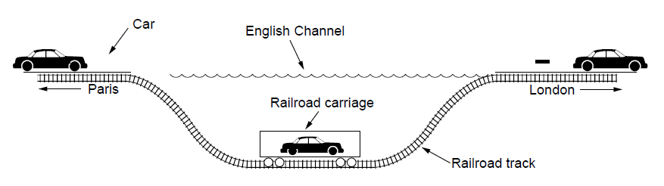
Tunneling
Tunneling a car from France to England

Slide 81
Internetwork Routing
Routing through an internet has some complications.
The two networks may have different routing algorithms. E.g., one uses link state algorithms that need to know the topology, the other uses distance vector algorithms that does not.
Networks may run by different operators.
Different ideas about best path, e.g., least delay, or least cost. Use different quantities to set the shortest-path costs.
One operator may not want another to know the details of path in its network for privacy issues.

Slide 82
Internetwork Routing
Solution: a two-level routing algorithm.
Within each network, an intradomain routing protocol.
Across networks, an interdomain routing protocol.
The networks may use different intradomain routing protocols, but must use the same interdomain protocol.
In the Internet, the interdomain routing protocol is BGP (Border Gateway Protocol), introduced later.
Since each network is operated independently of all the others, it is often referred to as an AS (Autonomous System. )

Slide 83
Packet Fragmentation
Packet size issues:
Hardware
Operating system
Protocols
Compliance with (inter)national standard.
Reduce error-induced retransmissions
Prevent packet occupying channel too long.

Slide 84
Packet Fragmentation
Maximum payloads for some common technologies are:
1500 bytes for Ethernet
2272 bytes for 802.11
65,515 bytes for IP
Two types of solutions:
Makes sure the problem does not occur. The packet size that the path allows is Path MTU (Path Maximum Transmission Unit).
Allow routers to break up packets into fragments. Sending each fragment as a separate network layer packet.

Slide 85
Packet Fragmentation
The problem with packet fragmentation is how to recombine the fragments back together.
Strategy 1: make fragmentation caused by a “small-packet” network transparent to any subsequent networks. Shown in figure (a).
E.g., an oversized packet arrives at G1, the router breaks it up into fragments. Each fragment is addressed to the same exit router G2. G2 recombines the pieces. Subsequent networks are not aware of the fragmentation (transparent).

Slide 86
Packet Fragmentation
Strategy 1: transparent fragmentation. Problems:
The exit router must know when it has received all pieces.
All fragments must exit via the same router, the routes are constrained.
The router may have to do a large amount of work, e.g., buffer the fragments, decide when to throw them away if not all fragments arrive (error).
Packet may pass through a series of small packet networks and need to be repeatedly fragmented and reassembled.

Slide 87
Packet Fragmentation
Strategy 2: reassemble at the destination host. Shown in figure (b).
Once a packet has been fragmented, each fragment is treated as an original packet.
Little work on routers.
The fragments to be numbered so that the original data stream can be reconstructed.
In IP, every fragment has a packet number, an absolute byte offset within the packet, and a flag indicating whether it is the end of the packet.
Fragments can be further fragmented.
Retransmissions of the packet can be fragmented.

Slide 88
Packet Fragmentation
Strategy 2: reassemble at the destination host. Problems:
The overhead is higher than transparent fragmentation because fragment headers are not needed in some networks.
If any of its fragments is lost, the packet is lost.

Slide 89
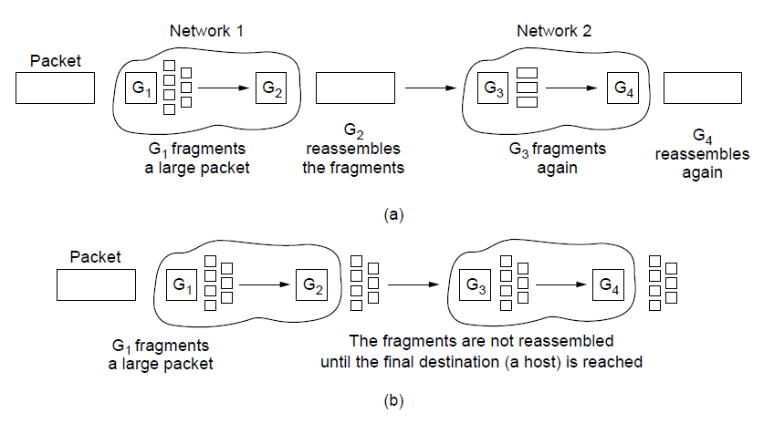
Packet Fragmentation
Transparent fragmentation.
Nontransparent fragmentation

Slide 90
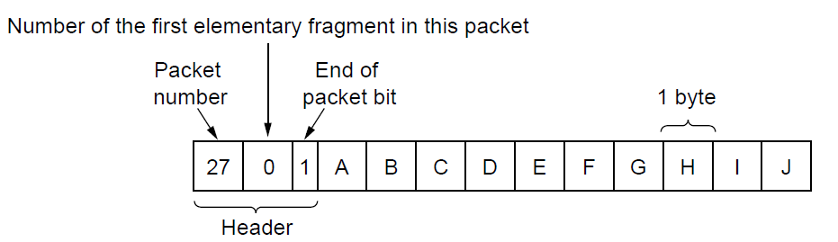
Packet Fragmentation
Fragmentation when the elementary data size is 1 byte. (a) Original packet, containing 10 data bytes.

Slide 91
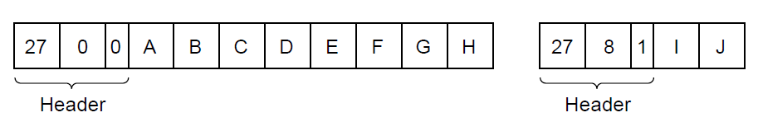
Packet Fragmentation
Fragmentation when the elementary data size is 1 byte
(b) Fragments after passing through a network
with maximum packet size of 8 payload bytes plus header.

Slide 92
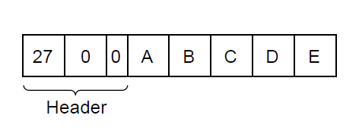
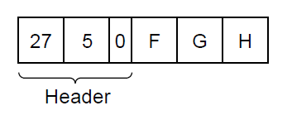
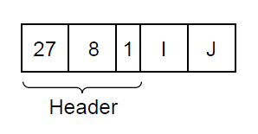
Packet Fragmentation
Fragmentation when the elementary data size is 1 byte
(c) Fragments after passing through a size 5 gateway.

Slide 93
Packet Fragmentation
Strategy 3: path MTU discovery.
Improved transparent fragmentation
Each IP packet is sent with its header bits set to indicate that no fragmentation is allowed.
If a router receives a packet that is too large, it generates an error packet back to the source.
The source uses the information in the error packet to re-fragment the packet.
If a router further down the path has an even smaller MTU, the process is repeated.
If the routes change, new error packets will be triggered and the source will adapt to the new path.

Slide 94
Packet Fragmentation
Strategy 3: path MTU discovery. Problem:
May add startup delays.
More than one round-trip delay may be needed to probe the path and find the MTU before any data is delivered to the destination.

Slide 95
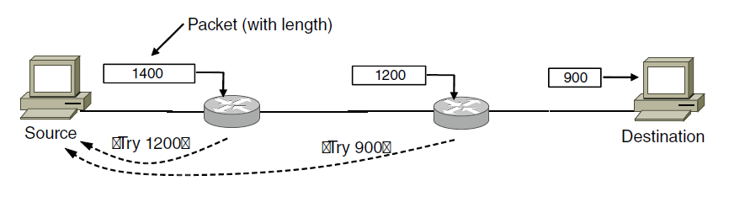
Packet Fragmentation
Path MTU Discovery

Slide 96
The Network Layer In the Internet
In the network layer, the Internet can be viewed as a collection of networks or ASes (Autonomous Systems) that are interconnected.
Tier 1 networks: several major backbones to which everyone else connects to reach the rest of the Internet.
Attached to the backbones are ISPs that provide Internet access to homes and businesses, data centers and regional networks.
Attached to the regional networks are more ISPs, LANs at universities and companies, and other edge networks.

Slide 97
The Network Layer In the Internet
The glue that holds the whole Internet together is the network layer protocol, IP (Internet Protocol).
IP was designed from the beginning with internetworking in mind.
As shown in the following figure, a packet originating at a host on the home network traverses four networks and a large number of IP routers to get to the company network.
There is much redundant connectivity in the Internet, with backbones and ISPs connecting to each other in multiple locations.
The IP routing protocols decide which paths to use.

Slide 98
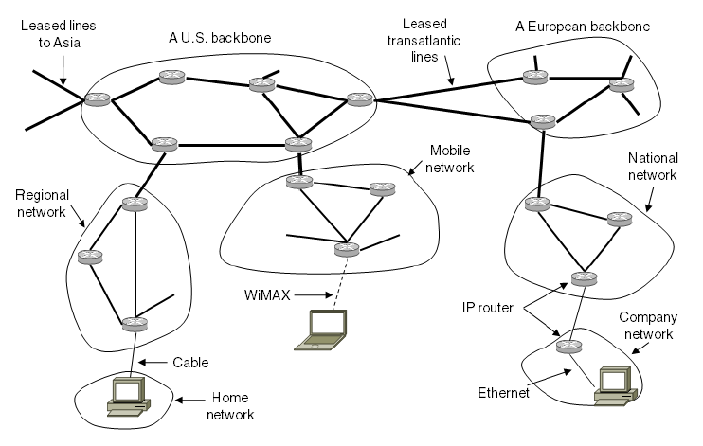
The Network Layer in the Internet
The Internet is an interconnected collection of many networks.

Slide 99
The Network Layer Principles
Make sure it works
Keep it simple
Make clear choices
Exploit modularity
Expect heterogeneity . . .

Slide 100
The Network Layer Principles
. . .
Avoid static options and parameters
Look for good design (not perfect)
Strict sending, tolerant receiving
Think about scalability
Consider performance and cost

Slide 101
The Network Layer in the Internet
The IP Version 4 Protocol
IP Addresses
IP Version 6
Internet Control Protocols
Label Switching and MPLS
OSPF—An Interior Gateway Routing Protocol
BGP—The Exterior Gateway Routing Protocol
Internet Multicasting
Mobile IP

Slide 102
The IP Version 4 Protocol
An IPv4 datagram consists of a header part and a body or payload part.
The header has a 20-byte fixed part and a variable length optional part.
Version field. Version of the protocol the datagram belongs to.
IHL field. Tells how long the header is, in 32-bit words (4 bytes), since the header length is not constant. The minimum value is 5 (20 bytes), and the maximum value is 15 (60 bytes), thus the Options fields is limited to 40 bytes.

Slide 103
The IP Version 4 Protocol
Differentiated services field. First 6 bits mark the packet with its service class (recall expediated and assured services). Last 2 bits carry explicit congestion information (used in congestion control).
IHL field. Tells how long the header is, in 32-bit words (4 bytes), since the header length is not constant. The minimum value is 5 (20 bytes), and the maximum value is 15 (60 bytes), thus the Options fields is limited to 40 bytes.
Total length field. The length including both header and data. The maximum length is 65,535 bytes.
Identification field. The destination host uses to determine which packet a fragment belongs to. All fragments of a packet have the dame Identification value.

Slide 104
The IP Version 4 Protocol
An unused bit.
DF field. Don’t Fragment. Used to discover the path MTU.
MF field. More Fragments. All fragments except the last one have this bit set.
Fragment offset field. Tells where in the current packet this fragment belongs.
TtL (Time to live) field. Limit packet lifetimes. Allowing a maximum lifetime of 255 sec. It is decremented on each hop. When it hits zero, the packet is discarded and a warning packet is sent back to the source.
Protocol field. Which transport process to give the packet to, e.g., TCP, UDP.

Slide 105
The IP Version 4 Protocol
Header checksum field. Since the header carries vital information such as addresses, it rates its own checksum for protection. It must be recomputed at each hop since at least the TtL field changes.
Source address and Destination address field.
Options field. Variable length. Originally, 5 options were defined.
Security option. How secret the information is.
Strict source routing option. Gives the complete path from source to destination as a sequence of IP addresses. The datagram is required to follow that exact route.

Slide 106
The IP Version 4 Protocol
Options field.
Loose source routing option. Requires the packet to traverse the list of routers specified, in the order specified, but it is allowed to pass through other routers on the way.
Record route option. Tells each router on the path to append its IP address to the Options field. This allows system managers to track down bugs in the routing algorithms.
Timestamp option. Tells each router to append a 32-bit timestamp.

Slide 107
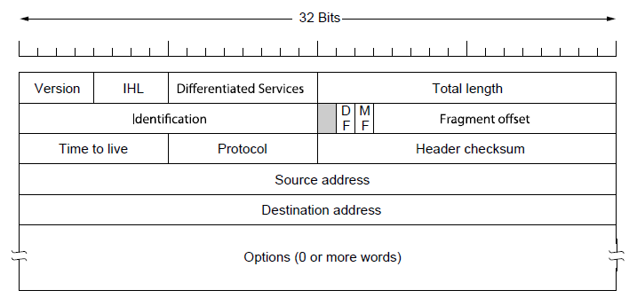
The IP Version 4 Protocol
The IPv4 (Internet Protocol) header.

Slide 108
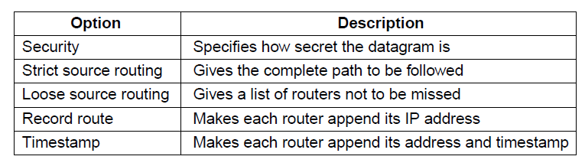
The IP Version 4 Protocol
Some of the IP options.

Slide 109
IP Addresses Prefixes
A defining feature of IPv4 is its 32-bit addresses.
The IP addresses refers to a network interface, but not a host.
If a host is on 2 networks, it has 2 IP addresses.
IP addresses are hierarchy. Each 32-bit address is comprised of
a variable-length network portion in the top bits.
The network portion has the same value for all hosts on a single network, e.g., an Ethernet LAN.
The network portion is called the prefix
a host portion in the bottom bits.

Slide 110
IP Addresses Prefixes
IP addresses are written in dotted decimal notations, e.g., the 32-bit hexadecimal address 80D00297 is written as 128.208.2.151.
Prefixes are written by the lowest IP address in the block and the length of the network portion. E.g., 128.208.0.0/24
Since the prefix length cannot be inferred from the IP address alone, routing protocols must carry the prefixes to routers.
Prefixed can be described by their length, as in “\16”.
Subnet mask. A binary mask of 1s in the network portion. It can be ANDed with the IP address to extract only the network portion.
Example, in the following figure, the subnet mask is 255.255.255.0.

Slide 111
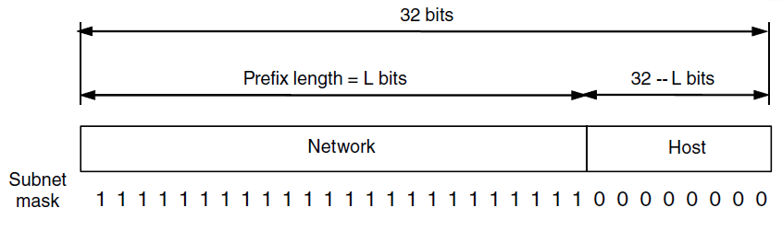
IP Addresses Prefixes
An IP prefix.

Slide 112
IP Addresses Prefixes
Hierarchical addresses advantage.
Routers can forward packets based on only the network portion of the address.
All hosts on the same network will be sent in the same direction.
Only when the packets reach the destined network that they are forwarded to the correct host.
Reduce the size of the routing table.
Disadvantages.
The IP address of a host depends on where it is located in the network. Ethernet address is unique globally. A mobile host has to change IP address when move to another network.
A shortage of IP addresses.

Slide 113
IP Addresses Subnets
Network numbers are managed by a nonprofit corporation called ICANN (Internet Corporation for Assigned Names and Numbers) to avoid conflicts.
ICANN has delegated parts of the address space to various regional authorities, which dole out IP addresses to ISPs and other companies.
If a company is allocated a block of IP addresses, it can split them into several parts for internal use as multiple networks, called subnetting.

Slide 114
IP Addresses Subnets
Example. A university with the single /16 prefix.
Half of the block, a /17, is allocated to the CS Dept.
A quarter, a /18, is allocated to the EE Dept.
One eighth, a /19, is allocated to the Art Dept.
CS: 1000000 11010000 1|xxxxxxx xxxxxxxx
EE: 1000000 11010000 00|xxxxxx xxxxxxxx
Art: 1000000 11010000 001|xxxxx xxxxxxxx
CS: 128.208.128.0/17
EE: 128.208.0.0/18
Art: 128.208.96.0/19

Slide 115
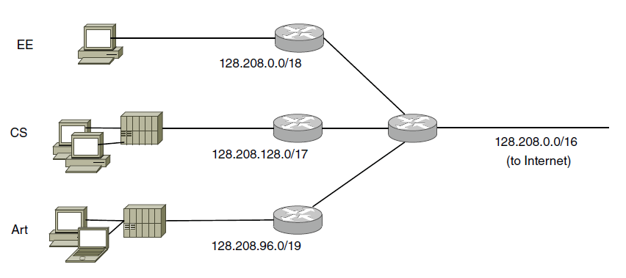
IP Addresses Subnets
Splitting an IP prefix into separate networks with subnetting.

Slide 116
IP Addresses Subnets
When a packet comes into the main router, the router looks at the destination address of the packet and checks which subnet it belongs to.
Do this by ANDing the destination address with the mask for each subnet and checking to see if the result is the corresponding prefix.
For example, consider a packet destined for IP address 128.208.2.151.
For the CS Dept, AND with 255.255.128.0 to take the first 17 bits (which is 128.208.0.0), which do not match the prefix address (128.208.128.0).
For the EE Dept., check the first 18 bits we get 128.208.0.0 when ANDing with the subnet mask. This matches the prefix address.

Slide 117
IP Addresses CIDR—Classless InterDomain Routing
To deal with the routing table explosion problem, we should reduce table size.
Route aggregation. In contrast to subnetting, we combine multiple small prefixes into a single larger prefix. The resulting larger prefix is called a supernet.
CIDR. Example. A block of 8192 IP addresses is available starting at 194.24.0.0.
2048 is assigned to Cambridge university.
1024 is assigned to Edinburgh university.
4096 is assigned to Oxford university.
The remaining 1024 is unallocated.

Slide 118
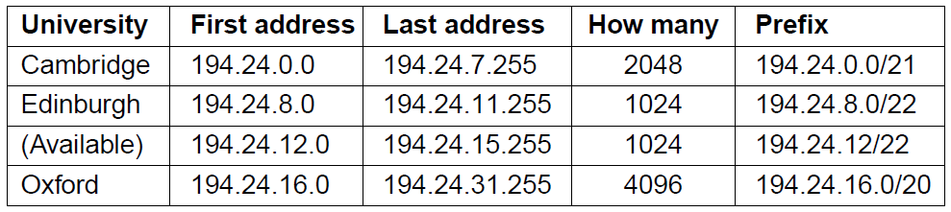
IP Addresses CIDR
A set of IP address assignments

Slide 119
IP Addresses CIDR—Classless InterDomain Routing
Routers close to the universities (e.g., a router in London) have an entry for each of the prefixes in their routing table.
The London router combines the three prefixed into a single aggregate entry for the prefix 194.24.0.0/19 to pass to the New York router.
The New York router has a single entry that covers 8K addresses of the 3 universities.
Prefixes may overlap.
Use the longest matching prefix for routing.

Slide 120
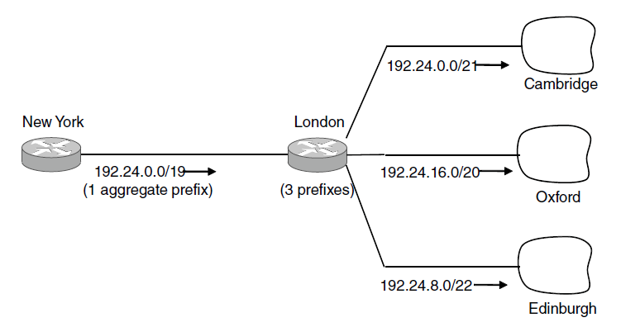
IP Addresses CIDR
Aggregation of IP prefixes

Slide 121
IP Addresses CIDR—Classless InterDomain Routing
Longest matching prefix. Example. We allocate the previous available block addresses is allocated to a network in San Francisco.
At the New York router, an overall prefix 192.24.0.0/19 is used to direct traffic to London.
A more specific prefix 192.24.12.0/22 is used to direct a portion of the larger prefix to San Francisco.
When a packet comes in, scan the routing table. Multiple entries with different prefix lengths will match. The longest prefix is used. E.g., there is a match for the /19 mask and the /22 mask, the /22 entry is used to look up the outgoing line.

Slide 122
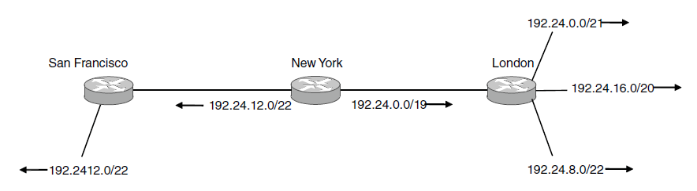
IP Addresses CIDR
Longest matching prefix routing at the New York router.

Slide 123
IP Addresses NAT—Network Address Translation
NAT deals with the problem of running out of IP addresses.
the ISP assigns each home or business a single IP address for Internet traffic.
Within the customer network, every computer gets a unique IP address for routing intramural traffic.
The internal network can use the reserved IP addresses.
10.0.0.0 – 10.255.255.255/8 (16,777,216 hosts)
172.16.0.0 – 172.31.255.255/12 (1,048,576 hosts)
192.168.0.0 – 192.168.255.255/16 (65,536 hosts)
When the packet exits the network, internal IP address is replaced by the shared public IP address.

Slide 124
IP Addresses NAT—Network Address Translation
Example. In the following figure.
Inside the customer premises, every machine has a unique address of the form 10.x.y.z
A packet leaving the customer premises passes through a NAT box that converts the internal IP source address to the customer’s true IP address.
When the reply comes back, it is addressed to 198.60.42.12. How does the NAT box know which internal address to replace it with?
The NAT designers observed that most IP packets carry either TCP or UDP payloads. Both have headers containing a 16-bit source port and a destination port.

Slide 125
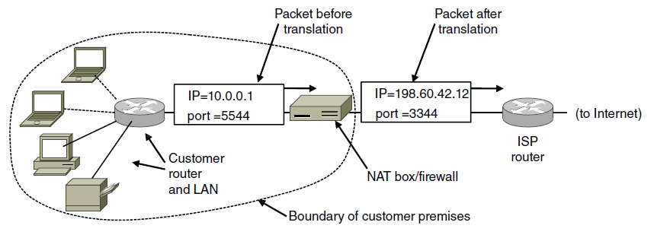
IP Addresses NAT
Placement and operation of a NAT box.

Slide 126
IP Addresses NAT—Network Address Translation
When an outgoing packet enters the NAT box, the 10.x.y.z source address is replaced by the customer’s true IP address. The TCP source port field is replaced by an index into the NAT box’s 65,536-entry translation table.
The table entry contains the original IP address and the original source port.
When a packet arrives at the NAT box from the ISP, the source port in the TCP header is extracted and used as an index into the NAT box’s mapping table.
Locate the internal IP address and original TCP source port.
Pass the packet to the customer router using the 10.x.y.z address.

Slide 127
IP Version 6 Goals
Support billions of hosts
Reduce routing table size
Simplify protocol
Better security
Attention to type of service
Aid multicasting
Roaming host without changing address
Allow future protocol evolution
Permit coexistence of old, new protocols. . .

Slide 128
IP Version 6 The Main Header
Version field. Always 6 bit.
Differentiated services field. Same as IPv4.
Flow label field. Mark a group of packets for a source and destination with the same requirements. The flow is set up in advance and given an identifier.
When a packet with a nonzero Flow label shows up, all routers can look it up in internal tables to see what kind of special treatment it requires.
Each flow for QoS purposes is designated by the source address, destination address and flow number.
Payload length filed. The total length excluding the header.

Slide 129
IP Version 6 The Main Header
Next header field. There can be additional (optional) extension headers.
Tells which of the 6 extension headers, if any, follows this one.
If this is the last IP header, tells which transport protocol (e.g., TCP, UDP) to pass the packet to.
Hop limit field. Same as TtL in IPv4.
Source address and Destination address field.
The 16-byte address is written as 8 groups of 4 hexadecimal digits with colons, e.g., 8000:0000:0000:0000:0123:4567:89AB:CDEF.
Leading 0s within a group can be omitted. Groups of 0s can be replaced by a pair of colons, e.g., 8000::123:4567:89AB:CDEF.
IPv4 addresses is written as ::192.31.20.46

Slide 130
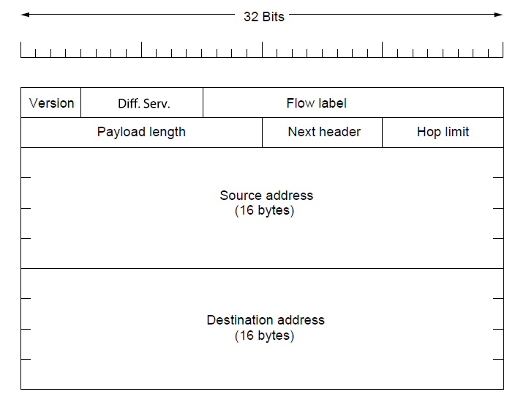
IP Version 6 The Main Header
The IPv6 fixed header (required).

Slide 131
IP Version 6 The Main Header
IPv6 vs IPv4:
No IHL field since IPv6 header has a fixed length.
The Protocol field is replaced by Next header field.
No fragmentation-related fields since IPv6 uses the path MTU discovery procedure without fragmentation.
No Checksum field. Data link layer and transport layers normally have their own checksums.

Slide 132
Internet Control Protocols ICMP
In addition to IP, the Internet has several companion control protocols in the network layer.
ICMP – the Internet Control Message Protocol.
When something unexpected occurs, the event is reported to the sender by the ICMP.
Also used to test the Internet.
Carried encapsulated in an IP packet.
A dozen types of ICMP messages are defined.
Destination Unreachable message.
The router cannot locate the destination or when a packet with the DF bit cannot be delivered due to large packet size.

Slide 133
Internet Control Protocols ICMP
Time Exceeded message.
A packet is dropped because its TtL counter hits 0.
Parameter Problem message.
An illegal value detected in a header field. A bug in the sending host’s IP software.
Source Quench message.
Throttle a fast hosts.
Redirect message.
A packet is routed incorrectly. The sending host is informed to update to a better route.

Slide 134
Internet Control Protocols ICMP
Echo and Echo Reply messages.
The hosts send Echo to see if a given destination is reachable. The destination sends back an Echo Reply message.
Timestamp Request and Timestamp Reply messages.
Record the arrival time of the message and the departure time of the reply.
Used to measure network performance.
Router Advertisement and Router Solicitation messages.
Let hosts find nearby routers.
A host needs to learn the IP address of at least one router to send packets off the local network.

Slide 135
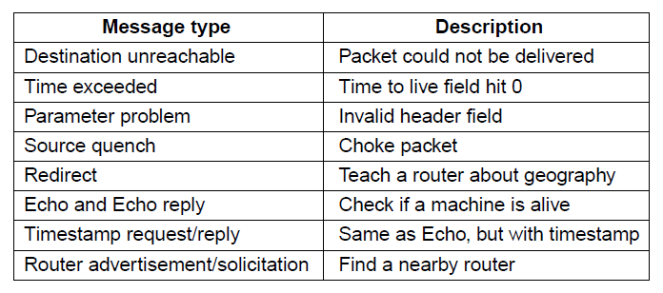
Internet Control Protocols ICMP
The principal ICMP message types.

Slide 136
Internet Control Protocols ARP
ARP—The Address Resolution Protocol
IP address is not enough for sending packets. Data link layer devices do not understand IP addresses. We need to map IP addresses onto data link layer addresses.
Example. In the following figure, a university with two /24 networks. The CS network is a switched Ethernet with prefix 192.32.65.0/24. The EE network is switched Ethernet with prefix 192.32.63.0/24. Each machine has a unique Ethernet address E1~E6, and a unique IP address.

Slide 137
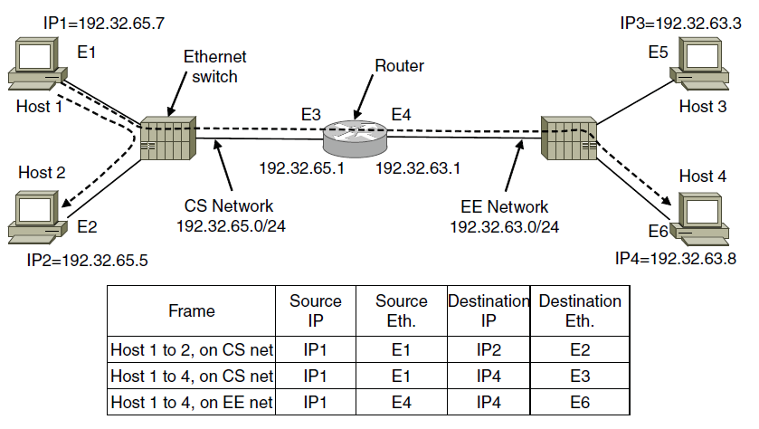
Internet Control Protocols ARP
Two switched Ethernet LANs joined by a router

Slide 138
Internet Control Protocols ARP
How does host 1 send a packet to host 2?
Assume that host 1 knows the name of host 2, e.g., eagle.cs.uni.edu.
Step 1: get the IP address of host 2. Performed by DNS. Introduced later.
Step 2: after DNS returns the IP address, host 1 sees that host 2 is on the same network. To find the Ethernet address to send the frame, host 1 broadcasts a packet asking who owns IP address 192.32.65.5.
Step 3: the broadcast arrives at every machine on the CS Ethernet. Host 2 will respond with its Ethernet address.
This ask and answer protocol is ARP.

Slide 139
Internet Control Protocols ARP
Optimization of ARP.
Host 1 will cache the reply of ARP from host 2. Next time host 1 will find the mapping in its caching.
Host 1 includes its IP-to-Ethernet mapping in the ARP broadcast. Every hosts receiving this message can cache the mapping.
Host 1 may move to a new network, and configure to use a new IP address. It can broadcast its mapping when it is configured. Every hosts receiving this message can update their cache.

Slide 140
Internet Control Protocols ARP
How does host 1 send a packet to host 4?
Step 1: Host 1 learns that host 4 is not on the CS network from the IP address.
Step 2: Host 1 sends all off-network traffic to the router. Host 1 needs to know the Ethernet address of the router, e.g., by ARP broadcast for 198.31.65.1.
Step 3: the router knows that host 4 is on the EE network. If the router does not know the Ethernet address of host 4, it will use ARP again.
The Ethernet addresses change with the frame on each network while the IP addresses remain constant.

Slide 141
Internet Control Protocols DHCP
DHCP – The Dynamic Host Configuration Protocol
To configure computers with their IP addresses.
With DHCP, every network must have a DHCP server.
When a computer is started, it has a built-in Ethernet or other link layer address but no IP address.
The computer broadcasts a DHCP DISCOVER packet.
The DHCP receives the request and allocates a free IP address that is sent to the host in a DHCP OFFER packet. The server can identify a host using its Ethernet address.

Slide 142
Internet Control Protocols DHCP
Computers may leave the network without returning the IP address to the DHCP server.
The DHCP server leases the IP addresses to hosts for a fixed period of time.
Before the lease expires, the host must ask for a DHCP renewal, otherwise, the host can no longer use the IP address it was given earlier.

Slide 143
Label Switching and MPLS
Besides IP, MPLS (MultiProtocol Label Switching) is another important network layer protocol.
MPLS adds a label in front of each packet, and forwarding is based on the label rather than on the destination address.
The label is an index into an internal table to find the output line.
On a router-to-router line using PPP as the framing protocol, the frame format includes the PPP, MPLS, IP and TCP headers.

Slide 144
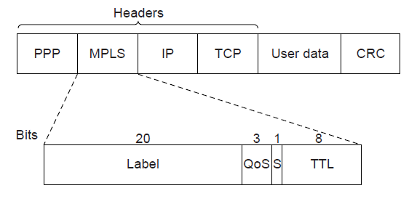
Label Switching and MPLS
Transmitting a TCP segment using IP, MPLS, and PPP.

Slide 145
Label Switching and MPLS
MPLS header is 4 bytes long and has 4 fields.
Label field. The index
QoS field. The class of service.
S field, related to stacking multiple labels.
TtL field, Time to Live.
MPLS falls between the IP network layer protocol and the PPP link layer protocol. A layer 2.5 protocol.
Since most hosts and routers do not understand MPLS, the labels are attached to packets when an IP packet reaches the edge of an MPLS network.

Slide 146
Label Switching and MPLS
The LER (Label Edge Router) inspects the destination IP address and other fields to see which MPLS path the packet should follow, and puts the right label on the front of the packet.
Within the MPLS network, this label is used to forward the packet.
At the other edge of the MPLS network, the label is removed to reveal the IP packet for the next network.
Routers may group multiple flows that end at a particular router or LAN and use a single label for them. These flows are called FEC (Forwarding Equivalence Class)

Slide 147
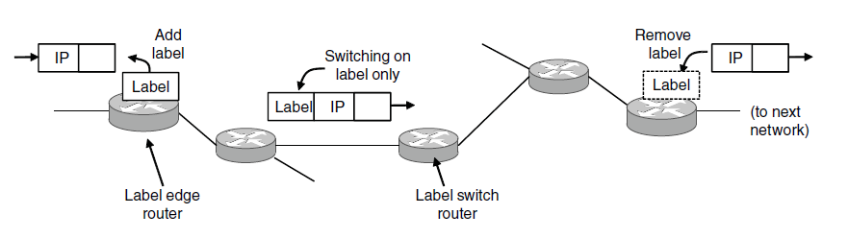
Label Switching and MPLS
Forwarding an IP packet through an MPLS network

Slide 148
Label Switching and MPLS
MPLS can add more than one label to the front of a packet.
A stack of labels.
The outermost label guides the packets along the path. It is removed at the end of the path, and the labels revealed, if any, are used to forward the packet further.
The S field allows a router removing a label to know if there are any additional labels left.

Slide 149
OSPF– An Interior Gateway Routing Protocol
The Internet is made up of a large number of ASes (Autonomous Systems) that are operated by different organizations.
Inside its own network, the organization can use its own algorithm for internal routing, called intradomain routing, or interior gateway protocol.
OSPF is widely used intradomain routing protocol.
It is drew on a similar protocol called IS-IS (Intermediate-System to Intermediate-System)
Example. In the following figure, an AS network.
OSPF abstracts the actual networks, routers and links into a directed graph in which each arc has a weight (distance, delay, etc)
A pair of arcs between two routers.

Slide 150
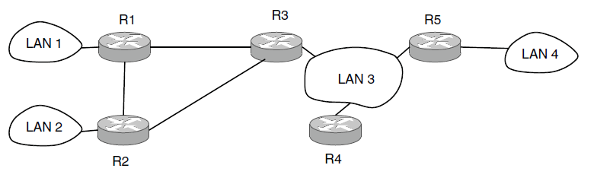
OSPF—An Interior Gateway Routing Protocol
An autonomous system

Slide 151

OSPF—An Interior Gateway Routing Protocol
A graph representation of the previous slide.

Slide 152
OSPF– An Interior Gateway Routing Protocol
Based on the graph representation of the network, OSPF uses the link state method to have every router computer the shortest path to all other nodes.
Multiple paths may be found that are equally short. OSPF will split traffic across them when forwarding, called ECMP (Equal Cost MultiPath).
An AS can be divided into numbered areas.
Every AS has a backbone area, called area 0. The routers in this area are called backbone routers.
All areas are connected to the backbone, so it is possible to go from any area in the AS to any other area in the AS via the backbone.

Slide 153
OSPF– An Interior Gateway Routing Protocol
Internal routers: lie wholly within an area.
Area border router: connected to two or more areas.
Summarize the destinations in one area and inject this summary into the other areas to which it is connected. Only pass the cost information, but not the detailed topology. Other routers can select the best area border router.
AS boundary router: injects routes to external destinations on other ASes into the area.

Slide 154

OSPF—An Interior Gateway Routing Protocol
The relation between ASes, backbones, and areas in OSPF.

Slide 155
OSPF– An Interior Gateway Routing Protocol
Each router within an area has the same link state database and runs the same shortest path algorithm.
For a source and destination in the same area, the best intra-area router is chosen.
For a source and destination in different areas, the inter-area router must go from the source to the backbone, across the backbone to the destination area, and then to the destination.

Slide 156
OSPF– An Interior Gateway Routing Protocol
When a router boots, it sends HELLO messages on all of its lines. From the responses, the router learns who its neighbors are. Routers on the same LAN are all neighbors.
OSPF exchanges information between adjacent routers, not neighbor routers.
A router is elected as the designated router, and is said to be adjacent to all other routers on its LAN, and exchange information with them.
Non-adjacent routers do not exchange information.
Routers periodically flood LINK STATE UPDATE messages to each of its adjacent routers.

Slide 157
OSPF– An Interior Gateway Routing Protocol
DATABASE DESCRIPTION messages give the sequence number of all link state entries currently held by the sender.
The receivers can determine who has the most recent values.
A router can request link state information from the other one by LINK STATE REQUEST messages.
Each pair of adjacent routers checks to see who has the most recent data.
Backbone routers accept information from the area border routers to compute the best route to every other router. With these routes, internal routers can select the best route to a destination outside their area.

Slide 158

OSPF—An Interior Gateway Routing Protocol
The five types of OSPF messages

Slide 159
BGP—The Exterior Gateway Routing Protocol
The goals of an intradomain protocol and an interdomain protocol are not the same.
Examples of routing constraints:
No commercial traffic for educat. network
Never put Iraq on route starting at Pentagon
Choose cheaper network
Choose better performing network
Don’t go from Apple to Google to Apple

Slide 160
BGP– The Exterior Gateway Routing Protocol
A routing policy is implemented by deciding what traffic can flow over which of the links between ASes.
Policy 1: transit service. a customer ISP pays another provider ISP to deliver packets to and receive packets from any other destination.
The customer ISP is said to buy transit service from the provider ISP.
The provider will advertise routes to all destinations on the Internet to the customer over the link that connects them, so that the customer has a router to send packets.
The customer will advertise routes only to the destinations on its network to the provider, so that the provider can send traffic to the customer only for those addresses.

Slide 161
BGP– The Exterior Gateway Routing Protocol
Example. Four ASes that are connected. AS2, AS3, AS4 are customers of AS1.
AS4 advertises C as a destination to its transit provider AS1, to let sources reach C via AS1. AS1 advertises a router C to its other customers, including AS2, to let the customers know that they can send traffic to C via AS1.
When source A sends to destination C, the packets travel from AS2 to AS1 and finally to AS4.

Slide 162

BGP—The Exterior Gateway Routing Protocol
Routing policies between four Autonomous Systems

Slide 163
BGP– The Exterior Gateway Routing Protocol
Policy 2: peering. Suppose AS2 and AS3 exchange a lot of traffic. Instead of paying each other, they can use a different policy: send traffic directly to each other for free.
Two ASes send routing advertisement to each other for the addresses that reside in their networks.
Peering is not transitive. E.g., AS3 and AS4 also peer with each other, which allows traffic from C for B to be sent directly to AS3.
Suppose C wants to send a packet to A.
AS3 only advertising a route to B to AS4. it is not advertising a route to A. Thus the traffic will not pass from AS4 to AS3 to AS2, even though a physical path exists.
Instead, AS4 gets transit service from AS1. Thus, AS1 will carry the packet from C to A.

Slide 164
BGP– The Exterior Gateway Routing Protocol
How do routers running BGP advertise routes across ASes?
BGP is a form of distance vector protocol, but it is quite unlike intradomain distance vector protocols.
BGP routers keep track of the path used, called a path vector protocol.
The path consists of the next hop router and the sequence of ASes.
Example. In the following figure. 3 ASes and AS2 provides transit to AS1 and AS3.
A route advertisement to C starts in AS3. When it is propagated to R2c, it has the AS path of simply AS3 and the next hop router of R3a.
The path inside AS3 is hidden as AS may not want to reveal its internal metrics.

Slide 165
BGP– The Exterior Gateway Routing Protocol
How do routers running BGP advertise routes inside one ASes?
May use intradomain protocol.
But BGP has another protocol called iBGP (internal BGP). The regular use of BGP is called eBGP (external BGP)
The rule is that every router at the boundary of the AS learns of all the routes seen by all the other boundary routers.
Example. Router R2b will know that it can reach C via either router R2c or R2d.
The leftmost routes show the next hop points to a router in the same AS but not a router in the next AS.

Slide 166
BGP– The Exterior Gateway Routing Protocol
How do routers choose which route to use?
Unlike intradomain protocols, interdomain protocols depend more on policies by the AS.
Some common strategies:
1. routes via peered networks are preferred to transit providers. The former is free. The customer routes are given higher preference than peering routes. The former pays money.
2. shorter AS paths are better. However, an AS could be a network of any size. The routes inside another AS is unknown. A path through one big AS may be longer than 3 small AS.
3. the route with a lower cost within the AS is more preferred. E.g., packets from A to C exit AS1 at R1a as the interdomain route is shorter.

Slide 167

BGP—The Exterior Gateway Routing Protocol
Propagation of BGP route advertisements

Slide 168
End
Chapter 5

