Slide 1
Introduction
Chapter 1

Slide 2
Reference Models
OSI reference model
TCP/IP reference model
Model in this course
Comparison of OSI and TCP/IP
Critique of OSI model and protocols
Critique of TCP/IP model

Slide 3
OSI Reference Model
Open Systems Interconnection (OSI) reference model
Developed by the International Standards Organization (ISO)

Slide 4
The OSI Reference Model
Principles for the seven layers
Layers created for different abstractions
Each layer performs well-defined function
Function of layer chosen with definition of international standard protocols in mind
Minimize information flow across interfaces between boundaries
Number of layers optimum

Slide 5
OSI Reference Model
Open Systems Interconnection (OSI) reference model
Developed by the International Standards Organization (ISO)

Slide 6
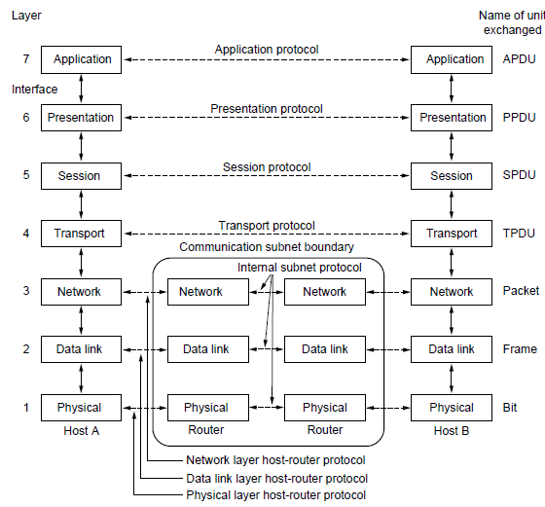
The OSI Reference Model
The OSI reference model

Slide 7
OSI Reference Model Layers
Physical layer
Data link layer
Network layer
Transport layer
Session layer
Presentation layer
Application layer

Slide 8
The OSI Reference Model
The Physical Layer
Transmit raw bits over a communication channel
Make sure when one side send a 1 bit it is received by the other side as a 1 bit not as a 0 bit
What electrical signals should be used to represent a 1 and a 0
How many nanoseconds a bit lasts
How the initial connection is established
How the connection is broken

Slide 9
The OSI Reference Model
The Data Link Layer
Transform a raw transmission into a line that appears free of undetected transmission errors
Have the sender break the input data into data frames (~100 or ~1,000 bytes)
Transmit the frames sequentially
Have the receive confirm the receipt of each frame by sending back an acknowledgement frame
Flow control: keep a fast sender from drowning a slower receiver
Medium access control sublayer: control access to the shared channel in broadcast networks

Slide 10
The OSI Reference Model
The Network Layer
Control the operation of the subnet
Routing problem: how packets are routed from source to destination
Routing table: initially build and dynamically updated
Congestion control: too many packets in the subnet
QoS issues: delay, transmit time, jitter
Interconnect heterogeneous networks: different addressing, different protocols

Slide 11
The OSI Reference Model
The Transport Layer
Accept data from above it, split it up into smaller units if need be, pass them to the network layer, and ensure the pieces all arrive correctly at the other end
Determine what type of service to provide to the session layer, e.g.,
Error-free point-to-point channel that delivers messages in order
Transport isolated messages with no guarantee about the order of delivery
Broadcast messages to multiple destinations

Slide 12
The OSI Reference Model
The Transport Layer
An end-to-end layer
Carries data from the source to the destination
A program on the source machine communicates with a similar program on the destination machine using the message headers and control messages
Layer 1~3: chained
The protocol is between a machine and its immediate neighbors, not between the ultimate source and destination machines
Layer 4 and above: end-to-end

Slide 13
The OSI Reference Model
The Session Layer
Allows users on different machines to establish sessions between them. Sessions offer
Dialog control (keep track of whose turn it is to transmit)
Token management (prevent two parties from attempting the same critical operations simultaneously)
Synchronization (allow transmissions to resume from the checkpoint after a crash)

Slide 14
The OSI Reference Model
The Presentation Layer
Consider the syntax and semantics of the information transmitted
Define data structures that allow computers with different internal data representations to communicate
The presentation layer manages these abstract data structures and allows higher-level data structures (e.g., banking records) to be defined and exchanged

Slide 15
The OSI Reference Model
The Application Layer
Protocols used by users, e.g.,
HTTP (HyperText Transfer Protocol), bases for World Wide Web
File transfer
Email
Network news

Slide 16
The TCP/IP Reference Model Layers
Link layer
Internet layer
Transport layer
Application layer
Computer Networks, Fifth Edition by Andrew Tanenbaum and David Wetherall, © Pearson Education-Prentice Hall, 2011

Slide 17
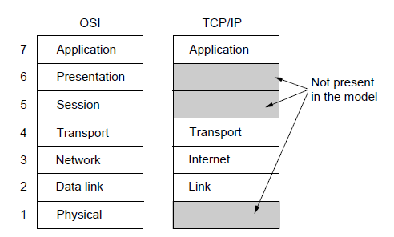
The TCP/IP Reference Model
The TCP/IP reference model

Slide 18
The TCP/IP Reference Model
The Link Layer
A connectionless layer that supports a packet-switching network across different networks
Describes what links (e.g., serial lines, Ethernet) must do to meet the need of this connectionless layer
Not really a layer but rather an interface between hosts and transmission links

Slide 19
The TCP/IP Reference Model
The Internet Layer
Allow hosts to inject packets into the network and have them arrive independently at the destination
The packets may arrive out of order; the higher layers are responsible for rearranging them if in-order delivery is desired
Like the mail system. The user sends many international letters to a foreign country, most of which will reach the correct destination. The letters may travel along different paths and arrive in different orders. Each country (i.e. each network) has its own stamps but the delivery rules (protocol) is hidden from users

Slide 20
The TCP/IP Reference Model
The Internet Layer
IP (Internet protocol) and ICMP (internet Control Message Protocol)
Deliver IP packets
Packet routing
Congestion control

Slide 21
The TCP/IP Reference Model
The Transport Layer
Allow peers on the source and destination hosts to carry on a conversation like the transport layer of the OSI model
End-to-end
TCP (Transmission Control Protocol) vs UDP (User Datagram Protocol)
TCP
Reliable connection-oriented protocol
Sequencing: Segment byte stream into messages; pass them to the internet layer; reassemble them at the destination TCP process
Flow control: a fast sender does not drown a slow receiver

Slide 22
The TCP/IP Reference Model
The Internet Layer
UDP
Unreliable, connectionless protocol
For applications that values prompt delivery more than accurate delivery, e.g.,
  One-shot client-server type queries or real-time applications, e.g., video/audio streaming

Slide 23
The TCP/IP Reference Model
The Application Layer
No session or presentation layer; the session and representation functions included in the applications
Higher-level protocols, e.g.,
Virtual terminal, TELNET protocol
File transfer, FTP protocol
Email, SMTP protocol
Addressing, DNS protocol
Real-time media delivery, RTP

Slide 24
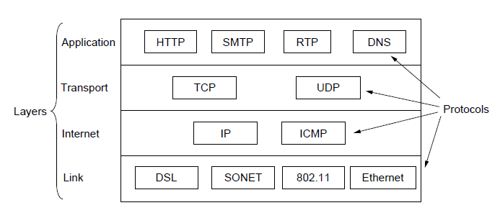
The TCP/IP Reference Model
The TCP/IP reference model with some protocols we will study

Slide 25
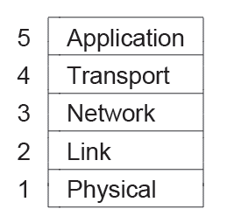
The Model Used in this Course
The reference model used in this course.

Slide 26
The Model in this Course
Combine the strength of the OSI reference model and the TCP/IP reference model
Physical layer: how to transmit bits across different media as electrical (or other analog) signals
Link layer: how to send finite-length messages between directly-connected machines (not end-to-end), e.g., Ethernet and 802.11
Network layer: how to combine multiple links into networks to send packets between the source and the destination (end-to-end), e.g., IP
Transport layer: strengthen the delivery guarantees of the network layer with increased reliability, e.g., TCP
Application layer: user programs

Slide 27
Comparison of the OSI and
TCP/IP Reference Models
Similarities
A stack of independent protocols
Similar functionalities of the layers, e.g., transport layer
But the two models have many differences

Slide 28
Comparison of the OSI and
TCP/IP Reference Models
Concepts central to OSI model
Services
Interfaces
Protocols

Slide 29
Comparison of the OSI and
TCP/IP Reference Models
The biggest contribution of the OSI model is to make the distinction between the three concepts explicit
Services
Each layer provides some services to the layer above it
Define what the layer should do, but not how to do it or how the above layer can access it
Interface
A layer’s interface defines how the layer above it can access it, e.g., parameters
Does not say how the layer works inside

Slide 30
Comparison of the OSI and
TCP/IP Reference Models
Protocols
Allow peer entities of the same layer to communicate to provide the services
Can be changed without affecting the higher layers

Slide 31
Comparison of the OSI and
TCP/IP Reference Models
The OSI reference model was devised before the corresponding protocols were invented
The TCP/IP reference model: the protocols came first, and the model was just a description of the existing protocols

Slide 32
Critique of the OSI Model
Bad timing.
Bad technology.
Bad implementations.
Bad politics.

Slide 33
OSI Model Bad Timing
A theory of standards: the apocalypse of the two elephants

Slide 34
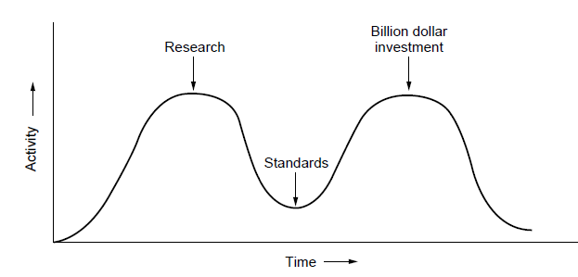
OSI Model Bad Timing
The apocalypse of the two elephants.

Slide 35
OSI Model Bad Timing
First elephant: after a subject is first discovered, research activities first spike then subside
Second elephant: corporations discover the subject and the billion-dollar wave of investment hits
The standards should be written in the trough in between the two elephants
Too early. Not well understand the subject
Too late. Too many companies already doing things differently
If the trough is too short, the standards may be crushed, i.e., OSI model

Slide 36
OSI Model Bad Technology/Implementations/Politics
Bad technology
Flawed designed: empty session and presentation layers; overfull network and data link layers
Inefficiency: some functions repeated in different layers
Bad implementation
Initial implementations are of poor quality
Bad politics
Developed by governments
Less involvement of researchers and programmers

Slide 37
Critique of the TCP/IP Model
Does not clearly distinguish the concepts of services, interfaces, and protocols; not much of a use for designing new networks using new technologies
Not general; cannot describe any protocol stack other than TCP/IP, e.g., Bluetooth
The link layer is not a layer but an interface
Does not distinguish the physical layer and the data link layer

Slide 38
Example Networks
Different kinds of computer networks have different goals, scales and technologies

Slide 39
Example Networks
Internet
ARPANET
NSFNET
Third-generation mobile phone networks
Wireless LANs: 802.11
RFID and sensor networks

Slide 40
The Internet
A vast collection of different networks that use certain common protocols and provide certain common services
Not planned by anyone; not controlled by anyone\
The brief history of the ARPANET
The public telephone network (connected by switching offices) is considered as vulnerable by the United States Department of Defense (DoD)
Paul Baran proposes a highly distributed and fault-tolerant design
A new research organization ARPA (Advanced Research Projects Agents) helped build the ARPANET

Slide 41
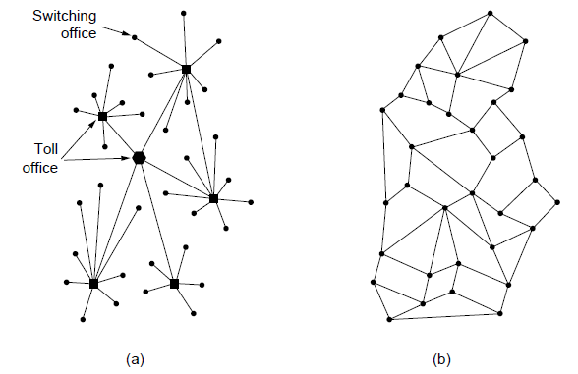
The ARPANET
Structure of the telephone system.
Baran’s proposed distributed switching system.

Slide 42
The ARPANET
Original design
Subnet consisting of IMPs (Interface Message Processers) and transmission lines
Each node of the network consists of an IMP and a host; the host send the messages to the IMP; the IMP breaks the messages into packets and forward them independently towards the destination

Slide 43
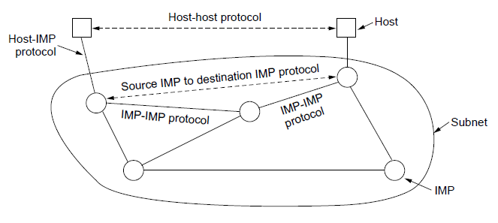
The ARPANET
The original ARPANET design

Slide 44
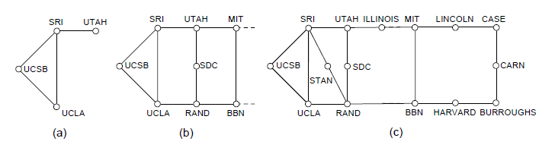
The ARPANET
Growth of the ARPANET.
December 1969.
July 1970.
March 1971.

Slide 45
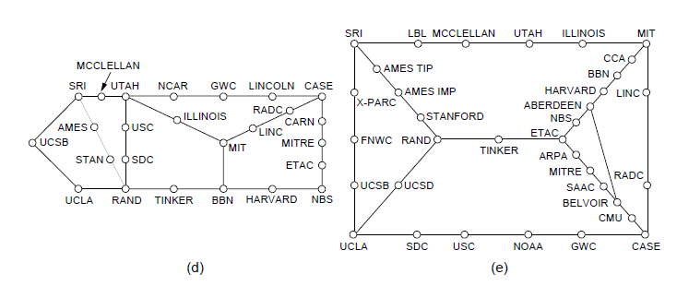
The ARPANET
Growth of the ARPANET.
April 1972.
September 1972.

Slide 46
NSFNET
NSF (The U.S. National Science Foundation) funded the NSFNET
A successor to the ARPANETS but open to all university research groups

Slide 47
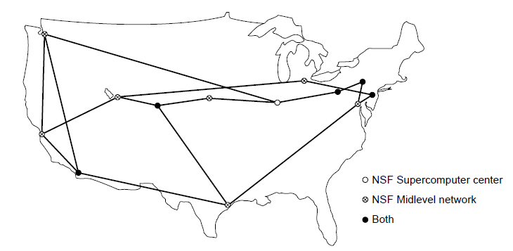
NSFNET
The NSFNET backbone in 1988.

Slide 48
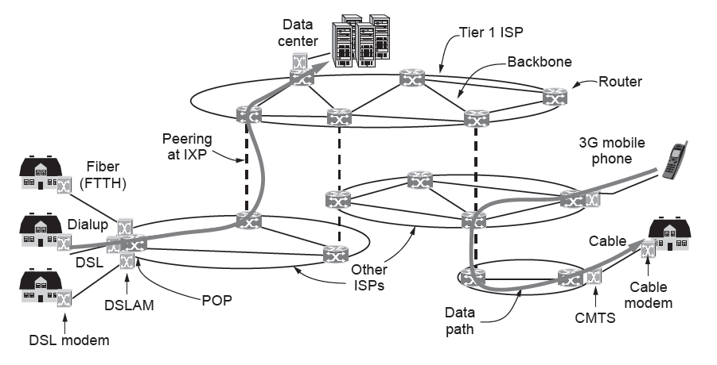
Architecture of the Internet
Overview of the Internet architecture

Slide 49
Architecture of the Internet
Start with a home computer
Purchase Internet access or connectivity from an Internet Service Provider (ISP) to exchange packets with other accessible hosts on the Internet
Many kinds of Internet access of different bandwidth and cost
  DSL uses the phone line; at the sender side, DSL modem converts between digital packets and analog signals; at the receiver side, DSLAM converts between signals and packets
  Dial-up also uses the phone line
  CMTS uses the cable TV system
  FTTH uses optical fiber
  Wireless, e.g., 4G

Slide 50
Architecture of the Internet
Packets moving between the home and the ISP
PoP (Point of Presence): the location at which customer packets enter the ISP network
Backbone network of the ISP: transmission links that interconnect routers at POPs of the ISP
If the packet is destined for a host served by the ISP, it will be routed over the backbone to the destination
Packets moving between ISPs
ISPs connect their networks to exchange traffic at IXPs (Internet eXchange Points)
IXPs forward packets from one ISP backbone to the other ISP backbone

Slide 51
Architecture of the Internet
Packets moving between ISPs
Different business relationship between ISPs
  A small ISP pays a larger ISP for connectivity to a remote user
  Large ISPs exchange traffic without paying
  Tier 1 ISP operates international backbone networks, e.g., AT&T
Data centers
Content providers, e.g., YouTube and Google, locate their servers in data centers
Colocation or hosting data centers allow customers to put servers at ISP POPs to quickly connect to the Internet

Slide 52
Third-Generation Mobile Phone Networks
1G: transmit voice calls as analog signals; AMPS (Advanced Mobile Phone System)
2G: transmit voice calls in digital forms; GSM (Global System for Mobile communications)
3G: digital voice and broadband digital data services; UMTS (Universal Mobile Telecommunications System)
Spectrum resource
Scarce and limited
Government license to mobile phone network operators through auction
Frequency reuse

Slide 53
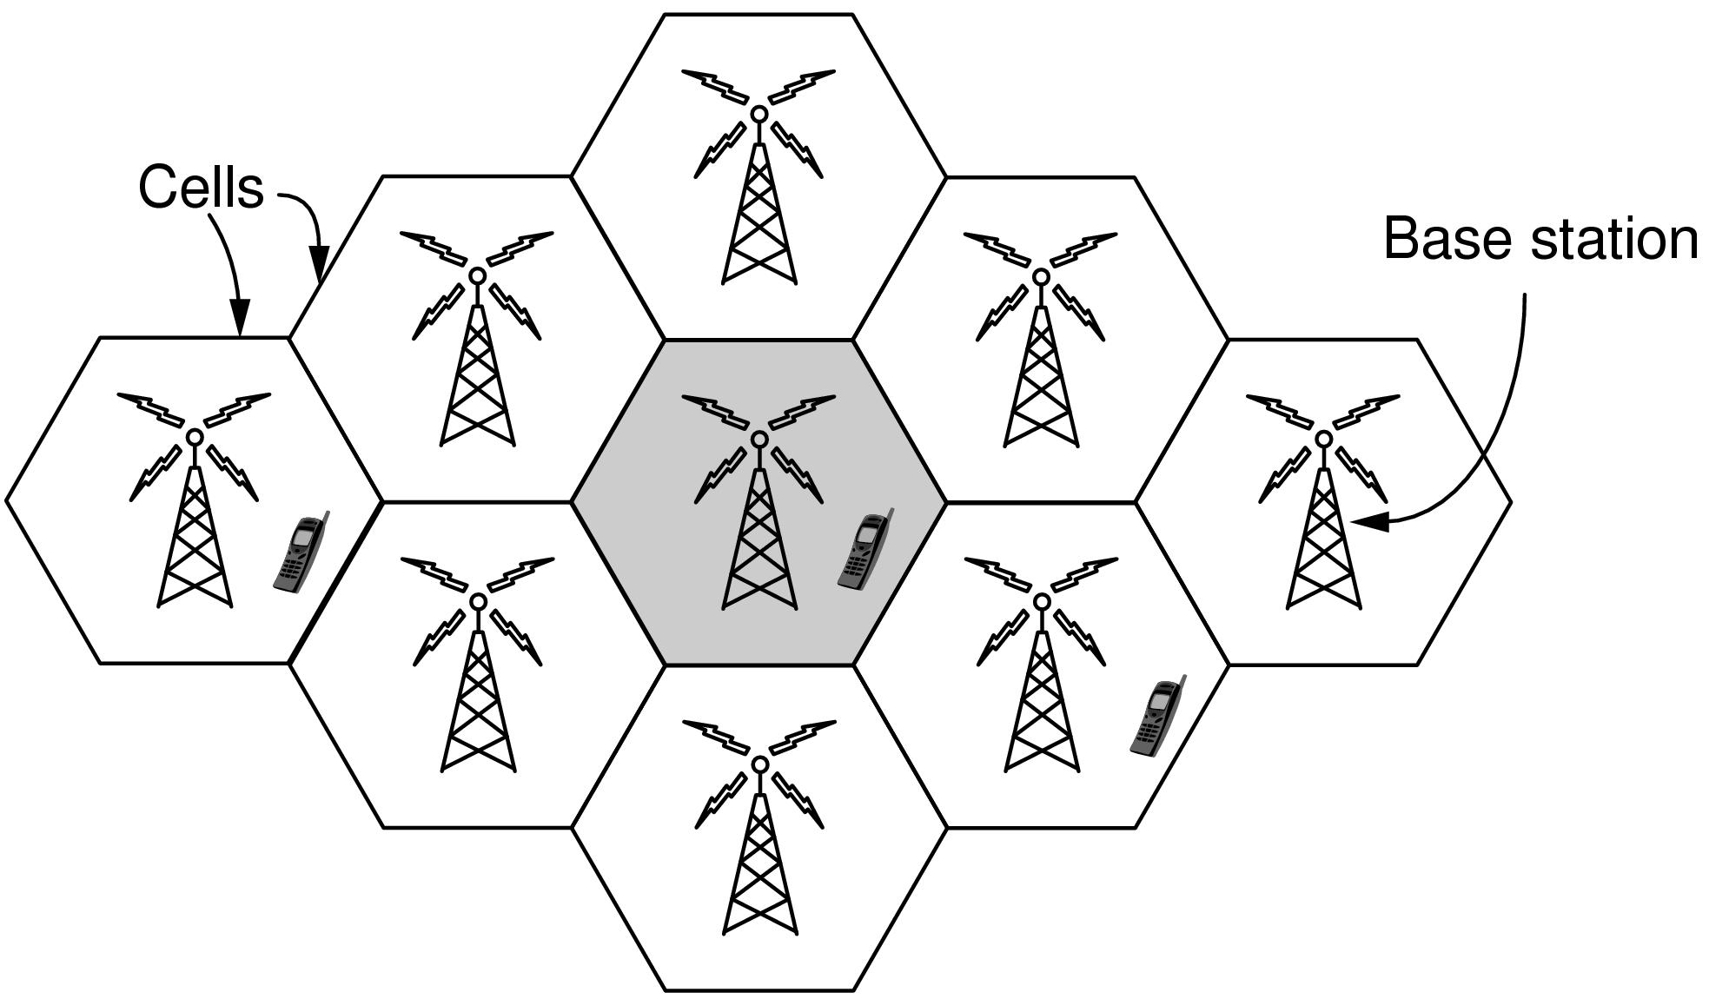
Third-Generation Mobile
Phone Networks
Cellular design of mobile phone networks

Slide 54
Third-Generation Mobile Phone Networks
Frequency reuse & cellular network
Signal strength fades along the transmission path so that faraway users can use the same frequency with tolerable interference
The coverage area is divided into cells; frequency reuse among cells

Slide 55
Third-Generation Mobile Phone Networks
Architecture of the mobile phone network
Air interface: radio communication protocol used over air between the mobile device and the cellular base station; use the CDMA (Code Division Multiple Access)
Radio access network: cellular base station (Node B) and its controller (RNC, Radio Network Controller)
Core network: carries the traffic for the radio access network
  Packet networks, i.e., connectionless subnets
  Circuit networks, i.e., connection-oriented subnets

Slide 56
Third-Generation Mobile Phone Networks
Packet networks, i.e., connectionless subnets
Every packet is routed independently
If one router goes down, alternative routes can be found
Packets may be lost at congested routers
Circuit networks, i.e., connection-oriented subnets
Establish a connection first between the source and the destination
If a line or switch goes down, the connection is aborted
Less fault tolerant
Support quality of service more easily; can reserve resources, e.g., bandwidth, switch buffer space, CPU, for the connection

Slide 57
Third-Generation Mobile Phone Networks
Architecture of the mobile phone network
Core network: supports both packet networks and circuit networks
Circuit networks
  Set up connections over PSTN (Public Switched Telephone Network) via MSC (Mobile Switching Center), GMSC (Gateway Mobile Switching Center) and MGW (Media Gateway)
Packet networks
  Access the Internet via SGSN (Serving GPRS Support Node) and GGSN (Gateway GPRS Support Node)

Slide 58
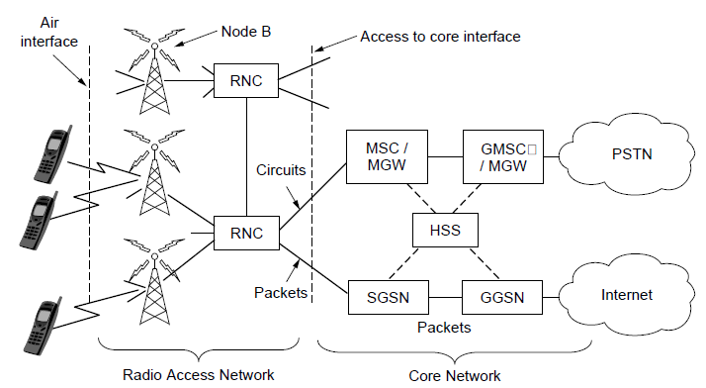
Third-Generation Mobile
Phone Networks
Architecture of the UMTS 3G mobile phone network.

Slide 59
Third-Generation Mobile Phone Networks
Mobility issue
When a user moves out of the range of one cellular base station and into the range of the other one
Handover or handoff: re-route the data from the old base station to the new one
  Hard handover: the mobile device disconnects from the old base station first, then connects to the new one
  Soft handover: the mobile device connects to the new base station first, then disconnects from the old one
HSS (Home Subscriber Server): find the location of each mobile user in the network

Slide 60
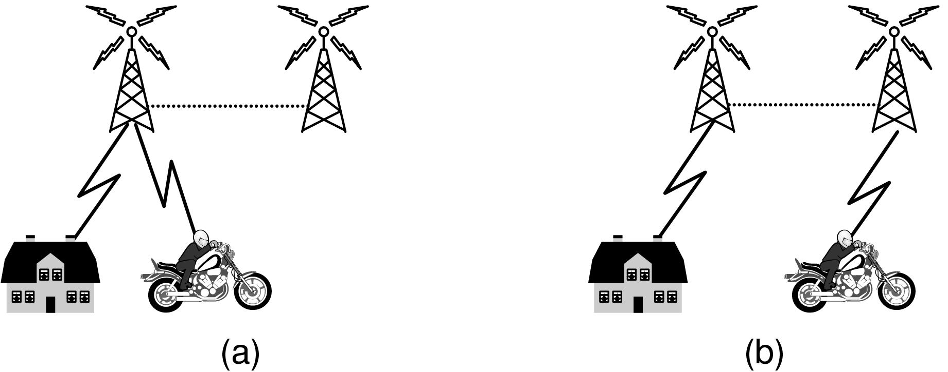
Third-Generation Mobile
Phone Networks (3)
Mobile phone handover (a) before, (b) after.

Slide 61
Third-Generation Mobile Phone Networks
Security issue
SIM card (Subscriber Identity Module): user authentication; also contains the cryptographic keys to encrypt transmissions

Slide 62
Wireless LANs: 802.11
ISM (Industrial, Scientific and Medical) bands defined by ITU-R, e.g., 902-928 MHz, 2.4-2.5 GHz, 5.725-5.825 GHz
Unlicensed, free
All devices can use, coexist, interference control
Compete with cordless mic, microwave oven
Mobile clients talk to the AP (Access Points); and APs connect to the wired network
Clients can talk directly within radio range, called ad hoc networks

Slide 63
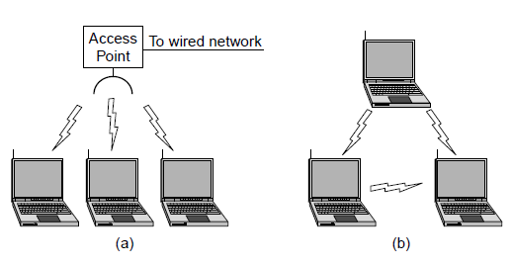
Wireless LANs: 802.11
Wireless network with an access point.
Ad hoc network.

Slide 64
Wireless LANs: 802.11
Multipath fading
radio signals reflected off solid objects so that multiple echoes of a transmission may reach the destination via different paths
these echoes can cancel or reinforce each other
Path diversity
Address multipath fading
E.g., use different frequencies across the allowed band, repeat bits over different period of time, follow different spatial paths between different pairs of antennas

Slide 65
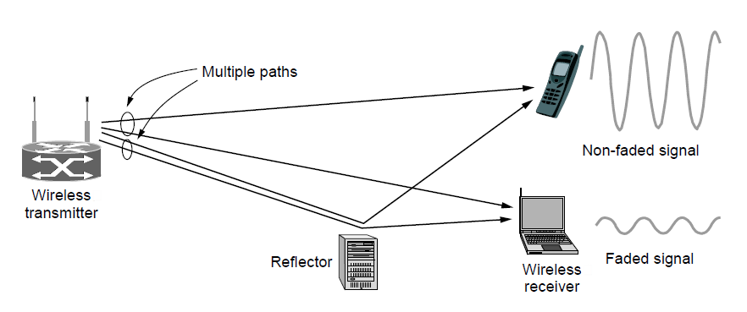
Wireless LANs: 802.11
Multipath fading

Slide 66
Wireless LANs: 802.11
Interference control
Multiple transmissions at the same time will collide
CSMA (Carrier Sense Multiple Access)
  1. Listen to the channel
    1.1 If busy, no transmission
    1.2 If clear, wait for a random short interval before transmitting
      1.2.1 If collision is detected, stop transmission; back off a random interval; return to 1
The hidden terminal problem due to limited transmission/sensing range
  C cannot hear A and starts transmitting; the transmissions of C and A collide

Slide 67
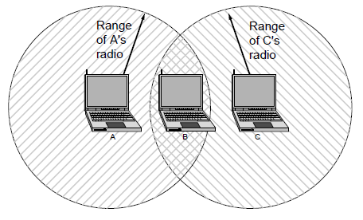
Wireless LANs: 802.11
The range of a single radio may not cover the entire system.

Slide 68
Wireless LANs: 802.11
Mobility issues
Move away from the range of an AP and into the range of a new one; handoff techniques
Less mobility issue compared with mobile phone network
Wireless LAN users are less mobile compared with cellular network users
Security issues
WPA (WiFi Protected Access) and WPA2, encryption schemes

Slide 69
RFID and Sensor Networks
Radio Frequency IDentification (RFID)
Tag
  Affixed to an object, e.g., a cow, a passport
  Consist of a microchip with a unique identifier and an antenna to receive radio signals
Reader
  Find tags when they come into range
  Inquiry tags for information
Applications: check identities, manage supply chain
Most RFID tags have no battery, but operate on the radio waves by RFID readers, i.e., passive RFID

Slide 70
RFID and Sensor Networks
Radio Frequency IDentification (RFID)
Tag
  Affixed to an object, e.g., a cow, a passport
  Consist of a microchip with a unique identifier and an antenna to receive radio signals
Reader
  Find tags when they come into range
  Inquiry tags for information
Applications: check identities, manage supply chain
Most RFID tags have no battery, but operate on the radio waves by RFID readers, i.e., passive RFID

Slide 71
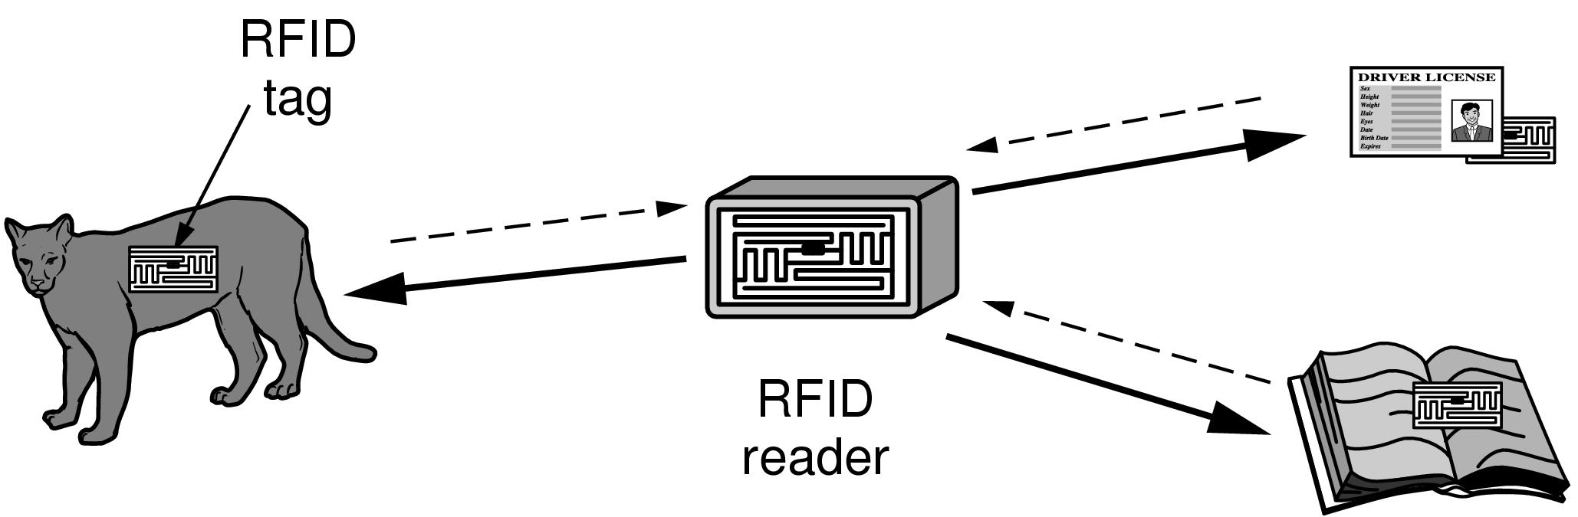
RFID and Sensor Networks
RFID used to network everyday objects.

Slide 72
RFID and Sensor Networks
Radio Frequency IDentification (RFID)
UHF RFID (Ultra-High Frequency): 902-928 MHz, several meters, shipping pallets and drivers licenses
HF RFID (High Frequency): 13.56 MHz, <1m, passport, credit cards, books, non-contact pay
LF RFID (Low Frequency): 120-150 kHz, several centimeters, animal tracking
Interference control
Several tags transmit to the sender simultaneously
Similar solution to WiFi
Security
Cannot run complicated cryptographic algorithms
Weak measures like password

Slide 73
RFID and Sensor Networks
Sensor Network
Deployed to monitor the physical world, e.g., bird habitats, volcanic activity, track perishable goods, pollution monitoring
Sensor nodes: small computers, e.g., temperature sensor, vibration sensor, light sensor
Often have batteries; sometimes can harvest energy from the environment, e.g., sun
Transmission via relay, i.e., a multihop network

Slide 74
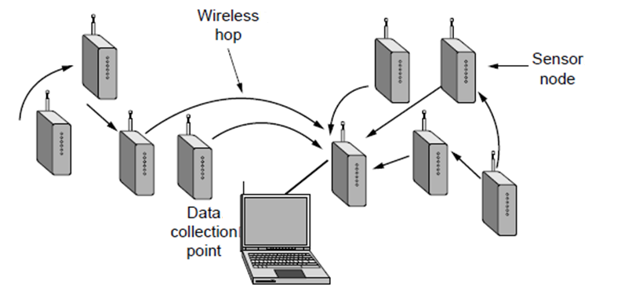
RFID and Sensor Networks (2)
Multihop topology of a sensor network

Slide 75
Network Standardization
Good standards allow different computers to communicate
Good standards also increase the market for products adhering to the standards, i.e., the network effect or economies of scales
Standards define what is needed for interoperability: no more, no less; leave the implementation choices to companies

Slide 76
Network Standardization
Who’s Who in telecommunications
Who’s Who in international standards
Who’s Who in internet standards

Slide 77
Network Standardization
Who’s Who in Telecommunications
ITU (International Telecommunication Union)
Standardize international telecommunications
About 200 governmental members, more than 700 sectors and associate members, including telephone companies (e.g., AT&T), telecom equipment manufacture (e.g., Huawei), computer vendors (e.g., Microsoft), chip manufacturers (e.g., Intel)

Slide 78
Network Standardization
Who’s Who in International Standards
ISO (International Standards Organization)
Members are national standards organizations
NIST (National Institute of Standards and Technology)
Part of the U.S. Department of Commerce
IEEE (Institute of Electrical and Electronics Engineers)
802 working groups

Slide 79
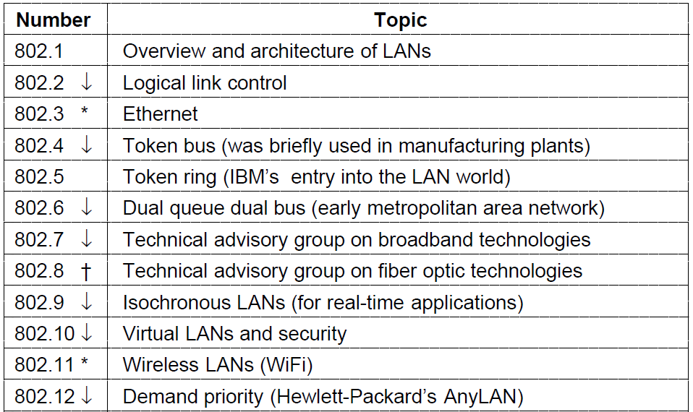
Who’s Who in International Standards
The 802 working groups. The important ones are marked with *.
The ones marked with ↓ are hibernating. The one marked with † gave up and disbanded itself.

Slide 80
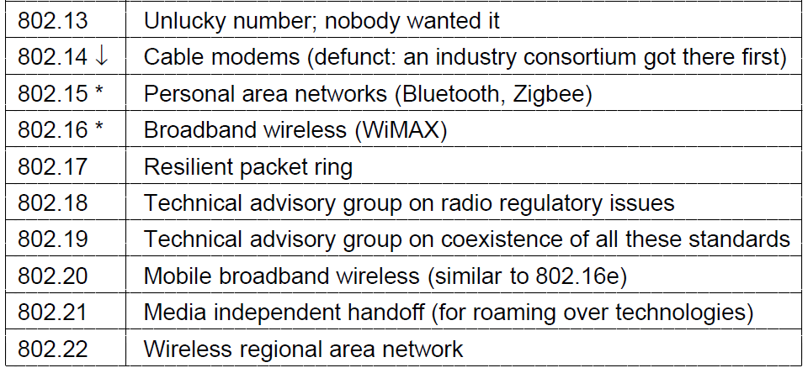
Who’s Who in International Standards
The 802 working groups. The important ones are marked with *.
The ones marked with ↓ are hibernating. The one marked with † gave up and disbanded itself.

Slide 81
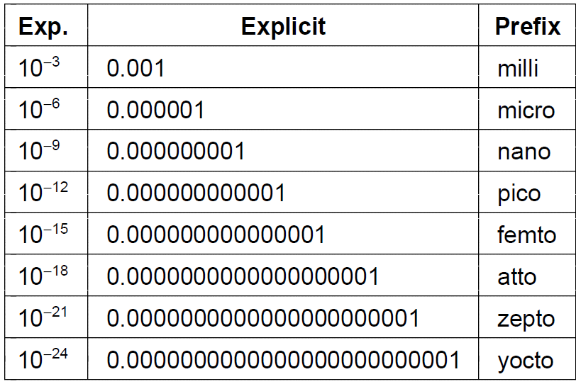
Metric Units
The principal metric prefixes

Slide 82
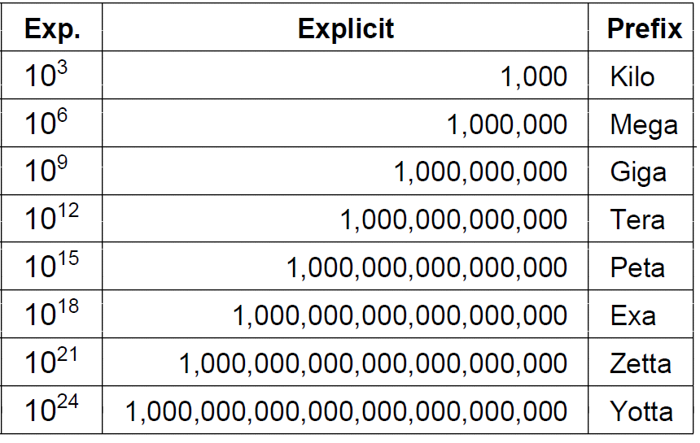
Metric Units
The principal metric prefixes

Slide 83
End
Chapter 1

