Slide 1
The Physical Layer
Chapter 2

Slide 2
Digital Modulation and Multiplexing
Wires and wireless channels carry analog signals such as continuously varying voltage, light intensity or sound intensity.
To send digital information, we must devise analog signals to represent bits.
Digital Modulation: the process of converting between bits and signals.

Slide 3
Digital Modulation and Multiplexing
Baseband transmission
Signal occupies frequencies from 0 up to a maximum
Common for wires
Passband transmission
Signal occupies a band frequencies around the frequency of the carrier signal
Common for wireless and optical channels.
Regulate the amplitude, phase or frequency of a carrier signal to convey bits
Multiplexing
Channels shared by multiple signals
Time, frequency, code division multiplexing

Slide 4
Digital Modulation and Multiplexing
Baseband Transmission
Passband Transmission
Frequency Division Multiplexing
Time Division Multiplexing
Code Division Multiplexing

Slide 5
Baseband Transmission
NRZ (Non-Return-to-Zero)
Use a positive voltage to represent a 1 and a negative voltage to represent a 0; use the presence of light to represent a 1 and the absence of light to represent a 0
At the receiving side, the receiver converts the signal into bits by sampling the signal at regular intervals of time
The received signal will be attenuated and distorted by the channel and the noise at the receiver
The receiver maps the signal samples to the closest symbols
A positive voltage is decoded as 1, and a negative voltage is decoded as 0

Slide 6
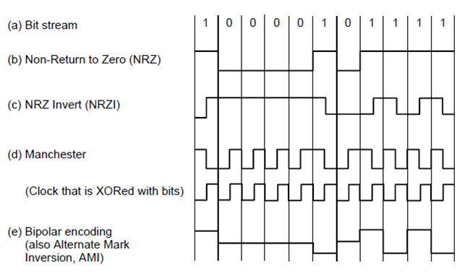
Baseband Transmission
Line codes: (a) Bits, (b) NRZ, (c) NRZI, (d) Manchester, (e) Bipolar or AMI.

Slide 7
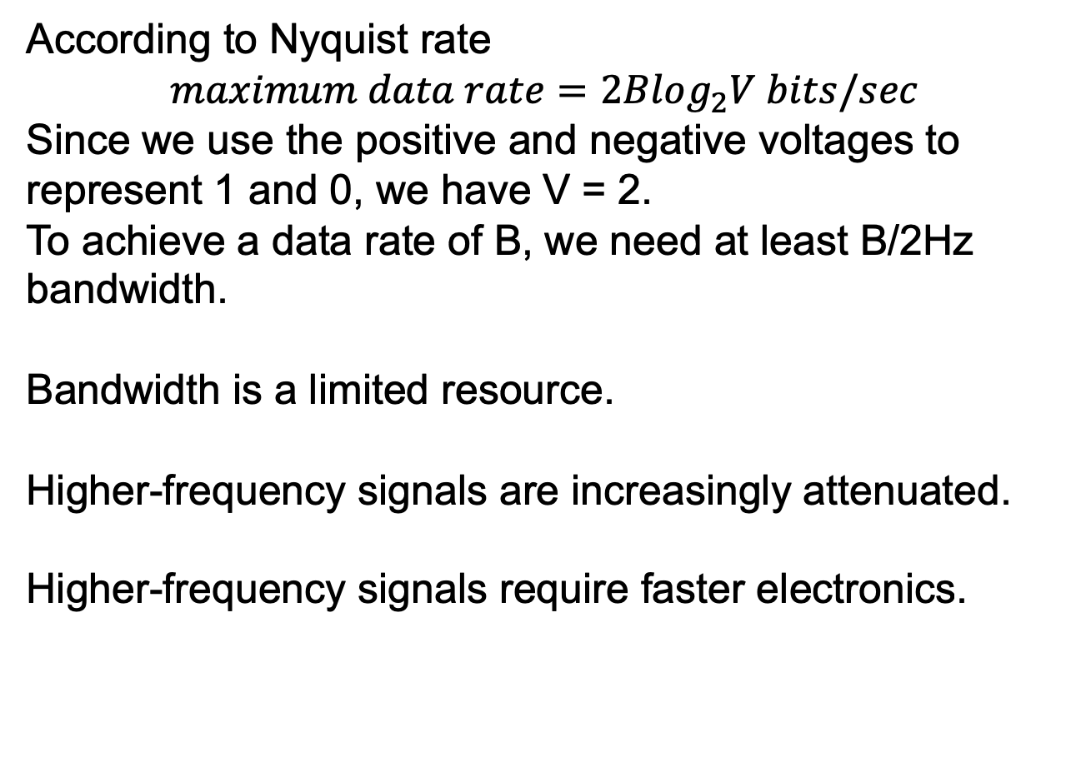
Baseband Transmission Bandwidth Efficiency
According to Nyquist rate
$$maximum data rate=2Blog_{2}V bits/sec$$
Since we use the positive and negative voltages to represent 1 and 0, we have V = 2.
To achieve a data rate of B, we need at least B/2Hz bandwidth.
Bandwidth is a limited resource.
Higher-frequency signals are increasingly attenuated.
Higher-frequency signals require faster electronics.

Slide 8
Baseband Transmission Bandwidth Efficiency
To improve bandwidth efficiency (use lower bandwidth to achieve a higher data rate), we can use more than two signaling levels.
For example, by using four voltage, we can send 2 bits at once as a single symbol.
The receiver should be able to distinguish the four levels
The rate at which the signal changes is half the bit rate, thus the needed bandwidth is reduced
Symbol rate/ baud rate: the rate at which the signal changes
Bit rate = symbol rate * bits per symbol

Slide 9
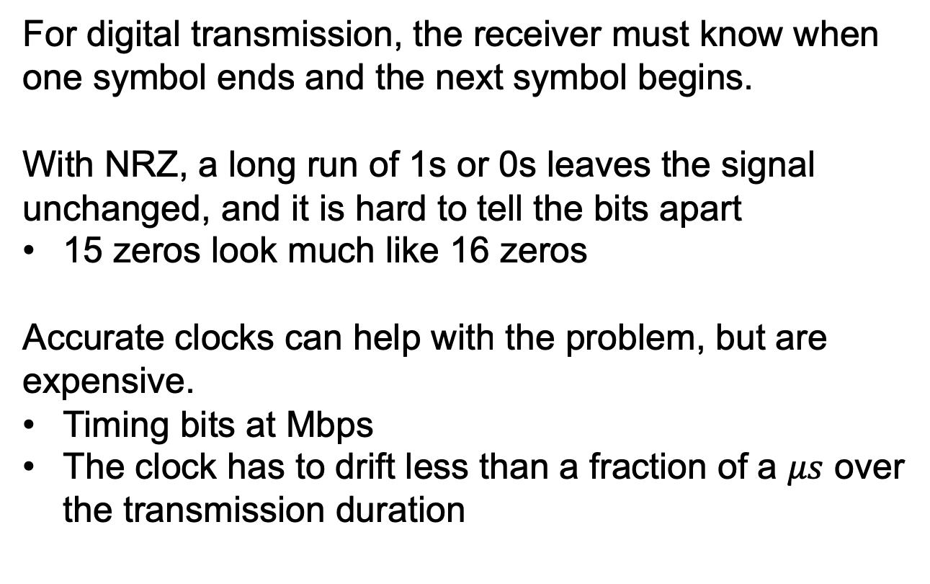
Baseband Transmission Clock Recovery
For digital transmission, the receiver must know when one symbol ends and the next symbol begins.
With NRZ, a long run of 1s or 0s leaves the signal unchanged, and it is hard to tell the bits apart
15 zeros look much like 16 zeros
Accurate clocks can help with the problem, but are expensive.
Timing bits at Mbps
The clock has to drift less than a fraction of a $μs$ over the transmission duration

Slide 10
Baseband Transmission Clock Recovery
Solution 1: send a separate clock signal to the receiver
Wasteful if we use a separate line to send the clock signal instead of the data
Manchester encoding:
A clever trick is to mix the clock signal with the data signal by XORing them
The clock makes a clock transition in every bit time, so it runs at twice the bit rate
Logical 1: a high-to-low transition
Logical 0: a low-to-high transition.
Used for classic Ethernet
The Manchester encoding requires twice as much bandwidth as NRZ because of the clock

Slide 11
Baseband Transmission
Line codes: (a) Bits, (b) NRZ, (c) NRZI, (d) Manchester, (e) Bipolar or AMI.

Slide 12
Baseband Transmission Clock Recovery
Solution 2: code the data to ensure that there are enough transition in the signal
NRZ has the clock recovery problems only for long runs of 0s and 1s; if there are frequent transitions, it will be easy for the receiver to stay synchronized with the incoming stream of symbols
Solution 2-1: NRZI (Non-Return-to-Zero Inverted)
Coding a 1 as a transition and a 0 as no transition
Used by the USB (Universal Serial Bus) standard for connecting computer peripherals
Long runs of 1s cause no problem but long runs of 0s still causes a problem

Slide 13
Baseband Transmission
Line codes: (a) Bits, (b) NRZ, (c) NRZI, (d) Manchester, (e) Bipolar or AMI.

Slide 14
Baseband Transmission Clock Recovery
Solution 2-2: mapping small groups of bits to be transmitted so that groups with successive 0s are mapped to slightly longer patterns that do not have too many consecutive 0s.
For example, 4B/5B coding:
Every 4 bits is mapped into a 5-bit pattern with a fixed transition table
The 5-bit patterns are chosen to avoid a run of more than 3 consecutive 0s.
25% overhead
16 input combinations and 32 output combinations; some unused output combinations are used for control signals, e.g., “11000” represents the start of a frame

Slide 15
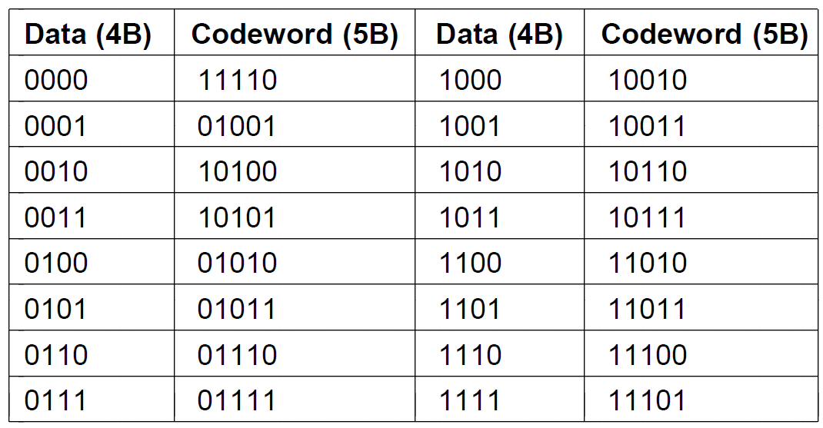
Baseband Transmission Clock Recovery
4B/5B mapping.

Slide 16
Baseband Transmission Clock Recovery
Solution 2-3: XORing the data with a pseudorandom sequence before it is transmitted
Scrambling: make the data look random; random data usually has frequent transitions
The receiver XORs the incoming bits with the same pseudorandom sequence to recover the real data
The pseudorandom sequence can be generated by a random number generator
Pros: No bandwidth or time overhead; random signals spread energy across frequencies to avoid electromagnetic radiation.
Cons: no guarantee there will be no long runs.
Killer packets: If the data is the same as the pseudorandom sequence, it will XOR to all 0s

Slide 17
Baseband Transmission Balanced Signals
Balanced signals: signals that have much positive voltage as negative voltage even over short period of time.
Average to 0; no DC electrical component;
Balanced signals are ideal because:
DC component is strongly attenuated by some channels, e.g., coax, and some channels only pass AC portion of a signal
Good for clock recovery since there is a mix of positive and negative signals
Receiver can average the signal as the decision threshold to decode 0s and 1s

Slide 18
Baseband Transmission Balanced Signals
Solution 1: bipolar encoding or AMI (Alternate Mark Inversion)
use two voltage levels to represent a logical 1 (+1 V and -1 V), and 0 V to represent a logical 0
To send a 1, the transmitter alternates between +1 V and -1 V
Add a voltage level to achieve balance

Slide 19
Baseband Transmission
Line codes: (a) Bits, (b) NRZ, (c) NRZI, (d) Manchester, (e) Bipolar or AMI.

Slide 20
Baseband Transmission Balanced Signals
Solution 2: 8B/10B
Maps 8 bits of input to 10 bits of output
80% efficient
The 8 bits are split into 5+3 bits; the first 5 bits are mapped to 6 bits; the last 3 bits are mapped to 4 bits
The input patterns are mapped to balanced output patterns, e.g., “001” is mapped to “1001”
Not enough balanced combinations
Some input patterns are mapped to 2 output patterns: one has an extra 1 and the other has an extra 0, e.g., “000” is mapped to “1011” and “0100”; The encoder remembers the total number of 0s or 1s by which the signal is out of balance, then selects between 2 output patterns to reduce disparity

Slide 21
Passband Transmission
The capacity of a channel depends on the bandwidth but not the absolute frequency values.
We can take a baseband signals from 0~B Hz and shift it up to a passband of S~S+B Hz before transmission, and shift it back to baseband at the receiver

Slide 22
Passband Transmission
We can modulate the amplitude, frequency, or phase of the carrier signal.
ASK (Amplitude Shift Keying), two different amplitudes are used to represent 0 and 1.
FSK (Frequency Shift Keying), two or more frequencies are used
PSK (Phase Shift Keying), the carrier wave is shifted by different degrees at each symbol
BPSK (Binary Phase Shift Keying), shift the signal for 0 or 180 degree to represent two symbols
QPSK (Quadrature Phase Shift Keying), shift the signal for 45, 135, 225 or 315 degrees to represent 4 symbols

Slide 23
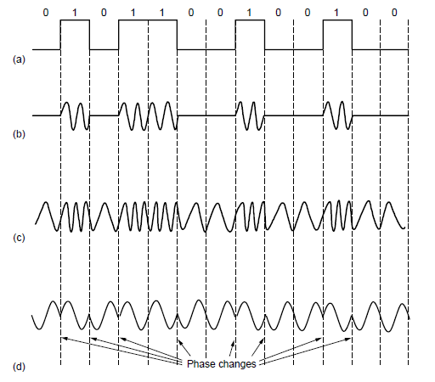
Passband Transmission
(a) A binary signal. (b) Amplitude shift keying. (c) Frequency shift keying. (d) Phase shift keying.

Slide 24
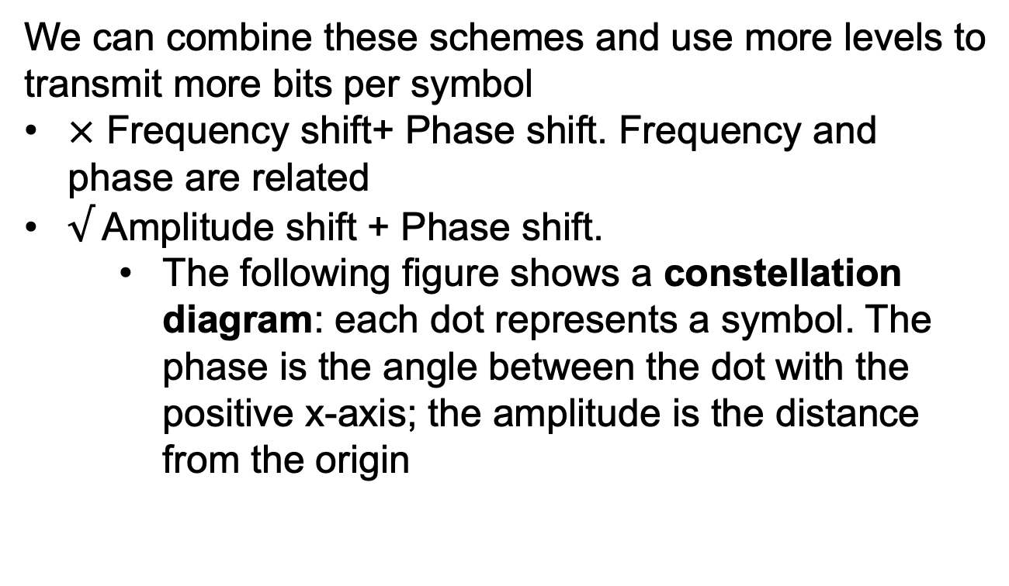
Passband Transmission
We can combine these schemes and use more levels to transmit more bits per symbol
$×$ Frequency shift+ Phase shift. Frequency and phase are related
$√$ Amplitude shift + Phase shift.
The following figure shows a constellation diagram: each dot represents a symbol. The phase is the angle between the dot with the positive x-axis; the amplitude is the distance from the origin

Slide 25
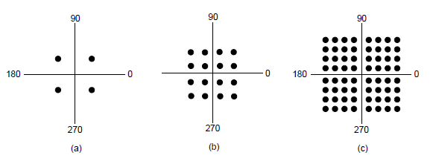
Passband Transmission
(a) QPSK. (b) QAM-16. (c) QAM-64.

Slide 26
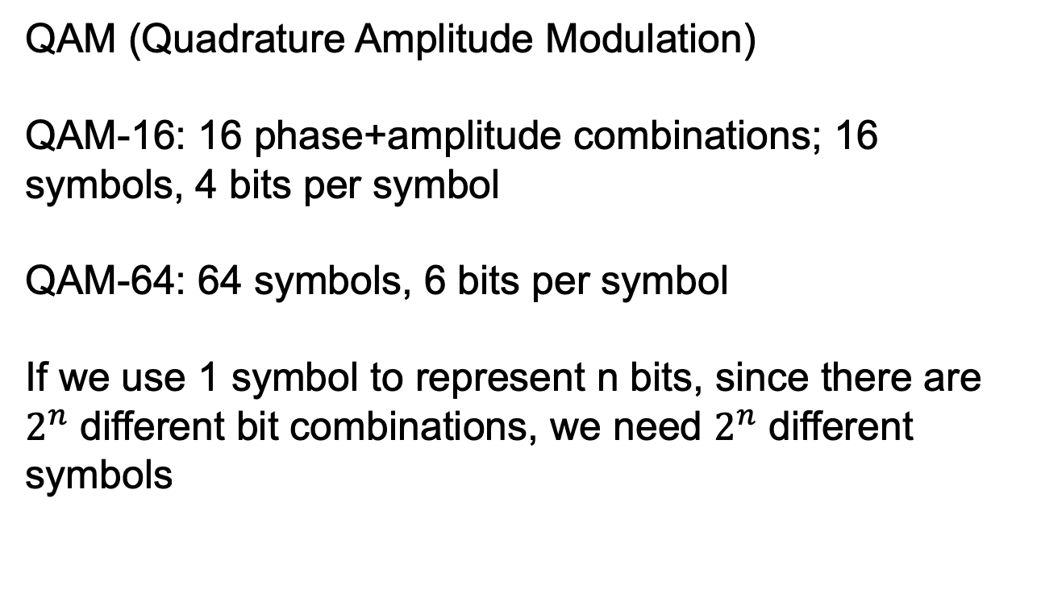
Passband Transmission
QAM (Quadrature Amplitude Modulation)
QAM-16: 16 phase+amplitude combinations; 16 symbols, 4 bits per symbol
QAM-64: 64 symbols, 6 bits per symbol
If we use 1 symbol to represent n bits, since there are $2^{n}$ different bit combinations, we need $2^{n}$ different symbols

Slide 27
Passband Transmission
How to assign bits to symbols?
Principle: minimize errors
Assigning consecutive bit values to adjacent symbols will lead to large errors, e.g., if one symbol stands for 0111 and the neighboring symbol stands for 1000, if the receiver mistakenly picks the adjacent symbol due to noise, all of the bits will be decoded as wrong
Gray code: map bits to symbols so that adjacent symbols differ in only 1 bit position.
The decoded symbol is usually close to the transmitted symbol
Cause only a single bit error in expectation

Slide 28
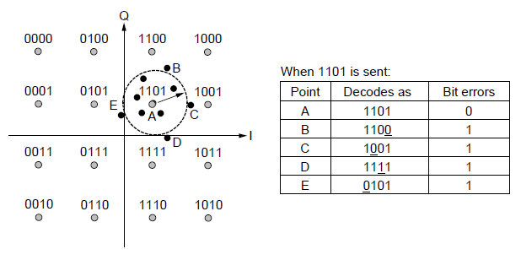
Passband Transmission
Gray-coded QAM-16.

Slide 29
Frequency Division Multiplexing
Passband/Baseband Transmission: convert bits into signals
Multiplexing: share a channel with multiple signals
It costs essentially the same amount of money to install and maintain a high-bandwidth transmission line as a low-bandwidth line
The costs come from dig the trench and not from from what kind of cable or fiber goes into it
FDM (Frequency Division Multiplexing)
Divide the spectrum into frequency bands, each user have exclusive possession of some bands for transmission
Interchannel separation great enough to prevent interference

Slide 30
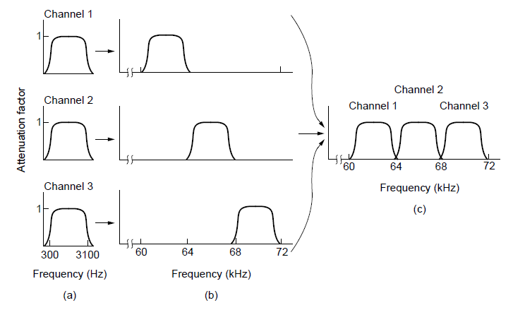
Frequency Division Multiplexing
Frequency division multiplexing. (a) The original bandwidths. (b) The bandwidths raised in frequency. (c) The multiplexed channel.

Slide 31
Frequency Division Multiplexing
In the above figure, we have three telephone channels
4000 Hz is allocated per channel, achieved by filters
3100 Hz usable bandwidth per channel
The excess is a guard band, to keep the channels well separated.
The voice channels are raised in frequency, each by a different amount, then combined between no two channels occupy the same portion of the spectrum
There will still be overlap since real filters do not have ideal sharp edges
Application: telephone networks

Slide 32
Frequency Division Multiplexing
OFDM (Orthogonal Frequency Division Multiplexing)
In digital transmission, the spectrum can be divided efficiently without guard bands
The channel bandwidth is divided into subcarriers; subcarriers are packed tightly and the signals from each subcarrier extend to adjacent ones
The frequency response of each subcarrier is designed so that it is zero at the center of the adjacent subcarriers
The subcarriers can sample at their center frequencies without interference from their neighbors.

Slide 33
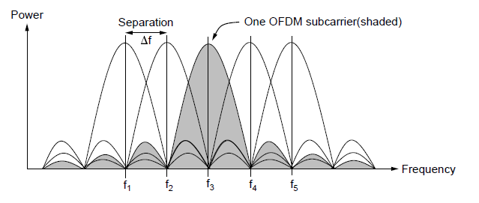
Frequency Division Multiplexing
Orthogonal frequency division multiplexing (OFDM).

Slide 34
Time Division Multiplexing
Users takes turns (in a round-robin fashion), each one periodically getting the entire bandwidth for a little burst of time.
Bits from each input stream are taken in a fixed time slot.
The streams must be synchronized in time. Small intervals of guard time are added to accommodate small timing variations.
Widely used in telephone and cellular networks

Slide 35
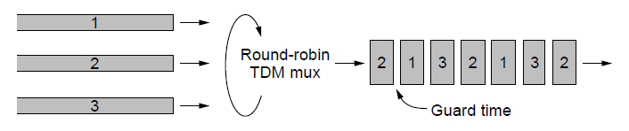
Time Division Multiplexing
Time Division Multiplexing (TDM).

Slide 36
Code Division Multiplexing
CDM is a form of spread spectrum communication in which a narrowband signal is spread out over a wider frequency band.
More tolerant of noise; allow multiple signals from different users to share the same frequency band.
Also called CDMA (Code Division Multiple Access)

Slide 37
Code Division Multiplexing
Allow each user to transmit over the entire frequency spectrum all the time.
Analogy: an airport lounge with many pairs of people conversing.
TDM: each pair taking turns speaking.
FDM: pairs speaking at different pitches simultaneously, some higher-pitched and some lower-pitched.
CDMA: each pair taking simultaneously, but in different languages. French-speaking pair will reject everything non-French as noise.
The key to CDMA is to be able to extract the desired signal while rejecting everyone else as random noise.

Slide 38
Code Division Multiplexing
Each bit time is subdivided into m short intervals called chips.
64 or 128 chips per bit; we use 8 chips/bit as an example
Each user is assigned a unique m-bit code called a chip sequence.
We use -1 and +1 to denote the chip sequences.
To transmit a 1, a user sends its chip sequence; to transmit a 0, a user sends the negation of its chip sequence; no other sequences are allowed.
If the chip sequence is -1 -1 -1 +1 +1 -1 +1 +1, a user can send a 1 by transmitting -1 -1 -1 +1 +1 -1 +1 +1, and a 0 by transmitting +1 +1 +1 -1 -1 +1 -1 -1

Slide 39
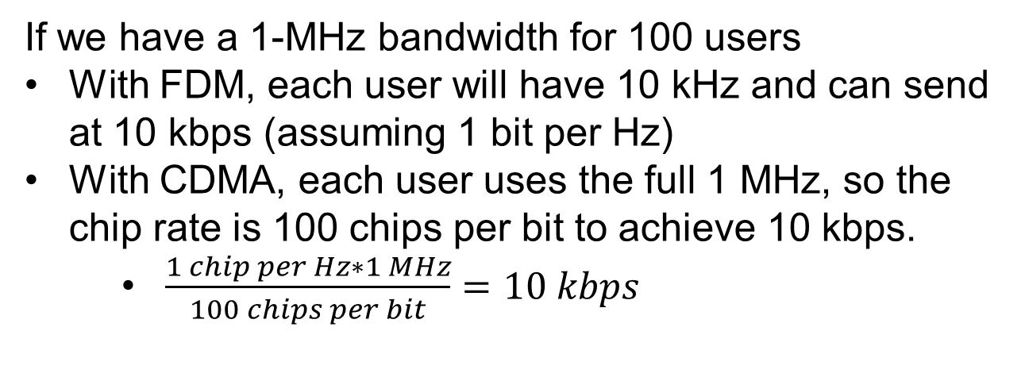
Code Division Multiplexing
If we have a 1-MHz bandwidth for 100 users
With FDM, each user will have 10 kHz and can send at 10 kbps (assuming 1 bit per Hz)
With CDMA, each user uses the full 1 MHz, so the chip rate is 100 chips per bit to achieve 10 kbps.
$\frac{1 chip per Hz∗1 MHz}{100 chips per bit}=10 kbps$

Slide 40
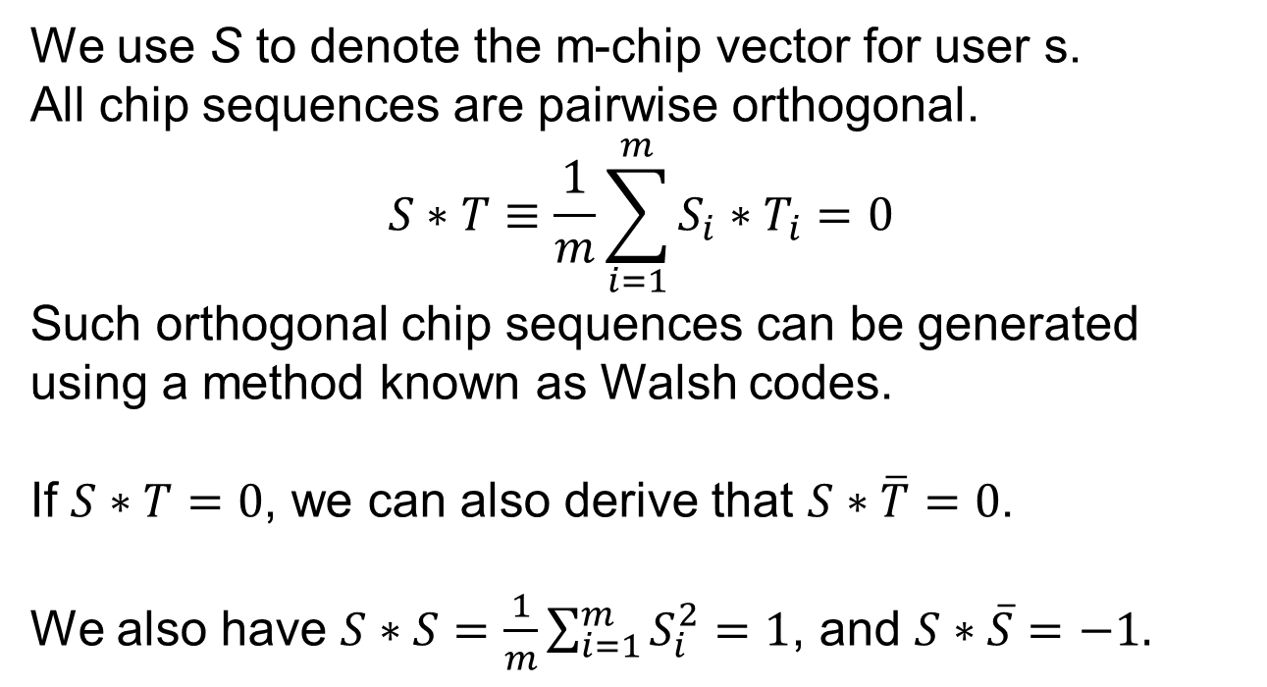
Code Division Multiplexing
We use S to denote the m-chip vector for user s.
All chip sequences are pairwise orthogonal.
$$S∗T≡\frac{1}{m}\sum_{i=1}^{m}{S_{i}∗T_{i}}=0$$
Such orthogonal chip sequences can be generated using a method known as Walsh codes.
If $S∗T=0$, we can also derive that $S∗\overline{T}=0$.
We also have $S∗S=\frac{1}{m}\sum_{i=1}^{m}{S_{i}^{2}}=1$, and $S∗\overline{S}=−1.$

Slide 41
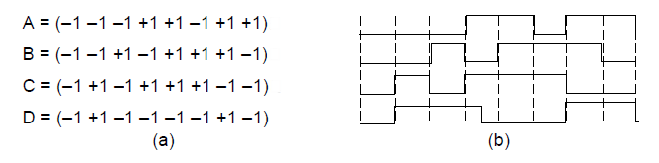
Code Division Multiplexing
Chip sequences for four stations.
Signals the sequences represent

Slide 42
Code Division Multiplexing
Assume that all users are synchronized in time, so all chip sequences begin at the same instant. When two or more users transmit simultaneously, their sequences add linearly (like voltages superimposed on the channel added up). For example, if B and C both transmit 1, we have:
(-1 -1 +1 -1 +1 +1 +1 -1) + (-1 +1 -1 +1 +1 +1 -1 -1)
= (-2 0 0 0 +2 +2 0 -2)
If the receiver wants to decode the bit stream of a transmitter, he must know the chip sequence of the transmitter.

Slide 43
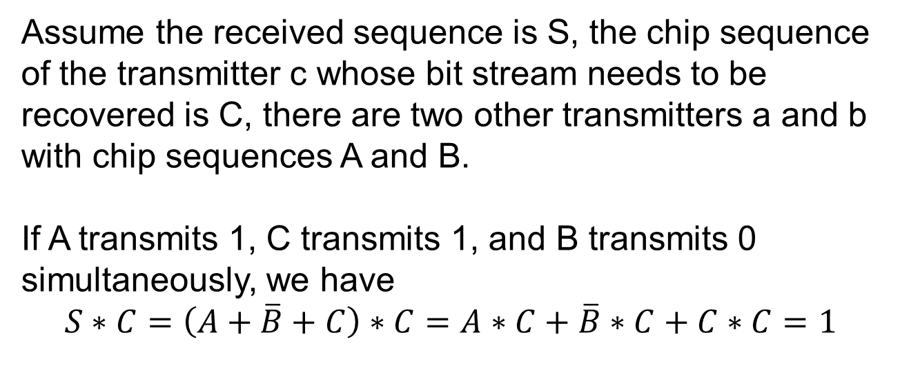
Code Division Multiplexing
Assume the received sequence is S, the chip sequence of the transmitter c whose bit stream needs to be recovered is C, there are two other transmitters a and b with chip sequences A and B.
If A transmits 1, C transmits 1, and B transmits 0 simultaneously, we have
$$S∗C=\left(A+\overline{B}+C\right)∗C=A∗C+\overline{B}∗C+C∗C=1$$

Slide 44
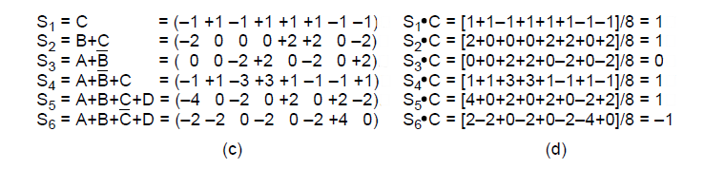
Code Division Multiplexing
Six examples of transmissions.
Recovery of station C’s

Slide 45
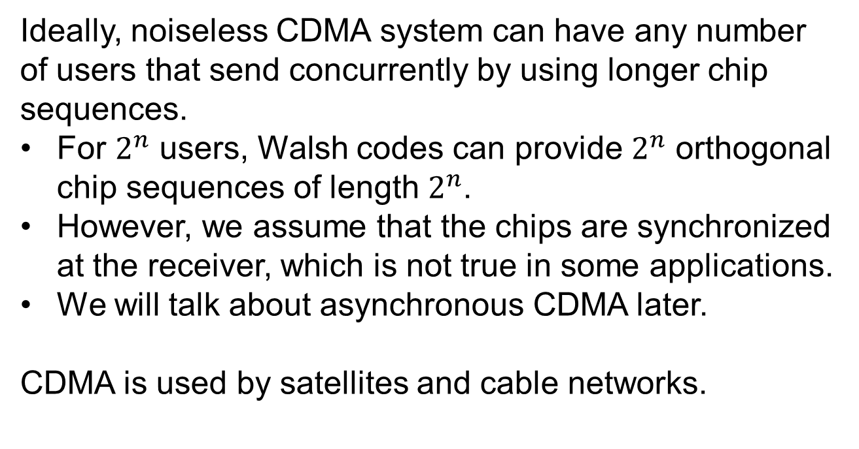
Code Division Multiplexing
Ideally, noiseless CDMA system can have any number of users that send concurrently by using longer chip sequences.
For $2^{n}$ users, Walsh codes can provide $2^{n}$ orthogonal chip sequences of length $2^{n}$.
However, we assume that the chips are synchronized at the receiver, which is not true in some applications.
We will talk about asynchronous CDMA later.
CDMA is used by satellites and cable networks.

Slide 46
The Public Switched Telephone Network
PSTN (Public Switched Telephone Network) is tightly intertwined with computer networks, so we devote some time to study it.

Slide 47
The Public Switched Telephone Network
Structure of the telephone system
Politics of telephones
Local loop: modems, ADSL, and fiber
Trunks and multiplexing
Switching

Slide 48
Structure of the Telephone System
Initially, if a telephone owner wanted to talk to n other telephone owners, separate wires had to be strung to all n houses.
Bell Telephone Company opened its first switching office in 1878.
The user call the telephone company’s switching office, and an operator will manually connect the caller to the callee.
To enable long-distance calls between cities, the Bell System began to connect switching offices by second-level switching offices.

Slide 49
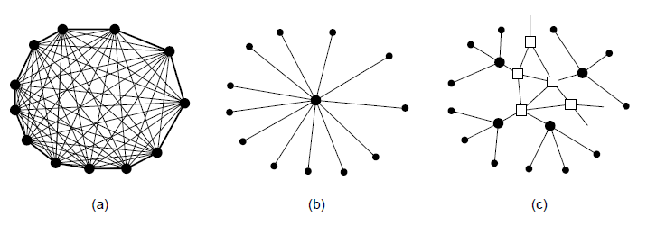
Structure of the Telephone System
Fully interconnected network.
Centralized switch.
Two-level hierarchy.

Slide 50
Structure of the Telephone System
Each telephone has two copper wires that go directly to the telephone company’s nearest end office.
Local loop: the two-wire connections between each subscriber’s telephone and the end office
1~10 km
If a user attached to an end office calls another one attached to the same end office, the switching system at the office sets up a direct connection between the two local loops.
If the callee is attached to another end office. We need another mechanism.

Slide 51
Structure of the Telephone System
If the callee is attached to another end office. We need another mechanism.
Each end office has outgoing lines (called toll connecting trunks) to one or more nearby switching centers, called toll offices or tandem offices.
If the caller’s and the callee’s end offices have a toll connecting trunk to the same toll office, the connection will be established.
If the caller and the callee do not have a toll office in common, a path will have to be established between the two toll offices via high-bandwidth intertoll trunks.

Slide 52
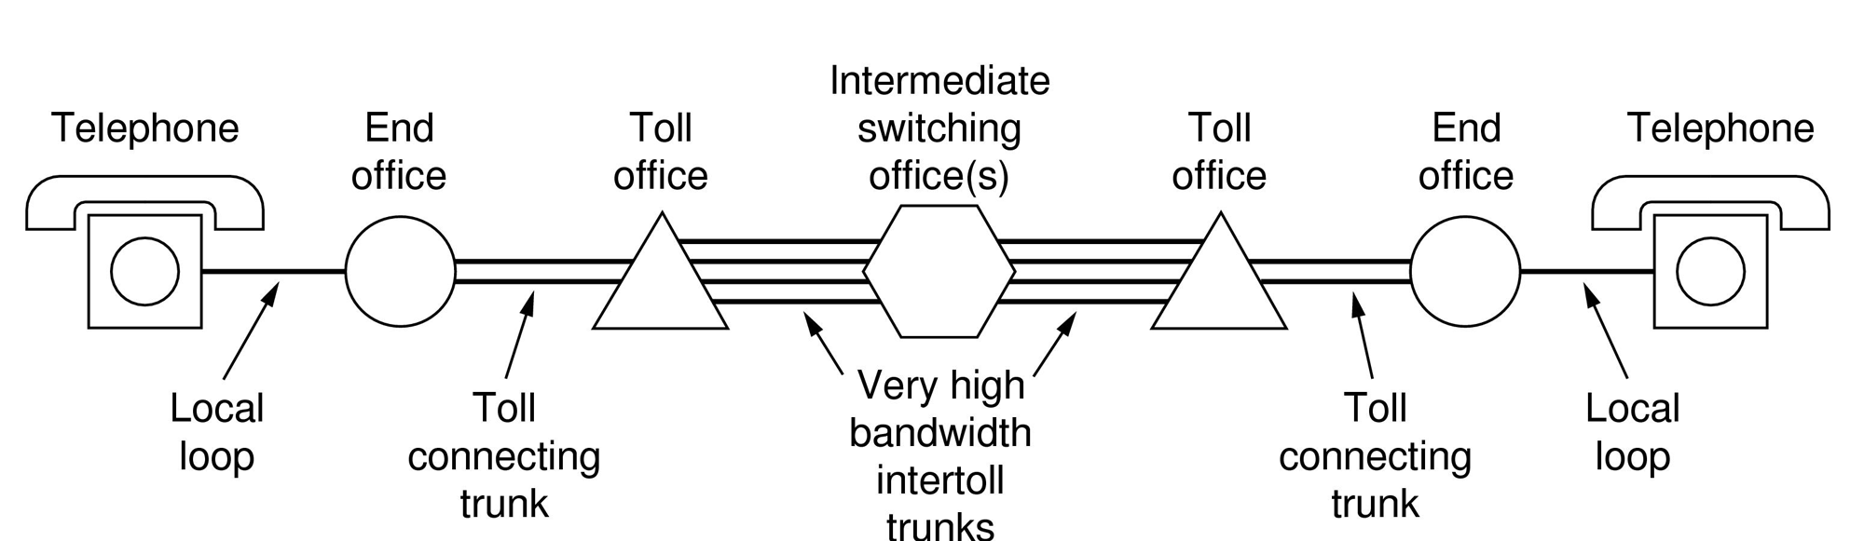
Structure of the Telephone System
A typical circuit route for a long-distance call.

Slide 53
Structure of the Telephone System
Major Components
Local loops analog twisted pairs to houses, businesses).
Trunks (digital fiber optic links between switching offices).
Switching offices (calls are moved from one trunk to another).

Slide 54
The Politics of Telephones
The United States was divided up into 164 LATA (Local Access and Transport Areas)
A LATA is about the area covered by one area code
Within each LATA, there are LECs (Local Exchange Carrier) to provide local telephone services.
Inter-LATA traffic was handled by an IXC (IntereXchange Carrier).
The IXC build a switching office called a POP (Point of Presence) in a LATA.
The LEC connects each IXC to every end office, either directly, as in LATA 1 and 3, or indirectly, as in LATA 2.

Slide 55
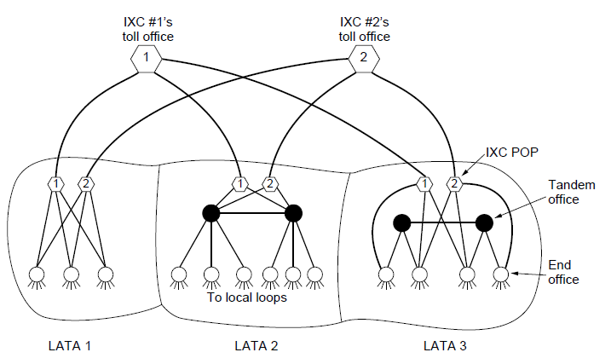
The Politics of Telephones
The relationship of LATAs, LECs, and IXCs. Circles are LEC switching offices. Hexagons belong to IXC whose number is in it.

Slide 56
The Politics of Telephones
1996 law required that LECs implement local number portability.
A user can change local telephone companies without having to get a new telephone number.
Portability for mobile phone numbers followed suit in 2003.

Slide 57
The Local Loop: Modems, ADSL, and Fiber
The local loop is often referred to as the “last mile”, although the length can be several miles.
Limitations of local loops:
Relatively narrow bandwidth
Attenuation and distortion of signals
Susceptibility to electrical noise

Slide 58
The Local Loop: Modems, ADSL, and Fiber Telephone Modems
To send bits over the local loop, they must be converted to analog signals that can be transmitted over the channel. At the receiver, the analog signal is converted back to bits.
Modem: the device that converts between digital bits and analog signal that represent the bits.
The modem is inserted between the (digital) computer and the (analog) telephone system.
Telephone modems send bits over a voice-grade line with 3100 Hz, about four orders of magnitude less than the bandwidth for Ethernet or 802.11.

Slide 59
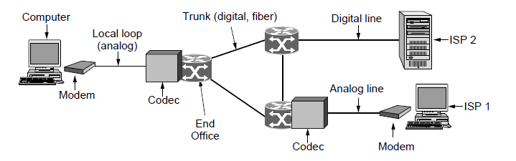
Telephone Modems
Use of both analog and digital transmission for computer -to-computer call. Conversion done by modems and codecs.

Slide 60
The Local Loop: Modems, ADSL, and Fiber Telephone Modems
According to Nyquist theorem, with a perfect 3000 Hz line, we can send symbols no faster than 6000 baud. In practice, most modems send at 2400 symbols/sec, and focus on getting multiple bits per symbol.
Higher-speed modems use some of the symbols for error correction.
V.32 modem standard uses 32 constellation points to transmit 4 bits and 1 check bit per symbol at 2400 baud to achieve 9600 bps.
V. 34 uses 14 data bits/symbol at 2400 baud to achieve 33,600 bps
The Shannon limit for the telephone system is about 35 kbps.

Slide 61
The Local Loop: Modems, ADSL, and Fiber Digital Subscriber Lines
Services with more bandwidth than standard telephone service are sometimes called broadband.
At the point where each local loop terminates in the end office, the wire runs through a filter that attenuates all frequencies below 300 Hz and above 3400 Hz.
In xDSL, the incoming line is connected to a different kind of switch that does not have the filter, thus making the entire capacity of the local loop available, i.e., around 1 MHz.
The capacity of the local loop falls quickly with distance from the end office, depending on the thickness and general quality of the twisted pair.

Slide 62
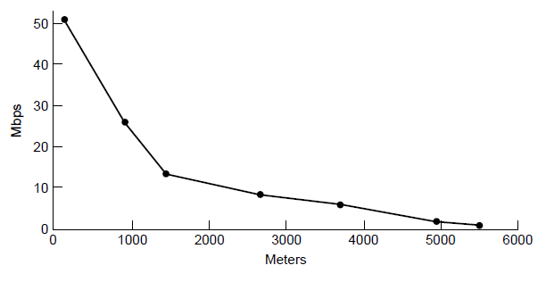
Digital Subscriber Lines
Bandwidth versus distance over Category 3 UTP for DSL.

Slide 63
The Local Loop: Modems, ADSL, and Fiber Digital Subscriber Lines
The available 1.1 MHz spectrum on the local loop is divided into 256 independent channels of 4312.5 Hz each. The OFDM scheme is used to send data over these channels; it is called DMT in the context of ADSL.
Channel 0 is used for POTS (Plain Old Telephone Service)
Channel 1-5 are not used, to keep the voice and data signals from interfering with each other.
Of the remaining 250 channels, one is used for upstream control, one is used for downstream control, and others are used for data.
The provide decides how many channels are used for upstream and downstream. Most providers allocate 80-90% to the downstream channel. Hence the “A” (Asymmetric) in ADSL

Slide 64
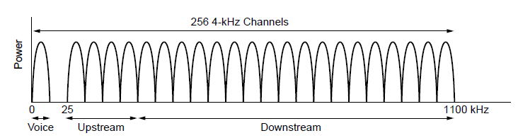
Digital Subscriber Lines
Operation of ADSL using discrete multitone modulation.

Slide 65
The Local Loop: Modems, ADSL, and Fiber Digital Subscriber Lines
Within each channel, QAM modulation is used at a rate of roughly 4000 symbols/sec.
Different channels may have different data rates, with up to 15 bits per symbol sent on a channel with a high SNR, and down to 2, 1, or no bits per symbol sent on a channel with a low SNR.

Slide 66
The Local Loop: Modems, ADSL, and Fiber Digital Subscriber Lines
A typical ADSL arrangement
A NID (Network Interface Device) is installed on the user’s premises.
A splitter, an analog filter that separates the 0-4000 Hz used by POTS from the data. The POTS signal is routed to the telephone or fax. The data signal is routed to an ADSL modem.
The computer is connected to the modem using Ethernet, a USB cable or 802.11

Slide 67
The Local Loop: Modems, ADSL, and Fiber Digital Subscriber Lines
At the end office,
A splitter filtered the voice signal to be sent to the voice switch. The signal above 26 kHz is routed to a DSLAM (Digital Subscriber Line Access Multiplexer)
DSLAM recovers the bits from the signal, forms packets, and sends them to the ISP.

Slide 68
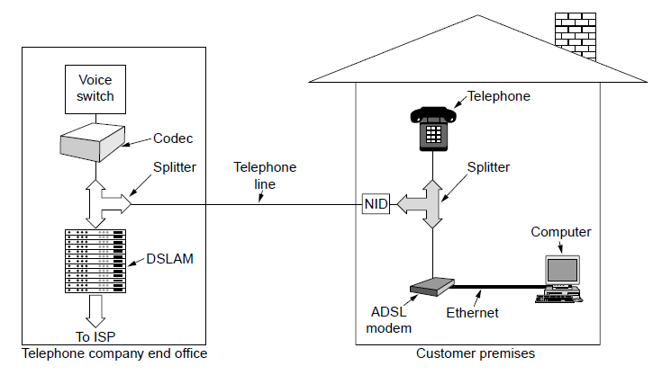
Digital Subscriber Lines
A typical ADSL equipment configuration.

Slide 69
The Local Loop: Modems, ADSL, and Fiber Fiber To The Home
FttH (Fiber To The Home): Telephone companies are upgrading local loops by installing optical fiber to houses and offices.
PON (Passive Optical Network).
The fibers from the houses are jointed together so that only a single fiber reaches the end office per group of up to 100 houses.
In the downstream, optical splitters divide the signal from the end office so that it reaches all houses.
The tremendous bandwidth and low attenuation of fiber mean that PONs can provide high rates to users over distances of up to 20 km, several Gbps

Slide 70
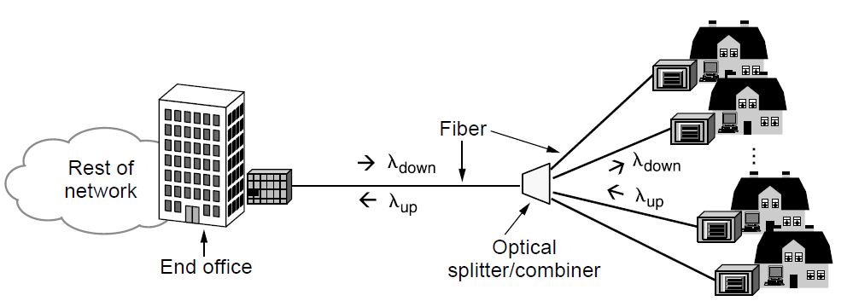
Fiber To The Home
Passive optical network for Fiber To The Home.

Slide 71
Trunks and Multiplexing
Compared with local loops, trunks
Mush faster
Carries digital information, not analog information, that is, bits not voice.
Carry thousands, even millions, of calls simultaneously by TDM and FDM multiplexing
How voice signals are digitized?
How TDM is used to carry bits on trunks?
How FDM is applied to fiber optics?

Slide 72
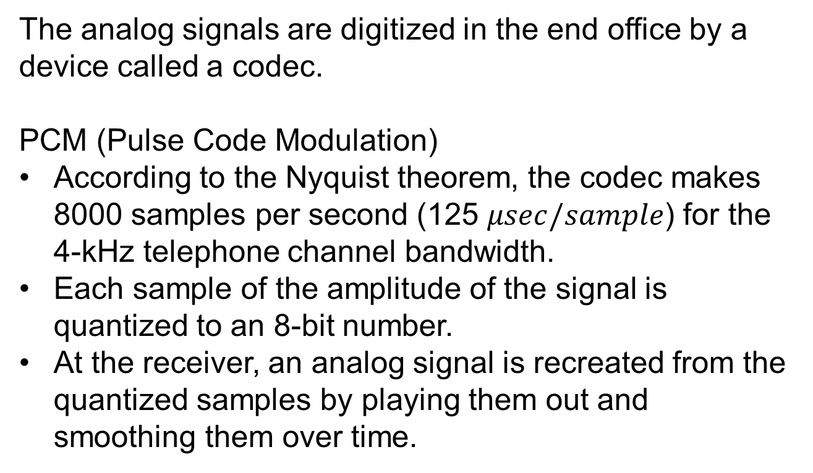
Trunks and Multiplexing Digitizing Voice Signals
The analog signals are digitized in the end office by a device called a codec.
PCM (Pulse Code Modulation)
According to the Nyquist theorem, the codec makes 8000 samples per second (125 $μsec/sample$) for the 4-kHz telephone channel bandwidth.
Each sample of the amplitude of the signal is quantized to an 8-bit number.
At the receiver, an analog signal is recreated from the quantized samples by playing them out and smoothing them over time.

Slide 73
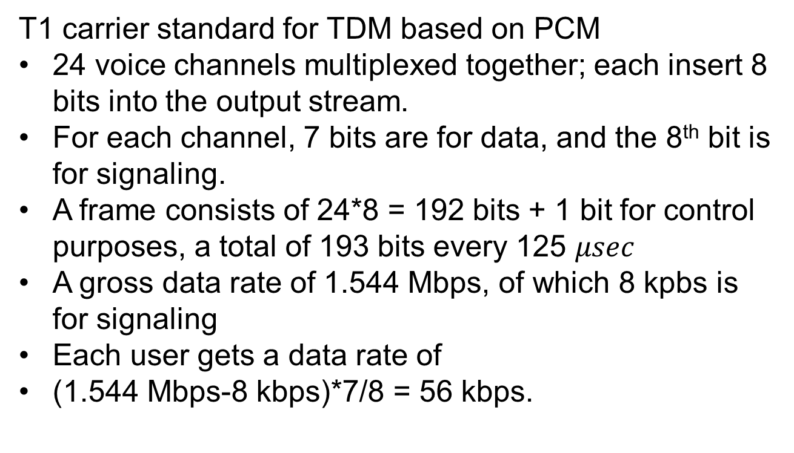
Trunks and Multiplexing Time Division Multiplexing
T1 carrier standard for TDM based on PCM
24 voice channels multiplexed together; each insert 8 bits into the output stream.
For each channel, 7 bits are for data, and the 8th bit is for signaling.
A frame consists of 24*8 = 192 bits + 1 bit for control purposes, a total of 193 bits every 125 $μsec$
A gross data rate of 1.544 Mbps, of which 8 kpbs is for signaling
Each user gets a data rate of
(1.544 Mbps-8 kbps)*7/8 = 56 kbps.

Slide 74
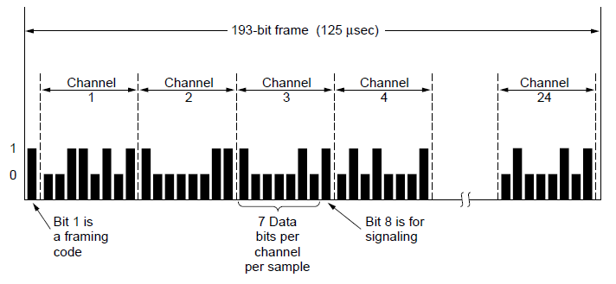
Time Division Multiplexing
The T1 carrier (1.544 Mbps).

Slide 75
Trunks and Multiplexing Time Division Multiplexing
TDM allows multiple T1 carriers to be multiplexed into higher-order carriers.
4 T1 channels are multiplexed into one T2 channel
7 T2 channels are multiplexed into one T3 channel
6 T3 channels are multiplexed into one T4 channel
The multiplexing at T2 and above is done bit for bit, rather than byte for byte with the 24 voice channels that make up a T1 frame.
At each step a small amount of overhead is added for framing and recovery in case the synchronization between sender an receiver is lost.

Slide 76
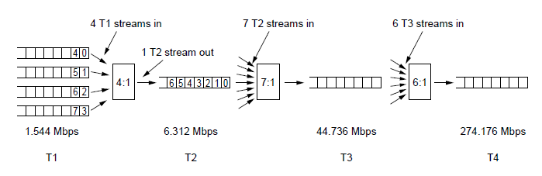
Time Division Multiplexing
Multiplexing T1 streams into higher carriers

Slide 77
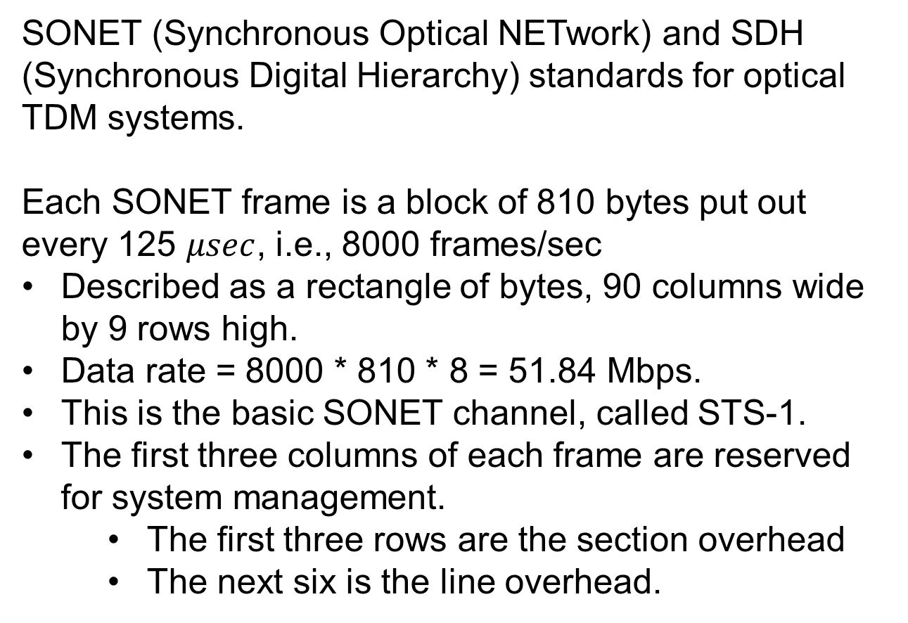
Trunks and Multiplexing SONET/SDH
SONET (Synchronous Optical NETwork) and SDH (Synchronous Digital Hierarchy) standards for optical TDM systems.
Each SONET frame is a block of 810 bytes put out every 125 $μsec$, i.e., 8000 frames/sec
Described as a rectangle of bytes, 90 columns wide by 9 rows high.
Data rate = 8000 * 810 * 8 = 51.84 Mbps.
This is the basic SONET channel, called STS-1.
The first three columns of each frame are reserved for system management.
The first three rows are the section overhead
The next six is the line overhead.

Slide 78
Trunks and Multiplexing SONET/SDH
A SONET transmitter sends back-to-back 810-byte frames, without gapes between them, even when there are no data (in which case it sends dummy data)
The first 2 bytes of each frame contain a fixed pattern for the receiver to detect the beginning of a frame.
The remaining 87 columns of each frame hold 87*9*8*8000 Mbps of user data.
The SPE (Synchronous Payload Envelope), which carriers the user data does not always start at row 1, column 4.
The SPE can start anywhere in the frame.
The pointer to the first byte is in the first row of the line overhead.
SPE can span two frames.

Slide 79
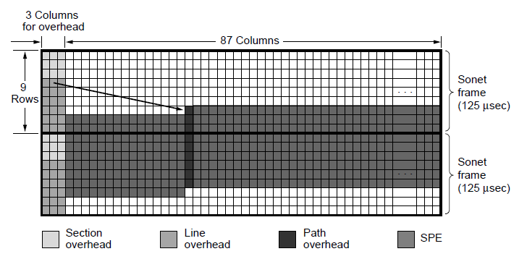
SONET/SDH
Two back-to-back SONET frames.

Slide 80
Trunks and Multiplexing SONET/SDH
SONET/SDH multiplexing hierarchy is shown in the next table.
STS-n is called OC-n but is bit for bit the same except for a certain bit reordering needed for synchronization.
The SDH names are different and start at OC-3.
Gross data rate: includes all the overhead
SPE data rate: excludes the line and section overhead
User data rate: excludes all overhead and counts only the 87 payload columns.

Slide 81
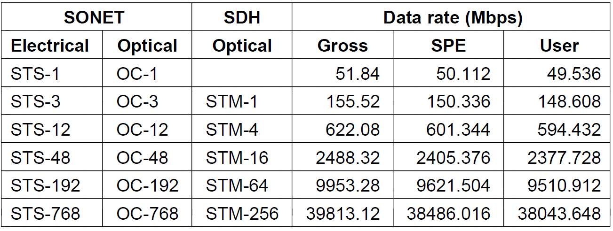
SONET/SDH
SONET and SDH multiplex rates.

Slide 82
Trunks and Multiplexing Wavelength Division Multiplexing
WDM (Wavelength Division Multiplexing)
A form of frequency division multiplexing.
In the example in the following slide, four fibers each with its energy present at a different wavelength.
At the transmitter side, combined onto a single shared fiber for transmission
At the receiver side, split up over as many fibers as there were on the input side
Each output fiber has a specially constructed core that filters out all but one wavelength.

Slide 83
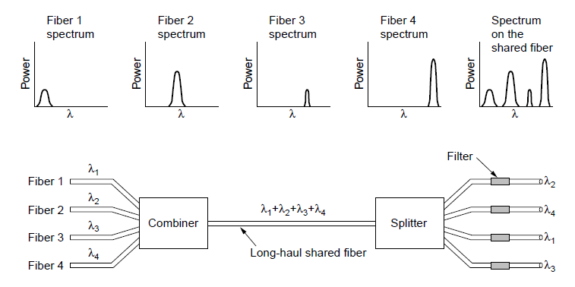
Wavelength Division Multiplexing
Wavelength division multiplexing

Slide 84
Trunks and Multiplexing Switching
Two different switching techniques:
Circuit switching
Packet switching
Traditional telephone system is based on circuit switching.
Voice over IP is based on packet switching.

Slide 85
Trunks and Multiplexing Circuit Switching
When a telephone call is placed, the switching equipment within the telephone system seeks out a physical path all the way from the caller to the callee.
Once a call has been set up, a dedicated path between both ends exists and will continue to exist until the call is finished.
In the figure in the next slide, each of the six rectangles represents a switching office, each office has 3 incoming lines and 3 outgoing lines. When a call happens, a physical connection is established between the line on which the call came in and one of the output links.

Slide 86
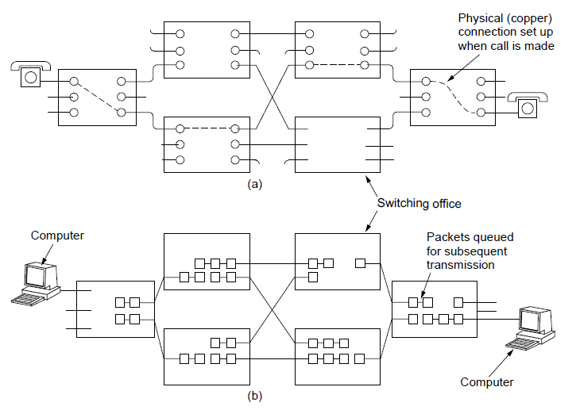
Circuit Switching/Packet Switching
(a) Circuit switching. (b) Packet switching.

Slide 87
Trunks and Multiplexing Circuit Switching
Time cost:
Establish time is long to find a path before data transmission happened, 10 sec or more.
Once the setup has been completed, the delay for data is the propagation time for the electromagnetic signal, about 5 msec per 1000 km.
No danger of congestion after the connection is established.

Slide 88
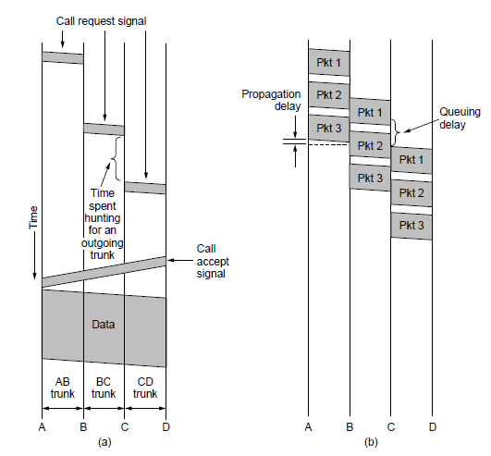
Circuit Switching/Packet Switching
Timing of events in (a) circuit switching, (b) packet switching

Slide 89
Trunks and Multiplexing Packet Switching
Packets are sent as soon as they are available. No dedicated path. The routers use store-and-forward transmission to send each packet on its way to the destination on its own.
Queuing delay: since no bandwidth is reserved, packets may have to wait to be forwarded.

Slide 90
Trunks and Multiplexing Packet Switching vs Circuit Switching
Circuit switching: guaranteed service, wasting resources
Reserved bandwidth will be wasted if there is no traffic
No congestion after the connection is established
Packet switching: no guaranteed service, no wasting resources
Packet can be out of order
Limit on the packet size
Congestion when there are too many packets at the same time
More fault tolerant, packet can be routed around dead switches

Slide 91
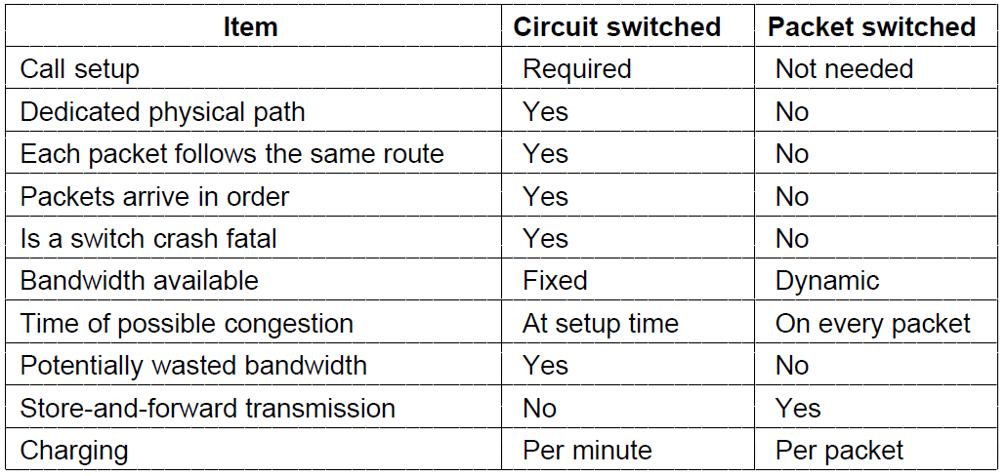
Circuit Switching/Packet Switching
A comparison of circuit-switched and packet-switched networks.

Slide 92
Mobile Telephone System
First-Generation (1G) Mobile Phones Analog Voice
Second-Generation (2G) Mobile Phones Digital Voice
Third-Generation (3G) Mobile Phones Digital Voice + Data

Slide 93
First-Generation: Analog Voice
AMPS (Advanced Mobile Phone System)
A geographic region is divided up into cells
Each cell uses some set of frequencies not used by its neighbors.
Small cells and reuse of frequencies improves capacity
At the center of each cell is the base station.
All base stations are connected to an MSC (Mobile Switching Center). The MSCs communicate with the base station using a packet switching network.

Slide 94
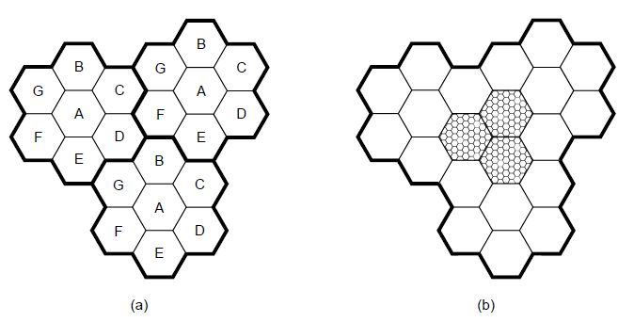
Advanced Mobile Phone System
(a) Frequencies are not reused in adjacent cells. (b) To add more users, smaller cells can be used.

Slide 95
First-Generation: Analog Voice
Handoff:
At any instance, each mobile phone is in one specific cell and controlled by that cell’s base station.
If the phone leaves the cell, the base station detects the phone’s signal fading away and asks all the surrounding base stations how much power they are getting from the phone
With the answers, the base station transfers the ownership to the cell with the strongest signal.
The phone is informed of its new boss, and is asked to switch to a new channel.

Slide 96
First-Generation: Analog Voice
Channels:
FDM to separate the channels. 30 kHz each
832 channels divided into four categories
Control channels (base to mobile): manage the system
Paging channels (base to mobile): alert users to calls for them
Access channels (bidirectional): call setup and channel assignment
Data channels (bidirectional): carry voice and data

Slide 97
First-Generation: Analog Voice
Call management:
The phone broadcast its serial number and telephone number
The base station hears it and tells the MSC to record the customer and inform the customer’s home MSC of his current location.
Outgoing calls:
The phone transmits the number to be called and its own identity on the access channel.
The base station gets the request and informs the MSC.
The MSC looks for an idle channel for the call, and sends the channel number back on the control channel to the phone.
The phone switches to the channel and waits.

Slide 98
First-Generation: Analog Voice
Call management:
Incoming calls
All idle phones continuously listen to the paging channel to detect messages directed at them
A packet is sent to the callee’s home MSC to find out where it is.
The packet is sent to the base station in its current cell. The base station sends a broadcast on the paging channel, e.g., “Unit 14, are you there?”
The phone responds with a “Yes” on the access channel
The base says “Unit 14, call for you on channel 13”
The phone switches to channel 13.

Slide 99
Second-Generation: Digital Voice
GSM (The Global System for Mobile Communications)
Based on cells, frequency reuse across cells, and mobility with handoffs similar to 1G
The mobile is divided into the handset and a removable chip.
SIM card for user identification and encrypting conversation
The base station are connected to a BSC (Base Station Controller) that controls the resources of cells and handles handoff.
The BSC is connected to an MSC that routes calls to the PSTN (Public Switched Telephone Network).

Slide 100
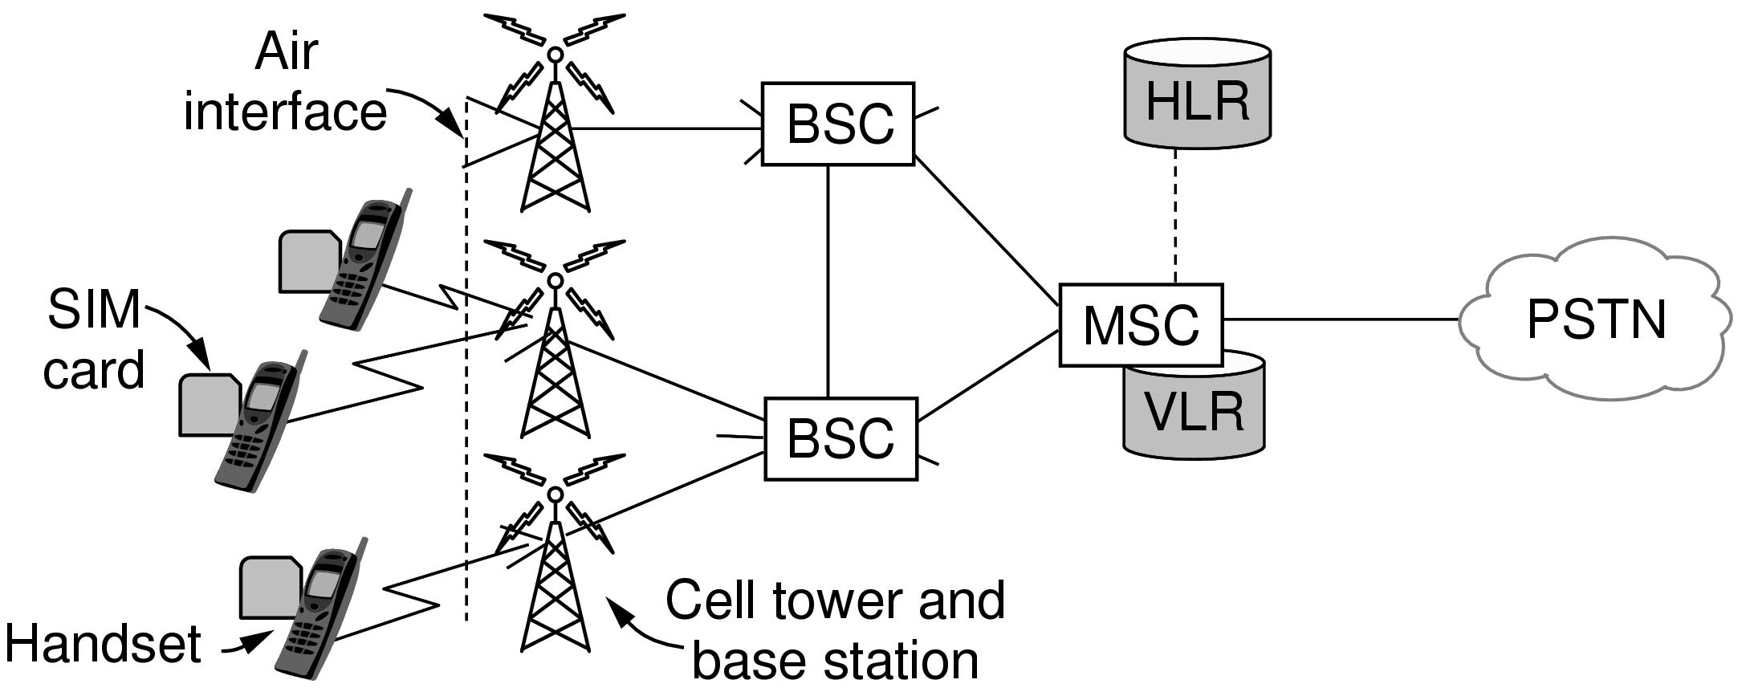
GSM—The Global System for Mobile Communications
GSM mobile network architecture.

Slide 101
Second-Generation: Digital Voice
The MSC maintains a VLR and an HLR database.
VLR (Visitor Location Register): Nearby mobiles that are associated with the cells it manages.
HLR (Home Location Register): the last known location of each mobile to route incoming calls to the right locations.

Slide 102
Second-Generation: Digital Voice
GSM channels
Much wider than 1G (200 kHz vs 30 kHz)
Each channel is 200 kHz, and supports 8 connections, using TDM.

Slide 103
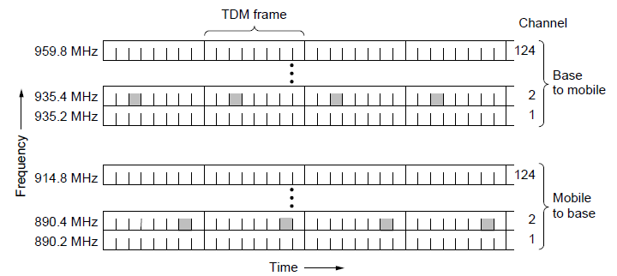
GSM—The Global System for Mobile Communications (2)
GSM uses 124 frequency channels, each of which uses an eight-slot TDM system.

Slide 104
Second-Generation: Digital Voice
Each TDM slot consists of a 148-bit data frame.
Each data frame starts and ends with three 0 bits for frame delineation.
57-bit Information fields, contains a control bit that indicates whether the following Information field is for voice or data
26-bit Sync field used by the receiver to synchronize to the sender’s frame boundaries.
8 data frames make up a TDM frame and 26 TDM frames make up a multiframe.
Slot 12 in a multiframe is used for control, Slot 25 is reserved for future use.

Slide 105
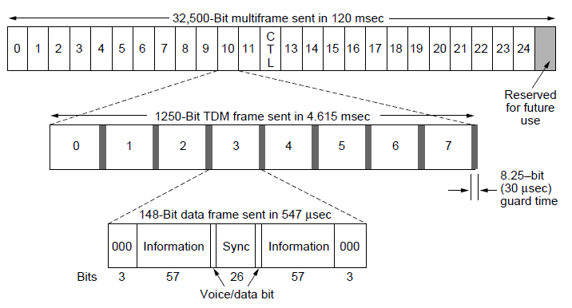
GSM—The Global System for Mobile Communications
A portion of the GSM framing structure.

Slide 106
Second-Generation: Digital Voice
Dedicated control channel: used for location updating, registration and cell update.
Common control channel split up into 3 subchannels
Paging channel: the base station uses to announce incoming calls. Mobile station monitors it continuously to watch for calls.
Random access channel, allow user to request a slot on the dedicated control channel. Using the dedicated control channel slot, the station can set up a call.
Access grant channel, base station uses to announce the assigned slot on the dedicated control channel to the mobile.

Slide 107
Second-Generation: Digital Voice
Handoff:
Different from 1G
MAHO (Mobile Assisted Handoff): the mobile measures signal quality to other nearby base station and sends this information to the BSC to determine when a mobile is leaving so that it can perform handoff.

Slide 108
Third-Generation: Digital Voice and Data
Basic services intend by IMT-2000 network (issued by ITU for 3G)
High-quality voice transmission.
Messaging (replacing email, fax, SMS, chat).
Multimedia (music, videos, films, television).
Internet access (Web surfing, incl. audio, video).

Slide 109
Third-Generation: Digital Voice and Data
Use of CDMA:
Each user sends on the same frequency band at the same time
Use asynchronous CDMA
Synchronous CDMA is based on the assumption that all users are synchronized on the start time of their chip sequences, so that orthogonal chip sequences cancel out.
Synchronous CDMA can be used for base station transmitting to mobiles at the same time.
It is difficult to synchronize independent mobile phones. Their transmission will arrive at different times with no guarantee of orthogonality.
Power level
The cross-correlation with a powerful signal may overwhelm the auto-correlation with a weak signal

Slide 110
Third-Generation: Digital Voice and Data
Use of CDMA:
Each user sends on the same frequency band at the same time
Asynchronous CDMA
Synchronous CDMA is based on the assumption that all users are synchronized on the start time of their chip sequences, so that orthogonal chip sequences cancel out.
Synchronous CDMA can be used for base station transmitting to mobiles at the same time.
It is difficult to synchronize independent mobile phones. Their transmission will arrive at different times with no guarantee of orthogonality.

Slide 111
Third-Generation: Digital Voice and Data
Asynchronous CDMA
Use pseudorandom sequences as chip sequences
A low cross-correlation with each other (cancel interference)
A high auto-correlation with itself (detect useful signal)

Slide 112
Third-Generation: Digital Voice and Data
Power level
The cross-correlation of a power signal may overwhelm the auto-correlation of a weak signal.
The power level received at a base station depend on the distance.
Equalize the received power by having each mobile to transmit to the base station at the inverse of the power level it receives from the base station.
The weaker the received power, the more faraway from the base station, the higher transmission power should be

Slide 113
Third-Generation: Digital Voice and Data
Use soft handoff instead of hard handoff (in 2G)
Soft handoff is easy with CDMA since all frequencies are used in each cell.
Hard handoff is the norm with FDM to avoid the cost of having the mobile transmit or receive on two frequencies simultaneously.

Slide 114
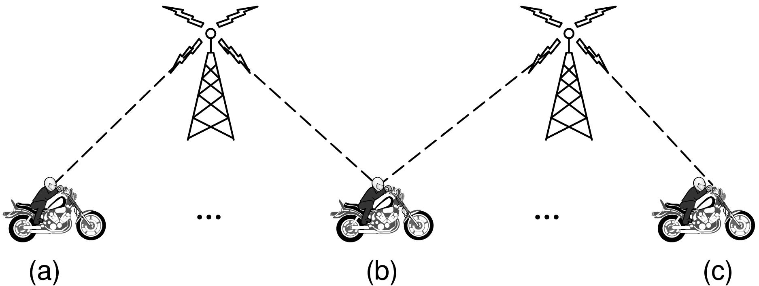
Third-Generation: Digital Voice and Data

Slide 115
Cable Television
Community antenna television
Internet over cable
Spectrum allocation
Cable modems
ADSL versus cable

Slide 116
Community Antenna Television
A big antenna to pick up the television signal out of the air.
An amplifier, called the headend, to strengthen the signal.
A coaxial cable to deliver the signal to people’s houses.
Transmission was one way, from the headend to the users.

Slide 117
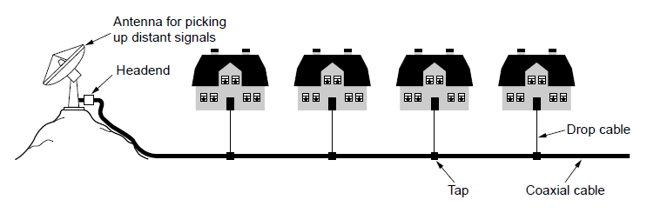
Community Antenna Television
An early cable television system

Slide 118
Internet over Cable
HFC (Hybrid Fiber Coax) system: fiber for the long-haul runs and coaxial cable to the house.
Fiber nodes: the electro-optical converters that interface between the optical and electrical parts of the system.

Slide 119
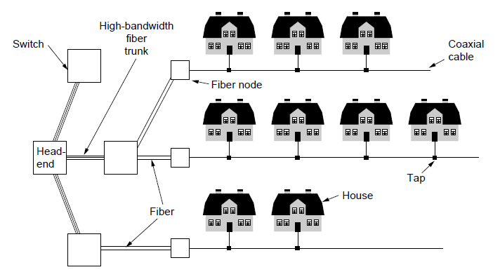
Internet over Cable
Cable television

Slide 120
Internet over Cable
Differences between HFC and the telephone system.
The one-way amplifiers in the HFC system have to be replaced by two-way amplifiers to support upstream traffic.
In HFC, a single cable is shared by many houses; in telephone system, every house has its own local loop.
For TV program broadcasting, it does not matter if there are 10 viewers or 10,000 viewers.
For internet access, the more users there are, the more competition there is for bandwidth.
The solution is to split up long cables and connect each one directly to a fiber node. Typical cables nowadays have 500-2000 houses.

Slide 121
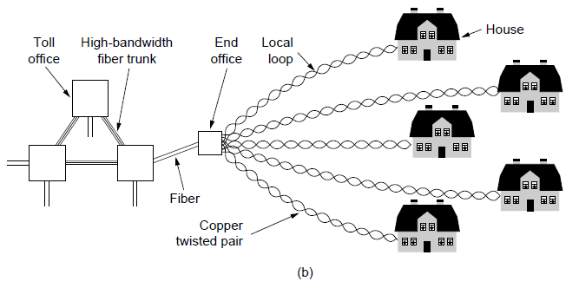
Internet over Cable
The fixed telephone system.

Slide 122
Spectrum Allocation
Television and Internet coexist on the same cable by frequency division multiplexing.
TV: 54-550 MHz
Upstream channels: 5-42 MHz
Downstream channels: 550-750 MHz
Asymmetry in the upstream and downstream bandwidth.
The headend has to be upgraded from a dumb amplifier to an intelligent digital computer system with a high-bandwidth fiber interface to an ISP.
The name of the “headend” is upgraded to CMTS (Cable Modem Termination System)

Slide 123
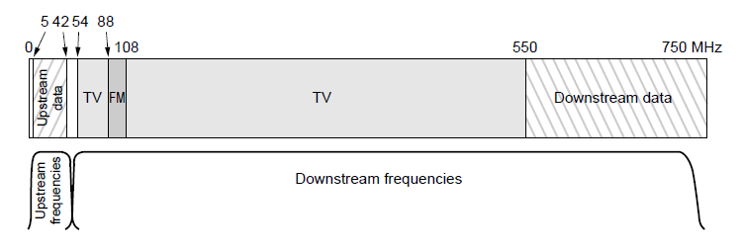
Spectrum Allocation
Frequency allocation in a typical cable TV system used for Internet access.

Slide 124
Cable Modems
Cable modem: a device with two interfaces, one to the computer and one to the cable network.
Modem-to-computer interface is simple, normally Ethernet and occasionally USB.
Modem-to-cable network interface is complicated, with FDM, TDM and CDMA to share the bandwidth of the cable between subscribers.

Slide 125
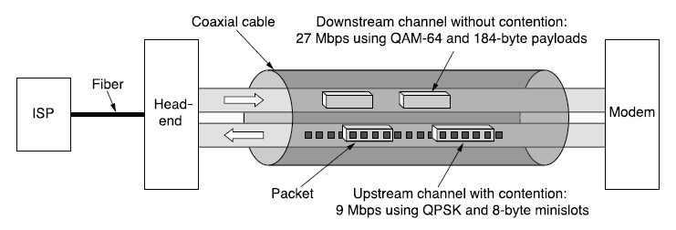
Cable Modems
Typical details of the upstream and downstream channels in North America.

Slide 126
Cable Modems
Initiation: when a new cable modem is plugged in and powered up
Scan the downstream channels looking for special packet periodically sent by the headend to provide system parameters to modems that just come online
Announce its presence on one of the upstream channels
The headend responds by assigning the modem to its upstream and downstream channels.

Slide 127
Cable Modems
FDM is used for each cable modem to send data on one or multiple. downstream channels. Each /downstream channel is usually 6 or 8 MHz.
Downstream is usually modulated using QAM-64, get about 36 Mbps.
TDM is used to share bandwidth on the upstream across multiple subscribers to avoid collision at the headend
Upstream is more noisy, and usually modulated using QPSK.

Slide 128
Cable Modems
Time is divided into minislots and different subscribers send in different minislots.
Minislot assignment:
Every modem must know its distance from the headend to get the timing right. Send a special packet and see how long it takes to get the response.
The headend announces the start of a new round of minislots periodically.
Each modem hears the starting gun at different times due to different distances from the headend. Knowing the distance helps determine the starting time.

Slide 129
Cable Modems
During initiation, the headend assigns each modem to a minislot to use for requesting upstream bandwidth.
Multiple modems will be assigned the same minislot, which leads to contention.
CDMA may be used to share minislots between users. All users with a CDMA code sequence can send at the same time.
Downstream versus upstream
One downstream sender (the headend), no contention
Much larger downstream traffic

Slide 130
ADSL vs Cable
Both use fiber in the backbone, but differ on the edge.
Cable uses coax; ADSL uses twisted pair.
Theoretical capacity of coax is hundreds of times more than twisted pair. But much of the cable’s bandwidth is for TV programs.
ADSL providers are specific about the bandwidth. Cable providers cannot give guarantees because the effective capacity depends on how many people are currently active on the users’ cable segment.

Slide 131
End
Chapter 2

