Slide 1
The Data Link Layer
Chapter 3

Slide 2
Data Link Layer Design Issues
Network layer services
Framing
Error control
Flow control

Slide 3
Data Link Layer Design Issues
The data link layer uses the services of the physical layer to send and receive bits over communication channels.
The data link layer has a number of functions:
Providing a well-defined service interface to the network layer.
Dealing with transmission errors.
Regulating the flow of data so that slow receivers are not swamped by fast senders.

Slide 4
Data Link Layer Design Issues
The data link layer takes the packets from the network layer and encapsulates them into frames for transmission.
Each frame contains:
A frame header
A payload field for holding the packet
A frame trailer

Slide 5
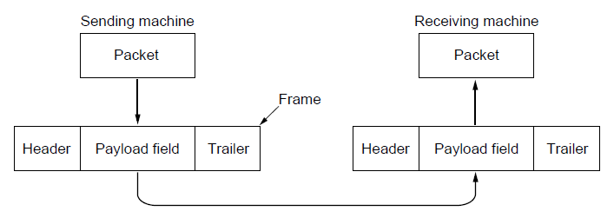
Packets and Frames
Relationship between packets and frames.

Slide 6
Data Link Layer Design Issues
The function of the data link layer is to provide services to the network layer.
Transfer data from the network layer of the source machine to the network layer of the destination machine.
The process in the network layer hands some bits to the data link layer for transmission to the destination machine so that they can be handed over to the network layer there.
The actual transmission follows Figure (b), but we can think of two data link layer process communicating using a data link protocol as in Figure (a).

Slide 7
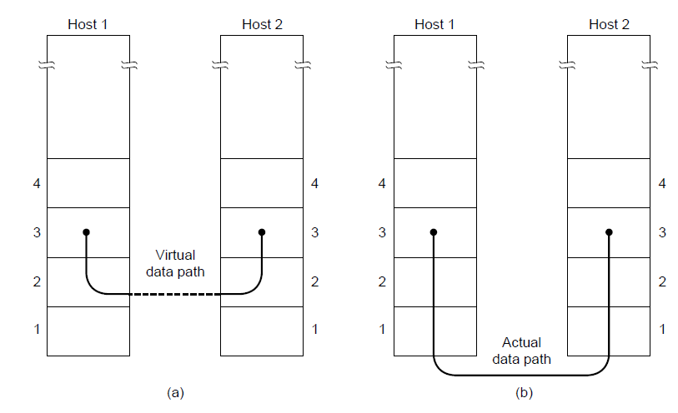
Network Layer Services
(a) Virtual communication. (b) Actual communication.

Slide 8
Possible Services Offered
Unacknowledged connectionless service.
Acknowledged connectionless service.
Acknowledged connection-oriented service.

Slide 9
Possible Services Offered
Unacknowledged connectionless service
Have the source machine send frames to the destination machine without having the destination machine acknowledge them.
No logical connection established or released.
If a frame is lost, no attempt is made to detect the lost or recover from it in the data link layer.
Appropriate when the error rate is very low, so recovery is left to higher layers. E.g., Ethernet
Appropriate for real-time traffic.

Slide 10
Possible Services Offered
Acknowledged connectionless service
No logical connections
Each frame sent is individually acknowledged.
The sender knows whether a frame has arrived correctly or lost. If it has not arrived within a specified time interval, it can be sent again.
Useful over unreliable channels, e.g., wireless systems, WiFi

Slide 11
Possible Services Offered
Connection-oriented service
The source and the destination establish a connection before any data are transferred
Each frame sent over the connection is numbered
The data link layer guarantees that each frame is received exactly once and that all frames are received in the right order.
Appropriate over long, unreliable links, e.g., satellite channel.
Phase 1: establish the connection by both sides to initialize variables
Phase 2: use the connection to transmit frames
Phase 3: release the connection, free up the variables, buffers and other resources

Slide 12
Framing
The data link layer provides services to the network layer, and uses services provided by the physical layer.
The physical layer transmits bit stream which is not guaranteed to be error free.
To detect and correct errors, the data link layer first breaks up the bit stream into discrete frames.
Breaking up the bit stream into frames is non-trivia.
A good design must make it easy for a receiver to find the start of new frames while using little of the channel bandwidth.

Slide 13
Framing Methods
Byte count.
Flag bytes with byte stuffing.
Flag bits with bit stuffing.
Physical layer coding violations.

Slide 14
Framing Byte Count
Use a field in the header to specify the number of bytes in the frame.
The data link layer at the destination sees the byte count and knows where the end of the frame is.
The count can be garbled by a transmission error.
If the count is wrong, the destination is unable to locate the correct start of the next frame.
Even if the destination knows that the count is wrong, it still cannot tell where the next frame starts
Ask the source for retransmission does not help, since the destination does not know how many bytes to skip over to get to the start of the retransmission.

Slide 15
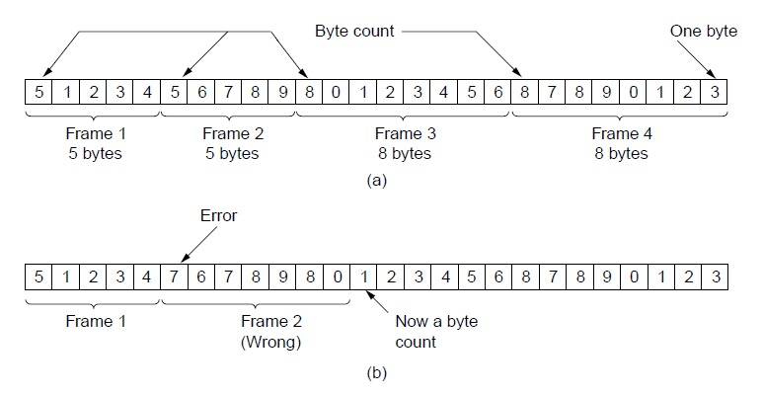
Framing
A byte stream. (a) Without errors. (b) With one error.

Slide 16
Framing Flag Bytes with Byte Stuffing
Have each frame start and end with special bytes, often the same byte, called a flag byte.
If the receiver loses synchronization, it can search for two flag bytes to find the end of the current frame and the start of the next frame.
Problem: flag byte may occur in the data.
Solution: insert a special escape byte (ESC) before each “accidental” flag byte in the data.
This solution is called byte stuffing.
The data link layer on the receiver removes the escape byte before giving the data to the link layer.

Slide 17
Framing Flag Bytes with Byte Stuffing
Problem: escape byte may occur in the data
Solution: insert an escape byte before each “accidental” escape byte in the data.
This solution is called byte stuffing.
At the receiver, the first escape byte is removed, leaving the data byte that follows.
In all cases, the byte sequence after destuffing is exactly the same as the original byte sequence.
We can still search for a frame boundary by looking for two flag bytes in a row.

Slide 18
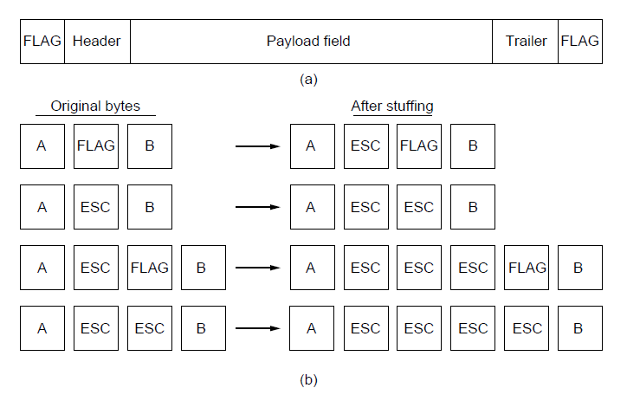
Framing
A frame delimited by flag bytes.
Four examples of byte sequences before and after byte stuffing.

Slide 19
Framing Flag Bits with Bit Stuffing
Byte stuffing is tied to the use of 8-bit byte.
Framing can also be done at the bit level.
Each frame begins and ends with a special bit pattern 01111110.
Whenever the sender’s data link layer encounters 5 consecutive 1s in the data, it stuffs a 0 bit into the outgoing bit stream.
When the receiver sees 5 consecutive incoming 1 bits, followed by a 0 bit, it destuffs the 0 bit.
If the user data contain the flag pattern 01111110, this is transmitted as 011111010.
With bit stuffing, the boundary between two frames can be unambiguously recognized by the flag pattern.

Slide 20
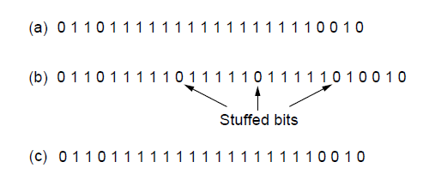
Framing
Bit stuffing. (a) The original data. (b) The data as they appear on
the line. (c) The data as they are stored in the receiver’s memory after destuffing.

Slide 21
Framing Physical Layer Coding Violations
Side effect of bit and byte stuffing: the length of a frame depends on the contents of the data.
If there are no flag bytes in the data, 100 bytes is carried in a frame of about 100 bytes.
If the data consists solely of flag bytes, each flag byte will be escaped, and the frame will be around 200 bytes.
With bit stuffing, the increase would be about 12.5% since 1 bit is added to every byte.

Slide 22
Framing Physical Layer Coding Violations
The encoding of bits as signals often includes redundancy.
In the 4B/5B code, 4 bits are mapped to 5 bits to ensure sufficient bit transitions.
16 out of 32 signal possibilities are not used.
We can use some reserved signals to indicate the start and end of frames. Using code violations to delimit frames.
Since they are reserved signals, there is no need to stuff the data.

Slide 23
Error Control
Assume that the receiver can tell whether a frame contains correct or faulty information (introduced later in this chapter).
The usual way to ensure reliable delivery is to provide the sender with some feedback.
If the sender receives a positive acknowledgement about a frame, it knows the frame has arrived safely.
If the sender receives a negative acknowledgement about a frame, the sender may retransmit the frame.

Slide 24
Error Control
Problem: the frame may be lost completely, then the receiver will not react at all (no positive or negative acknowledgement)
Solution: introducing timers into the data link layer.
When the sender transmits a frame, it also starts a timer.
The timer is set to expire after an interval long enough for the frame to reach the destination, be processed, and have the acknowledgement propagate back to the sender.
If either the frame or the acknowledgement is lost, the timer will go off, the sender may transmit the frame again.

Slide 25
Error Control
Problem: the frames may be transmitted multiple times, and the receiver will accept the same frame multiple times.
Solution: assign sequence numbers to outgoing frames, so that the receiver can distinguish retransmissions from originals.

Slide 26
Flow Control
A sender that systematically wants to transmit frames faster than the receiver can accept them.
The sender is running on a fast, powerful computer and the receiver is running on a slow, low-end machine.
Two solutions:
Feedback-based flow control. The receiver sends back information to the sender giving it permission to send more data.
Rate-based flow control. A built-in mechanism that limits the rate at which senders may transmit data

Slide 27
Error Detection and Correction
Error-detecting codes.
Include enough redundancy to allow the receiver to deduce that an error has occurred (but not which error), and request a retransmission.
Cheaper for channels that are highly reliable, e.g., fiber, and just retransmit the occasional faulty block
Error-correcting codes
Include enough redundancy to enable the receiver to deduce what the transmitted data must have been.
Often referred to as FEC (Forward Error Correction).
For channels that make many mistakes, e.g., wireless. Retransmission are likely to be faulty as the first transmission.

Slide 28
Error Detection and Correction
Types of error is the key consideration.
Neither error-correcting codes nor error-detecting codes can handle all possible errors.
The redundant bits are as likely to be received in error as the data bits.
Model 1: isolated single-bit errors.
Caused by extreme values of thermal noise
Brief and occasionally
Model 2: bursty errors.
Caused by deep fade on a wireless channel or transient electrical interference on a wired channel.

Slide 29
Error Detection and Correction
Bursty error model compared with isolated single-bit error model
Advantage: if the block size is 1000 bits and the error rate is 0.001 per bit. With the isolated single-bit error model, most blocks will contain an error. If the errors come in bursts of 100, only one block out of 100 would be affected.
Disadvantage: harder to correct
Other types of error models:
Erasure channel: the location of an error is known, perhaps because the received analog signal is far from the expected value for a 0 or a 1.

Slide 30
Error-Correcting Codes
Hamming codes.
Binary convolutional codes.
Reed-Solomon codes.
Low-Density Parity Check codes.

Slide 31
Error-Correcting Codes
A frame consists of
m data bits
r redundant (check) bits
Block code:
The r check bits are computed solely as a function of the m data bits with which they are associated.
Systematic code:
The m data bits are sent directly, along with the check bits, rather than being encoded themselves.
Linear code:
The r check bits are computed as a linear function of the m data bits.

Slide 32
Error-Correcting Codes
The total length of a block is n = m+r, called an (n,m) code.
An n-bit unit containing data and check bits is referred to as n-bit codeword.
Code rate: m/n. the fraction of the codeword that carries non-redundant information.
E.g., ½ for a noisy channel, close to 1 for a high-quality channel.

Slide 33
Error-Correcting Codes
Given two transmitted and received codewords, e.g., 10001001 and 10110001, we determine how many corresponding bits differ but XORing them and count the number of 1s.
10001001
10110001
--------------
00111000
Hamming distance: the number of bit positions in which two codewords differ.
If two codes are d Hamming distance apart, it requires d single-bit errors to convert one into the other.

Slide 34
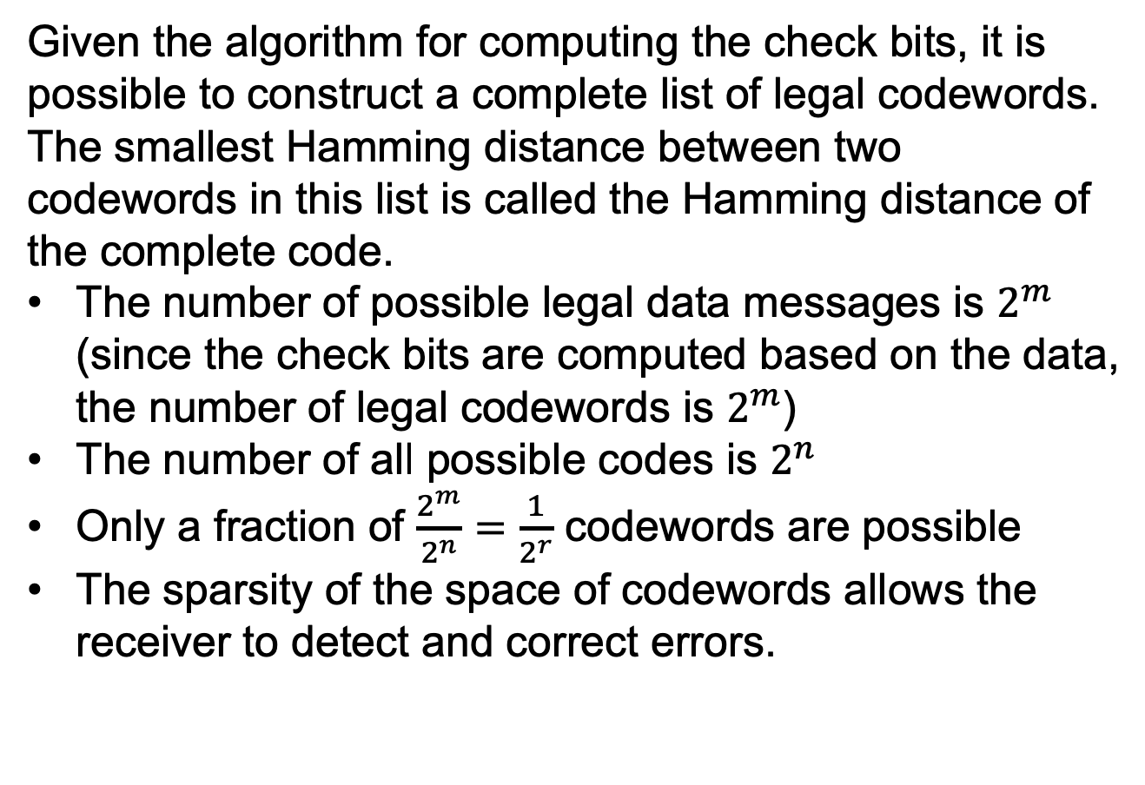
Error-Correcting Codes
Given the algorithm for computing the check bits, it is possible to construct a complete list of legal codewords. The smallest Hamming distance between two codewords in this list is called the Hamming distance of the complete code.
The number of possible legal data messages is $2^{m}$ (since the check bits are computed based on the data, the number of legal codewords is $2^{m}$)
The number of all possible codes is $2^{n}$
Only a fraction of $\frac{2^{m}}{2^{n}}=\frac{1}{2^{r}}$ codewords are possible
The sparsity of the space of codewords allows the receiver to detect and correct errors.

Slide 35
Error-Correcting Codes
The error detecting and correcting property of a block code depend on its Hamming distance.
To detect d errors, we need a distance d+1 code
There is no way that d single-bit errors can change a valid codeword into another valid codeword.
To correct d errors, we need a distance 2d+1 code
With d single-bit errors, the codeword is still closer to the original codeword.

Slide 36
Error-Correcting Codes
An example of an error-correcting code. There are only 4 valid codewords.
0000000000 0000011111 1111100000 1111111111
The distance is 5, can detect 4-bit errors and correct 2-bit errors.
Correct 2-bit errors: if we receive 0000000111, and only expect 2-bit errors, we know the original code is 0000011111.
Cannot correct 3-bit errors: If a 3-bit error may happen, we do not know whether the original code is 0000000000 or 0000011111

Slide 37
Error-Correcting Codes
An example of an error-correcting code. There are only 4 valid codewords.
0000000000 0000011111 1111100000 1111111111
The distance is 5, can detect 4-bit errors and correct 2-bit errors.
Detect 4-bit errors: if we receive 0000001111, and only expect 4-bit errors, we know the code is wrong. If we receive 0000011111, and only expect 4-bit errors, we know the code is right.
Cannot detect 5-bit errors: if we receive 0000011111, we do not know whether it is right or the original code is 0000000000 (converted to 0000011111 with 5-bit errors)

Slide 38
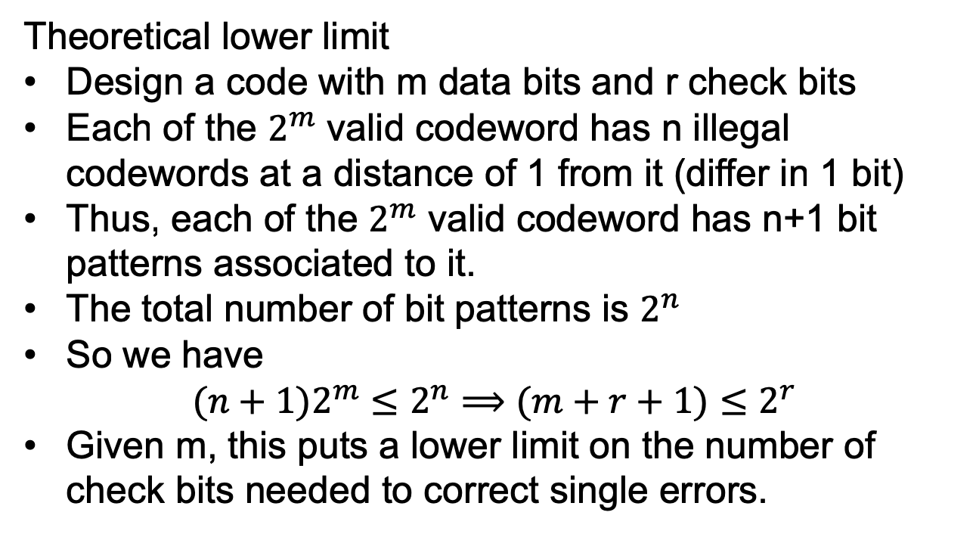
Error-Correcting Codes
Theoretical lower limit
Design a code with m data bits and r check bits
Each of the $2^{m}$ valid codeword has n illegal codewords at a distance of 1 from it (differ in 1 bit)
Thus, each of the $2^{m}$ valid codeword has n+1 bit patterns associated to it.
The total number of bit patterns is $2^{n}$
So we have
$$(n+1)2^{m}≤2^{n}⟹(m+r+1)≤2^{r}$$
Given m, this puts a lower limit on the number of check bits needed to correct single errors.

Slide 39
Error-Correcting Codes Hamming Codes
Sender:
The bits of the codeword are numbered consecutively.
The bit positions that are powers of 2 (1,2,4,8,…) are check bits.
The rest bits are data bits
Each check bit forces the modulo 2 sum (or parity) or some collection of bits (including itself) to be even (or odd).
Receiver
Redo the check bit computations. If the check bits are correct, the codeword is accepted as valid.
If not, use the error syndrome to pinpoint and correct the single-bit error

Slide 40
Error-Correcting Codes Hamming Codes
The example in the next page (7,11) Hamming codes
Position 1 = 1
Position 2 = 2
Position 3 = 1+2
Position 4 = 4
Position 5 = 1+4
Position 6 = 2+4
Position 7 = 1+2+4
Position 8 = 8
Position 9 = 1+8
Position 10 = 2+8
Position 11 = 1+2+8
Position 1, 3, 5, 7, 9, 11 contributes to check bit 1, position 2, 3, 6, 7, 10, 11 contributes to check bit 2, position 4, 5, 6, 7 contributes to check bit 4, position 8, 9, 10, 11 contributes to check bit 8.
The sum of the bit positions contributing to each check bit is 0 (modulo 2).

Slide 41
Error-Correcting Codes Hamming Codes
The received code is 00101001001.
We compute the sum of bit positions contributing to each check bit as 0101 (error syndrome).
The received code contains error.
The error occurs on 4+1 = 5 bit position. (convert the binary error syndrome to decimal number)
Flip the error bit and get the original valid codeword.
Note that this design can only correct single-bit errors.

Slide 42
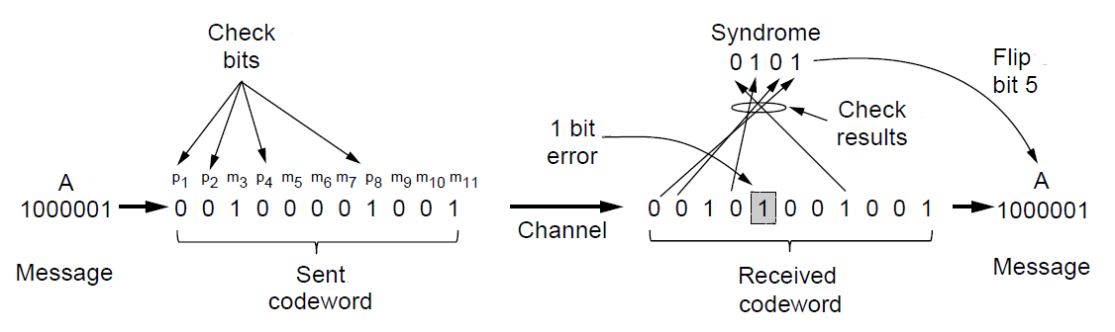
Hamming Codes
Example of an (11, 7) Hamming code correcting a single-bit error.

Slide 43
Error-Correcting Codes Convolutional Code
An encoder processes a sequence of input bits and generates a sequence of output bits.
The output depends on the current and previous input bits.
The encoder has memory.
The number of previous bits on which the output depends is called the constraint length of the code.
Convolutional codes are specified by code rate (m/n) and constraint length.
Not a block code.
Widely used in GSM, satellite communications, and 802.11.

Slide 44
Error-Correcting Codes Convolutional Code
An example, r = ½, constraint length = 7.
Each input bit produces two output bits that are XOR sums of the input and the internal state.
A binary, linear code.
Since 1 input bit produces 2 output bits, the code rate is r = ½

Slide 45
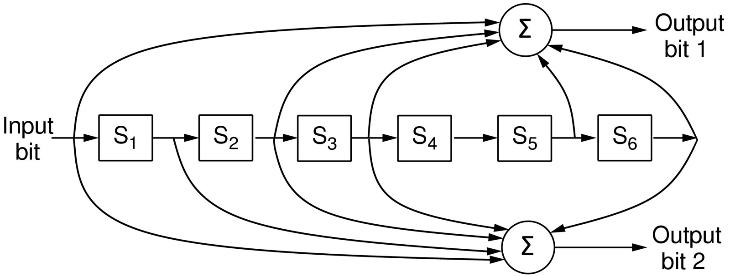
Convolutional Codes
The NASA binary convolutional code used in 802.11.

Slide 46
Error-Correcting Codes Convolutional Code
The internal state is kept in six memory registers. Each time another bit is input, the values in the registers are shifted to the right.
E.g., if 111 is input and the initial state is all zeros, the internal state (left->right) will be 100000, 110000, 111000 after the 1st, 2nd, and 3rd bits have been input.
The output bits will be 11, 10, and 01.
It takes 7 shifts to flush an input completely so that it does not affect the output. Thus the constraint length is 7.
The decoding process is based on an algorithm developed by Viterbi (too complicated and ignored here)

Slide 47
Error-Correcting Codes Reed-Solomon Code
Linear block codes, often systematic too. We will explain it by analogy.
Reed-Solomon codes are based on the fact that every n degree polynomial is uniquely determined by n+1 points.
A line having the form ax+b is determined by 2 points. Extra points on the line is redundant, helpful for error correction.
We have two data points on a line and send them plus two check points that also lie on the same line.
If one point is received in error, we can recover the data points by fitting a line to the received points. 3 of the points will like on the line, and the wrong one will not. By finding the line, we can correct the error.

Slide 48
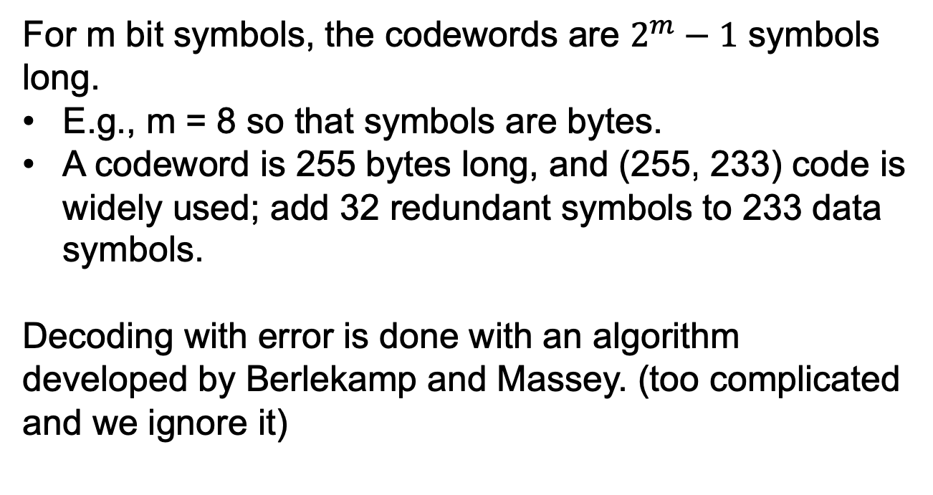
Error-Correcting Codes Reed-Solomon Code
For m bit symbols, the codewords are $2^{m}−1$ symbols long.
E.g., m = 8 so that symbols are bytes.
A codeword is 255 bytes long, and (255, 233) code is widely used; add 32 redundant symbols to 233 data symbols.
Decoding with error is done with an algorithm developed by Berlekamp and Massey. (too complicated and we ignore it)

Slide 49
Error-Correcting Codes Reed-Solomon Code
Widely used because of its strong error-correction properties.
DSL, data over cable, satellite communications
When 2t redundant symbols are added, a Reed-Solomon code can correct up to t errors in any of the transmitted symbols.
The (255,233) code adds 32 redundant symbols, and can correct up to 16 symbol errors. Since the symbols may be consecutive and each symbol is 8 bits, an error burst of up to 128 bits can be corrected.

Slide 50
Error-Correcting Codes Reed-Solomon Code
Reed-Solomon codes are often used in combination with other codes.
E.g., convolutional code.
Convolutional codes are good at handling isolated bit errors, but will fail for bursty errors.
Add a Reed-Solomon code within the convolutional code. The overall code provides good protection against both single and bursty errors.

Slide 51
Error-Correcting Codes LDPC code
LDPC (Low-Density Parity Check) code
Linear block codes
Each output bit is formed from only a fraction of the input bits.
A matrix representation of the code that has a low density of 1s.
The received codewords are decoded with an approximation algorithm.
Practical for large block sizes with excellent error-correcting abilities in practice.
Digital video broadcasting, 10 Gbps Ethernet, …

Slide 52
End
Chapter 3

