Slide 1
The Data Link Layer
Chapter 3

Slide 2
Error-Detecting Codes
Linear, systematic block codes
Parity.
Checksums.
Cyclic Redundancy Checks (CRCs).

Slide 3
Error-Detection Codes Parity
A single parity bit is appended to the data.
The parity bit is chosen so that the number of 1 bits in the codeword is even (or odd).
Compute the (even) parity bit as the modulo 2 sum or XOR of the data bits
For example, to send 1011010 with even parity, a bit is added to the end to make it 1011000. With odd parity, it becomes 10110101.
A code with a single parity bit has a Hamming distance of 2, since any single-bit error produces a codeword with the wrong parity.
It can detect single-bit errors.

Slide 4
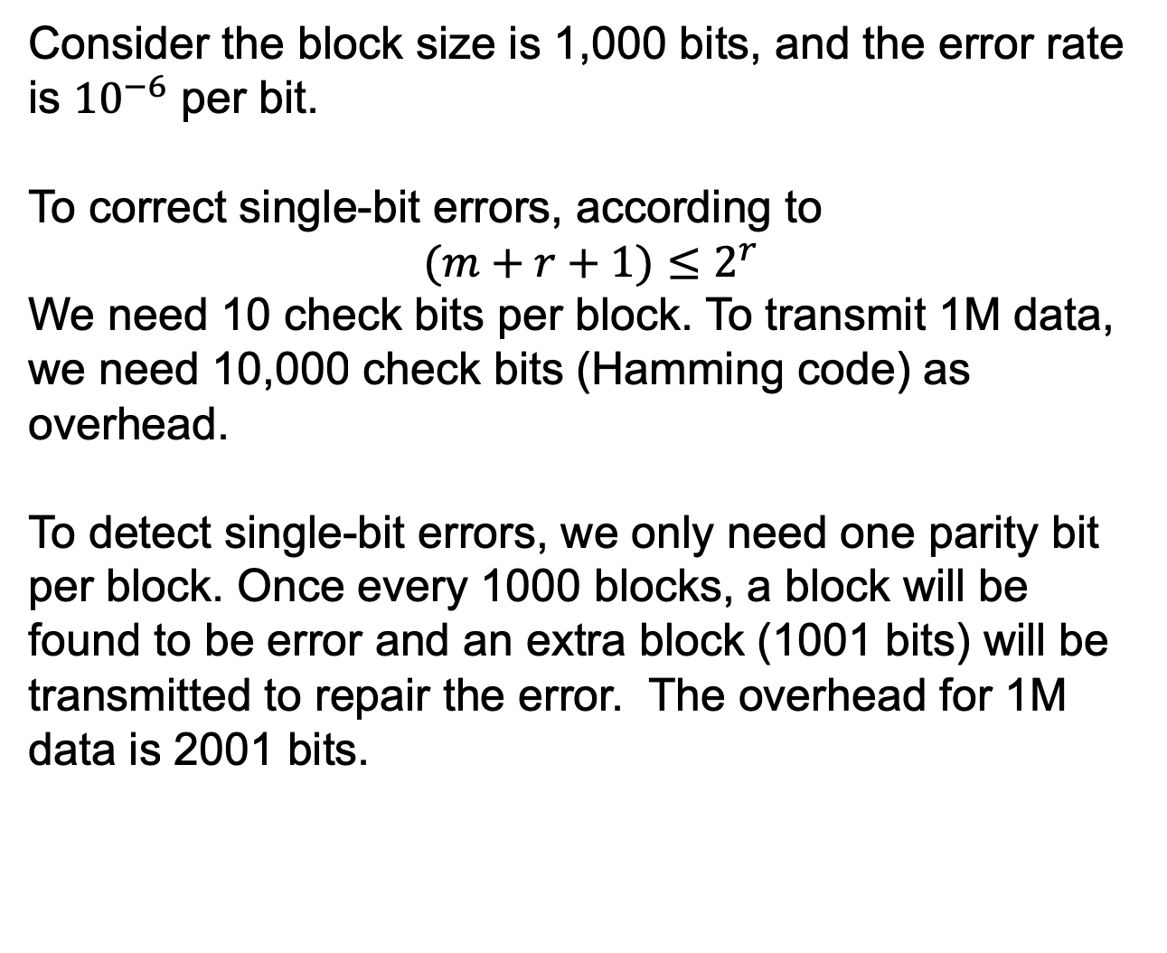
Error-Detection Codes Parity
Consider the block size is 1,000 bits, and the error rate is ${10}^{−6}$ per bit.
To correct single-bit errors, according to
$$(m+r+1)≤2^{r}$$
We need 10 check bits per block. To transmit 1M data, we need 10,000 check bits (Hamming code) as overhead.
To detect single-bit errors, we only need one parity bit per block. Once every 1000 blocks, a block will be found to be error and an extra block (1001 bits) will be transmitted to repair the error. The overhead for 1M data is 2001 bits.

Slide 5
Error-Detection Codes Parity
A single parity bit can only reliably detect a single-bit error in the block.
If the block is badly garbled by a long burst error, it is hard to detect the error.
We can represent the block as an n*k matrix, and compute one parity bit for each row. Up to k bit errors will be reliably detected if there is at most one error per row.

Slide 6
Error-Detection Codes Parity
Interleaving: compute the parity bits over the data in a different order than the order in which the data bits are transmitted.
Provide better protection against burst errors.
Compute a parity bit for each of the n columns
Send the data bits as k rows in the usual manner. At the last row, send the n parity bits.

Slide 7
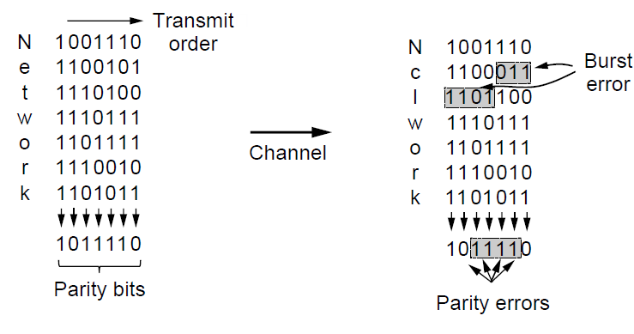
Error-Detecting Codes
Interleaving of parity bits to detect a burst error.

Slide 8
Error-Detection Codes Parity
Interleaving is a general technique to convert a code that detects/corrects isolated errors into a code that detects/corrects burst errors.
In the above figure, when a burst error of n=7 occurs, the bits that are in error are spread across different columns (a burst error does not imply that all the bits are wrong; it just implies that at least the first and last are wrong)
At most 1 bit in each of the n columns will be affected, so the parity bits on those columns will detect the error.
n parity bits are used on blocks of kn data bits to detect a single burst error of length n or less.

Slide 9
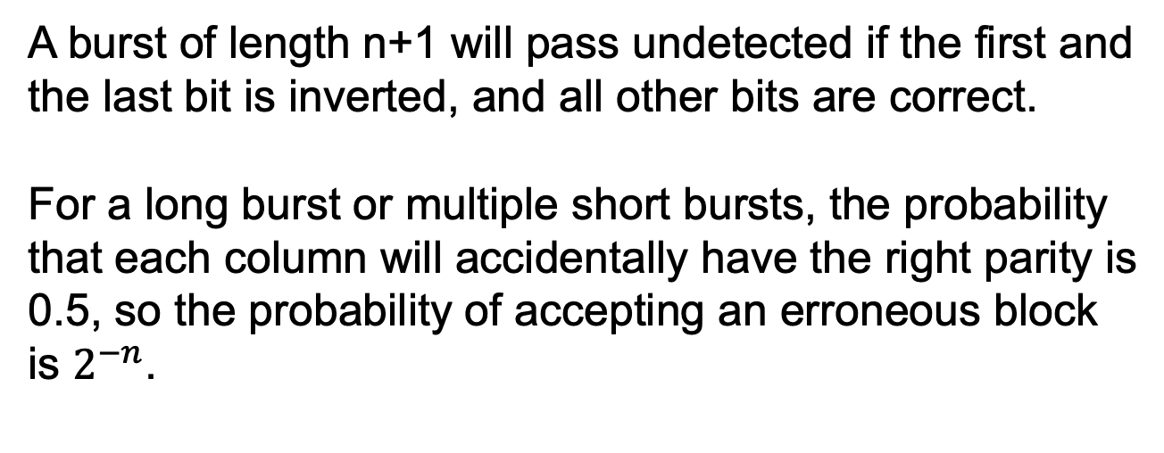
Error-Detection Codes Parity
A burst of length n+1 will pass undetected if the first and the last bit is inverted, and all other bits are correct.
For a long burst or multiple short bursts, the probability that each column will accidentally have the right parity is 0.5, so the probability of accepting an erroneous block is $2^{−n}$.

Slide 10
Error-Detection Codes Checksum
Checksum: a group of check bits associated with a message, regardless of how are calculated.
The checksum is usually placed at the end of the message, as the complement of the sum function.
Errors may be detected by summing the data bits and checksum.
If the result is 0, no error has been detected.

Slide 11
Error-Detection Codes Checksum
16-bit Internet checksum
Used on all Internet packets as part of the IP protocol.
A sum of the message bits divided into 16-bit words.
More protective than parity
If the lowest order bit in two different words is flipped from 0 to 1, the parity check will pass, but two 1s will be added to the 16-bit checksum to produce a different result, and the error will be detected.

Slide 12
Error-Detection Codes Checksum
16-bit Internet checksum
The checksum field is the 16-bit one’s complement of the one’s complement sum of 16-bit words in header.
One’s complement: a negative number is the bitwise complement of its positive counterpart.
E.g., one’s complement for 1000 is 0001.
For example, the header is 4500 0073 0000 4000 4011 c0a8 0001 c0a8 00c7
Calculate the sum of each 16-bit value word
4500 + 0073 + 0000 + 4000 + 4011 + c0a8 + 0001 + c0a8 + 00c7 = 2479C
The first digit is the carry count and is added to the sum: 2 + 479C = 479E
Take the one's complement of this result: B861

Slide 13
Error-Detection Codes Checksum
Fletcher’s checksum
Includes a positional component, adding the product of the data and its position to the running sum.
This provides stronger detection of changes in the position of data.

Slide 14
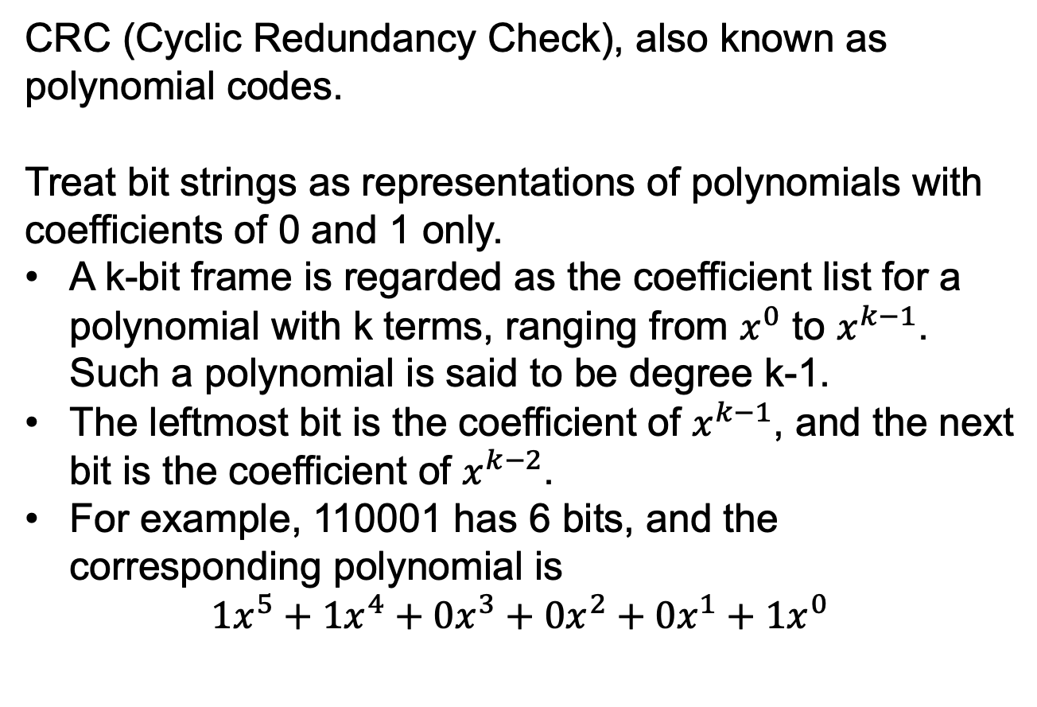
Error-Detection Codes CRCs
CRC (Cyclic Redundancy Check), also known as polynomial codes.
Treat bit strings as representations of polynomials with coefficients of 0 and 1 only.
A k-bit frame is regarded as the coefficient list for a polynomial with k terms, ranging from $x^{0}$ to $x^{k−1}$. Such a polynomial is said to be degree k-1.
The leftmost bit is the coefficient of $x^{k−1}$, and the next bit is the coefficient of $x^{k−2}$.
For example, 110001 has 6 bits, and the corresponding polynomial is
$${1x}^{5}+{1x}^{4}+{0x}^{3}+{0x}^{2}+{0x}^{1}+{1x}^{0}$$

Slide 15
Error-Detection Codes CRCs
Both addition and subtraction of polynomial arithmetic are identical to XOR:
10011011 00110011 11110000
+/- 11001010 +/- 11001101 +/- 10100110
------------------- ------------------- ------------------
01010001 11111110 01010110
The polynomial of the m-bit frame is M(x).
The sender and the receiver must agree upon a generator polynomial G(x).
M(x) must be longer than G(x).
The highest and lowest coefficient of G(x) must be 1.

Slide 16
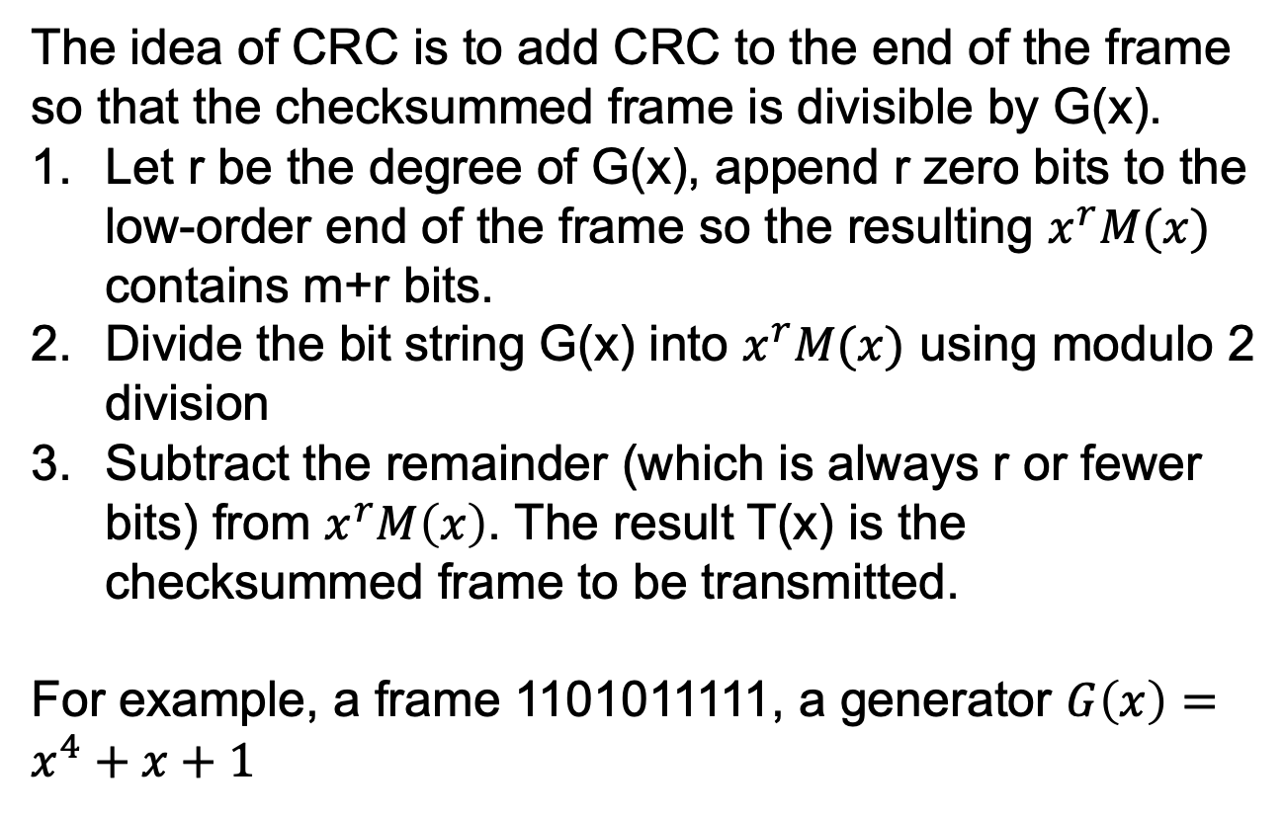
Error-Detection Codes CRCs
The idea of CRC is to add CRC to the end of the frame so that the checksummed frame is divisible by G(x).
Let r be the degree of G(x), append r zero bits to the low-order end of the frame so the resulting $x^{r}M(x)$ contains m+r bits.
Divide the bit string G(x) into $x^{r}M(x)$ using modulo 2 division
Subtract the remainder (which is always r or fewer bits) from $x^{r}M\left(x\right)$. The result T(x) is the checksummed frame to be transmitted.
For example, a frame 1101011111, a generator $G\left(x\right)=x^{4}+x+1$

Slide 17
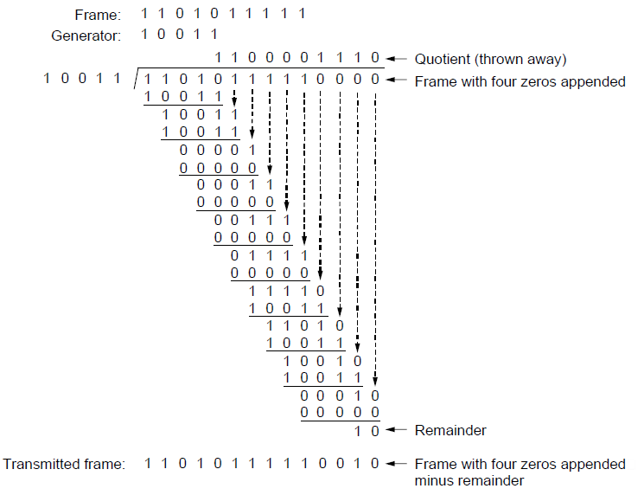
Error-Detecting Codes (3)
Example calculation of the CRC

Slide 18
Error-Detection Codes CRCs
T(x) is always divisible by G(x), since we subtract the remainder from the dividend.
E.g., in the base of 10, divide 8 by 3, the remainder is 2. If we subtract 2 from 8, the leftover is divisible by 3.
Error analysis.
Let E(x) denote the error. Each 1 bit in E(x) denotes a bit that has been inverted.
If k single-bit errors occurs, there are k 1 bits in E(x).
Upon receiving T(x)+E(x), the receiver computes [T(x)+E(x)]/G(x). We know T(x)/G(x)=0. so the computation is just E(x)/G(x).
The errors that make E(x)/G(x)=0 will not be detected, and others will be detected.

Slide 19
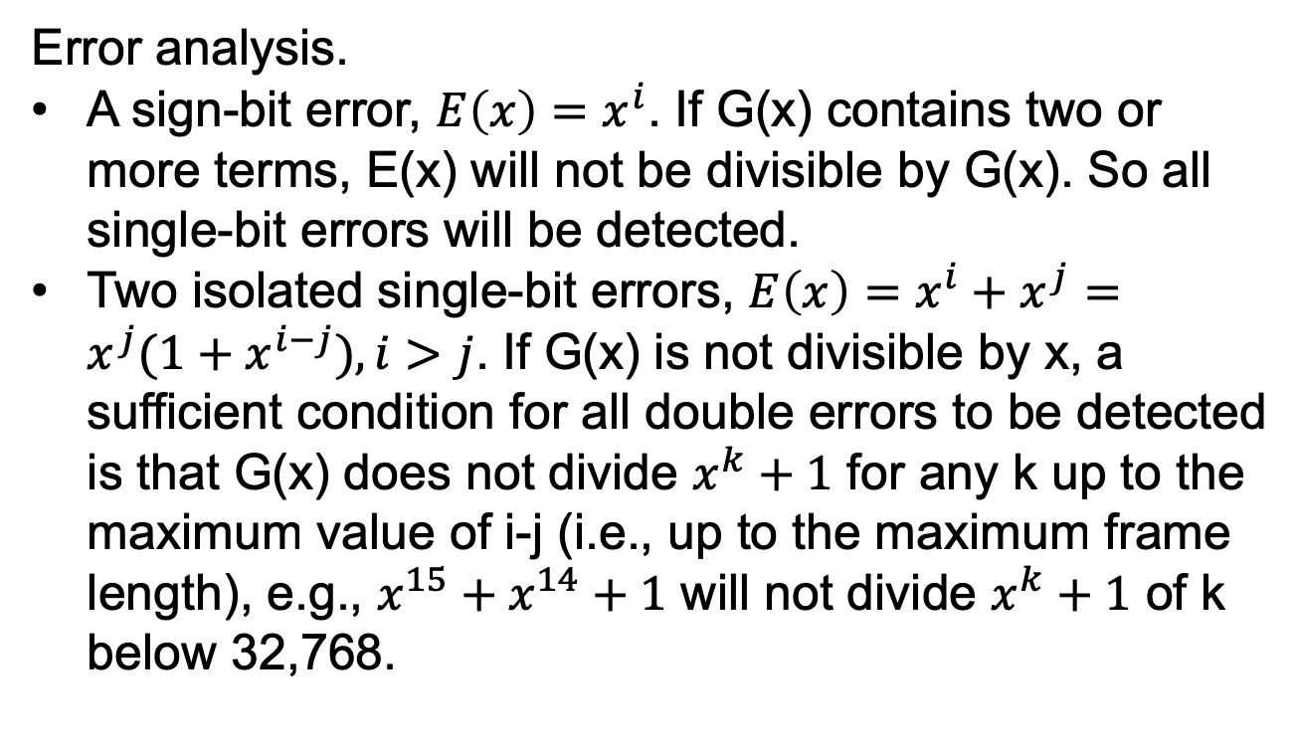
Error-Detection Codes CRCs
Error analysis.
A sign-bit error, $E\left(x\right)=x^{i}$. If G(x) contains two or more terms, E(x) will not be divisible by G(x). So all single-bit errors will be detected.
Two isolated single-bit errors, $E\left(x\right)=x^{i}+x^{j}=x^{j}(1+x^{i−j}), i>j$. If G(x) is not divisible by x, a sufficient condition for all double errors to be detected is that G(x) does not divide $x^{k}+1$ for any k up to the maximum value of i-j (i.e., up to the maximum frame length), e.g., $x^{15}+x^{14}+1$ will not divide $x^{k}+1$ of k below 32,768.

Slide 20
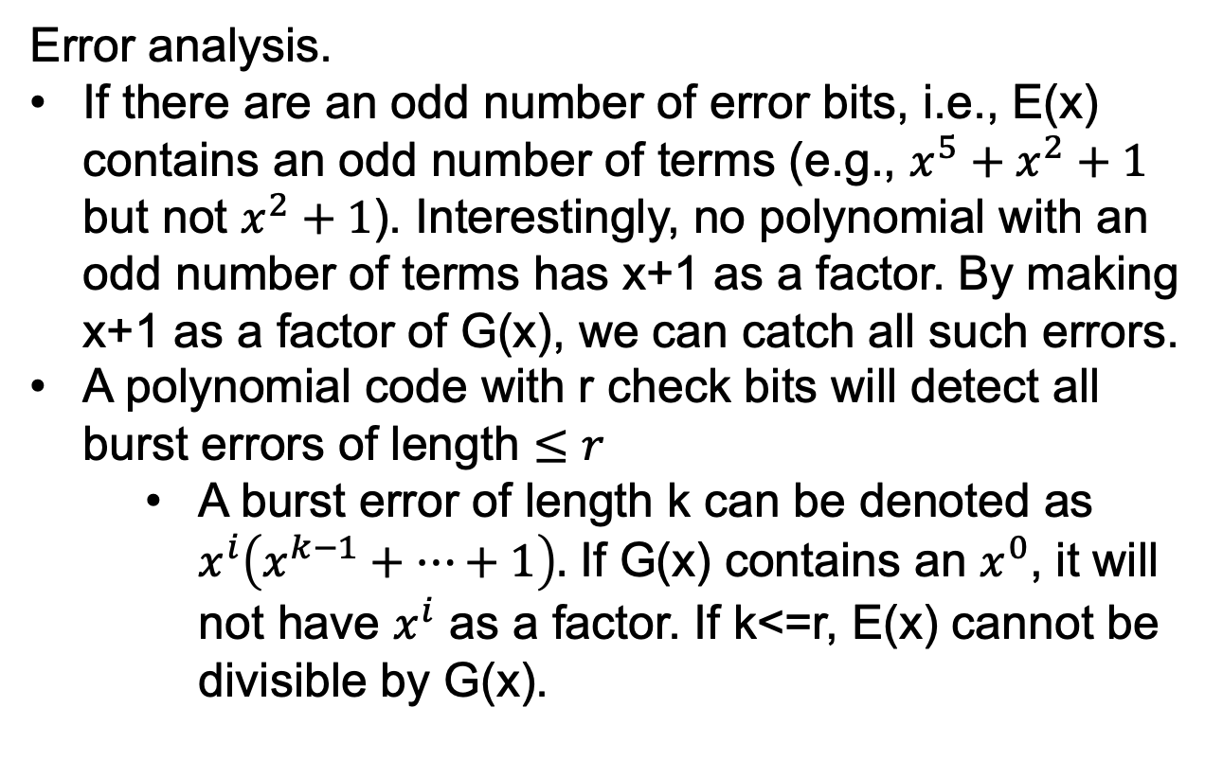
Error-Detection Codes CRCs
Error analysis.
If there are an odd number of error bits, i.e., E(x) contains an odd number of terms (e.g., $x^{5}+x^{2}+1$ but not $x^{2}+1$). Interestingly, no polynomial with an odd number of terms has x+1 as a factor. By making x+1 as a factor of G(x), we can catch all such errors.
A polynomial code with r check bits will detect all burst errors of length $≤r$
A burst error of length k can be denoted as $x^{i}\left(x^{k−1}+…+1\right).$ If G(x) contains an $x^{0}$, it will not have $x^{i}$ as a factor. If k<=r, E(x) cannot be divisible by G(x).

Slide 21
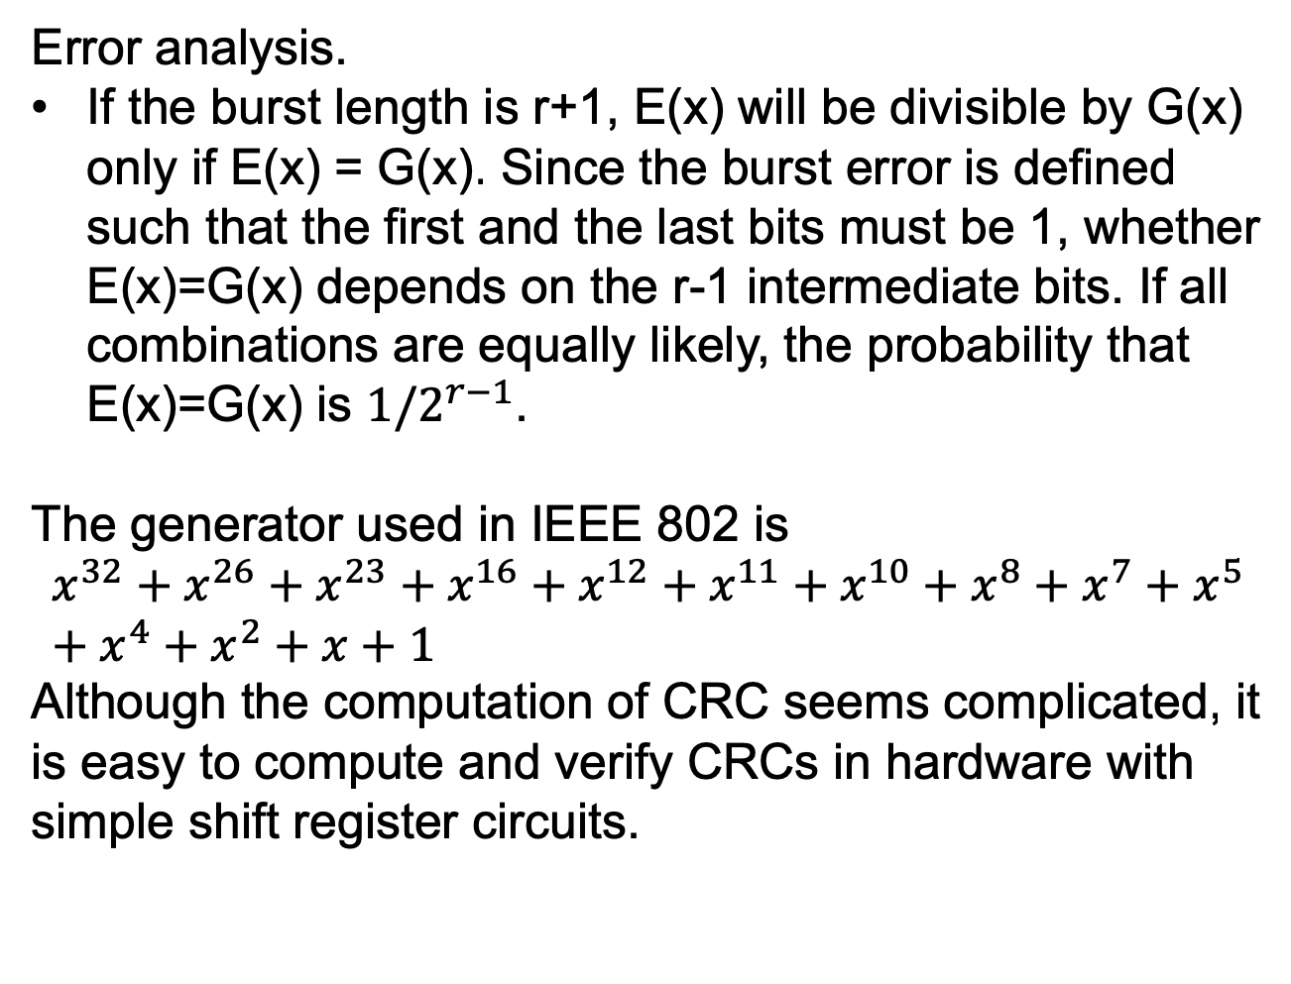
Error-Detection Codes CRCs
Error analysis.
If the burst length is r+1, E(x) will be divisible by G(x) only if E(x) = G(x). Since the burst error is defined such that the first and the last bits must be 1, whether E(x)=G(x) depends on the r-1 intermediate bits. If all combinations are equally likely, the probability that E(x)=G(x) is $1/2^{r−1}$.
The generator used in IEEE 802 is
$$x^{32}+x^{26}+x^{23}+x^{16}+x^{12}+x^{11}+x^{10}+x^{8}+x^{7}+x^{5}+x^{4}+x^{2}+x+1$$
Although the computation of CRC seems complicated, it is easy to compute and verify CRCs in hardware with simple shift register circuits.

Slide 22
Elementary Data Link Protocols
Utopian Simplex Protocol
Simplex Stop-and-Wait Protocol
Error-Free Channel
Simplex Stop-and-Wait Protocol
Noisy Channel

Slide 23
Elementary Data Link Protocols
The physical layer process and some of the data link layer process run on dedicate hardware called a NIC (Network Interface Card).
The rest of the link layer process and the network layer process run on the main CPU as part of the operating system, with the software for the link layer process often taking the form of a device driver.
We treat the three layers as separate processes to make the discussion cleaner.

Slide 24
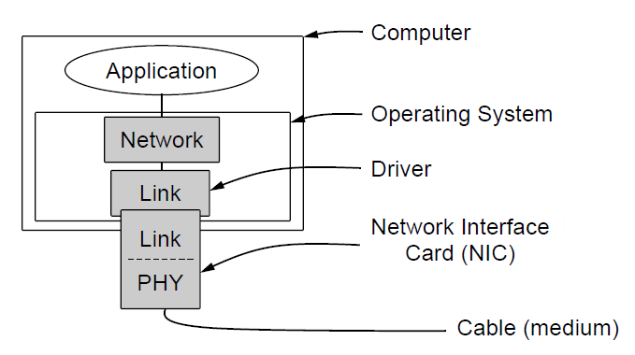
Elementary Data Link Protocols
Implementation of the physical, data link, and network layers.

Slide 25
Elementary Data Link Protocols
We consider the scenario where machine A wants to send a long stream of data to machine B using a reliable connection-oriented service.
We assume A has infinite supply of data to send and never has to wait for data to be produced. i.e., when A’s data link layer asks for data, the network layer is always able to comply immediately.
We assume that machines do not crash
A frame consists of an embedded packets, some control information (in the header), and a checksum (in the trailer). The frame is transmitted to the data link layer on the other machine.

Slide 26
Elementary Data Link Protocols
We assume that there exist suitable library procedures to_physical_layer to send a frame and from_physical_layer to receive a frame.
Initially, the receiver has nothing to do but waiting for something to happen by the procedure call wait_for_event(&event).
Upon return, the variable event tells what happened.
When a frame arrives at the receiver:
If the checksum is incorrect, the data link layer is informed (event =cksum_err).
If the checksum is correct, the data link layer is informed (event=frame_arrival)
The receiving data link layer checks the header of a correct frame, passes the packet to the network layer

Slide 27
Elementary Data Link Protocols
Under no circumstances is a frame header given to a network layer.
To keep the network and data link protocols completely separate.
The data link layer protocol can be changed without requiring changes to the network layer’s software.
E.g., a new NIC is installed in a computer.

Slide 28
Elementary Data Link Protocols
Common declarations used in the protocols.
Five data structures: boolean, seq_nr, packet, frame_kind, frame
boolean: true or false
seq_nr: a small integer to number the frames. The sequence numbers run from 0 to MAX_SEQ.
packet: the unit of information exchanged between the network layer and the data link layer on the same machine, or between network layer peers.
Always contains MAX_PKT bytes
frame: composed of four fields

Slide 29
Elementary Data Link Protocols
Common declarations used in the protocols.
Five data structures: boolean, seq_nr, packet, frame_kind, frame
frame: composed of four fields: kind, seq, ack and info
kind: whether there are data in the frame, some frames may only contain control information
seq/ack: sequence numbers and acknowledgements.
info: a single packet. The info field of a control frame is not used.

Slide 30
Elementary Data Link Protocols
Frame vs packet
The network layer builds a packet by taking a message from the transport layer and adding the network layer header to it.
The packet is passed to the data link layer for inclusion in the info field of a frame.
Upon arriving, the data link layer extracts the packet from the frame and passes the packet to the network layer.
The network layers seem to exchange packets directly.

Slide 31
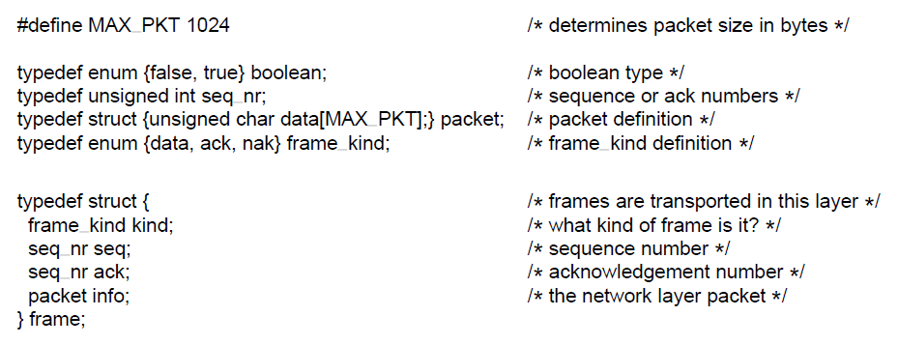
Elementary Data Link Protocols
. . .
Some definitions needed in the protocols to follow. These definitions are located in the file protocol.h.

Slide 32
Elementary Data Link Protocols
Common procedures used in the protocols.
wait_for_event: wait for something to happen
to_network_layer and from_network_layer: used by the data link layer to pass and accept packets to and from network layer
from_physical_layer and to_physical_layer pass frames between data link layer and the physical layer
Timeout events (event=timeout)
The frames may get lost. The data link layer starts a timer whenever a frame is sent. If no reply is received within a certain time interval, the clock times out.
start_timer and stop_timer turn the timer on or off.

Slide 33
Elementary Data Link Protocols
start_ack_timer and stop_ack_timer control an auxiliary timer to generate acknowledgement under certain conditions.
enable_network_layer and disable_network_layer is used when we don’t assume that the network layer always has packets to send.
enable_network_layer, the network layer is permitted to interrupt when it has a packet to be sent by indication event=network_layer_ready
disable_network_layer, it may not cause such events.

Slide 34
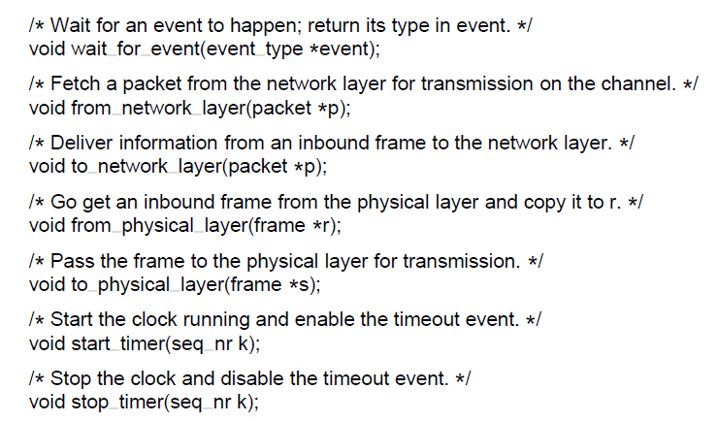
Elementary Data Link Protocols
. . .
Some definitions needed in the protocols to follow. These definitions are located in the file protocol.h.

Slide 35
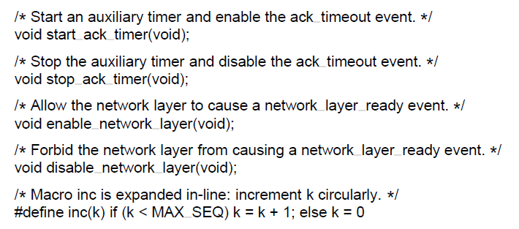
Elementary Data Link Protocols
Some definitions needed in the protocols to follow. These definitions are located in the file protocol.h.

Slide 36
A Utopian Simplex Protocols
Utopian scenario
Data are transmitted in one direction only
Both transmitting and receiving network layers are always ready
Processing time is ignored
Infinite buffer space is available
The communication channel between the data link layers never damages or loses frames.
The protocol consists of two distinct procedures, a sender and a receiver.
No sequence numbers or acknowledgements are used, so MAX_SEQ is not needed.
The only event type is frame_arrival.

Slide 37
A Utopian Simplex Protocols
The sender
An infinite while loop pumping data onto the line.
Go fetch a packet from the network layer
Construct a frame using the variable s
Send the frame
Only the info field is used since we do not consider error or flow control
The receiver
Wait for something to happen
The frame arrives and wait_for_event returns event = frame_arrival
The call to from_physical_layer removes the frame from the hardware buffer and puts it in the variable r.
The data portion is the passed on to the network layer.

Slide 38
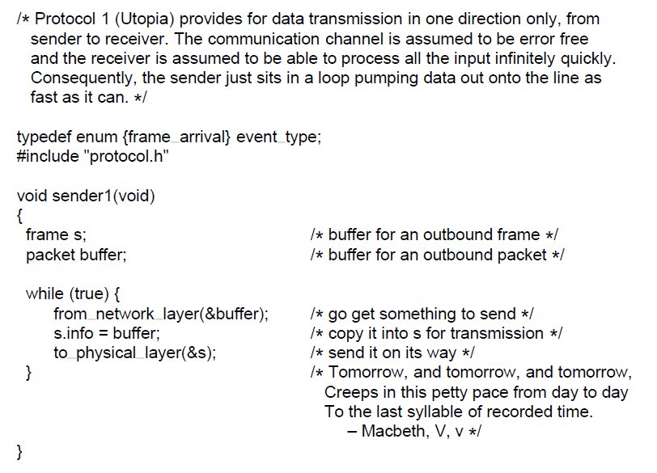
Utopian Simplex Protocol
. . .
A utopian simplex protocol.

Slide 39
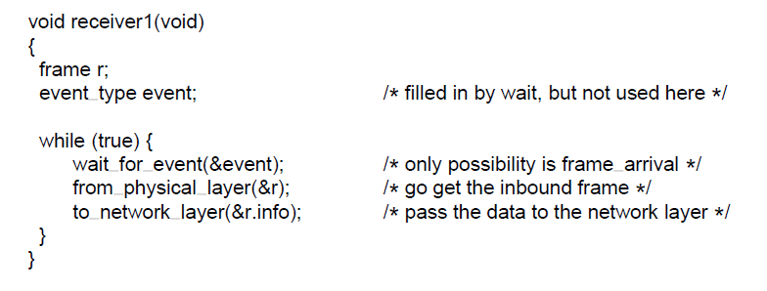
Utopian Simplex Protocol
A utopian simplex protocol.

Slide 40
A Simplex Stop-and-Wait Protocol for an Error-Free Channel
Tackle the problem of preventing the sender from flooding the receiver with frames faster than the latter is able to process them.
Assume the channel is error-free
The traffic is simplex
Stop-and-wait, a simple example of control flow
After having sent a frame, the sender is required by the protocol to wait for the little dummy (i.e., acknowledgement) frame
After having passed a packet to the network layer, the receiver sends a dummy frame to the sender to give permission to transmit the next frame.

Slide 41
A Simplex Stop-and-Wait Protocol for an Error-Free Channel
Unlike in protocol 1, the sender must wait until an acknowledgement frame arrives before looping back and fetching the next packet from the network layer.
The sending data link layer need not inspect the incoming frame as it is always an acknowledgement.
The only difference between receiver1 and receiver2 is that after delivering a packet to the network layer, receiver2 sends an acknowledgement frame back to the sender before entering the wait loop.

Slide 42
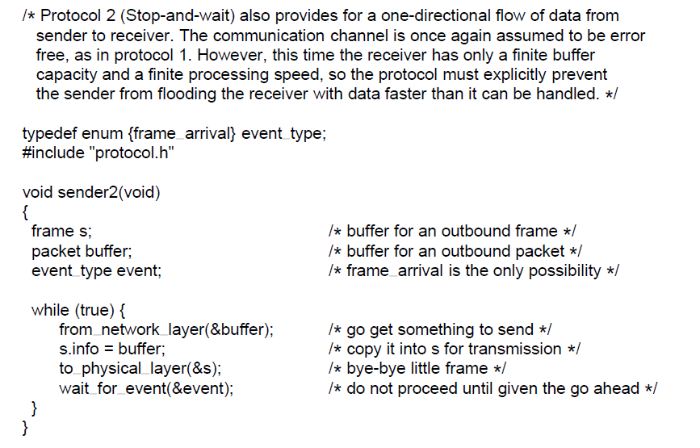
Simplex Stop-and-Wait Protocol for an Error-Free Channel
. . .
A simplex stop-and-wait protocol.

Slide 43
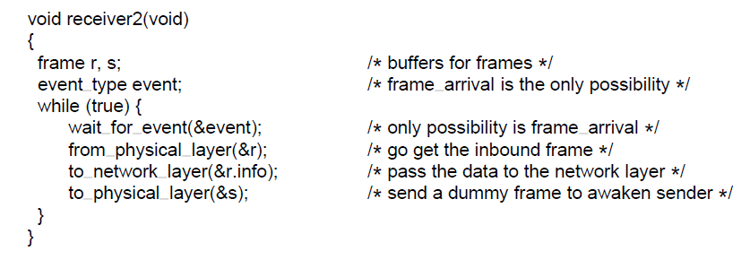
Simplex Stop-and-Wait Protocol for an Error-Free Channel
A simplex stop-and-wait protocol.

Slide 44
A Simplex Stop-and-Wait Protocol for a Noisy Channel
Consider the normal situation that frames may be damaged or lost.
Assume that the receiver can detect the damage by computing the checksum.
If the frame is damaged but the checksum is correct, this protocol will fail.
Problem of simple timeout-based retransmission: The network layer on B has no way of knowing that a packet has been lost or duplicated, so the data link layer must guarantee that no duplicate packet to be delivered to a network layer.

Slide 45
A Simplex Stop-and-Wait Protocol for a Noisy Channel
Consider the situation:
The network layer on A gives packet 1 to its data link layer. The packet is correctly received at B and passed to the network layer on B. B sends an acknowledgement to A
The acknowledgement frame gets lost completely.
The data link layer on A times out. Assuming the frame is lost or damaged, A sends the frame of packet 1 again.
The duplicate frame arrives intact at the data link layer on B and passed to the network layer.
If A is sending a file to B, part of the file will be duplicated.

Slide 46
A Simplex Stop-and-Wait Protocol for a Noisy Channel
For the receiver to distinguish a frame that is new from a retransmission, the sender can put a sequence number in the header of each frame it sends.
What is the minimum number of bits needed for the sequence number?
A 1-bit sequence number (0 or 1) is sufficient.
At each time, the receiver expects a particular sequence number first. When the frame with the correct sequence number arrives, it is accepted and acknowledged. Then the expected number is inverted (1 becomes 0 and 0 becomes 1)
The frame with the wrong sequence number is rejected, and the last acknowledgement is repeated to let the sender know that the frame is received

Slide 47
A Simplex Stop-and-Wait Protocol for a Noisy Channel
ARQ (Automatic Repeat reQuest) or PAR (Positive Acknowledgement with Retransmission): protocols in which the sender waits for a positive acknowledgement before sending the next data item.
Different from Protocols 1 and 2, Protocol 3 has a variable next_frame_to_send for the sender to remember the sequence number of the next frame, and variable frame_expected for the receiver to remember to the sequence number of the next frame.

Slide 48
A Simplex Stop-and-Wait Protocol for a Noisy Channel
After transmitting a frame, the sender starts the timer, and waits for events to happen. 3 possibilities.
An acknowledgment frame arrives undamaged, the sender fetches the next packet from the network layer, and advances the sequence number.
A damaged acknowledgement frame arrives
The time expires.
In both 2& 3, the sequence number is unchanged, and a duplicate is sent.
The timer should be long enough for the frame to reach the receiver, be processed, and for the acknowledgement to propagate back to the sender

Slide 49
A Simplex Stop-and-Wait Protocol for a Noisy Channel
When the receiver gets a frame
A valid frame, its sequence number is checked to see if it is a duplicate. If not, it is accepted, passed to the network layer, and an acknowledgement is generated.
Duplicates and damaged frames are rejected.

Slide 50
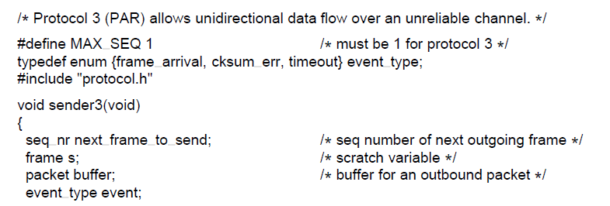
A Simplex Stop-and-Wait Protocol for a Noisy Channel
. . .
A positive acknowledgement with retransmission protocol.

Slide 51
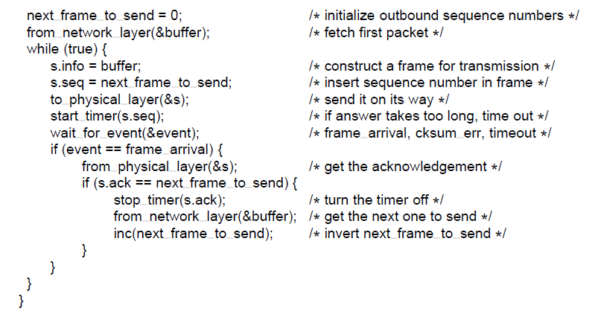
A Simplex Stop-and-Wait Protocol for a Noisy Channel
. . .
A positive acknowledgement with retransmission protocol.

Slide 52
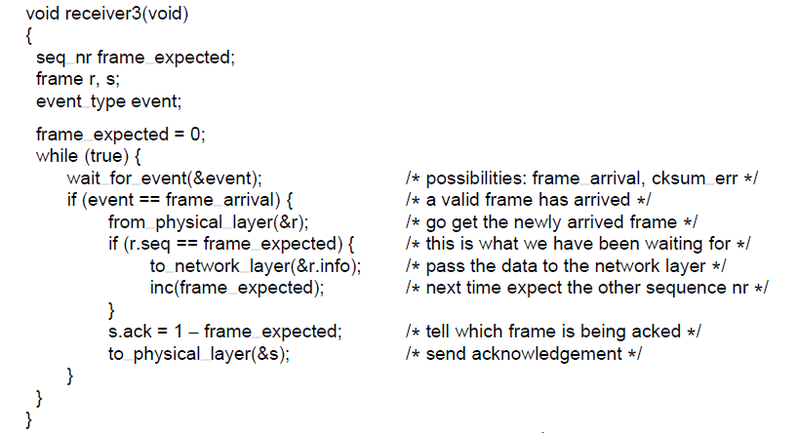
A Simplex Stop-and-Wait Protocol for a Noisy Channel
A positive acknowledgement with retransmission protocol.

Slide 53
Sliding Window Protocol
In the previous protocols, data frames were transmitted in one direction only.
Protocols 2&3 are half-duplex. The frames travel in both directions (data frame and acknowledgement frame), but a strict alternation of flow is required: first the sender sends the frame, then the receiver sends a frame, then the sender sends another frame. So the channel is half-duplex.
In most practical cases, there is a need to transmit data in both directions.
Solution 1: have two separate channels, each running the previous channels.
Solution 2: use one channel, and the kind field to distinguish data frame and acknowledgement frame

Slide 54
Sliding Window Protocol
Solution 3: piggybacking
When a data frame arrives, instead of immediately sending a separate control frame, the receiver waits until the network layer passes it the next packet. The acknowledgement is attached to the outgoing data frame (using the ack field in the header).
Using piggybacking is better than having distinct acknowledgement frame
The ack field in the header costs only a few bits, a separate frame will need a header, the acknowledgement, and a checksum.

Slide 55
Sliding Window Protocol
Problem of piggybacking: How long should the data link layer wait for a packet onto which to piggyback the acknowledgement?
If waiting longer than the sender’s timeout, the frame will be retransmitted.
An ad hoc solution: the data link layer waits a fixed duration. If a new packet arrives, the acknowledgement is piggypacked onto it. Otherwise, the data link layer sends a separate acknowledgement frame.

Slide 56
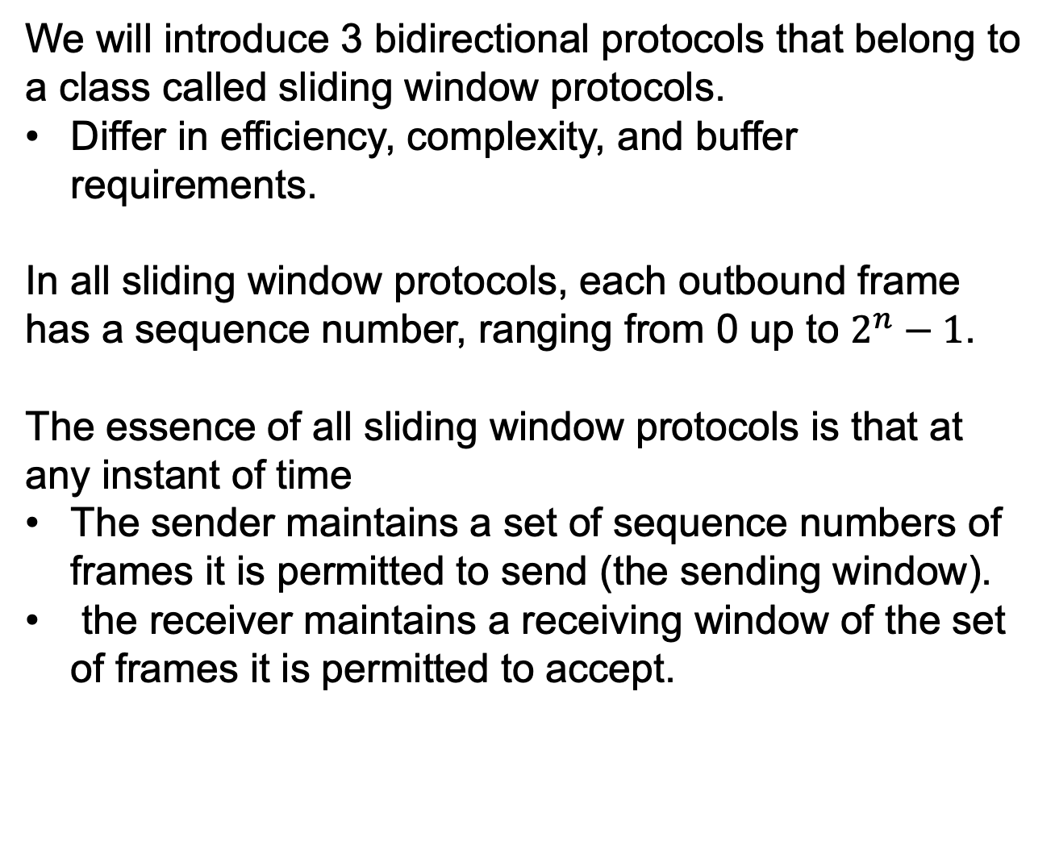
Sliding Window Protocol
We will introduce 3 bidirectional protocols that belong to a class called sliding window protocols.
Differ in efficiency, complexity, and buffer requirements.
In all sliding window protocols, each outbound frame has a sequence number, ranging from 0 up to $2^{n}−1$.
The essence of all sliding window protocols is that at any instant of time
The sender maintains a set of sequence numbers of frames it is permitted to send (the sending window).
the receiver maintains a receiving window of the set of frames it is permitted to accept.

Slide 57
Sliding Window Protocol
The sending window and the receiving window may be fixed in size or grow or shrink dynamically.
Sending window: frames that have been sent or can be sent but are as yet not acknowledged.
When a new packet arrives from the network layer, it is given the next highest sequence number, and the upper edge of the window is advanced by 1.
When an acknowledgement comes in, the lower edge is advanced by one.
If the maximum window size is n, n buffers are needed to hold the unacknowledged frames. If the maximum size is hit, the data link layer must shut off the network layer until another buffer becomes free.

Slide 58
Sliding Window Protocol
Receiving window: frames that may be accepted.
When a frame whose sequence number is equal to the lower edge of the window is received, it is passed to the network layer, and the window is rotated by one.
Any frame falling outside the window is discarded.
An acknowledgement is generated so that the sender may work out how to proceed.
Unlike the sending window, the receiving window always remains at its initial size, rotating as the next frame is accepted and delivered to the network layer.

Slide 59
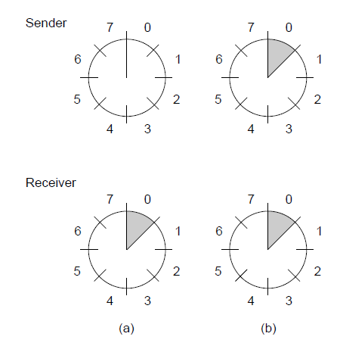
Sliding Window Protocols
A sliding window of size 1, with a 3-bit sequence number. (a) Initially. (b) After the first frame has been sent.

Slide 60
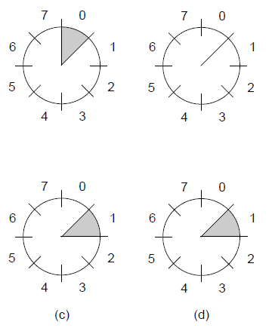


Sliding Window Protocols
A sliding window of size 1, with a 3-bit sequence number
(c) After the first frame has been received. (d) After the first acknowledgement has been received.

Slide 61
A One-Bit Sliding Window Protocol
The window size is 1.
next_frame_to_send: which frame the sender is trying to send
frame_expected: which frame the receiver is expecting.
Normal cases: one of the two data link layers goes first and transmit the first frame.
When the frame arrives, the receiving data link layer checks if it is a duplicate. The expected frame is passed to the network layer, and the receiver’s window is slid up.

Slide 62
A One-Bit Sliding Window Protocol
Normal cases: one of the two data link layers goes first and transmit the first frame.
The acknowledgement field contains the last frame received without error. If the number agrees with the sequence number of the frame the sender is trying to send, the sender fetched the next packet from the network layer; if not, the sender resend the same frame.

Slide 63
A One-Bit Sliding Window Protocol
One abnormal case: A and B initiate communication simultaneously.
In fig.(a) normal case: each frame arrival brings a new packet for the network layer, there are no duplicates.
In fig.(b) abnormal case: half of the frames contain duplicates, even though there are no transmission error.

Slide 64
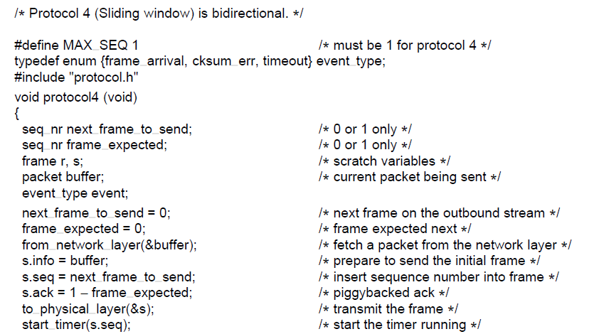
One-Bit Sliding Window Protocol
. . .
A 1-bit sliding window protocol.

Slide 65
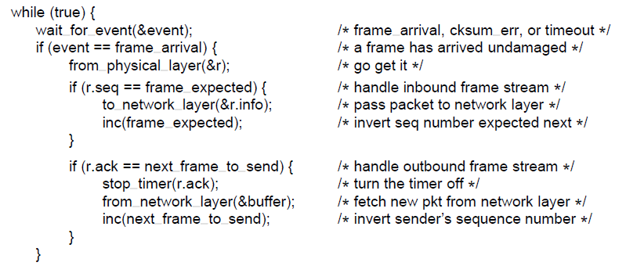
One-Bit Sliding Window Protocol
. . .
A 1-bit sliding window protocol.

Slide 66
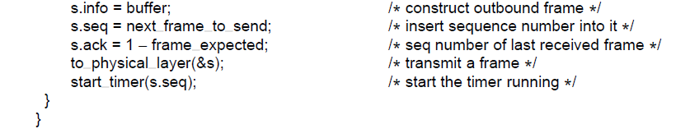
One-Bit Sliding Window Protocol
A 1-bit sliding window protocol.

Slide 67
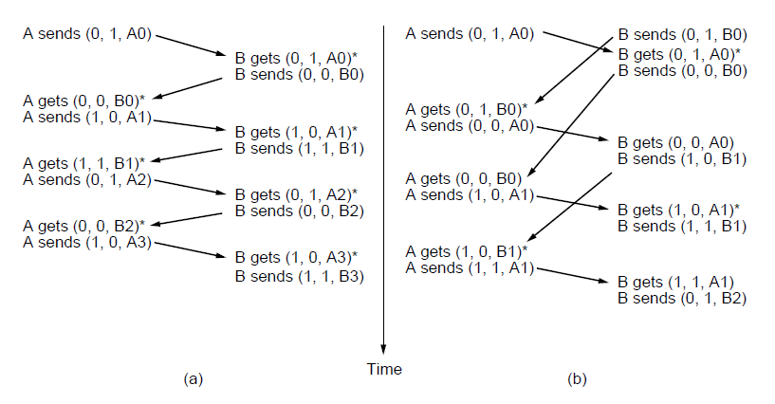
One-Bit Sliding Window Protocol
Two scenarios for protocol 4. (a) Normal case. (b) Abnormal
case. The notation is (seq, ack, packet number). An asterisk indicates where a network layer accepts a packet

Slide 68
A Protocol Using Go-Back-N
Problem with one-bit sliding window protocol:
Situations with long round-trip time, high bandwidth and short frame length.
E.g., a 50-kbps satellite channel, 500-msec round-trip delay, 1000-bit frame.
At t=0, the sender starts sending the first frame.
At t=20 msec, the frame has been completely sent.
At t=270 msec, the frame arrives at the receiver.
At t = 520 msec, the acknowledgement arrives at the sender.
The sender was blocked 500/520=96% of the time.
The problem is the result of the rule that the sender should wait for an acknowledgement before sending another frame.

Slide 69
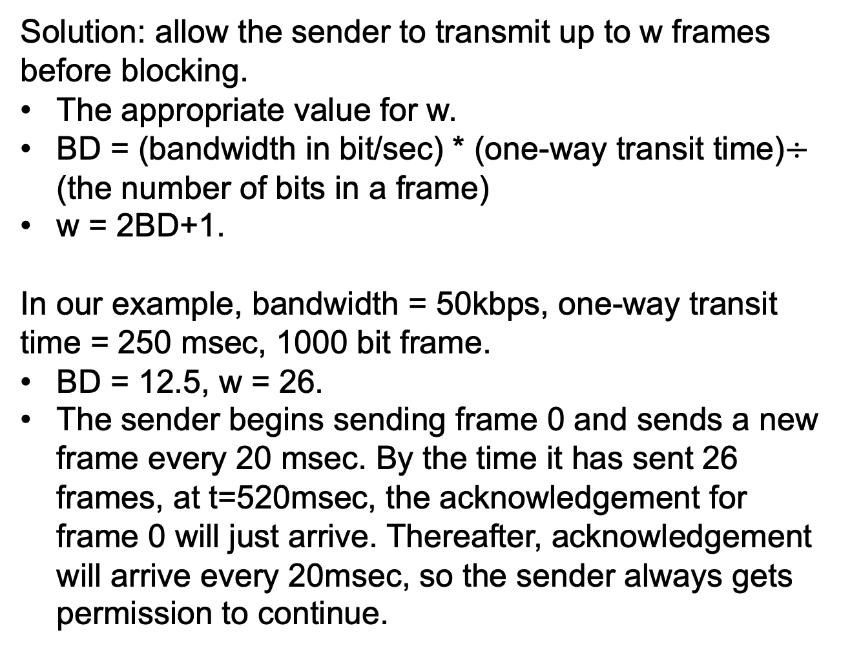
A Protocol Using Go-Back-N
Solution: allow the sender to transmit up to w frames before blocking.
The appropriate value for w.
BD = (bandwidth in bit/sec) * (one-way transit time)$÷$ (the number of bits in a frame)
w = 2BD+1.
In our example, bandwidth = 50kbps, one-way transit time = 250 msec, 1000 bit frame.
BD = 12.5, w = 26.
The sender begins sending frame 0 and sends a new frame every 20 msec. By the time it has sent 26 frames, at t=520msec, the acknowledgement for frame 0 will just arrive. Thereafter, acknowledgement will arrive every 20msec, so the sender always gets permission to continue.

Slide 70
A Protocol Using Go-Back-N
Pipelining: the technique of keeping multiple frames in flight.
Problem of pipelining: A frame in the middle of a long stream is damaged or lost, what should the receiver do with all the correct frames following it?
Solution 1: go-back-n. Discard all subsequence frames. A receiving window of size 1. The data link layer only accepts the next one it must give to the network layer.
Solution 2: selective repeat. Discard the bad frame, buffer the good frames. When the sender times out, only the oldest unacknowledged frame is retransmitted. The receiver may send an NAK when it detects an error.

Slide 71
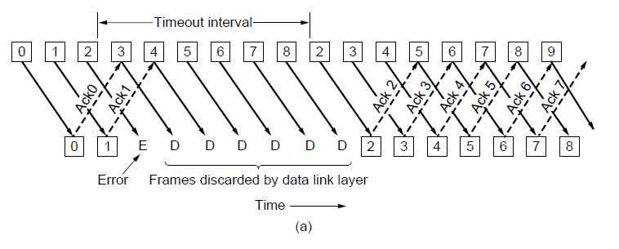
Protocol Using Go-Back-N
Pipelining and error recovery. Effect of an error when
(a) receiver’s window size is 1

Slide 72
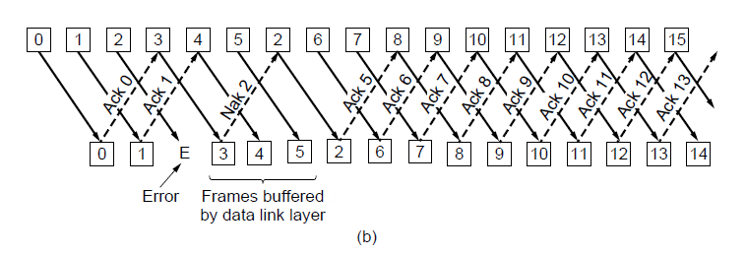
Protocol Using Go-Back-N
Pipelining and error recovery. Effect of an error when
(b) receiver’s window size is large.

Slide 73
A Protocol Using Go-Back-N
The following figure shows a go-back-n protocol in which the receiving data link layer only accepts frames in order; frames following an error are discarded.
Cumulative acknowledgement: when an acknowledgement comes in for frame n, frame n-1, n-2 and so on are also automatically acknowledged.

Slide 74
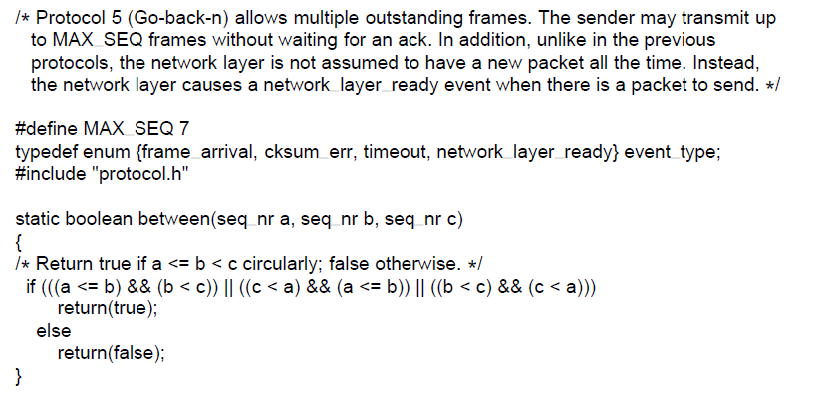
Protocol Using Go-Back-N
. . .
A sliding window protocol using go-back-n.

Slide 75
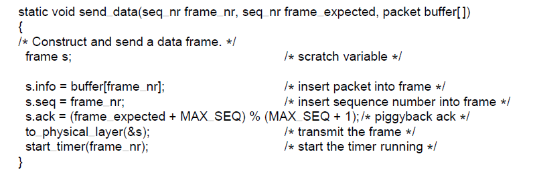
Protocol Using Go-Back-N
. . .
A sliding window protocol using go-back-n.

Slide 76
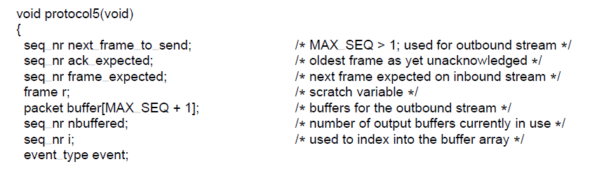
Protocol Using Go-Back-N
. . .
A sliding window protocol using go-back-n.

Slide 77
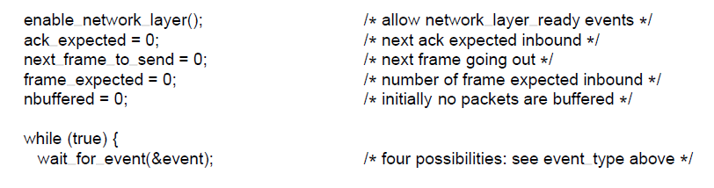
Protocol Using Go-Back-N
. . .
A sliding window protocol using go-back-n.

Slide 78
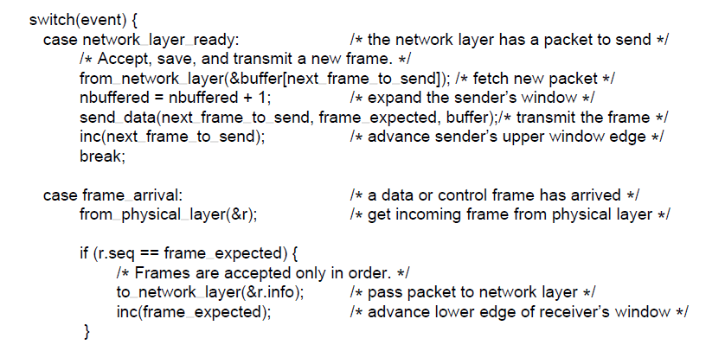
Protocol Using Go-Back-N
. . .
A sliding window protocol using go-back-n.

Slide 79
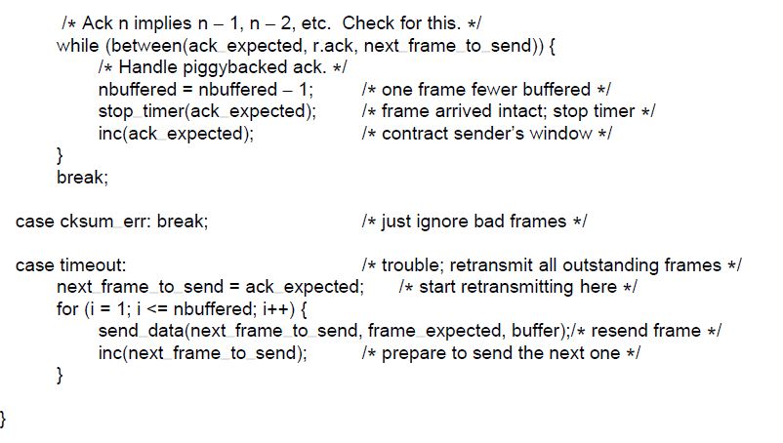
Protocol Using Go-Back-N
. . .
A sliding window protocol using go-back-n.

Slide 80
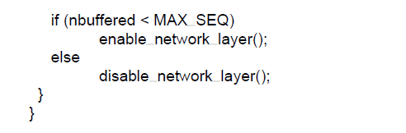
Protocol Using Go-Back-N
A sliding window protocol using go-back-n.

Slide 81
A Protocol Using Selective Repeat
Selective Repeat allows the receiver to accept and buffer the frames following a damaged or lost one.
Sender’s window: the size starts at 0 and grows to some predefined maximum
Receiver’s window: the size is fixed and equal to the predefined maximum.
The receiver has a buffer for each sequence number within its fixed window.
When a frame arrives, if its sequence number falls within the window and it has not already been received, it is accepted and stored. The frame must be kept within the data link layer and not passed to the network layer until all the lower-numbered frames are delivered to the network layer.

Slide 82
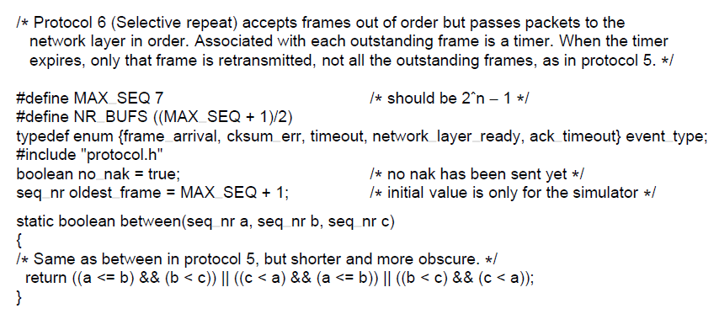
Protocol Using Selective Repeat
. . .
A sliding window protocol using selective repeat.

Slide 83
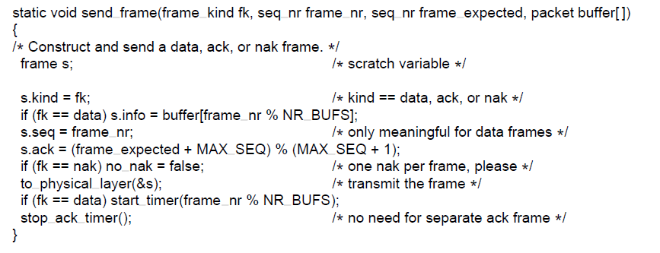
Protocol Using Selective Repeat
. . .
A sliding window protocol using selective repeat.

Slide 84
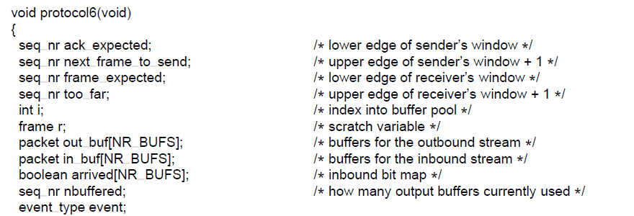
Protocol Using Selective Repeat
. . .
A sliding window protocol using selective repeat.

Slide 85
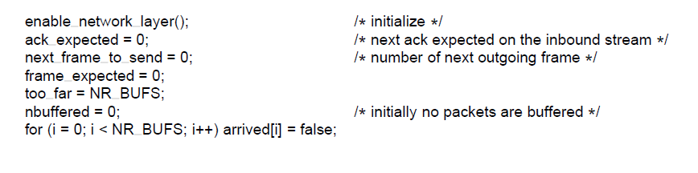
Protocol Using Selective Repeat
. . .
A sliding window protocol using selective repeat.

Slide 86
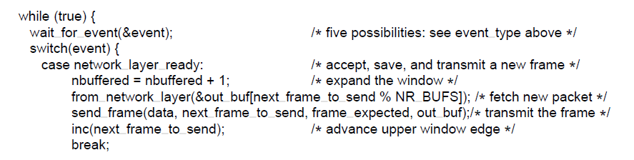
Protocol Using Selective Repeat
. . .
A sliding window protocol using selective repeat.

Slide 87
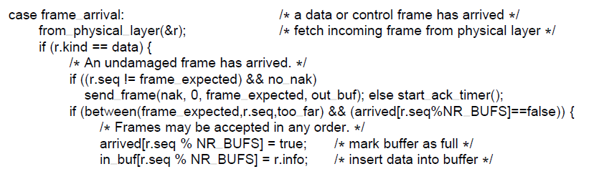
Protocol Using Selective Repeat
. . .
A sliding window protocol using selective repeat.

Slide 88
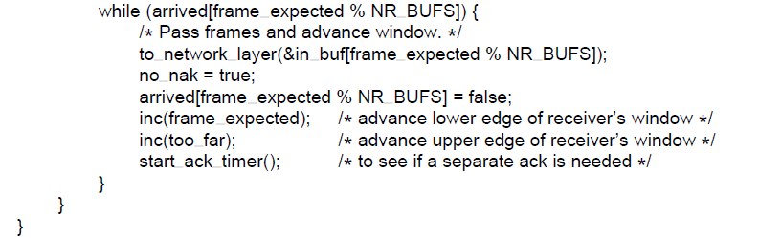
Protocol Using Selective Repeat
. . .
A sliding window protocol using selective repeat.

Slide 89
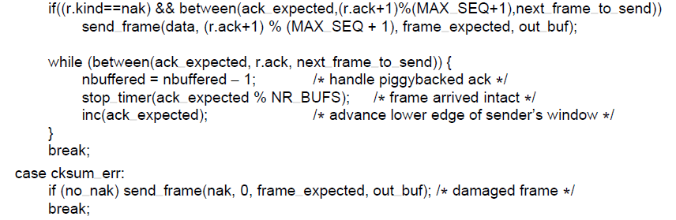
Protocol Using Selective Repeat
. . .
A sliding window protocol using selective repeat.

Slide 90
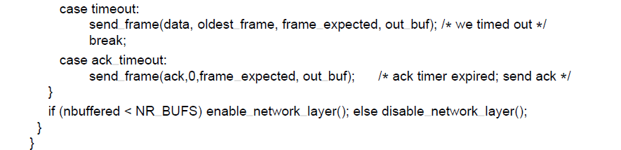
Protocol Using Selective Repeat
A sliding window protocol using selective repeat.

Slide 91
A Protocol Using Selective Repeat
The window size for Protocol 6 will be (MAX_SEQ+1)/2.
e.g., with 3 bits, the sequence number range from 0 to 7, the maximum window size is only (7+1)/2 = 4
The number of buffers need is equal to the window size, not to the range of sequence numbers.
If the receiver suspects an error, it sends back a negative acknowledgement (NAK) frame to request for retransmission of the frame specified in the NAK.

Slide 92
Example Data Link Protocols
Packet over SONET
ADSL (Asymmetric Digital Subscriber Loop)

Slide 93
Packet over SONET
SONET is the physical layer protocol most commonly used over the wide-area optical fiber links that make up the backbone of communication networks.
PPP (Point-to-Point Protocol) is used to send packets over these links:
PPP runs on IP routers to provide the framing mechanism for SONET.

Slide 94
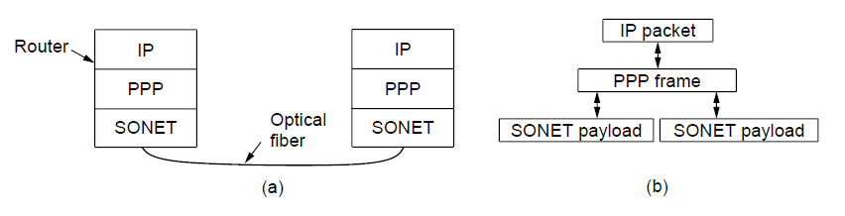
Packet over SONET
Packet over SONET. (a) A protocol stack. (b) Frame relationships

Slide 95
Packet over SONET
PPP features:
A framing method that unambiguously delineates the end of one frame and the start of the next one. Also handles error detection.
A link control protocol to establish and release links.
A network control protocol for each network layer supported.
PPP uses byte stuffing and all frames are an integral number of bytes.

Slide 96
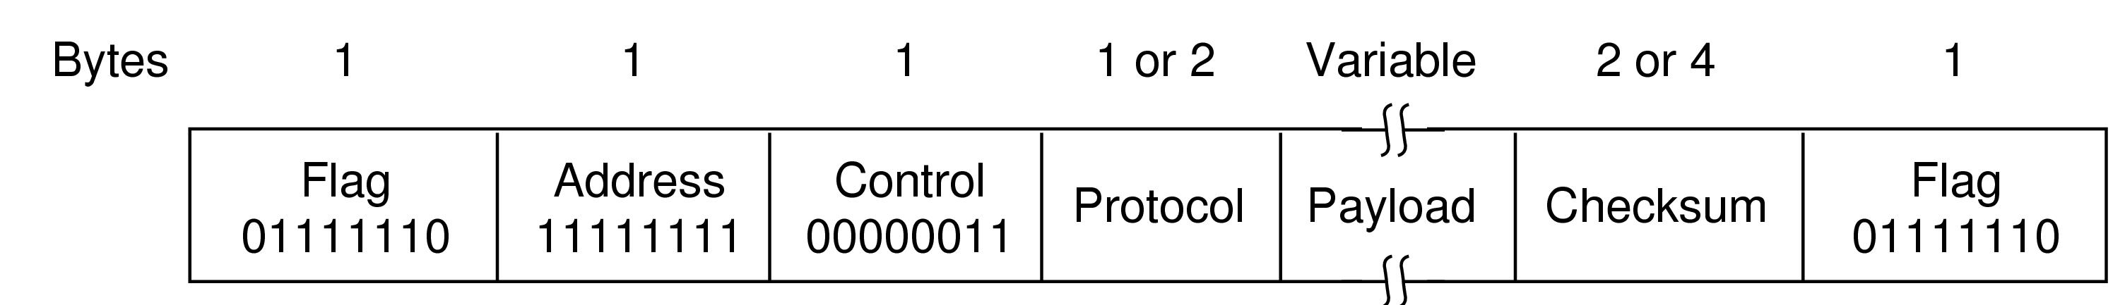
Packet over SONET
The PPP full frame format for unnumbered mode operation

Slide 97
Packet over SONET
PPP frame:
Flag field: 1 byte, 0x7E (01111110).
If the flag byte happens in the data, it is stuffed with the escape byte 0x7D, and the following byte is changed to 0x5E. For example 0x7D 0x5E is the escape sequence for the flag byte 0x7E. In this way, 0x7E will not happen in the data.
Only one flag byte is needed between frames.
Address field, default value is 11111111, all stations are to accept the frame.
Control field, default value is 00000011, indicates an unnumbered frame.

Slide 98
Packet over SONET
PPP frame:
Protocol field: what kinds of packet is in the Payload field, e.g., IPv4, IPv6, and other network layer protocols.
Payload field: variable length.
Checksum field: 2 or 4 bytes CRC.
PPP is a framing mechanism that can carry the packets of multiple protocols over many types of physical layers.
Before PPP frames can be carried over SONET lines, the PPP link must be established and configured.

Slide 99
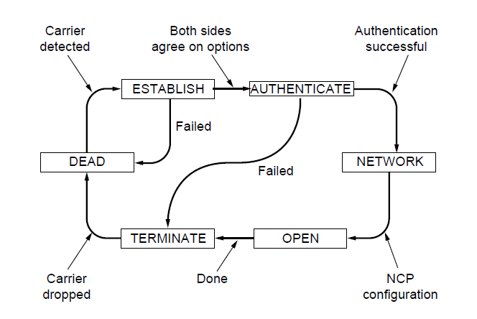
Packet over SONET
State diagram for bringing a PPP link up and down

Slide 100
Packet over SONET
DEAD state: there is no connection at the physical layer.
ESTABLISH state: a physical layer connection is established.
AUTHENTICATE state: the two parties can check each other’s identities.
NETWORK state: a series of packets are sent to configure the network layer.
OPEN state: data transport can start. IP packets are carried in PPP frames across the SONET links.
TERMINATE state: data transport is finished, drop the physical layer connection and go back to DEAD state.

Slide 101
ADSL
ADSL connects home subscribers to the Internet over the telephone local loop.
The DSL modem is added on the home side.
The PC sends IP packets to the DSL modem.
DSL model sends IP packets over the local loop to a device called DSLAM.
The DSLAM extracts the IP packets and enter an ISP network.
The PPP is the same as in SONET.
ATM and AAL5 are new protocols we’ve not seen before.

Slide 102
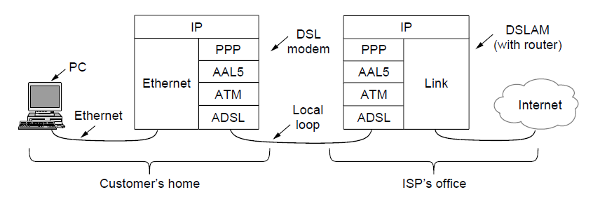
ADSL (Asymmetric Digital Subscriber Loop)
ADSL protocol stacks.

Slide 103
ADSL
ATM (Asynchronous Transfer Mode) is a link layer that is based on the transmission of fixed-length cells.
ATM is a connection-oriented technology.
Each cell carries a virtual circuit identifier in its header.
Each cell is 53 bytes long, consisting of a 48-byte payload and a 5-byte header.
To send data over an ATM network, it needs to be mapped into a sequence of cells, which is done by an ATM adaptation layer.
AAL5 (ATM Adaptation Layer 5) is the main one used for packet data.

Slide 104
ADSL
AAL5 frame:
Only the PPP protocol and the PPP payload fields are placed in the AAL5 payload.
The CRC is the same one used for PPP.
Padding: rounds up the overall length to be a multiple of 48 bytes so that the frame can be evenly divided into cells.

Slide 105

ADSL (Asymmetric Digital Subscriber Loop)
AAL5 frame carrying PPP data

Slide 106
End
Chapter 3

