Slide 1
The Medium Access Control Sublayer
Chapter 4

Slide 2
The Medium Access Control Sublayer
In broadcast network, the key issue is how to determine who gets to use the channel when there is competition for it.
Broadcast channels are referred to as multiaccess channels or random access channels.
The protocols used to determine who goes next on a multiaccess channel belong to a sublayer of the data link layer called the MAC (Medium Access Control) sublayer.
Especially important in LANs, particularly WLAN.
The central theme of this chapter is how to allocate a single broadcast channel among competing users.

Slide 3
Channel Allocation Problem
Static channel allocation
Assumptions for dynamic

Slide 4
Static Channel Allocation
The traditional way of allocating a single channel is to use multiplexing schemes.
FDM, TDM, CDMA
We will reveal the problem of static channel allocation.
For example, in FDM, we divide the bandwidth among N users. Each user has a private frequency band, and there is no interference among users.
If N is small and fixed, and each user has a steady stream or a heavy load of traffic, FDM is an efficient allocation mechanism.

Slide 5
Static Channel Allocation
If the number of senders is large and varying or the traffic is bursty, FDM is inefficient.
If the the spectrum is divided into N parts, but fewer than N users currently want to transmit frames, there will be a waste of spectrum.
If more than N users want to communicate, some will be denied permission for lack of bandwidth.
Even if the number of users is fixed at N, some users may rarely use the channel.

Slide 6
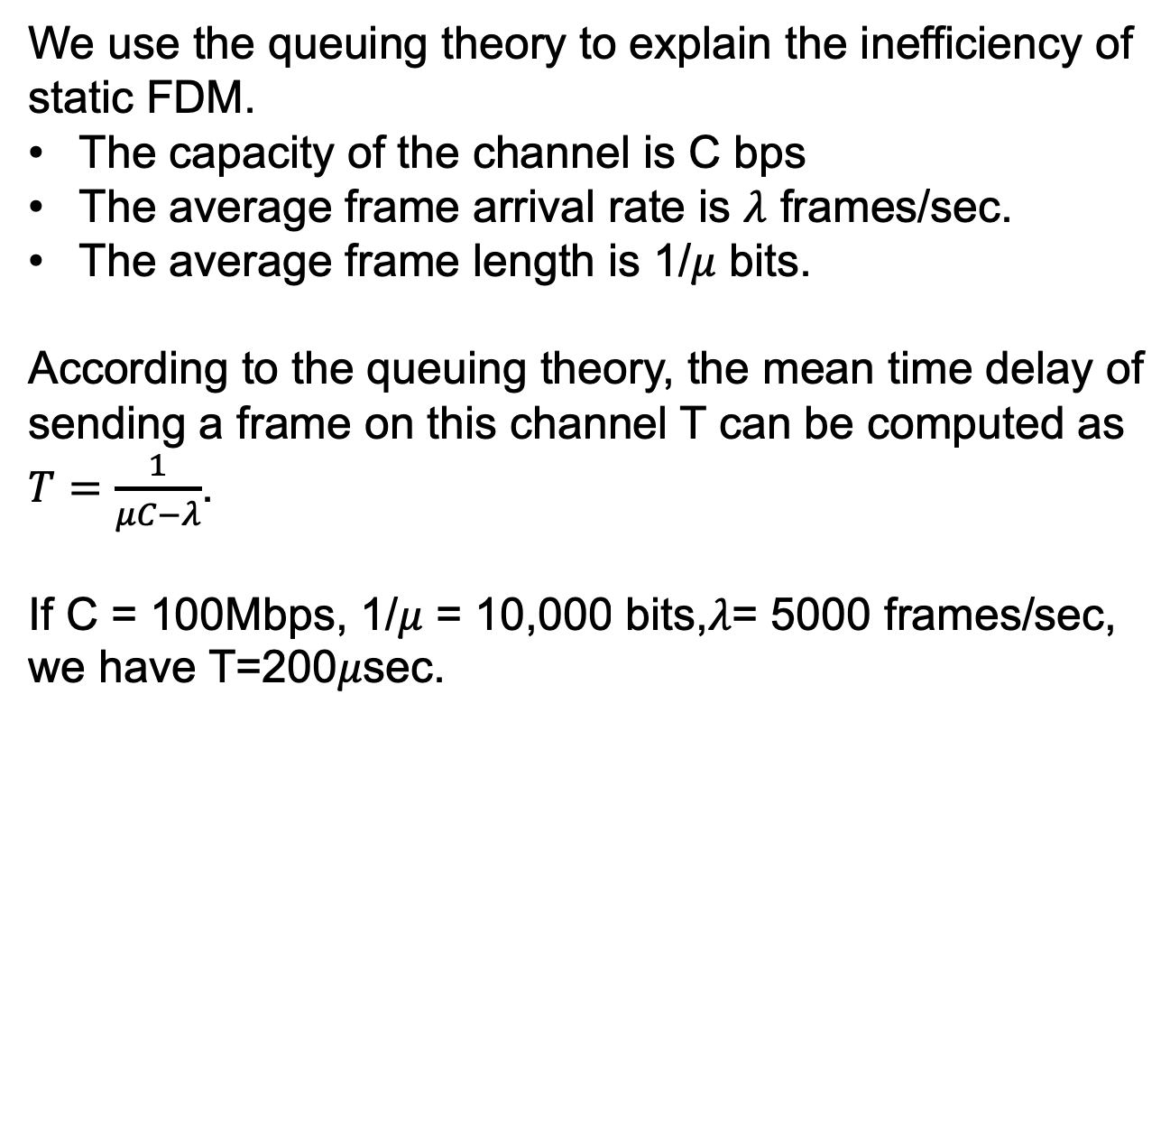
Static Channel Allocation
We use the queuing theory to explain the inefficiency of static FDM.
The capacity of the channel is C bps
The average frame arrival rate is $λ$ frames/sec.
The average frame length is 1/$μ$ bits.
According to the queuing theory, the mean time delay of sending a frame on this channel T can be computed as $T=\frac{1}{μC−λ}$.
If C = 100Mbps, 1/$μ$ = 10,000 bits,$λ$= 5000 frames/sec, we have T=200$μ$sec.

Slide 7
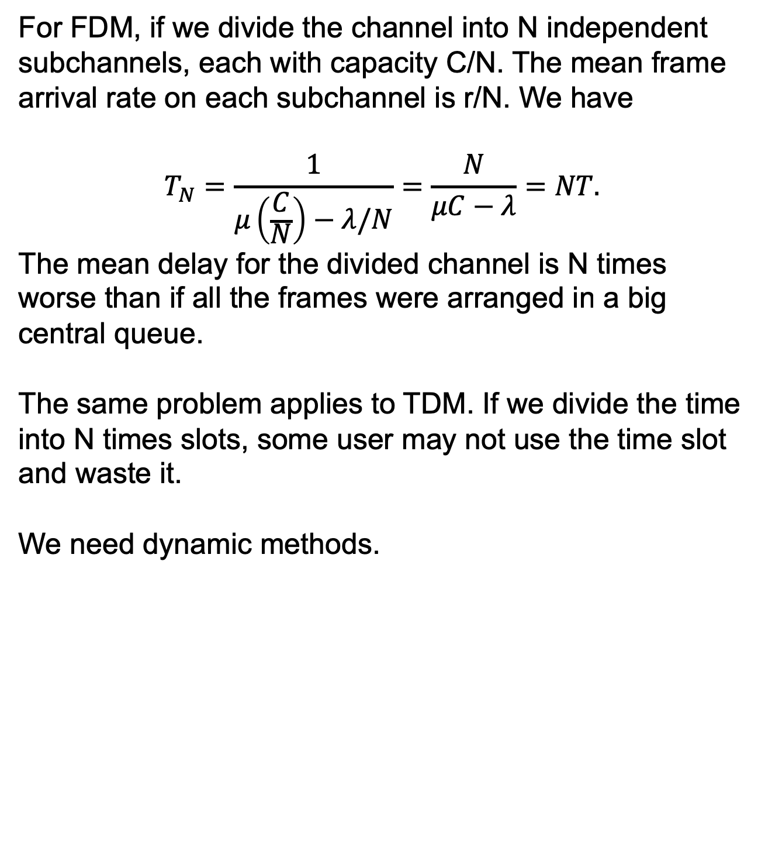
Static Channel Allocation
For FDM, if we divide the channel into N independent subchannels, each with capacity C/N. The mean frame arrival rate on each subchannel is r/N. We have
$$T_{N}=\frac{1}{μ\left(\frac{C}{N}\right)−λ/N}=\frac{N}{μC−λ}=NT.$$
The mean delay for the divided channel is N times worse than if all the frames were arranged in a big central queue.
The same problem applies to TDM. If we divide the time into N times slots, some user may not use the time slot and waste it.
We need dynamic methods.

Slide 8
Assumptions for Dynamic Channel Allocation
Independent traffic
Single channel
Observable Collisions
Continuous or slotted time
Carrier sense or no carrier sense

Slide 9
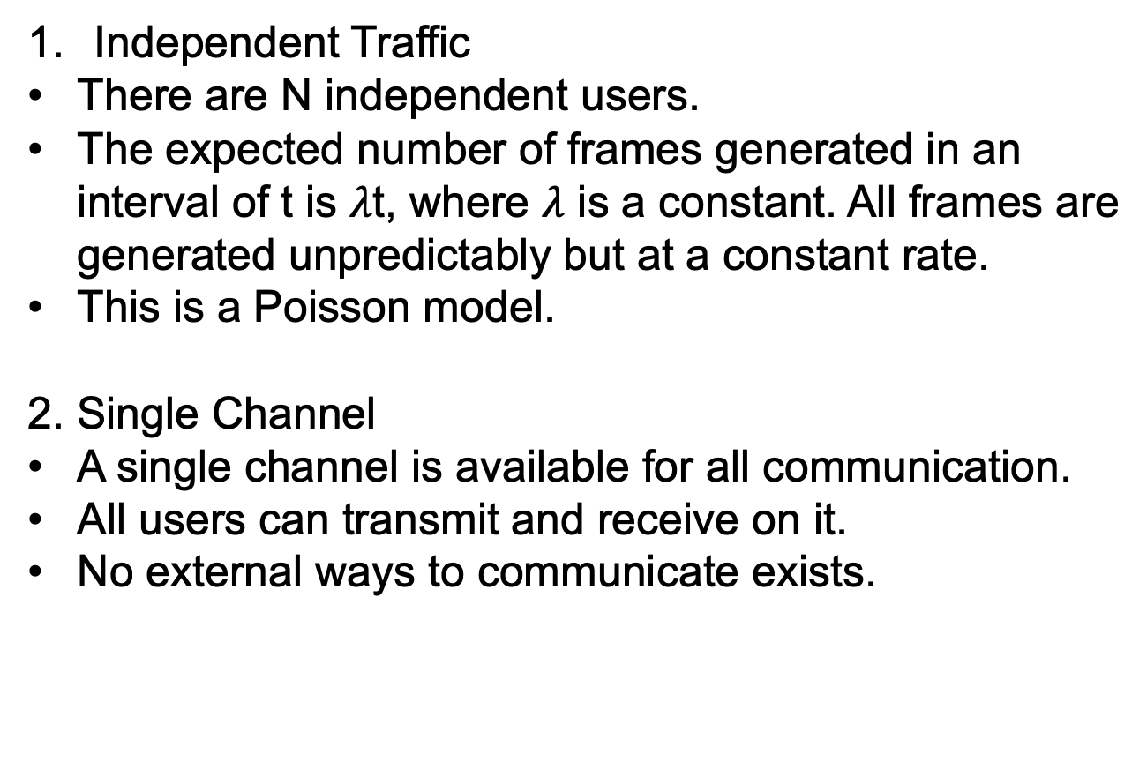
Assumptions for Dynamic Channel Allocation
Independent Traffic
There are N independent users.
The expected number of frames generated in an interval of t is $λ$t, where $λ$ is a constant. All frames are generated unpredictably but at a constant rate.
This is a Poisson model.
2. Single Channel
A single channel is available for all communication.
All users can transmit and receive on it.
No external ways to communicate exists.

Slide 10
Assumptions for Dynamic Channel Allocation
3. Observable Collisions.
If two frames are transmitted in overlapping time, both frames will be damaged. This event is called a collision. A collided frame will be transmitted again.
All users can detect the collision.
For wired channels, node hardware can be designed to detect collisions. Users can terminate their transmissions prematurely to avoid wasting capacity.
For wireless channels, collisions can be inferred by the lack of an expected acknowledgement frame.
Contention system: multiple users share a common channel in a way that can lead to collision.

Slide 11
Assumptions for Dynamic Channel Allocation
4. Continuous or Slotted Time.
Time may be assumed continuous, in which frame transmission can happen anytime.
Time may be slotted, and frame transmission must begin at the start of a slot.
5. Carrier Sense or No Carrier Sense.
Carrier sense: users can sense if the channel is in use. No one will use the channel if it is busy.
No carrier sense: users cannot sense the channel before trying to use it.
Wired networks generally have carrier sense but wireless networks cannot always use it effectively.

Slide 12
Multiple Access Protocols
ALOHA
Carrier Sense Multiple Access
Collision-free protocols
Limited-contention protocols
Wireless LAN protocols

Slide 13
ALOHA
First developed by Norman Abramson of the University of Hawaii.
Two versions of ALOHA: pure and slotted.

Slide 14
Pure ALOHA
Users can transmit whenever they have data to send.
There will be collisions, and the senders need some ways to detect collision.
In ALOHA system, the user sends its frame to the central computer, and this computer rebroadcasts the frame to all users. The sender listens to the broadcasts to see if its transmission is successful.
If there is a collision, the sender just waits a random amount of time and sends it again.
The throughput of ALOHA is maximized by having a uniform frame size.

Slide 15
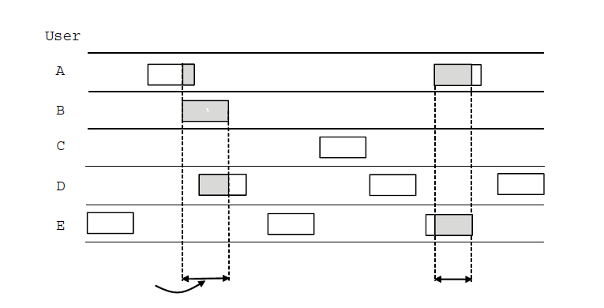
ALOHA (1)
User
A
B
C
D
E
Collision
Collision
Time
In pure ALOHA, frames are transmitted at completely arbitrary times

Slide 16
Pure ALOHA
What is the efficiency of ALOHA?
Frame time: frame length/ bit rate, the amount of time needed to transmit the fixed-length frame.
The new frame generation rate is N frames per frame time.
If N>1, the frames are generated at a higher rate then the channel can handle.
We expect 0<N<1.
Users also generate retransmissions of frames for collided ones.
The old and new frames combined are G frames per frame time.

Slide 17
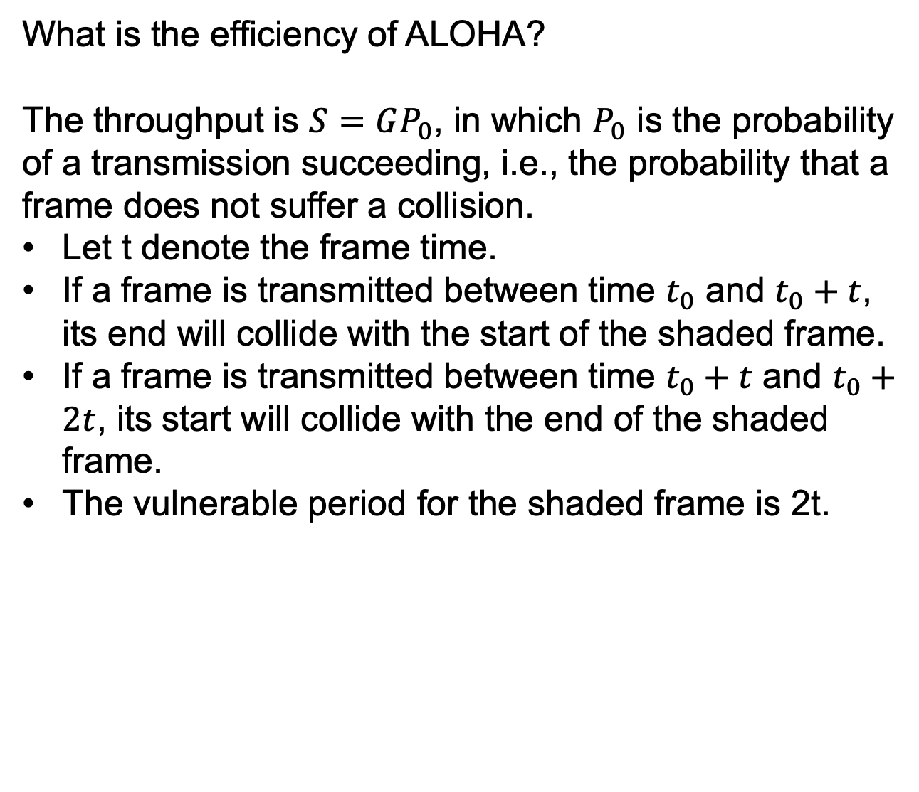
Pure ALOHA
What is the efficiency of ALOHA?
The throughput is $S=GP_{0}$, in which $P_{0}$ is the probability of a transmission succeeding, i.e., the probability that a frame does not suffer a collision.
Let t denote the frame time.
If a frame is transmitted between time $t_{0}$ and $t_{0}+t$, its end will collide with the start of the shaded frame.
If a frame is transmitted between time $t_{0}+t$ and $t_{0}+2t$, its start will collide with the end of the shaded frame.
The vulnerable period for the shaded frame is 2t.

Slide 18
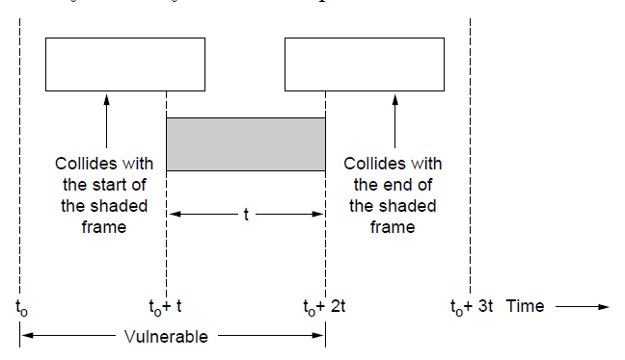
ALOHA (2)
Vulnerable period for the shaded frame.

Slide 19
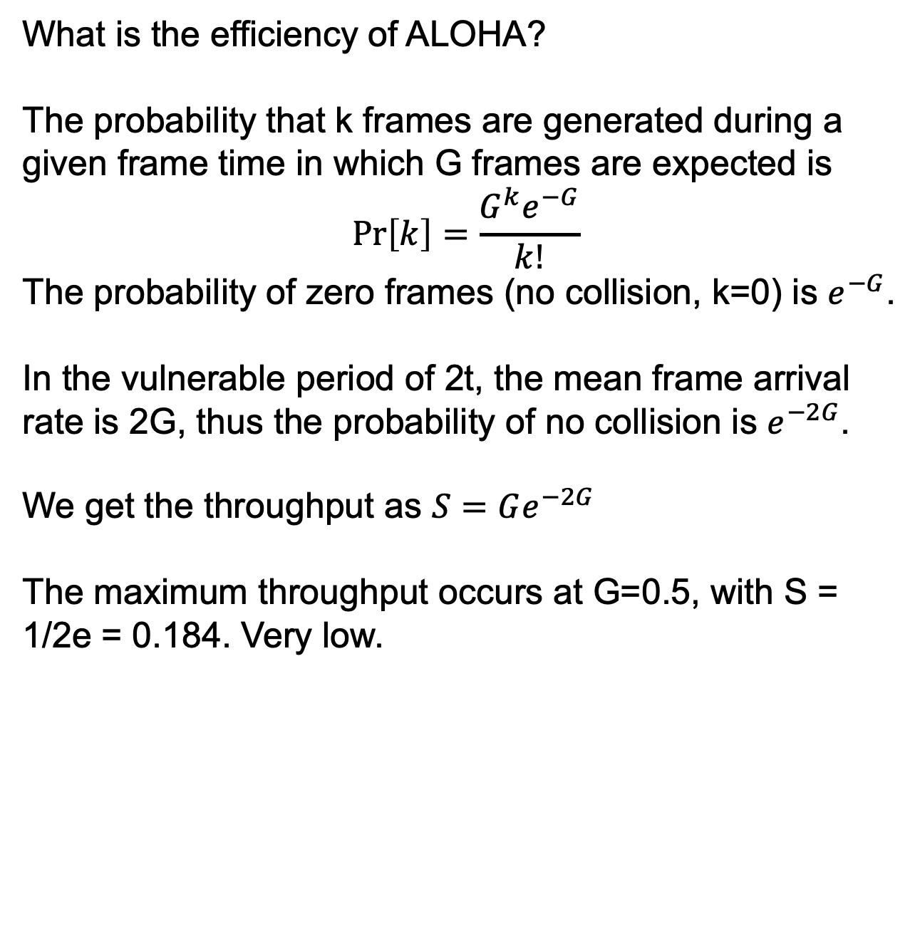
Pure ALOHA
What is the efficiency of ALOHA?
The probability that k frames are generated during a given frame time in which G frames are expected is
$$\operatorname{Pr}\left[k\right]=\frac{G^{k}e^{−G}}{k!}$$
The probability of zero frames (no collision, k=0) is $e^{−G}$.
In the vulnerable period of 2t, the mean frame arrival rate is 2G, thus the probability of no collision is $e^{−2G}$.
We get the throughput as $S=Ge^{−2G}$
The maximum throughput occurs at G=0.5, with S = 1/2e = 0.184. Very low.

Slide 20
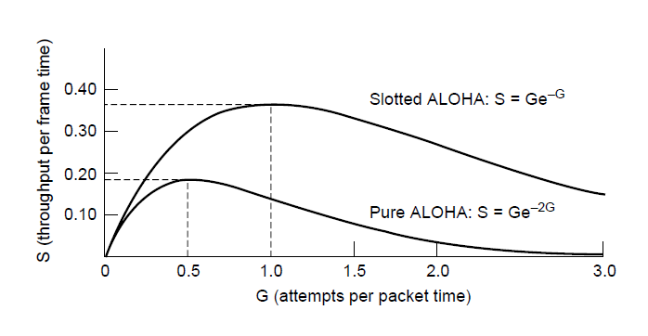
ALOHA (3)
Throughput versus offered traffic for ALOHA systems.

Slide 21
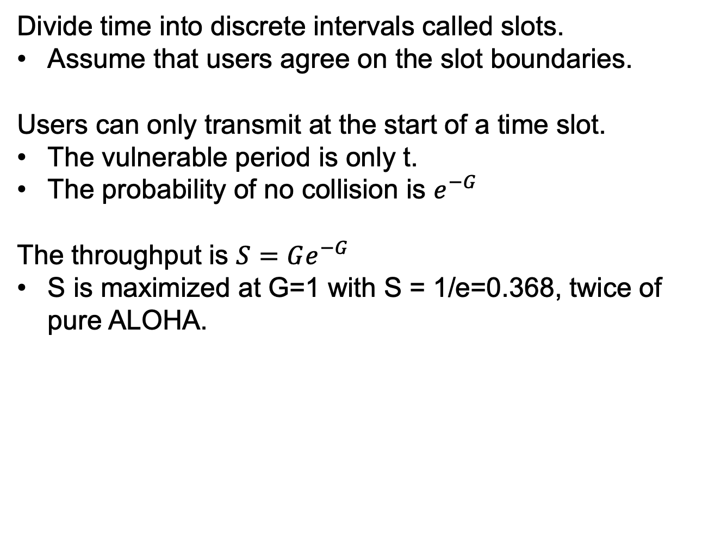
Slotted ALOHA
Divide time into discrete intervals called slots.
Assume that users agree on the slot boundaries.
Users can only transmit at the start of a time slot.
The vulnerable period is only t.
The probability of no collision is $e^{−G}$
The throughput is $S=Ge^{−G}$
S is maximized at G=1 with S = 1/e=0.368, twice of pure ALOHA.

Slide 22
Carrier Sense Multiple Access Protocols
The throughput of ALOHA is low partly due to a lack of carrier sense.
With carrier sense, users can detect what other users are doing and adjust their behaviors.
Protocols in which users listen for a carrier (i.e., a transmission) and act accordingly are called carrier sense protocols.

Slide 23
Persistent CSMA
1-persistent CSMA (Carrier Sense Multiple Access).
When a user has data to send.
1. listen to the channel to see if anyone else is transmitting.
2. if the channel is idle, transmit the data.
3. if the channel is busy, wait until the channel is idle and transmit.
4. if a collision occurs, wait a random amount of time and starts from 1.
The protocol is called 1-persistent since the station transmits with a probability of 1 when finding the channel idle.

Slide 24
Persistent CSMA
1-persistent CSMA may still cause a lot of collisions.
Example 1: two users wait for a busy channel to become idle, then transmit immediately after the channel is idle, collision happens.
Example 2: user 1 transmits first. Before the signal reach user 2, user 2 starts transmission, and collision happens.
Better performance than ALOHA, since users will not transmit if the channel is sensed to be busy.

Slide 25
Nonpersistent CSMA
When a user has data to send.
1. listen to the channel to see if anyone else is transmitting.
2. if the channel is idle, transmit the data.
3. if the channel is busy, wait a random amount of time and starts from 1.
4. if a collision occurs, wait a random amount of time and starts from 1.
Better channel utilization and longer delay.

Slide 26
p-persistent CSMA
Applies to slotted channels.
When a user has data to send.
1. sense the channel.
2. if the channel is idle, transmit with a probability of p. With probability of 1-p, the user defers to the next time slot.
If the next slot is idle, transmit or defer again with probability p and 1-p.
If the next slot is busy, treat it as a collision.
3. if the channel is busy, wait till the next time slot and starts from 1.
4. if a collision occurs, wait a random amount of time and starts from 1.

Slide 27
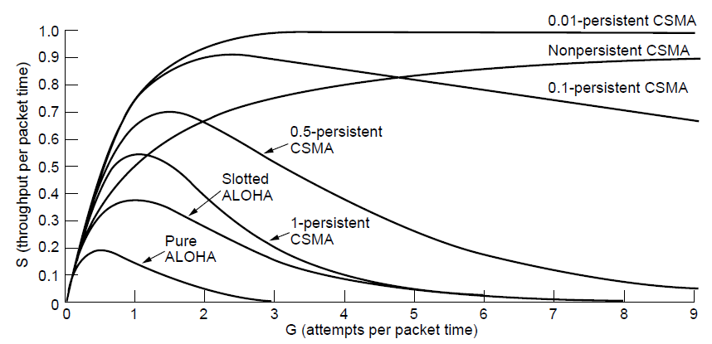
Persistent and Nonpersistent CSMA
Comparison of the channel utilization versus load for various random access protocols.

Slide 28
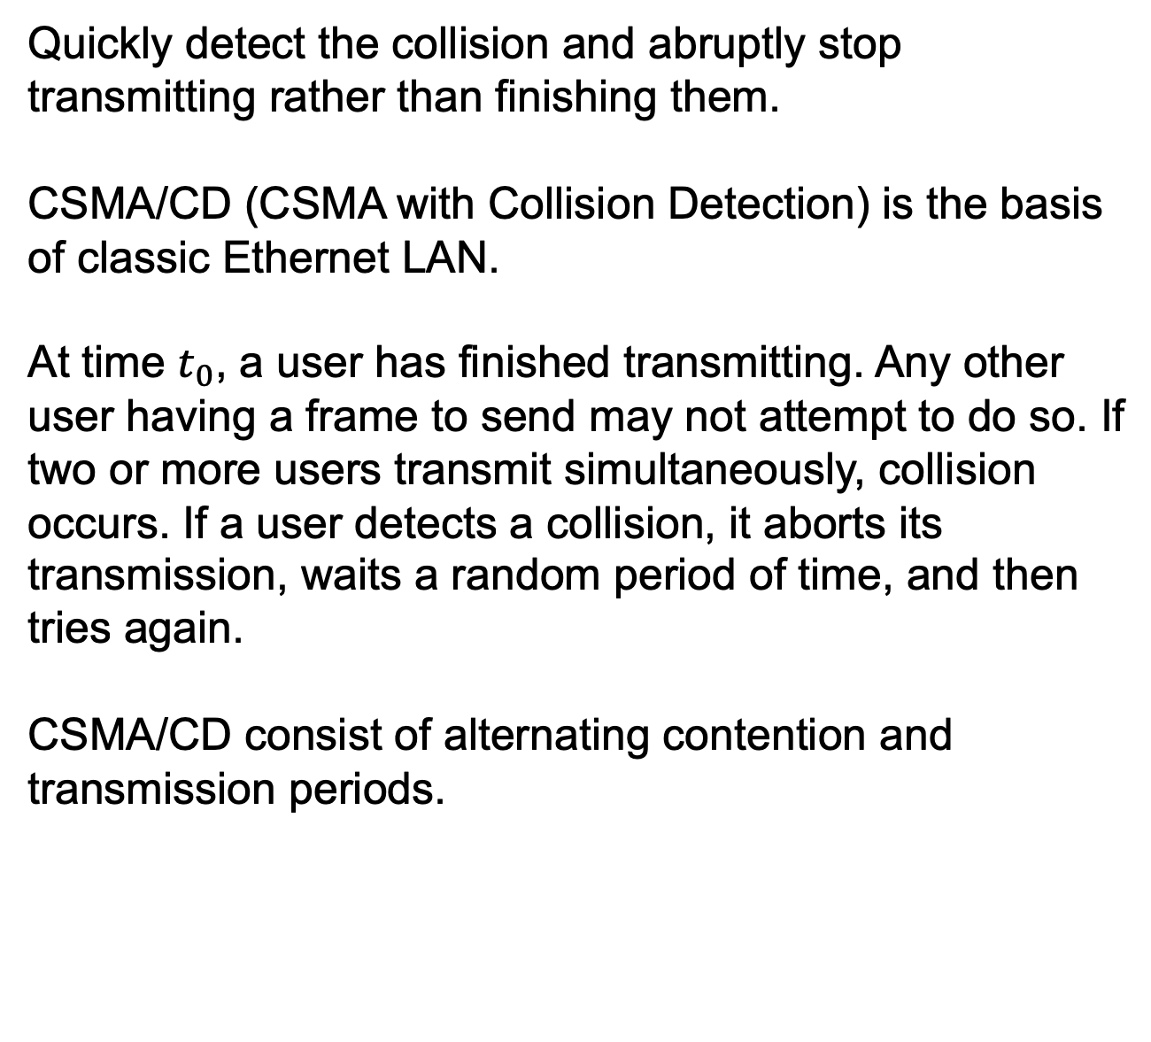
CSMA with Collision Detection
Quickly detect the collision and abruptly stop transmitting rather than finishing them.
CSMA/CD (CSMA with Collision Detection) is the basis of classic Ethernet LAN.
At time $t_{0}$, a user has finished transmitting. Any other user having a frame to send may not attempt to do so. If two or more users transmit simultaneously, collision occurs. If a user detects a collision, it aborts its transmission, waits a random period of time, and then tries again.
CSMA/CD consist of alternating contention and transmission periods.

Slide 29
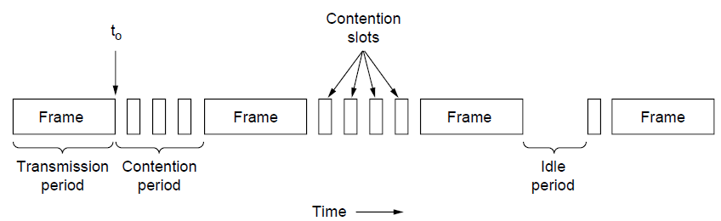
CSMA with Collision Detection
CSMA/CD can be in one of three states: contention, transmission, or idle.

Slide 30
Collision Free Protocols
Collisions reduce bandwidth, and make the time to send a frame variable, which is not good for real-time traffic such as VoIP.
We introduce some protocols that resolve the contention for the channel without any collisions at all, not even during the contention period.
We assume there are exactly N stations, each with a unique address from 0 to N-1.
We consider slotted contention period.

Slide 31
A Bit-Map Protocol
Each contention period consists of exactly N slots.
During the contention period, if user j has a frame to send, it will insert a 1 bit into slot j.
If user 0 has a frame to send, it transmits a 1 bit during the slot 0.
After all N slots have passed by, each user has complete knowledge of which users wish to transmit.
Users begin transmitting frames in numerical order.
There is no collision. After all users transmit, another contention period is begun.

Slide 32
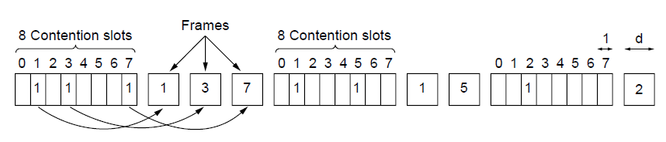
Collision-Free Protocols
The basic bit-map protocol.

Slide 33
A Bit-Map Protocol
Reservation protocols: the desire to transmit is broadcast before the actual transmission and the channel ownership is reserved in advance to prevent collisions.
At high load, i.e., every user has a frame to send, the overhead is 1 bit per frame, so the channel efficiency is 1/(1+d), in which d bits is the frame length.
At low load, i.e., only one user has a frame to send, the overhead is N bit per frame, so the channel efficiency is N/(N+d).
Bias: low-numbered users will wait longer than high-numbered users for transmission.

Slide 34
Token Passing
Pass a small message called a token from one user to the next in a predefined order.
The token represents permission to send.
If a user has a frame to send when it receives the token, it can send that frame before it passes the token to the next user.
If a user does not have a frame to send, it simply passes the token to the next user.
In a token ring protocol, users are connected in a single ring. A user receives the token from one direction and passes it to the other direction.

Slide 35
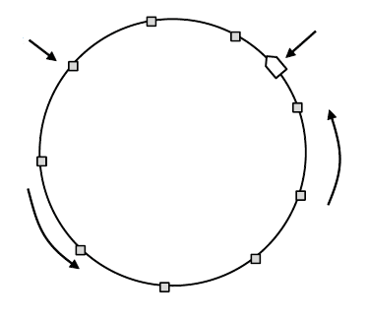
Collision-Free Protocols
Token
Station
Direction of
transmission
Token ring.

Slide 36
Binary Counting
The problem with the basic bit-map protocol is that the overhead is 1 bit per user, which does not scale well with thousands of users.
Each user has an address with the same length.
Users who want to use the channel broadcast their addresses. The bits in each address position from different users are BOOLEAN ORed by the channel.
Rule: as soon as a user sees that a high-order bit position that is 0 in its address has been overwritten with a 1, it gives up.

Slide 37
Binary Counting
Example: users 0010, 0100, 1001, and 1010 are all trying to get the channel.
In the first bit time, the users transmit 0, 0, 1, 1. These are ORed to form a 1. Users 0010 and 0100 see the 1 and know that a higher-numbered station is competing for the channel, so they give up for the current round. Users 1001 and 1010 continue.
The next bit is 0, 0, both uses continue.
The next bit is 0, 1, so 1001 gives up. The winner is 1010 with the highest address, and it transmits a frame, after which another bidding cycle starts.

Slide 38
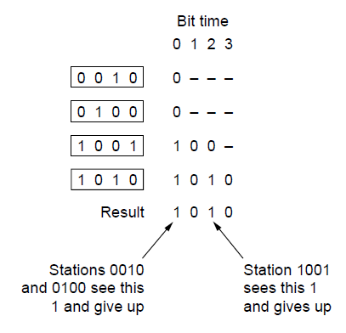
Binary Countdown
The binary countdown protocol. A dash indicates silence.

Slide 39
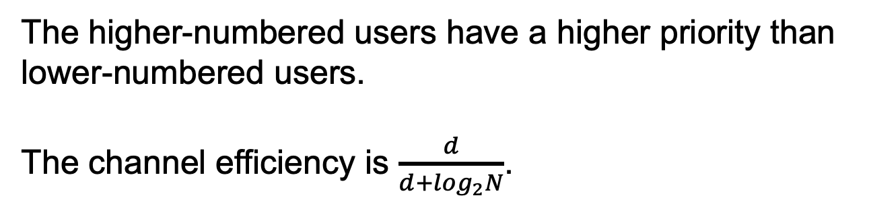
Binary Counting
The higher-numbered users have a higher priority than lower-numbered users.
The channel efficiency is $\frac{d}{d+\log_{2}N}$.

Slide 40
Limited-Contention Protocols
Contention-based protocols, as CSMA
Low delay at light load (few collisions)
Low channel efficiency at high load (a lot collisions and retransmissions)
Collision-free protocols.
Long delay at light load.
High channel efficiency at high load. (since the overhead is fixed)
We want to combine the best properties of the two types of protocols.

Slide 41
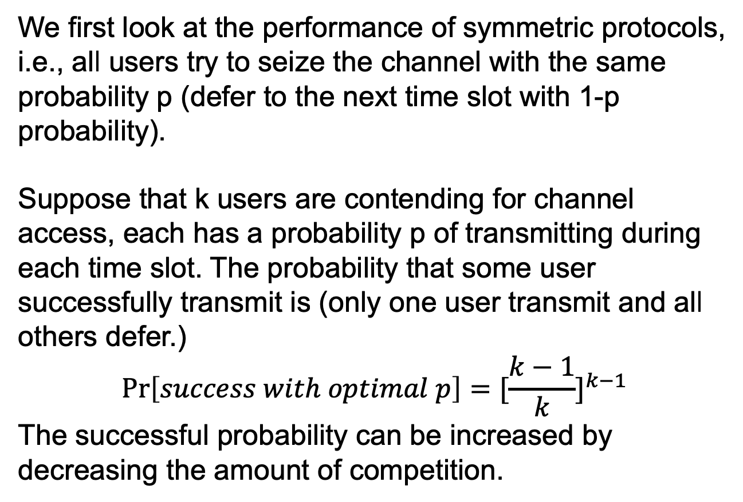
Limited-Contention Protocols
We first look at the performance of symmetric protocols, i.e., all users try to seize the channel with the same probability p (defer to the next time slot with 1-p probability).
Suppose that k users are contending for channel access, each has a probability p of transmitting during each time slot. The probability that some user successfully transmit is (only one user transmit and all others defer.)
$$\operatorname{Pr}\left[success with optimal p\right]={[\frac{k−1}{k}]}^{k−1}$$
The successful probability can be increased by decreasing the amount of competition.

Slide 42
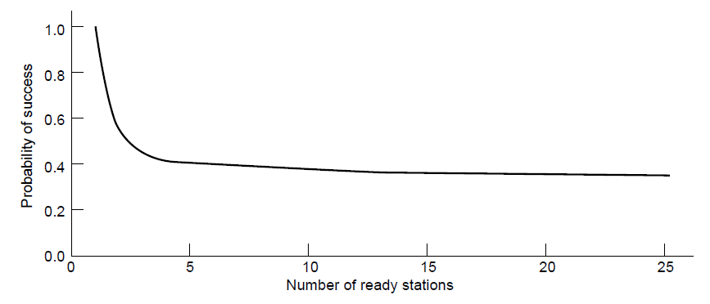
Limited-Contention Protocols
Acquisition probability for a symmetric contention channel.

Slide 43
Limited-Contention Protocols
The idea is to divide the users into groups.
Only members of group 0 are permitted to compete for slot 0. If one of them succeeds, the winner can transmit. If a collision happens or if no transmission happens, the members of group 1 contend for slot 1.
The trick is how to assign users to slots.

Slide 44
The Adaptive Tree Walk Protocol
Treat users as leaves of a binary tree.
In the first contention slot following a successful frame transmission, slot 0, all users are permitted to contend for the channel.
If one succeeds, the transmission happens.
If a collision happens, during slot 1, only users falling under node 2 in the tree may contend. If one succeeds, the following slot is reserved for those users under node 3. If a collision happens, during time slot 2, only users falling under node 4 in the tree may contend.

Slide 45
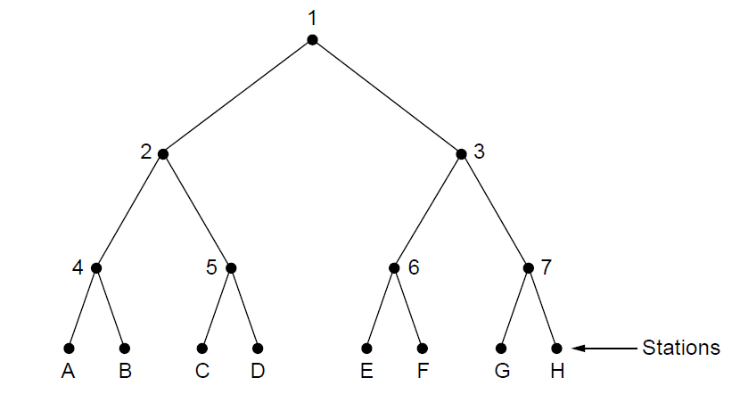
The Adaptive Tree Walk Protocol
The tree for eight stations

Slide 46
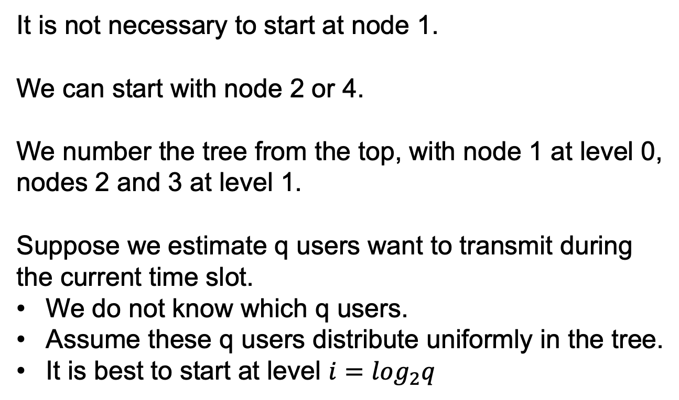
The Adaptive Tree Walk Protocol
It is not necessary to start at node 1.
We can start with node 2 or 4.
We number the tree from the top, with node 1 at level 0, nodes 2 and 3 at level 1.
Suppose we estimate q users want to transmit during the current time slot.
We do not know which q users.
Assume these q users distribute uniformly in the tree.
It is best to start at level $i=\log_{2}q$

Slide 47
Wireless LAN Protocols
Wireless LAN has different properties from LAN, and needs different MAC protocols.
Wireless systems cannot normally detect a collision when it is occurring due to the limited radio range. Acknowledgements are used to discover collisions.
Within a WLAN, a user may not be able to transmit or receive frames from all other users due to limited radio range.
Typical WLAN: an office building with APs located around the building. The APs are wired together using copper or fiber and provide connectivity to wireless devices.

Slide 48
Wireless LAN Protocols
We assume that each radio transmitter has some fixed range, represented by a circular coverage range. Within this range, another user can sense and receiver the user’s transmission.
The coverage range may not be circular due to the environment, e.g., walls and other obstacles.
We look at two examples. We have four users A, B, C, D. A and B are within each other’s range and can potentially interfere with one another. C can potentially interfere with both B and D, but not A.
Simple CSMA will cause two problems.

Slide 49
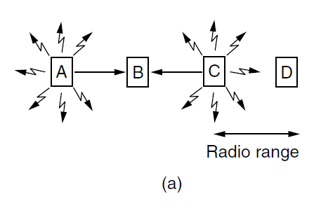
Wireless LAN Protocols
A wireless LAN. (a) A and C are hidden terminals when transmitting to B.

Slide 50
Wireless LAN Protocols
Hidden terminal problem.
A and C transmit to B.
A sends and then C immediately senses the medium, it will not hear A because A is out of range. C falsely conclude that it can transmit to B.
If C transmits, it will interfere at B.
A station not being able to detect a potential competitor for the medium because the competitor is too far away.

Slide 51
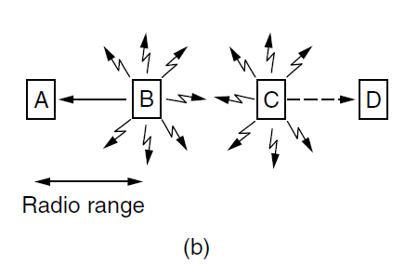
Wireless LAN Protocols
A wireless LAN. (b) B and C are exposed terminals when transmitting to A and D.

Slide 52
Wireless LAN Protocols
Exposed terminal problem.
B transmits to A at the same time C wants to transmit to D.
If C senses the medium, it will hear a transmission. C falsely conclude that it may not send to D.
In fact, such a transmission will cause bad reception only in the zone between B and C, but not to D.

Slide 53
Wireless LAN Protocols
The key problem is that in wireless transmission, the CSMA can only tell the activity near the transmitter but not the the activity near the receiver.
The protocol tackles these problems in WLAN is MACA (Multiple Access with Collision Avoidance).
The key idea is for the sender to stimulate the receiver into outputting a short frame, so users nearby can detect this transmission and avoid transmitting for the duration of the upcoming data frame.

Slide 54
Wireless LAN Protocols
MACA: how A sends a frame to B
A sends an RTS (Request To Send) frame to B. This short frame contains the length of the data frame that follows.
B replies with a CTS (Clear To Send) frame, also contains the data frame length.
Upon receipt of the CTS frame, A begins transmission.
Any users hearing the RTS is close to A and must remain silent long enough for the CTS to be transmitted back to A without conflict.
Any users hearing the CTS is close B and must remain silent during the upcoming data transmission.

Slide 55
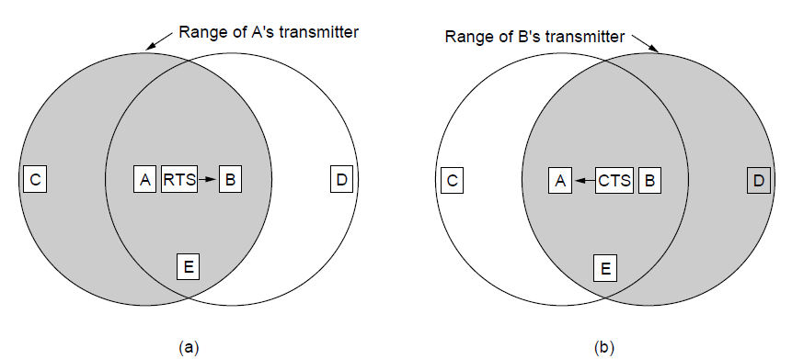
Wireless LAN Protocols
The MACA protocol. (a) A sending an RTS to B. (b) B responding with a CTS to A.

Slide 56
Wireless LAN Protocols
For example, C is within range of A but not B. C hears the RTS from A but not the CTS from B. As long as C does not interfere with CTS, it is free to transmit while the data frame is being sent.
D is within the range of B but not A. D cannot hear the RTS but can hear the CTS. The hearing of CTS makes it silent during data transmission.
E can hear both RTS and CTS. E will remain silent until data transmission completes.
Collisions can still occur, e.g., B and c may both send RTS frames to A at the same time.

Slide 57
Ethernet
Physical layer
MAC sublayer protocol
Ethernet performance
Switched Ethernet
Fast Ethernet
Gigabit Ethernet
10 Gigabit Ethernet
IEEE 802.2: Logical Link Control
Retrospective on Ethernet

Slide 58
Classic Ethernet Physical Layer
1976, Bob Metcalfe and David Boggs designed and implemented the first local area network. It used a single long, thick coaxial cable and ran at 3 Mbps.
They called the system Ethernet.
DEC, Intel and Xerox drew up a standard in 1978 for a 10-Mbps Ethernet, called the DIX standard, which became the 802.3 standard in 1983.

Slide 59
Classic Ethernet Physical Layer
Classic Ethernet has a single long cable to which all computers were attached, called the thick Ethernet.
Thin Ethernet succeeded thick Ethernet, bent more easily and made connections using BNC connectors.
Early version of Ethernet has a maximum cable length per segment (i.e., unamplified length) over which the signal will propagate.
To allow larger networks, multiple cables are connected by repeaters.
A repeater is a physical layer device that receivers, amplifies and retransmits signals in both directions.

Slide 60
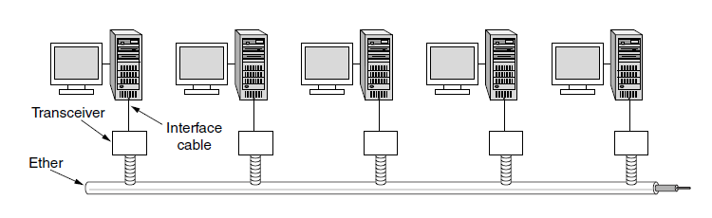
Classic Ethernet Physical Layer
Architecture of classic Ethernet

Slide 61
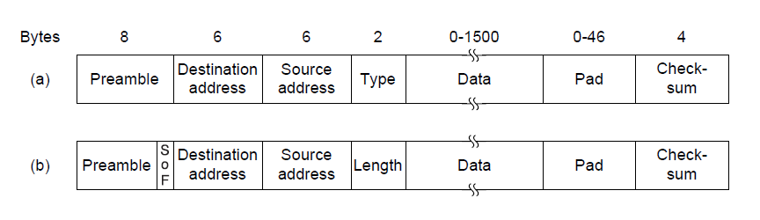
MAC Sublayer Protocol
Frame formats. (a) Ethernet (DIX). (b) IEEE 802.3.

Slide 62
Classic Ethernet MAC Sublayer Protocol
The format used to send frames.
Preamble. 8 bytes, each containing the bit pattern 10101010.
The last byte, the last 2 bits are set to 11. The last byte is called the Start of Frame delimiter.
The last two 1 bits tell the receiver that the rest of the frame is about to start.
Address, include the destination address and source address. Each 6 byte long.
The first transmitted bit of the destination address is a 0 for ordinary addresses and a 1 for group addresses.
Group addresses allow multiple users to listen to a single address.

Slide 63
Classic Ethernet MAC Sublayer Protocol
The format used to send frames.
Address, include the destination address and source address. Each 6 byte long.
Sending to a group of users is called multicasting.
The address consisting of all 1 bits is reserved for broadcasting.
Multicasting involves group management but broadcasting does not.
Addresses are globally unique, assigned centrally by IEEE.

Slide 64
Classic Ethernet MAC Sublayer Protocol
The format used to send frames.
Type or Length.
Any number less than or equal to 0x600 can be interpreted as Length. Length is the length of the frame.
Any number greater than 0x600 can be interpreted as Type. Multiple network-layer protocols may be in use, e.g., a type code of 0x0800 means that the data contains an IPv4 packet.

Slide 65
Classic Ethernet MAC Sublayer Protocol
The format used to send frames.
Data
Data is up to 1500 bytes.
There is also a minimum frame length. Ethernet requires that valid frames must be at least 64 bytes long. The Pad field is used to fill out the frame to the minimum size.
Why do we have a minimu length frame? To prevent a user from completing the transmission of a short frame before the first bit has reached the far end of the cable, where it may collide with another frame.

Slide 66
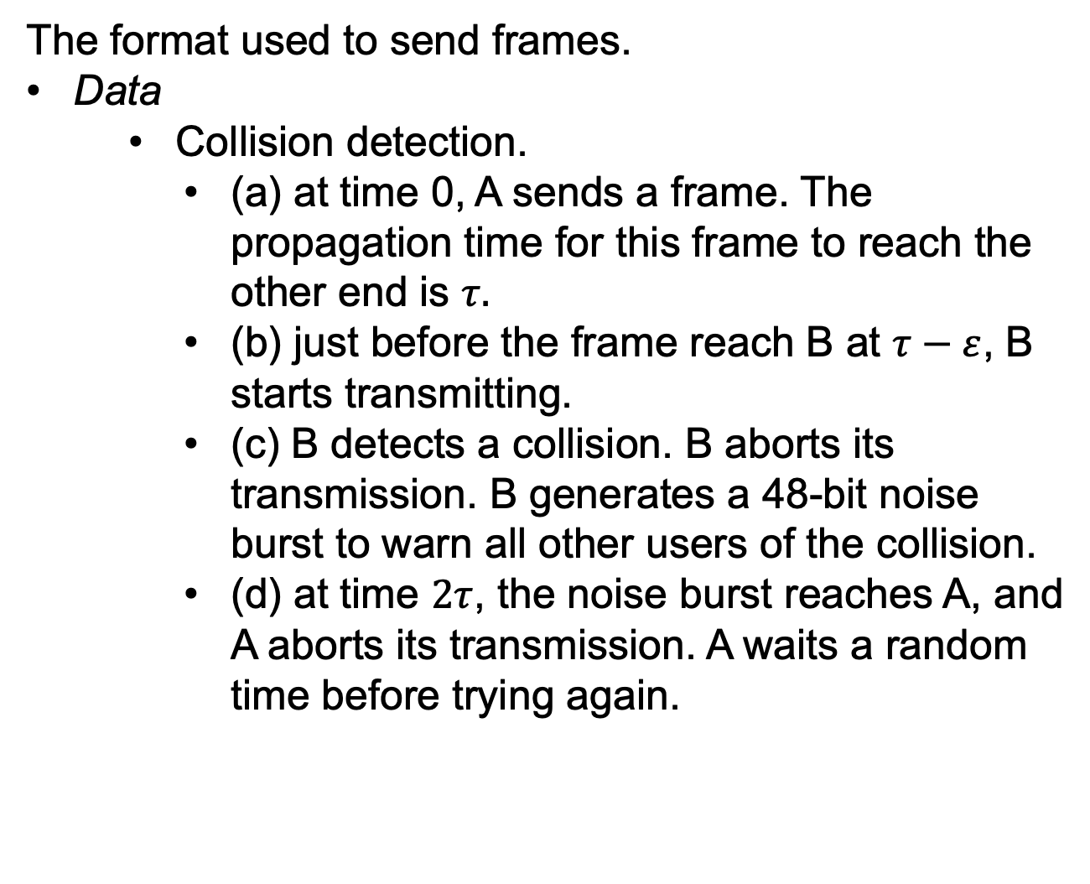
Classic Ethernet MAC Sublayer Protocol
The format used to send frames.
Data
Collision detection.
(a) at time 0, A sends a frame. The propagation time for this frame to reach the other end is $τ.$
(b) just before the frame reach B at $τ−ε$, B starts transmitting.
(c) B detects a collision. B aborts its transmission. B generates a 48-bit noise burst to warn all other users of the collision.
(d) at time $2τ$, the noise burst reaches A, and A aborts its transmission. A waits a random time before trying again.

Slide 67
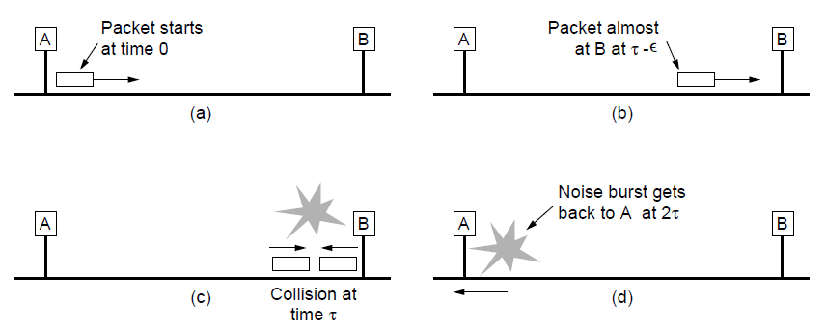
MAC Sublayer Protocol
Collision detection can take as long as 2τ.

Slide 68
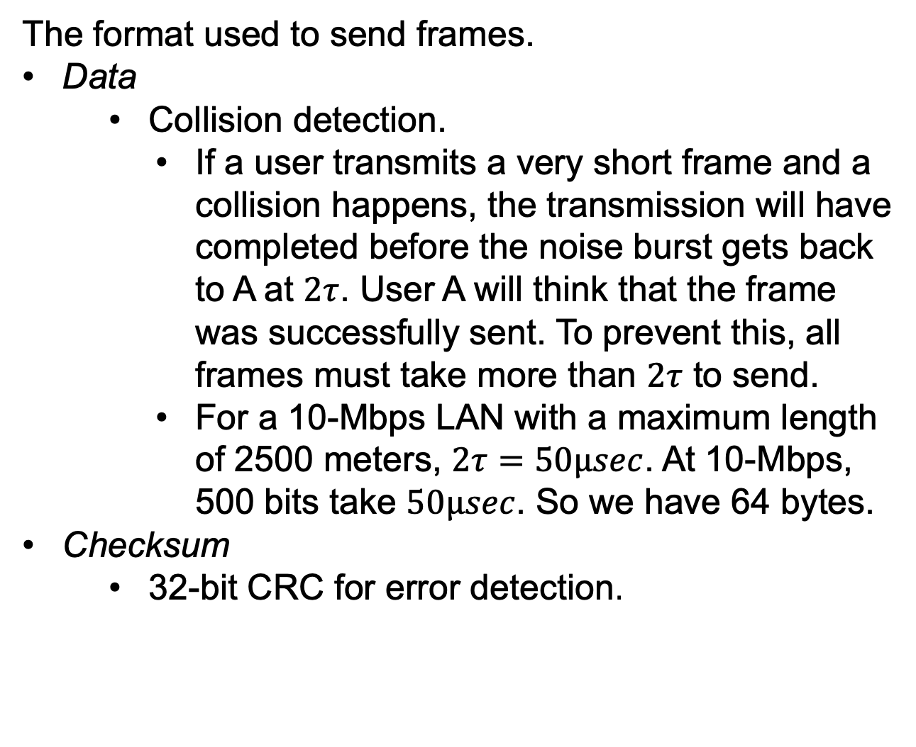
Classic Ethernet MAC Sublayer Protocol
The format used to send frames.
Data
Collision detection.
If a user transmits a very short frame and a collision happens, the transmission will have completed before the noise burst gets back to A at $2τ$. User A will think that the frame was successfully sent. To prevent this, all frames must take more than $2τ$ to send.
For a 10-Mbps LAN with a maximum length of 2500 meters, $2τ=50μsec$. At 10-Mbps, 500 bits take $50μsec$. So we have 64 bytes.
Checksum
32-bit CRC for error detection.

Slide 69
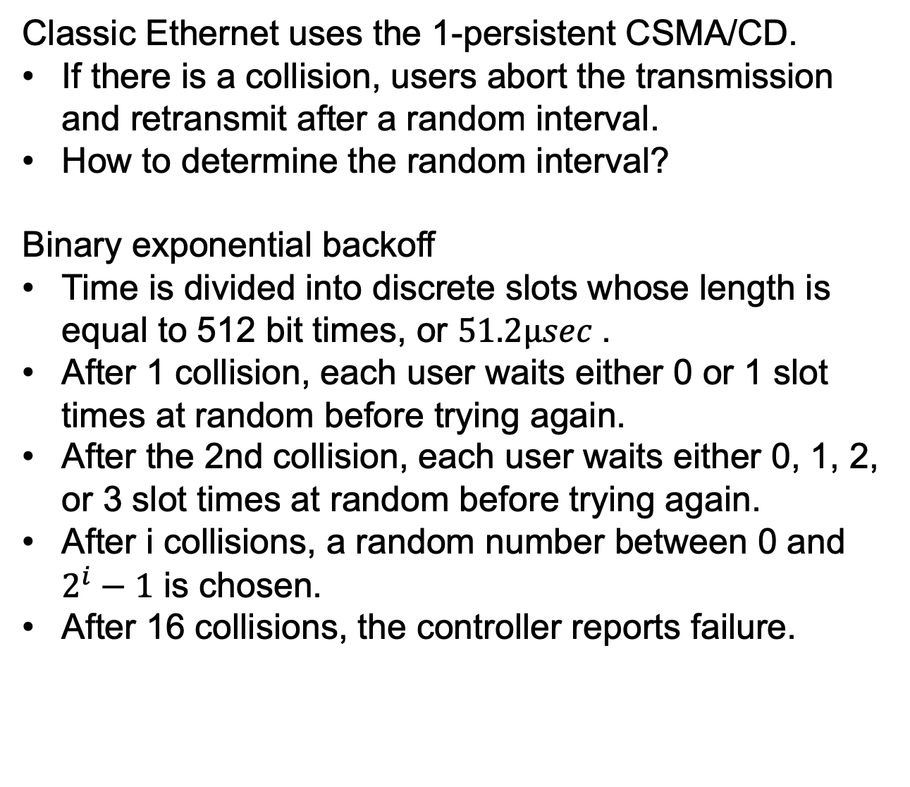
CSMA/CD with Binary Exponential Backoff
Classic Ethernet uses the 1-persistent CSMA/CD.
If there is a collision, users abort the transmission and retransmit after a random interval.
How to determine the random interval?
Binary exponential backoff
Time is divided into discrete slots whose length is equal to 512 bit times, or $51.2μsec$.
After 1 collision, each user waits either 0 or 1 slot times at random before trying again.
After the 2nd collision, each user waits either 0, 1, 2, or 3 slot times at random before trying again.
After i collisions, a random number between 0 and $2^{i}−1$ is chosen.
After 16 collisions, the controller reports failure.

Slide 70
CSMA/CD with Binary Exponential Backoff
Binary exponential backoff dynamically adapt to the number of users trying to send.
If the randomization interval is fixed as 1023, the chance of collision will be negligible, but the average wait after a collision will be hundreds of slot times.
If each user delay for either 0 or 1 slot, and 100 users try to send, they will collide over and over until 99 of them pick 1 and the remaning user pick 0, which may take years.
By having the randomization interval grow exponentially, the algorithm ensures a low delay with light load and ensure that the collisions are resolved in a reasonable interval with heavy load.

Slide 71
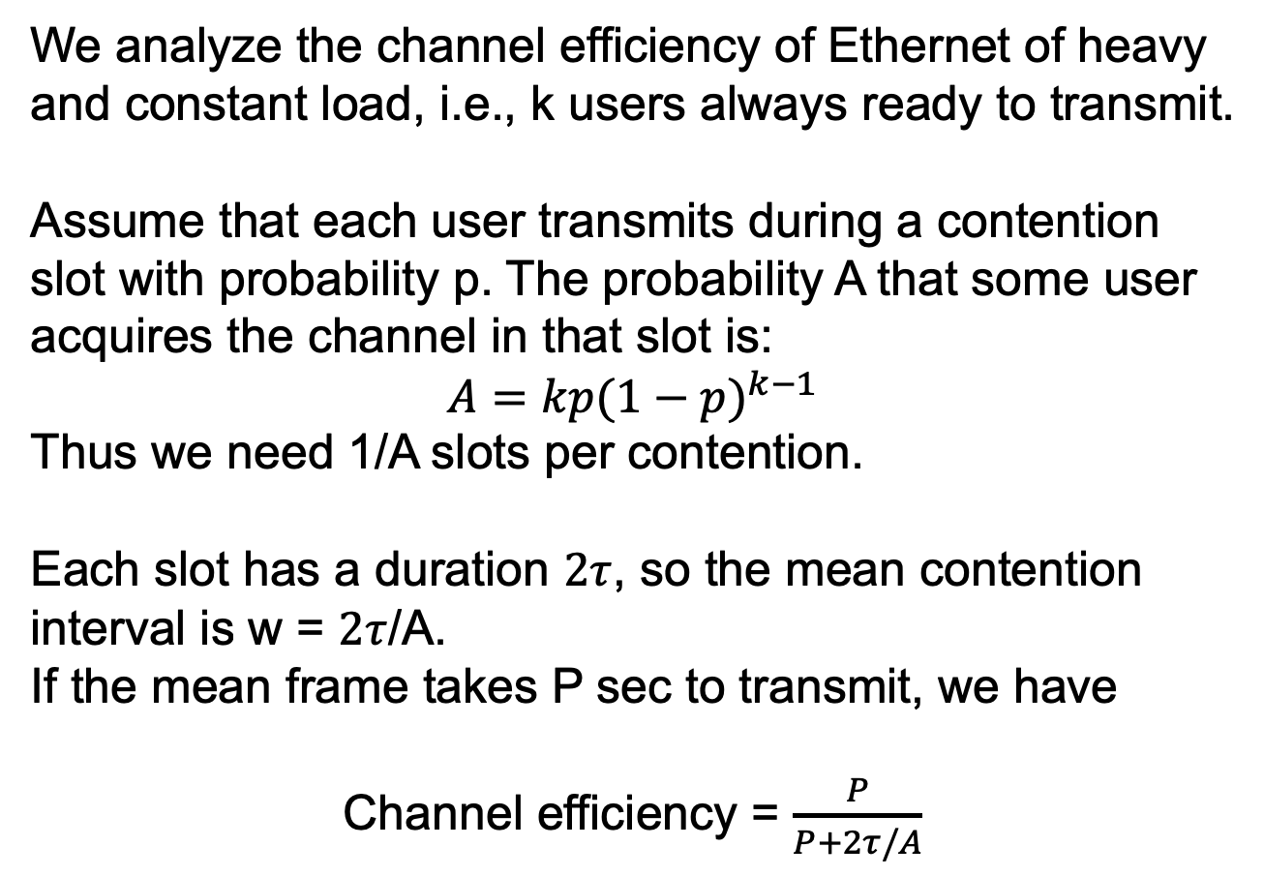
Ethernet Performance
We analyze the channel efficiency of Ethernet of heavy and constant load, i.e., k users always ready to transmit.
Assume that each user transmits during a contention slot with probability p. The probability A that some user acquires the channel in that slot is:
$$A=kp{(1−p)}^{k−1}$$
Thus we need 1/A slots per contention.
Each slot has a duration $2τ$, so the mean contention interval is w = $2τ$/A.
If the mean frame takes P sec to transmit, we have
Channel efficiency = $\frac{P}{P+2τ/A}$

Slide 72
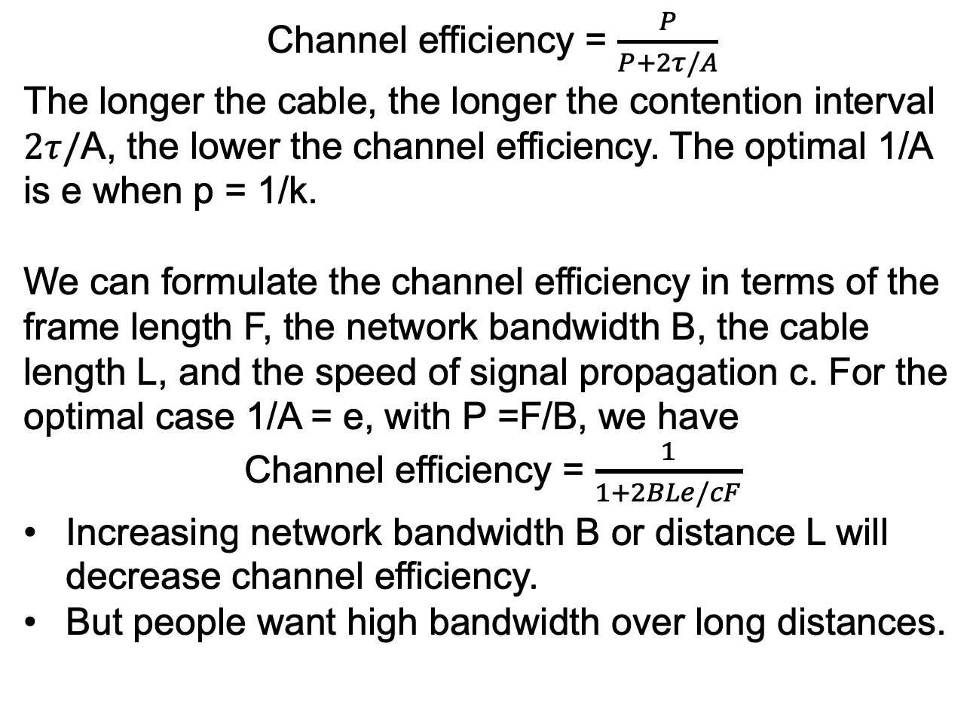
Ethernet Performance
Channel efficiency = $\frac{P}{P+2τ/A}$
The longer the cable, the longer the contention interval $2τ/$A, the lower the channel efficiency. The optimal 1/A is e when p = 1/k.
We can formulate the channel efficiency in terms of the frame length F, the network bandwidth B, the cable length L, and the speed of signal propagation c. For the optimal case 1/A = e, with P =F/B, we have
Channel efficiency = $\frac{1}{1+2BLe/cF}$
Increasing network bandwidth B or distance L will decrease channel efficiency.
But people want high bandwidth over long distances.

Slide 73
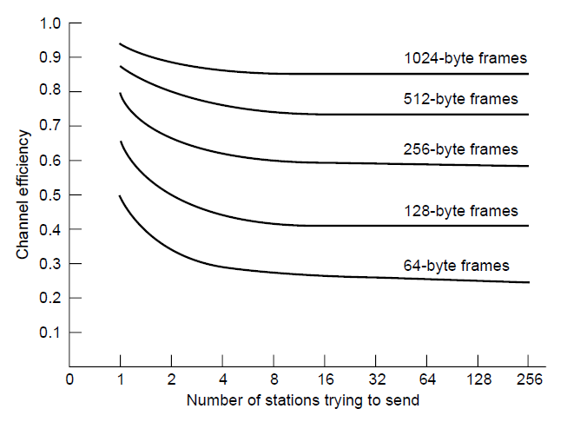
Ethernet Performance
Efficiency of Ethernet at 10 Mbps with 512-bit slot times.

Slide 74
Switched Ethernet
Different wiring pattern than the single long cable architecture of the Ethernet.
Hub
Switch
Hub: each user has a dedicated cable running to a central hub; the hub simply connects all the attached wires electrically.
The wires were telephone company twisted pairs.
Adding or removing a station is simple.
Cable breaks can be detected easily.
However, as more and more stations are added, each station gets a decreasing sharing of the fixed capacity of the hub.

Slide 75
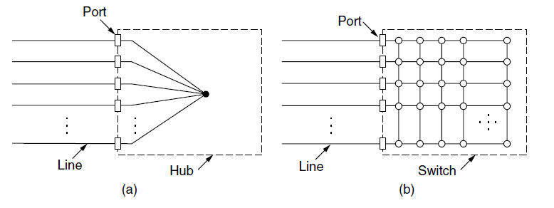
Switched Ethernet
(a) Hub. (b) Switch.

Slide 76
Switched Ethernet
Switch: contain a high-speed backplane that connects all of the ports.
Similar to hub in appearance, with 4 to 48 ports. Each cable connects the switch or hub to a computer. Easy to add or remove a station. Easy to find faults.
Different from the hub, the switch only outputs frames to the ports for which those frames are destined.
When a switch port receives an Ethernet frame from a user, it checks the Ethernet addresses to see which port the frame is destined for.
We will introduce how to find the port corresponds to an address later.
None of other ports knows the frame exists.

Slide 77
Switched Ethernet
Switch: contain a high-speed backplane that connects all of the ports.
In a hub, all users are in the same collision domain, they must use the CSMA/CD algorithm to schedule their transmission; in a switch, each port is its own independent collision domain.

Slide 78
Switched Ethernet
Switch versus hub.
The capacity of switch is higher than the hub since there are no collisions in switches.
With a switch multiple frames can be sent simultaneously. These frames will travel over the switch’s backplane to be output on the proper ports.
Multiple frames may be sent to the same output port at the same time, so the switch must have buffering to queue the input frame.
The switch is more secure than the hub. In the hub, all attached computer can see the traffic sent between all of the other computers. With a switch, traffic is forwarded only to the destined port.
The port of the switch can connect to a hub.

Slide 79
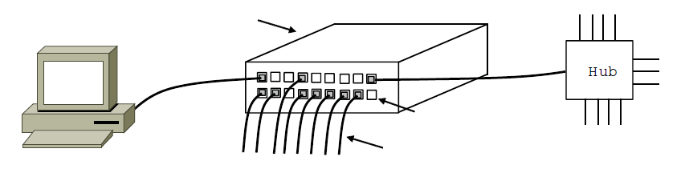
Switched Ethernet
Switch
Hub
Switch ports
Twisted pair
An Ethernet switch.

Slide 80
Fast Ethernet
10Mbps Ethernet is not enough.
Fast Ethernet provides 100Mbps.
The basic idea of fast Ethernet:
keep all the old frame formats, interfaces, and procedural rules
Increase the bit rate to 100Mbps, thus reducing the bit time from 100 nsec to 10 nnsec.
To conform to the collision detection, we must reduce the maximum cable length by a factor of 10.
Al fast Ethernet systems use hubs and switches.

Slide 81
Fast Ethernet
Support 3 types of wire.
100Base-T4
Use Category 3 twisted pair
Use Manchester encoding
Use four twisted pairs to reach 100Mbps. One is from the hub, one is to the hub, and the other two are switchable to the current transmission direction.
100Base-TX
Use Cat 5 UTP
Two twisted pairs per use, one to the hub and one from it.
Use 4B/5B encoding.
100Base-FX
Two strands of multimode fiber.

Slide 82
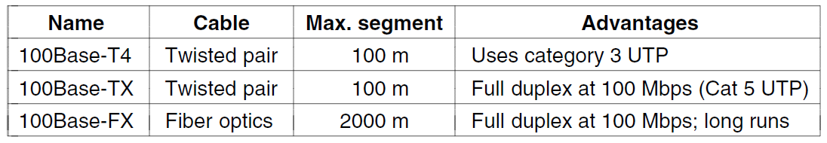
Fast Ethernet
The original fast Ethernet cabling.

Slide 83
Fast Ethernet
Fast Ethernet allows interconnection by either hubs or switches.
To ensure that CSMA/CD algorithm continues to work, the relationship between the minimum frame size and maximum cable length must be maintained.
The speed goes up from 10 Mbps to 100 Mbps.
The maximum distance between any two users come down by a factor of 10.
Fast Ethernet switches can handle a mix of 10Mbps and 100Mbps stations.
A mechanism called auto-negotiation allows two stations automatically negotiate the optimum speed (10 Mbps or 100 Mbps)

Slide 84
Gigabit Ethernet
Gigabit Ethernet, ratified in the standard IEEE 802.3ab.
Increase performance tenfold.
Compatible with all existing Ethernet standards.
Maintain the same frame format.
Gigabit Ethernet uses point-to-point links, with two configurations.
Configuration 1: two computers are directly connected to each other.
Configuration 2: a switch or a hub connected to multiple computers.

Slide 85
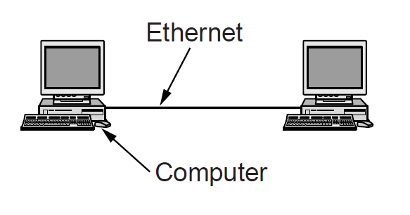
Gigabit Ethernet
A two-station Ethernet

Slide 86
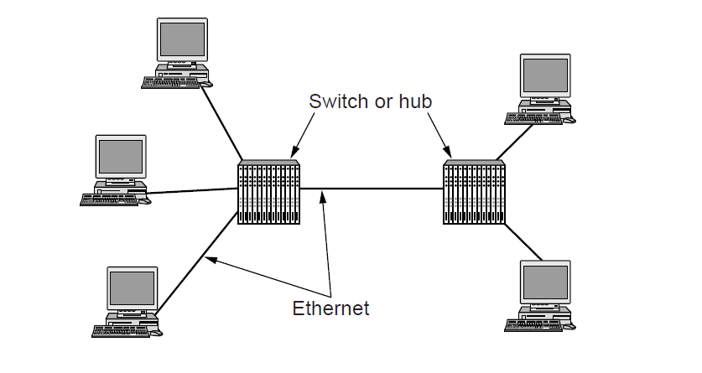
Gigabit Ethernet
A multistation Ethernet

Slide 87
Gigabit Ethernet
Gigabit Ethernet supports two modes of operation: full-duplex and half duplex.
Full duplex
Allows traffic in both directions.
A central switch connects to the computer.
On the line between the switch and the computer, the computer is the only sender to the switch, and the transmission will succeed even if the switch is currently sending a frame to the computer (the line is full duplex.)
No collision. No CSMA/CD protocol is used.

Slide 88
Gigabit Ethernet
Half duplex
A hub connects to the computer.
The hub connects all lines, so collision will happen. The standard CSMA/CD protocol is required.
To allow collision detection, we either increase the minimum frame size to 640 bytes or reduce the length to 25 meters.
To increase the maximum cable length to 200 meters, gigabit Ethernet adds two features.
Feature 1: carrier extension, add padding to extend the frame to 512 bytes. The original 64 byte frame will have a low efficiency.
Feature 2: frame bursting, transmit a concatenated sequence of multiple frames. If the total burst length < 512 bytes, pad again.

Slide 89
Gigabit Ethernet
Gigabit Ethernet supports both copper and fiber cabling.
1000Base-SX
Fiber optics, 0.85 micros wavelength.
Multimode fiber.
Short distance, connections within a building.
1000Base-LX
Fiber optics, 1.3 micros wavelength.
Single-mode fiber.
Long distance between buildings, e.g., campus backbone.
8B/10B encoding are used

Slide 90
Gigabit Ethernet
1000Base-CX
Short, shielded copper cables.
1000Base-T
Use existing Cat 5 UTP.
Use four twisted pairs. Each pair is used in both directions at the same time by using digital signal processing to separate signals.
Five voltage levels that carry 2 bits are used.
Involve scrambling, for transitions.
Error correcting codes

Slide 91
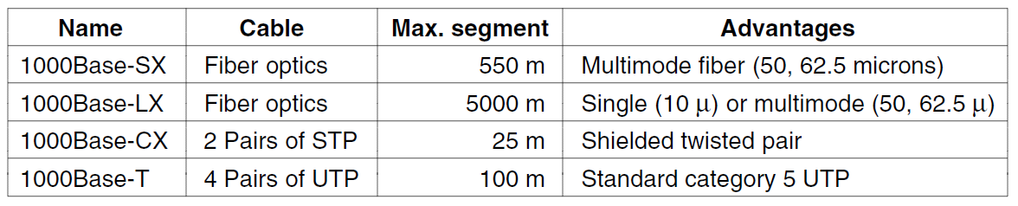
Gigabit Ethernet
Gigabit Ethernet cabling.

Slide 92
Gigabit Ethernet
Flow control is important.
If a receiver is busy with some other task for even 1 msec and does not empty the input buffer, up to 1953 frames may have accumulated.
Gigabit Ethernet flow control consists of one end sending a special control frame to the other end telling it to pause for some time.
Pauses are given in time unit of 512 nsec, the longest pause is 33.6 msec.
Jumbo frames allow for frames to be longer than 1500 bytes, usually up to 9 KB.

Slide 93
10-Gigabit Ethernet
1000x faster than the original Ethernet.
Used for data centers and exchanges to connect high-end routers, switches and servers.
Used for long-distance, high-bandwidth trunks
10-gigabit Ethernet only support full-duplex operation.
No CSMA/CD

Slide 94
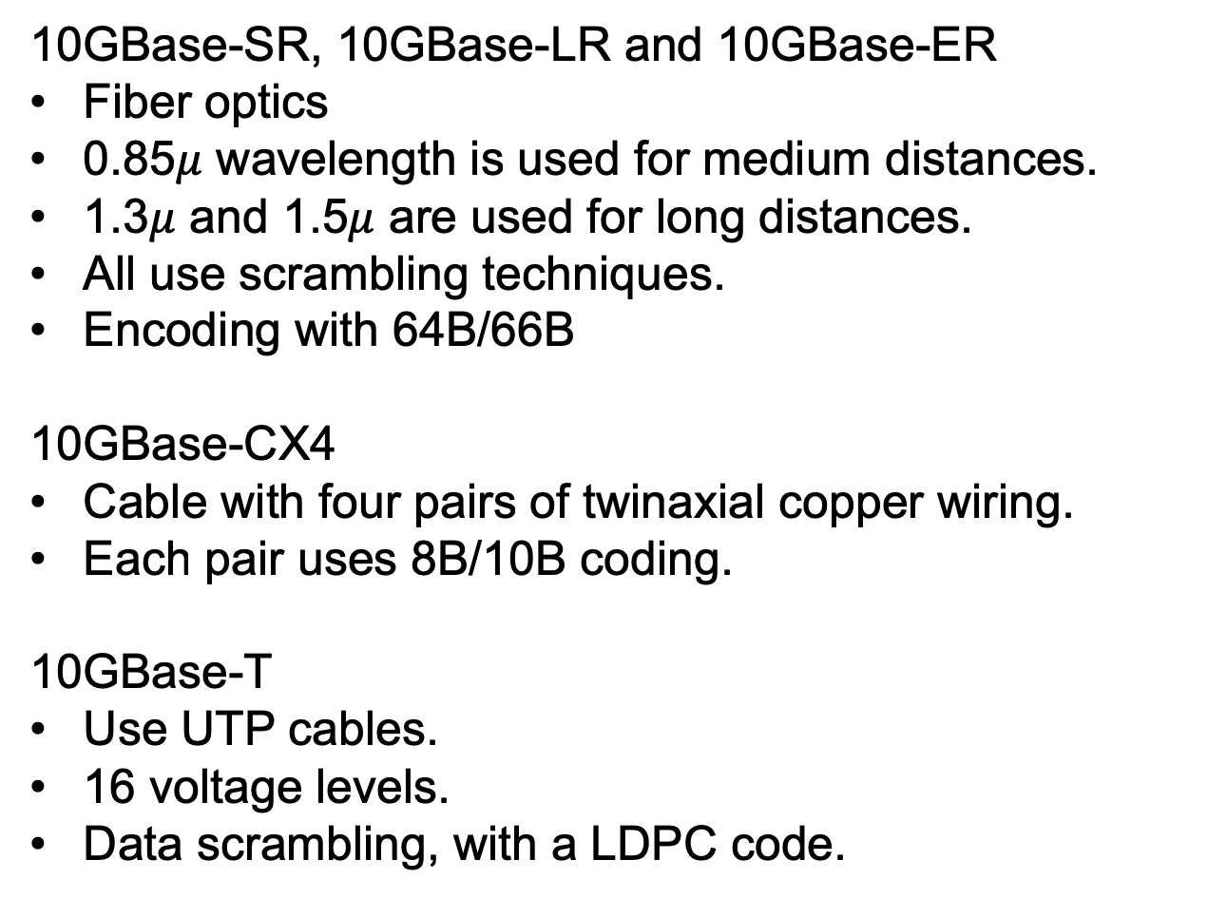
10-Gigabit Ethernet
10GBase-SR, 10GBase-LR and 10GBase-ER
Fiber optics
0.85$μ$ wavelength is used for medium distances.
1.3$μ$ and 1.5$μ$ are used for long distances.
All use scrambling techniques.
Encoding with 64B/66B
10GBase-CX4
Cable with four pairs of twinaxial copper wiring.
Each pair uses 8B/10B coding.
10GBase-T
Use UTP cables.
16 voltage levels.
Data scrambling, with a LDPC code.

Slide 95
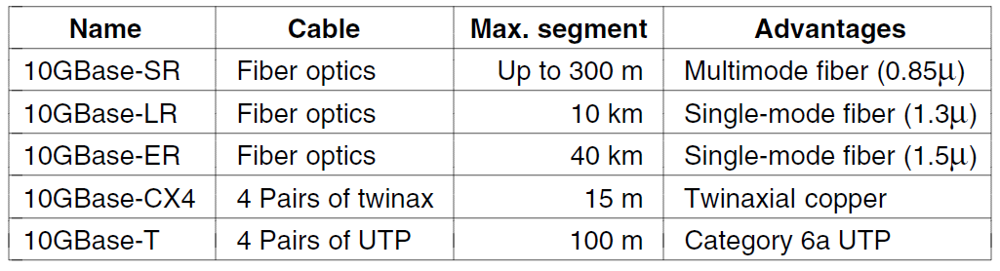
10 Gigabit Ethernet
Gigabit Ethernet cabling

Slide 96
Retrospective on Ethernet
Reliable
The hub and switch architecture has few failures.
Cheap
Twisted-pair wiring is relatively inexpensive.
Easy to maintain
No software to install. Adding new hosts is simply plugging them in.
Interworks easily with TCP/IP
Both Ethernet and TCP/IP are connectionless.
No requirement to change to software as the speed goes up by several orders.

Slide 97
Wireless LANs
802.11 architecture and protocol stack
802.11 physical layer
802.11 MAC sublayer protocol
802.11 frame structure
Services

Slide 98
802.11 Architecture and Protocol Stack
802.11 networks can be used in two modes.
Infrastructure mode
Connect clients, e.g., laptops and smartphones, to the Internet or intranet via AP (Access Point)
APs may be connected together, typically by a wired network called a distribution system.
Ad hoc network
A collection of PCs so that they can directly send frames to each other.
No APs.

Slide 99
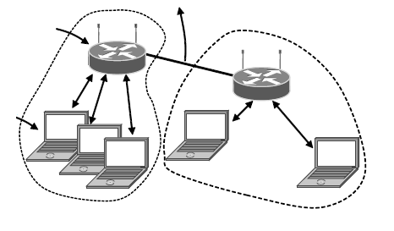
802.11 Architecture and Protocol Stack
To Network
Access Point
Client
802.11 architecture – infrastructure mode

Slide 100
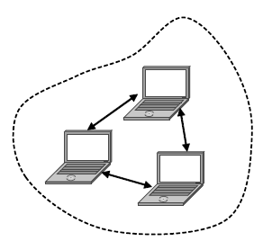
802.11 Architecture and Protocol Stack
802.11 architecture – ad-hoc mode

Slide 101
802.11 Architecture and Protocol Stack
The protocol stack is the same for the client and the APs.
Physical layer
802.11b, direct sequence spread spectrum at 1 or 2 Mbps in the 2.4GHz band.
802.11a, OFDM at 5GHz, 54Mbps
802.11g, OFDM at 2.4GHz, 54Mbps
802.11n, MIMO (Multiple-Input-Multiple-Output), multiple antennas at the transmitter and receiver. 600Mbps
Data link layer
MAC sublayer
LLC (Logical Link Control) sublayer, hide the differences between 802 variants to the network layer.

Slide 102
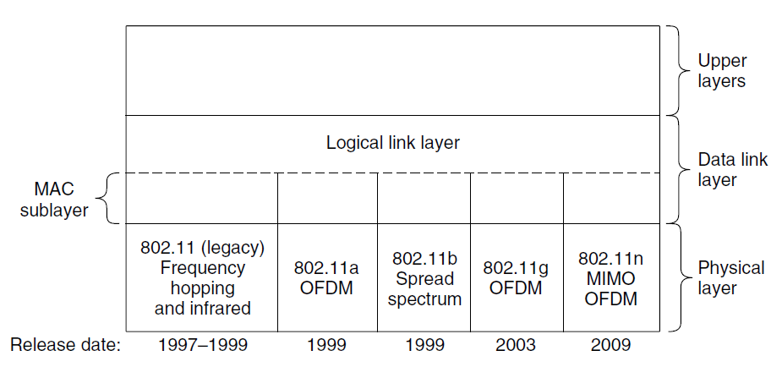
802.11 Architecture and Protocol Stack
Part of the 802.11 protocol stack.

Slide 103
802.11 Architecture and Protocol Stack
The protocol stack is the same for the client and the APs.
Physical layer
802.11b, direct sequence spread spectrum at 1 or 2 Mbps in the 2.4GHz band.
802.11a, OFDM at 5GHz, 54Mbps
802.11g, OFDM at 2.4GHz, 54Mbps
802.11n, MIMO (Multiple-Input-Multiple-Output), multiple antennas at the transmitter and receiver. 600Mbps
Data link layer
MAC sublayer
LLC (Logical Link Control) sublayer, hide the differences between 802 variants to the network layer.

Slide 104
802.11 Physical Layer
All 802.11 techniques use 2.4GHz or 5GHz ISM frequency band.
Unlicensed. Can be used freely but subject to constraint, e.g., the power is no more than 1W.
Suffer from interference from other devices, e.g., garage door openers, cordless phones.
All transmission methods define multiple rate.
If the wireless signal is weak, a low rate can be used
If the wireless signal is clear, the highest rate can be used
Rate adaptation.

Slide 105
802.11 MAC Sublayer Protocol
Different from Ethernet that uses CSMA/CD, 802.11 MAC uses CSMA/CA (CSMA with collision Avoidance)
Collision detection does not work in wireless networks.
A user that has a frame to send
1. sense that there is no signal for a short period of time (introduced later)
2. choose a random backoff and start to count down
3. if another transmission happens during the countdown, the countdown pauses
4. when the counter reaches 0, send the frame.
5. if the frame gets through, the receiver sends a short acknowledgement back.
6. a lack of acknowledgement indicates an error, the sender doubles the backoff period and tries again.

Slide 106
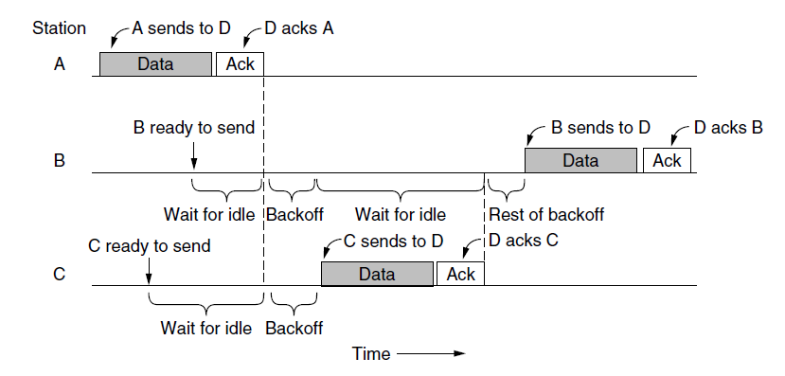
The 802.11 MAC Sublayer Protocol (1)
Sending a frame with CSMA/CA.

Slide 107
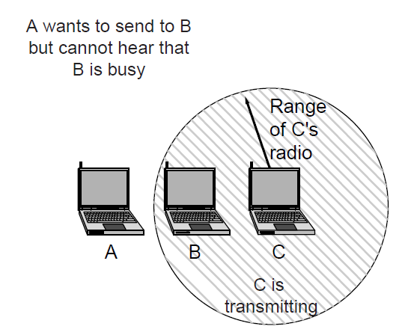
The 802.11 MAC Sublayer Protocol (2)
The hidden terminal problem.

Slide 108
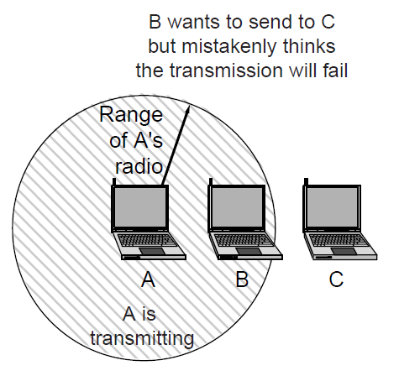
The 802.11 MAC Sublayer Protocol (3)
The exposed terminal problem.

Slide 109
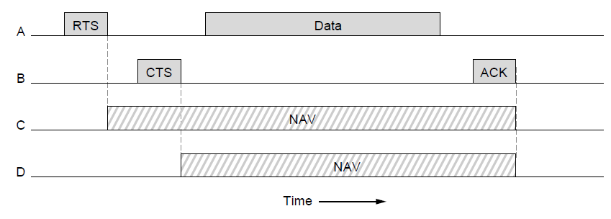
The 802.11 MAC Sublayer Protocol (4)
The use of virtual channel sensing using CSMA/CA.

Slide 110
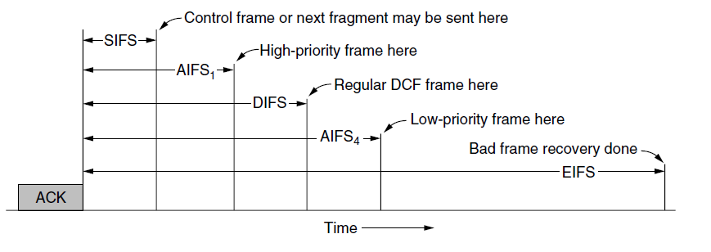
The 802.11 MAC Sublayer Protocol (5)
Interframe spacing in 802.11

Slide 111
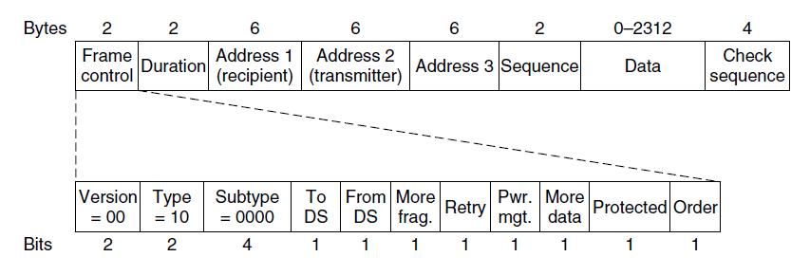
802.11 Frame Structure
Format of the 802.11 data frame

Slide 112
End
Chapter 4

