Slide 1
The Medium Access Control Sublayer
Chapter 4

Slide 2
Wireless LANs
802.11 architecture and protocol stack
802.11 physical layer
802.11 MAC sublayer protocol
802.11 frame structure
Services

Slide 3
802.11 Architecture and Protocol Stack
802.11 networks can be used in two modes.
Infrastructure mode
  Connect clients, e.g., laptops and smartphones, to the Internet or intranet via AP (Access Point)
  APs may be connected together, typically by a wired network called a distribution system.
Ad hoc network
  A collection of PCs so that they can directly send frames to each other.
  No APs.

Slide 4
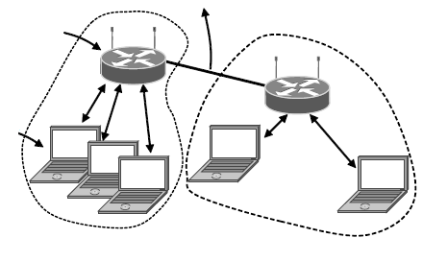
802.11 Architecture and Protocol Stack
To Network
Access
Point
Client
802.11 architecture – infrastructure mode

Slide 5
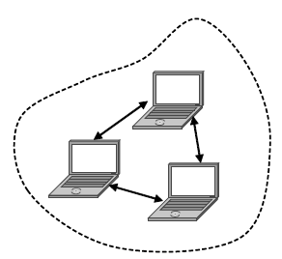
802.11 Architecture and Protocol Stack
802.11 architecture – ad-hoc mode

Slide 6
802.11 Architecture and Protocol Stack
The protocol stack is the same for the client and the APs.
Physical layer
  802.11b, direct sequence spread spectrum at 1 or 2 Mbps in the 2.4GHz band.
  802.11a, OFDM at 5GHz, 54Mbps
  802.11g, OFDM at 2.4GHz, 54Mbps
  802.11n, MIMO (Multiple-Input-Multiple-Output), multiple antennas at the transmitter and receiver. 600Mbps
Data link layer
  MAC sublayer
  LLC (Logical Link Control) sublayer, hide the differences between 802 variants to the network layer.

Slide 7
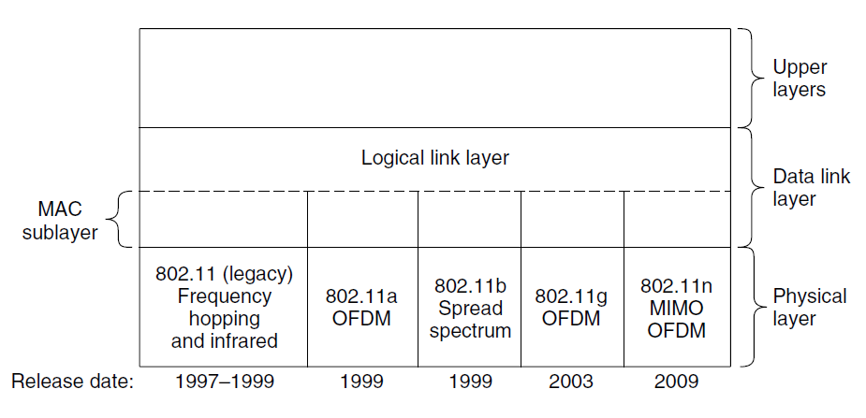
802.11 Architecture and Protocol Stack
Part of the 802.11 protocol stack.

Slide 8
802.11 Architecture and Protocol Stack
The protocol stack is the same for the client and the APs.
Physical layer
  802.11b, direct sequence spread spectrum at 1 or 2 Mbps in the 2.4GHz band.
  802.11a, OFDM at 5GHz, 54Mbps
  802.11g, OFDM at 2.4GHz, 54Mbps
  802.11n, MIMO (Multiple-Input-Multiple-Output), multiple antennas at the transmitter and receiver. 600Mbps
Data link layer
  MAC sublayer
  LLC (Logical Link Control) sublayer, hide the differences between 802 variants to the network layer.

Slide 9
802.11 Physical Layer
All 802.11 techniques use 2.4GHz or 5GHz ISM frequency band.
Unlicensed. Can be used freely but subject to constraint, e.g., the power is no more than 1W.
Suffer from interference from other devices, e.g., garage door openers, cordless phones.
All transmission methods define multiple rate.
If the wireless signal is weak, a low rate can be used
If the wireless signal is clear, the highest rate can be used
Rate adaptation.

Slide 10
802.11 MAC Sublayer Protocol
Different from Ethernet that uses CSMA/CD, 802.11 MAC uses CSMA/CA (CSMA with collision Avoidance)
Collision detection does not work in wireless networks.
A user that has a frame to send
1. sense that there is no signal for a short period of time (introduced later)
2. choose a random backoff and start to count down
3. if another transmission happens during the countdown, the countdown pauses
4. when the counter reaches 0, send the frame.
5. if the frame gets through, the receiver sends a short acknowledgement back.
6. a lack of acknowledgement indicates an error, the sender doubles the backoff period and tries again.

Slide 11
802.11 MAC Sublayer Protocol
An example:
User A is the first to send a frame. When A is sending, B and C become ready to send. B and C see that the channel is busy and wait for it to become idle.
Shortly after A receives an acknowledgement, the channel goes idle. Rather than sending a frame right away and collide, B and C both perform a backoff.
C picks a short backoff, and thus sends first.
B pauses its countdown while it senses that C is using the channel, and resumes after C has received an acknowledgement.
B soon completes its backoff and sends its frame.

Slide 12
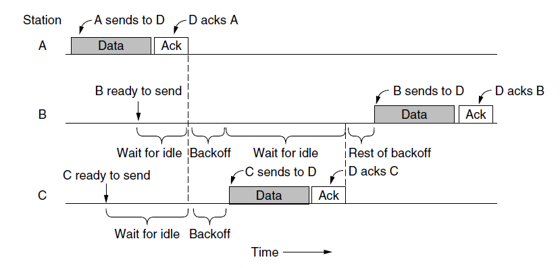
802.11 MAC Sublayer Protocol
Sending a frame with CSMA/CA.

Slide 13
802.11 MAC Sublayer Protocol
Two differences from Ethernet.
In Ethernet, when the users sense the channel to be idle, they send right away. In 802.11, when the users sense the channel to be idle, they backoff a random period to avoid collisions.
In Ethernet, collision detection is used. In 802.11, acknowledgement is used to to infer collisions.

Slide 14
802.11 MAC Sublayer Protocol
The hidden terminal and exposed terminal problem review.
In hidden terminal problem (a), user C is transmitting to user B. If A senses the channel, it will not hear anything and will falsely conclude that it may now start transmitting to B, which leads to a collision.
In exposed terminal problem (b), B wants to send to C, so it listens to the channel. When it hears a transmission from A, it falsely concludes that it may not send to C.

Slide 15
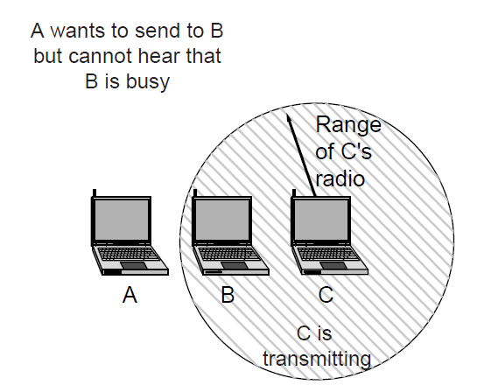
802.11 MAC Sublayer Protocol
The hidden terminal problem.

Slide 16
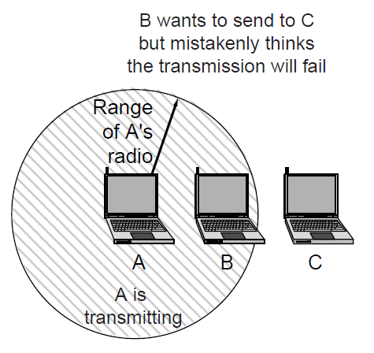
802.11 MAC Sublayer Protocol
The exposed terminal problem.

Slide 17
802.11 MAC Sublayer Protocol
To mitigate these problems, 802.11 defines channel sensing to consist of both physical sensing and virtual sensing.
Physical sensing: check the medium to see if there is a valid signal.
Virtual sensing: each user keeps a logical record of when the channel is in use by tracking the NAV (network Allocation Vector)
  Each frame carries a NAV field that says how long the current transmission will take to complete, e.g., the NAV of a data frame includes the time needed to send an acknowledgment.
  All users will know that the channel will be busy for the period indicated by the NAV

Slide 18
802.11 MAC Sublayer Protocol
An example of RTS/CTS mechanism uses the NAV
A wants to send to B. C is within range of A. D is within range of B but not within range of A.
A begins by sending an RTS frame to B.
  C hears the RTS. C updates its record of the NAV to indicate that the channel is busy.
B answers with a CTS frame.
  D does not hear the RTS, but hears the CTS, so it also updates its NAV.
Upon receipt of the CTS, A sends its frame and starts an ACK timer.
B responds with an ACK frame.
If A’s ACK time expires before the ACK gest back, it is treated as a collision with an exponential backoff.

Slide 19
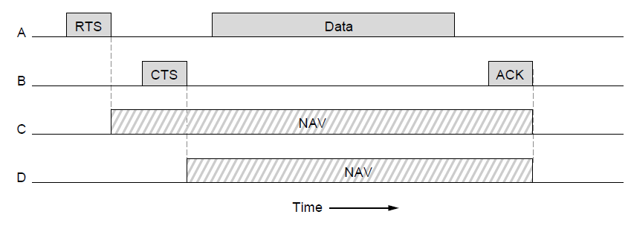
802.11 MAC Sublayer Protocol
The use of virtual channel sensing using CSMA/CA.

Slide 20
802.11 MAC Sublayer Protocol
CSMA/CA with physical and virtual sensing is the core of the 802.11 protocol. We further consider several other mechanisms to deal with Reliability, Saving power, and Quality of Service.
Reliability.
Wireless networks are noisy and unreliable. The use of acknowledgement and retransmissions is of little help if the probability of getting a frame through is small in the first place.
Strategy 1: lower the transmission rate.
  Slower rates use more robust modulations that are more likely to be received correctly for a given SNR. Rate adaptation according to channel conditions.

Slide 21
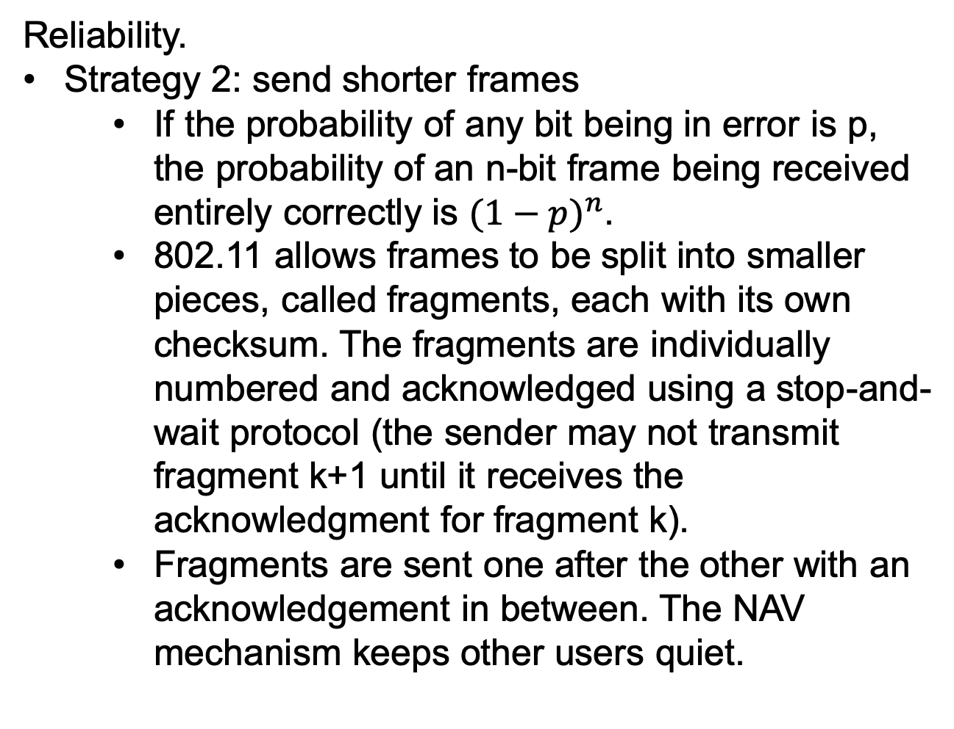
802.11 MAC Sublayer Protocol
Reliability.
Strategy 2: send shorter frames
  If the probability of any bit being in error is p, the probability of an n-bit frame being received entirely correctly is ${(1−p)}^{n}$.
  802.11 allows frames to be split into smaller pieces, called fragments, each with its own checksum. The fragments are individually numbered and acknowledged using a stop-and-wait protocol (the sender may not transmit fragment k+1 until it receives the acknowledgment for fragment k).
  Fragments are sent one after the other with an acknowledgement in between. The NAV mechanism keeps other users quiet.

Slide 22
802.11 MAC Sublayer Protocol
Power saving
Strategy 1: beacon frames
  Beacons are periodic broadcasts by the AP to advertise the presence of the AP to clients.
  Clients can set a power-management bit in frames that are sent to the AP to tell it that they are entering power-save mode. The AP will buffer traffic intended for it.
  The client wakes up for every beacon. The beacon frame contains a traffic map to see if there is buffered traffic. If so, the client sends a poll message to the AP, which then sends the buffered traffic.

Slide 23
802.11 MAC Sublayer Protocol
Power saving
Strategy 2: APSD (Automatic Power Save Delivery)
  The AP buffers frames and sends them to a client just after the client sends frames to the AP.
  The client then go to sleep until it has more traffic to send.
  Works well for applications such as VoIP that have frequent traffic in both directions.

Slide 24
802.11 MAC Sublayer Protocol
Quality of service
Strategy 1: different priorities
  After a frame has been sent, a certain amount of idle time is required before any user may send a frame.
  The trick is to define different time intervals for different kinds of frames.
  Five intervals are depicted.
    1. DIFS (DCF InterFrame Spacing) for regular data frames. Any user may try to acquire the channel after the medium has been idle for DIFS.
    2. SIFS (Short InterFrame Spacing), the shortest for ACK, control frames like RTS/CTS and a burst of fragments.

Slide 25
802.11 MAC Sublayer Protocol
Quality of service
Strategy 1: different priorities
  Five intervals are depicted.
    3. AIFS₁ (Arbitration InterFrame Space). Smaller than DIFS but longer than SIFS. Used by the AP to move voice or other high-priority traffic to the head of the line.
    4. AIFS₂ larger than DIF. Used for background traffic that can be deferred until after regular traffic.
    5. EIFS (Extended InterFrame Spacing). Used by a user that just have received a bad or unknown frame to report the problem.

Slide 26
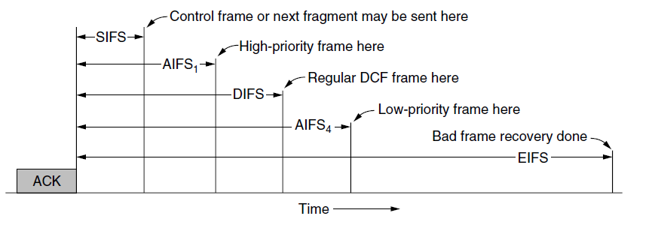
802.11 MAC Sublayer Protocol
Interframe spacing in 802.11

Slide 27
802.11 MAC Sublayer Protocol
Quality of service
Strategy 2: transmission opportunity
  The original CSMA/CA mechanism let users send one frame at a time. With different protocols, e.g., 802.11a/g, one user may transmit at 6 Mbps and the other user may transmit at 54 Mbps. The 6-Mbps user takes nine times as long as the 54-Mbps user to send a frame.
  With transmission opportunities, each user gest an equal amount of airtime, not an equal number of frames.

Slide 28
802.11 Frame Structure
The 802.11 standard defines 3 different classes of frames: data, control and management.
Each has a header with a variety of fields for the MAC sublayer.
Data frame format.
Frame control field. 11 subfields.
  Protocol version, allow future versions of 802.11 to operate.
  Type, i.e., data, control, or management.
  Subtype, e.g., RTS or CTS
  To DS and From DS, indicate whether the frame is going to or coming from the network connected to the APs.

Slide 29
802.11 Frame Structure
Data frame format.
Frame control field. 11 subfields.
  More fragment, more fragments will follow.
  Retry, retransmission or not.
  Power management, indicates that the sender is going into power-save mode
  More data, indicates that the sender has additional frames for the receiver.
  Protected Frame, the frame body has been encrypted for security.
  Order, tells the receiver that the higher layer expects in-order sequence

Slide 30
802.11 Frame Structure
Data frame format.
Duration field. Tells how long the frame and its acknowledgement will occupy the channel. Used to manage the NAV mechanism.
Address 1, 2, 3
  1, receiver.
  2, transmitter
  3, the AP is just the relay between the client and another point on the network, thus the 3rd address is for a distant client in the Internet
Sequence field, numbers frames
  4 bits identify the fragment
  12 bits for frame sequence number

Slide 31
802.11 Frame Structure
Management frame have the save format as data frames.
The data portion varies with the subtype.
Control frames are short.
They have the Frame control, Duration, and Frame check sequence fields.
However, they may have only one address and one data portion.

Slide 32
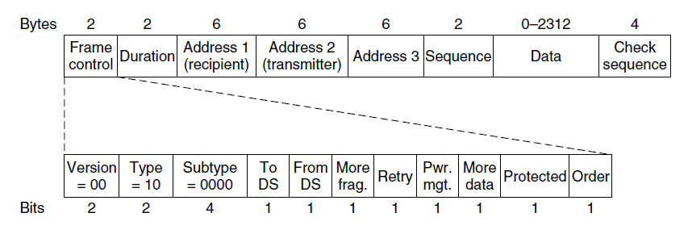
802.11 Frame Structure
Format of the 802.11 data frame

Slide 33
802.11 Service
Association service.
Used by mobile stations to connect to APs.
When a user moves within the radio range of an AP, it leans the identity and capabilities of the AP, e.g., data rate supported, security arrangements, power-saving capabilities, quality of service support.
The user send a request to associate with the AP.
The AP accepts or rejects the request.
Reassociation service.
Like a handover in the cellular network.
When a station moves from one AP to another AP in the same extended 802.11 LAN.

Slide 34
802.11 Service
Authenticate service.
The stations must authenticate before they can transmit frames via the AP.
If the network is open, anyone can use it.
If the network is not open, users provide a username and password to prove it has the right credentials.
Distribution service.
Determine how to route a frame.
If the destination is local to the AP, the frames can be sent out directly over the air.
If not, the frames have to be forwarded over the wired network.

Slide 35
802.11 Service
Integration service.
Handles any translation needed for a frame to be sent outside the 802.11 LAN or to arrive from outside the 802.11 LAN
Data delivery service.
Data transmission
Privacy service.
Encryption and decryption.
The encryption is based on AES (Advanced Encryption Standard)

Slide 36
802.11 Service
QoS traffic scheduling service.
Give voice and video traffic preferential treatment compared to best-effort and background traffic
Transmit power control service.
Give stations the information to meet regulatory limits on transmit power that vary from region to region
Dynamic frequency selection service.
Give stations the information to avoid transmitting on frequencies in the 5-GHz band that are being used for radar in the proximity.

Slide 37
Broadband Wireless
Comparison of 802.16 with 802.11, 3G
802.16 architecture and protocol stack
802.16 physical layer
802.16 frame structure

Slide 38
Comparison of 802.16 with 802.11 and 3G
802.16 or WiMAX (Worldwide Interoperability for Microwave Access) is a standard for outdoor wireless metropolitan area network. combines aspects of both 802.11 and 3G, making it more like a 4G technology.
WiMAX aims at wirelessly connecting devices to the Internet at megabit/sec speeds.
WiMAX base stations are more powerful than 802.11 APs.
Use more power and better antennas, performs more processing to handle errors.
Transmissions are scheduled by the base station, no collisions, no CSMA/CA.
Use licensed spectrum. Resembles the 4G LTE.

Slide 39
802.16 Architecture and Protocol Stack
Base stations connect directly to the provider’s backbone network, which is connected to the Internet.
The protocol stack is similar to that of the other 802 networks, but with more sublayers.
Physical layer deals with transmission, fixed and mobile WiMAX, both operate in licensed spectrum below 11 GHz and use OFDM
Data link layer has 3 sublayers.
  Security sublayer deals with privacy and security.
  MAC common sublayer, the main protocols are located. The base station completely controls the system. Unlike other 802 protocols, it is completely connection oriented.

Slide 40
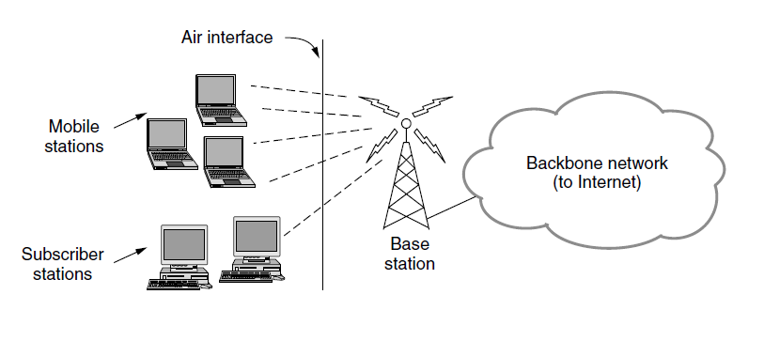
802.16 Architecture and Protocol Stack
The 802.16 architecture

Slide 41
802.16 Architecture and Protocol Stack
The protocol stack is similar to that of the other 802 networks, but with more sublayers.
Physical layer
Data link layer has 3 sublayers.
  Security sublayer deals with privacy and security.
  MAC common sublayer
  Service-specific convergence sublayer. Provide an interface to the network layer, e.g., IP, Ethernet and ATM. Since IP is connectionless and 802.16 MAC sublayer is connection-oriented, this layer must map between addresses and connections.

Slide 42
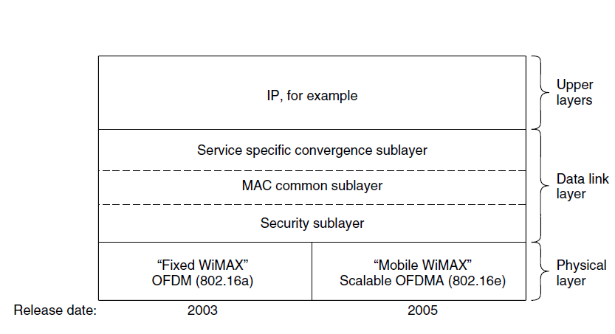
802.16 Architecture and Protocol Stack
The 802.16 protocol stack

Slide 43
802.16 Physical Layer
Transmissions are sent with OFDM.
Compared with 802.11, the 802.16 OFDM divides channel into more subcarriers with a longer symbol duration to tolerate larger wireless signal degradations.
Symbols on each subcarrier are sent with QPSK, QAM-16 or QAM-64.
With high SNR, QAM-64 is used to send 6 bits per symbol.
With low SNR, QPSK is used to deliver 2 bits per symbol.
Error correction with convolutional coding.

Slide 44
802.16 Physical Layer
Some other networks use equal frequency bands for upstream and downstream traffic. But the downstream traffic is usually more than upstream traffic.
802.16 divides the channel between users using OFDMA (Orthogonal Frequency Division Multiple Access)
Different sets of subcarriers can be assigned to different stations, so that more than one station can send or receiver at once.
In 802.11, all subcarriers is used by one station to send at any given moment.
This allowed the base station to assign subcarriers to the stations that can use them best.

Slide 45
802.16 Physical Layer
Example of the frame structure.
Preamble to synchronize all stations.
Downstream transmission from the base station.
  The base station sends maps to tell all stations how the downlink and uplink subcarriers are assigned over the frame.
  The base station controls the map, and can allocate different amounts of bandwidth to stations from frame to frame.
  Downstream bursts of traffic to different stations on different subcarriers.
A guard time for stations to switch from receiving to transmitting
Bursts of uplink traffic to the base station according to the map. Ranging: new stations request initial bandwidth to connect to the base station.

Slide 46
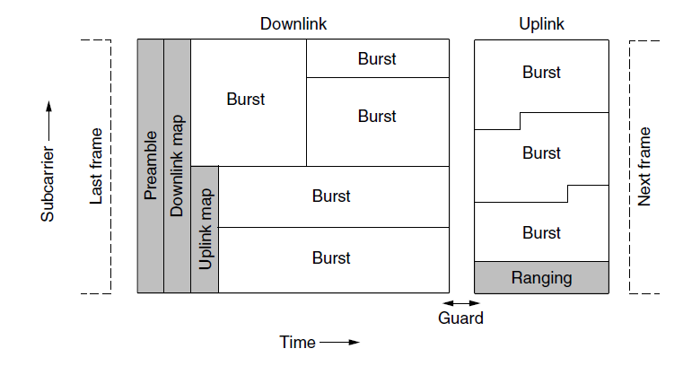
802.16 Physical Layer
Frames structure for OFDMA with time division duplexing.

Slide 47
802.16 MAC Sublayer Protocol
Security sublayer.
Only encrypt the frame payload but not the header.
A snooper can see who is talking to whom but not what they are saying to each other.
MAC common sublayer
Connection-oriented and point-to-multipoint. One base station with multiple stations.
The downlink direction is controled by the base station to send frames to different stations.
The uplink is up for contention of competing users. The allocation of uplink bandwidth is done by the base station based on the four classes of services.

Slide 48
802.16 MAC Sublayer Protocol
MAC common sublayer
Uplink bandwidth allocation depends on 4 services.
1. constant bit rate service.
  For transmitting uncompressed voice. Send a predetermined amount of data at predetermined time intervals.
  Dedicated bandwidth is allocated.
2. rea-time variable bit rate service
  For compressed multimedia and other soft real-time applications.
  The amount of bandwidth needed at each instant may vary.
  The base station polls the user at a fixed interval to ask how much bandwidth is needed this time.

Slide 49
802.16 MAC Sublayer Protocol
MAC common sublayer
3. non-rea-time variable bit rate service
  For heavy transmission that are not real time, e.g., large file transfers.
  The base station polls the users often, but not at fixed time intervals.
  Connections with this service can also use best-effort service.
4. best-effort service.
  For everything else.
  No polling is done and the user must request bandwidth in the uplink burst.
  If a request is successful, its success will be noted in the next downlink map.

Slide 50
802.16 MAC Frame Structure
All MAC frames begin with a generic header. The header is followed by an optional payload and an optional checksum.
The payload is not needed in control frames.
The checksum is also optional, e.g., no retransmission for real-time frames. If there is checksum, it is the standard IEEE 802 CRC.
The 802.16 protocols has many kinds of frames.
Header fields of a generic frame in (a).
EC tells whether the payload is encrypted.
Type field identifies the frame type.
CI field indicates whether the final checksum is present

Slide 51
802.16 MAC Frame Structure
Header fields of a generic frame.
EK field tells which encryption key is used
Length field gives the complete length of the frame, including the header.
Connection identifier tells which connection this frame belongs to.
Header CRC fields is a checksum over the header only.
A bandwidth request frame in (b).
Starts with a 1 bit not a 0 bit
The second and the third bytes form a 16-bit number telling how much bandwidth is needed.
Bandwidth request frames do not carry a payload or full-frame CRC.

Slide 52
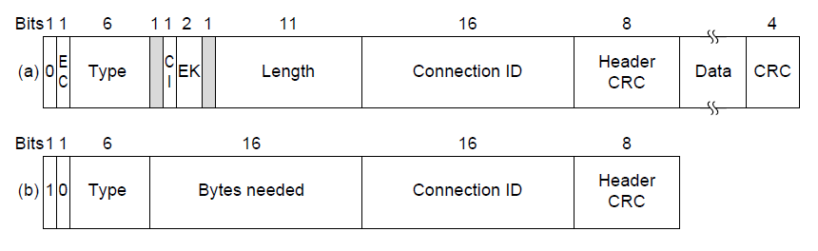
802.16 Frame Structure
(a) A generic frame. (b) A bandwidth request frame.

Slide 53
Bluetooth
Architecture
Applications
Protocol stack
Radio layer
Link layers
Frame structure

Slide 54
Bluetooth Architecture
Bluetooth interconnects computing and communication devices and accessories using short-range, low-power, inexpensive wireless radios.
The Bluetooth protocol let devices find and connect to each other, an act called pairing.
Piconet : The basic unit of a Bluetooth system.
A piconet consists of a master node, up to 7 active slave nodes, and up to 255 parked nodes within a distance of 10m.
Multiple piconets can be connected via a bridge node.
Scatternet: an interconnected collection of piconets.
Parked state: a low-power state, the device cannot do anything except respond to an activation or beacon signal from the master.

Slide 55
Bluetooth Architecture
A piconet is a centralized TDM system
The master controls the clock and determines which device gets to communicate in which time slot.
Master/slave mode
No slave-slave communication.

Slide 56
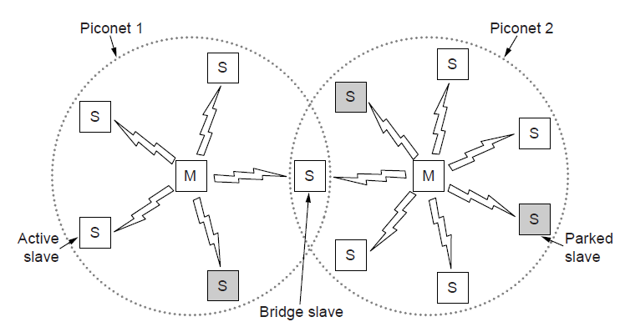
Bluetooth Architecture
Two piconets can be connected to form a scatternet

Slide 57
Bluetooth Protocol Stack
Unlike 802.11, Bluetooth provides different protocol stacks for each particular application.
There are 25 applications (may be growing), called profiles, each with a different protocol stack.
The Bluetooth protocol structure does not follow the OSI model, the TCP/IP model, the 802 model, or any other model.
Physical radio layer, like the physical layer in the OSI and 802 model.
  Radio transmission and modulation
Link control layer, analogous to the MAC sublayer but also includes elements of physical layer.
  How the master controls time slots.
  How time slots are grouped into frames.

Slide 58
Bluetooth Protocol Stack
The Bluetooth protocol structure
Link manager
  Handles the establishment of logical channels between devices, including power management, pairing, encryption and quality of service.
L2CAP (Logical Link Control Adaptation Protocol)
  Frames variable-length messages and provides reliability if needed.
Service discovery protocol
  Locate services within the network.
RFcomm protocol.
  Emulate the standard serial port found on PCs for connecting the keyboard, mouse etc.
Application layer
  Different profiles define a slice of the protocol stack

Slide 59
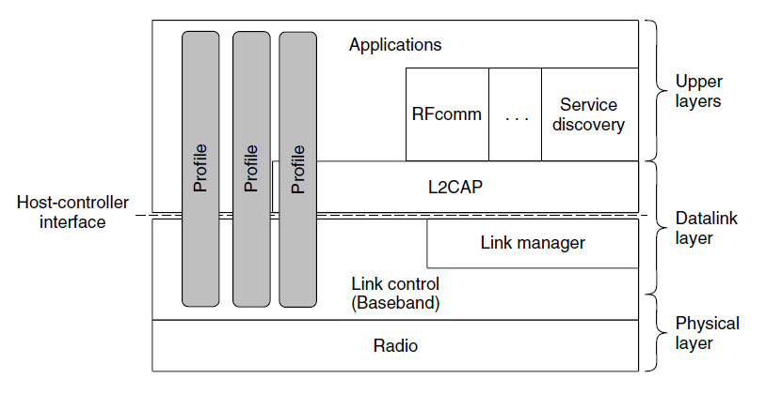
Bluetooth Protocol Stack
The Bluetooth protocol architecture.

Slide 60
Bluetooth Radio Layer
Radio layer
Moves the bits from master to slave.
2.4-GHz ISM band as 802.11.
The band is divided into 79 channels of 1 MHz each
Frequency hopping spread spectrum is used.
3 forms of modulation.
  Frequency shift keying, 1-bit symbol, 1 Mbps
  Phase shift keying, 2 or 3 bits per symbol, 2 or 3 Mbps

Slide 61
Bluetooth Link Layer
Link layer
Turns the raw bit stream into frames.
TDM: the master defines a series of time slots, with the master’s transmission starting in the even slots and the slaves’ transmissions starting in the odd slots.
Link manager protocol
Set up logical channels, called links, to carry frames between the master and a slave.
A pairing procedure to ensure that the two devices are allowed to communicate, e.g., use passkey.
2 kinds of links.
  SCO (Synchronous Connection Oriented) links
  ACL (Asynchronous Connectionless) links

Slide 62
Bluetooth Link Layer
Link manager protocol
2 kinds of links.
  SCO (Synchronous Connection Oriented) links
    For real-time data
    Allocated a fixed slot in each direction.
    No retransmission due to real-time nature
  ACL (Asynchronous Connectionless) links
    For packet-switch data that is available at irregular intervals
    Best-effort
    Frames may be lost and retransmitted.
  The data sent over ACL links come from the L2CAP layer.

Slide 63
Bluetooth Frame Structure
Bluetooth defines several frame formats.
Basic rate data frame formats in (a).
Access code, identifies the master so that slaves within radio range of two masters can tell which traffic is for them.
Header, 54-bit.
Data field. Up to 2744bits.
Enhanced rate data frame (b).
Access code and header the same as (a).
Guard/synchronization field, to switch to faster data rate. The access code and header are sent at the basic rate and only the data is sent at the faster rate.
Data field, up to 2 or 3 times as (a).
A short trailer

Slide 64
Bluetooth Frame Structure
The common header.
Address field, which of the 8 active devices the frame is intended for.
Type field, identifies the frame type (ACL, SCO, pol or null), the type of error correction used in the data field, and how many slots long the frame is.
Flow field, if a slave’s buffer is full, asserts flow control.
Acknowledgement field, piggyback ACK
Sequence field, number the frames.
Checksum, 8-bit header checksum.
The entire 18-bit header is repeated 3 times.
  The receiver examines the 3 copies. If all 3 are the same, accept; otherwise, the majority wins.
  Cheap and low-power

Slide 65
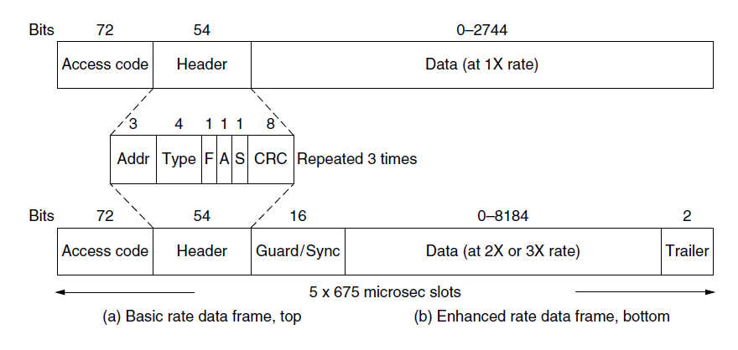
Bluetooth Frame Structure
Typical Bluetooth data frame at (a) basic, and
(b) enhanced, data rates.

Slide 66
RFID
EPC Gen 2 architecture
EPC Gen 2 physical layer
EPC Gen 2 tag identification layer
Tag identification message formats

Slide 67
EPC Gen 2 Architecture
RFID (Radio Frequency IDentification).
We introduce the form EPC (Electronic Product Code) that started with the Auto-ID Center at the Massachusetts Institute of Technology in 1999.
The second generation is called EPC Gen 2.
Key components: tags and readers.
Tags:
96-bit EPC identifier
A small memory read or written by the reader.
The tiny dot is the RFID integrated circuit.
No battery, gather power from the radio transmission of an RFID reader.

Slide 68
EPC Gen 2 Architecture
Readers:
Analogous to based stations and APs.
Has power sources
Multiple antennas.
In charge of when tags send and receive messages.
When multiple tags are within the reading range, resolve the multiple access problem.
There may be multiple readers that can contend with each other in the same area.

Slide 69
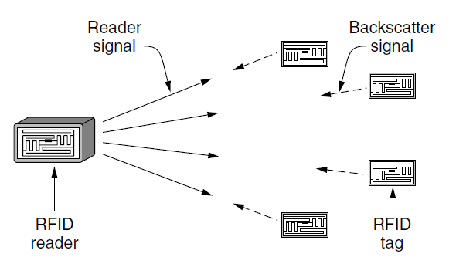
EPC Gen 2 Architecture
RFID architecture.

Slide 70
EPC Gen2 Physical Layer
The physical layer defines how bits are sent between the RFID reader and tags.
Use unlicensed 902-908 MHz ISM band in the U. S..
Use frequency hopping to spread the signal across the channel.
Use a form of ASK (Amplitude Shift Keying) modulation.
Two differences from other physical layers.

Slide 71
EPC Gen2 Physical Layer
Difference1: the reader is always transmitting a signal, regardless of whether the reader or tag is communicating.
Backscatter: for the tags to send bits to the reader. The reader transmits a fixed carrier signal that carries no bits. The tags harvest this signal to get the power.
  A low-energy way for the tag to send bits to the reader at a low rate.
  The tag cannot receive or sense transmissions from other tags.

Slide 72
EPC Gen2 Physical Layer
Difference 2: use ASK simple modulation.
Low power and costs.
Reader to tag: use two amplitude levels. Bits are either 0 or 1 depending on how long the reader waits before a low-power period.
Tag to reader: alternate its backscatter state at fixed intervals to create a series of pulses in the signal. 1~8 pulse periods can be used to encode each 0 or 1. We show an example of two-pulse period coding (1s have fewer transitions than 0s).

Slide 73
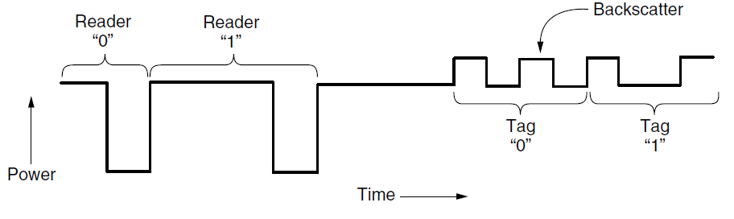
EPC Gen 2 Physical Layer
Reader and tag backscatter signals.

Slide 74
EPC Gen2 Tag Identification Layer
Multiple access problem: the reader wants to get the identifier from multiple tags, where the number of tags is unknown.
Slotted ALOHA is adapted for use in Gen 2 RFID.
In slot 0, the reader sends a Query message.
QRepeat messages are sent every slot.
  Tell the tags the range of slots over which to randomize transmission.
Tags pick a random slot in which to reply.

Slide 75
EPC Gen2 Tag Identification Layer
In slot 0, the reader sends a Query message.
QRepeat messages are sent every slot.
The tag replies in slot 2
  First with a short 16-bit random number in an RN16 message.
  If there is no collision, the reader sends an ACK message.
  The tag sends its EPC identifier.
  Reason: EPC identifier is long so collision would be expensive. A short exchange is used to test whether the tag can safely use the slot to send its identifier.
The tag temporarily stops responding to new Query messages so that all remaining tags can be identified.

Slide 76
EPC Gen2 Tag Identification Layer
The reader adjust the number of slots to avoid collisions.
The adjustment is analogous to binary exponential backoff in Ethernet.
If the reader sees too many slots with no responses or too many slots with collisions, it sends a QAdjust message to decrease or increase the range of slots over which the tags are randomizing.
RFID can perform other operations on tags.
Select a subset of tags to query, e.g., collect response from tagged jeans but not tagged shirts.
Write data to tags.

Slide 77
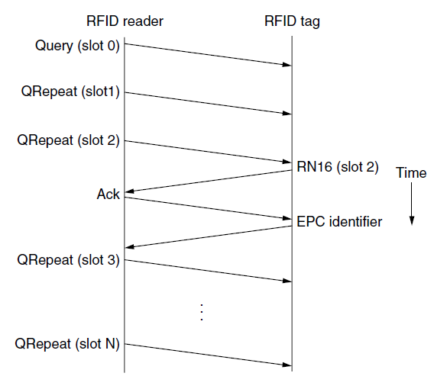
EPC Gen 2 Tag Identification Layer
Example message exchange to identify a tag.

Slide 78
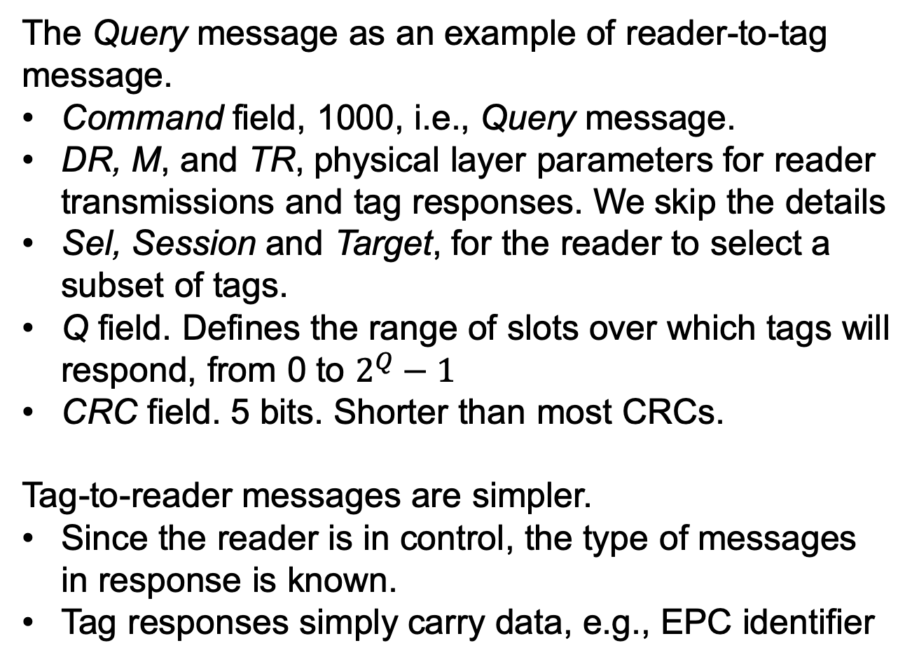
Tag Identification Message Formats
The Query message as an example of reader-to-tag message.
Command field, 1000, i.e., Query message.
DR, M, and TR, physical layer parameters for reader transmissions and tag responses. We skip the details
Sel, Session and Target, for the reader to select a subset of tags.
Q field. Defines the range of slots over which tags will respond, from 0 to $2^{Q}−1$
CRC field. 5 bits. Shorter than most CRCs.
Tag-to-reader messages are simpler.
Since the reader is in control, the type of messages in response is known.
Tag responses simply carry data, e.g., EPC identifier

Slide 79
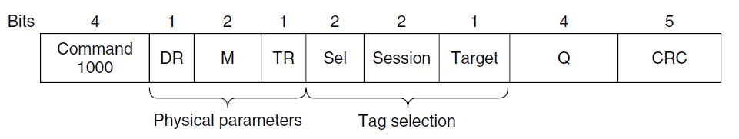
Tag Identification Message Formats
Format of the Query message.

Slide 80
Data Link Layer Switching
Uses of bridges
Learning bridges
Spanning tree bridges
Repeaters, hubs, bridges, switches, routers, and gateways
Virtual LANs

Slide 81
Uses of Bridges
Many organizations have multiple LANs and wish to connect them.
Reason 1: an organization has many department, each with its own LAN. These different LANs may want to interact with each other.
Reason 2: an organization may be geographically spread over several buildings. It may be cheaper to have separate LANs in each building and connect them with bridges.
Reason 3: it may be necessary to split a logical single LAN into separate LANs connected by bridges to accommodate the load (limited supported stations on a hub or switch)

Slide 82
Uses of Bridges
Switches are examples of bridges.
Bridges operate in the data link layer.
Examine data link layer addresses, e.g., Ethernet address, to forward frames. Can handle multiple network-layer protocols.
Ideal bridges should be transparent.
Simply plug in computers.
No hardware or software changes required.
Operation of the existing LANs should be not affected.
Two algorithms are used: a backward learning algorithm to stop traffic being sent where it is not needed; a spanning tree algorithm to break loops that may be formed when switches are cabled together.

Slide 83
Learning Bridges
Topology of two LANs bridged together.
(1): two multidrop LANs, such as classic Ethernets, are joined by the bridge.
(2): LANs with point-to-point cables, including one hub.
If the LAN technology is Ethernet, the bridge can be Ethernet switches.
All stations attached to the same port on a bridge belong to the same collision domain.
If there is more than one station at one port, as in a hub, the CSMA/CD protocol is used to send frames.
Different kinds of cables can be attached to one bridge, e.g., long-distance fiber optic link, short-haul twisted pair

Slide 84
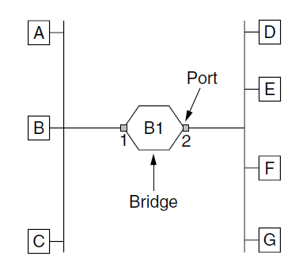
Learning Bridges (1)
Bridge connecting two multidrop LANs

Slide 85
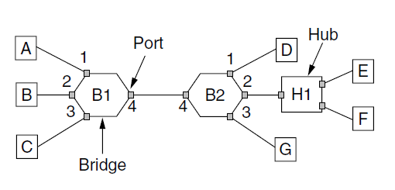
Learning Bridges (2)
Bridges (and a hub) connecting seven point-to-point stations.

Slide 86
Learning Bridges
Inside the bridge.
Accept frames from each of its ports.
Decide whether to forward or discard each frame by using the destination address. If the former, on which port to output the frame.
  In (1), if A sends a frame to B, bridge B1 receives the frame on port 1 and discards it because it is already on the correct port.
  In (2), A sends a frame to D. Bridge B1 receives the frame on port 1 and outputs it on port 4. Bridge B2 then receives the frame on its port 4 and outputs it on port 1.

Slide 87
Learning Bridges
To implement the routing rules, the bridge has a big hash table to list each possible destination and which output port it belongs on.
When a bridge are first plugged in, the tables are empty.
Backward learning:
  By looking at the source addresses, learn which machines are accessible on which ports.
    E.g., if bridge B1 in (2) sees a frame on port 3 from C, it knows that C is reachable via port 3, so it makes an entry in the hash table.
Handle dynamics: topology change as machines are powered up and down and moved around.

Slide 88
Learning Bridges
To implement the routing rules, the bridge has a big hash table to list each possible destination and which output port it belongs on.
Handle dynamics: topology change as machines are powered up and down and moved around.
  Each entry has a timestamp to tell the last time a frame from that machine was seen. When a frame whose source is in the table arrives, update the timestamp in the entry.
  Periodically scan the hash table and purges all entries more than a few minutes old.

Slide 89
Learning Bridges
Routing rule
1. if the port for the destination address is the same as the source port, discard the frame.
2. if the port for the destination address and the source port are different, forward the frame onto the destination port.
3. if the destination port is unknown, use flooding and send the frame on all ports except the source port.
Cut-through switching or wormhole routing.
Bridges only look at the MAC addresses, it can start forwarding as soon as the destination header field has come in, before the rest of the frame has arrived.

Slide 90
Learning Bridges
Bridge operation in terms of protocol stacks.
Consider A sends a frame to D; the LANs are Ethernet.
At station A, the packet comes from a higher layer and descends to the Ethernet MAC layer. It requires an Ethernet header. The frame is passed to the physical layer, goes out over the cable, to the bridge.
In the bridge, the frame is passed up from the physical layer to the Ethernet MAC layer.
  At this layer, the frame is passed to a relay, which only uses the Ethernet MAC header to determine how to route the frame.
  The relay passes the frame to the Ethernet MAC layer of the port for station D.
Relays may rewrite the headers. The bridge can never look inside the frame.

Slide 91
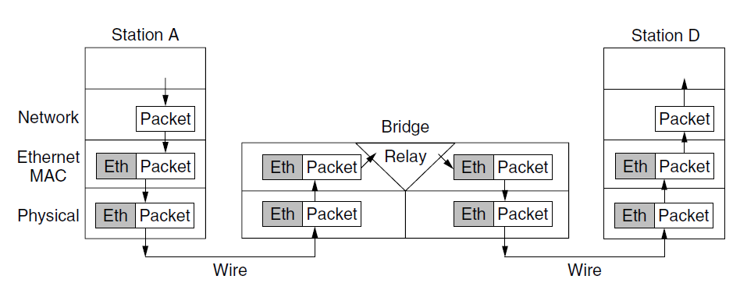
Learning Bridges
Protocol processing at a bridge.

Slide 92
Spanning Tree Bridges
To increase reliability, redundant links may be used between bridges, which may introduce loop problem.
Station A sends a frame F0 to a previously unobserved destination.
Bridge B1 sends copies of F0 out all of its other ports.
  Since there are two links from B1 to B2, two copies F1 and F2 will reach B2.
Bridge B2 receives these two frames, but does not know that they are copies of the same frame. B2 takes F1 and sends copies of it out all the other ports, and also takes F2 and sends copies of it out all the other ports. We have F3 and F4 sent back to B1.
Bridge B2 sees F3 and F4 with unknown destinations and copies them again.
The cycle goes on forever.

Slide 93
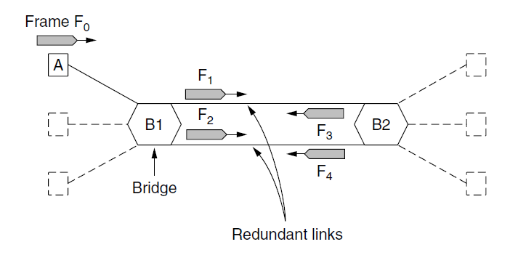
Spanning Tree Bridges
Bridges with two parallel links

Slide 94
Spanning Tree Bridges
Solution: spanning tree, a loop free topology that connects every bridge, some links may be ignored.
Example: 5 bridges. Drop the dashed line links, we have the spanning tree.
All bridges should agree on the spanning tree. All forwarding between stations follows the spanning tree.

Slide 95
Spanning Tree Bridges
The algorithm to build the spanning tree.
Each bridge periodically broadcasts a configuration message to all of its ports. Configuration messages are not forwarded since they are for building the tree.
Root selection. The bridges choose the bridge with the lowest identifier (based on MAC address) in the configuration message to be the root.
  Bridge B1 becomes the root.
Shortest path from the root.
  B1 can reach B2 and B3 in 1 hop.
  B1 can reach B4 in 2 hops, via either B2 or B3. the path via the bridge with the lowest identifier is chosen, so B4 is reached via B2.
4. After the tree is established, the algorithm continues to run during normal operation to detect topology changes and update the tree.

Slide 96
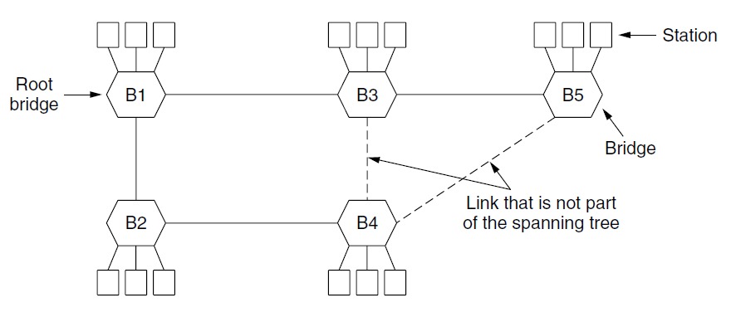
Spanning Tree Bridges
A spanning tree connecting five bridges. The dotted lines are links that are not part of the spanning tree.

Slide 97
Poem by Radia Perlman (1985)
Algorithm for Spanning Tree
I think that I shall never see
A graph more lovely than a tree.
A tree whose crucial property
Is loop-free connectivity.
A tree which must be sure to span.
So packets can reach every LAN.
. . .

Slide 98
Poem by Radia Perlman (1985)
Algorithm for Spanning Tree
. . .
First the Root must be selected
By ID it is elected.
Least cost paths from Root are traced
In the tree these paths are placed.
A mesh is made by folks like me
Then bridges find a spanning tree.

Slide 99
Repeaters, Hubs, Bridges, Switches, Routers and Gateways
Repeaters, hubs, bridges, switches, routers and gateways work in different layers.
Use different pieces of information to decide how to forward.
In a typical scenario, the user application generates some data to send to a remote machine.
  the data are passed to the transport layer and added a header, e.g., a TCP header, and passed to the network layer.
  The network layer adds a header, e.g., an IP header, to form a network layer packet, passed to the data link layer.
  The data link layer adds a header and checksum CRC, and send the frame to the physical layer for transmission.

Slide 100
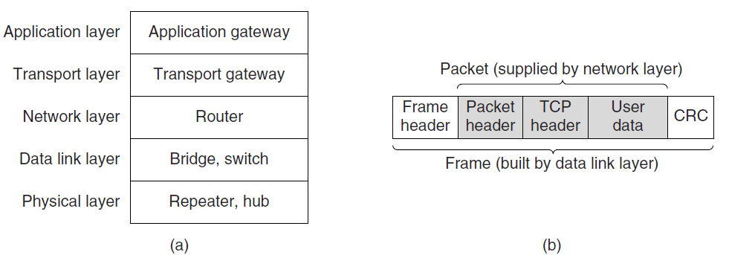
Repeaters, Hubs, Bridges, Switches, Routers, and Gateways
(a) Which device is in which layer.
(b) Frames, packets, and headers.

Slide 101
Repeaters, Hubs, Bridges, Switches, Routers and Gateways
Repeaters.
Analog devices that work with signals.
Clean up, amplify and put out the signal from one cable to another cable.
Do not understand frames, packets or headers.
Only understand symbols that encode bits as volts.
Hubs.
A number of input lines joined electrically.
Frames arriving on one line are sent out on all other lines.
If two frames arrive at the same time, they will collide.
Do not amplify the incoming signals.
Physical layer devices that do not examine the link layer addresses.

Slide 102
Repeaters, Hubs, Bridges, Switches, Routers and Gateways
Bridges
Connect two or more LANs.
Each port is isolated as one collision domain.
When a frame arrives, the destination address is extracted from the header to see where to send the frame, e.g., the 48-bit Ethernet address.
The bridge only outputs the frame on the port where it is need.
Can forward multiple frames at the same time.
Buffering inside the bridge to accept a frame on one port and transmit the frame out on a different port.
  The bridge may run out of buffer and discard frames.

Slide 103
Repeaters, Hubs, Bridges, Switches, Routers and Gateways
Switches. Modern bridges by another name.
Routers.
When a packet comes to a router, the frame header and trailer are stripped off and the packet in the frame’s payload field is passed to the routing software.
Use the packet header to choose an output line, e.g., a 32-bit IPv4 or 128-bit IPv6 address.
Do not see the frame address.
Transport gateways. Connect two computers that use different connection-oriented transport protocols. Introduced layer.
Application gateways. Introduced layer.

Slide 104
Virtual LANs
A mismatch between physical and logical layouts.
Geographically, computers nearby are joined together by hubs or switches.
However, network administrator wants to group users on LANs to reflect the organizational structure rather than the physical layout.
Decoupling logical topology from the physical topology.
In a company, a user may change department but do not change offices or change offices without changing department.
Rewire multiple LANs with restricted scopes entirely in software -> VLAN (Virtual LAN)

Slide 105
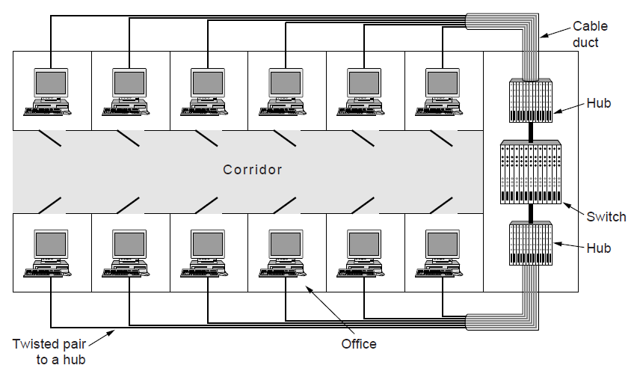
Virtual LANs
A building with centralized wiring using hubs and a switch.

Slide 106
Virtual LANs
Set up a VLAN-based network.
Decides how many VLANs there will be
Which computers will be on which VLAN
What the VLANs will be called, usually named by colors.
An example. 9 machines belong to the G (gray) VLAN and 5 belong to the W (white) VLAN. Machines from the G VLAN are spread across two switches, including two machines that connect to a switch via a hub.
Configuration tables are set up in the bridge to tell which VLANs are accessible via which ports.
A port may be labeled with multiple VLAN colors.

Slide 107
Virtual LANs
Example: one of the gray stations plugged into bridge B1 sends a frame to a destination that has not been observed before.
Bridge B1 receives the frame and sees that it comes from a machine on the gray VLAN.
Since the destination is unknown, B1 flood the frame on all ports labeled G except the incoming port.
At bridge B2, the frame is forwarded on all ports labeled G, including the hub.
The hub has both labels since it connects to machines from both VLANs. The hub will transmit the frame to all of its stations.
Note that a frame on the white VLAN will not be forwarded from bridge B2 to bridge B1.

Slide 108
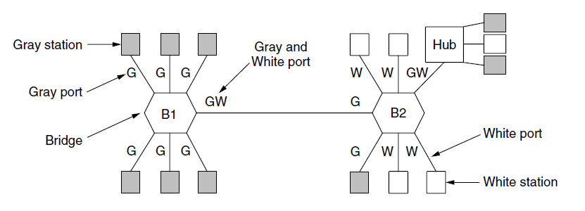
Virtual LANs
Two VLANs, gray and white, on a bridged LAN.

Slide 109
The IEEE 802.1Q Standard
VLAN is implemented by the IEEE 802.1Q standard.
Add a VLAN tag in the frame format.
We have a mix of VLAN-aware and VLAN unaware computers and switches.
The first VLAN-aware bridge that touches a frame adds VLAN fields and the last VLAN-aware bridge down the road removes them.

Slide 110
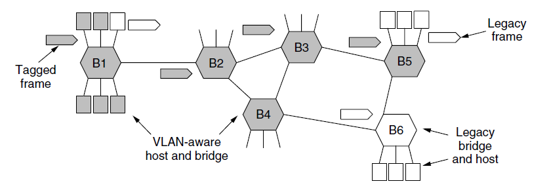
The IEEE 802.1Q Standard
Bridged LAN that is only partly VLAN-aware. The shaded symbols are VLAN aware. The empty ones are not.

Slide 111
The IEEE 802.1Q Standard
Frame format. Add two 2-byte fields.
VLAN protocol ID. Always have the value 0x8100.
VLAN identifier, the color of the VLAN to which the frame belongs.
Priority field. Distinguish hard real-time traffic from soft real-time traffic from time-insensitive traffic to provide better quality of service over Ethernet.
CFI field. Have nothing to do with VLAN.

Slide 112
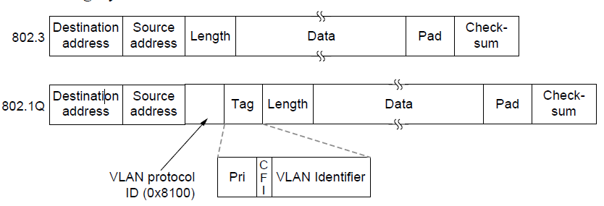
The IEEE 802.1Q Standard
The 802.3 (legacy) and 802.1Q Ethernet frame formats.

Slide 113
End
Chapter 4

